Slide 1
Credit Card Fraud Detection
Yan Chen · CS256 Spring 2020

Slide 2


Traditional statistics

Slide 3
Machine learning
Classification
(supervised)
Anomaly Detection
(unsupervised)

Slide 4
Project Overview – architecture diagram
Data Processing
Scaling
Balancing
Training
LOF
SVM
Compare Result
Time
Accuracy

Slide 5



Project Overview – tools used

Slide 6




Data Overview
Transactions in September 2013
by European cardholders
0 - normal, 1 - fraud
NO null values
Remove duplicates
284807
283726

Slide 7
Data scaling – overview
Class
Label
(0,1) → (-1,1)
31 Attributes
V1 – V28
Principal Components *
Time,
Amount
0 – 172792
0 – 25691.16
→ Need to scale

Slide 8
Data scaling – Principal Components
**Principal Components
2nd principle component
1st principle component

Slide 9

Data scaling – standard vs. robust
Standard Scaler
Robust Scaler
Removes the mean
Scales the data to unit variance
→Influenced by outliners
Based on percentiles
→not influenced by outliners

Slide 10
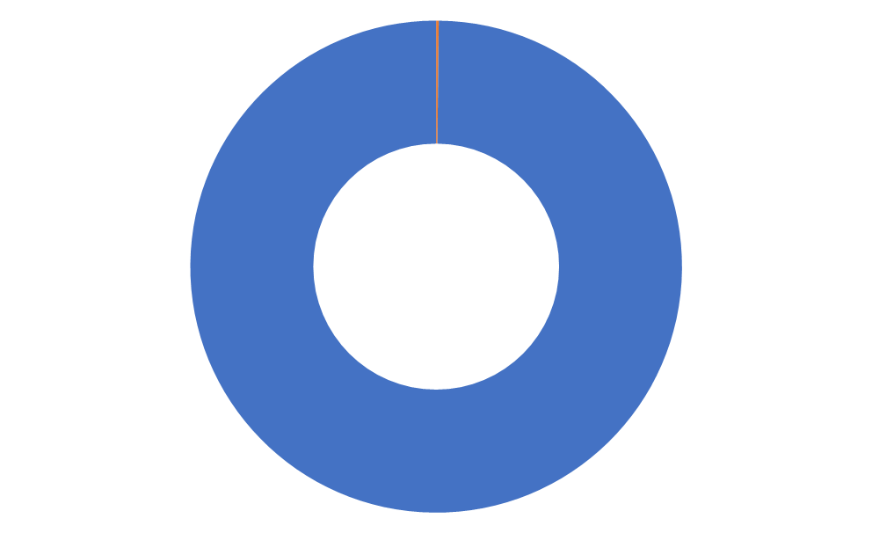
Data balancing – overview
Fraud
0.17%
Normal
99.83%

Slide 11
Data balancing – traditionally
Traditionally…
Minority
Majority
Minority
Majority
Under sampling
Over sampling
Loss of Data
Overfitting

Slide 12

Data balancing – cross validation
*Re-sampling and Cross-validation
Wrong:
Correct:
Include synthetic data!
Re-sampled
Data
Test
Test
Keep the same
Train
Train
Train
Train
ONLY re-sample
the Training data
Train
Train
Train
Train

Slide 13
Data balancing – this project_Under sampling
In this project: Under sampling + SMOTE + ENN
Under sampling
Random removing
Decrease the gap
Not increasing the data size
(Min/Maj) Ratio: 0.0017 → 0.0026

Slide 14
Data balancing – this project_SMOTE
In this project: Under sampling + SMOTE + ENN
2) SMOTE
Minority
Majority
Synthetic data

Slide 15
Data balancing – this project_ENN
In this project: Under sampling + SMOTE + ENN
3) ENN
Final Ratio: 1:2
Minority
Majority
Synthetic data
Removed

Slide 16
LOF – Overview
LOF
Number of neighbors to use: 20
Outliners

Slide 17
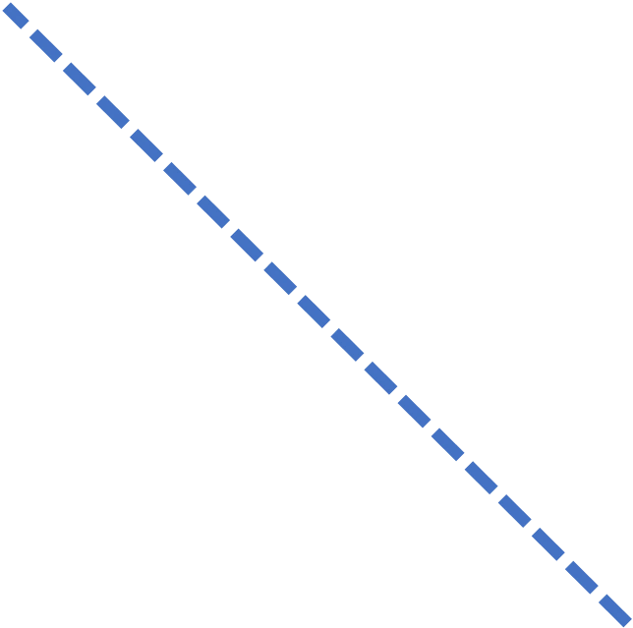



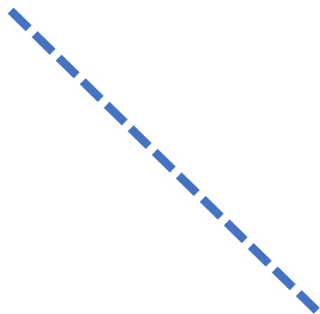
SVM – Overview_linear
SVM
Maximizing
the margin

Slide 18
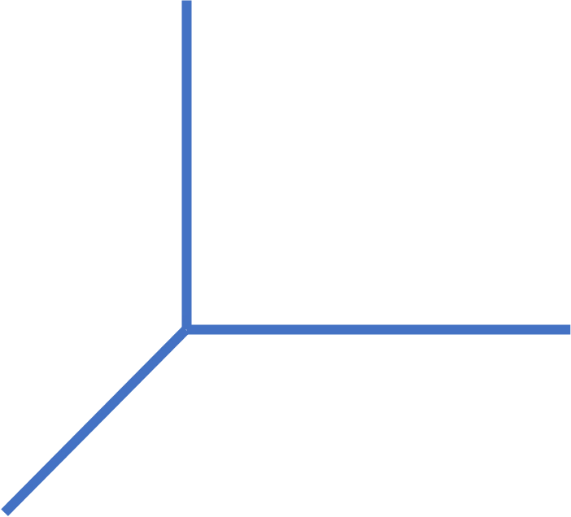

SVM – Overview_non_linear
SVM
kernel trick

Slide 19

SVM – Parameter used for this project
SVM - parameters
Kernel Functions:
1 / (n_features * X.var())
Radial Basis Function
(New) Polynomial function
Degree, 3
Dot product
0.0
Regularization Parameter “C”:
1.0

Slide 20
Measures – 4 outcomes
Measures
4 outcomes:
 |  | Predict
 |  | P | N
Actual | P | True Positive | False Negative
 | N | False Positive | True Negative
This project: P – fraud, N – normal

Slide 21
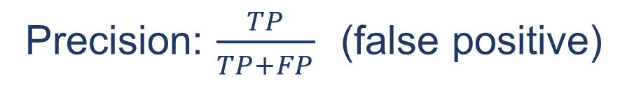
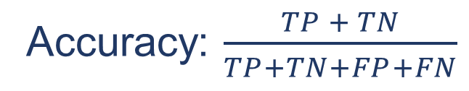
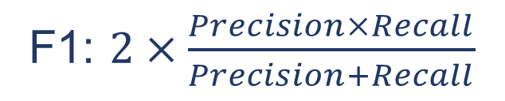
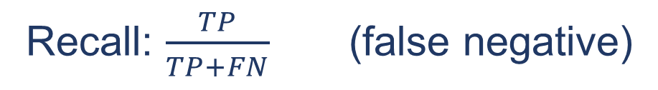
Measures – measures
Measures
 |  | Predict
 |  | P | N
Actual | P | 1 | 2
 | N | 0 | 997
Accuracy: $\frac{TP + TN}{TP+TN+FP+FN}$
Precision: $\frac{TP}{TP+FP}$ (false positive)
Recall: $\frac{TP}{TP+FN}$ (false negative)
99.8% accuracy
But only 33% fraud
are classified correctly
F1: $2×\frac{Precision×Recall}{Precision+Recall}$

Slide 22
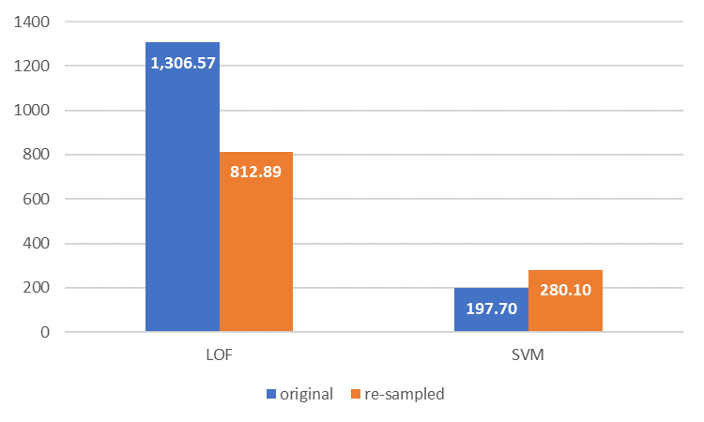
Result – Time
Time (in seconds)

Slide 23
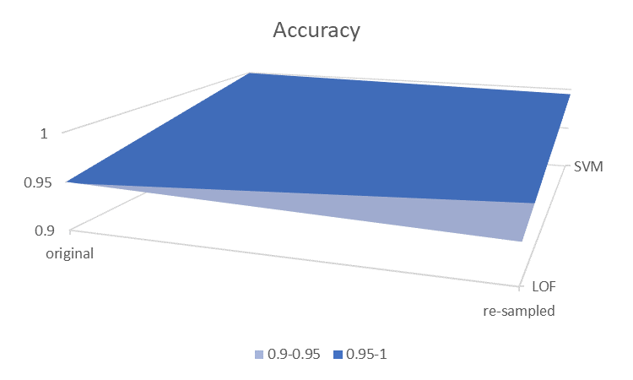
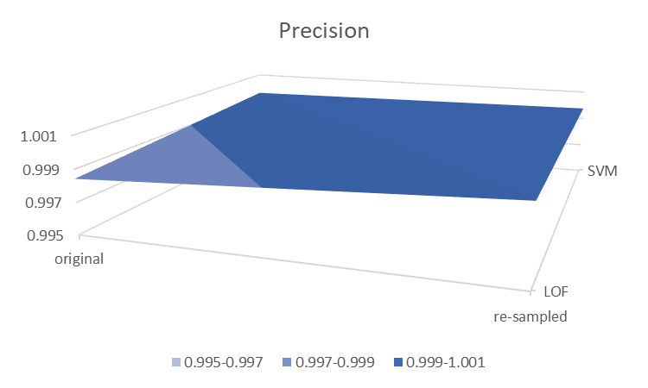
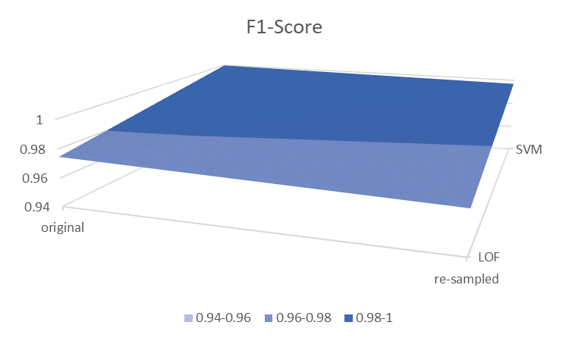
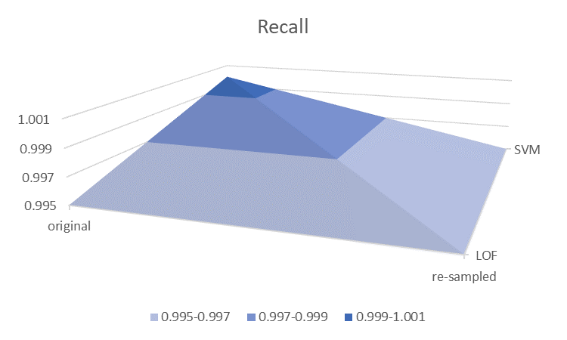
Result – All scores
Scores

Slide 24
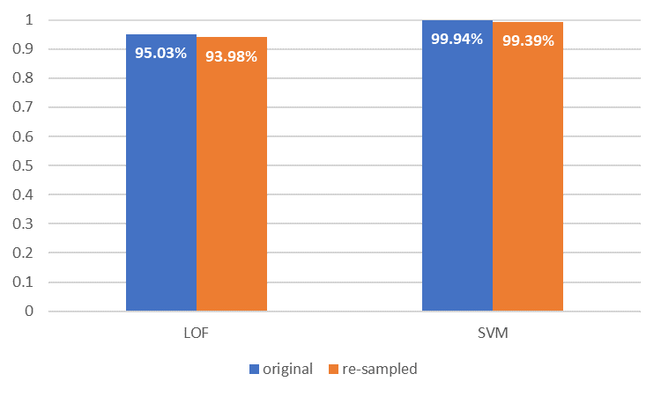
Result – Accuracy
Accuracy

Slide 25
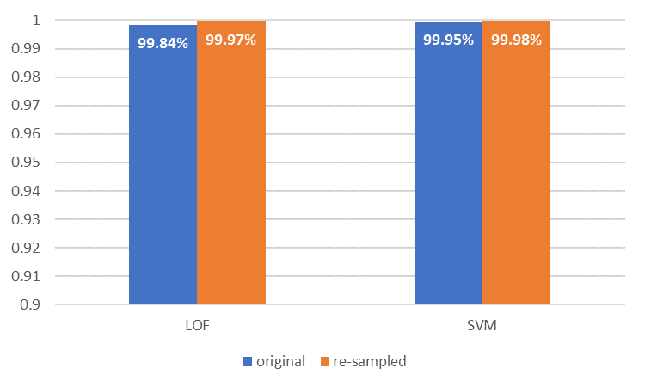
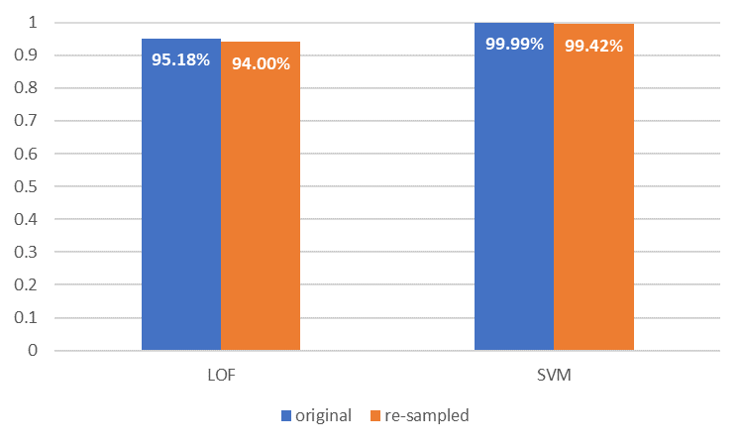
Result – Precision vs. Recall
Precision vs. Recall

Slide 26
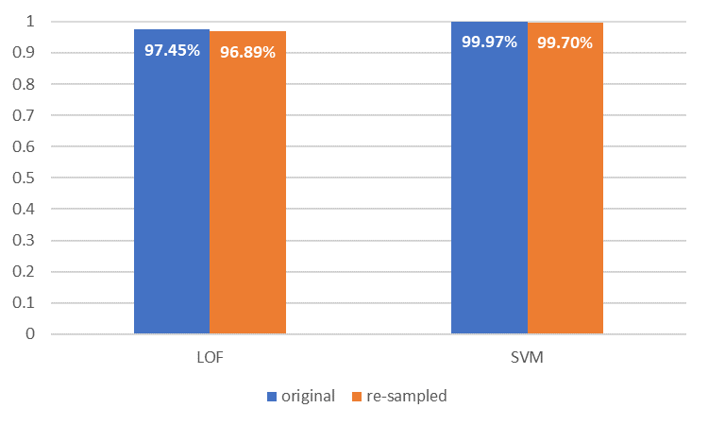
Result – F1 score
F1-Score

Slide 27
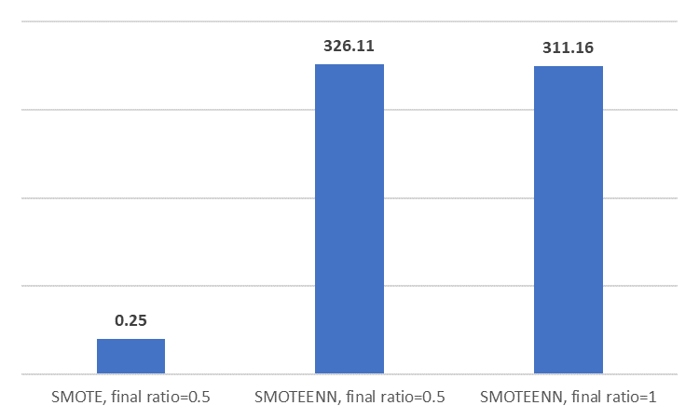
Result – Time – new – resampling time
Time (in seconds) (new) – resampling time
*excluding time for
random undersampling

Slide 28
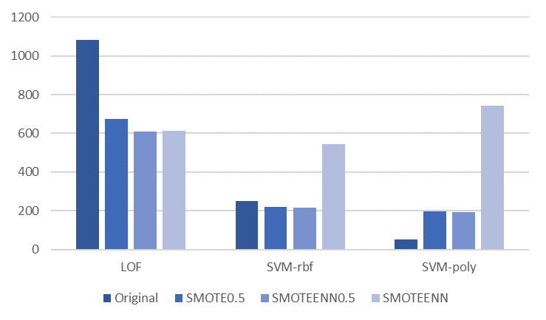
Result – Time – new – resampling time
Time (in seconds) (new) – training time

Slide 29
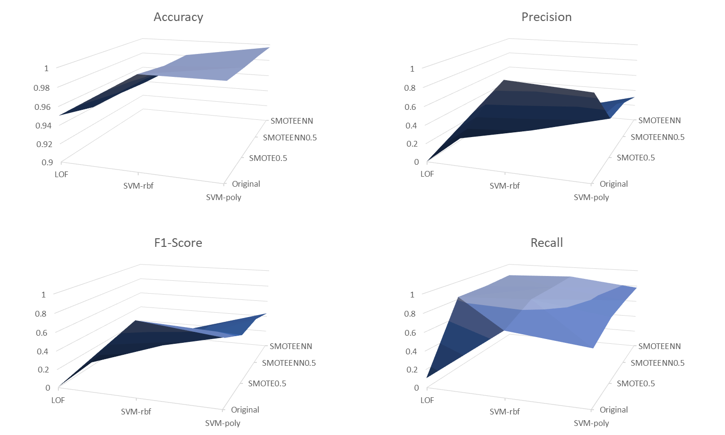
Result – All scores – new
Scores (new)

Slide 30
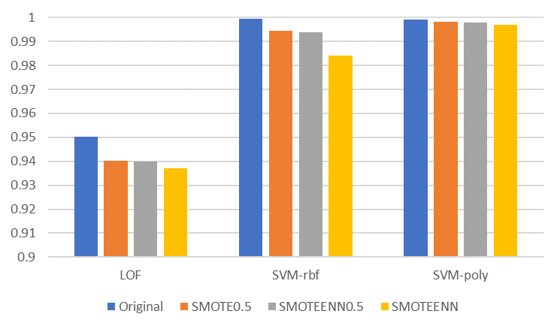
Result – Accuracy – new
Accuracy (new)

Slide 31
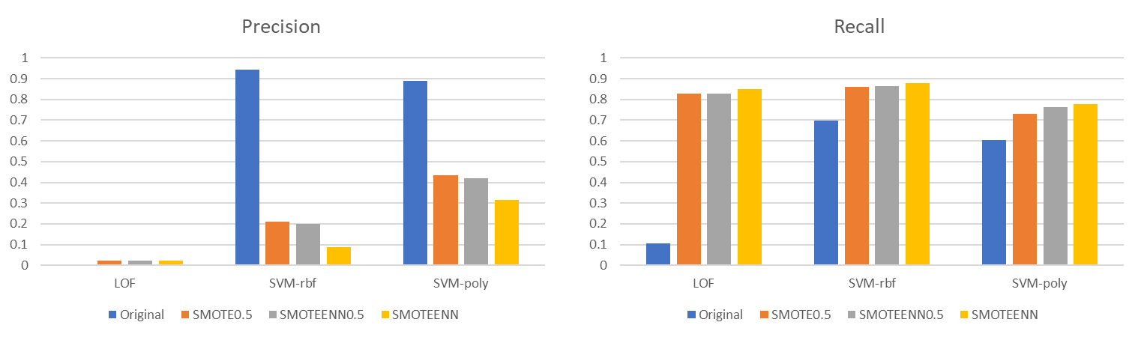
Result – Precision vs. Recall – new
Precision vs. Recall (new)

Slide 32
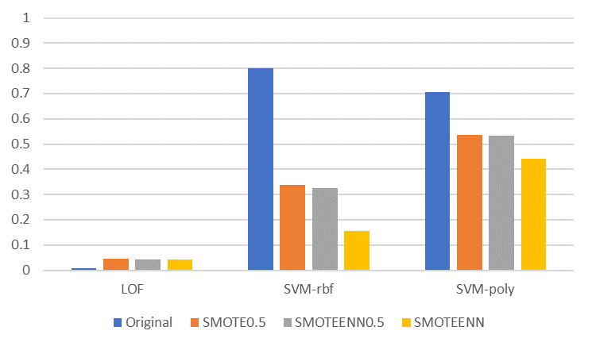
Result – F1 score
F1-Score

Slide 33
Summary
SVM less time, more accurate
Resampling increases precision
Original data separable
Or…did something wrong…

Slide 34
Future Work
Short-term
Test different re-sampling techniques
Test different parameters
Test different techniques
Long-term
Build app/program for fraud detection
(Tested on SMOTE only vs. SMOTEENN
And different final ratio)
(Tested on different kernel functions for SVM)

Slide 35
Reference
Kaggle, "Credit Card Fraud Detection," [Online]. Available: https://www.kaggle.com/mlg-ulb/creditcardfraud.
scikit-learn, "Compare the effect of different scalers on data with outliers," [Online]. Available: https://scikit-learn.org/stable/auto_examples/preprocessing/plot_all_scaling.html.
scikit-learn, "cross_validate," [Online]. Available: https://scikit-learn.org/stable/modules/generated/sklearn.model_selection.cross_validate.html.
imbalanced-learn, "SMOTEENN," [Online]. Available: https://imbalanced-learn.readthedocs.io/en/stable/generated/imblearn.combine.SMOTEENN.html.
scikit-learn, "LocalOutlierFactor," [Online]. Available: https://scikit-learn.org/stable/modules/generated/sklearn.neighbors.LocalOutlierFactor.html.
scikit-learn, "Support Vector Classification," [Online]. Available: https://scikit-learn.org/stable/modules/generated/sklearn.svm.SVC.html
scikit-learn, "Metrics and scoring: quantifying the quality of predictions," [Online]. Available: https://scikit-learn.org/stable/modules/model_evaluation.html

