Slide 1


Electrical Basics
& Safety Training
A practical, cabinet-first approach to safer troubleshooting
Notes:
Talking points
• Welcome the class and set the level: this is practical field training for technicians, not an electrical-engineering course.
• The goal is to make troubleshooting safer, more deliberate, and easier to explain on the next service call.
• Preview the progression: protect the equipment, understand the electrical behavior, select the right meter test, follow the power path, use diagrams, practice, and document the result.
Class Q&A
• Ask: “What electrical task or meter reading are you least comfortable with today?”
• Use the answers to identify topics that may need extra demonstration time.

Slide 2
SECTION 01
Introduction
Today’s mission: make every test safer and smarter.
Notes:
Talking points
• Frame the section around the mission on the slide: make every test safer and smarter.
• Explain that the class will focus on the decisions made before, during, and after a measurement.
• Encourage questions throughout the day; good troubleshooting depends on understanding why a test is useful.

Slide 3

01 • INTRODUCTION - LEARNING PATH
We build from safe habits to confident troubleshooting.
01
Introduction
05
Meter Safety & Use
Set expectations and a safety mindset
Choose the right function before touching a circuit
02
Electrical Safety & ESD
06
Wiring Diagrams
Prevent damage you can see—and damage you cannot
Read the map, then trace the physical circuit
03
Electrical Fundamentals
07
Hands-On Lab
AC, DC, voltage, current, resistance
Continuity, AC, DC, resistance, batteries
04
Power Flow
08
In Closing
Follow power from the wall to the cabinet load
Review, certificates, and survey
Notes:
Talking points
• Walk through the sequence without reading every line word for word.
• Point out that each section prepares the class for the next: safe habits first, then electrical concepts, meter use, power flow, diagrams, and supervised practice.
• Explain that each instructional section will end with a visible Review / Q&A pause.
• Set the expectation that the closing section will connect the technical work to verification, documentation, and handoff.
Class Q&A
• Ask: “Looking at the learning path, where do you expect the most hands-on practice?”
• Expected answer: meter safety and use, power-flow tracing, wiring diagrams, and the lab.

Slide 4

01 • INTRODUCTION - WHY WE ARE HERE
To understand static electricity, the power types we work with, how power flows through a cabinet, and how to use a multimeter when troubleshooting.
This class will build the practical electrical knowledge needed to troubleshoot and service gaming equipment safely.
You’ll leave with:
A better understanding of ESD to protect equipment
Effective troubleshooting skills
Greater confidence using test equipment
A clear mental model of how power flows through a cabinet
It is technician-level knowledge applied to the equipment we see every day.
Notes:
Talking points
• Explain that the class connects four practical topics: static electricity, AC and DC power, cabinet power flow, and multimeter use.
• Emphasize the technician-level outcomes shown on the slide: protect equipment, troubleshoot more effectively, use test equipment confidently, and picture the cabinet’s power path.
• Reinforce that safe troubleshooting is not slow troubleshooting. A planned test usually saves time by reducing guesses and unnecessary part replacement.
Class Q&A
• Ask: “Which outcome on this slide would improve your work the most?”
• Follow up: “What usually gets in the way of that outcome now?”

Slide 5
01 • INTRODUCTION - OUTCOMES
By the end, you'll be able to work the problem—not guess at it
01
Recognize
Electrical hazards and ESD risks inside a cabinet
02
Explain
AC vs. DC and where each appears
03
Measure
Voltage, resistance, continuity, and batteries safely
04
Trace
A circuit using diagrams, connectors, colors, and test points
Notes:
Talking points
• Present the four verbs as the student promise for the day: recognize, explain, measure, and trace.
• “Recognize” means noticing electrical hazards and ESD risks before work begins.
• “Explain” means identifying whether the expected behavior is AC or DC and describing what voltage, resistance, and current mean.
• “Measure” and “trace” turn that understanding into evidence from the meter, diagram, connectors, and test points.
Class Q&A
• Ask: “Which must come first on a service call—recognize, explain, measure, or trace?”
• Expected discussion: recognizing hazards and defining the expected behavior come before placing probes.

Slide 6
SECTION 02
Electrical Safety & ESD
The damage you cannot see still counts.
Notes:
Talking points
• Transition from class expectations to the first repeatable safety habit: control static before touching sensitive electronics.
• Stress the subtitle: damage can occur even when there is no spark, sound, or immediate failure.
• Preview the section’s practical outcome: discharge, handle boards correctly, use static-control packaging correctly, and re-discharge when returning to the work.
Class Q&A
• Ask: “Can a board be damaged even when you never feel a static discharge?”
• Expected answer: yes; a discharge below the level we feel can still damage sensitive components.

Slide 7
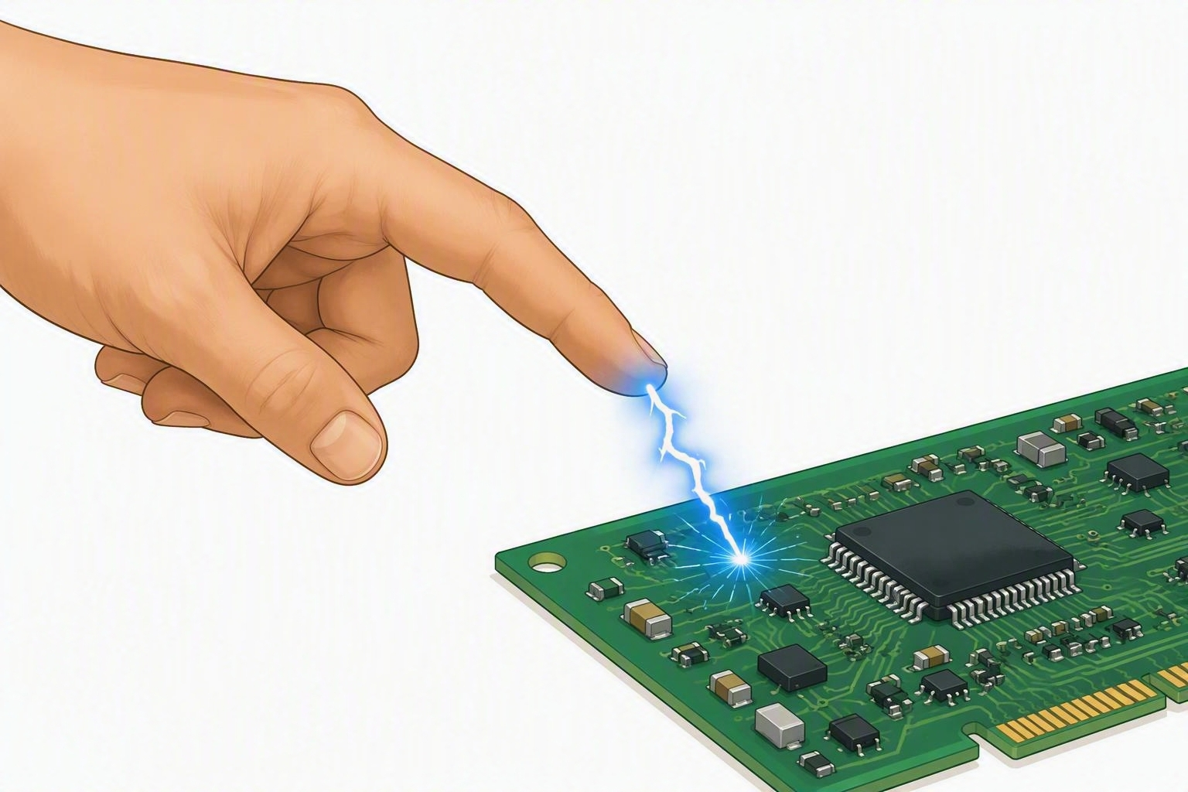
02 • ELECTROSTATIC DISCHARGE - ESD
ESD - Electrostatic Discharge – What is it?
Definition: A sudden transfer of static electricity stored on surfaces, materials, or people.
Cause: Rubbing materials together (triboelectric effect) or touching a grounded object with a built-up charge.
Impact: Can fry microchips, degrade circuit boards, or cause hidden latent defects in hardware.
Prevention: Using anti-static wrist straps, grounding mats, and special packaging.
The goal is simple: Control the charge before it reaches the electronics.
Notes:
Talking points
• Define static charge as an imbalance that can build when materials touch and separate.
• Define ESD as the sudden movement of that charge between objects at different electrical potentials.
• Explain the two failure types shown: catastrophic damage causes an immediate failure; latent damage weakens a component that may fail later.
• Acknowledge that formal ESD controls include grounding, wrist straps, mats, and static-shielding packaging. For normal floor service in this class, emphasize the approved cabinet-discharge and handling habits.
• Keep the focus on the goal at the bottom of the slide: control the charge before it reaches the electronics.
Class Q&A
• Ask: “Which failure is harder to connect to the original service event—catastrophic or latent?”
• Expected answer: latent, because the part may continue operating before it fails.

Slide 8
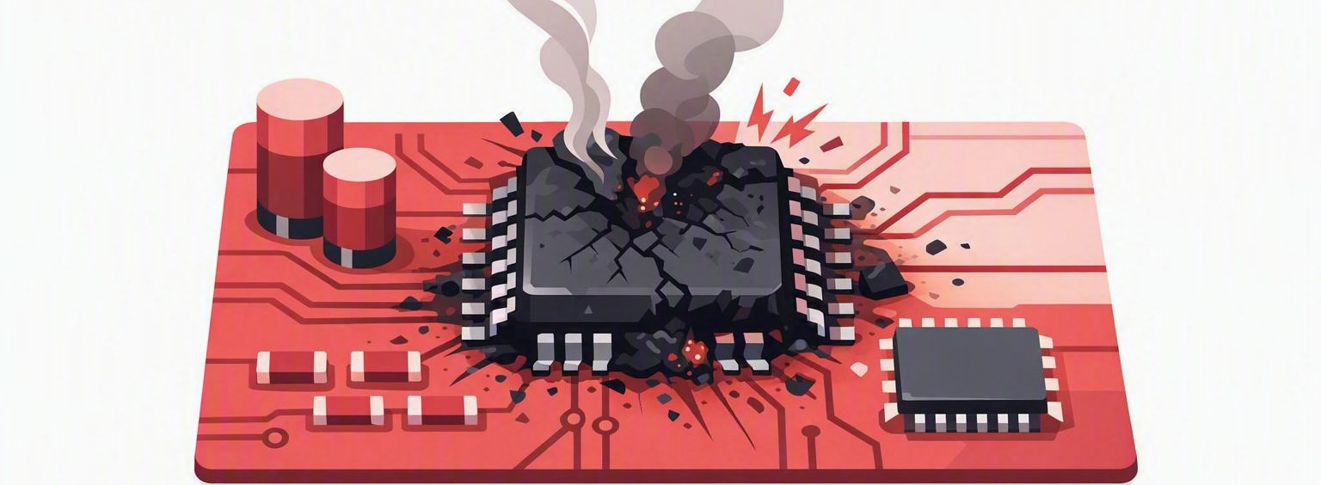
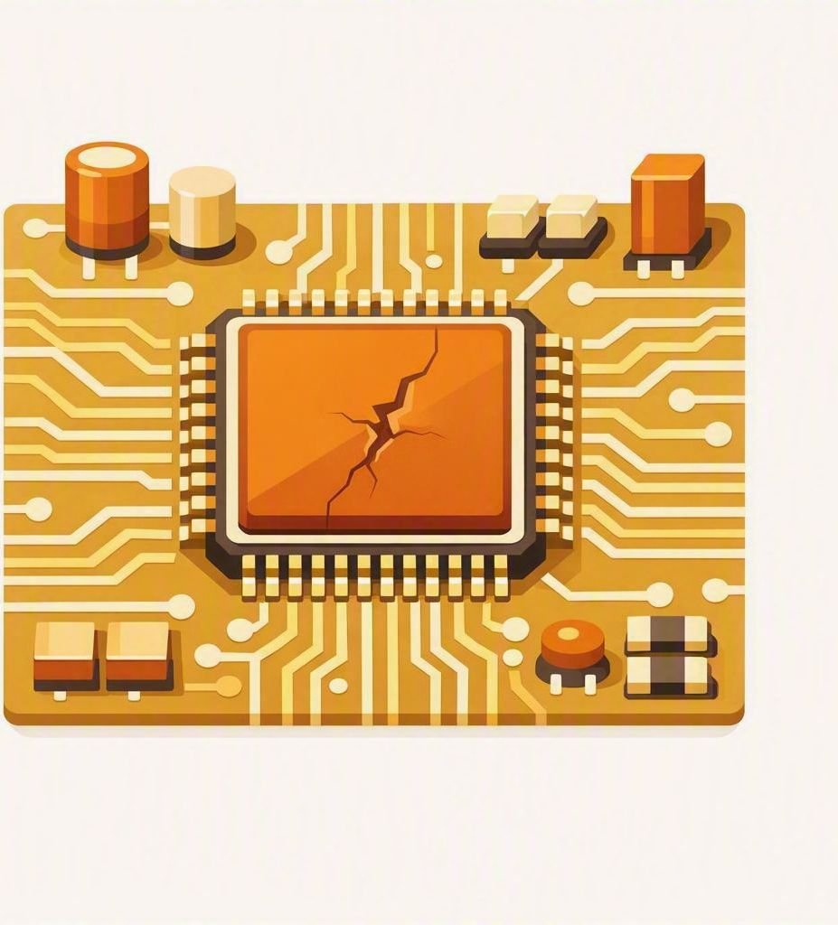
02 • ELECTROSTATIC DISCHARGE - ESD
Static damage is not always loud, immediate, or obvious.
Static events happen quickly—and often without a visible spark.
The event may be too small to feel, but still powerful enough to damage sensitive electronic components.
A typical household static shock ranges from 1,000 to 20,000 volts.
Despite the massive voltage, these shocks are harmless to your body because the amperage (current) is extremely low and lasts only a fraction of a microsecond.
Sensitive components can be damaged below the level we feel
Damage may be microscopic or latent
Damage can occur during installation, inspection, or service
Catastrophic damage causes an immediate or complete failure
Latent damage weakens a component, allowing it to work temporarily before failing later
Integrated circuits, memory devices, and logic boards are especially vulnerable
CATASTROPHIC
FAILURE
LATENT
FAILURE
Notes:
Talking points
• Contrast the three panels: immediate failure, delayed or latent failure, and the technician’s preventive field habit.
• Use the voltage examples only to show that static can become very high; do not imply that a technician can judge ESD risk by whether a spark is felt.
• Emphasize that component damage can occur below the human sensation threshold.
• Reinforce the floor habit shown: touch grounded cabinet metal before handling boards.
Class Q&A
• Ask: “If a board still works after being handled, does that prove no ESD damage occurred?”
• Expected answer: no; latent damage may not appear immediately.

Slide 9
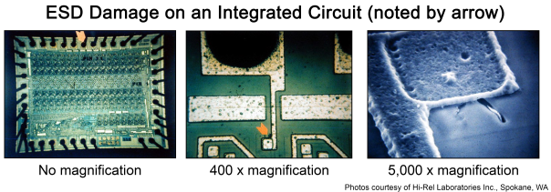
02 • ELECTROSTATIC DISCHARGE - ESD
Static damage is not always loud, immediate, or obvious.
Notes:
Talking points
• Use the magnified images to show why ESD damage is often invisible during normal inspection.
• Point out the progression from no magnification to 400× and 5,000×. The damaged area becomes apparent only at high magnification.
• Connect the image to field behavior: technicians cannot rely on sight, sound, or touch to decide whether an ESD event was harmless.
• Prevention must happen before handling the component because the damage may be too small to see and too late to reverse.
Class Q&A
• Ask: “What does this image tell us about using visual inspection as proof that a board is undamaged?”
• Expected answer: visual inspection alone cannot rule out microscopic ESD damage.

Slide 10
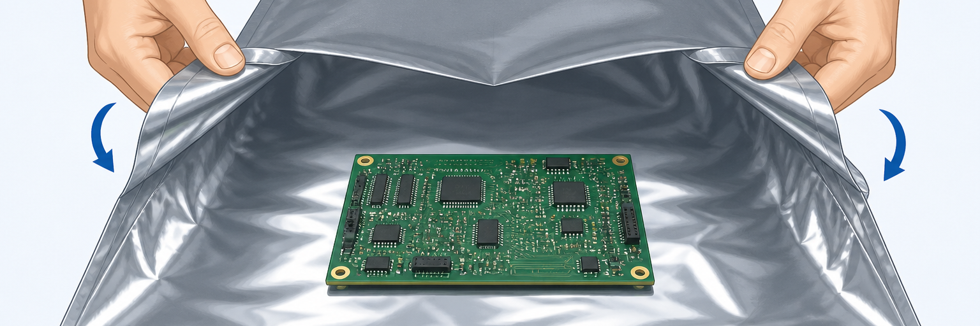
02 • ELECTROSTATIC DISCHARGE - ESD
Good ESD practice is a short sequence you can repeat every call.
01
02
03
04
Discharge
Handle edges
Use the bag correctly
Re-discharge
Touch grounded cabinet metal before handling a board.
Avoid traces, pins, connectors, and components.
Don’t remove the part from the bag before you are ready to work on it.
Repeat when you move away and return to the cabinet.
Static-control bag myth
If a temporary work surface is needed, turn the bag inside out so the protected inner surface faces outward.
Notes:
Talking points
• Walk through the four steps in order: discharge, handle by the edges, use the bag correctly, and re-discharge after moving away.
• Demonstrate with a real board and static-control bag if available.
• Explain that pins, traces, connectors, and components should be avoided because direct contact increases contamination and ESD risk.
• Clarify the bag reminder: do not place a board on the bag’s outside surface. If the bag is being used as a temporary protected surface under the approved procedure, turn it inside out.
Class Q&A
• Ask: “You discharge, step away to get a tool, and return. Which step must be repeated?”
• Expected answer: discharge again on grounded cabinet metal.

Slide 11

02 • ELECTROSTATIC DISCHARGE - REVIEW / Q&A
Protect the board before you touch it.
QUICK REVIEW
CLASS Q&A
Static damage may be immediate or latent.
Discharge on grounded cabinet metal.
Handle boards by their edges.
When should you re-discharge?
Why can a board fail later?
What is wrong with using the bag’s outside surface?
The safest ESD habit is the one you repeat every call.
Notes:
Talking points
• Use this as a retrieval pause. Ask learners to explain the four ESD habits without looking back.
• Have the class distinguish immediate failure from latent failure in their own words.
• Use the static bag as a prop and ask someone to identify the protected surface.
• Take section questions before introducing electrical fundamentals.
Class Q&A
• Ask the three questions displayed on the slide.
• Scenario: “You return to a cabinet and are about to pick up a board. What should happen first?”
• Expected answer: re-discharge on grounded cabinet metal, then handle the board by its edges.

Slide 12
SECTION 03
Electrical Fundamentals
Voltage pushes. Resistance limits. Current flows.
Notes:
Talking points
• Introduce voltage, resistance, and current as the vocabulary behind useful meter readings.
• Use the subtitle as the basic relationship: voltage provides the electrical difference, resistance limits the path, and current flows through a complete path.
• Keep the section practical. The aim is to predict expected behavior before selecting a meter function.
Class Q&A
• Ask: “What are the units for voltage, resistance, and current?”
• Expected answer: volts, ohms, and amps.

Slide 13

03 • ELECTRICAL FUNDAMENTALS - Safety
If someone is being shocked, protect yourself first.
A REAL-WORLD MISTAKE
DO NOT GRAB THE PERSON
Someone touches exposed metal leads while plugging equipment into AC. The person may be unable to let go.
1
Shut off or unplug the power only if you can do it safely.
The first rule is simple: do not become the second person in the circuit.
2
If power cannot be shut off immediately, use a dry, clean, known nonconductive object—such as a wooden board or plastic handle—to separate the person from the source. Do not attempt this around high voltage.
DO NOT USE A BELT OR METAL OBJECT
3
Call 911 or the site emergency response number. Do not approach until the scene is safe.
Leather may be wet or have metal hardware. Use only a dry, clean, known nonconductive object—and only as a last resort.
4
Then provide first aid or CPR if trained; follow dispatcher instructions.
When in doubt: step back, keep others away, and wait for trained help.
Notes:
TALKING POINTS
Use this slide before the first AC measurement or live-voltage demonstration.
Emphasize the example: if someone touches metal leads while plugging into AC, do not grab them while they are still energized.
Power should be disconnected before approaching. If power cannot be shut off immediately, OSHA and CDC guidance allow a dry, clean, known nonconductive object such as a wooden board or plastic handle to separate the person from the source. Do not use a belt, metal object, or improvised tool whose insulating properties are uncertain. Do not attempt this around high voltage. Once the scene is safe, provide first aid or CPR if trained and follow dispatcher instructions.
[Sources]
- OSHA, Train-the-Trainer: Basic Electricity Safety, https://www.osha.gov/sites/default/files/2019-04/Basic_Electricity_Materials.pdf.
- American Red Cross, First Aid/CPR/AED Participant’s Manual, https://www.redcross.org/content/dam/redcross/training-services/no-index/First%20Aid-CPR-AED-Participant%27s-Manual.pdf.
- CDC, What to Do to Protect Yourself From Electrical Hazards, https://www.cdc.gov/natural-disasters/response/what-to-do-protect-yourself-from-electrical-hazards.html.

Slide 14
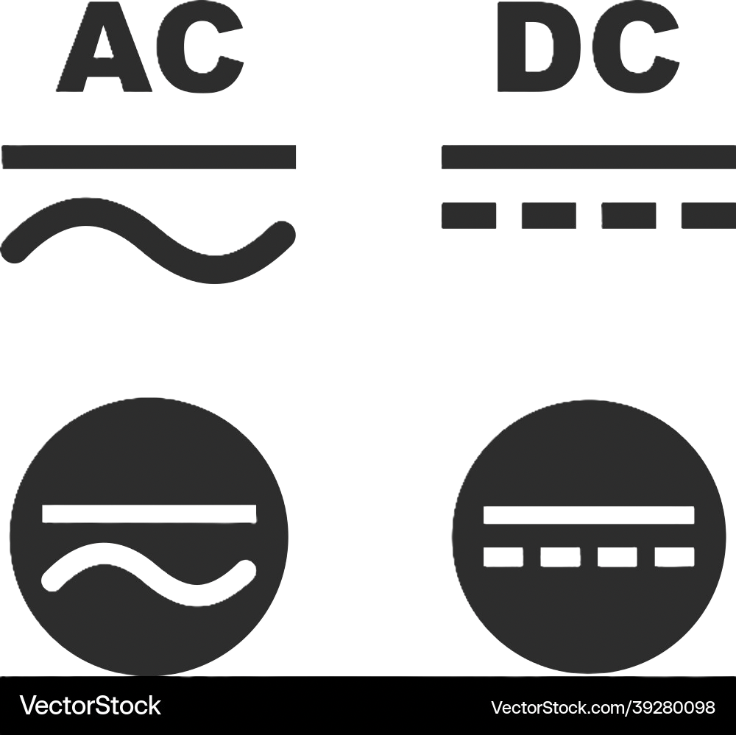
03 • ELECTRICAL FUNDAMENTALS - BASIC ELECTRICAL UNDERSTANDING
Basic Electrical
01
02
Alternating Current (AC)
Direct Current (DC)
Electric charge periodically reverses direction, cycling back and forth.
Electric charge flows steadily in a single, constant direction through the circuit.
Direction: reverses periodically (60 Hz in the US)
Typical sources: wall outlets, generators, utility power grid
Common use: building power, most equipment supply
Direction: one direction only, does not reverse
Typical sources: batteries, solar cells, USB power, PCB rails
Common use: electronics, circuit boards, sensitive components
Why this matters for ESD safety
The cabinet receives AC power from the building, normally through a floor or wall connection. Depending on the location and actual measured supply, technicians may commonly hear this described as 110, 115, or 120 volts AC.
Notes:
Talking points
• Define AC as electrical charge that reverses direction periodically; in the United States, utility power normally cycles at 60 Hz.
• Define DC as charge flowing in one consistent direction through the circuit.
• Connect the examples to field work: wall or floor power is AC; batteries, USB power, PCB rails, and many cabinet outputs are DC.
• Explain why identification matters: the meter must be set for the type of voltage expected at the test point.
• Correct the wording connection on the slide: the AC cabinet input is an electrical-safety issue, while ESD is a separate static-control issue.
Class Q&A
• Ask: “Where would you expect AC in or around a cabinet, and where would you expect DC?”
• Expected answer: AC at the building input and AC distribution; DC after the power supply and at batteries or electronic rails.

Slide 15


03 • ELECTRICAL FUNDAMENTALS - BASIC ELECTRICAL UNDERSTANDING
Voltage pushes. Resistance limits. Current flows.
VOLTAGE
(V)
RESISTANCE
(Ω)
CURRENT
(A)
The electrical difference between two points. Measure voltage across the circuit or component.
How strongly a path opposes current. Check resistance only with power removed.
The flow through a complete path. The load and resistance determine how much flows.
Notes:
Talking points
• Describe voltage as the electrical difference between two points, which is why voltage is measured across a source, circuit, or component.
• Describe resistance as opposition to current and reinforce that resistance is checked only after power is removed.
• Describe current as flow through a complete path. Current depends on the applied voltage and the resistance or load.
• Use the three small graphics as a sequence: push, restriction, resulting flow.
• Keep Ohm’s law conceptual: for the same voltage, more resistance means less current; an open path prevents current flow.
Class Q&A
• Ask: “If the same voltage is applied and resistance increases, what happens to current?”
• Expected answer: current decreases.

Slide 16
03 • ELECTRICAL FUNDAMENTALS - BASIC ELECTRICAL UNDERSTANDING
AC comes in; DC powers the electronics.
AC
≈ 110–120 V
POWER
SUPPLY
DC
OUTPUTS
Incoming building power
Potentially hazardous
Measure in AC mode
Converts AC to the DC outputs used by cabinet components
CPU backplane • Monitors
LEDs • Peripherals
Measure in DC mode
Notes:
Talking points
• Follow the diagram from left to right: incoming building AC enters the power supply, which converts it into DC outputs for cabinet systems.
• Explain that technicians may hear incoming voltage described as 110, 115, or 120 VAC; the actual voltage must be measured safely rather than assumed.
• Identify likely DC loads shown: CPU, backplane, monitors, LEDs, and peripherals.
• Before testing, decide whether the point should be AC or DC, what value is expected, and what reference point will be used.
• Remind the class that voltage inside a cabinet can still be hazardous.
Class Q&A
• Ask: “If you are testing the input side of a cabinet power supply, which voltage mode do you expect? What about its output side?”
• Expected answer: AC on the input side and DC on the output side, subject to the diagram and label.

Slide 17
03 • ELECTRICAL FUNDAMENTALS - REVIEW / Q&A
Name the electrical behavior before you test it.
QUICK REVIEW
CLASS Q&A
AC reverses direction; DC flows one way.
Voltage pushes; resistance limits.
Current flows through a complete path.
Cabinet supplies convert AC into DC.
Where do we expect AC in a cabinet?
Where do we expect DC?
What happens to current when resistance rises?
The expected electrical behavior determines the useful meter test.
Notes:
Talking points
• Ask learners to connect each quantity to its unit and practical meaning.
• Reinforce the cabinet transition from incoming AC to distributed DC.
• Use the visible questions to check whether learners can predict electrical behavior before they reach for the meter.
• Keep the review conceptual; calculations are not the main objective.
Class Q&A
• Ask the three questions displayed on the slide.
• Follow up: “Why does naming AC or DC first matter to the next test?”
• Expected answer: it determines the correct meter function and the expected behavior.

Slide 18
SECTION 04
Power Flow
Follow the energy. Find the fault.
Notes:
Talking points
• Transition from individual meter functions to the full cabinet power path.
• Explain that a symptom identifies what is wrong; the power path helps identify where to begin testing.
• Preview the mental model: source, distribution or protection, conversion, distributed power, load, and return.
Class Q&A
• Ask: “If a cabinet load is dead, what should guide the first test point?”
• Expected answer: the known power path, the symptom, and the expected voltage at logical points.

Slide 19
04 • POWER FLOW - THE FULL PATH
Troubleshooting gets easier when you can picture the whole path.
WALL / FLOOR
AC INPUT
POWER
DISTRIBUTION
AC → DC
POWER SUPPLY
DISTRIBUTED
DC
CABINET
LOADS
CPU / backplane
monitors / LEDs
peripherals
Some cabinets combine distribution and conversion. Others use multiple supplies for different cabinet systems.
Notes:
Talking points
• Follow the diagram from left to right: wall or floor AC input, power distribution, AC-to-DC power supply, distributed DC, and cabinet loads.
• Use a real cabinet as the anchor and point out the physical location of each stage where possible.
• Explain that some cabinets combine distribution and conversion while others use multiple power supplies for different systems.
• Mention the examples shown: CPU or backplane, monitors, LEDs, and peripherals may be powered through different branches.
• The diagram is a mental starting point, not a replacement for the cabinet-specific documentation.
Class Q&A
• Ask: “If the CPU is operating but the cabinet LEDs are dead, what does that tell you about the path?”
• Expected discussion: some common source power is present; investigate the LED branch, its supply, connectors, control, and return.

Slide 20
04 • POWER FLOW - SEVEN-STEP METER SEQUENCE
Use the same seven-step meter sequence every time.
1
Define the measurement
5
Place probes safely
AC voltage, DC voltage, resistance, or continuity
Fingers behind guards; avoid body paths and accidental shorts
2
Inspect the meter
6
Remove power first
Leads, probes, common terminal, and test terminal
Required for resistance and continuity checks
3
Select a safe function
7
Record the result
Choose the range and treat unknown circuits conservatively
Name both test points, the operating condition, and the reading
4
Prove the meter
Use a known source or known condition when the procedure allows
A number without test-point context is weak evidence.
Notes:
Talking points
• Use this as the standard script before every supervised measurement.
• Walk through the steps in order: define, inspect, select, prove, place, de-energize when required, and record.
• Explain “prove the meter” as confirming operation with a known source or known condition when the procedure allows.
• For unknown circuits, select a safe function and treat the circuit conservatively.
• Emphasize the bottom line: a number is weak evidence unless both test points, the operating condition, and the selected function are known.
Class Q&A
• Ask: “Which step happens before selecting the function?” Expected answer: define the measurement and inspect the meter.
• Ask: “What must be documented with the number?” Expected answer: both test points, operating condition, function, and reading.

Slide 21
04 • POWER FLOW - Q&A
Follow the power path—not the symptom.
QUICK REVIEW
CLASS Q&A
Start at a known source or logical split point.
Trace distribution, conversion, and loads.
Compare each reading with the expected value.
Record both test points and conditions.
Where would you start for a dead cabinet?
What makes a reading useful evidence?
When should you split the path?
A planned sequence turns scattered readings into a diagnosis.
Notes:
Talking points
• Ask learners to describe the cabinet power path without looking back at slide 27.
• Have them choose a first test for a completely dead cabinet and explain why.
• Discuss when it is efficient to start at the source and when a logical midpoint can split the path.
• Reinforce that every reading must be compared with an expected value.
Class Q&A
• Ask the three visible questions.
• Ask: “What information must be recorded with a voltage reading?”
• Expected answer: selected function, both test points or reference, operating condition, expected result, and actual reading.

Slide 22
SECTION 05
Meter Safety & Use
Set the meter before the probes touch.
Notes:
Talking points
• Transition from electrical behavior to the tool used to test it.
• Reinforce the section rule: complete the setup before the probes touch the circuit.
• Preview the four class priorities: AC voltage, DC voltage, resistance or continuity, and battery testing.
• Explain that the meters may look different, but the measurement logic remains consistent.
Class Q&A
• Ask: “What should be verified before the probes touch anything?”
• Listen for meter and lead condition, input terminals, selected function, AC or DC, expected value, and reference point.

Slide 23
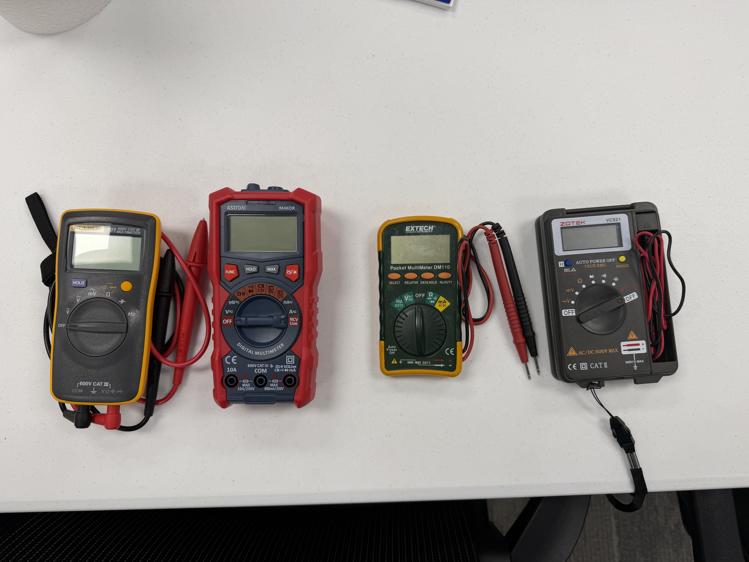
05 • MULTIMETERS - INTRODUCTION
Different meters, one shared workflow.
WHAT STAYS THE SAME
Black lead in COM.
Red lead in the voltage / resistance jack.
Choose the function before contact.
Read the display and units.
Remove power for resistance and continuity.
Notes:
Talking points
• Identify the four meters in the photograph and the AstroAI as the classroom demonstration meter.
• Note that the smaller Extech and Zotek meters have had some field deployment around GCG, so students may already recognize them.
• Compare the common controls: display, selector, voltage and resistance functions, continuity, black/common connection, and red measurement connection.
• Read the shared workflow on the left: correct leads, correct jack, function before contact, confirm units, and remove power before resistance or continuity.
• Explain that button names, dial positions, ranges, and lead storage may vary by model.
Class Q&A
• Ask: “What features or symbols can you find on all four meters?”
• Follow up: “Which differences mean you must inspect the individual meter before testing?”

Slide 24
05 • MULTIMETERS - INTRODUCTION
Different meters, one shared workflow.
Notes:
Talking points
• Use the colored annotations to compare where voltage and resistance or continuity appear on each meter.
• Point out that the same function may use a different dial location or share a position with another function.
• On meters with shared positions, the select or function button changes the active measurement; the display must confirm the choice.
• Do not teach by dial position alone. Teach students to match the symbol, active display indicator, and expected measurement.
• Use this slide as a visual identification exercise before focusing on the AstroAI.
Class Q&A
• Ask a learner to point out voltage on each meter, then resistance or continuity.
• Ask: “Why is copying the dial position from a different meter unsafe?”
• Expected answer: the controls and shared functions differ by model.

Slide 25
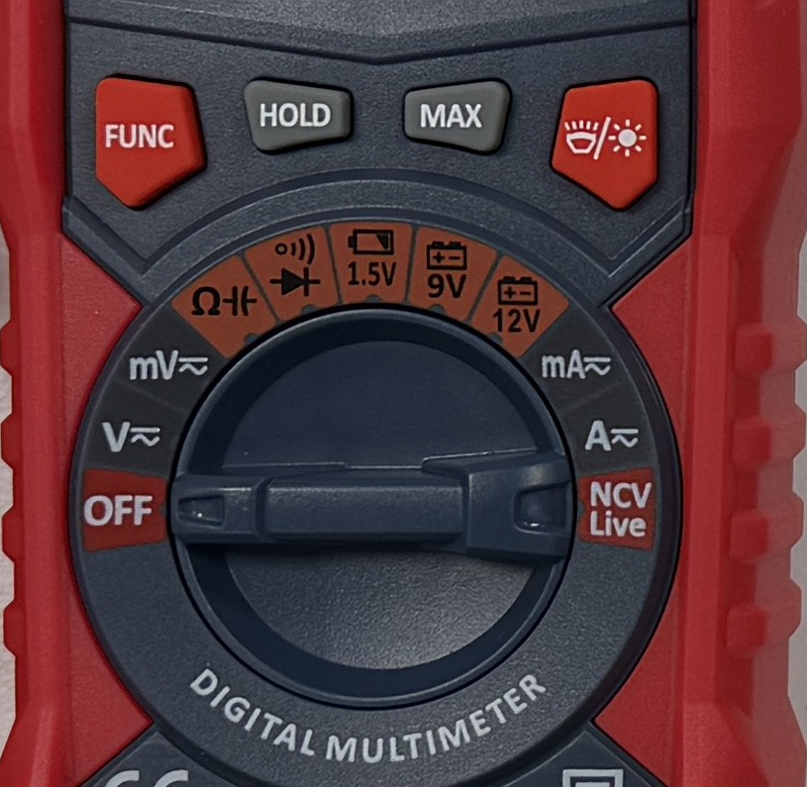
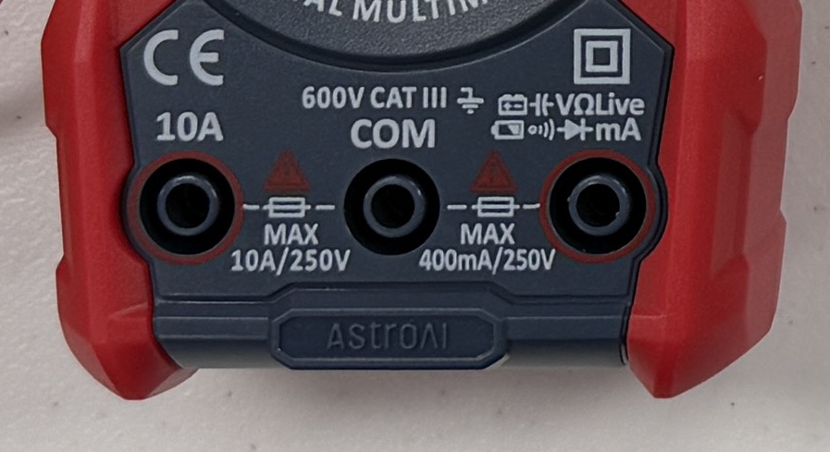
05 • MULTIMETERS - ABOUT THE DIAL
Most general troubleshooting uses four dial positions.
THE MODES WE NEED
V: AC or DC voltage; press FUNC and check the display.
Ω: resistance on a de-energized circuit.
Continuity: same dial area; press FUNC for the audible check.
Battery presets: only 1.5 V, 9 V, and 12 V batteries.
Use DC volts when the battery does not match a preset.
Confirm leads before selecting a mode
Notes:
Talking points
• Use the actual AstroAI while pointing to the four areas highlighted on the slide.
• For voltage, select V, use FUNC to choose AC or DC, and verify the display before contact.
• For resistance or continuity, prove the circuit is de-energized, select the resistance/continuity area, and use FUNC for the audible continuity check.
• Keep the black lead in COM and the red lead in the voltage/resistance input for all class measurements on this slide—not the 10 A terminal.
• Explain that the 1.5 V, 9 V, and 12 V battery positions are loaded presets and should be used only when the battery matches the label.
Class Q&A
• Scenario: “You need to check a 24 VDC power-supply output. Where should the dial point, and what must the display show?”
• Expected answer: voltage mode with DC confirmed on the display.

Slide 26
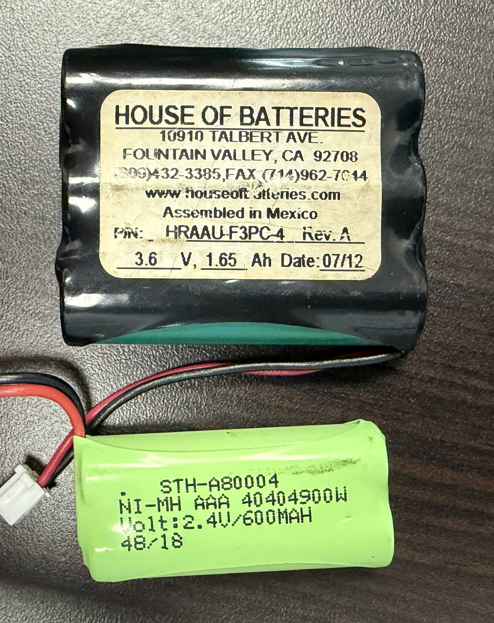
05 • MULTIMETERS - SAFETY & USE
Battery presets only work when the labels match.
MATCH THE BATTERY TO THE SETTING — NEVER USE CURRENT OR RESISTANCE
CHOOSE THE TEST BY BATTERY TYPE
SERIES PACK RULE
A preset applies a built-in load. Use DC volts for any battery or pack that does not match 1.5 V, 9 V, or 12 V.
Cell voltages add.
2 cells @ 1.5v each ≈ 3.0 V
3 cells @ 1.5v each ≈ 4.5 V
Test at the pack output Compare with IGT label
1.5 V
AA / AAA cell → use the 1.5 V preset
3.2 V
Coin cell → use DC volts
3.0–4.5 V
2–3 AA / AAA cells in series → use DC volts
Notes:
Talking points
• Explain that a battery preset applies a built-in load; it is not simply another DC-voltage range.
• Use the 1.5 V preset for an individual AA or AAA cell when that preset matches the battery.
• Use regular DC volts for the 3.2 V coin cell because no preset matches it.
• For two- or three-cell AA/AAA packs wired in series, the cell voltages add. Expect about 3.0 V for two fresh 1.5 V cells and about 4.5 V for three.
• Test a series pack at its output and compare the reading with the pack label and current product guidance.
• Never place the meter in current or resistance mode directly across a battery.
Class Q&A
• Scenario: “A pack has three 1.5 V cells in series. What nominal voltage do you expect, and which mode should you use?”
• Expected answer: approximately 4.5 V using regular DC-voltage mode.

Slide 27
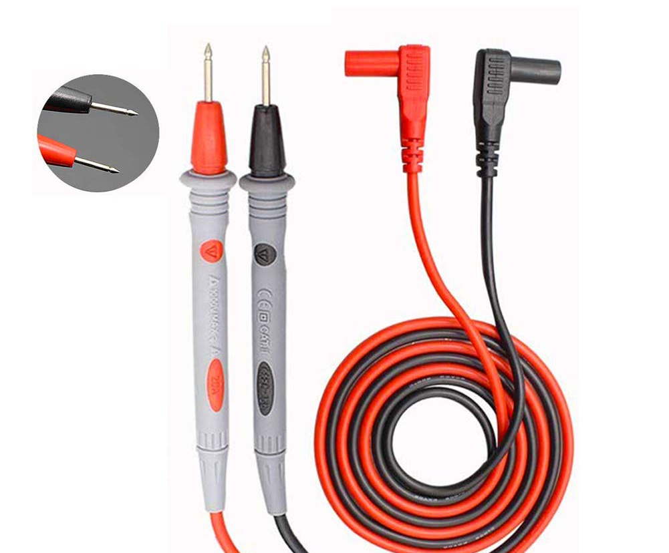
05 • MULTIMETERS - SAFETY
The safest meter reading starts before the probes touch anything.
RED LEAD
IN THE WRONG
TERMINAL CAN TURN a voltage check into a dangerous current measurement.
CHECK BEFORE YOU TEST
Inspect the meter, leads, and probes.
Confirm the black lead is in COM.
Confirm the red lead is in the correct terminal.
Select AC, DC, resistance, or continuity before contact.
Keep fingers behind probe guards.
Never use resistance or continuity on an energized circuit.
Say what you expect to read before you test.
Notes:
Talking points
• Pause here before any live-voltage demonstration.
• Demonstrate the complete pre-test check: inspect the meter and leads, black in COM, red in the correct terminal, correct function selected, and fingers behind the probe guards.
• Explain the red-terminal warning. A lead left in a current input can turn a voltage check into a short circuit or blow the meter fuse.
• Have the learner say the expected voltage type, expected approximate value, and reference point before placing probes.
• Repeat the rule: never attempt a voltage measurement while the meter is in current, resistance, or continuity mode.
Class Q&A
• Ask: “What can happen if the red lead is left in a current terminal during a voltage check?”
• Expected answer: a short circuit, blown meter fuse, equipment damage, arc or spark, and possible injury.

Slide 28
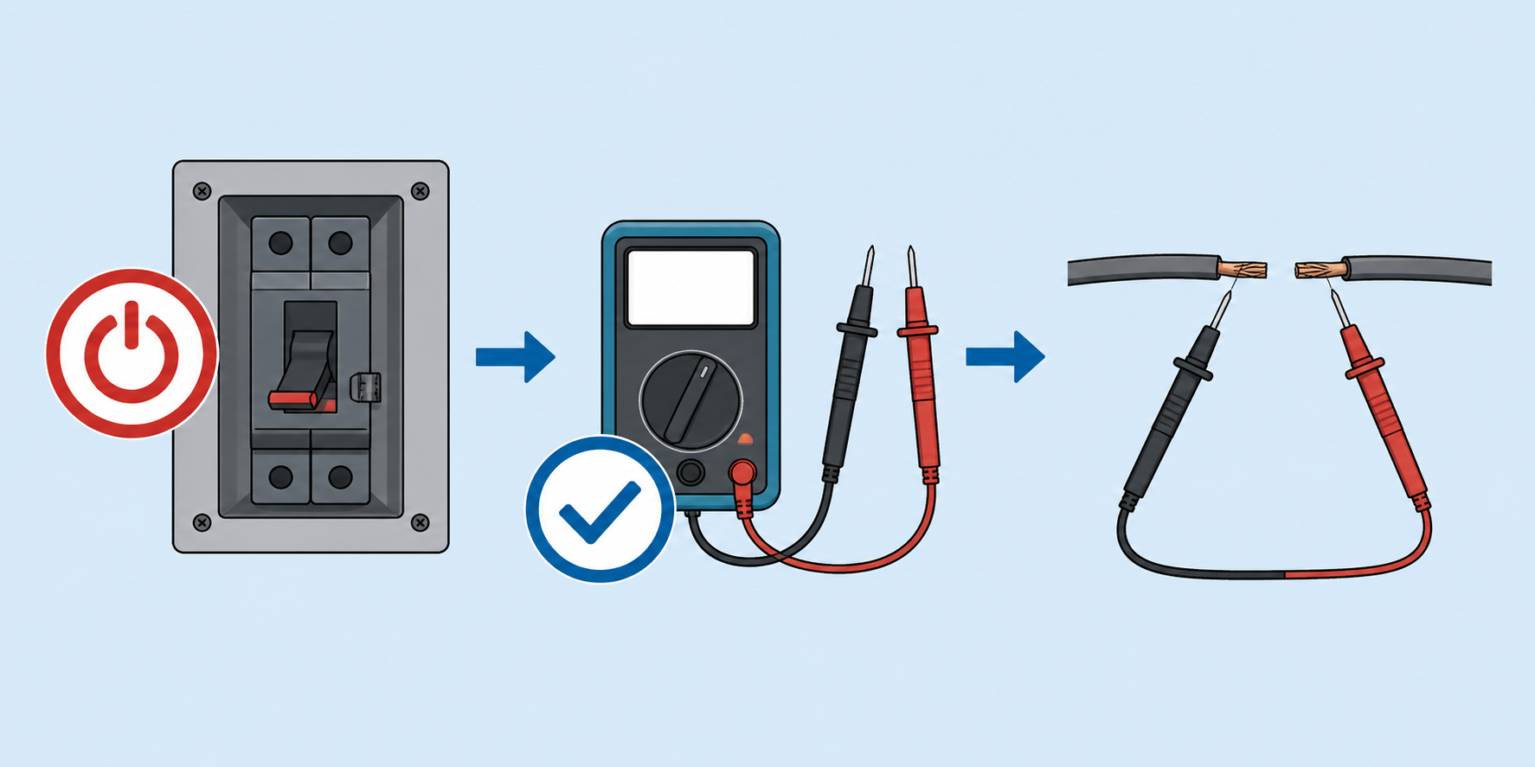
05 • MULTIMETERS - SAFETY
Continuity and resistance checks require power off.
READ THE RESULT
Low resistance or a tone: the two points are connected.
OL / open: the path is interrupted or out of range.
Higher-than-expected resistance: inspect for corrosion, damage, or loose connections.
Continuity proves a path—not that it can carry the required load.
Compare the reading with the diagram or specification.
POWER OFF FIRST
Resistance and continuity modes apply their own test signal. An energized circuit can damage the meter or produce a false result.
Prove the circuit is de-energized before switching modes.
Notes:
Talking points
• Demonstrate OL or open with the probes separated, then a very low resistance with the probes touching.
• Explain the three result patterns shown: expected low resistance, open path, and higher-than-expected resistance.
• Use higher-than-expected resistance to introduce corrosion, loose terminals, damaged conductors, or poor connections.
• Stress that a continuity tone confirms an electrical connection under the meter’s small test signal; it does not prove the path can carry the equipment’s normal load.
• Prove the circuit is de-energized before selecting resistance or continuity.
Class Q&A
• Ask: “What must be proven before selecting resistance or continuity?”
• Expected answer: the circuit is de-energized.
• Follow up: “Does a beep prove the connection will carry its normal load?” Expected answer: no.

Slide 29
05 • MULTIMETERS - CONTINUITY
Use continuity to answer binary path questions quickly.
EASY USE CASES
PATH CHECK NOT A LOAD TEST
Continuity is a fast yes / no check. Keep both probes on de-energized points and ask one path question at a time.
Power connection: end-to-end on each wire in a harness.
Harness pin: pin 3 here → pin 3 there.
Fuse or switch: closed when commanded or pressed.
Ground path: ground pin to ground pin.
Connector path: when voltage is not the first question.
A good tone tells you the path is connected—not why the circuit works.
Notes:
TALKING POINTS
Walk through the use cases as yes / no path questions: does this wire reach the other end, does this pin land where the drawing says, is the switch closed, does the fuse pass, and does ground reach ground?
Keep the sequence consistent: power off, isolate if needed, choose continuity, touch both points, then compare the result with the drawing or expected path.
Emphasize that continuity is a fast path check—not a substitute for a voltage or load test when the circuit must deliver power.
[Sources]
- No external sources; instructional copy based on standard digital-multimeter continuity behavior.

Slide 30

05 • MULTIMETERS - CONTINUITY
When a cable is too tight to trace, let continuity do the walking.
A PROT TIP FOR TRACING WIRES
Pick one reference conductor—often ground.
Probe one end, then find the same conductor at the other end.
Tone = same continuous path.
No tone / OL = wrong pin or broken conductor.
On a harness, repeat pin-to-pin from the drawing.
GROUND → GROUND
USB, video, or harness: continuity lets the meter trace what your eyes cannot.
Start with one known conductor. Once you find it, the rest of the cable gets easier.
Notes:
TALKING POINTS
Use this as the memorable field trick. When a cable or harness disappears into a tight space, choose one conductor you can identify at one end—ground is often the easiest—and use continuity to find that same conductor at the other end.
For a harness, use the wiring diagram to choose a pin and test pin-to-pin. A tone means the path is continuous; OL means the path is open or you are on the wrong pin.
Ask the class: “If the cable is too tight to trace with your eyes, what could you test first?”
[Sources]
- Generated visual: OpenAI ImageGen, generated 2026-08-10; generic cable / harness continuity-tracing illustration.
- No external sources; instructional copy based on standard digital-multimeter continuity behavior.

Slide 31
05 • MULTIMETERS - Q&A
Set the meter before the probes touch.
QUICK REVIEW
CLASS Q&A
Black lead in COM; red lead in the correct jack.
Choose AC, DC, resistance, or continuity first.
Remove power for resistance and continuity.
Use battery presets only when labels match.
How would you test 24 VDC?
How would you test a 3.2 V coin cell?
What can a wrong red-lead terminal cause?
What does OL tell you when testing continuity?
Why must power be off before using resistance or continuity mode?
A harness wire reads OL end-to-end. What are two possible causes?
Does a continuity beep prove the connection can carry the equipment’s normal load?
Function, terminals, expected value, reference point—then probes.
Notes:
Talking points
• Use the actual AstroAI while learners answer the visible questions.
• Require the learner to identify the correct input terminals and dial function before giving the answer.
• Reinforce that continuity is a power-off test and that unmatched batteries use regular DC volts.
• Use the slide’s bottom sequence as the section summary: function, terminals, expected value, reference point, then probes.
Class Q&A
• Ask all three questions displayed on the slide.
• Scenario: “You need to test a 3.2 V coin cell. Which mode do you choose?”
• Expected answer: regular DC volts, not one of the loaded battery presets.

Slide 32
SECTION 06
Wiring Diagrams
Read the map. Then prove it on the cabinet.
Notes:
Talking points
• Introduce a wiring diagram as a map of electrical relationships, not a picture of physical routing.
• Stress that the drawing must match the cabinet model, configuration, and revision before it guides work.
• Preview the section goal: use the diagram to find source, connectors, pins, expected values, loads, and returns, then prove the path on the cabinet.
Class Q&A
• Ask: “What must match before a wiring diagram can guide the test?”
• Expected answer: cabinet model, configuration or options, and revision.

Slide 33

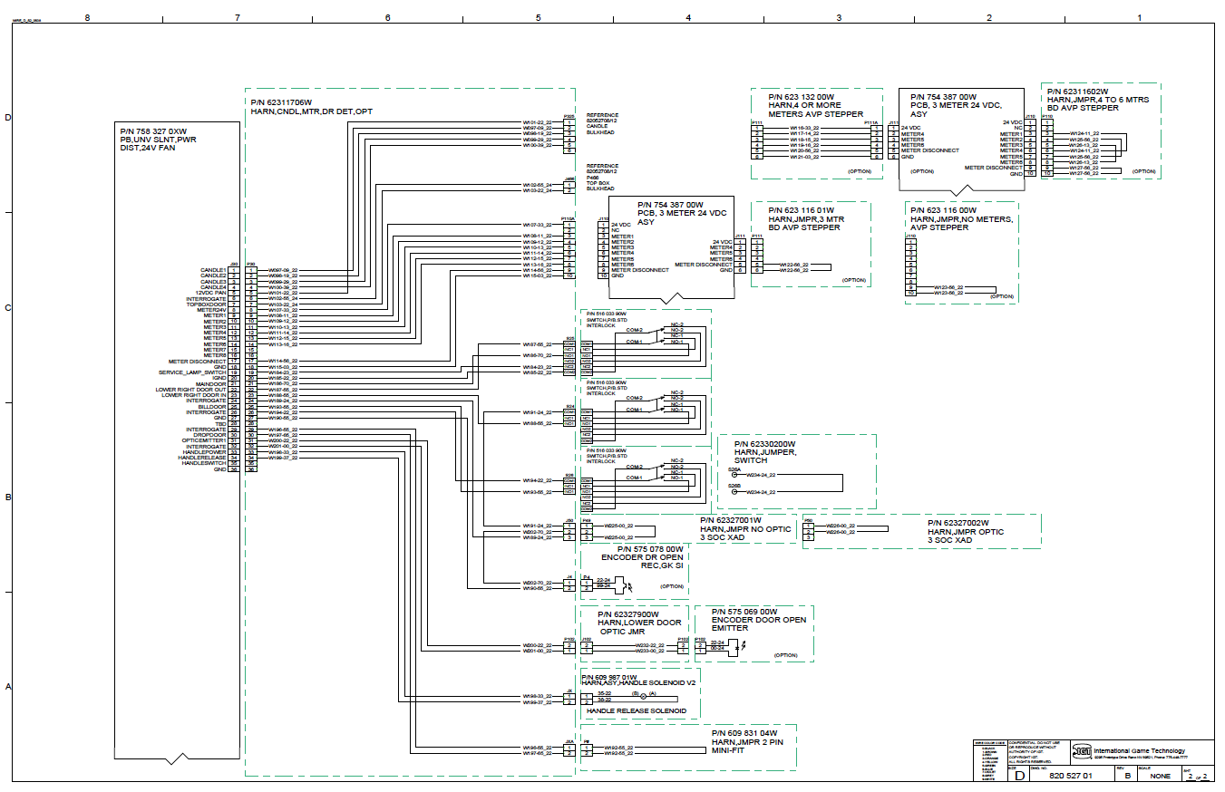
06 • WIRING DIAGRAMS - BEFORE YOU TRACE
Match the drawing to the cabinet before you test.
BEFORE YOU TRACE
Confirm cabinet model and revision.
Read the title block and legend.
Find connector IDs, pin numbers, grounds, returns, and expected voltages.
Use wire color as a clue—not as proof.
Match one diagram point to one physical point before measuring.
REFERENCE CABINET
IGT Universal Slant
Notes:
Talking points
• Identify the reference cabinet as the IGT Universal Slant and compare it with the title block or identifying information on the drawing.
• Before tracing, locate the connector IDs, pin numbers, grounds or returns, and expected voltages.
• Explain that wire color is useful for orientation but does not prove identity, voltage, or continuity.
• Ask learners to match one point on the diagram to one physical connector or test point before measuring.
• Use the full-page view to teach orientation rather than trying to read every wire at once.
Class Q&A
• Ask: “What four pieces of information should you find before placing the probes?”
• Expected answer: source, connector and pin, expected voltage, and return or reference point.

Slide 34
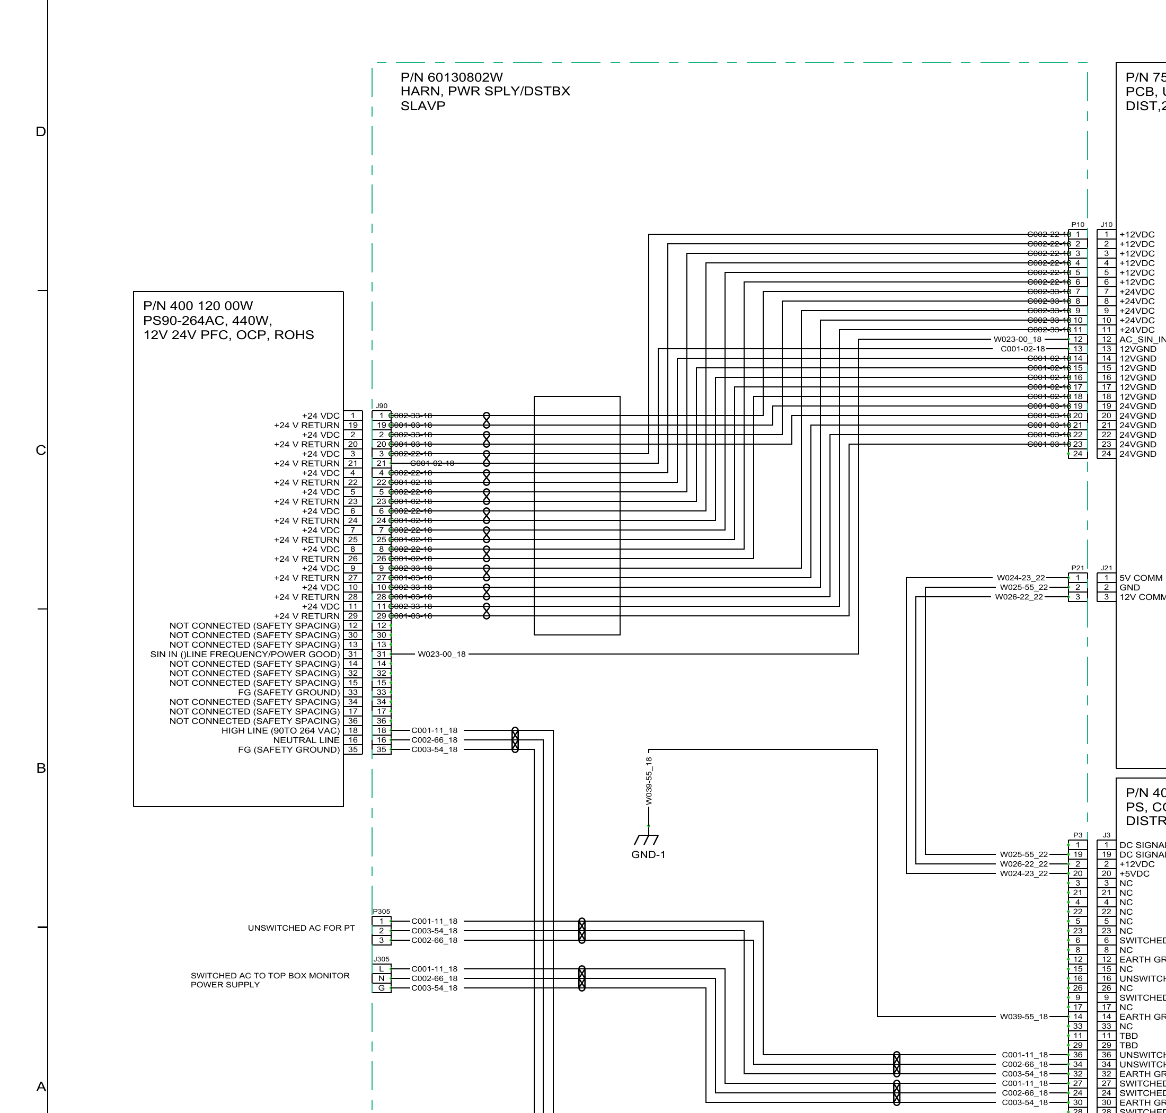
06 • WIRING DIAGRAMS - BEFORE YOU TRACE
Match the drawing to the cabinet before you test.
POWER SUPPLY WIRING
BEFORE YOU TRACE
Confirm cabinet model and revision.
Read the title block and legend.
Find connector IDs, pin numbers, grounds, returns, and expected voltages.
Use wire color as a clue—not as proof.
Match one diagram point to one physical point before measuring.
REFERENCE CABINET
Use the source, connector/pin, expected voltage, and return as the test plan.
IGT Universal Slant
Notes:
• Explain that this slide zooms in on the power-supply portion of the same IGT drawing.
• Start at the labeled source and follow one conductor to a connector and pin instead of scanning the whole page.
• Identify the expected voltage label and the correct return reference for the proposed measurement.
• Match the connector and pin on the diagram to the cabinet before taking a reading.
• Use the bottom statement as the test plan: source, connector or pin, expected value, and return.
Class Q&A
• Ask a learner to choose one labeled output and state: “Where is the source, which connector or pin is the test point, what voltage is expected, and what is the return?”

Slide 35
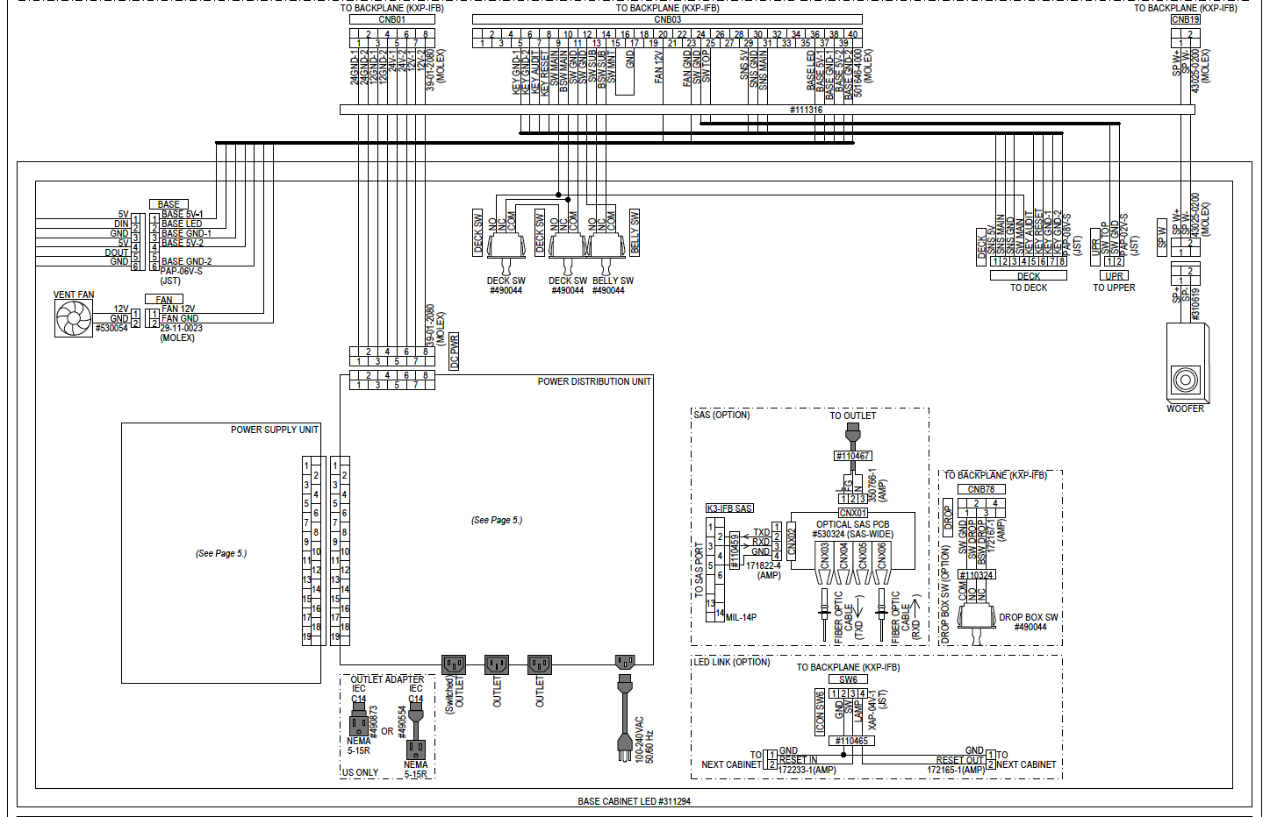
06 • WIRING DIAGRAMS - REFERENCE DRAWING
Konami – Dimensions 49 Wiring Diagram
Notes:
Talking points
• Transition to a different manufacturer to show that diagram appearance changes but the reading method does not.
• Use this full-page view to identify major blocks: power-supply unit, power-distribution unit, backplane connections, cabinet switches, outlets, and optional branches.
• Point out cross-references such as “See Page 5.” They indicate that part of the circuit continues elsewhere in the documentation.
• Do not begin by following every conductor. First identify the block related to the reported symptom.
Class Q&A
• Ask: “If the symptom is a dead cabinet fan, which area of this drawing would you inspect first?”
• Expected answer: the fan connection and its path back through the distribution and supply blocks.

Slide 36
06 • WIRING DIAGRAMS - REFERENCE DRAWING
Konami – Dimensions 49 Wiring Diagram
Notes:
Talking points
• Use the zoom to identify labeled low-voltage circuits for the base lighting and vent fan.
• Point out the 5V, 12V, and GND labels and the named connectors. These labels establish the expected DC test values and return points.
• Show the connection toward the backplane at CNB01, where both 12 V and 24 V conductors and grounds are labeled.
• Explain that voltage must be measured between the correct supply pin and its correct ground or return—not merely against any nearby metal point.
Class Q&A
• Ask: “For the vent fan, what voltage and return labels would you use to plan the test?”
• Expected answer: FAN 12V and FAN GND at the identified connector.

Slide 37
06 • WIRING DIAGRAMS - REFERENCE DRAWING
Konami – Dimensions 49 Wiring Diagram
Notes:
Talking points
• Use the zoom to identify deck switches, the belly switch, the backplane connector, and the woofer branch.
• Point out how connector and pin labels let the technician trace an input or load without relying only on wire color.
• Explain that a switch circuit may include common, normally open, and normally closed contacts; the diagram shows which terminals should change state.
• For the woofer branch, separate the signal path from the power or speaker conductors before choosing a test.
Class Q&A
• Ask: “How would you verify a deck switch with power removed?”
• Expected answer: identify the correct common and NO/NC pins from the drawing, then use resistance or continuity while operating the switch.

Slide 38
06 • WIRING DIAGRAMS - REFERENCE DRAWING
Konami – Dimensions 49 Wiring Diagram
Notes:
Talking points
• Use this zoom to locate the 100–240 VAC input, power-distribution unit, switched and unswitched outlets, and the connection to the power-supply unit.
• Explain that this portion of the drawing contains hazardous AC and must be approached with the approved live-testing controls.
• Point out the 20-pin connection between the power-supply and distribution units and the “See Page 5” cross-reference.
• Before testing, identify whether the chosen point is AC or DC, the expected value, and the correct reference.
• Use the outlets to discuss the difference between a source that is always present and one controlled by a cabinet switch or interlock.
Class Q&A
• Ask: “If an unswitched outlet has power but a switched outlet does not, what part of the path becomes the next focus?”
• Expected discussion: the switch or interlock control, branch wiring, connector, and switched-output path.

Slide 39
06 • WIRING DIAGRAMS - ISOLATING THE FAULT
Find the fault between the last good and first bad reading.
1
Find the symptom
Start with the component that is not working.
2
Find it on the diagram
Identify connector, pins, supply, and return.
3
Trace the path
Move through fuses, switches, harnesses, and plugs.
4
Test logically
Compare each reading with the expected voltage.
5
Narrow the fault
Focus between last known-good and first incorrect.
Check source → connector → fuse/switch → supply → monitor
MONITOR NOT POWERING ON
Notes:
Talking points
• Walk through the five-step sequence: define the symptom, locate it on the diagram, trace the path, test logically, and narrow the fault.
• Use the monitor example at the bottom: source, connector, fuse or switch, supply, and monitor.
• Do not jump directly to replacing the monitor. Ask where power is last correct and where it first becomes incorrect.
• Explain that the fault is usually in the path or components between those two test points.
Class Q&A
• Scenario: “Correct voltage is present before a connector but missing after it. Where should the investigation focus?”
• Expected answer: the connector, terminals, conductor, and related path between those points.

Slide 40
06 • WIRING DIAGRAMS - TROUBLESHOOTING STEPS
Use evidence to isolate the fault.
1
Define the symptom
5
Inspect first
What is not working, under what conditions, and what still works?
Look for loose connectors, damage, heat, corrosion, contamination, or incorrect assembly.
2
Make it safe
6
Test with purpose
Control energy, secure moving parts, and apply required barriers or PPE.
Measure from a known source toward the load, or split the path at a logical point.
3
Gather evidence
7
Correct and verify
What changed, when did it start, and was the equipment recently serviced?
Repair the cause, then retest under the original failure condition.
4
Predict the path
8
Document the handoff
Use the documentation to identify source, protection, control, path, load, and return.
Record the symptom, test points, readings, action, verification, and follow-up.
Notes:
Talking points
• Present the eight steps as the repeatable workflow for a service call.
• Emphasize the distinction between symptom and cause. A reset or part replacement does not prove the original cause was corrected.
• Point out that documentation guides the predicted path; visual inspection comes before intrusive testing.
• Explain that a purposeful test must change the next decision or narrow the fault.
• The job is complete only after correction, retesting under the original condition, restoration, and documentation.
Class Q&A
• Ask: “Which step helps prevent unnecessary part replacement?” Expected answer: predicting the path, inspecting first, and testing with purpose.
• Ask: “Which step proves the repair?” Expected answer: correct and verify under the original failure condition.

Slide 41
06 • WIRING DIAGRAMS - SYMPTOM GUIDE
Let the symptom guide the next test.
SYMPTOM
INVESTIGATE
NEXT USEFUL QUESTION / TEST
Nothing operates
Source, protection, main switch/interlock, common return
Is the source present at the defined input point?
One load is dead
Local connector, branch protection, control, supply, return, load
Does the load receive expected voltage when commanded on?
Protection opens
Short, overload, miswiring, damaged insulation, failed load
What condition causes it to open? Stop replacing protection blindly.
Intermittent operation
Loose terminal, weak crimp, corrosion, flex, thermal change
Can the symptom be reproduced under a controlled condition?
Low voltage at load
Weak source, high resistance, damaged path, overload
Where does the voltage first become low?
A good reading at the wrong test point can still lead to a wrong conclusion.
Notes:
Talking points
• Use each table row as a short scenario rather than reading the complete table at once.
• For “nothing operates,” begin with common source, protection, switch or interlock, and return—not an individual load.
• For “one load is dead,” focus on the local branch, command condition, supply, return, connector, and load.
• When protection opens, stop replacing it blindly; determine what condition produces the overload or short.
• For intermittent or low-voltage conditions, reproduce the symptom safely and find where the reading first changes.
• Reinforce the warning: a correct number at the wrong test point can support the wrong conclusion.
Class Q&A
• Give the class one symptom from the table and ask: “What is the next test that would change your decision?”
• Require the answer to include both test points, the operating condition, and the expected result.

Slide 42
06 • WIRING DIAGRAMS - Q&A
Use the drawing to choose the next test.
QUICK REVIEW
CLASS Q&A
Match the drawing to the cabinet and revision.
Find connectors, pins, supply, and return.
Use labels as expected values.
Narrow between the last good and first bad reading.
What must match before tracing?
Why is wire color only a clue?
Where does the fault most likely sit?
The diagram is the test plan; the meter proves what is happening.
Notes:
Talking points
• Ask learners to identify the title block, connector, pin, source, expected voltage, and return on one displayed drawing.
• Reinforce that wire color is a clue, while the meter and correct documentation provide evidence.
• Use last-good and first-bad readings to define the smallest practical fault area.
• Take questions about both the IGT and Konami diagram examples.
Class Q&A
• Ask the three questions displayed on the slide.
• Scenario: “Voltage is correct at one connector and missing at the next. Where should the investigation focus?”
• Expected answer: the path, terminals, conductors, protection, or components between the two points.

Slide 43
SECTION 07
Hands-On Lab
Your turn: measure, compare, explain.
Notes:
Slide 41 — Section 07: Hands-On Lab
Talking points
• Shift from instructor demonstration to supervised learner practice.
• Require each learner to state the selected function, expected value, and reference point before testing.
• Explain that the lab goal is not simply to obtain a number; learners must compare and explain what the number proves.
• Review stop-work expectations before groups begin.
Class Q&A
• Ask each group: “Before your first reading, what function, expected value, and reference point will you state?”

Slide 44
07 • HANDS-ON LAB - STATION ROTATION
Small groups build repeatable meter habits.
ROTATE THROUGH STATIONS
01
Continuity + resistance
02
AC voltage
De-energized wiring, fuses, switches, and sample components
Approved power strip or training supply input
03
DC voltage
04
Battery testing
Power-supply outputs and cabinet test points
Healthy vs. weak CR2032 readings and follow-up
Before every live test: state the meter function, expected value, and reference point.
Notes:
Talking points
• Divide the class into small groups and explain the rotation through continuity or resistance, AC voltage, DC voltage, and battery testing.
• At station 1, confirm power is removed before testing wires, fuses, switches, or sample components.
• At station 2, limit live AC measurements to the approved power strip or training source under direct supervision.
• At station 3, use labeled power-supply outputs, cabinet test points, and the relevant diagram.
• At station 4, compare healthy and weak CR2032 readings and discuss what the result does—and does not—prove.
• Before every live test, have the learner state the function, expected value, and reference point aloud.
Class Q&A
• Ask: “Which stations require an energized circuit, and which require power removed?”
• Expected answer: AC and DC voltage normally require the relevant circuit energized; resistance and continuity require it de-energized. Battery voltage uses the battery as the source.

Slide 45

07 • HANDS-ON LAB - CMOS BATTERY EXAMPLE
Small battery, big service consequence.
IGT CMOS BATTERY EXAMPLE
REPLACEMENT MAY REQUIRE
Use the meter to find a weak battery before it becomes a game problem.
RAM clear
Re-optioning
NOM / Notification of Maintenance
Site or tribal documentation
≈ 3.2 V
Healthy / nominal field reading
≈ 2.8 V
Recommend replacement per current guidance
≈ 2.7 V
Soft-tilt warning may begin
Notes:
Talking points
• Frame the slide as a draft teaching example, exactly as the banner states. Do not present the listed thresholds as final policy until current IGT and property guidance has been verified.
• Explain the service lesson: a small CMOS or RTC battery can affect stored settings and create a larger operational consequence.
• Use DC-voltage mode for a CR2032 or similar coin cell because the AstroAI battery presets do not match it.
• Compare the reading with the current product procedure, the battery specification, and the property’s maintenance policy before recommending replacement.
• Explain that replacement may require a RAM clear, re-optioning, NOM or Notification of Maintenance, and site or tribal documentation.
• Mention the RTC relationship where applicable: the battery may support real-time-clock and nonvolatile functions, but the exact behavior depends on the platform.
Class Q&A
• Ask: “Why is replacing the battery not necessarily the end of the job?”
• Expected answer: the platform may require RAM clear, re-optioning, verification, notification, and property-specific documentation.
• Ask: “Which meter mode should be used for the coin cell?” Expected answer: regular DC volts.

Slide 46
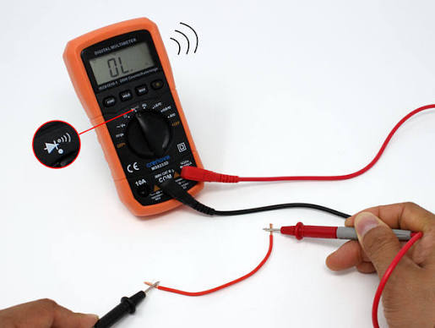
07 • HANDS-ON LAB - CONTINUITY TEST
Connecting two points
Continuity Test
REPLACEMENT MAY REQUIRE
Use the meter to find the good or bad connections between two points of a component, with and without a tone.
Replacement of component
Rewiring or replacing a pin
Running a new harness
Notes:
Adding continuity test page
Talking points
• Frame the slide as a draft teaching example, exactly as the banner states. Listen for the beeps • Explain the service lesson: finding the correct component that has the proper connection from one end to the other.
• Use with and without a tone. Two components such as a door switch and a harness
Class Q&A
• Ask: “When the connection is broken and the display shows the OL, what does the OL stand for and what does that mean?”
• Expected answer: Open Loop, no connection
• Ask: “What shows when the is a connection?”
• Expected answer: small voltage and a beep (if the sound is on) whats wrong with that picture?

Slide 47
07 • HANDS-ON LAB - Q&A
Turn every reading into useful evidence.
QUICK REVIEW
CLASS Q&A
State the function before every live test.
Predict the expected value and reference point.
Compare, explain, and narrow the fault.
Document the test and result clearly.
Which station changed your thinking?
What setup step was easiest to miss?
What would you test differently next time?
Practice becomes a field habit when you can explain each choice.
Notes:
Talking points
• Use this as a lab debrief rather than another lecture.
• Ask each group to share one measurement, the expected value, the actual value, and what the result proved.
• Ask what the reading did not prove and what the next useful test would be.
• Correct setup or reasoning errors while the equipment and decisions are still fresh.
Class Q&A
• Ask the three questions displayed on the slide.
• Final group prompt: “What did one of your readings prove—and what did it not prove?”

Slide 48
SECTION 08
In Closing
Turn today’s practice into tomorrow’s habit.
Notes:
Slide 45 — Section 08: In Closing
Talking points
• Transition from practice to verification, documentation, certificates, and next steps.
• Reinforce the complete habit loop: measure safely, trace logically, correct the cause, verify the original condition, restore the cabinet, and document the work.
• Ask each learner to identify one behavior they will apply on the next call.
Class Q&A
• Ask: “Which habit from today will save the most time or prevent the most risk on your next call?”

Slide 49



08 • POLICIES AND CLOSE - REVIEW
Safe work includes the paperwork and the handoff.
REVIEW
CERTIFICATES
NEXT CALL
Stanchion policy
Safety reminders
Required documentation
Questions
Reissue or provide certificates upon successful completion, as applicable.
Leave with a skill you can use on the very next service call.
Measure safely. Trace logically. Document completely.
Notes:
Talking points
• Review the stanchion policy, safety reminders, and required documentation using the current policy source or main screen.
• Answer remaining technical and procedural questions before moving to certificates.
• Explain how certificates will be issued or reissued after successful completion, as applicable.
• Return to the opening promise: learners should leave with a safer and more deliberate process they can use on the next service call.
Class Q&A
• Ask: “What documentation is required before a service call is considered complete at your property?”
• Clarify any differences between training examples and current site policy.

Slide 50

08 • POLICIES AND CLOSE - VERIFY AND CLOSE
A repair is not complete until the original failure is verified.
BEFORE YOU CLOSE THE JOB
Did I correct the cause—not only reset or replace the symptom?
Did I retest under the original failure condition?
Did I verify that no connector, cover, guard, or safety ground was left loose or omitted?
Did I record the test points and readings clearly enough for another technician to follow?
Is any product-specific or policy-specific follow-up still required?
REPAIR → RETEST → RESTORE → RECORD
The handoff is part of the repair. Leave the next technician evidence, not a mystery.
Measure safely. Trace logically. Document completely.
Notes:
Talking points
• Use the checklist to define “complete”: correct the cause, retest under the original failure condition, restore hardware and safety features, record the evidence, and complete required follow-up.
• Emphasize that a reset or part replacement is not verification by itself.
• Discuss the need to restore connectors, covers, guards, and safety grounds before returning equipment to service.
• Explain that a good handoff lets another technician understand the symptom, tests, readings, action, and verification without repeating the diagnosis.
• Tie product-specific follow-up back to the battery-service example.
Class Q&A
• Ask: “What evidence would another technician need to understand this repair without starting over?”
• Expected answer: original symptom and condition, test points, readings, actions, verification result, restored items, and remaining follow-up.

Slide 51
08 • POLICIES AND CLOSE - FIELD REFERENCE
When the symptom is unclear, return to the map.
START HERE
REMEMBER
What is not working—and what still works?
Can I make the situation safe?
What should the source → protection → control → path → load → return map look like?
What is the next test that will change my decision?
A symptom is not a diagnosis.
A meter gives evidence; it does not choose the test.
Name both test points and the expected result.
Repair the cause, verify the original condition, and document the handoff.
The safe next step is always more valuable than a confident guess.
Notes:
Talking points
• Present this as the reset tool when troubleshooting begins to drift into guessing or part swapping.
• Start with the symptom and what still works, then make the situation safe.
• Rebuild the path: source, protection, control, conductor path, load, and return.
• Choose the next test based on whether its result will change the decision.
• Reinforce the four reminders: symptom is not diagnosis, meter readings need a planned test, both test points matter, and the repair must be verified and documented.
Class Q&A
• Give a vague symptom such as “the monitor is dead” and ask: “Which question on this slide should we answer first?”
• Expected answer: define exactly what is not working and what still works, then make the situation safe and map the power path.

Slide 52
08 • POLICIES AND CLOSE - REVIEW / Q&A
Finish with habits that make work repeatable.
QUICK REVIEW
CLASS Q&A
Verify the original failure condition is corrected.
Restore connectors, covers, guards, and grounds.
Record readings, actions, and verification.
Communicate required follow-up.
Which habit will you use on your next call?
What still needs clarification?
What belongs in a complete handoff?
Measure safely. Trace logically. Verify completely. Document clearly.
Notes:
Talking points
• Use the slide to connect the day’s technical skills with repeatable field habits.
• Review the four closeout actions: verify the original condition, restore the cabinet, record readings and actions, and communicate follow-up.
• Invite final questions and short troubleshooting scenarios from the class.
• Ask each learner to state one habit they will use immediately.
• Close with the final line: measure safely, trace logically, verify completely, and document clearly.
Class Q&A
• Ask the three questions displayed on the slide.
• Final prompt: “What evidence should the next technician receive so the diagnosis does not have to be repeated?”

