Slide 1



Deep learning
Episode 1
Neural networks 101

Slide 2
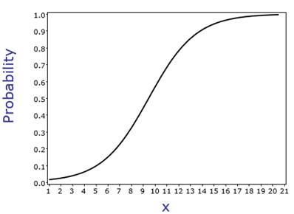
Recap: logistic regression
X
Wx +b
P(y)

Slide 3
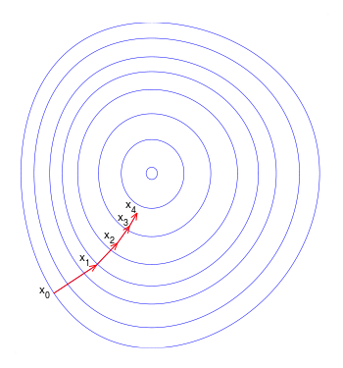
Gradient descent
Repeat until convergence
Ɵ~{W,b}

Slide 4
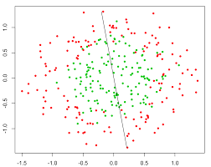
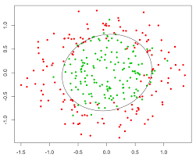
Nonlinear dependencies
What we have What we want
How to get that?

Slide 5
Feature extraction
Loss, for example:
Model:
Feature
Extractor
(manual)
Classifier
Ɵ1~{W,b}
X
Prediction
Training:

Slide 6

Features would tune to your problem automatically!

Slide 7
What do we want, exactly?
Loss, for example:
Model:
Feature
Extractor
Ɵ2
Classifier
Ɵ1~{W,b}
X
Prediction
?
Training:

Slide 8
What do we want, exactly?
Loss, for example:
Model:
Feature
Extractor
Ɵ2 ~ {?!}
Classifier
Ɵ1~{W,b}
X
Prediction
Gradients:

Slide 9
Try linear
Model:
Linear
model
Logistic
Regres-
sion
X
Prediction

Slide 10
Try linear
Model:
Linear
model
Logistic
Regres-
sion
X
Prediction
Output:
Is it any better than logistic regression?

Slide 11
Try linear

Slide 12
Try linear
Model:
Linear
model
Logistic
Regres-
sion
X
Prediction
Output:
Is it any better than logistic regression?

Slide 13
Nonlinearity
Model:
Linear
model
σ(h)
Logistic
Regres-
sion
X
Prediction

Slide 14
Nonlinearity
Model:
Linear
model
σ(h)
Logistic
Regres-
sion
X
Prediction
Output:

Slide 15
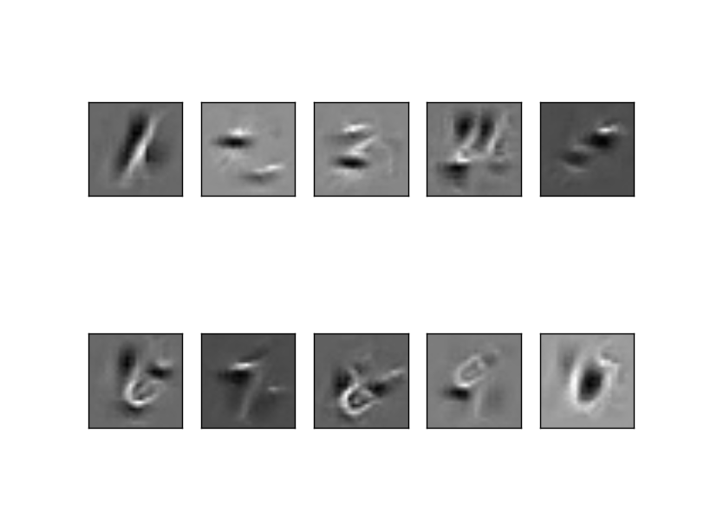
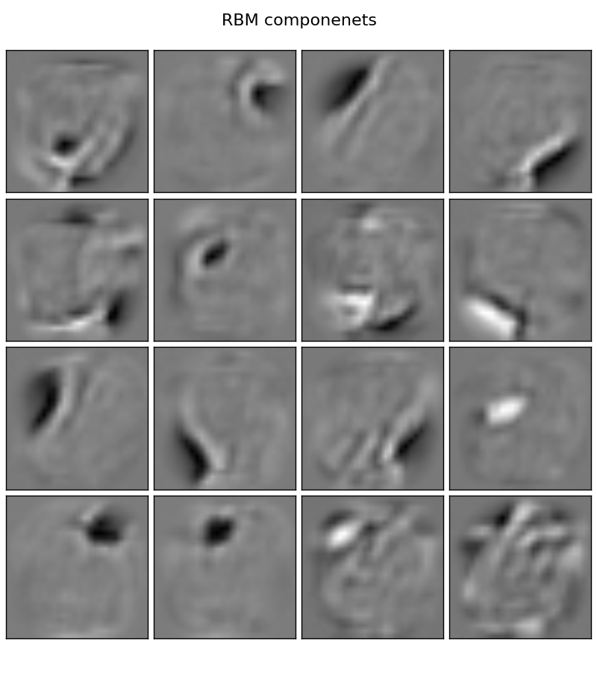
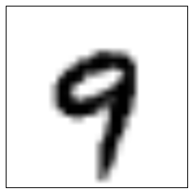
Nonlinearity
Model:
Linear
model
σ(h)
Logistic
Regres-
sion
X
Prediction
P(“1”)
P(“2”)
...
P(“9”)

Slide 16
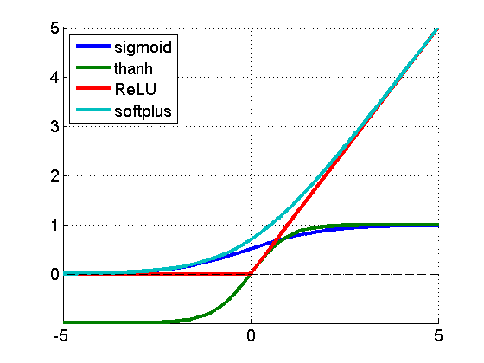
Nonlinearity
f(a) = 1/(1+e^a)
f(a) = tanh(a)
f(a) = max(0,a)
f(a) = log(1+e^x)

Slide 17
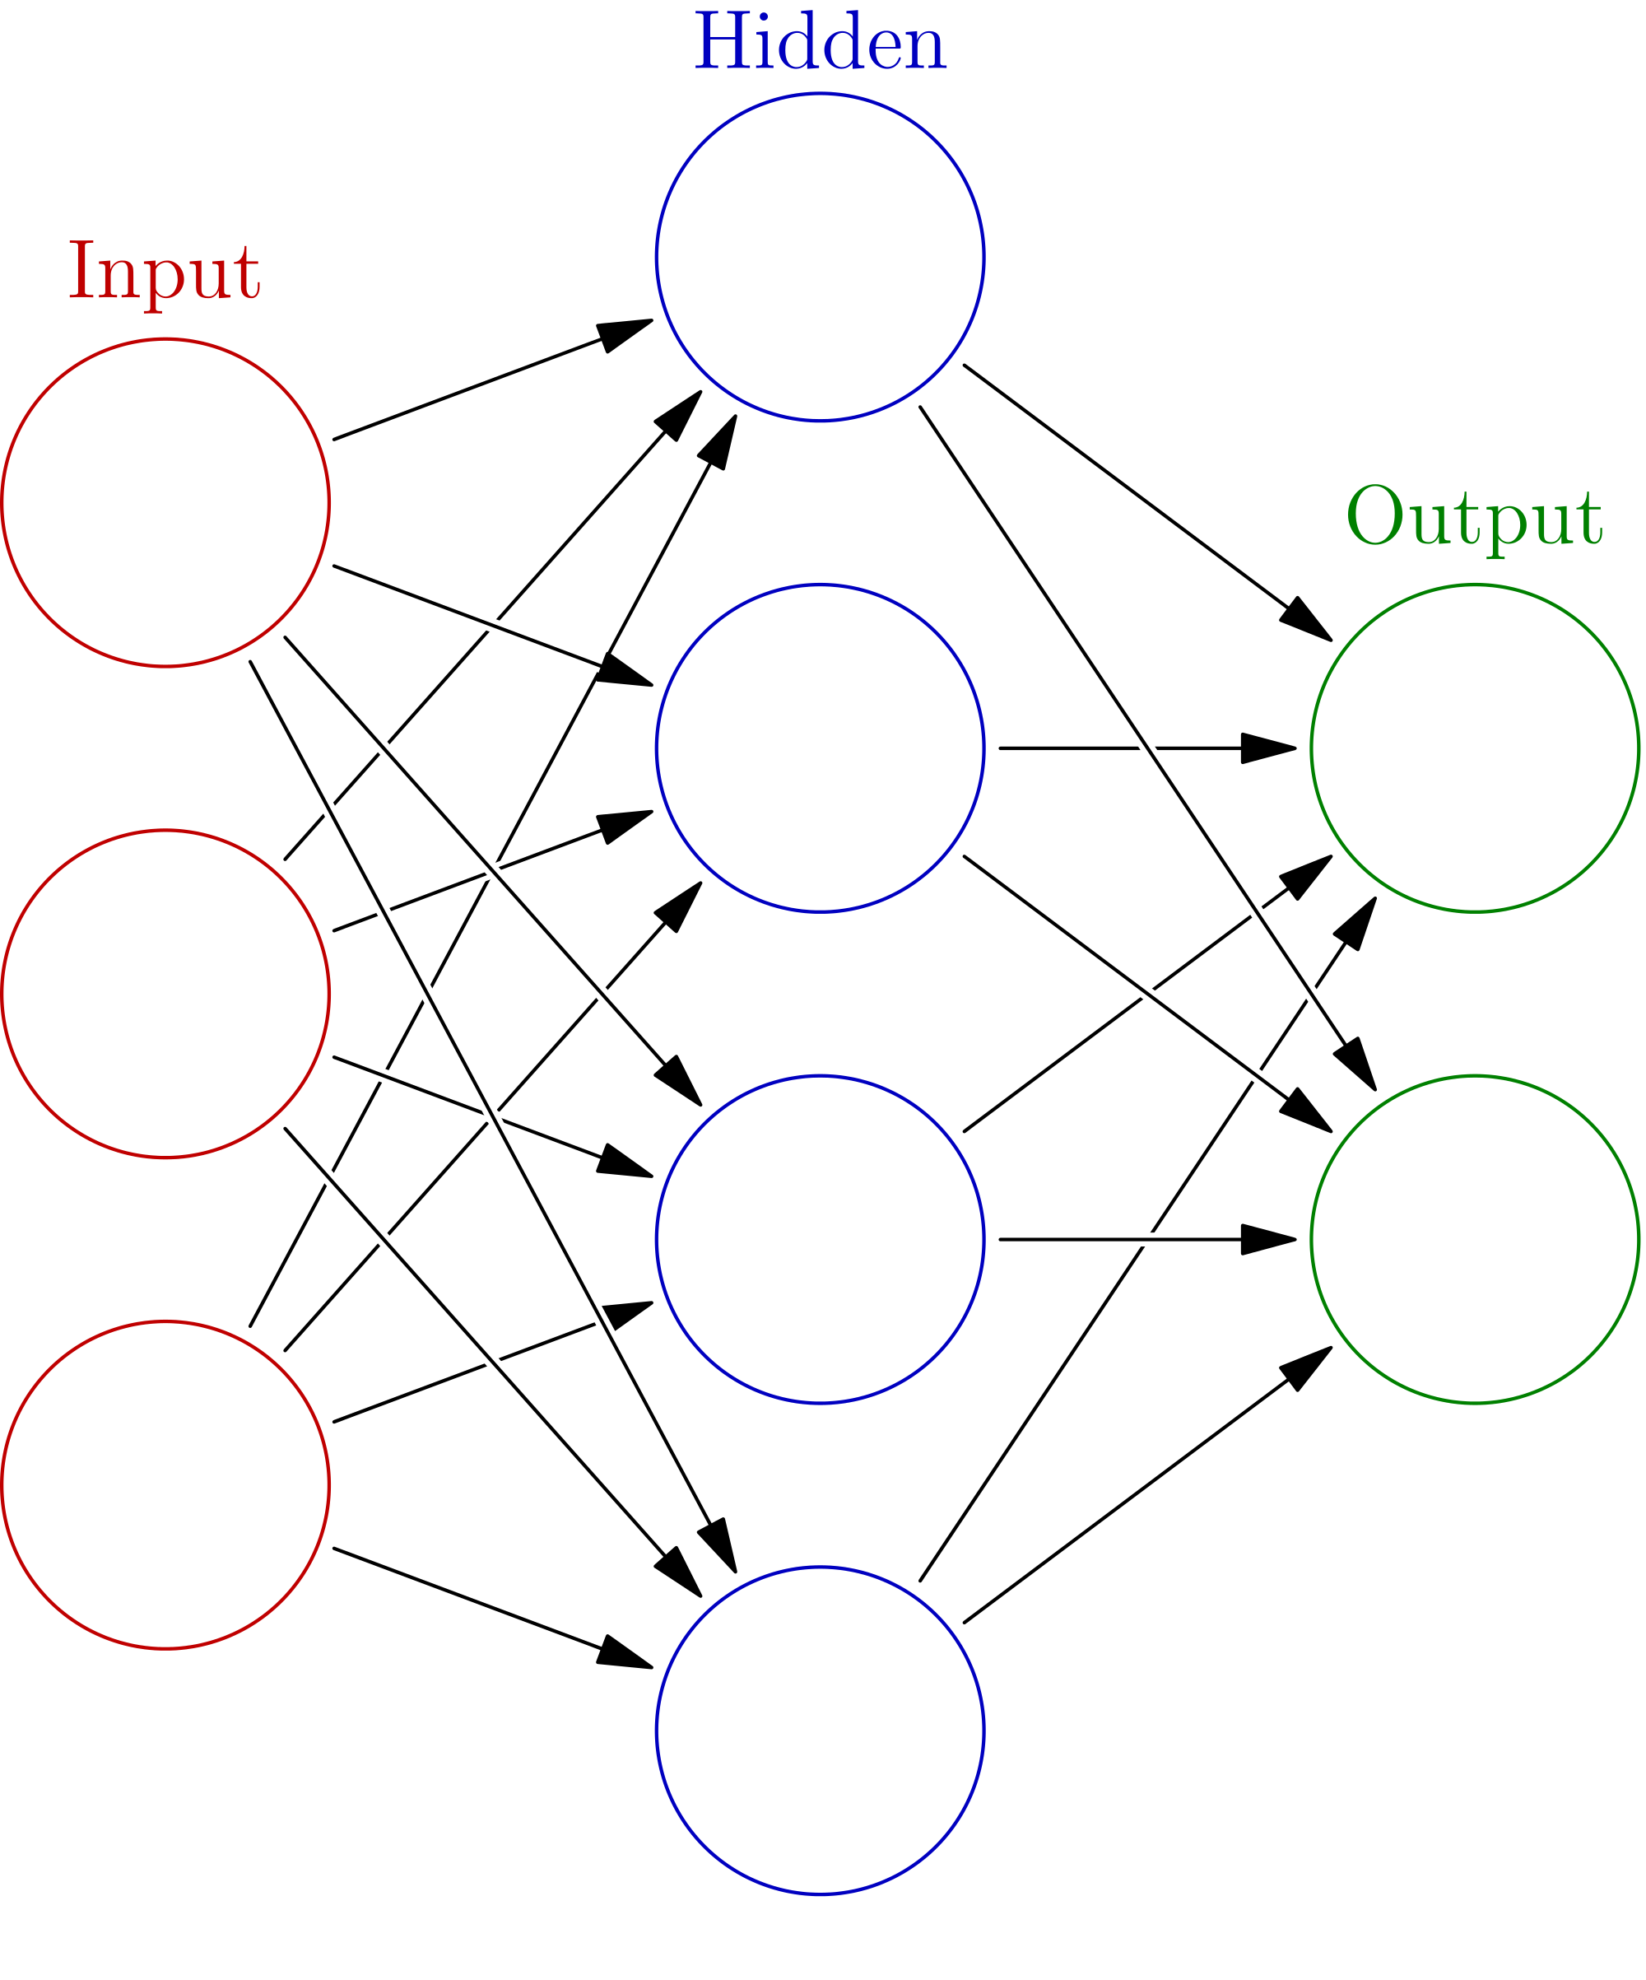
Initialization, symmetry problem
h0
Initialize with zeros
W ← 0
What will the first step look like?
x0
h1
y0
x1
h2
y1
h2
x2
h3

Slide 18
Initialization, symmetry problem
h0
Break the symmetry!
Initialize with random numbers!
W ← N(0,0.01)?
W ← U(0,0.1)?
Can get a bit better for deep NNs
x0
h1
y0
x1
h2
y1
h2
x2
h3

Slide 19
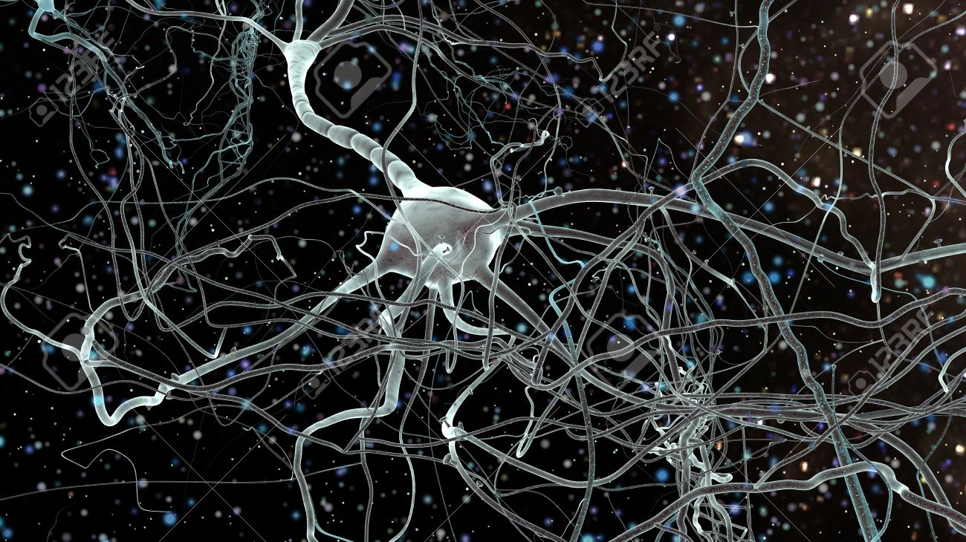
Biological inspiration

Slide 20
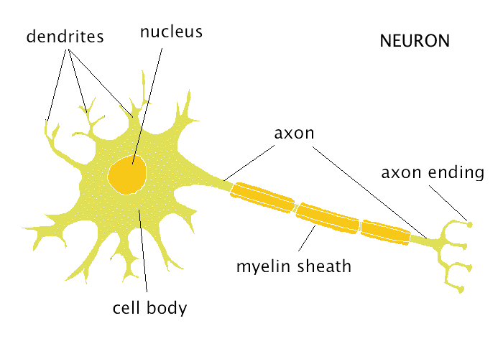
Biological inspiration

Slide 21
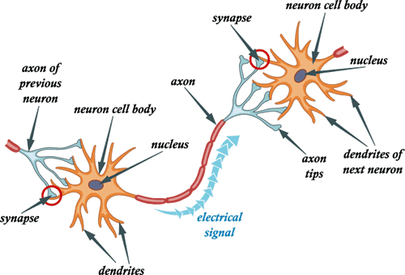
Biological inspiration

Slide 22
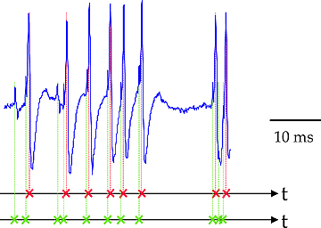
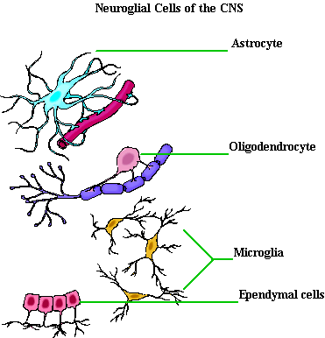
Not actual neurons :)
Neurons react in “spikes”,
  not real numbers
Neurons maintain/change
  their states over time
No one knows for sure how
they “train”
Neuroglial cells are important
  But noone knows, why

Slide 23
Connectionist phrasebook
Layer – a building block for NNs :
    “Dense layer”: f(x) = Wx+b
    “Nonlinearity layer”: f(x) = σ(x)
    Input layer, output layer
    A few more we gonna cover later
Activation – layer output
    i.e. some intermediate signal in the NN
Backpropagation – a fancy word for “chain rule”

Slide 24
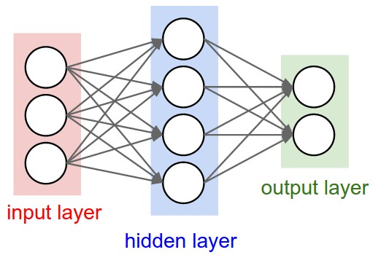
Connectionist phrasebook
Dense layer
with a nonlinearity
“Train it via backprop!”

Slide 25

Connectionist phrasebook
How do we train it?

Slide 26


Slide 27
Potential caveats?

Slide 28
Potential caveats?
Hardcore overfitting
No “golden standard” for architecture
Computationally heavy

Slide 29
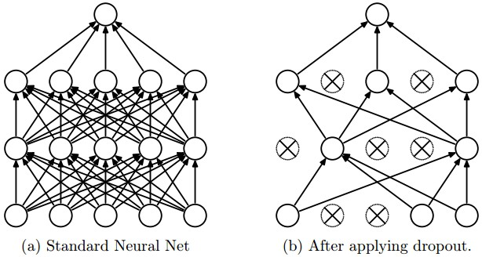
Regularization
L1, L2, as usual
Dropout

Slide 30
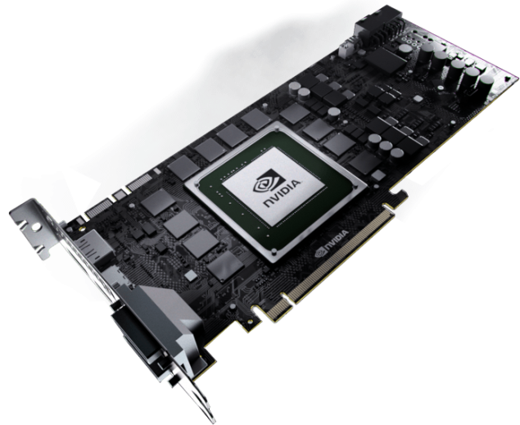
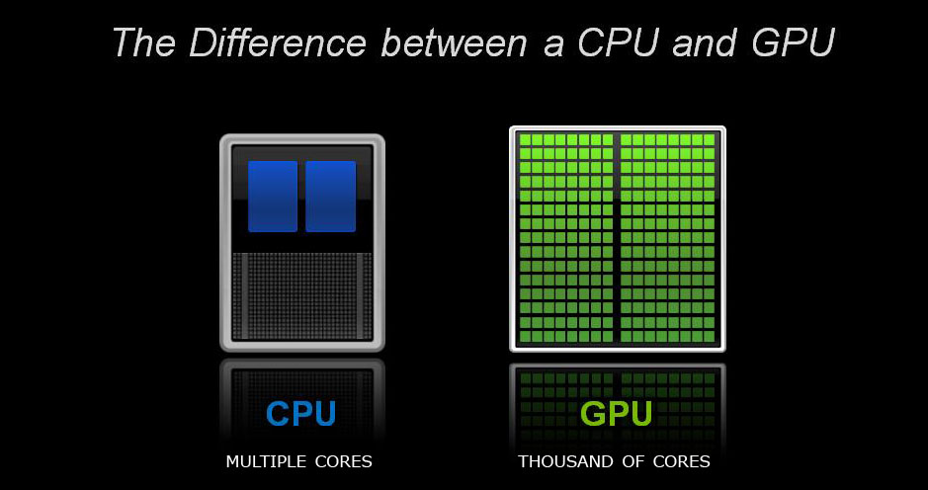
Computation

Slide 31
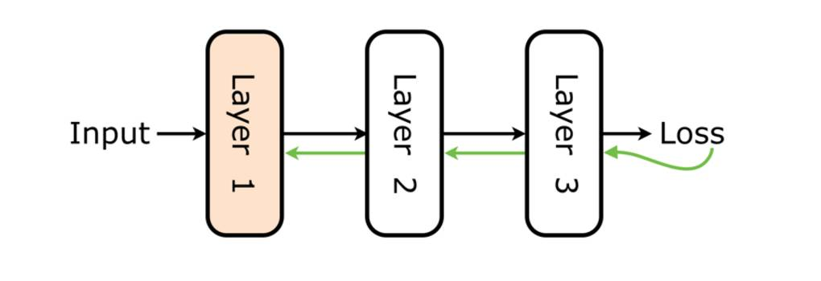
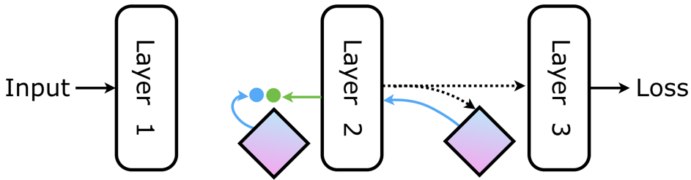
Is backprop the only choice?

Slide 32

Nuff
Let's code some neural networks!

