Slide 1




Deep Learning
Episode 5
Beating around image captioning
Maxim Borisyak, Mikhail Usvyatsov, Andrey Ustyuzhanin

Slide 2
Recap: rnn step
output
Elementwise
Wx+b
H units
+
sigmoid
Last
State
New
state
Wx+b
H units
time
Input at
This tick

Slide 3
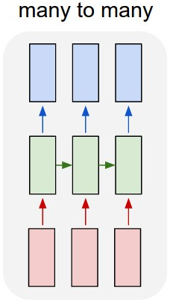
Recurrent Architectures: regular
  Read sequence
  Predict sequence of answers at each tick
Tasks:
  Language model
  POS Tagging
How to implement?
  See last lecture

Slide 4
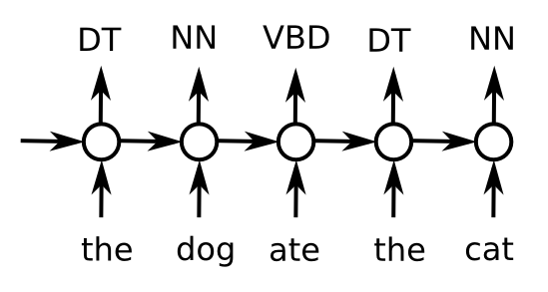
Recurrent Architectures: regular
  Read sequence
  Predict sequence of answers at each tick
POS tagging
Why RNN?

Slide 5
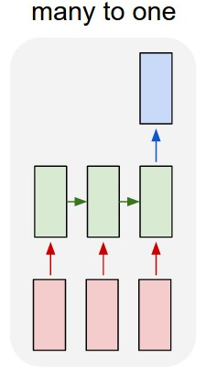
Recurrent Architectures: Encoder
Encoder
  Read sequence
  Predict once
Tasks:
  ?!
How to implement?
  ?!

Slide 6
Recurrent Architectures: Encoder
Encoder
  Read sequence
  Predict once
Tasks:
  Sentiment analysis
  Detect age by status
  Week3 homework
  Any text analysis
How to implement?
  Take last/max/mean over time

Slide 7
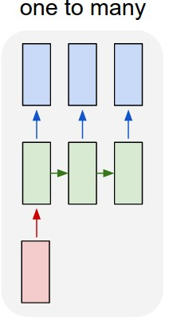
Recurrent Architectures: Decoder
Decoder
  Take one state
  Generate sequence
Tasks:
  Generate tweet given age & interests
  Generate molecule given desired properties
How to implement?
  ?!

Slide 8
Recurrent Architectures: Decoder
Decoder
  Take one state
  Generate sequence
How to implement?
  First hidden state
    (instead of zeros)
  Input at first tick
  Additional input at each tick

Slide 9
Seq2seq
How do we convert sequence to sequence of different kind/without time synchronization?
Example: Machine translation

Slide 10
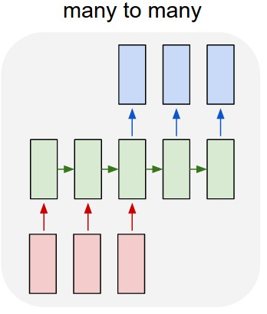
Seq2seq
Idea:
  first read (encode) the sequence
  then generate new one out of the encoded vector
How to implement that?

Slide 11
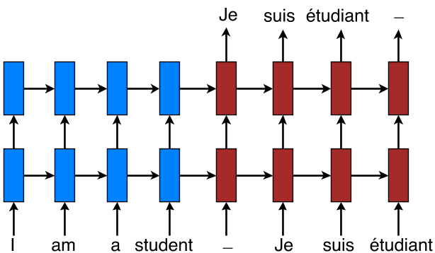
Seq2seq: Machine translation

Slide 12
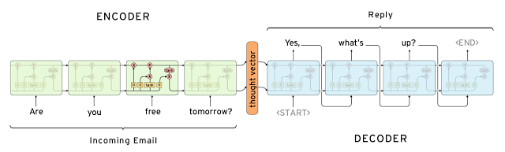
Seq2seq: Conversation model
Exactly the same

Slide 13


Slide 14
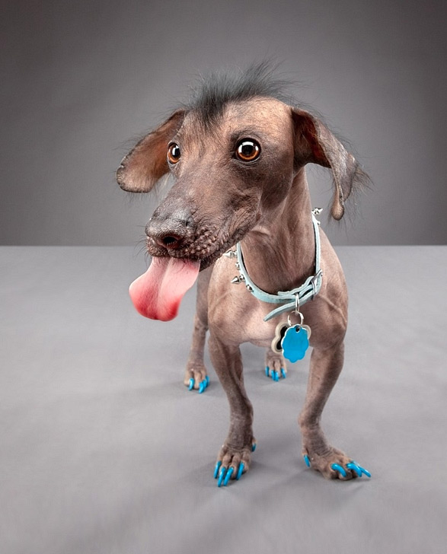
Image recognition
“Dog”

Slide 15
Image recognition
“Dog”
How do we solve that?

Slide 16
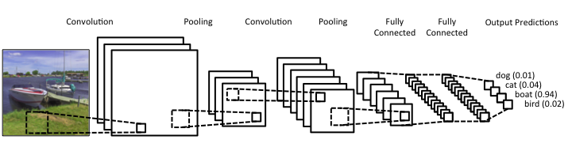
Image recognition

Slide 17
Image captioning
“A weird dog with a blue collar is standing on a gray floor”

Slide 18
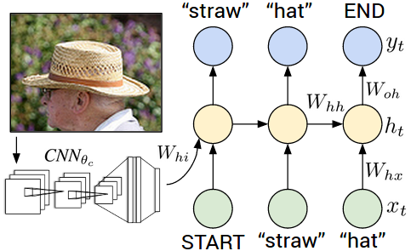
Task decomposition
Convolutional “encoder”
Recurrent “decoder”

Slide 19
Problem: we need a large CNN

Slide 20
Pre-training
Original network
      Requires 10^6 samples
      Trains for 1-2 weeks (GPU)
  Typical problem
      10^4 samples
      It must work in 3 days
        or your boss kills you
      How do you survive?

Slide 21

Pre-training
1. Train a network on large dataset
cifar Y
cifar X
Large Neural Net

Slide 22

Pre-training
1. Train a network on large dataset
2. Take some intermediate layer
cifar Y
cifar X
Large Neural Net

Slide 23
Pre-training
1. Train a network on large dataset
2. Take some intermediate layer
cifar Y
cifar X
Large Neural Net

Slide 24
Pre-training
1. Train a network on large dataset
2. Take some intermediate layer
3. Build model on top of it
cifar Y
model
cifar X
Large Neural Net

Slide 25
Pre-training
1. Train a network on large dataset
2. Take some intermediate layer
3. Build model on top of it
4. Train model for your objective
your Y
model
your X
Large Neural Net

Slide 26
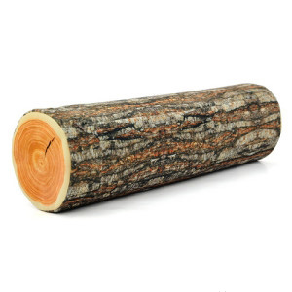
Reusing features
Chop off “head”
use “neck” as feature extractor
Train ANY classifier
  even random forest will do
X
Y
Large Neural Net

Slide 27

Fine-tuning
Chop off “head”
“freeze” body (consider constant)
Build new neural network in it's place
Train “head” only for several iteratons
Un-freeze body and train full network
X
Y
Large Neural Net

Slide 28
Model zoo
Most deep learning frameworks have a library of pre-trained networks
    e.g. VGG, GoogleNet, char-RNN
You just need to download weights
https://github.com/Lasagne/Recipes/

Slide 29
Task decomposition
Convolutional “encoder”
Recurrent “decoder”

Slide 30
Task decomposition
Convolutional “encoder”
Start with pre-trained
Recurrent “decoder”
Train from scratch

Slide 31
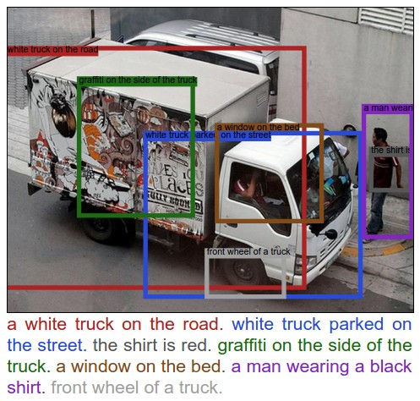
Captioning objects on image
How could we approach this one?

Slide 32

Brace yourselves

Slide 33
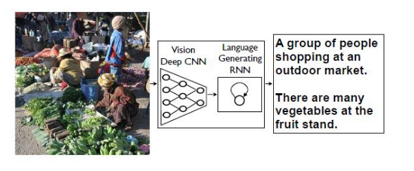
Image captioning demos
Demo - http://stanford.io/2esMxOq
Upload your image - http://bit.ly/2eAoueP

