Slide 1




ML @ Imperial
Episode 15
Intro to deep learning

Slide 2
Linear Regression
Model:
Objective function:
Optimization (exact):
pred
X
Wx +b
Y

Slide 3
Linear Regression
Model:
Objective function:
Optimization (iterative):
pred
X
Wx +b
Y

Slide 4
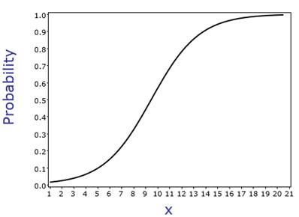
Logistic Regression
X
Wx +b
P(y)
Objective function ?

Slide 5
Logistic Regression
Model:
Objective function:
Optimization (iterative):
You guessed it!
X
Wx +b
P(y|x)

Slide 6
Logistic Regression
Model:
Objective function:
P(y=a|X)
P(y=b|X)
P(y=c|X)
X

Slide 7
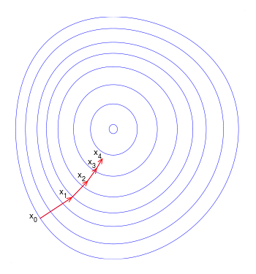
Gradient descent
Update:
a – learning rate a<<1
L – loss function
Can we do better?

Slide 8
Gradient descent
Update:
a – learning rate a<<1
L – loss function
Can we do better?

Slide 9
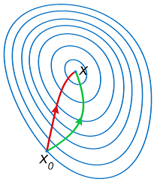
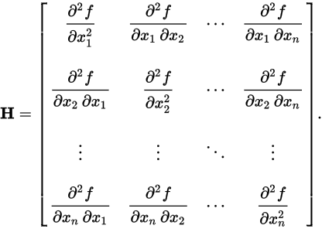
Newton-Raphson
Parameter update
Hessian:
Red: Newton-Raphson
Green: gradient descent
Any drawbacks?

Slide 10
Newton-Raphson
Parameter update
Hessian:
Red: Newton-Raphson
Green: gradient descent
Quadratic time/memory!

Slide 11
Stochastic gradient descent
Loss function is mean over
all data samples.
Approximate with 1 or few random samples.
Update:
E – expectation
Learning rate should decrease
sgd
gd

Slide 12
SGD with momentum
Idea: move towards “overall gradient direction”,
Not just current gradient.
Helps for noisy gradient / canyon problem

Slide 13
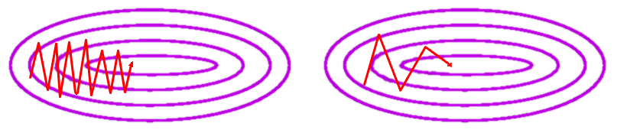
SGD with momentum
Idea: move towards “overall gradient direction”,
Not just current gradient.

Slide 14
AdaGrad
Idea: decrease learning rate individually for each parameter in proportion to sum of it's gradients so far.
“Total update path length”
(for each parameter)

Slide 15
RMSProp
Idea: make sure all gradient steps have approximately same magnitude (by keeping moving average of magnitude)

Slide 16
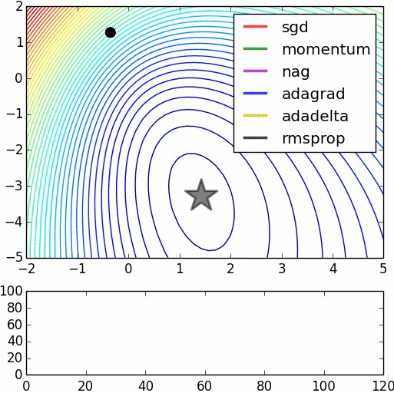
Alltogether

Slide 17
Moar stuff
Without Hessian
Adadelta ~ adagrad with window
Adam ~ rmsprop + momentum
Nesterov-momentum
Hessian-free (narrow)
Conjugate gradients
Estimate inverse Hessian
BFGS
L-BFGS
****-BFGS

Slide 18
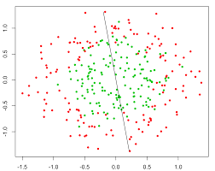
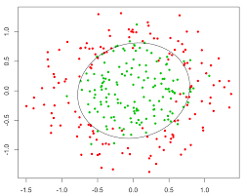
Nonlinear dependencies
What we have What we want
How to get that?

Slide 19
Feature extraction
Loss, for example:
Model:
Feature
Extractor
(manual)
Classifier
Ɵ1~{W,b}
X
Prediction
Training:

Slide 20

Features would tune to your problem automatically!

Slide 21
What do we want, exactly?
Loss, for example:
Model:
Feature
Extractor
Ɵ2
Classifier
Ɵ1~{W,b}
X
Prediction
?
Training:

Slide 22
What do we want, exactly?
Loss, for example:
Model:
Feature
Extractor
Ɵ2 ~ {?!}
Classifier
Ɵ1~{W,b}
X
Prediction
Gradients:

Slide 23
Try linear
Model:
Linear
model
Logistic
Regres-
sion
X
Prediction

Slide 24
Try linear
Model:
Linear
model
Logistic
Regres-
sion
X
Prediction
Output:
Is it any better than logistic regression?

Slide 25
Try linear

Slide 26
Try linear
Model:
Linear
model
Logistic
Regres-
sion
X
Prediction
Output:
Is it any better than logistic regression?

Slide 27
Nonlinearity
Model:
Linear
model
σ(h)
Logistic
Regres-
sion
X
Prediction

Slide 28
Nonlinearity
Model:
Linear
model
σ(h)
Logistic
Regres-
sion
X
Prediction
Output:

Slide 29
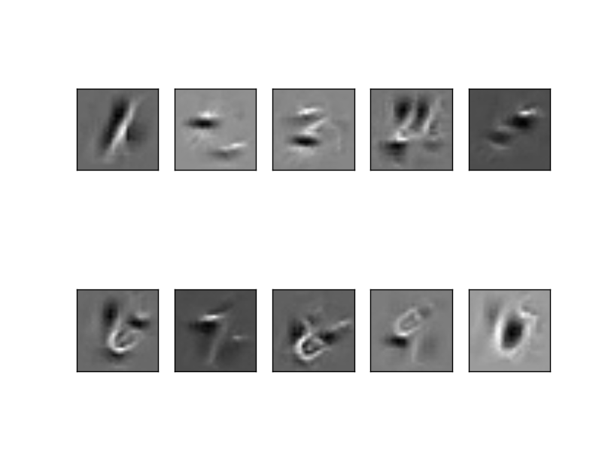
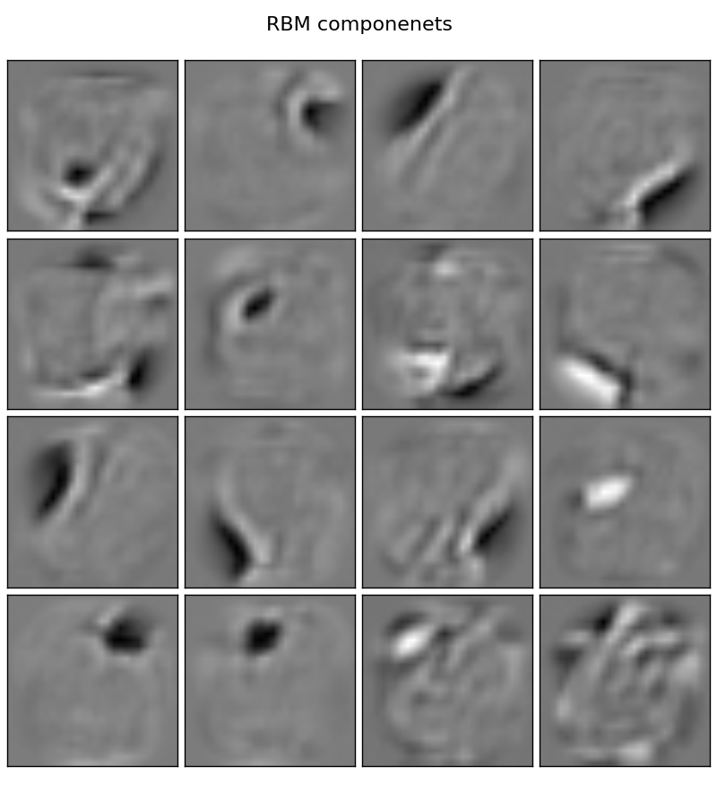
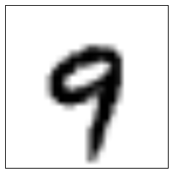
Nonlinearity
Model:
Linear
model
σ(h)
Logistic
Regres-
sion
X
Prediction
P(“1”)
P(“2”)
...
P(“9”)

Slide 30
Nonlinearity
Model:
Linear
model
σ(h)
Logistic
Regres-
sion
X
Prediction
Output:
Gradient of what?
w.r.t. what?
Training:

Slide 31
Nonlinearity
Model:
Linear
model
σ(h)
Logistic
Regres-
sion
X
Prediction
Output:
Training:

Slide 32
Nonlinearity
Model:
Linear
model
σ(h)
Logistic
Regres-
sion
X
Prediction
Output:
Losses:
(task-dependent)
crossentropy
MSE, MAE
Training:

Slide 33
Backpropagation
TL;DR: backprop = chain rule*

Slide 34
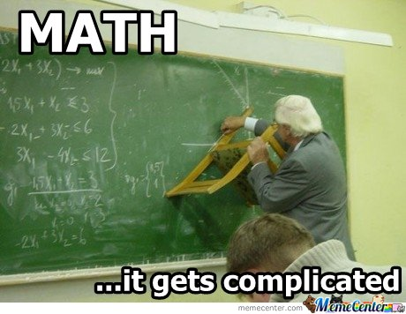
Backpropagation
TL;DR: backprop = chain rule*
* g and x can be vectors/vectors/tensors

Slide 35
Backpropagation
linear
|h|=64
W1,b1
σ(h)
linear
|h|=1
W1,b1
σ(h)
X
Prediction
Y
Loss

Slide 36
Backpropagation
linear
|h|=64
W1,b1
σ(h)
linear
|h|=1
W1,b1
σ(h)
X
Prediction
Y
Loss

Slide 37
Backpropagation
linear
|h|=64
W1,b1
σ(h)
linear
|h|=1
W1,b1
σ(h)
X
Prediction
Y
Loss

Slide 38
Backpropagation
linear
|h|=64
W1,b1
σ(h)
linear
|h|=1
W1,b1
σ(h)
X
Prediction
Y
Loss

Slide 39
Backpropagation
linear
|h|=64
W1,b1
σ(h)
linear
|h|=1
W1,b1
σ(h)
X
Prediction
Y
Loss

Slide 40
Matrix derivatives
Let’s compute:
What?
Variable shapes:
[batch size, features]
[features, outputs]
[outputs]
[batch size, features]
[batch size, outputs]

Slide 41
Matrix derivatives
Let’s compute:
Variable shapes:
[batch size, features]
[features, outputs]
[outputs]
[batch size, features]
[batch size, outputs]

Slide 42
Matrix derivatives (words)
Works for any kind of x
(scalar, vector, matrix, tensor)

Slide 43
Matrix derivatives (formulae)
Works for any kind of x
(scalar, vector, matrix, tensor)

Slide 44

Back to neural networks
Model:
linear
|h|=64
W1,b1
σ(h)
linear
|h|=1
W1,b1
σ(h)
X
Prediction
Training:

Slide 45
Back to neural networks
Model:
linear
|h|=64
W1,b1
σ(h)
linear
|h|=1
W1,b1
σ(h)
X
Prediction

Slide 46
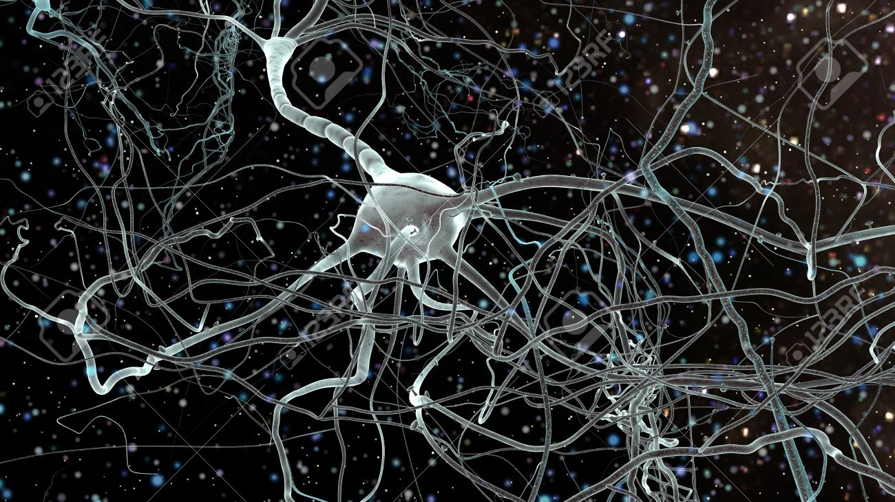
Biological inspiration

Slide 47
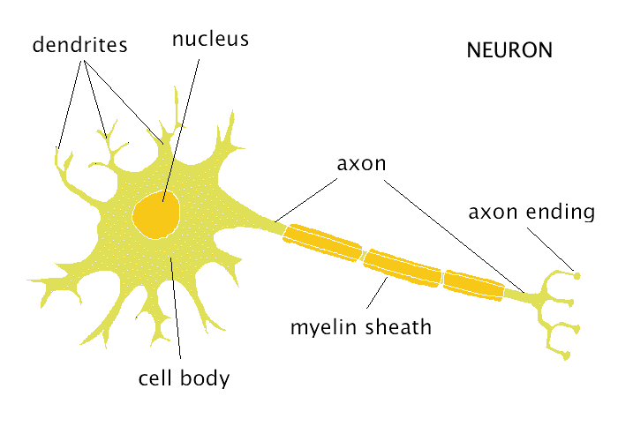
Biological inspiration

Slide 48
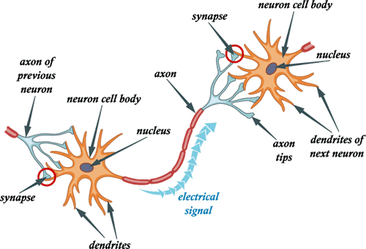
Biological inspiration

Slide 49
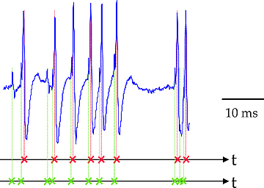
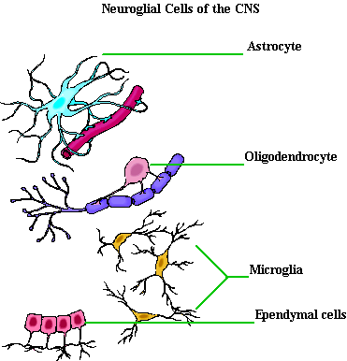
Not actual neurons :)
Neurons react in “spikes”,
  not real numbers
Neurons maintain/change
  their states over time
No one knows for sure how
they “train”
Neuroglial cells are important
  But noone knows, why

Slide 50
Connectionist phrasebook
Layer – a building block for NNs :
    “Dense layer”: f(x) = Wx+b
    “Nonlinearity layer”: f(x) = σ(x)
    Input layer, output layer
    A few more we gonna cover later
Activation – layer output
    i.e. some intermediate signal in the NN
Backpropagation – a fancy word for “chain rule”

Slide 51
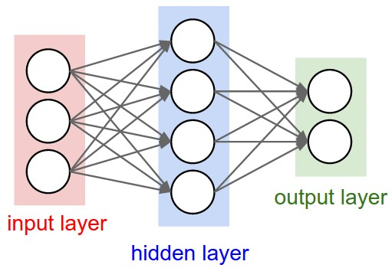
Connectionist phrasebook
Dense layer
with a nonlinearity
“Train it via backprop!”

Slide 52
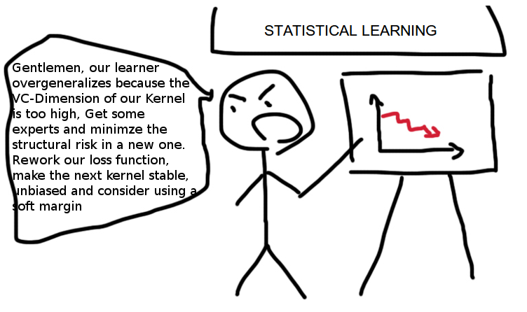
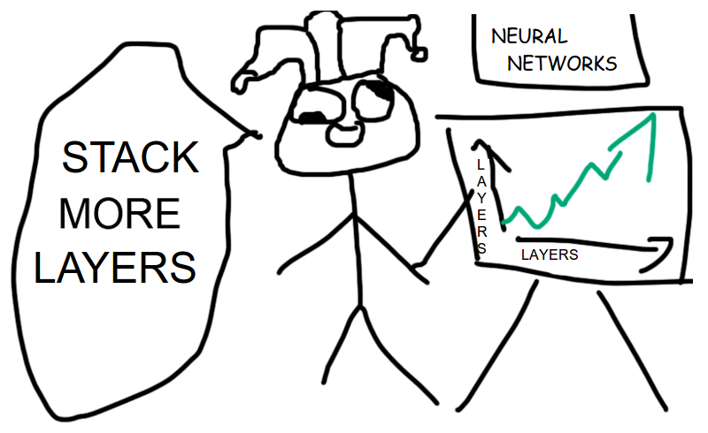
More layers

Slide 53

More layers
How do we train it?

Slide 54


Slide 55
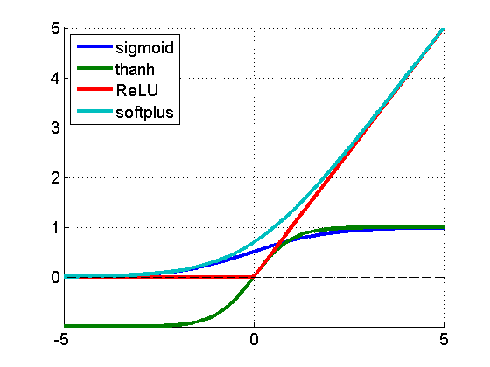
Nonlinearity
f(a) = 1/(1+e^a)
f(a) = tanh(a)
f(a) = max(0,a)
f(a) = log(1+e^a)
f(a)
a

Slide 56
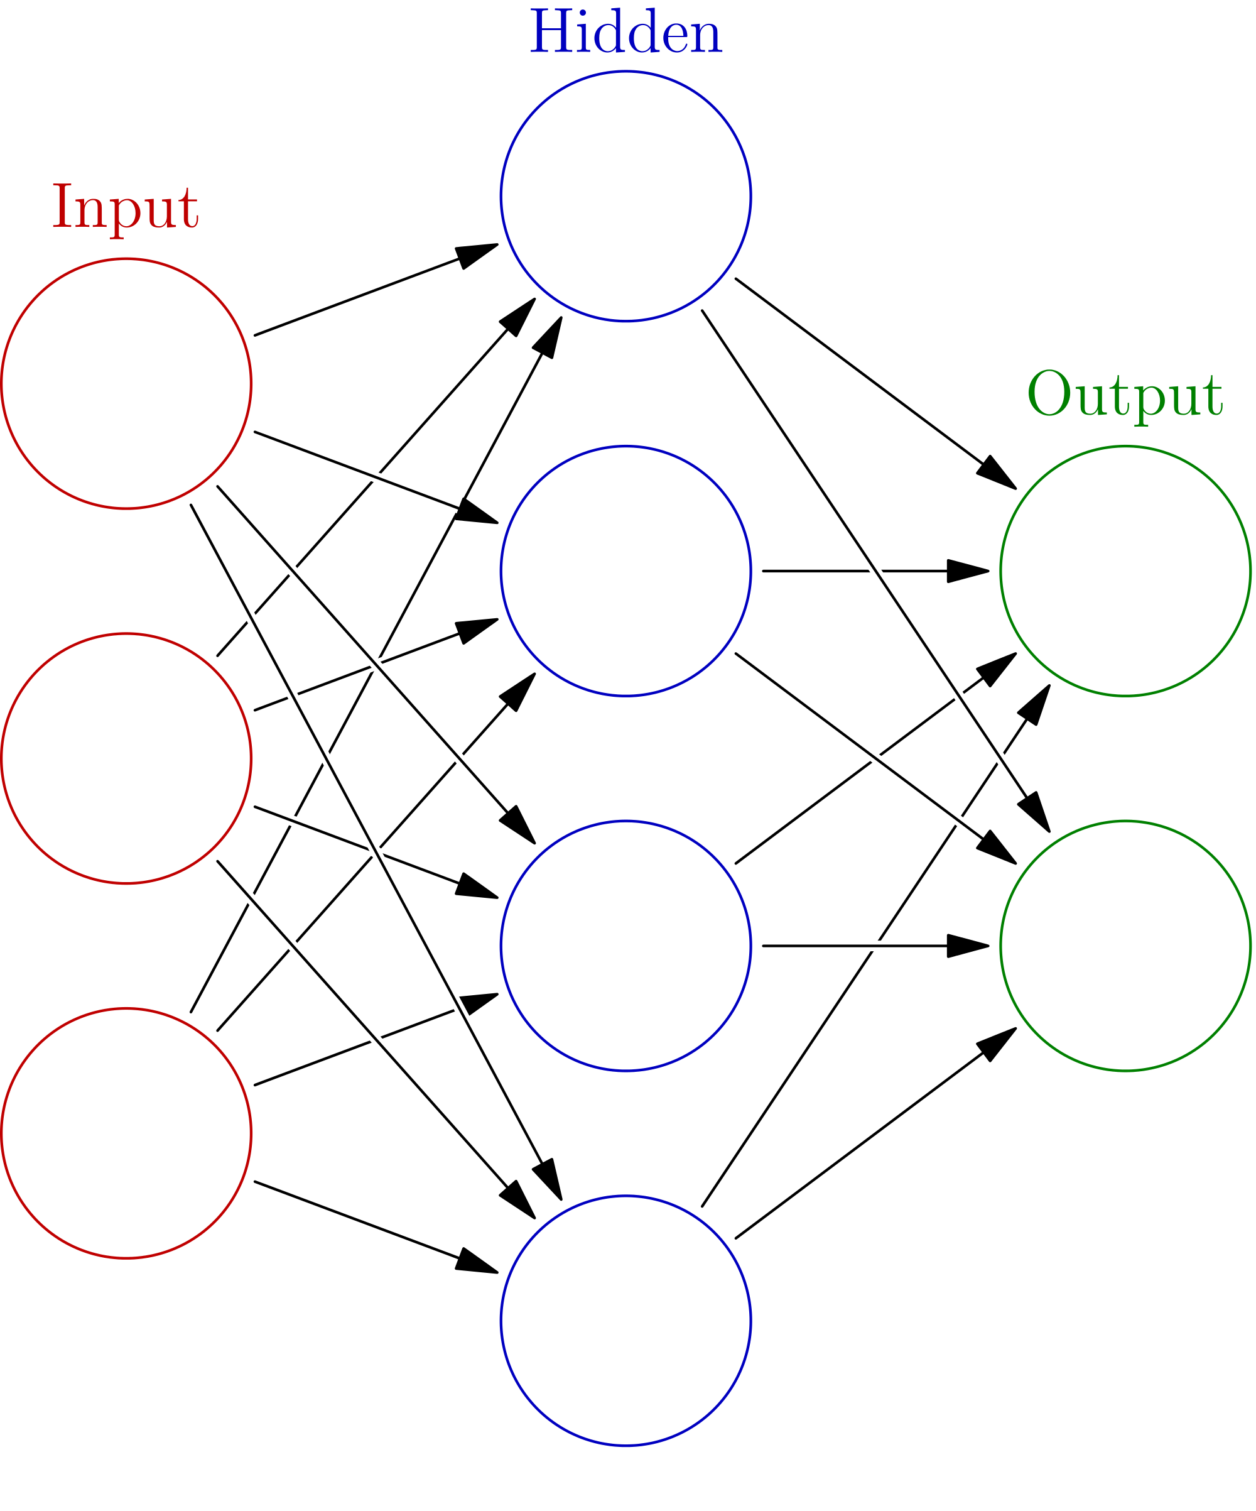
Initialization, symmetry problem
h0
Initialize with zeros
W ← 0
What will the first step look like?
x0
h1
y0
x1
h2
y1
h2
x2
h3

Slide 57
Initialization, symmetry problem
h0
Break the symmetry!
Initialize with random numbers!
W ← N(0,0.01)?
W ← U(0,0.1)?
Can get a bit better for deep NNs
x0
h1
y0
x1
h2
y1
h2
x2
h3

Slide 58
Potential caveats?

Slide 59
Potential caveats?
Hardcore overfitting
No “golden standard” for architecture
Computationally heavy

Slide 60

You gonna code this
today

