Slide 1



Deep Learning
Episode 0
ML recap. Adaptive optimization

Slide 2
Linear Regression
Model:
Objective function:
Optimization (exact):
pred
X
Wx +b
Y

Slide 3
Linear Regression
Model:
Objective function:
Optimization (iterative):
pred
X
Wx +b
Y

Slide 4
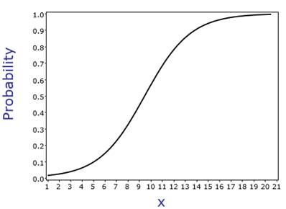
Logistic Regression
X
Wx +b
P(y)
Objective function ?

Slide 5
Logistic Regression
Model:
Objective function:
Optimization (iterative):
You guessed it!
X
Wx +b
P(y|x)

Slide 6
Logistic Regression
Model:
Objective function:
P(a|X)
P(b|X)
P(c|X)
X

Slide 7
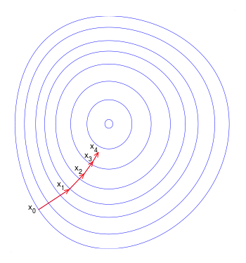
Gradient descent
Update:
a – learning rate a<<1
L – loss function
Can we do better?

Slide 8
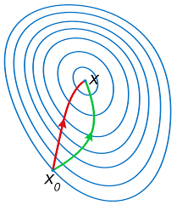
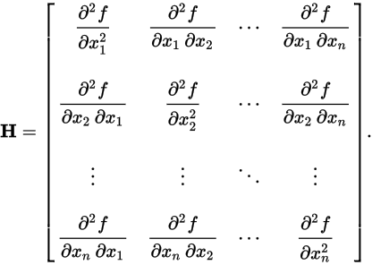
Newton-Raphson
Parameter update
Hessian:
Red: Newton-Raphson
Green: gradient descent
Any drawbacks?

Slide 9
Stochastic gradient descent
Loss function is mean over
all data samples.
Approximate with 1 or few random samples.
Update:
E – expectation
Learning rate should decrease
sgd
gd

Slide 10
SGD with momentum
Idea: move towards “overall gradient direction”,
Not just current gradient.
Helps for noisy gradient / canyon problem

Slide 11
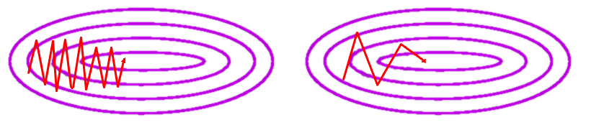
SGD with momentum
Idea: move towards “overall gradient direction”,
Not just current gradient.

Slide 12
AdaGrad
Idea: decrease learning rate individually for each parameter in proportion to sum of it's gradients so far.
“Total update path length”
(for each parameter)

Slide 13
RMSProp
Idea: make sure all gradient steps have approximately same magnitude (by keeping moving average of magnitude)

Slide 14
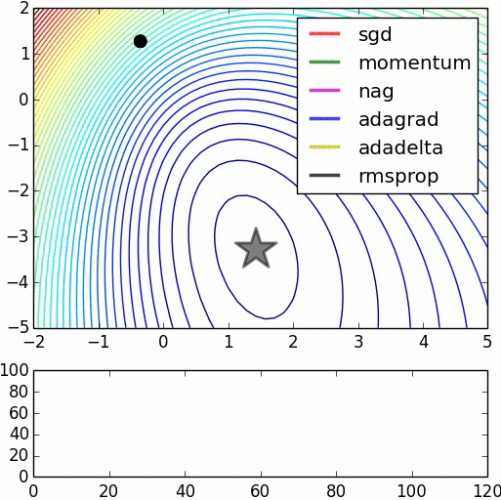
Alltogether

Slide 15
Moar stuff
Without Hessian
Adadelta ~ adagrad with window
Adam ~ rmsprop + momentum
Nesterov-momentum
Hessian-free (narrow)
Conjugate gradients
Estimate inverse Hessian
BFGS
L-BFGS
****-BFGS

Slide 16
Regularization (weight)
General idea:
performance = how_i_fit_data + how_reasonable_i_am
L2 regularizer
linear models: theta = {w,b}
a.k.a. weight decay
a.k.a. Tikhonov regularizer
a.k.a. normal prior on params

Slide 17
Regularization (weight)
L2 regularizer
L1 regularizer
Difference between L1, L2?
Any other way to regularize?

Slide 18
Regularization(other)
Distort input
Distort weights
Additional objective
Domain-specific stuff
Moar data :)
etc.
Most are domain- or model-specific

Slide 19
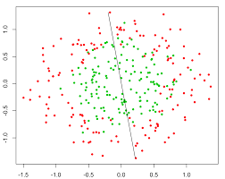
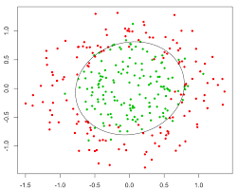
Nonlinear dependencies
What we have What we wan
How to get that?

Slide 20
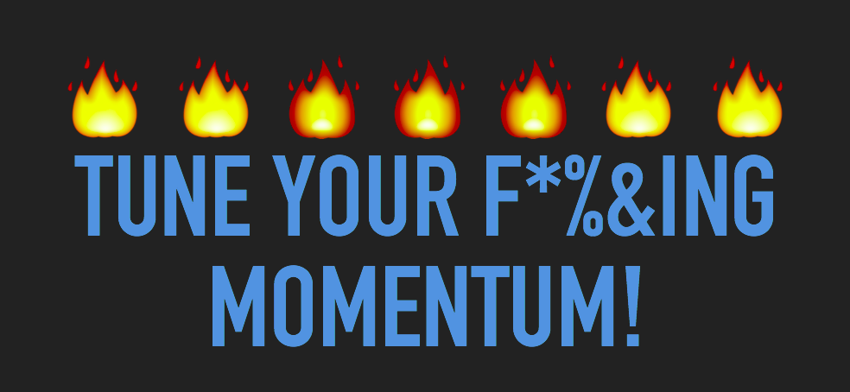
Nuff
Go implement that!

