Slide 1



Deep Learning
Episode 6
How you actually do it :)

Slide 3
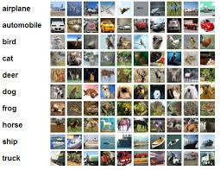
CIFAR
60k images
10 classes (left)
32x32 RGB
subclasses
aquatic mammals
fish
flowers
food containers
beaver, dolphin, otter, seal, whale
aquarium fish, flatfish, ray, shark, trout
orchids, poppies, roses, sunflowers, tulips
bottles, bowls, cans, cups, plates

Slide 4
The only problem: you only have 5k images e.g. transport vs military aircrafts
Ideas?

Slide 5
Regular solutions
Regularize really hard
Super small network
Data augmentation
Whatever

Slide 6
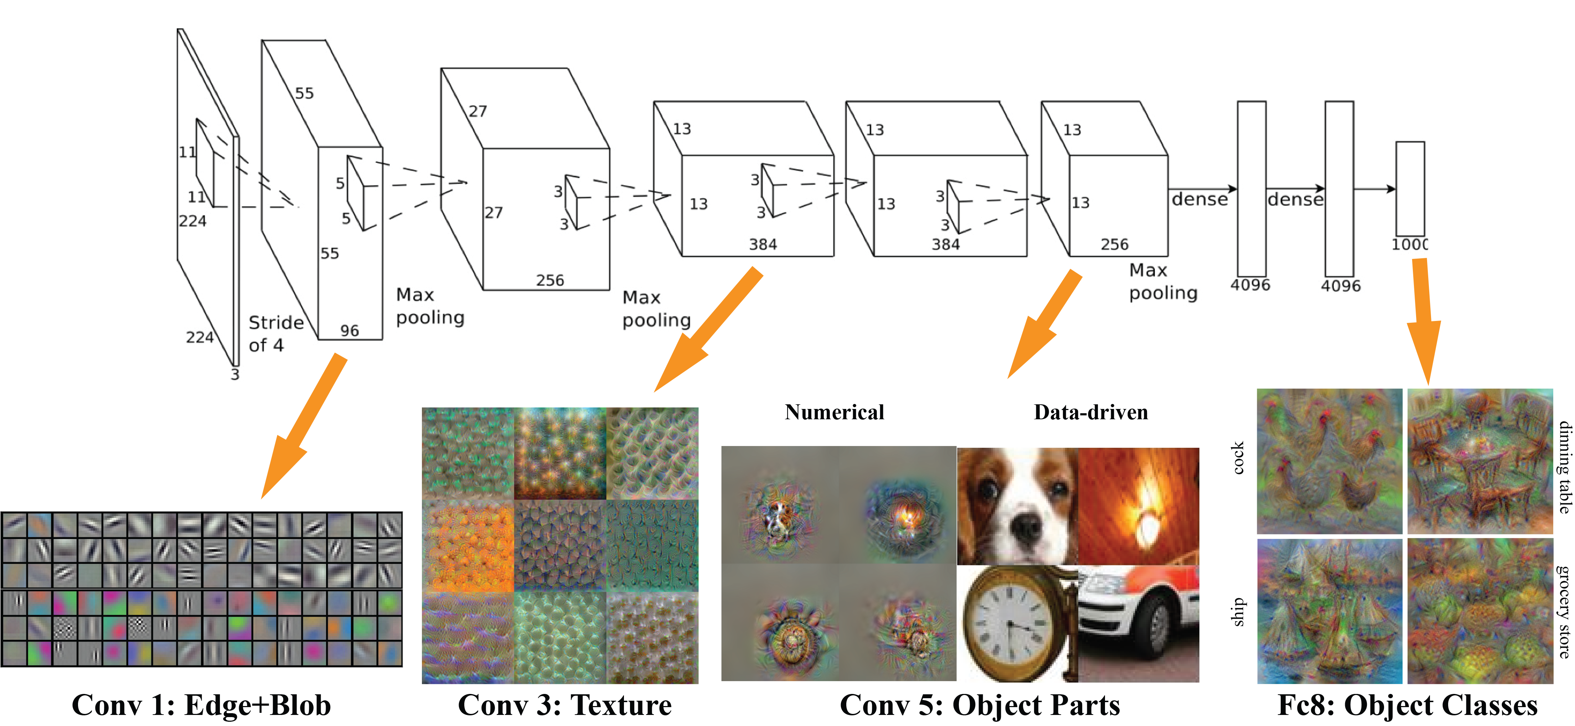
Feature learning

Slide 7
Feature learning
Idea: let's pre-train network on a larger dataset

Slide 8

Pre-training
1. Train a network on large dataset
cifar Y
cifar X
Large Neural Net

Slide 9
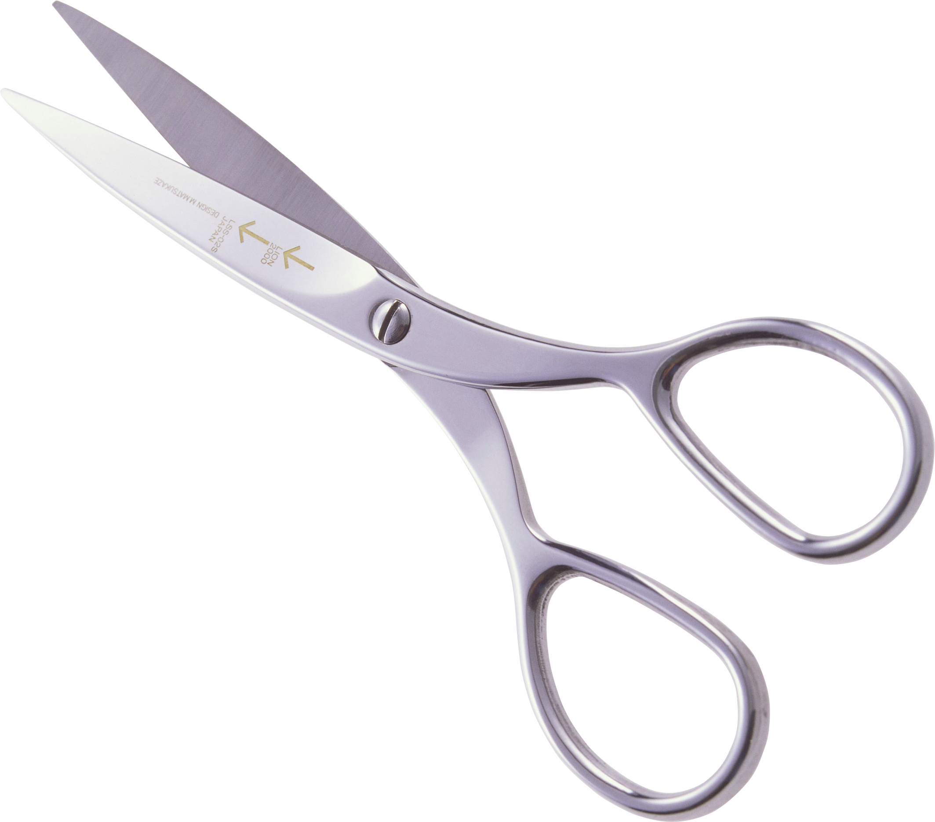
Pre-training
1. Train a network on large dataset
2. Take some intermediate layer
cifar Y
cifar X
Large Neural Net

Slide 10
Pre-training
1. Train a network on large dataset
2. Take some intermediate layer
cifar Y
cifar X
Large Neural Net

Slide 11
Pre-training
1. Train a network on large dataset
2. Take some intermediate layer
3. Build model on top of it
cifar Y
model
cifar X
Large Neural Net

Slide 12
Pre-training
1. Train a network on large dataset
2. Take some intermediate layer
3. Build model on top of it
4. Train model for your objective
your Y
model
your X
Large Neural Net

Slide 13
CIFAR
60k images
10 classes (left)
32x32 RGB
subclasses
aquatic mammals
fish
flowers
food containers
beaver, dolphin, otter, seal, whale
aquarium fish, flatfish, ray, shark, trout
orchids, poppies, roses, sunflowers, tulips
bottles, bowls, cans, cups, plates

Slide 14
Pfft... weakling

Slide 15
ImageNet

Slide 16
ImageNet

Slide 17
What kind of network will handle that?

Slide 18
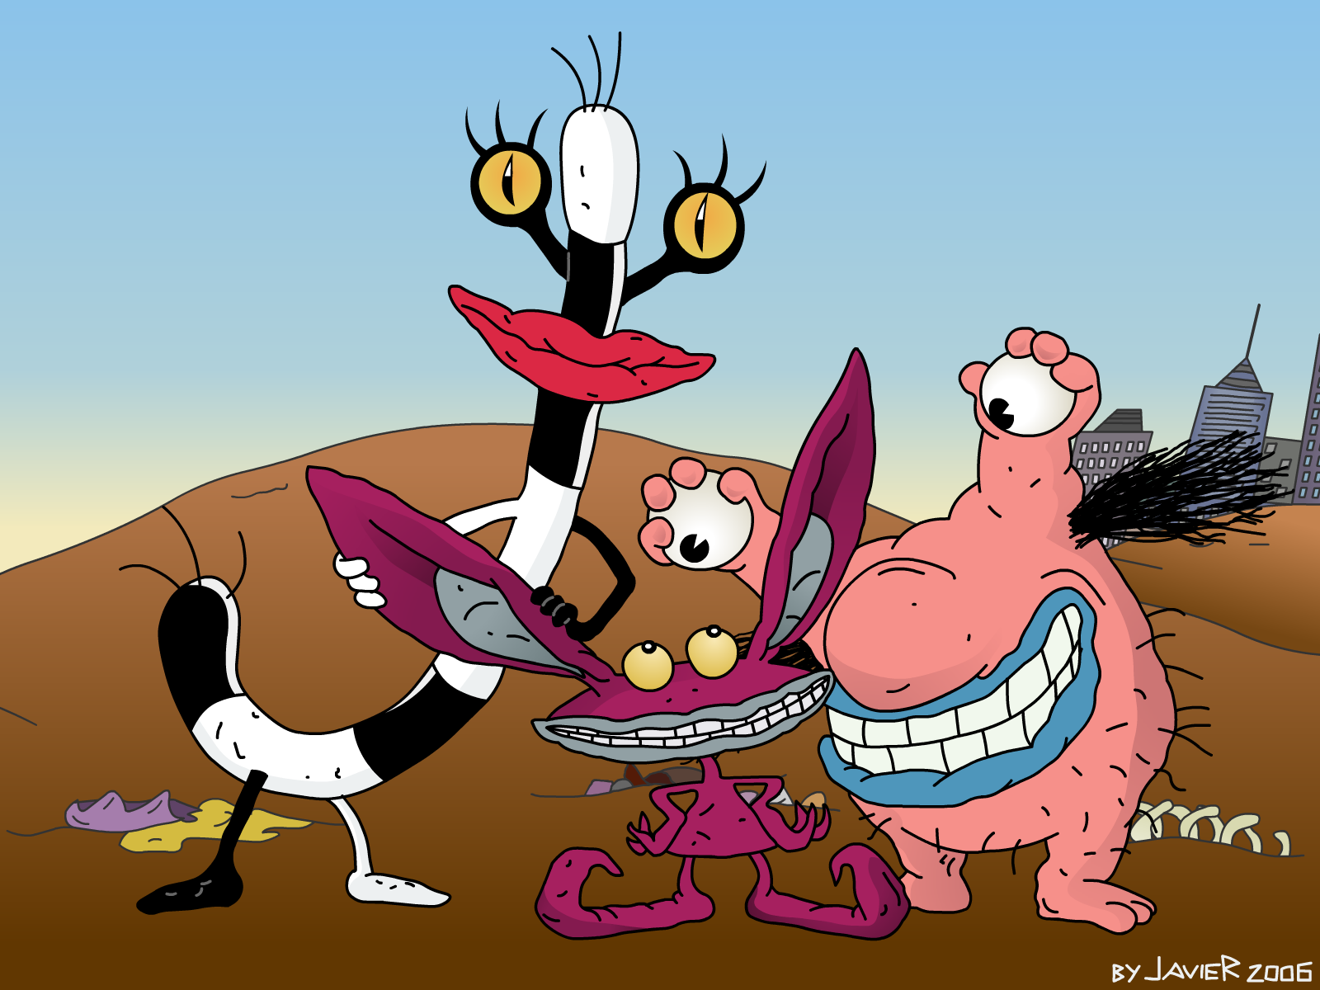

Slide 19
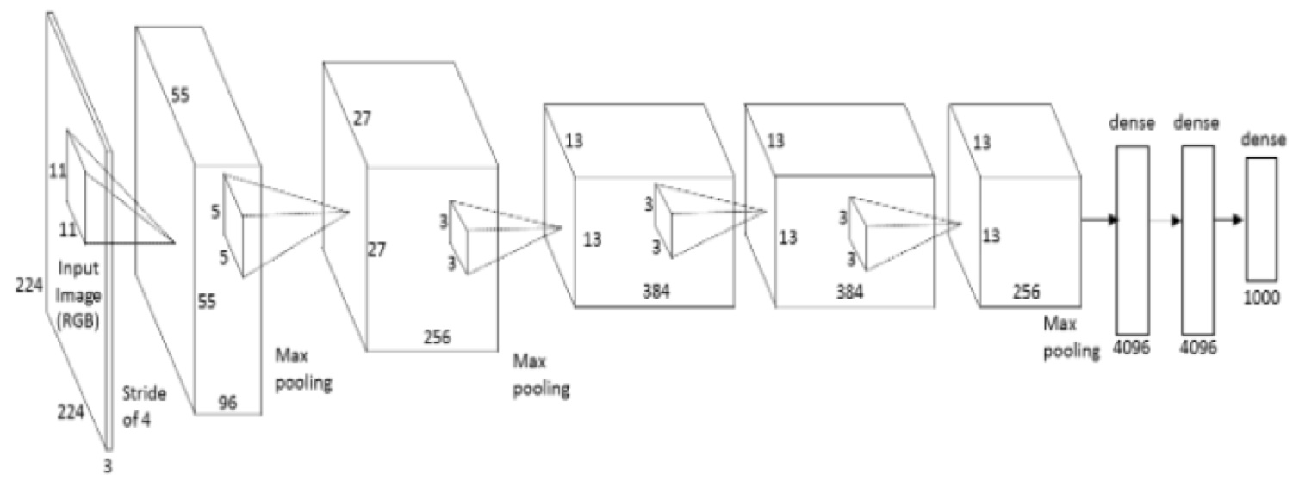
Alexnet
(Krizhevsky et al.)

Slide 20
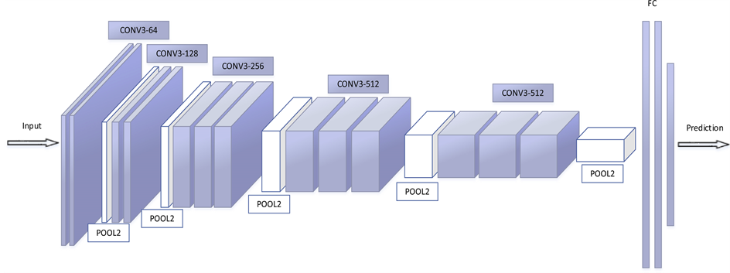
VGG
Karen Simonyan and Andrew Zisserman

Slide 21
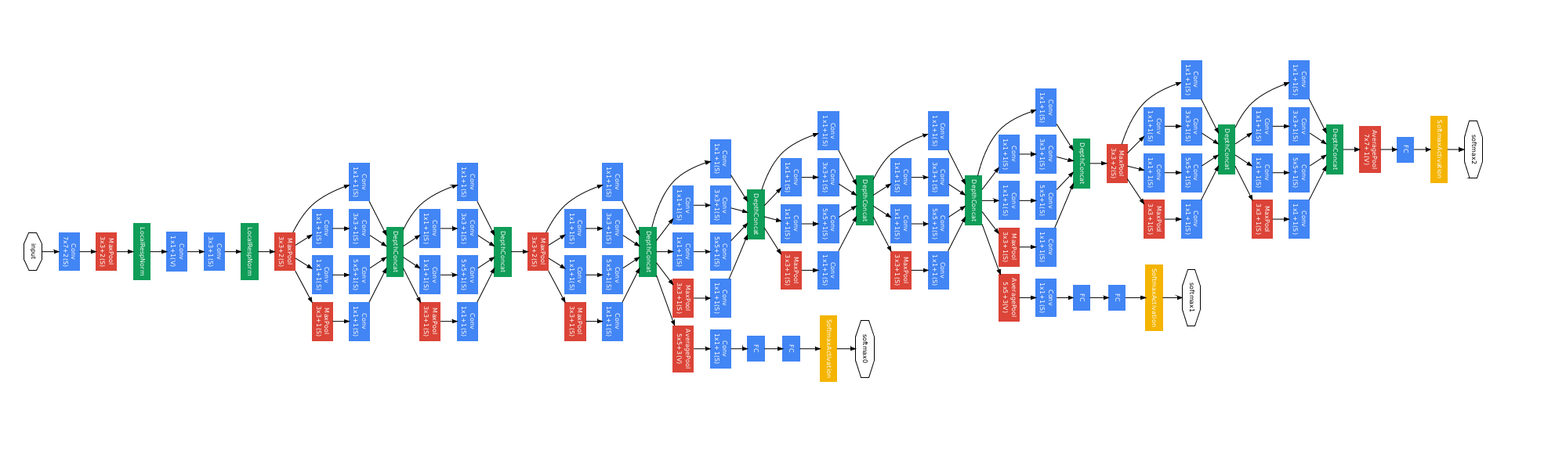
Googlenet (inception)
Szegedy et al

Slide 22
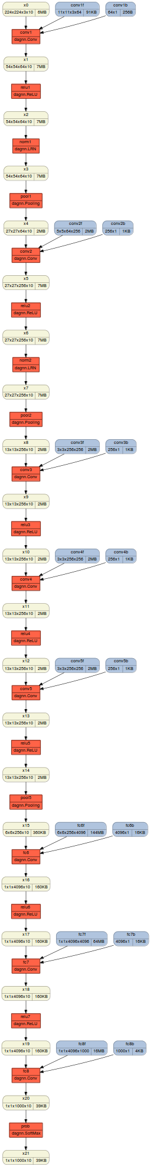
ResNet-152

Slide 23
ResNet-152

Slide 24
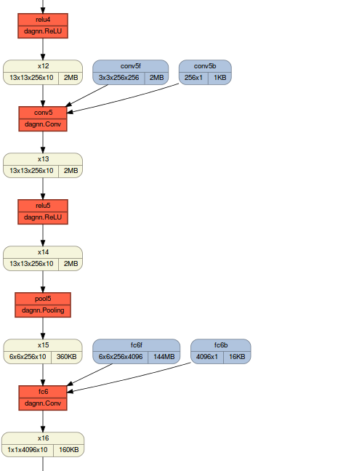
ResNet-152

Slide 25
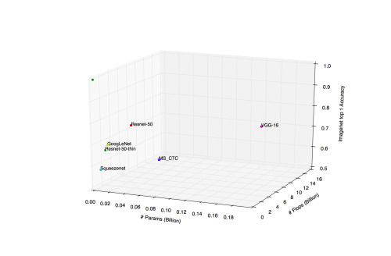
Monster stats

Slide 26
Can we use them?*
*for aircraft problem

Slide 27
Can we use them?
~ anywhere
even bran scans
casual photos
i.e. not satelite maps
photos
any kinds
highly similar
tasks

Slide 28
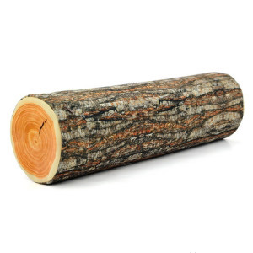
Reusing features
Chop off “head”
use “neck” as feature extractor
Train ANY classifier
  even random forest will do
X
Y
Large Neural Net

Slide 29

Fine-tuning
Chop off “head”
“freeze” body (consider constant)
Build new neural network in it's place
Train “head” only for several iteratons
Un-freeze body and train full network
X
Y
Large Neural Net

Slide 30
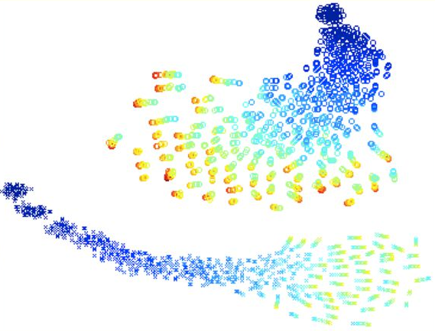
Comparison
TSNE of network weights
Crosses = pre-training, Rounds = no pre-training
Color = epoch (hotter means higher)
No overlap!

Slide 31
Alright, we did it!
But how do we fit large NN into an Iphone?

Slide 32
That's simple!
  We just train a smaller network
  Or use a remote server with GPUs
  Maybe use float16 instead of float32
Can we do better?

Slide 33
Decomposition trick
Pre-final dense layer 4096x4096 matrix
Filters 512x256x3x3
Can we reduce the size/complexity?

Slide 34
Decomposition trick
Pre-final dense layer 4096x4096 matrix
Filters 512x256x3x3
Can we reduce the size/complexity?
  Yes, we can! (c)
  SVD (flatten to matrix), TensorTrain, ...

Slide 35

Soft Targets, Optimal Brain Damage

