Slide 1



Deep Learning
Episode 5
Recurrent Neural Networks II

Slide 2
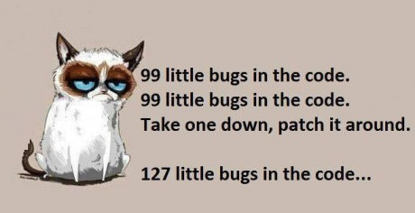
Homework assignment TBA
{we fucked up}
Last wave of homeworks (last 5 days) to be checked until the end of the weekend

Slide 3


Slide 4
Deep Learning
Episode 5
Recurrent Neural Networks II

Slide 5
Recap: rnn step
output
Elementwise
Wx+b
H units
+
sigmoid
Last
State
New
state
Wx+b
H units
time
Input at
This tick

Slide 6
Recap: rnn layer
W1
W2
W3
W4
embed
embed
embed
embed
W0=”the”
W1=”cat”
W2=”sat”
W3=”on”

Slide 7
Recap: multi-layer models
Dense
(softmax)
W1
W2
W3
W4
RNN 2
RNN 1
embed
embed
embed
embed
Embedding
Input
W0=”the”
W1=”cat”
W2=”sat”
W3=”on”

Slide 8
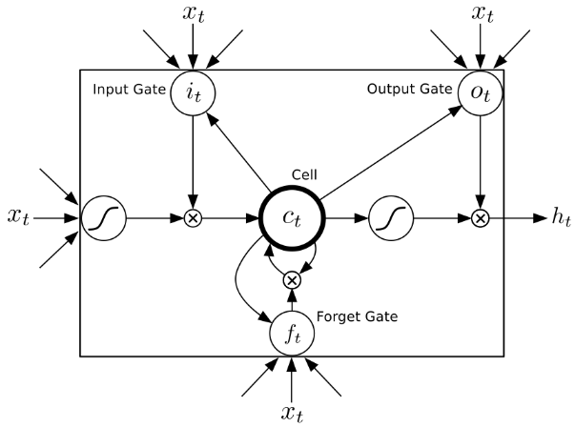
Recap: OMFG LSTM
Problem to fix:
Vanishing gradients
2 hidden states:
Cell (“private” state)
Output (“public” state)
4 blocks:
Update
Forget gate
Input gate
Output gate

Slide 9
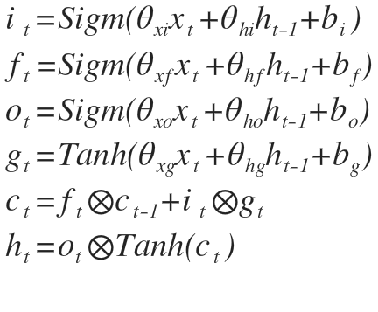
Recap: LSTM

Slide 10
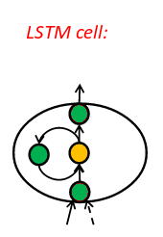
LSTM: not a monster
[Pictures: E Lobacheva, D Vetrov ]

Slide 11
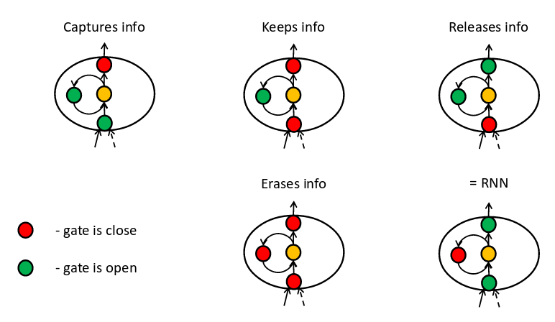
LSTM: not a monster
[Pictures: E Lobacheva, D Vetrov ]

Slide 12
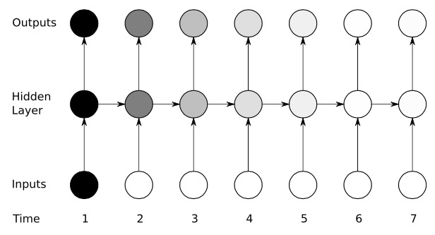
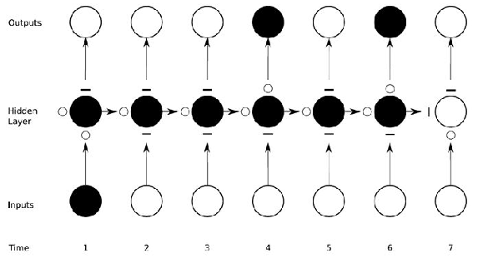
LSTM vs RNN
RNN activation
LSTM activation

Slide 13
Recurrent dropout
Wait, what does regular dropout do in the first place?

Slide 14
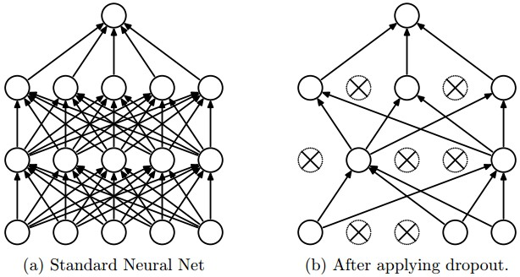
Recap: dropout
A way to prevent overfitting
Randomly turn off some fraction of neurons on each training iteration

Slide 15
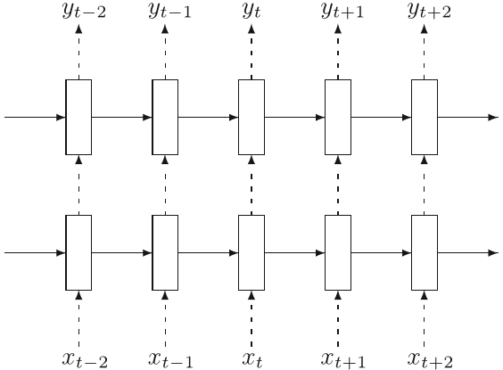
Recurrent dropout
Say, we dropout 10% activations on each tick
The dropouts are different at each tick.

Slide 16
Recurrent dropout
Say, we dropout 10% activations on each tick
The dropouts are different at each tick.
Trivia: What is the probability that a one cell will NOT be dropped out:
  over 10 ticks?
  over 100 ticks?

Slide 17
Recurrent dropout
Say, we dropout 10% activations on each tick
The dropouts are different at each tick.
Trivia: What is the probability that a one cell will NOT be dropped out:
  over 10 ticks? ~0.35
  over 100 ticks? ~10^-5
How does this influence long-term learning?

Slide 18
Recurrent dropout: Naive
Naive dropout inside recurrence sucks.
Idea 1: Let us only use dropout on non-recurrent connections (vertical arrows)

Slide 19
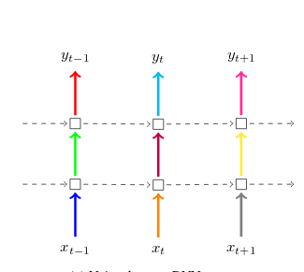
Recurrent dropout: Naive
Random dropout mask
  (each one is different

Slide 20
Recurrent dropout: Variational
Naive dropout inside recurrence sucks.
Idea 2: Let us share the same dropout mask between recurrent connections.
    Neurons stay alive all through the sequence.
https://arxiv.org/abs/1512.05287

Slide 21
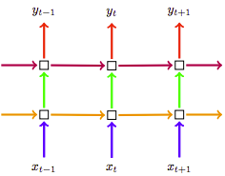
Recurrent dropout: Variational
Arrows: Each color denotes some dropout mask
(same color = same dropout)
https://arxiv.org/abs/1512.05287

Slide 22
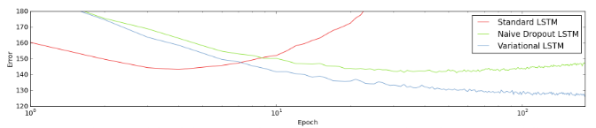
Recurrent dropout pic-cha
Task: language modelling
(Penn Treebank dataset)
Naive = only dropout non-recurrent
Variational = use same masks
https://arxiv.org/abs/1512.05287

Slide 23
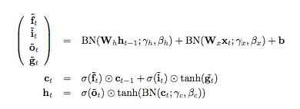
Recurrent Batch Norm
https://arxiv.org/abs/1603.09025

Slide 24
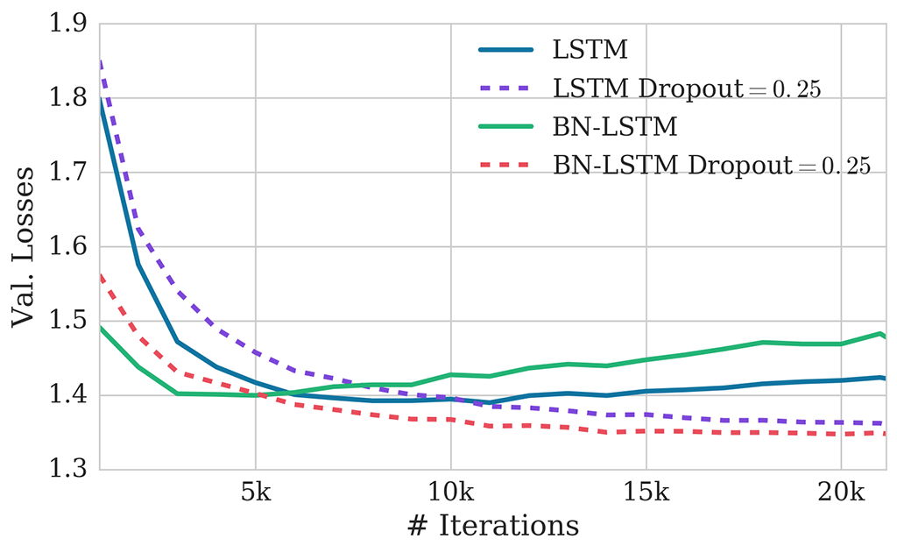
Recurrent Batch Norm
https://arxiv.org/abs/1603.09025

Slide 25
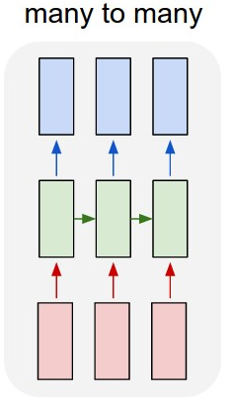
Recurrent Architectures: regular
  Read sequence
  Predict sequence of answers at each tick
Tasks:
  Language model
  POS Tagging
How to implement?
  See last week

Slide 26
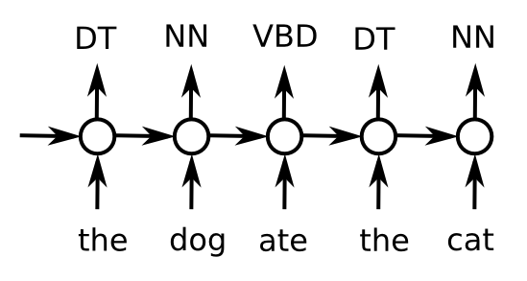
Recurrent Architectures: regular
  Read sequence
  Predict sequence of answers at each tick
POS tagging
Why RNN?

Slide 27
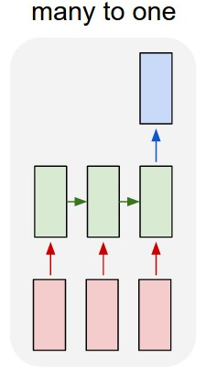
Recurrent Architectures: Encoder
Encoder
  Read sequence
  Predict once
Tasks:
  ?!
How to implement?
  ?!

Slide 28
Recurrent Architectures: Encoder
Encoder
  Read sequence
  Predict once
Tasks:
  Sentiment analysis
  Detect age by status
  Week3 homework
  Any text analysis
How to implement?
  Take last/max/mean over time

Slide 29
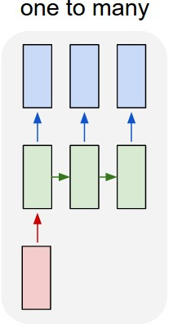
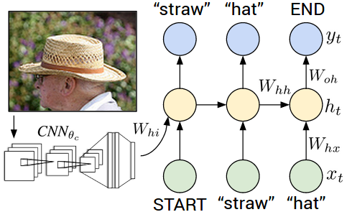
Recurrent Architectures: Decoder
Decoder
  Take one state
  Generate sequence
Tasks:
  Image captioning
How to implement?
  ?!

Slide 30
Recurrent Architectures: Decoder
Decoder
  Take one state
  Generate sequence
Tasks:
  Image captioning
How to implement?
  First state init (instead of zeros)
  Input at each tick

Slide 31
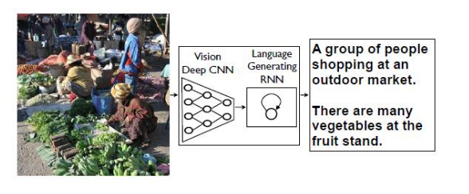
Image captioning
Demo - http://stanford.io/2esMxOq
Upload your image - http://bit.ly/2eAoueP

Slide 32
Seq2seq
How do we convert sequence to sequence of different kind/without time synchronization?
Example: Machine translation

Slide 33
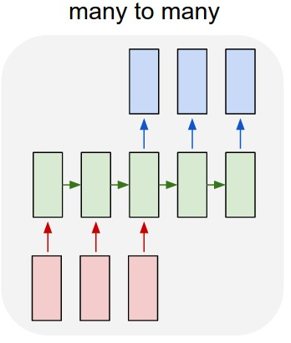
Seq2seq
Idea:
  first read (encode) the sequence
  then generate new one out of the encoded vector
How to implement that?

Slide 34
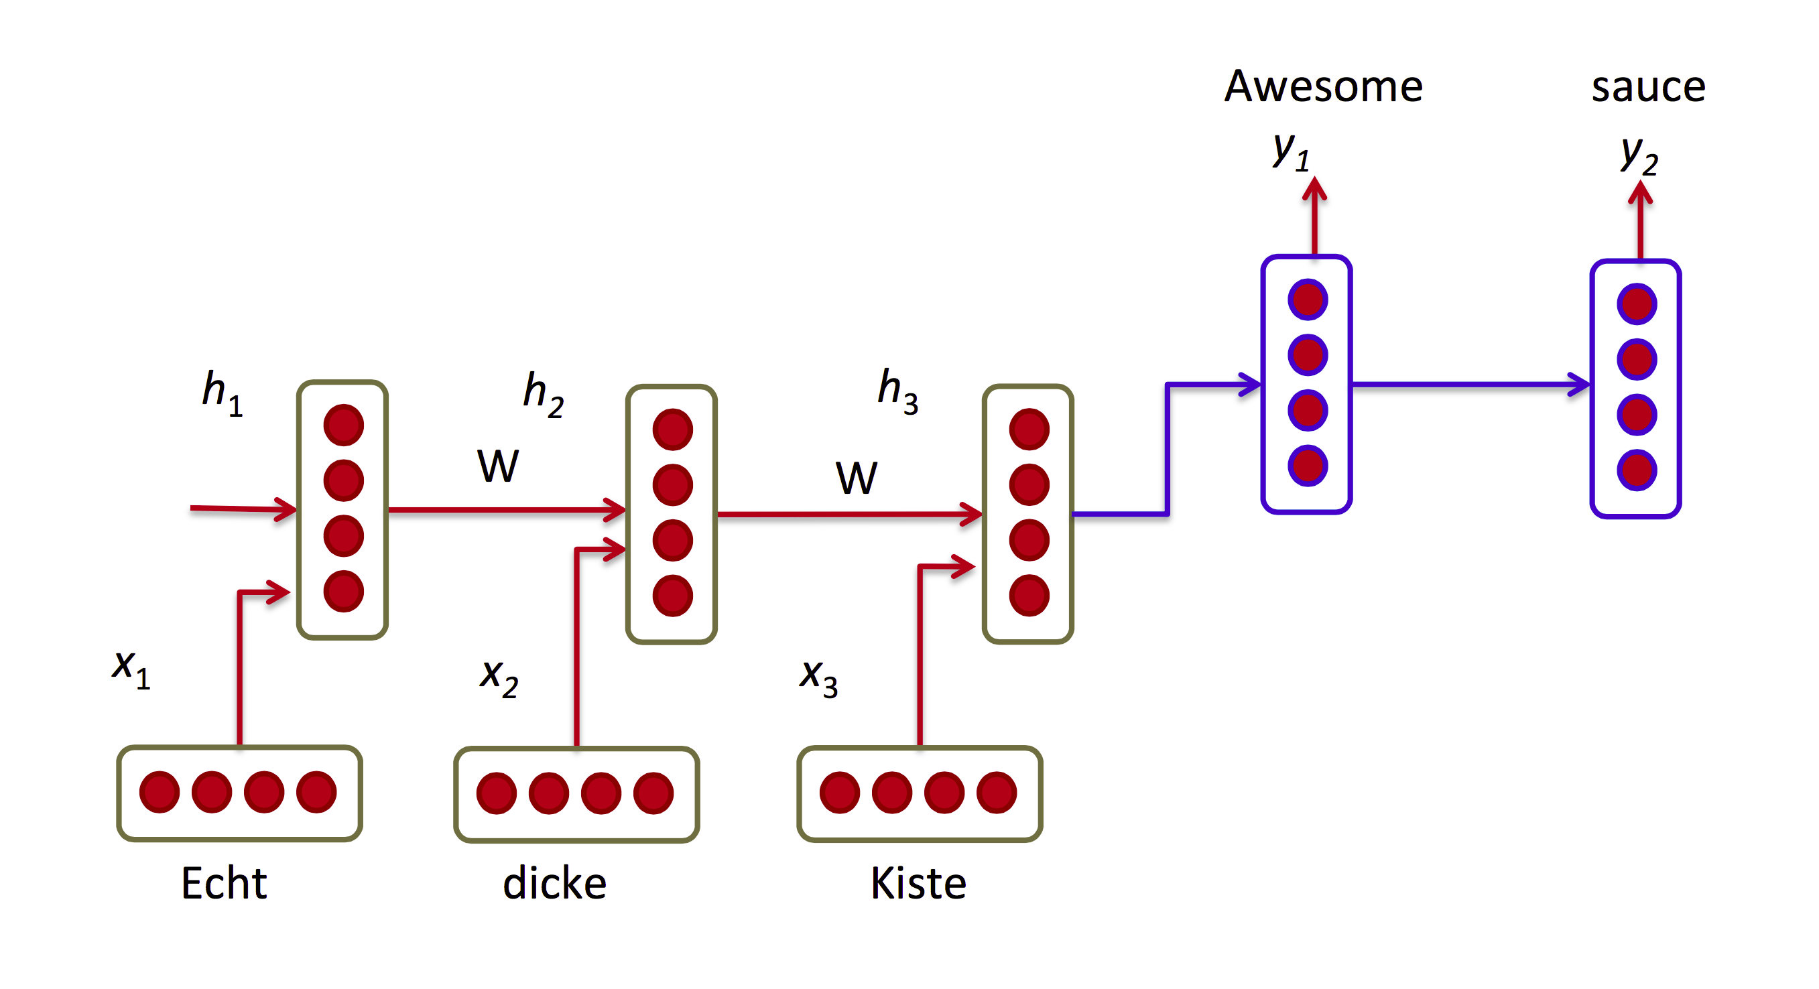
Seq2seq: encoder-decoder

Slide 35
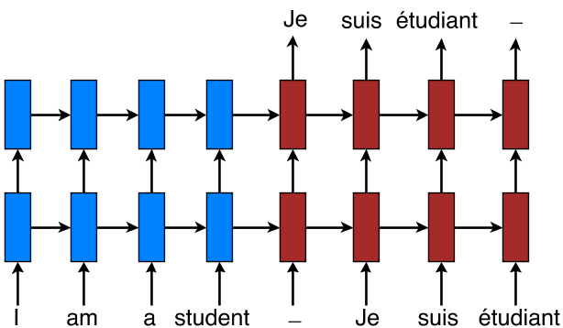
Seq2seq: Machine translation

Slide 36
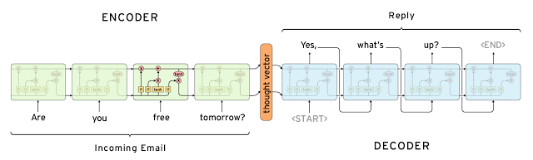
Seq2seq: Conversation model
Exactly the same

Slide 37

Augmentations

Slide 38
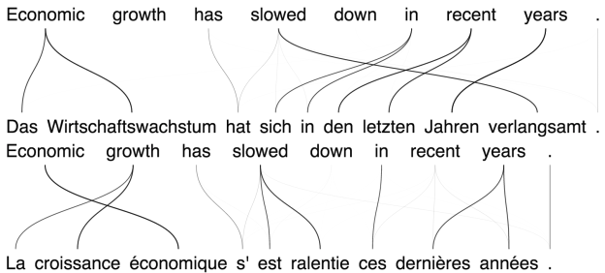
Back to machine translation
Idea: parallel sentences have corresponding words aligned with language syntax rules

Slide 39
Back to machine translation
Can we learn to focus on the correct source word when translating the sentence?

Slide 40
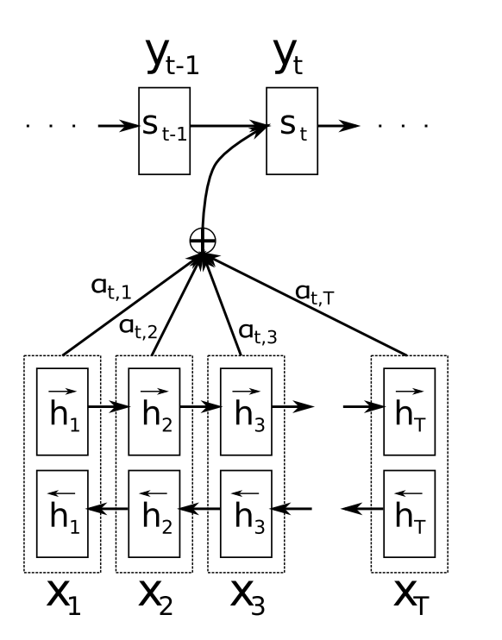
Attention
Idea: on every tick, predict which word do you want to see.
Attentive decoder
Attention
Encoder
At = another neural net prediction
St = recurrent step (e.g. lstm)
http://arxiv.org/abs/1409.0473

Slide 41
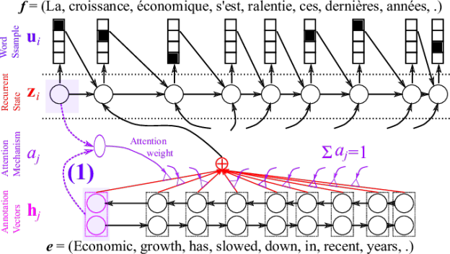
Back to machine translation

Slide 42
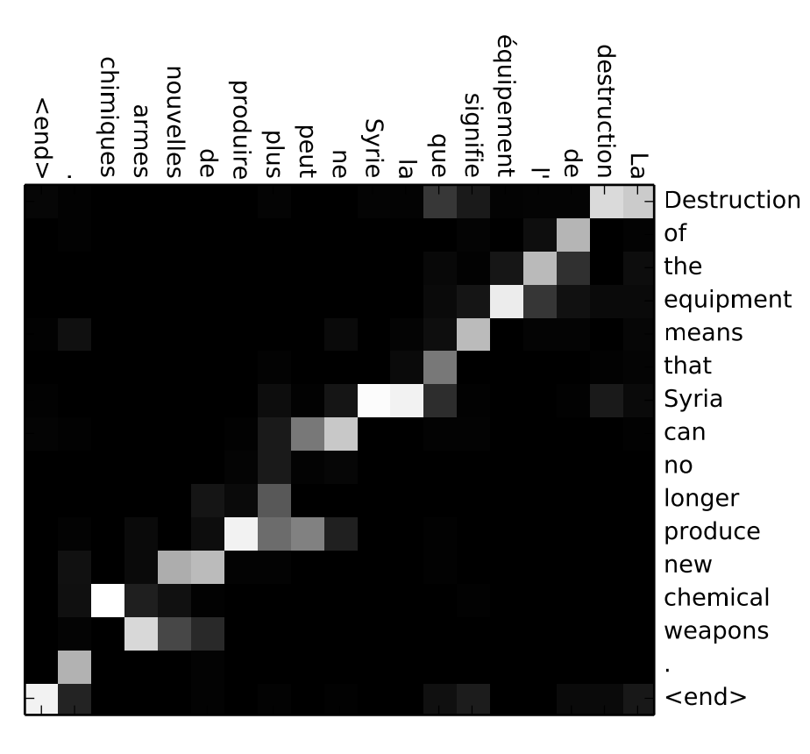
Back to machine translation
Image: attention vectors: where network “looks” when translating each word

Slide 43
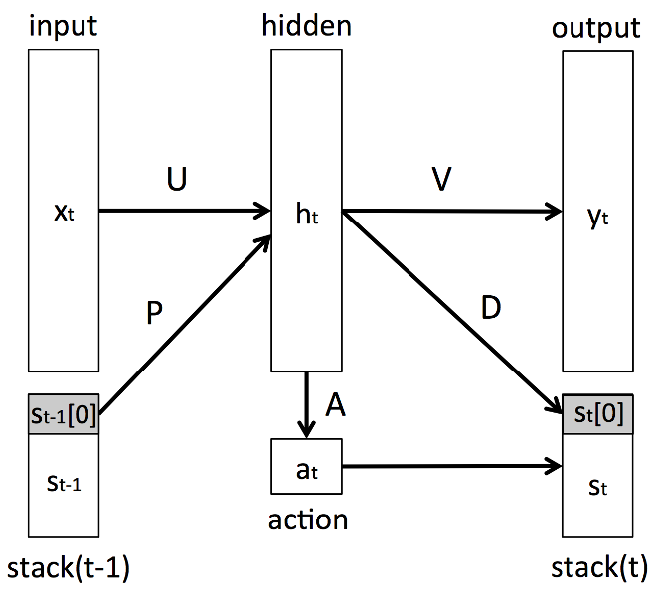
Stack-augmented RNN

Slide 44
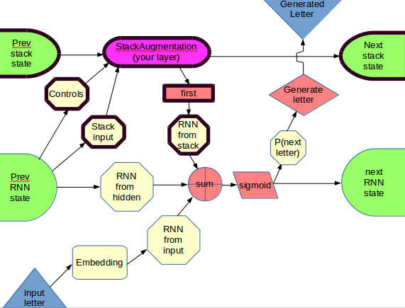
Stack-augmented RNN

Slide 45
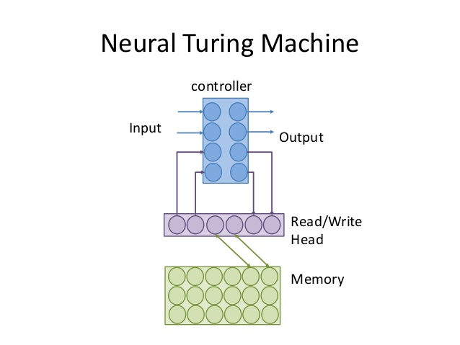
Stack-augmented RNN

Slide 46
Nuff
And now, let's go implement some!

