Slide 1



Deep learning episode 12
Bayesian methods in DL

Slide 2

What is probability?

Slide 3
What is probability?
What does it mean if P(event) = 0.25?
How evaluate P(coin lands heads)?

Slide 4


A coin was flipped 2 times
Heads both times
P(heads) = ?

Slide 5

Frequentist Vs Bayesian
Probability is objective nondeterminism
There is no prior, there's data
Hypothesis testing
Quantum Physics
Trust Regions
Maximum Likelihode Estimate
Probability is subjective ignorance
Through prior I gain strength
Regularization
Structured learning
Posterior distributions
Maximum a-posteriori

Slide 6
Bayes theorem
Conditional probability
Probability of a given b
Bayes theorem

Slide 7
Bayes theorem
Conditional probability
Probability of a given b
Bayes theorem

Slide 8
Marginalization

Slide 9
Logistic regression
Binary classification
Data: X (objects) Y(answers)
Model:
What parameters does logreg have?

Slide 10
Logistic regression
Binary classification
Data: X (objects) Y(answers)
Model:
How do we estimate ?

Slide 11
Logistic regression
Binary classification
Data: X (objects) Y(answers)
Model:

Slide 12
Logistic regression
Binary classification
Data: X (objects) Y(answers)
Model:
Objective:

Slide 13

Frequentist Vs Bayesian
- Is it possible to learn such power?
- Not from a frequentist

Slide 14
Maximum a-posteriori
Objective:

Slide 15
Maximum a-posteriori
Objective:
const(θ)
const(θ)

Slide 16
Maximum a-posteriori
Objective:
Likelihood:
Result:
Product of many <1 terms,
Computationally unstable
Quiz: can we optimize some-
thing more stable?

Slide 17
Maximum a-posteriori
Objective:

Slide 18
Logistic regression
Model:

Slide 19
Logistic regression
Model:
Replace if with multiplication

Slide 20
Logistic regression
Model:

Slide 21

Logistic Regression
Assume uniform prior (const)
Replace max(a) by min(-a)

Slide 22
Prior
Information about weights before observation
Which of these weights you'd prefer?
First set of weights:
Second set of weights:
-0.554, 2.726, 0.999, 2.573, -0.694, 0.323, -1.903, -0.070
154016218671.074, 133023030621.400, 72847832520.938, 130909237163.079, -134435263422.709, 72550546946.769, 121468470400.514, -55724178429.301

Slide 23
Prior
Weights should be small,
P(0.1) > P(10^5)
Which distributions support that?

Slide 24
Prior
Weights should be small,
P(0.1) > P(10^5)
Which distributions support that?
Actually, all kinds of distributions, but we'll name a few...

Slide 25
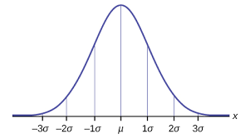
Prior
Weights should be small,
P(0.1) > P(10^5)
Which distributions support that?
Normal
Assumuing mean = 0

Slide 26
Prior
Weights should be small,
P(0.1) > P(10^5)
Which distributions support that?
Normal

Slide 27
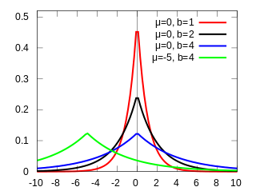
Moar
Laplacian prior
Guess the final term for loss... :)
Other: exponential for ensembling, mixtures, etc.

Slide 28
Linear regression
Regression
Predict P(y|x) with a gaussian
  mean = wx+b
  variance = 1

Slide 29
Linear regression
Regression
Predict P(y|x) with a gaussian
  mean = wx+b
  variance = 1
Hence, MSE

Slide 30
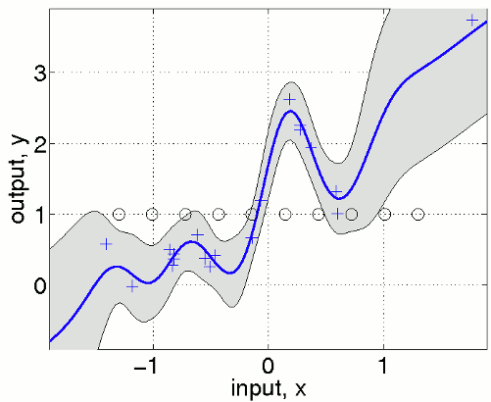
Why do we need certainty?
To which extent do we trust our model?
Sampling from generative models

Slide 31
Predicting distributions
Before:
X
Dense
Dense
μ
Likelihood
σ=1

Slide 32
Predicting distributions
After:
Sigma = how certain are you?
X
Dense 1
Dense 2
μ
Likelihood
σ=1

Slide 33
Predicting distributions
Distribution on activations:
How do we train that thing?
X
Dense 1
Dense 2
μ
...
σ=1

Slide 34
Predicting distributions
Distribution on activations:
X
Dense 1
Dense 2
μ
...
σ=1

Slide 35
Predicting distributions
Distribution on activations:
X
Dense 1
Dense 2
μ
...
σ=1
weights

Slide 36
Reparameterization trick
Idea:
Replace parameterized distribution
with some expression over noise
Works with many(but not all) distributions

Slide 37
How to train?
Reparameterization trick:
Was:
Now:
noise

Slide 38
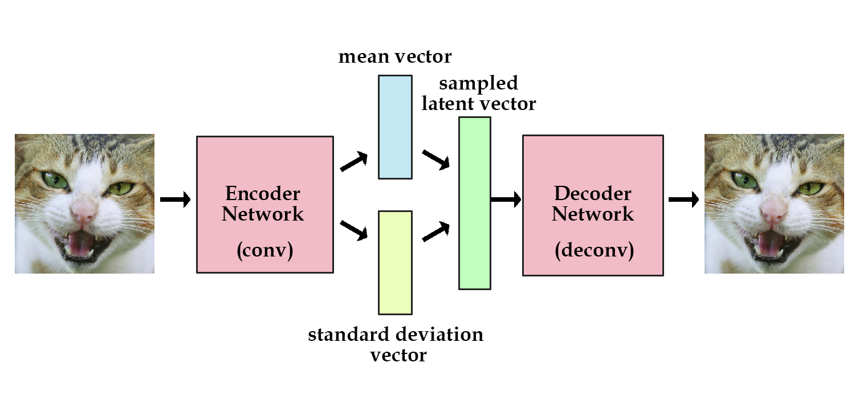
Seminar announcement

Slide 39
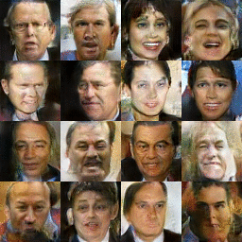
Seminar announcement

