Slide 1



Deep learning episode 2
Computer vision applications

Slide 2
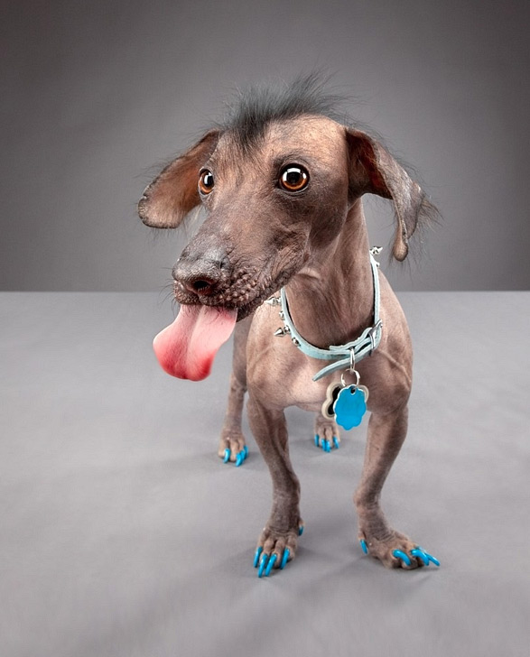
Image recognition
“Dog”

Slide 3
Image recognition
“Gray wall”
“Dog tongue”
“Dog”
<a particular kind of dog>
“Animal sadism”

Slide 4
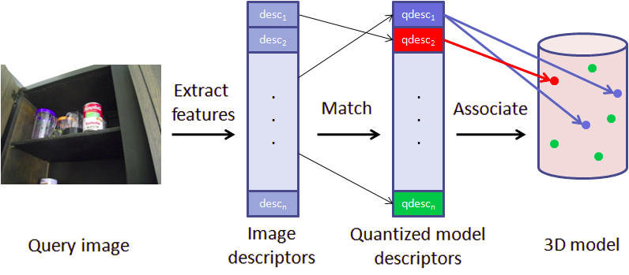
Classical approach
“Dog”

Slide 5

NN approach
P(Dog)
  What features could NN learn this way?

Slide 6
Problem
Should we require, say, “Dog ear” feature
      Linear combination can only select dog ear at a one (or a few) positions.
      Need to learn independent features for each position
      Next layer needs to react on “dog ear 0,0 or dog ear 0,1 or … or dog ear 255,255”
      Introduce a lot of parameters and risk overfitting.
  Idea: force all these “dog ear” features to use exactly same weights, shifting weight matrix each time.

Slide 7
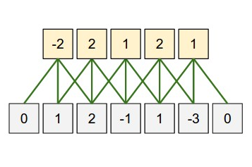

Convolution
Apply same weights to all patches
output
weights
image

Slide 8
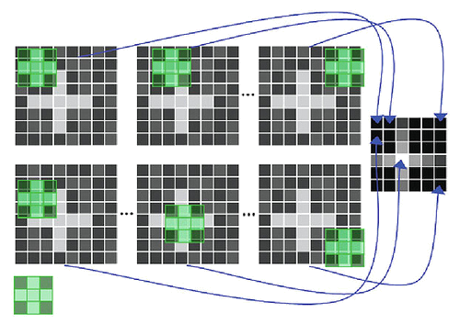
Convolution
apply same filter to all patches

Slide 9
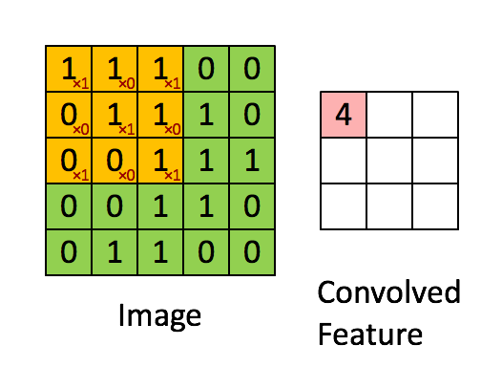
Convolution
5x5
3x3 (5-3+1)
Intuition: how cat-like is this square?

Slide 10
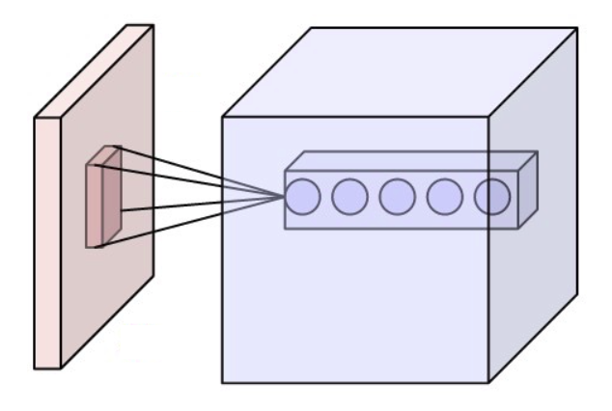
Convolution
Intuition: how cat-like is this square?

Slide 11
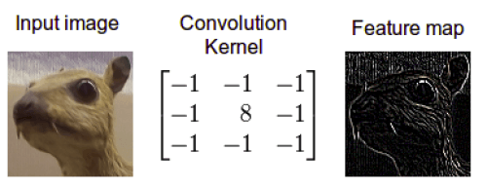
Convolution
Intuition: how edge-like is this square?

Slide 12
Convolution
?!
Filters: 100x(3x5x5)
Image : 3 (RGB) x 100 px x 100 px

Slide 13
Convolution
100x96x96
~10^6
Filters: 100x(3x5x5)
Image : 3 (RGB) x 100 px x 100 px
Somewhat too many!

Slide 14
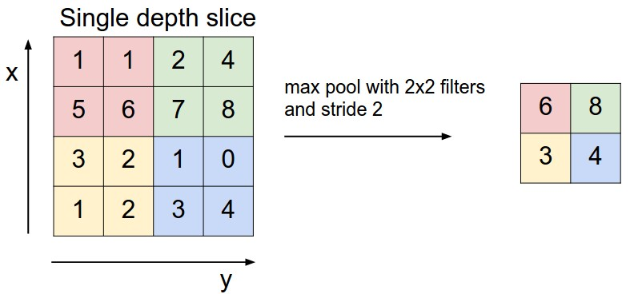
Pooling
Intuition: What is the max cat-likelihood over this area?

Slide 15
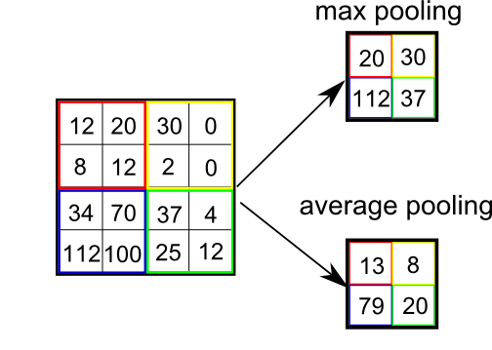
Pooling
Motivation:
Reduce layer size by a factor
Make NN less sensitive to small image shifts
Popular types:
Max
Mean(average)

Slide 16
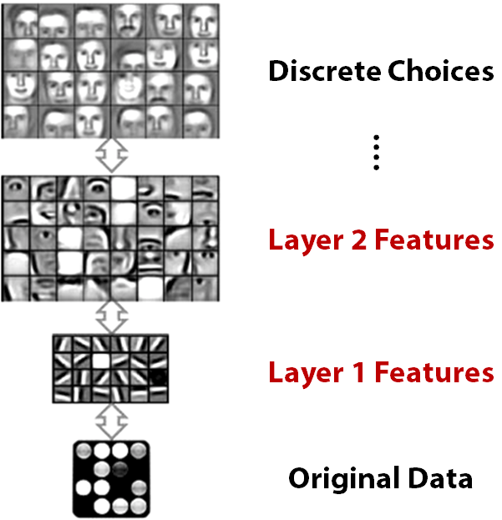

Slide 17
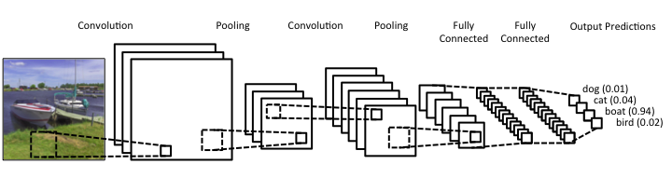
Convolutional NNs

Slide 18
Convolutional NNs
32 filters 5x5
3x3
3x3
64 filters 5x5
512
512
4
3x100x100
Quiz:
1) What is the blob size after second pooling

Slide 19
Convolutional NNs
32 filters 5x5
3x3
3x3
64 filters 5x5
512
512
4
3x100x100
Quiz:
2) How many image pixels does one cell after second convolution depend on?

Slide 20
Convolutional NNs
32 filters 5x5
3x3
3x3
64 filters 5x5
512
512
4
3x100x100
Quiz:
3) Which layer is hardest to compute?
4) Which layer has most independent parameters?

Slide 21
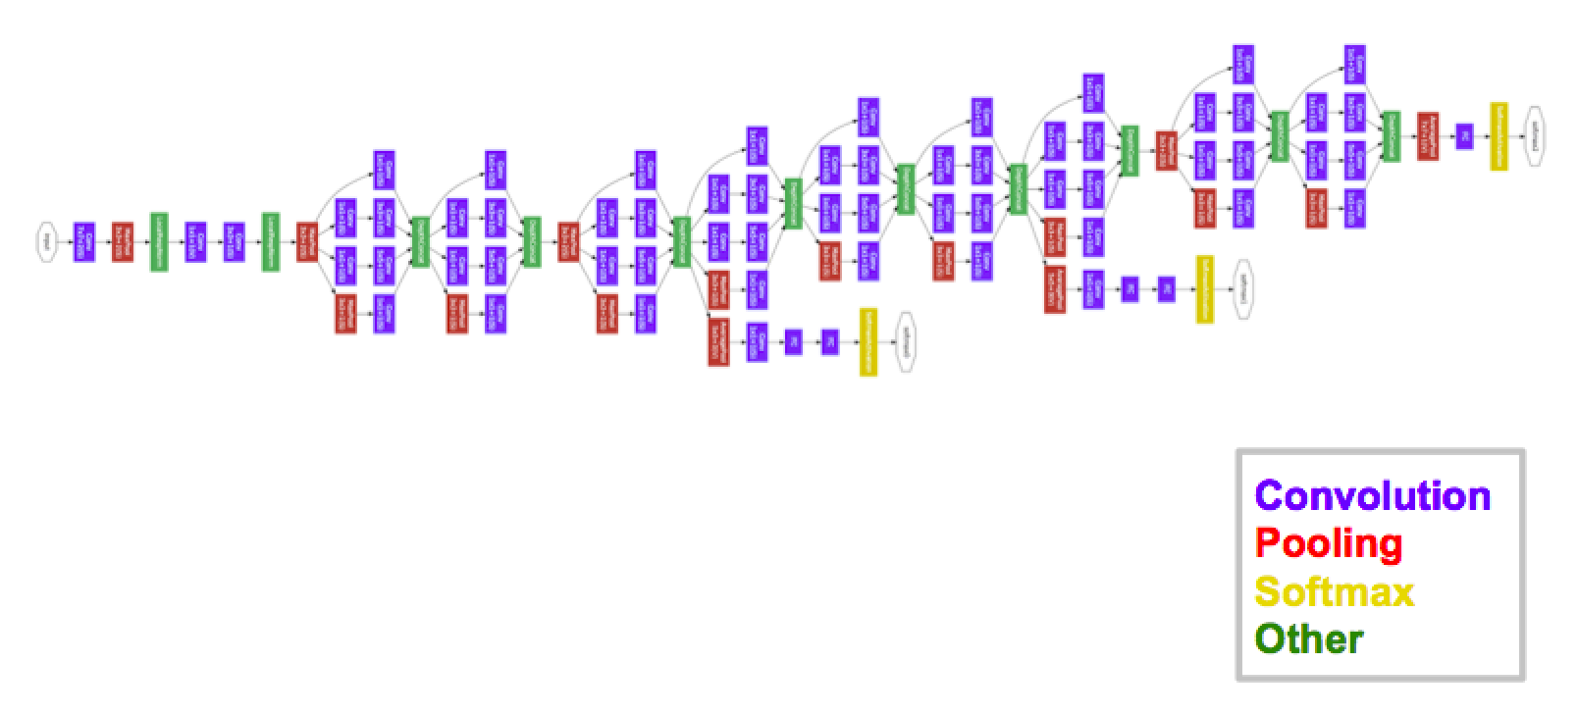
Inception-GoogleNet
[moar, inception]
It is not a moon. It is a space station (c)

Slide 22
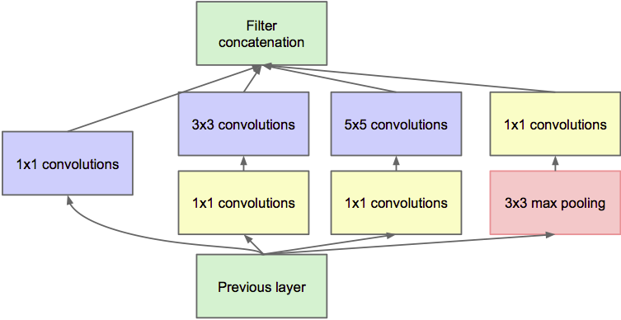
Inception-GoogleNet
[moar, inception]

Slide 23
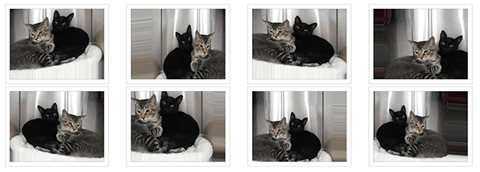
Data augmentation
Idea: we can get N times more data by tweaking images.
If you rotate cat image by 15°, it's still a cat
Rotate, crop, zoom, flip horizontally, add noize, etc.
Sound data: add background noizes

Slide 24
Batch normalization
Problem:
  Consider a neuron in any layer beyond first
  At each iteration we tune it's weights towards better loss function
  But we also tune it's inputs. Some of them become larger, some – smaller
  Now the neuron needs to be re-tuned for it's new inputs

Slide 25
Batch normalization
TL;DR:
  It's usually a good idea to normalize linear model inputs
      (c) Every machine learning lecturer, ever

Slide 26
Batch normalization
Idea:
  We normalize activation of a hidden layer
    (zero mean unit variance)
  Update with moving average while training

Slide 27
Batch normalization
Idea:
  We normalize activation of a hidden layer
    (zero mean unit variance)
  Update with moving average while training
i stands for i-th neuron

Slide 28

Batch normalization
Linear
model
σ(h)
Batch
norm
Linear
model
Batch
norm
σ(h)

Slide 29
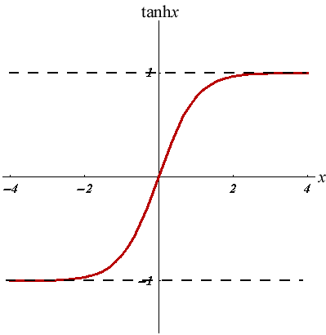
Batch normalization
Good side effect #1:
  Vanishing gradient less a problem for sigmoid-like nonlinearities
Good side effect #2:
  We no longer need to train bias (+b term in Wx+b)

Slide 30
Other CV applications
Real computer vision starts when image classification is no longer enough.

Slide 31
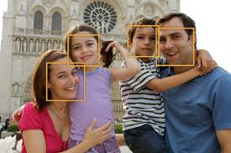
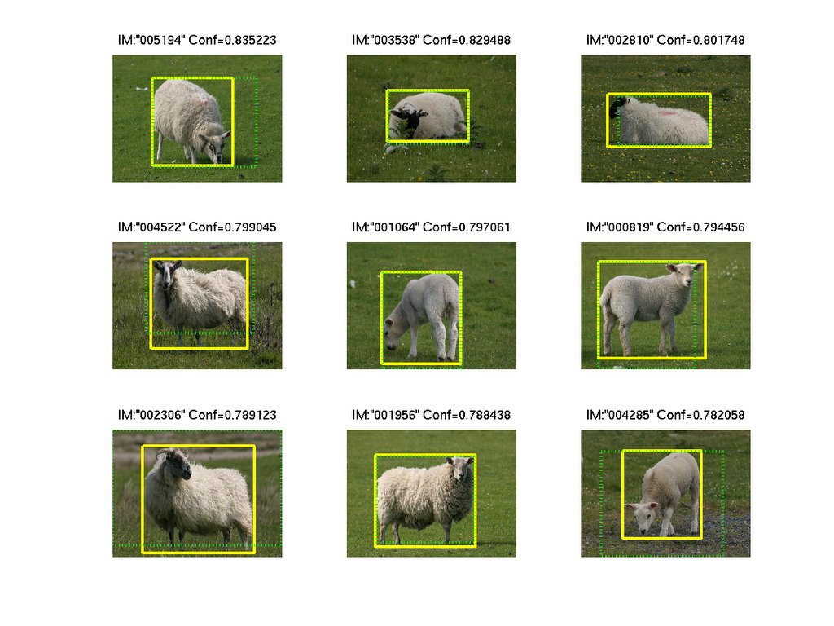
Bounding box regression
Predict object bounding box
(x0,y0,w,h)
or several bounding boxes for multiple objects.
Applications examples:
Face detection @ cameras
Surveillance cameras
Self-driving cars

Slide 32
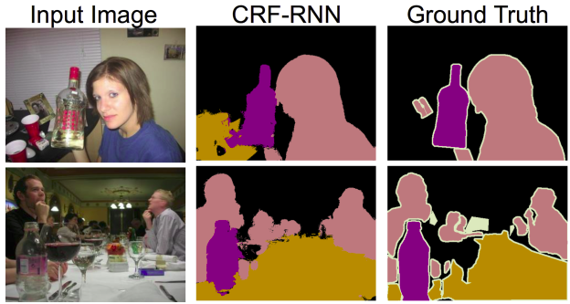
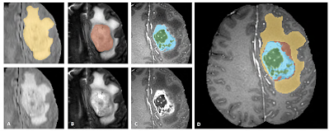
Segmentation
Predict class for each pixel
(fully-convolutional networks)
Applications examples:
Moar surveillance
Brain scan labeling
Map labeling

Slide 33
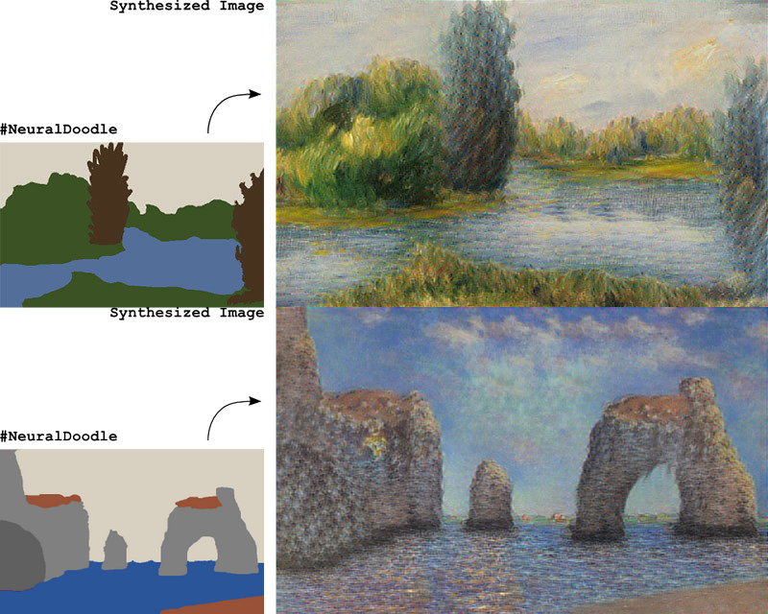
Image generation/transformation
Generation: Given a set of reference images, learn to generate new images, resembling those you were given.
Transformation: Given a set of reference images, learn to convert other images into ones resembling the reference set.
Neural Doodle
(D. Ulyanov et al.)

Slide 34
Fine-tuning
Adversarial Networks
Variational Autoencoders
Knowledge transfer
Domain adaptation
Online learning
Explaining predictions
Soft targets
Scene reconstruction
3D object retrieval
Classifier optimization
Image tagging
Image captioning
Image retrieval
Image encoding
Image morphing
Image encoding
Image upscaling
Object tracking on video
Video processing
Video interpolation

Slide 35
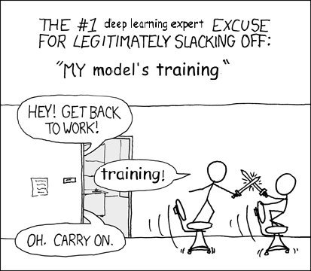
Nuff
Let's train some CNNs!

