Slide 1



Reinforcement learning
Episode 2
Approximate & deep RL

Slide 2

Recap: MDP
Classic MDP(Markov Decision Process)
Agent interacts with environment
  Environment states:
  Agent actions:
  State transition:
  Reward:

Slide 3

Recap: total reward
Objective:
  Total reward
γ ~ patience
Reinforcement learning:
  Find policy that maximizes
    the expected reward

Slide 4
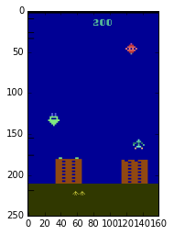

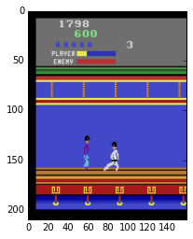
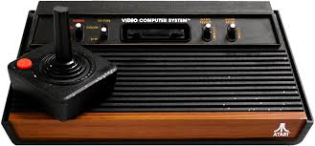
Reality check: videogames
  Trivia: What are the states and actions?

Slide 5


Recap: Q-learning
One approach:
action Q-values
Definition: Q(s,a) is an expected total reward R that can be obtained starting from state s by taking action a and following optimal policy since next state.

Slide 6
Recap: Q-learning
One approach:
action Q-values
Initialize with zeros/random
Iteratively minimize

Slide 7
Real world
observe
Agent
apply
action
Observation
action
?!
We never know exactly
how it works

Slide 8
Problem:
State space is usually large,
sometimes continuous.
              And so is action space;
However, states do have a structure, similar states have similar action outcomes.

Slide 9
From tables to approximations
Before:
  For all states, for all actions, remember Q(s,a)
Now:
  Approximate Q(s,a) with some function
  e.g. linear model over state features
  Trivia: should we use linear regression or logistic regression?

Slide 10

Deep learning approach: DQN

Slide 11


MDP again
Agent
observe
apply
action
Observation
action
Environment

Slide 12

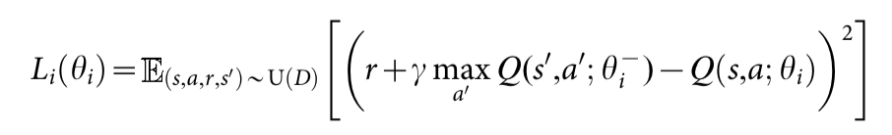
Deep learning approach: DQN

Slide 13
Approximate Q-learning
Q-values:
Q(s,a0),
Q(s,a1),
Q(s,a2)
model
W = params
Objective:
Gradient step:
image

Slide 14
Approximate Q-learning
Q-values:
Q(s,a0),
Q(s,a1),
Q(s,a2)
model
W = params
Objective:
consider const
Gradient step:
image

Slide 15
Let's devise some network

Slide 16
DQN
ϵ-greedy rule
(tune ϵ or use probabilistic rule)
action
apply
action
Qvalues is a dense layer with no nonlinearity
Qvalues
Dense
Change axis order to fit in with lasagne convolutions
Any neural network you can think of.
conv
pool
dense
dropout
batchnorm
...
Conv1
image
(i,w,h,3)
Dimshuffle
(i,3,w,h)
Conv0

Slide 17

Because TSNE
  Embedding of pre-last layer activations
  Color = state value = max_a Q(s,a)

Slide 18


Slide 19
How bad is it if agent spent
last 1000 ticks under the left rock?

Slide 20

Problem
  Training samples are not “i.i.d”,
  Model forgets parts of environment it hasn't
  visited for some time
  Drops on learning curve
  Any ideas?

Slide 21

Multiple agent trick
parameter
server
W
Idea: Throw in several agents with shared W.
agent0
agent1
agent2
env0
env1
env2

Slide 22
Multiple agent trick
parameter
server
W
Idea: Throw in several agents with shared W.
  Chances are, they will be exploring different parts of the environment,
  More stable training,
  Requires a lot of interaction,
  Alternative to experience replay.
agent0
agent1
agent2
env0
env1
env2

Slide 23
Experience replay
Interaction
Idea: store several past interactions
<s,a,r,s'>
Train on random subsamples
Any +/- ?
Agent
training
<s,a,r,s'>
<s,a,r,s'>
<s,a,r,s'>
<s,a,r,s'>
<s,a,r,s'>
<s,a,r,s'>
<s,a,r,s'>
~
training
batches
Replay
buffer

Slide 24
Experience replay
Interaction
Idea: store several past interactions
<s,a,r,s'>
Train on random subsamples
  Atari DQN: >10^5 interactions
  Closer to i.i.d
  pool contains several sessions
  Older interactions were obtained under weaker policy
  Further development: prioritizing samples based on their importance.
  https://arxiv.org/abs/1511.05952
Agent
training
<s,a,r,s'>
<s,a,r,s'>
<s,a,r,s'>
<s,a,r,s'>
<s,a,r,s'>
<s,a,r,s'>
<s,a,r,s'>
~
training
batches
Replay
buffer

Slide 25
Autocorrelation
  Reference is based on predictions
  Any error in Q approximation is propagated to neighbors
  If some Q(s,a) is mistakenly over-exaggerated,
  neighboring qvalues will also be increased in a cascade
  Worst case: divergence
  Any ideas?

Slide 26
Target networks
Idea: use older network snapshot
to compute reference
  Update Q old periodically
    Slows down training

Slide 27
Target networks
Idea: use older network snapshot
to compute reference
  Update Q old periodically
    Slows down training
  Smooth version:
    use moving average
    Θ = weights

Slide 28

Final problem
Left or right?

Slide 29
Problem:
Most practical cases are partially observable:
Agent observation does not hold all information about process state (e.g. human field of view).
Any ideas?

Slide 30
Problem:
Most practical cases are partially observable:
Agent observation does not hold all information about process state (e.g. human field of view).
However, we can try to infer hidden states from sequences of observations.
Intuitively that's agent memory state.

Slide 31
Partially observable MDP
observe
Agent
apply
action
Observation
action
Hidden state
(Markov assumption holds)
[but no one cares]

Slide 32

N-gram heuristic
Idea:
  e.g. ball movement in breakout
  One frame
  Several frames

Slide 33
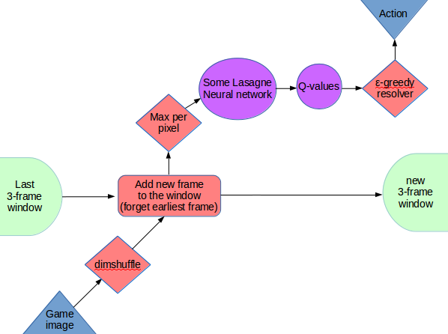
N-gram heuristic

Slide 34
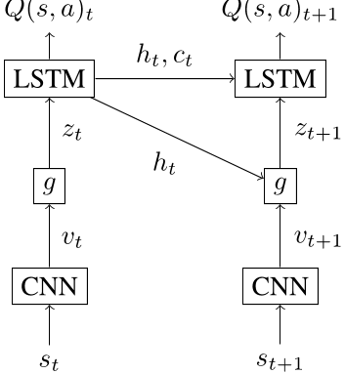
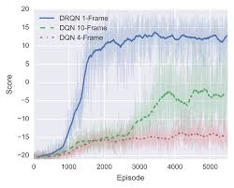
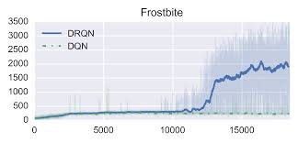
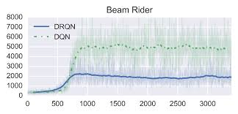
Deep Recurrent RL
Recurrent agent memory
  Agent has his own hidden state.
  Trained via BPTT with a fixed depth
  Problem: next input depends on chosen action
  Even more autocorrelations :)

Slide 35
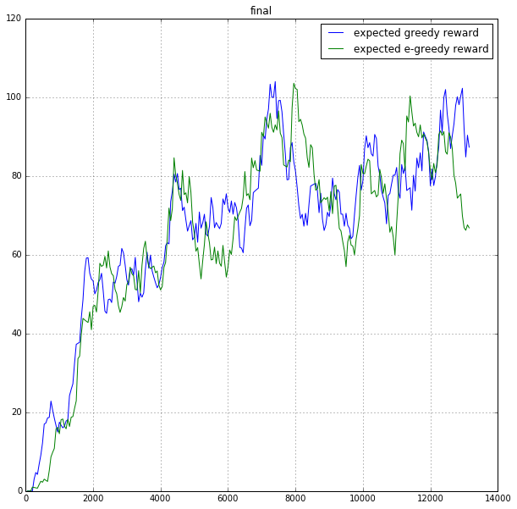
Deep Recurrent RL
Learning curves for KungFuMaster

Slide 36

http://mybinder.org/repo/yandexdataschool/dqn_binder

Slide 37
Most important slide
      RL isn't magical
        It won't learn everything in the world given any data
        Requires interaction
        Sparse and/or delayed rewards are a major problem
        Less playing Atari, more real world problems
        No, doom is not a real world problem, dummy!
        Getting rid of heuristics towards mathematical soundness
        Machine Intelligence revolution date TBA

