Slide 1



Deep Learning
Episode 3
Natural Language Processing

Slide 2

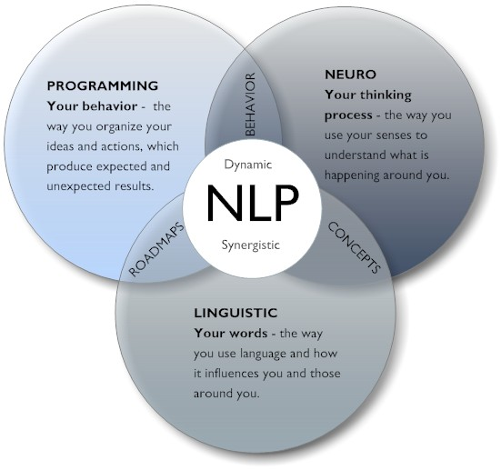
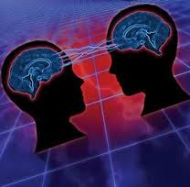
What is NLP?
NLP
здорового человека
NLP
курильщика

Slide 3
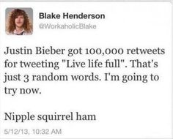

Text classification/regression
Other usage:
Adult content filter (safe search)
Detect age/gender/interests by search querries
Convert movie review into “stars”
Survey public opinion for the new iphone Vs old one (SNA)
...

Slide 4
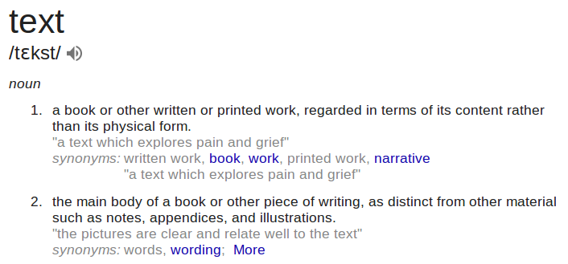
Text 101

Slide 5

Text 101: nlp perspective
Text:
A sequence of tokens(words).
Token/word:
A sequence of characters.
Character:
An atomic element of text.
¯\_(ツ)_/¯

Slide 6
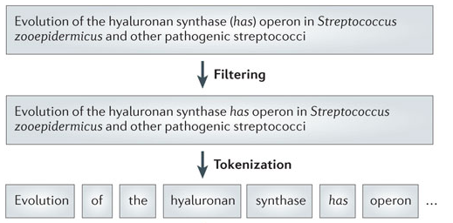
Text 101: tokens

Slide 7
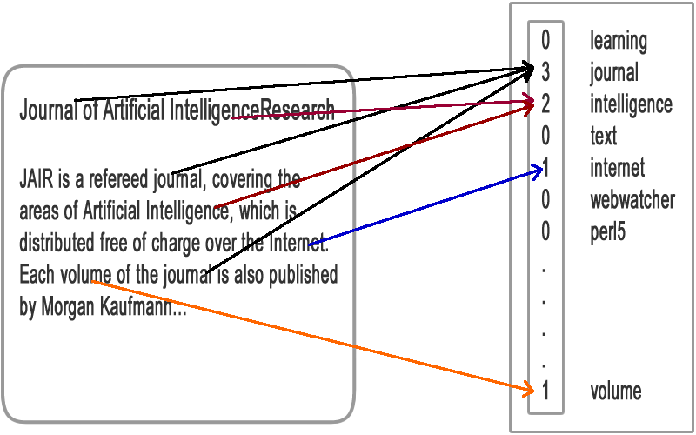
What is a text 101: bag of words

Slide 8
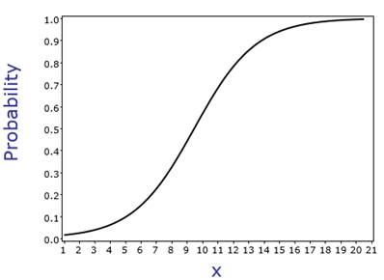
Text classification: BoW + linear
Wx +b
P(y)
Divination: How many features (approx) will such model have?

Slide 9

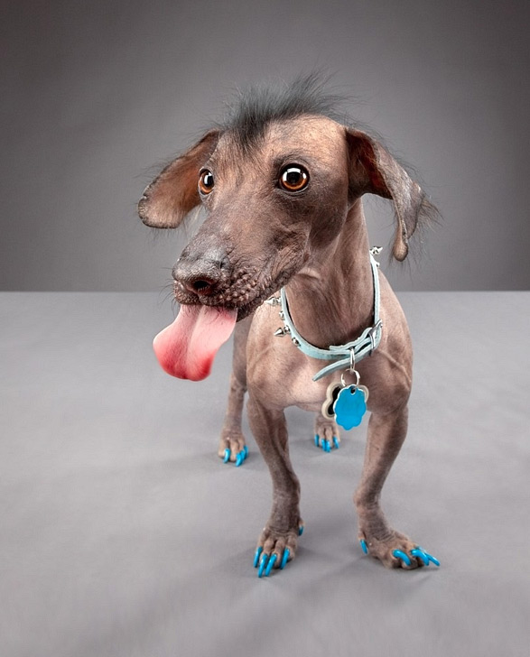
Text classification: BoW + linear
Oops... wrong slide...

Slide 10
Text classification: BoW + linear

Slide 11
Sparse vector products
0
0
0
…
0
0
1
0
0
…
0
0
“word”
(id1337)
Wx
...
Word!
text
token
1-hot
linear

Slide 12
Sparse vector products
0
0
0
…
0
0
1
0
0
…
0
0
W0
W1
W2
…
W1335
W1336
W1337
W1338
W1339
…
Wn-1
Wn
“word”
(id1337)
dot
token
1-hot
linear

Slide 13
Sparse vector products
0
0
0
…
0
0
1
0
0
…
0
0
W0
W1
W2
…
W1335
W1336
W1337
W1338
W1339
…
Wn-1
Wn
“word”
(id1337)
dot
1-hot
n tokens
token
linear

Slide 14
Sparse vector products
0
0
0
…
0
0
1
0
0
…
0
0
Wij
i = 1 … n
j = 1... h
“word”
(id1337)
dot
?
token
1-hot
n tokens
hidden layer
h units

Slide 15
Embedding
0
0
0
…
0
0
1
0
0
…
0
0
Wij
i = 1 … n
j = 1... h
W[1337,:]
“word”
(id1337)
dot
row 1337
token
1-hot
n tokens
hidden layer
h units

Slide 16
Embedding: word2vec
“Peace is a lie, there is only passion”
0
0
0
…
0
0
1
0
0
…
0
0
Wij
i = 1 … n
j = 1... h
Wjk
j = 1 … h
k = 1 ... n
0
1
0
…
1
0
0
0
1
…
1
0
passion
only
~
lie
dot
dot
is
peace
1-hot
n tokens
hidden layer
h units

Slide 17
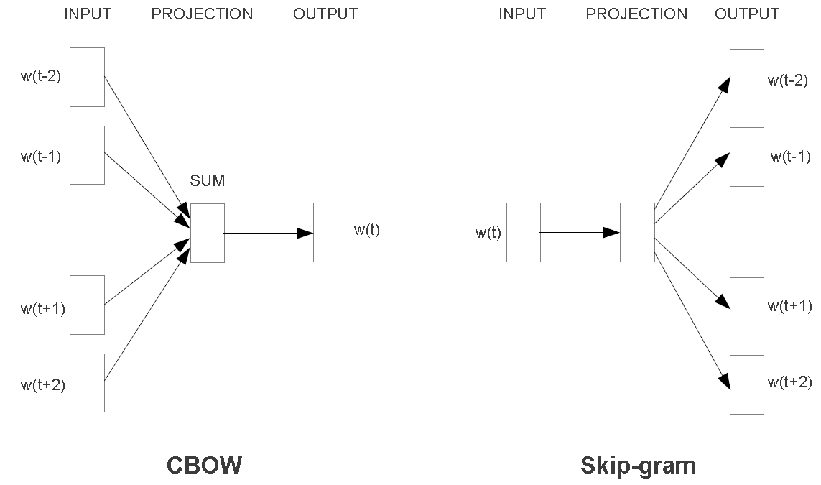
Embedding: word2vec
the distributional hypothesis : similar context = similar meaning

Slide 18
Embedding: word2vec
Side effect: synonyms
“nice” ~ “beautiful”
“hard” ~ “difficult”
Side effect: word algebra
“king” - “man” + “queen” ~ “queen”
“moscow” - “russia” + “france” ~ “paris”

Slide 19
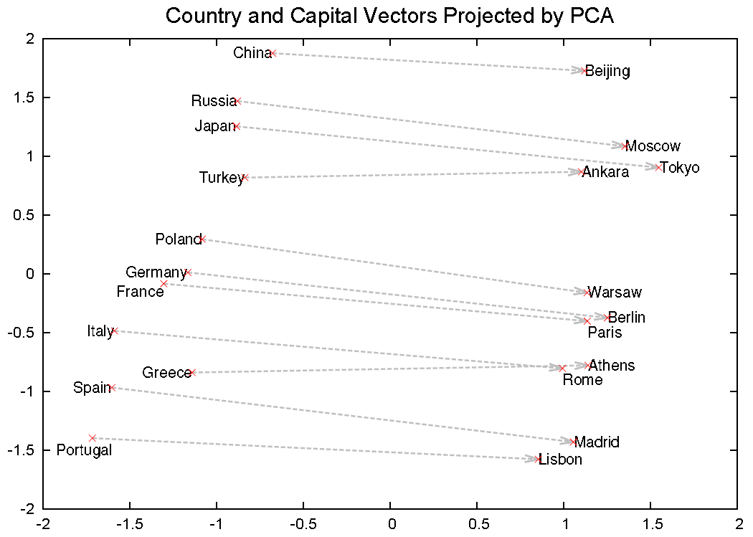
Embedding: word2vec
Side effect: word algebra

Slide 20
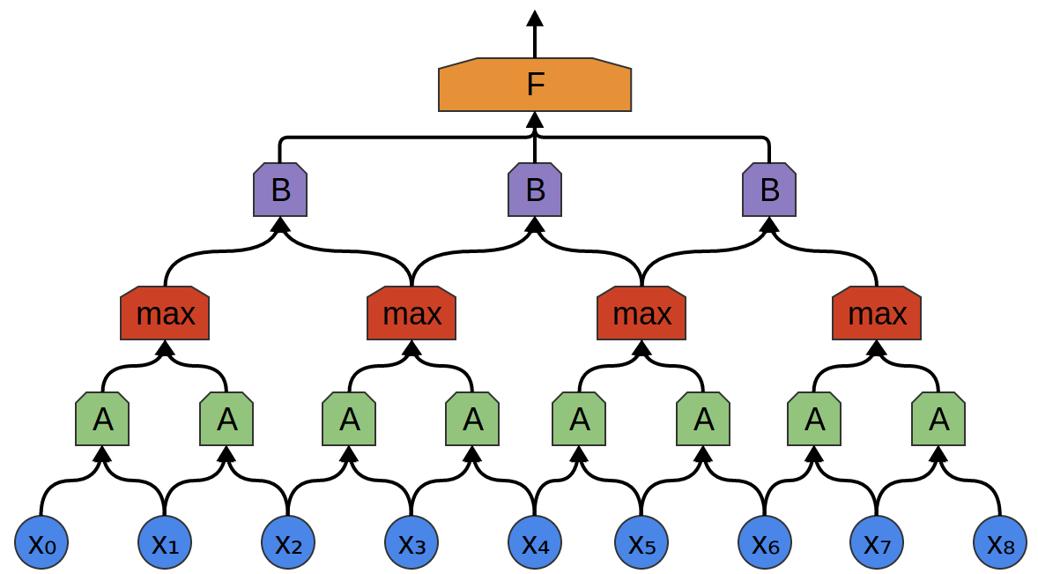
Text NN
P(y)
(n classes)
P(y)
Dense
(64)
Max
Max over time
Dense Layer
(64x3)
convolution
64x(32x2)
(32x4)
+
(32x4)
Bag of words
(sum of vectors)
(150000-size)
Max pooling size-2
(32x8)
convolution
32x(100x2)
(150000,9)
The
quick
brown
fox
jumps
over
lazy
dog
.
9 token one-hot vectors 150000-size
Pictures by colah

Slide 21
Text NN
P(y)
(n classes)
P(y)
Trivia: Can we get smaller than 1-hot vectors?
Dense
(64)
Max
Max over time
Dense Layer
(64x3)
convolution
64x(32x2)
(32x4)
+
(32x4)
Bag of words
(sum of vectors)
(150000-size)
Max pooling size-2
(32x8)
convolution
32x(100x2)
(150000,9)
The
quick
brown
fox
jumps
over
lazy
dog
.
9 token one-hot vectors 150000-size
Pictures by colah

Slide 22
Text NN
P(y)
Option 1:
Use pre-trained embedding
(e.g. glove on wikipedia)
Option 2:
Train embedding
(regular backprop)
P(y)
(n classes)
Dense
(64)
Max
Max over time
Dense Layer
(64x3)
convolution
64x(32x2)
(32x4)
+
(32x4)
Bag of words
(sum of vectors)
(100-size)
Max pooling size-2
(32x8)
convolution
32x(100x2)
(100,9)
The
quick
brown
fox
jumps
over
lazy
dog
.
9 token embedding vectors 100-size
Pictures by colah

Slide 23
Text NN
P(y)
(n classes)
P(y)
Best of both worlds:
Start with pre-trained embedding and train it
Dense
(64)
Max
Max over time
Dense Layer
(64x3)
convolution
64x(32x2)
(32x4)
+
(32x4)
Bag of words
(sum of vectors)
(100-size)
Max pooling size-2
(32x8)
convolution
32x(100x2)
(100,9)
The
quick
brown
fox
jumps
over
lazy
dog
.
9 token embedding vectors 100-size
Pictures by colah

Slide 24
Text NN
Trivia: How to change the bag of words operation to compute not
“how many such words are there”
but
“is there at least one such word”
P(y)
(n classes)
P(y)
Dense
(64)
Max
Max over time
Dense Layer
(64x3)
convolution
64x(32x2)
(32x4)
+
(32x4)
Bag of words
(sum of vectors)
(100-size)
Max pooling size-2
(32x8)
convolution
32x(100x2)
(100,9)
The
quick
brown
fox
jumps
over
lazy
dog
.
9 token embedding vectors 100-size
Pictures by colah

Slide 25
Text NN
(n classes)
P(y)
Dense
(64)
Max
Max over time
Dense Layer
(64x3)
convolution
64x(32x2)
(32x4)
max
(32x4)
Bag of words
(max)
(100-size)
Max pooling size-2
(32x8)
convolution
32x(100x2)
(100,9)
The
quick
brown
fox
jumps
over
lazy
dog
.
9 token embedding vectors 100-size
Pictures by colah

Slide 26
Text NN
Problem:
We're losing information about word order.
Use bi/trigram tokens?
Can we do better with NN?
P(y)
(n classes)
Dense
(64)
Max
Max over time
Dense Layer
(64x3)
convolution
64x(32x2)
(32x4)
max
(32x4)
Bag of words
(max)
(100-size)
Max pooling size-2
(32x8)
convolution
32x(100x2)
(100,9)
The
quick
brown
fox
jumps
over
lazy
dog
.
9 token embedding vectors 100-size
Pictures by colah

Slide 27
Text CNN
(n classes)
P(y)
Dense
(64)
Max
Max over time
(64x3)
convolution
64x(32x2)
(32x4)
(32x4)
Max pooling size-2
(32x8)
convolution
32x(100x2)
(100,9)
The
quick
brown
fox
jumps
over
lazy
dog
.
9 token embedding vectors 100-size
Pictures by colah

Slide 28
Text CNN
(n classes)
P(y)
Dense
(64)
Max
Max over time
(64x3)
convolution
64x(32x2)
(32x4)
(32x4)
Max pooling size-2
(32x8)
convolution
32x(100x2)
(100,9)
The
quick
brown
fox
jumps
over
lazy
dog
.
9 token embedding vectors 100-size
Pictures by colah

Slide 29
Text CNN
(n classes)
P(y)
Dense
(64)
Max
Max over time
(64x3)
convolution
64x(32x2)
(32x4)
(32x4)
Max pooling size-2
(32x8)
convolution
32x(100x2)
(100,9)
The
quick
brown
fox
jumps
over
lazy
dog
.
9 token embedding vectors 100-size
Pictures by colah

Slide 30
Text CNN
(n classes)
P(y)
Dense
(64)
Max
Max over time
(64x3)
convolution
64x(32x2)
(32x4)
(32x4)
Max pooling size-2
(32x8)
convolution
32x(100x2)
(100,9)
The
quick
brown
fox
jumps
over
lazy
dog
.
9 token embedding vectors 100-size
Pictures by colah

Slide 31
Text CNN
(n classes)
P(y)
Dense
(64)
Max
Max over time
(64x3)
convolution
64x(32x2)
(32x4)
(32x4)
Max pooling size-2
(32x8)
convolution
32x(100x2)
(100,9)
The
quick
brown
fox
jumps
over
lazy
dog
.
9 token embedding vectors 100-size
Pictures by colah

Slide 32
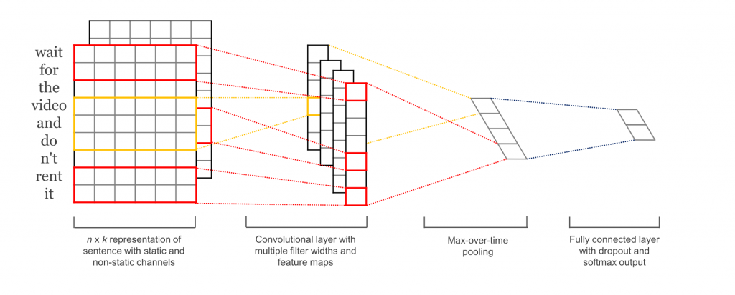
Text CNN
1-hot/emb

Slide 33
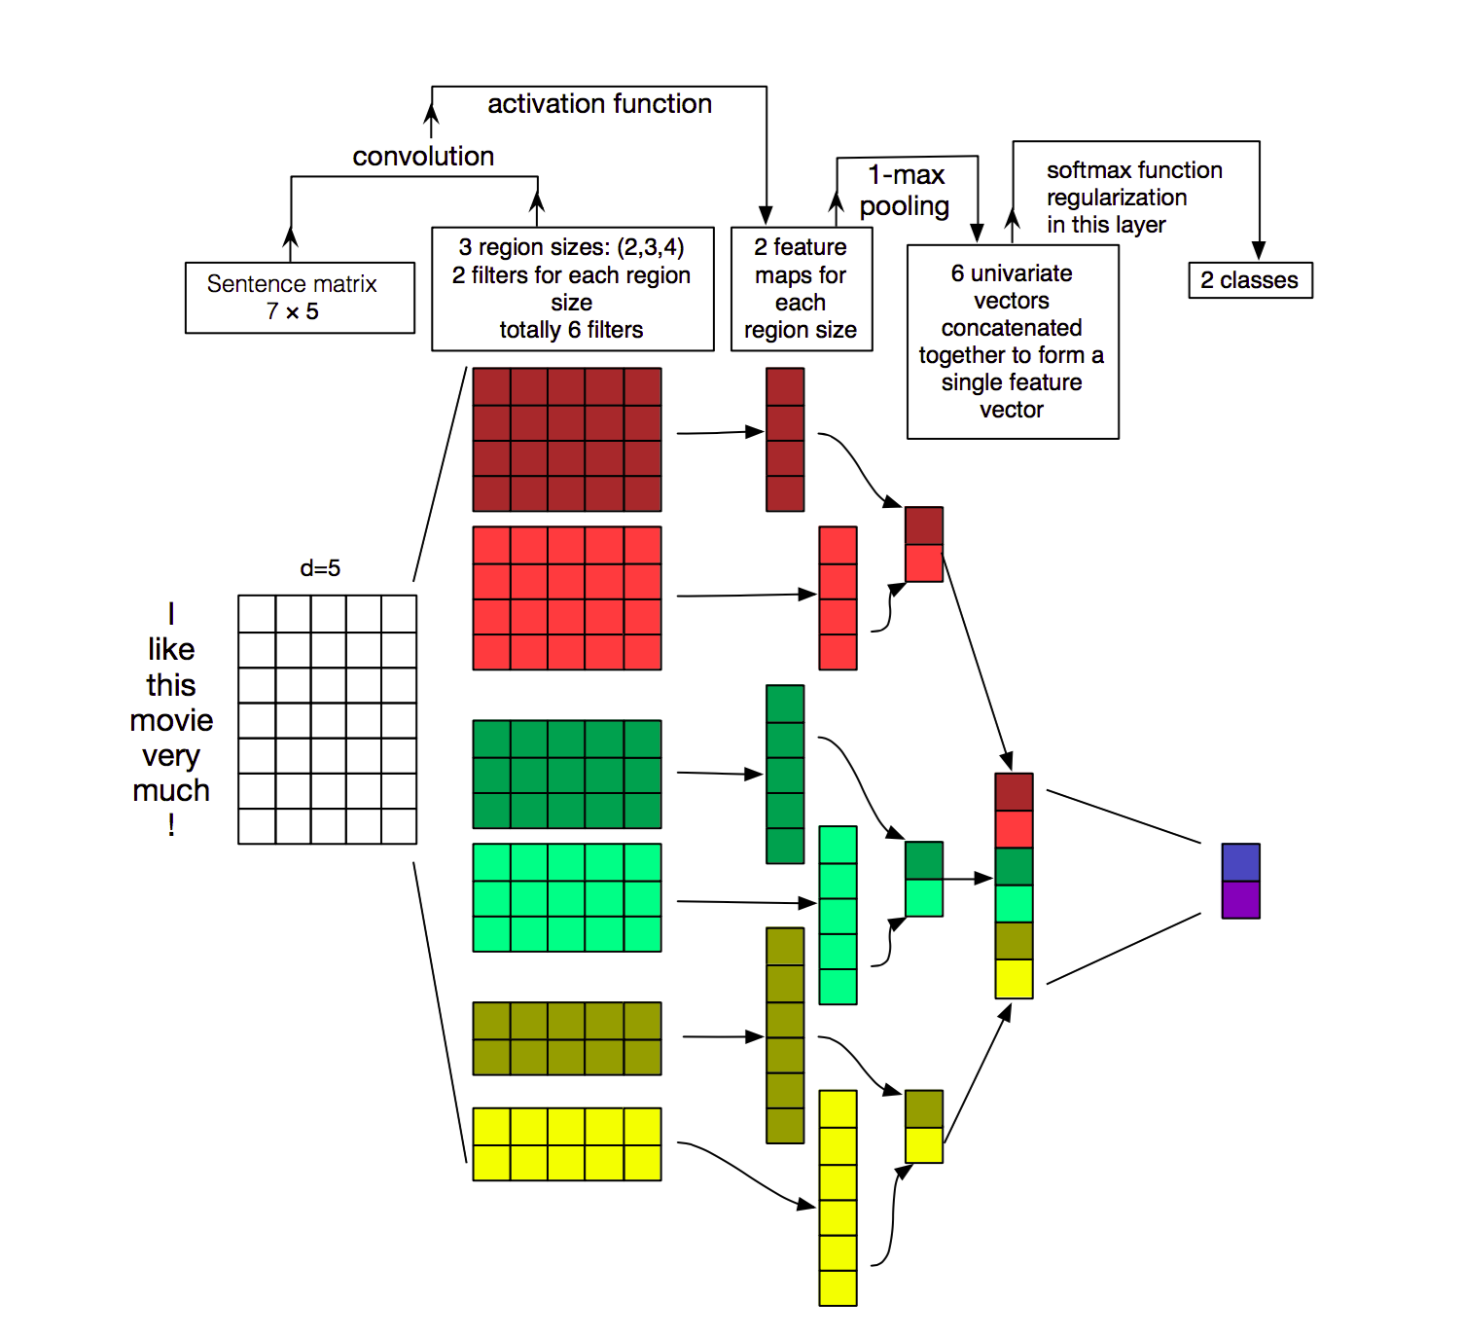
Text CNN: monsters

Slide 34
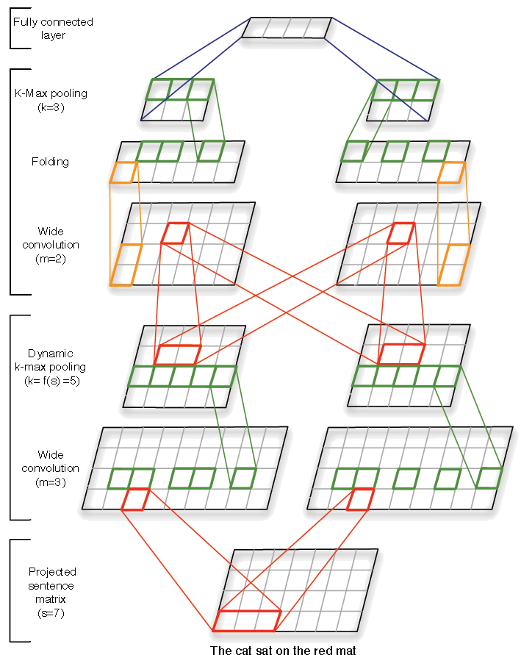
Text CNN: monsters
Dense layer
“Folding” = sum pooling along embedding direction
“K-max pooling” = take not 1 but k highest activations in their original order.
E.g. (0,1,3,2,0,1,4,1) → (3,2,4)
Wide convolution is convolution with full padding
filters
Time axis
Each word encoded with a vector (e.g. “one-hot”).
one-hot

Slide 35
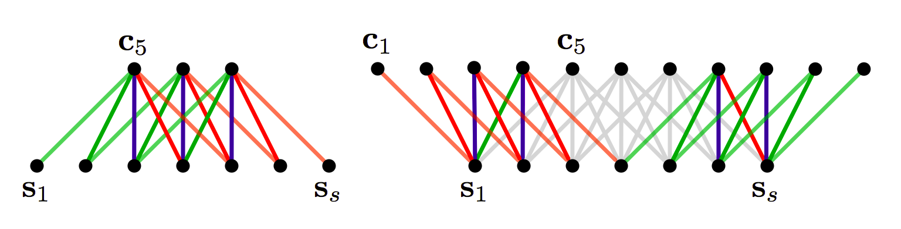
Text CNN: wide convolution
“Valid” convolution
“Wide” convolution

Slide 36
Other NLP problems
(coming soon)

Slide 37
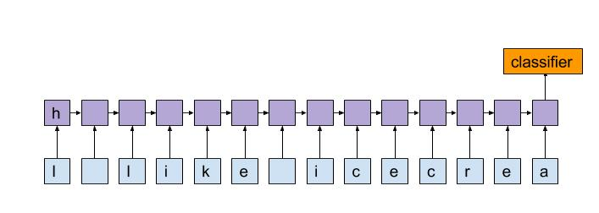
Language model

Slide 38

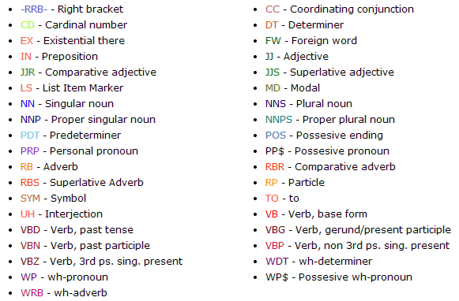
POS tagging

Slide 39
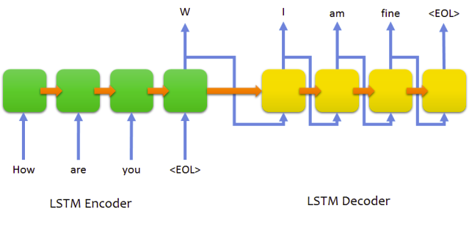
Conversation model

Slide 40
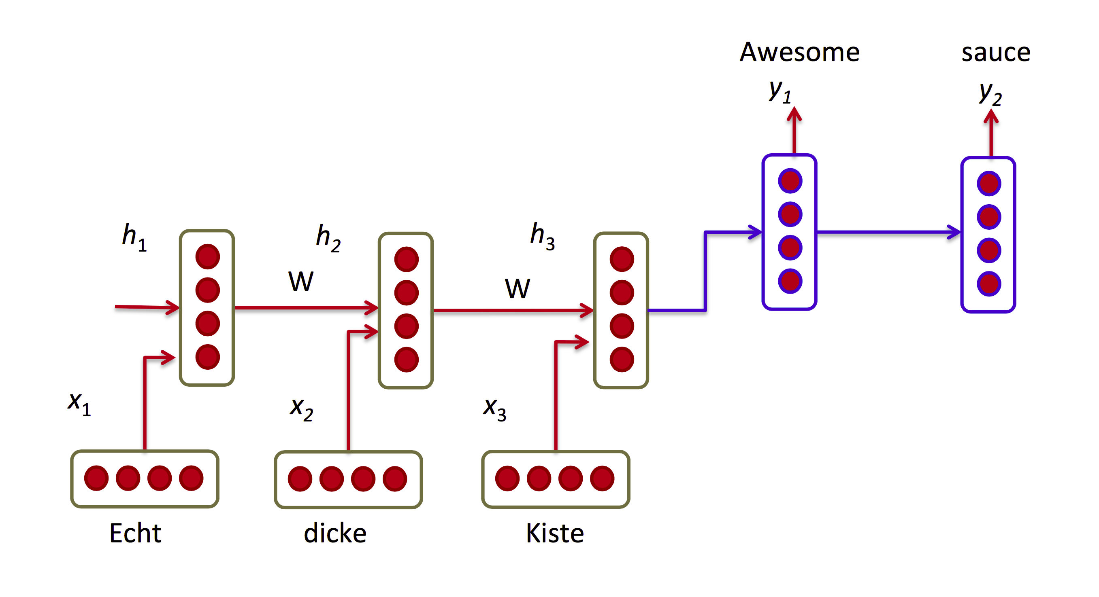
Machine translation

Slide 41
Nuff
Neural network won't write itself without you!
(except it will https://arxiv.org/abs/1511.06279 )

