Slide 1



Deep Learning
Episode 8
Generative & Unsupervised models

Slide 2
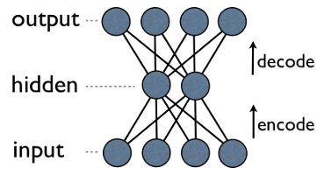
Autoencoders 101
Main idea:
Take data in some original (high-dimensional) space;
Project data into a new space from which it can then be accurately restored;
Encoder = data to hidden
Decoder = hidden to data
Decoder(Encoder(x)) ~ x

Slide 3
Why do we ever need that?
Compress data
  |code| << |data|
Dimensionality reduction
  Before feeding data to your XGBoost
<to be continued>

Slide 4
Matrix decompositions
Example: SVD/PCA
Minimizing reconstruction error
X
U
S
V^{T}
=

Slide 5
Matrix decomposition
A different perspective
X
Decoder
Data
D units
Dense
(linear)
D units
Encoder
Dense
(linear)
H units
MSE
H << D

Slide 6
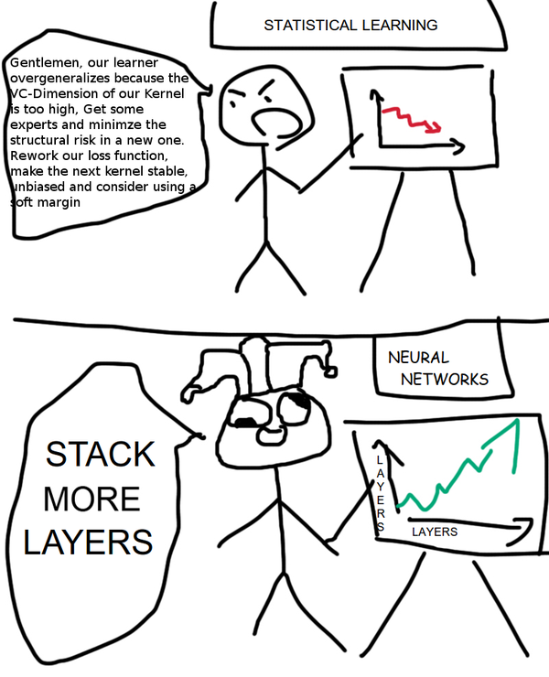

Slide 7
(kinda) Deep autoencoder
Stack more layers!
X
Data
D units
Encoder
Decoder
Dense
D units
Dense
Dense
Dense
MSE
H << D
Quiz: What if data is an image?

Slide 8
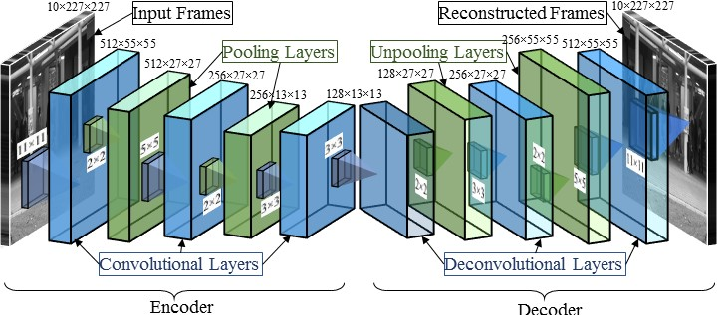
Image2image: fully-convolutional
Quiz: what is the compression rate here?

Slide 9
Why do we ever need that?
Compress data
  |code| << |data|
Dimensionality reduction
  Before feeding data to your XGBoost
Learn some great features!
  Before feeding data to your XGBoost

Slide 10
Expanding autoencoder
Bigger/richer representation
Encoder
Decoder
Dense
Dense
X
Dense
Dense
D units
Data
D units
MSE
H > D

Slide 11
Expanding autoencoder
Bigger/richer representation
Encoder
Decoder
Dense
Dense
X
Dense
Dense
D units
Data
D units
MSE
H > D
Something's wrong with this guy. Ideas?

Slide 12
Expanding autoencoder
Naive approach will learn identity function!
Gotta regularize!
X
Encoder
Decoder
Data
D units
MSE

Slide 13
Sparse autoencoder
Naive approach will learn identity function!
Idea 1: L1 on activations, sparse code
L1
X
Encoder
Decoder
Data
D units
MSE

Slide 14
Redundant autoencoder
Naive approach will learn identity function!
Idea 2: noize/dropout, redundant code
X
Encoder
Decoder
Data
D units
Dropout
/ noize
MSE

Slide 15
Denoizing autoencoder
Naive approach will learn identity function!
Idea 3: distort input, learn to undo distorsion
X
Encoder
Decoder
Data
D units
Dropout
/ noize
MSE

Slide 16
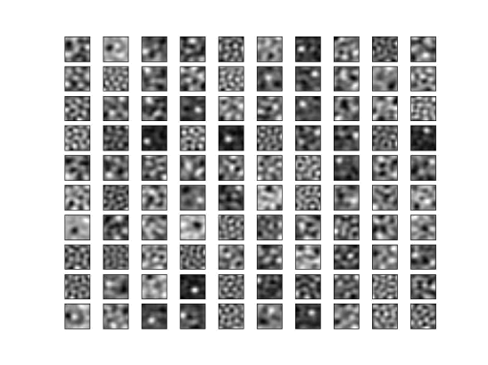
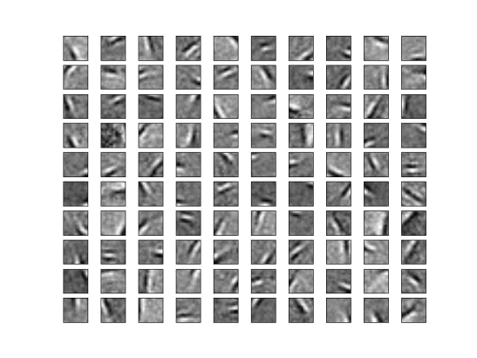
Sparse Vs Denoizing
Filter weights, 12x12 patches
Actually meaningless :)
Sparse AE
Denoizing AE
[Vincent et al. 2010]

Slide 17
Why do we ever need that?
Compress data
  |code| << |data|
Dimensionality reduction
  Before feeding data to your XGBoost
Learn some great features!
Unsupervised pretraining
  Large amounts of data
  Features may be irrelevant

Slide 18
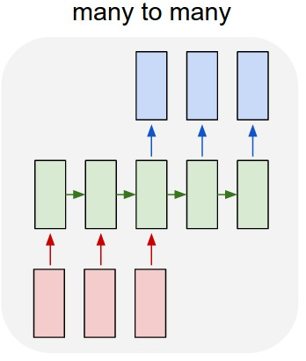
Recurrent autoencoders
Regular encoder-decoder
Where is the bottleneck?
How do we train it?

Slide 19
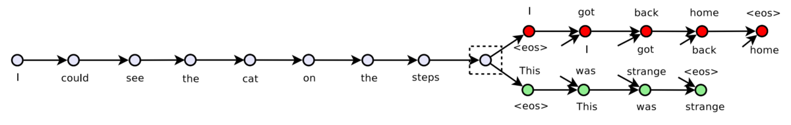
Skip-thought
Word2vec skip-gram:
  Word → neighboring words
  Embedding + Dense
  Word vectors
Phrase2vec skip-thought:
  Sentence → prev/next sentence
  Encoder-decoder
  Sentence vectors

Slide 20
Why do we ever need that?
Compress data
  |code| << |data|
Dimensionality reduction
  Before feeding data to your XGBoost
Learn some great features!
Unsupervised pretraining
  Large amounts of data
  Features may be irrelevant
Generating new images!

Slide 21
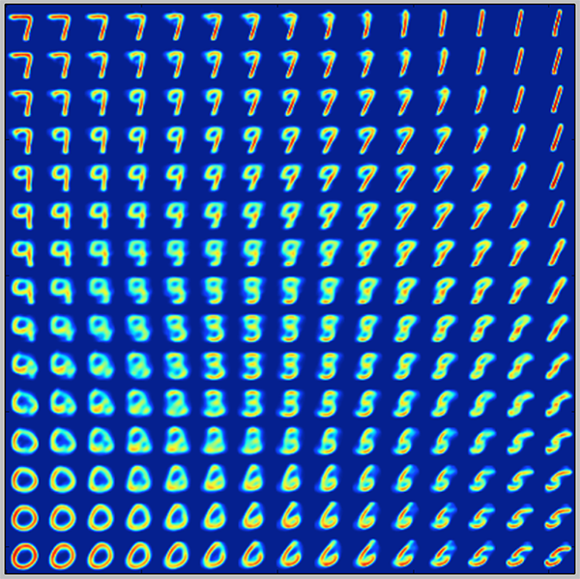
Image morphing with AE
Idea:
If Enc(image1) = c1
Enc(image2) = c2
Than maybe (c1+c2)/2 is a semantic average of the two images

Slide 22
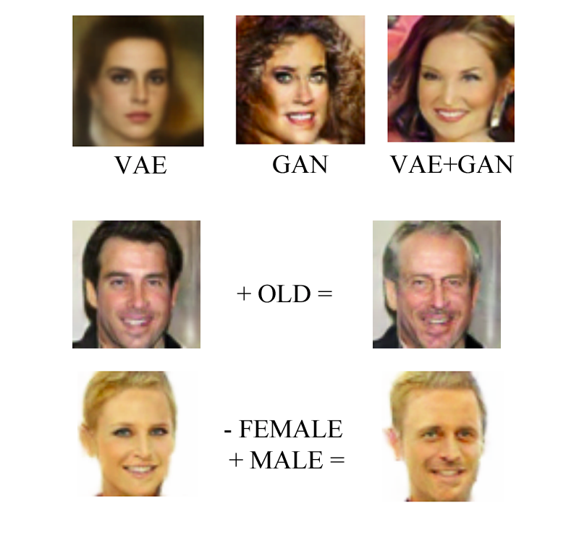
Image morphing with AE
Idea:
Look for a common direction vector for
“add mustache” or “add age” changes.
Apply to new images

Slide 23
Mean Squared Error
Pixelwise MSE:
A “cat on the left” is closer to “dog on the left” than to “cat on the right”
We may want to avoid that effect
Can we obtain image representation that is less sensitive to small shifts?

Slide 24
Sketch: using pre-trained nets
X
Encoder
Decoder
Data
D units
AlexNet
(pretrained)
AlexNet
(pretrained)
MSE

Slide 25

Image generation
Chairs (type, view, orientation)
Classifier
P(y|x)

Slide 26
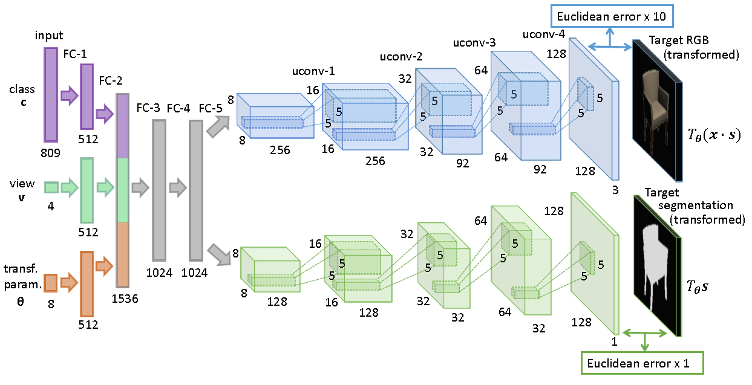
Image generation
Generator

Slide 27
Problem: MSE sucks at this task.
Ideas?

Slide 28
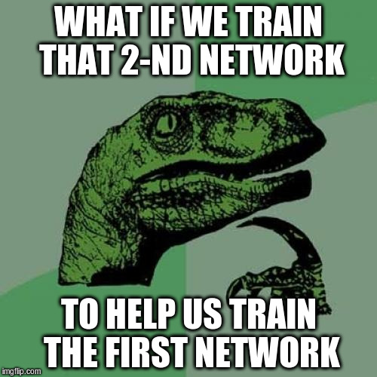

Slide 29
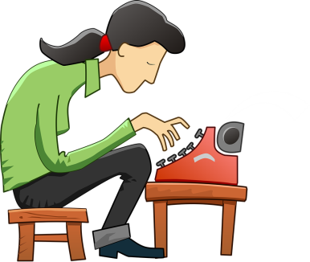
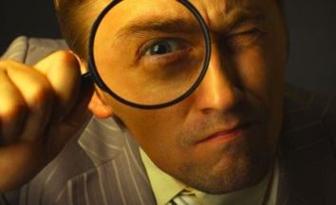
Generative Adversatial Networks
Generator
Discriminator
content
feedback
Generate image
(should be plausible)
Tell if image is plausible
(image) → P(fake)

Slide 30
Generative Adversarial Networks
Generator
Discriminator
Image
Fake
Image
Noize
/params
NN
Image
(fake/real)
Other NN
P(fake|image)

Slide 31
Generative Adversarial Networks
Generator
Discriminator
Image
Fake
Image
Noize
/params
Gen(seed)
Image
(fake/real)
Disc(x)
P(fake|image)

Slide 32
Generative Adversarial Networks
Generator
Discriminator
Image
Fake
Image
Noize
/params
Gen(seed)
Image
(fake/real)
Disc(x)
P(fake|image)

Slide 33
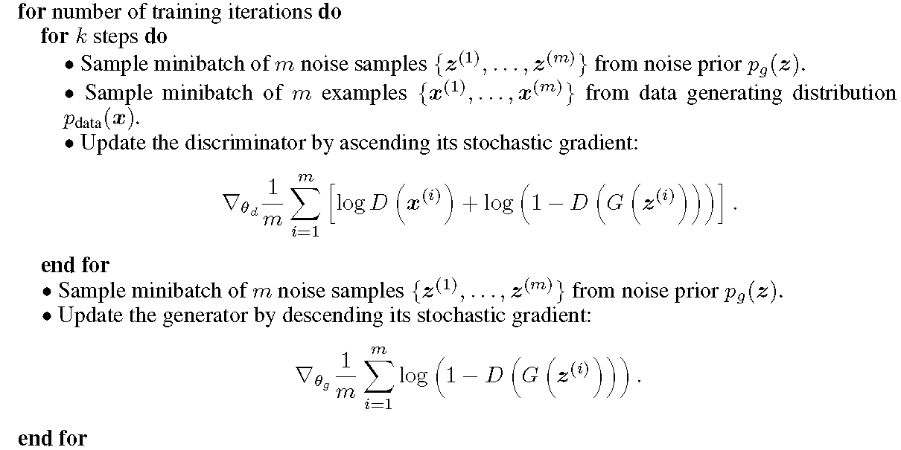
Generative Adversarial Networks

Slide 34
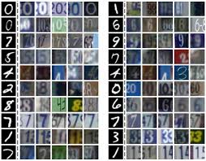
Adversarial domain adaptation
Two domains
  e.g. mnist digits Vs actual digits on photos
First domain is labeled, second is not
Wanna learn for the second domain

Slide 35
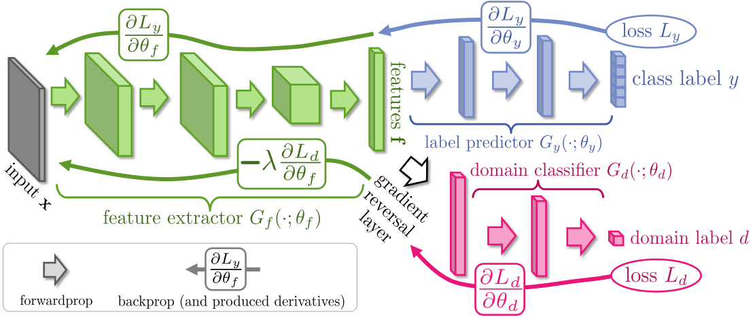
Domain adaptation
Idea: discriminator should not be able to distinguish features on two domains

Slide 36
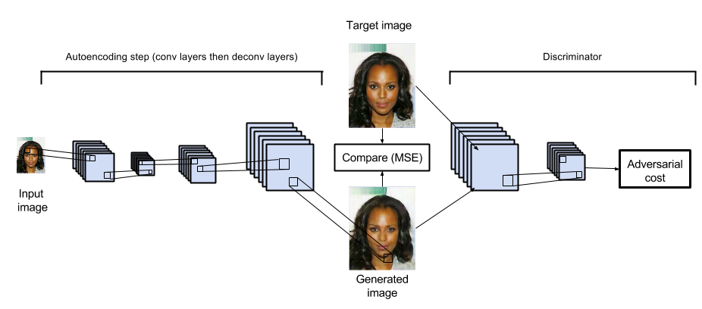
Adversarial autoencoders

Slide 37

Brace yourselves

Slide 38
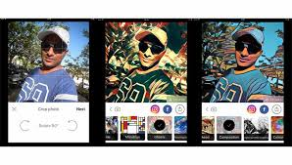
Art style transfer
Ideas?

