Slide 1



Deep Learning
Episode 4
Recurrent Neural Networks

Slide 2

Sequential data
Time series
  Financial data analysis
  Demand prediction
  Predict vehicle breakdown
    using sensor data
  Medical sensors
    e.g. sugar level
Sound
  Speech recognition
  Text to speech
  Music generation
  Music recommendation
  …
Text
  Generating tweets, poetry
  Sentiment analysis
  See last lecture :)
Spatio-temporal
  Video
  Precipitation maps
  Ultrasonography
  Could go on all day

Slide 3
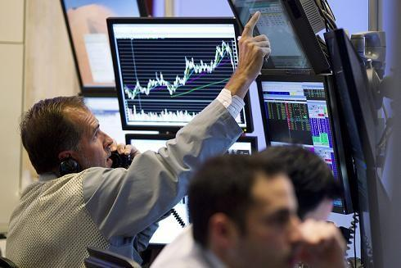
Time series @finance
Data:
  Stock indices indexes
  Commodities
  Forex
Objectives:
  Portfolio management
  Volatility targeting
  Estimating true value
  ...

Slide 4
Time series @finance
Data:
  Stock indices indexes
  Commodities
  Forex
Objectives:
  Portfolio management
  Volatility targeting
  Estimating true value
  ~ trading stuff
  ~ evaluating risk
  ...

Slide 5
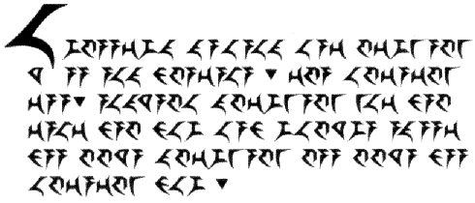
Natural language as time series
Data:
  Literature
  Conversation
  Tweets
  Book scans
  Speech

Slide 6
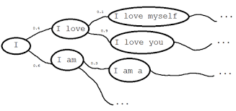
Language model
Objective:
    Learn P(text)

Slide 7
Language model
Why learning it?
    Detect languages as P(text|language)
    Sentiment analysis P(text|happy)
    Any text analysis you can imagine
    Generate texts!
      Cool article http://bit.ly/1K610Ie
      Generating clickbait: http://bit.ly/21cZM70

Slide 8
Language model
    Actual distribution
    Bag of words assumption (independent words)
    Anything better?

Slide 9
Language model
    Actual distribution
    Bag of words assumption (independent words)
    Markov assumption
      also 3-gram, 5-gram, 100-gram

Slide 10
Can we learn* arbitrarily long dependencies?
* without infinitely many parameters

Slide 11
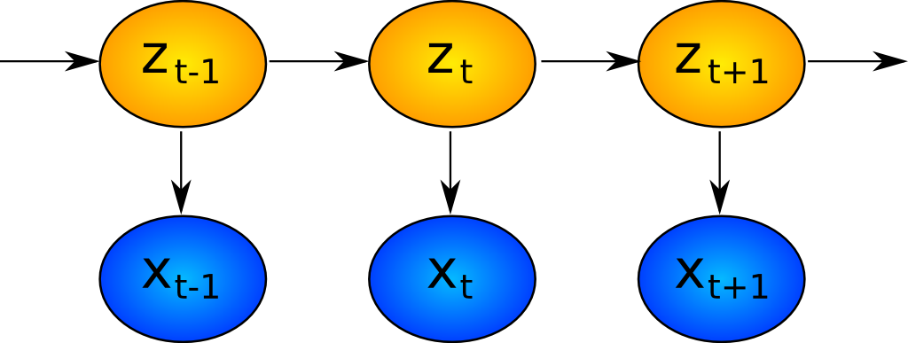
Hidden Markov Models: what is hidden
Hidden
Observed

Slide 12
Hidden Markov Models: what is hidden
Author's brain state
Hidden
Observed
Words

Slide 13
Recurrent neural network: one step
output
Elementwise
Wx+b
H units
+
sigmoid
Last
State
New
state
Wx+b
H units
time
Input at
This tick

Slide 14
Recurrent neural network
Zoom-out
of previous slide

Slide 15
Recurrent neural network
P(next)
t0=”the”
t1=”cat”
t2=”sat”
t3=”on”
How can we represent words?

Slide 16
Recurrent neural network
P(next)
h0
h1
h1
h2
h3
embed
embed
embed
embed
t0=”the”
t1=”cat”
t2=”sat”
t3=”on”

Slide 17
Recurrent neural network
P(next)
h0
h1
h1
h2
h3
embed
embed
embed
embed
t0=”the”
t1=”cat”
t2=”sat”
t3=”on”

Slide 18
Recurrent neural network
P(next)
h0
h1
h1
h2
h3
embed
embed
embed
embed
t0=”the”
t1=”cat”
t2=”sat”
t3=”on”

Slide 19
Recurrent neural network
P(next)
embed
embed
embed
embed
t0=”the”
t1=”cat”
t2=”sat”
t3=”on”

Slide 20
Recurrent neural network
Loss
P(next)
...
embed
embed
embed
embed
W0=”the”
W1=”cat”
W2=”sat”
W3=”on”

Slide 21
Recurrent neural network
Loss
How do we train it?
P(next)
...
embed
embed
embed
embed
W0=”the”
W1=”cat”
W2=”sat”
W3=”on”

Slide 22
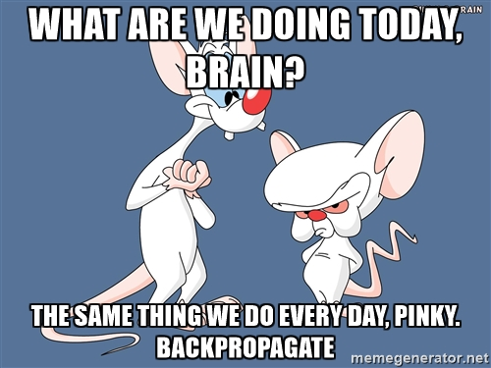

Slide 23

Backpropagation through time
Loss
Chain rule
unroll
P(next)
...
embed
embed
embed
embed
W0=”the”
W1=”cat”
W2=”sat”
W3=”on”

Slide 24

Truncated BPTT
Reality: roll for T steps, then truncate
(T=10? 20? 1000?)
Loss
Chain rule
unroll
P(next)
...
embed
embed
embed
embed
W0=”the”
W1=”cat”
W2=”sat”
W3=”on”

Slide 25
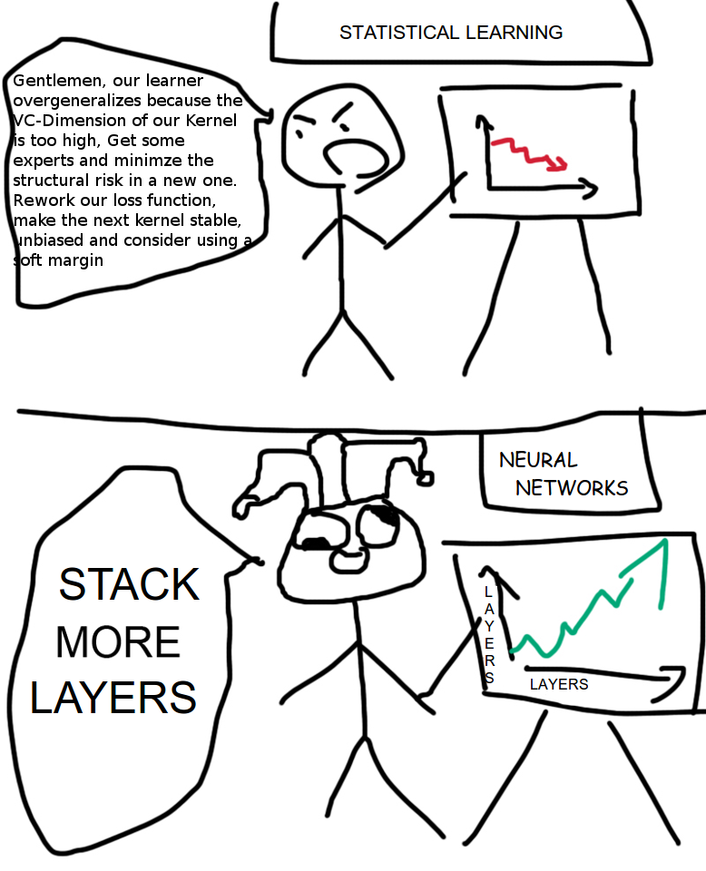

Slide 26
What is layer, again?
W1
W2
W3
W4
embed
embed
embed
embed
W0=”the”
W1=”cat”
W2=”sat”
W3=”on”

Slide 27
Layers
Where to stick more layers?
Dense
(softmax)
W1
W2
W3
W4
RNN
embed
embed
embed
embed
Embedding
Input
W0=”the”
W1=”cat”
W2=”sat”
W3=”on”

Slide 28
More layers
Dense
(softmax)
W1
W2
W3
W4
RNN 2
RNN 1
embed
embed
embed
embed
Embedding
Input
W0=”the”
W1=”cat”
W2=”sat”
W3=”on”

Slide 29
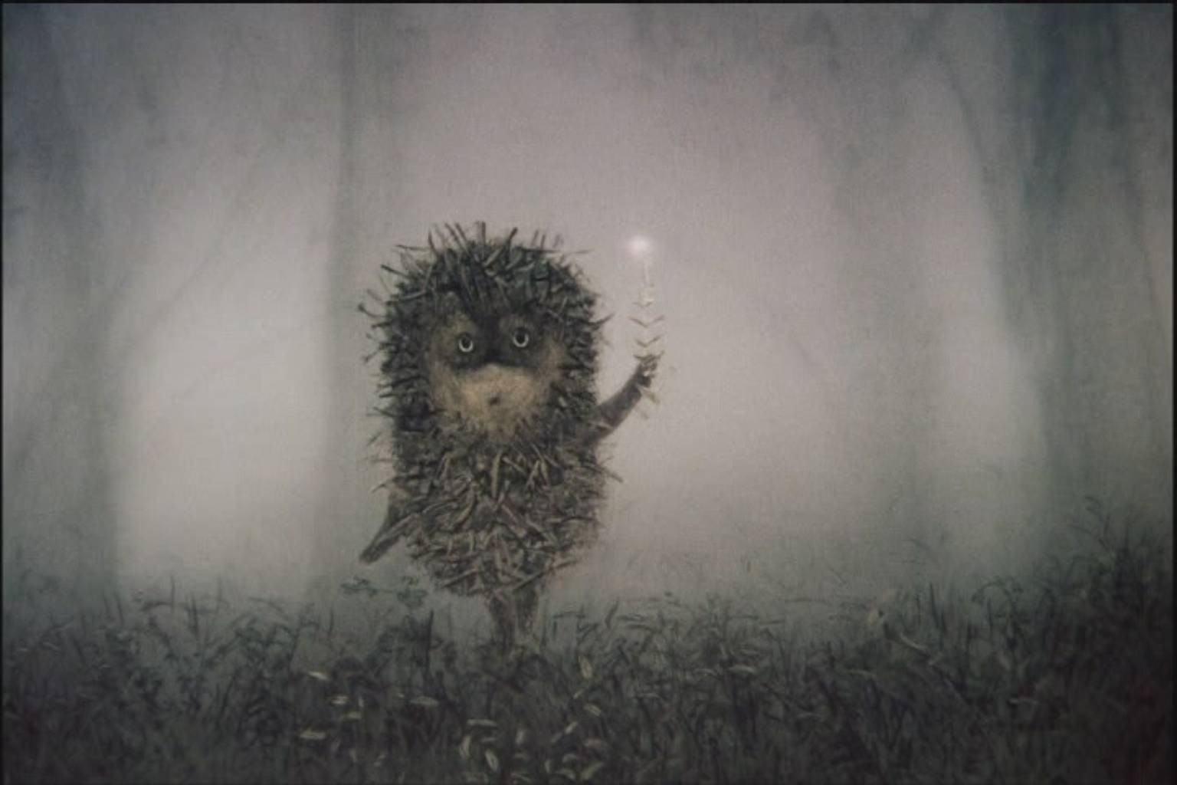
Too f**king complicated
Dense
(softmax)
W1
W2
W3
W4
RNN 2
RNN 1
embed
embed
embed
embed
Embedding
Input
W0=”the”
W1=”cat”
W2=”sat”
W3=”on”

Slide 30
2-layer RNN
Dense
(softmax)
W1
W2
W3
W4
RNN 2
RNN 1
embed
embed
embed
embed
Embedding
Input
W0=”the”
W1=”cat”
W2=”sat”
W3=”on”

Slide 31
BPTT again
Dense
(softmax)
W1
W2
W3
W4
RNN 2
RNN 1
embed
embed
embed
embed
Embedding
Chain rule
unroll
Input
W0=”the”
W1=”cat”
W2=”sat”
W3=”on”

Slide 32
BPTT Again
Loss
?!
P(next)
Chain rule
unroll
embed
embed
embed
embed
W0=”the”
W1=”cat”
W2=”sat”
W3=”on”

Slide 33
BPTT Again
Loss
P(next)
Chain rule
unroll
embed
embed
embed
embed
W0=”the”
W1=”cat”
W2=”sat”
W3=”on”

Slide 34
BPTT Again
Loss
P(next)
Chain rule
unroll
embed
embed
embed
embed
W0=”the”
W1=”cat”
W2=”sat”
W3=”on”

Slide 35
BPTT Again
Loss
Your guess?
P(next)
Chain rule
unroll
embed
embed
embed
embed
W0=”the”
W1=”cat”
W2=”sat”
W3=”on”

Slide 36
BPTT Again
Loss
P(next)
Chain rule
unroll
embed
embed
embed
embed
W0=”the”
W1=”cat”
W2=”sat”
W3=”on”

Slide 37
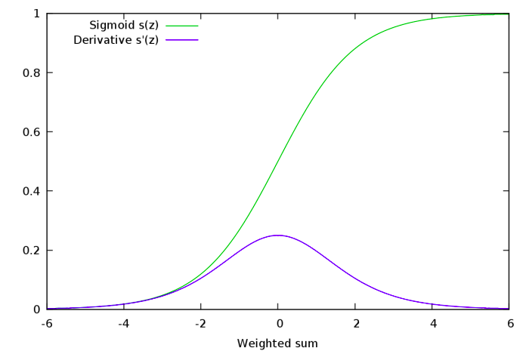
Gradient explosion and vanishing
Many sigmoids near 0 or 1
  Gradients → 0
  Not training for long-term dependencies
Many nonzero values
  Derivative stacks to >1
  Gradients → inf
  Weights → shit

Slide 38
RNN step
Elementwise
Wx+b
H units
+
Nonline-
arity
Last
State
New
state
Wx+b
H units
time
Input at
This tick

Slide 39
RNN step
Elementwise
Wx+b
H units
+
Tanh
Last
State
New
state
Wx+b
H units
time
Input at
This tick

Slide 40
Residual RNN step
Elementwise
+
New
state
Last
State
Elementwise
Wx+b
H units
+
Tanh
Wx+b
H units
time
Input at
This tick

Slide 41
Residual RNN step
Elementwise
+
New
state
Last
State
Elementwise
Wx+b
H units
+
Tanh
Difference:
Preserving information through time is now effortless.
Gradients do not vanish.
Much harder to get rid of something (reset cell to zero) when you need to do so.
Wx+b
H units
Chain rule
unroll
time
Input at
This tick

Slide 42
Residual RNN step
Elementwise
+
New
state
Last
State
Elementwise
Wx+b
H units
+
Tanh
Wx+b
H units
Update
time
Input at
This tick

Slide 43
Residual RNN step
Elementwise
+
New
state
Last
State
Update
time
Input at
This tick

Slide 44
Residual RNN step
Elementwise
+
New
state
Last
State
Update
time
Input at
This tick

Slide 45
Residual RNN step
Elementwise
mul
Elementwise
+
New
state
Last
State
sigm
Wx+b
Update
Trivia:
What should the new Wx+b be equivalent to previous slide RNN?
How can it fully erase the memory?
time
Input at
This tick

Slide 46
Residual RNN step
Elementwise
mul
Elementwise
+
New
state
Last
State
sigm
forget
gate
Wx+b
Update
Note: If at some tick we killed h while we needed them later, the gradient will cause forgetgate to “open”
time
Input at
This tick

Slide 47
What we drew

Slide 48
What we drew

Slide 49
What we drew

Slide 50
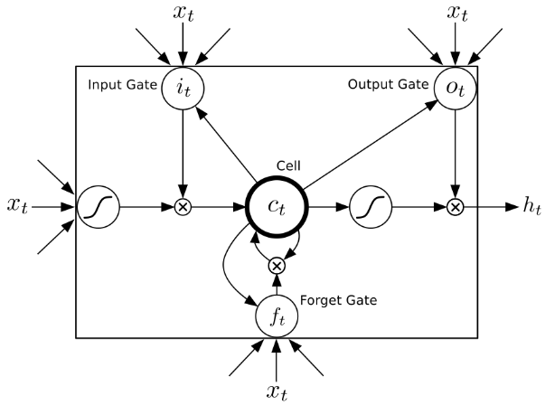
LSTM
2 hidden states:
Cell (“private” state)
Output (“public” state)
4 blocks:
Update
Forget gate
Input gate
Output gate

Slide 51
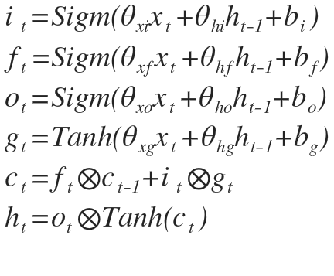
LSTM
Life is to short to draw full sheme

Slide 52

GRU

Slide 53
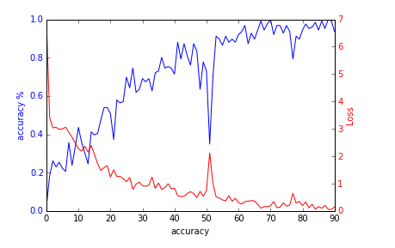
Okay, the gradients no longer vanish
except they still do
But how do we deal with exploding grads?
Ideas?

Slide 54
Gradient clipping
At each time tick,
  check if grad abs value is more than … 5?
  If so, clip it
      large positive is now 5,
      large negative -5
  How large is too large?
    Reduce clipping threshold until explosions disappear

Slide 55
Generating stuff
Easy:
  Names, small phrases
  Orthographically correct delirium
Medium:
  Grammatically coherent text
  Resembling particular author
Hard:
  C/C++ source code
  Music
  LaTex articles
  Your course projects

Slide 56
Nuff
Let's teach this network good manners!

Slide 57
Nuff
Let's teach this network good manners!

