Slide 1



Reinforcement learning
Episode 1
Temporal Difference

Slide 2

Recap: reinforcement learning
Agent
Can do anything
observation
action
Can't even see
(worst case)
Environment

Slide 3
Monte-carlo methods
R(z) – evaluated at the very end
Metaheuristics (genetic algorithm, etc.)
Stochastic optimization (crossentropy method)

Slide 4

Monte-carlo: drawbacks
Both need a full session to start learning
Requires a lot of interaction
  A lot of crashed robots / simulations

Slide 5

MDP formalism: reward on each tick
Classic MDP(Markov Decision Process)
Agent interacts with environment
  Environment states:
  Agent actions:
  State transition:
  Reward:

Slide 6

Discounted reward MDP
Objective:
  Total action value
γ ~ patience
Cake tomorrow is γ as good as now
Reinforcement learning:
  Find policy that maximizes
    the expected reward

Slide 7
Discounted reward MDP
Objective:
  Total action value
Trivia: which γ corresponds to
“only current reward matters”?
Reinforcement learning:
  Find policy that maximizes
    the expected reward

Slide 8
Discounted reward MDP
Objective:
  Total reward
Reinforcement learning:
  Find policy that maximizes
    the expected reward
Is optimal policy same as it would be
in monte-carlo (if we add-up all r_t)?

Slide 9

Optimal policy
Recurrent optimal strategy definition

Slide 10
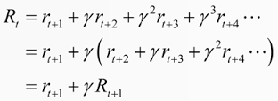
Optimal policy
We rewrite R with sheer power of math!

Slide 11
Value iteration (Temporal Difference)
Idea:
  For each state, obtain V(state)
  Definition V(s) – expected total reward R that can be obtained starting from state s under optimal policy

Slide 12
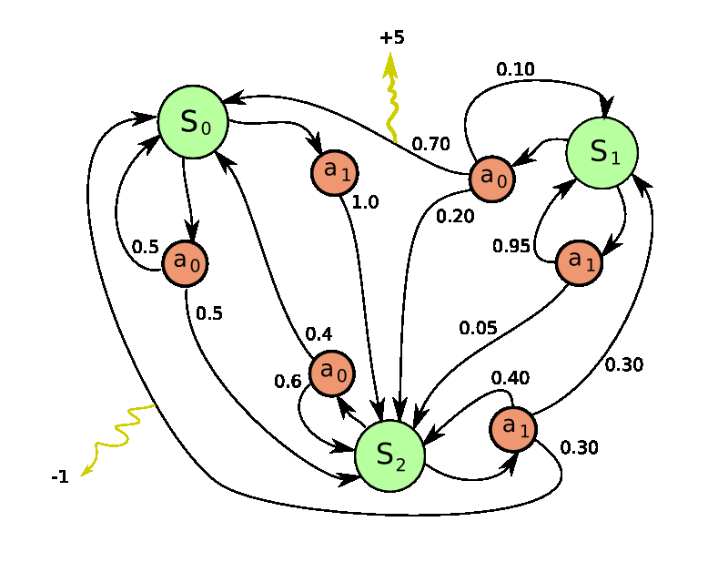
Value iteration (Temporal Difference)
Idea:
  For each state, obtain V(state)
  Stochastic action outcome
  Trivia: if we know the exact V(s) for all states,
    how do we determine the best actions?

Slide 13
Value iteration (TD)
Idea:
  Iterative updates

Slide 14

Value iteration (TD)
Idea:
  Iterative updates
0
0
0
0
0
0
0
0
0

Slide 15
Value iteration (TD)
Idea:
  Iterative updates
0
0
γ
0
0
0
0
0
0

Slide 16
Value iteration (TD)
Idea:
  Iterative updates
0
γ²
γ
0
γ²
0
0
0
0

Slide 17
Value iteration (TD)
Idea:
  Iterative updates
γ³
γ²
γ
γ⁴
γ²
γ⁵
γ⁴
γ³
γ⁴

Slide 18

Value iteration (TD)
Idea:
  Iterative updates

Slide 19
Voila! We've solved the reinforcement learning!

Slide 20
Voila! We've solved the reinforcement learning!
Or have we?
  What happens if we apply it to real world problems?

Slide 21



Reality check: web
Cases:
    Pick ads to maximize profit
    Design landing page to maximize user retention
    Recommend items to users
Common traits:
    Independent states
    Large action space

Slide 22




Reality check: dynamic systems

Slide 23

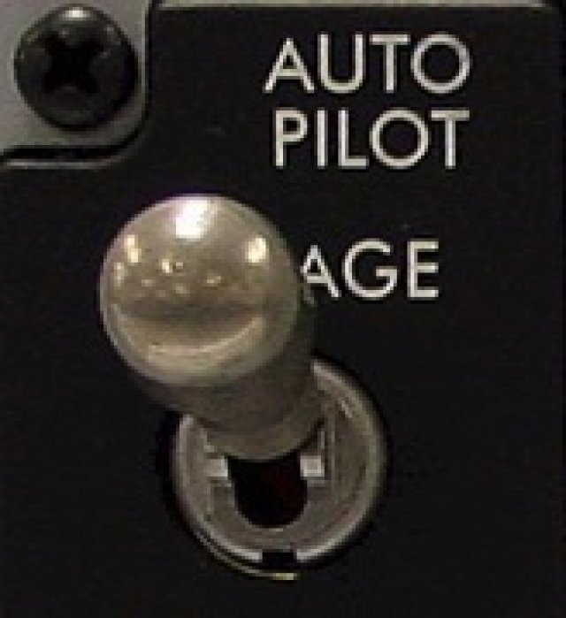
Reality check: MOAR
Cases:
    Robots
    Self-driving vehicles
    Pilot assistant
    More robots!
Common traits:
  Continuous state space
  Continuous action space
  Partially-observable environment
  LONG sessions

Slide 24




Reality check: videogames
  Trivia: What are the states and actions?
          What are the problems?

Slide 25
Real world
observe
Agent
apply
action
Observation
action
?!
We never know exactly
how it works

Slide 26
Real world
observe
Agent
apply
action
Large?
Conti-nuous?
Partial?
~Infinite?
Observation
action
?!
We never know exactly
how it works

Slide 27
Problem:
We never know actual
P(s'|s,a)
Learn it?
Get rid of it?

Slide 28
From V to Q
One approach:
action Q-values
Action value Q(s,a) is the expected total reward R agent gets from state s by taking action a and following policy π from next state.

Slide 29
From V to Q
One approach:
action Q-values
Action value Q(s,a) is the expected total reward R agent gets from state s by taking action a and following policy π from next state.

Slide 30
From V to Q
One approach:
action Q-values
Action value Q(s,a) is the expected total reward R agent gets from state s by taking action a and following policy π from next state.

Slide 31
From V to Q
One approach:
action Q-values
We can replace
P(s' | s,a)
with sampling

Slide 32

Exploration Vs Exploitation
Balance between using what you learned and trying to find something even better

Slide 33
Exploration Vs Exploitation
Strategies:
    ε-greedy
        With probability ε take a uniformly random action; otherwise take optimal action.
    Softmax
        Pick action proportional to softmax of shifted normalized Q-values.
    Some methods have a built-in
        exploration strategy (e.g. A2c)

Slide 34
Problem:
State space is usually large,
sometimes continuous.
              And so is action space;
However, states do have a structure, similar states have similar action outcomes.

Slide 35
From tables to approximations
Before:
  For all states, for all actions, remember Q(s,a)
Now:
  Approximate Q(s,a) with some function
  e.g. linear model over state features

Slide 36

Smells like a neural network

Slide 37

Not so fast...

Slide 38
Discounted reward MDP
Objective:
  Total reward
Reinforcement learning:
  Find policy that maximizes
    the expected reward
Optimal policy isn't always maximizing
monte-carlo reward!

Slide 39
Discounted reward fails #1
s0
Trivial example:
r=1
s1
s2
terminal state
s3
...
What path will agent choose?
    γ=0.9
    arrows = actions
    game ends at s1 or s100
r=10
s100
terminal state

Slide 40
Discounted reward fails #1
s0
Trivial example:
r=1
s1
s2
terminal state
s3
...
What path will agent choose?
    γ=0.9
    arrows = actions
    game ends at s1 or s100
    left action has higher R!
r=10
s100
terminal state

Slide 41

Discounted reward fails #2
Deephack'17 qualification round, Atari Skiing
You steer the red guy
Session lasts ~5k steps
You get -3~-7 reward each tick
(faster game = better score)
At the end of session, you get up to r=-30k
(based on passing gates, etc.)
Q-learning with gamma=0.99 fails
it doesn't learn to pass gates
What's the problem?
http://rl.deephack.me/

Slide 42
Discounted reward fails #2
Deephack'17 qualification round, Atari Skiing
You steer the red guy
Session lasts ~5k steps
You get -3~-7 reward each tick
(faster game = better score)
At the end of session, you get up to r=-30k
(based on passing gates, etc.)
  Q-learning with gamma=0.99 fails
http://rl.deephack.me/

Slide 43

Discounted reward fails #3
CoastRunner7 experiment (openAI)
You control the boat
Rewards for getting to checkpoints
Rewards for collecting bonuses
What could possibly go wrong?
“Optimal” policy video:
https://www.youtube.com/watch?v=tlOIHko8ySg
https://openai.com/blog/faulty-reward-functions/

Slide 44

Nuts and bolts: MC vs TD
Monte-carlo
Ignores intermediate rewards
  doesn't need γ (discount)
Needs full episode to learn
Infinite MDP are a problem
Doesn't use Markov property
  Works with non-markov envs
Temporal Difference
Uses intermediate rewards
  trains faster under right γ
Learns from incomplete episode
  Works with infinite MDP
Requires markov property
  Non-markov env is a problem

Slide 45
Nuts and bolts: discount
Effective horizon
Heuristic: your agent stops giving a damn in this many turns.
Typical values:
  γ=0.9, 10 turns
  γ=0.95, 20 turns
  γ=0.99, 100 turns
  γ=1, infinitely long
Higher γ = less stable algorithm.
γ=1 only works for episodic MDP (finite amount of turns).

Slide 46
Nuts and bolts: discount
Effective horizon
Heuristic: your agent stops giving a damn in this many turns.
Atari Skiing, reward was
delayed by in 5k steps
γ=0.99 is not enough
γ=1 and a few hacks
works better
Or use a better
reward function

Slide 47
Let's write some code!

