Slide 1



Reinforcement learning
Episode 0
Introduction to reinforcement learning

Slide 2
About the course
Practical skills first
  Methods that scale to real life problems
  Deep learning since next week :)
A lot of coding labs (11+)
  You don't have to do all of them, see grading
Recent discoveries
  Articles from '16, maybe '17
Not covering planning (trueЪ model-based)
Brief on monte-carlo RL and bandits

Slide 3
Terms
Ask!
  Even if the question feels stupid.
  Chances are, half of the group is just like you.
  If it's necessary, interrupt the speaker.
Contribute!
  Found an error? Got useful link? Ported the seminar to py3 from py2? Answered peer's question in the chat?
  You're awesome!

Slide 4
<a convenient slide for public survey>

Slide 5
Supervised learning
Given:
    objects and answers
    algorithm family
    loss function
Find:

Slide 6
Supervised learning
Given:
    objects and answers
    algorithm family
    loss function
Find:
[banner,page], ctr
linear / tree / NN
MSE, crossentropy

Slide 7
Supervised learning
Great... except if we have no reference answers

Slide 8


Online Ads
Great... except if we have no reference answers
We have:
  YouTube at your disposal
  Live data stream
  (banner & video features, #clicked)
  (insert your favorite ML toolkit)
We want:
  Learn to pick relevant ads
Ideas?

Slide 9

Giant Death Robot (GDR)
Great... except if we have no reference answers
We have:
  Evil humanoid robot
  A lot of spare parts
    to repair it :)
We want:
  Enslave humanity
  Learn to walk forward
Ideas?

Slide 10



Duct tape approach

Slide 11


Duct tape approach
Common idea:
  Initialize with naïve solution
  Get data by trial and error and error and error and error
  Learn (situation) → (optimal action)
  Repeat

Slide 12
Duct tape approach
Problem 1:
  What exactly does the “optimal action” mean in the Giant Death Robot setting?
  Push yourself forward as far as you can at each tick
  VS
Do what allows you to walk farther over next N seconds

Slide 13
Duct tape approach
Problem 2:
  If you only act by the “current optimal” policy, you may never hit the global optimum.
  If your learned to fall down and crawl forward, that it will never get examples of how to walk because it always crawls.
  Ideas?

Slide 14
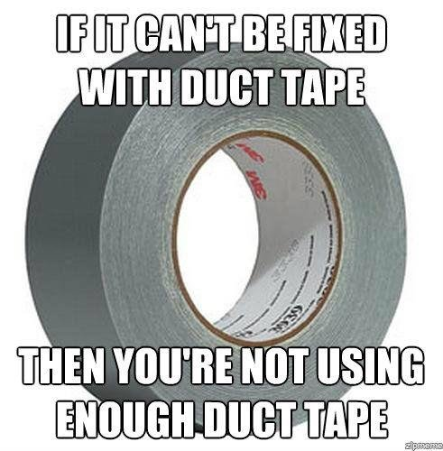
Duct tape approach

Slide 15

What is: reinforcement learning

Slide 16

What is: reinforcement learning
Agent
observation
action
Environment

Slide 17
What is: reinforcement learning
Agent
Can do anything
observation
action
Can't even see
(worst case)
Environment

Slide 18
What is: reinforcement learning
Agent interacts with environment
  site interacts with user
  robot interacts with the physical world
Feedback on agent performance
  Agent receives feedback on his performance
  Usually a real number (more=better)

Slide 19
What is: reinforcement learning
Agent interacts with environment
  site interacts with user
  robot interacts with the physical world
Feedback on agent performance
  Agent receives feedback on his performance
  Usually a real number (more=better)
You get to pick actions, not just observe data
Not given optimal actions as feedback

Slide 20
Reinforcement learning Vs regular ML
Algorithm can influence what samples it gets
Data is not i.i.d.
Goal is to learn optimal policy
  (observation→ what to do)

Slide 21
Reinforcement learning Vs regular ML
Algorithm can influence what samples it gets
Data is not i.i.d.
Goal is to learn optimal policy
  (observation→ what to do)
  Similar to “active learning”
Many optimization/inference require i.i.d.
RL can be viewed as supervised learning*
  * with some duct tape

Slide 22


Reality check: web
Cases:
    Pick ads to maximize profit
    Design landing page to maximize user retention
    Recommend items to users
Example
  Observation – user features
  Action – show banner #i
  Feedback – did user click?

Slide 23




Reality check: dynamic systems

Slide 24

Reality check: MOAR
Cases:
    Robots
    Self-driving vehicles
    Pilot assistant
    More robots!
Example
  Observation: sensor feed
  Action: signals to motors
  Feedback: how far did it move
    forward before falling

Slide 25




Reality check: videogames
  Trivia: What are observations, actions and feedback?

Slide 26


Other use cases
Personalized medical treatment
Even more games (Go, chess, etc)
  Trivia: What are observations, actions and feedback?

Slide 27



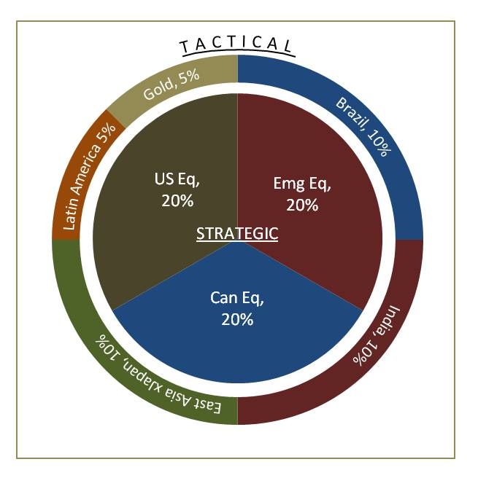
Other use cases
Conversation systems (additional goals)
Portfolio management (aka asset allocation)

Slide 28

The MDP formalism
Classic MDP(Markov Decision Process)
Agent interacts with environment
  Environment states:
  Agent actions:
  State transition:

Slide 29
The MDP formalism
Classic MDP(Markov Decision Process)
Agent interacts with environment
  Environment states:
  Agent actions:
  State transition:
Markov assumption

Slide 30

Optimal policy (Monte-carlo)
Naive objective:
Deterministic policy:
  Find policy with highest
  expected reward

Slide 31
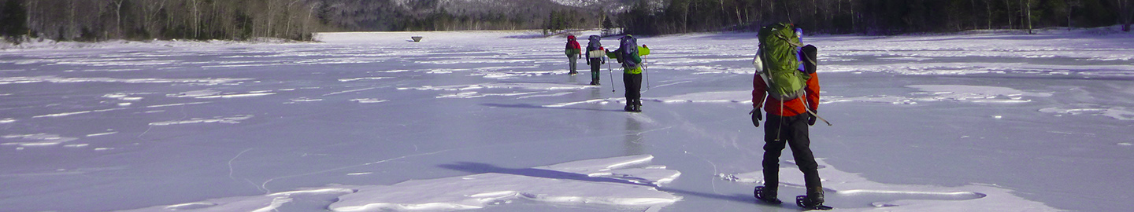
Context: FrozenLake
A grid world with a goal tile and ice holes
Quiz: what states, actions and rewards are used?
SFFF (S: starting point, safe)
FHFH (F: frozen surface, safe)
FFFH (H: hole, fall to your doom)
HFFG (G: goal, where the frisbee is located)

Slide 32
Model-based RL
Imagine you have an accurate model of the world
  e.g. physics model for robot
You know exactly:
  Forall
How can you get optimal action?

Slide 33
Combinatorial optimization
Maximize score over policy
No gradient
Naive solution: iterate over all policies
  Any problems with that?

Slide 34
Combinatorial optimization
Maximize score over policy
No gradient
Naive solution: iterate over all policies
  Bizillion candidates
Efficient algorithms for particular problems

Slide 35
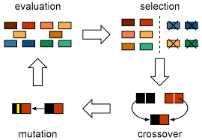
Genetic algorithms
biologically inspired heuristic
maintain a population of policies
reproduce (crossover) → mutate → prune

Slide 36
Genetic algorithms
no guarantees
biologically inspired heuristic
maintain a population of policies
reproduce (crossover) → mutate → prune

Slide 37
Genetic algorithms
Keep a pool of N policies
On each step,
  take M random pairs and mix them
  take K random policies and mutate them
  compute fitness ~ how good each policy is
  leave only top-N policies with highest fitness

Slide 38
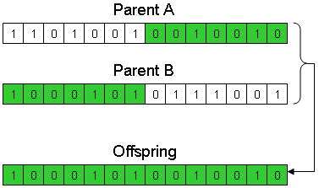
Crossover
Take 2 random policies (“parents”)
For each state, flip a coin
  If heads, take action from the first parent
  If tails, take action from the second parent

Slide 39
Crossover
Take 2 random policies (“parents”)
For each state, flip a coin
  If heads, take action from the first parent
  If tails, take action from the second parent
Any other ways to make it?

Slide 40
Genetic Algorithms
Cons
  Convergence not guaranteed
  Requires a lot of samples
  A lot of parameter tuning
  Hard to scale on large state spaces
Pros
  It sorta sometimes works
  You get to be a god!

Slide 41

Problem with GA & similar
need a full session to start learning
requires a lot of interaction
  A lot of crashed robots / simulations

