Slide 1


Model-Parallel Deep Learning
Episode III, YSDA’21
Yandex
Research

Slide 2
Training large DL models
Model-Parallel Deep Learning
Episode III, YSDA’21
Yandex
Research

Slide 3
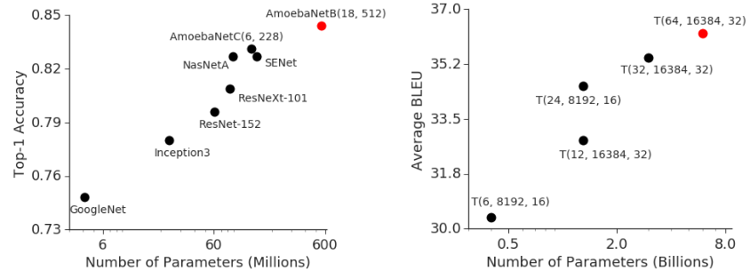
Recap: large models
Image Classification
ImageNet
Machine Translation
average over WMT
Source: https://arxiv.org/abs/1811.06965

Slide 4
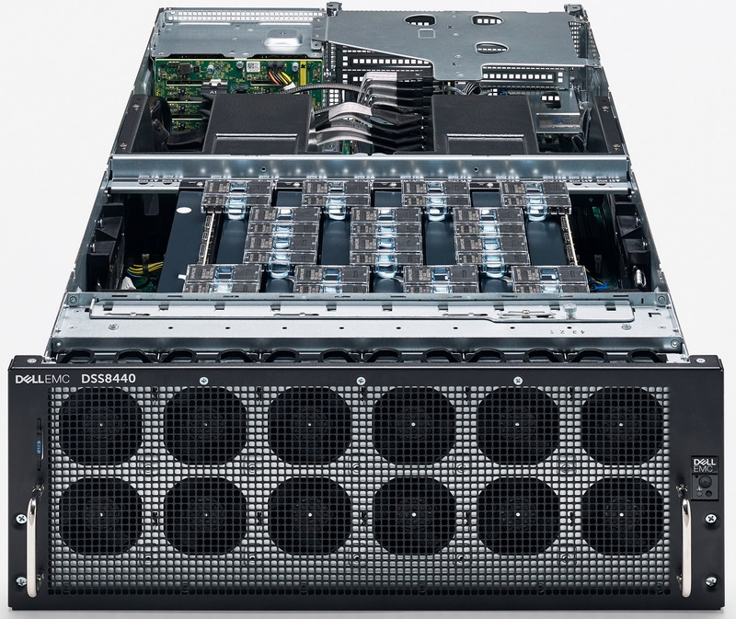
Recap: Ring allreduce
Bonus quest: you can only send data between adjacent gpus
GPU1
GPU2
GPU3
GPU4
Ring topology
Image: graphcore ipu server
Answer & more: tinyurl.com/ring-allreduce-blog

Slide 5
Recap: All-Reduce SGD
arxiv.org/abs/1706.02677
Idea: get rid of the host, each gpu runs its own computation
Q: why will weights be equal after such step?
Data
Get full grads on each device
new θ are equal across devices
Devices
θ
A
L
L
R
E
D
U
C
E
θ
GPU1
x1
forward pass
backward pass
∇θL(x1)
∇θL(x)
step
GPU2
θ
x2
forward pass
backward pass
∇θL(x2)
∇θL(x)
step
θ
GPU3
θ
x3
forward pass
backward pass
∇θL(x3)
∇θL(x)
step
θ
GPU4
θ
x4
forward pass
backward pass
∇θL(x4)
∇θL(x)
step
θ

Slide 6
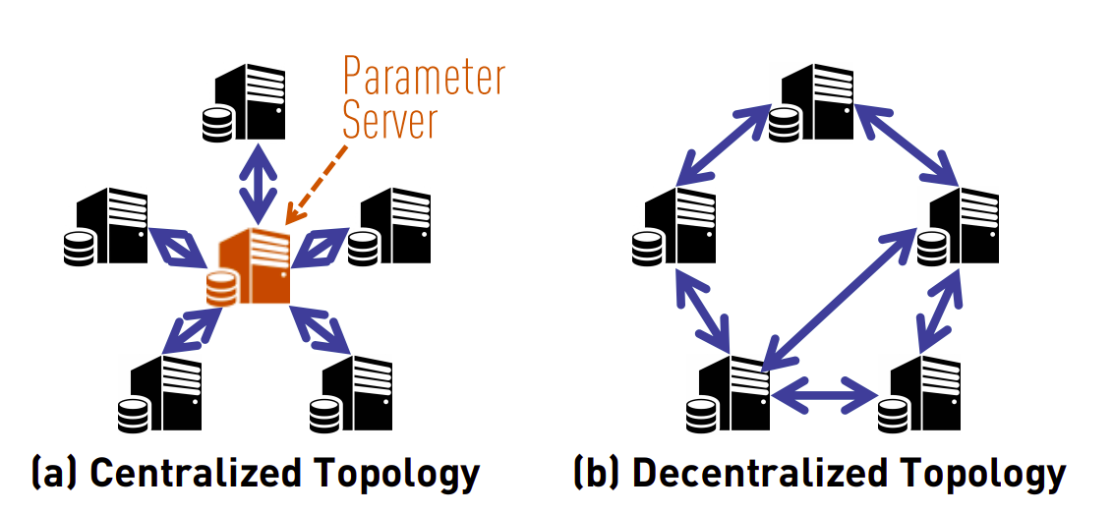
Recap: Decentralized SGD
Gossip (communication): https://tinyurl.com/boyd-gossip-2006
Gossip outperforms All-Reduce: https://tinyurl.com/can-dsgd-outperform

Slide 7
Q: What if a model is larger than GPU?

Slide 8
Q: What if a model is larger than GPU?
easy mode: cannot fit batch size 1
expert mode: not even parameters!

Slide 9
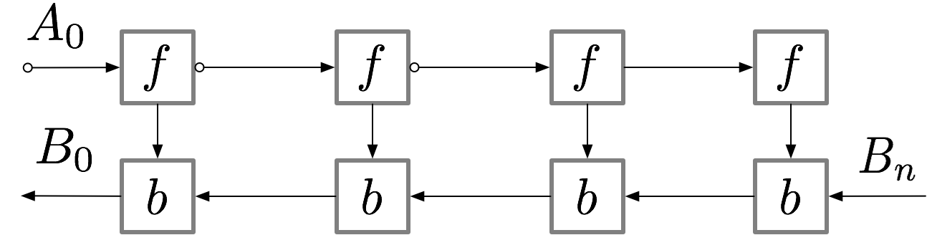
Gradient checkpointing
aka rematerialization
Paper (DL): arxiv.org/pdf/1604.06174.pdf
TF: github.com/cybertronai/gradient-checkpointing
Pytorch: pytorch.org/docs/stable/checkpoint.html

Slide 10
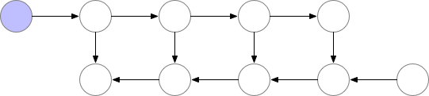
Gradient checkpointing
Normal backprop
Paper (DL): arxiv.org/pdf/1604.06174.pdf
TF: github.com/cybertronai/gradient-checkpointing
Pytorch: pytorch.org/docs/stable/checkpoint.html

Slide 11
Gradient checkpointing
Full rematerialization
Paper (DL): arxiv.org/pdf/1604.06174.pdf
TF: github.com/cybertronai/gradient-checkpointing
Pytorch: pytorch.org/docs/stable/checkpoint.html

Slide 12
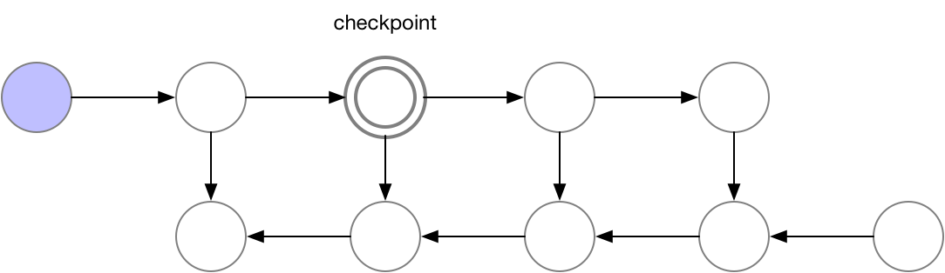
Gradient checkpointing
Single checkpoint
Paper (DL): arxiv.org/pdf/1604.06174.pdf
TF: github.com/cybertronai/gradient-checkpointing
Pytorch: pytorch.org/docs/stable/checkpoint.html

Slide 13
Gradient checkpointing
Single checkpoint
Paper (DL): arxiv.org/pdf/1604.06174.pdf
TF: github.com/cybertronai/gradient-checkpointing
Pytorch: pytorch.org/docs/stable/checkpoint.html

Slide 14
Q: What if a model is larger than GPU?
easy mode: cannot fit batch size 1
expert mode: not even parameters!

Slide 15
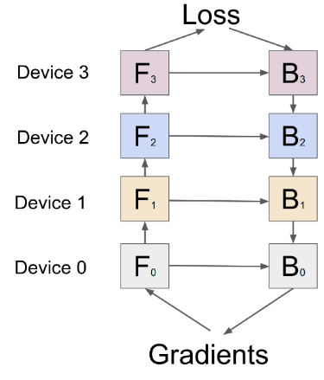
Model-parallel training
Q: What if a model is larger than GPU?

Slide 16
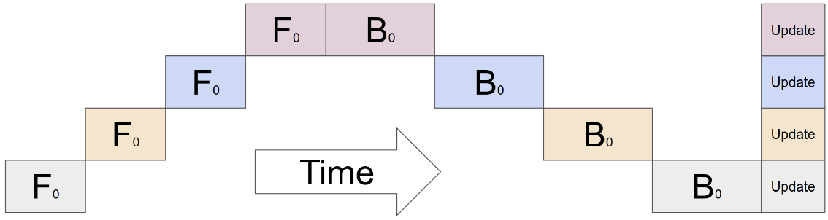
Model-parallel training
Q: What if a model is larger than GPU?
model size: O(N)
throughput: O(1)
Q: Can we go faster?

Slide 17
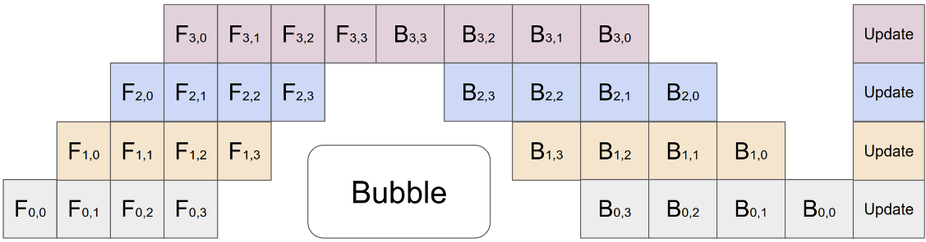
Pipelining
Idea: split data into micro-batches and form a pipeline (right)
GPipe: arxiv.org/abs/1811.06965 – good starting point, not the 1st paper
model size: O(n)
throughput: O(n) – with caveats

Slide 18
Pipelining
Idea: split data into micro-batches and form a pipeline (right)
GPipe: arxiv.org/abs/1811.06965 – good starting point, not the 1st paper
model size: O(n)
throughput: O(n) – with caveats
Q: Even faster?

Slide 19
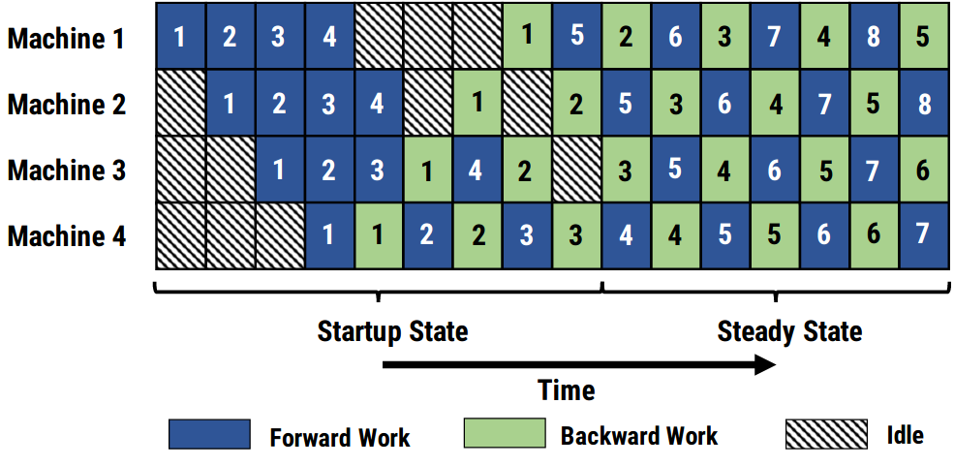
Pipeline-parallel training
Idea: apply gradients with every microbatch for maximum throughput
PipeDream: arxiv.org/abs/1806.03377
Also neat:
  Automatically partition layers to GPUs via dynamic programming
  Store k past weight versions to reduce
  gradient staleness
  Aims at high latency

Slide 20
Tensor-parallel training
Multiply by a
part of matrix
Partial
product
Scatter
-reduce
Device
input
all-gather
WEIGHT
MATRIX
x
=
∑
GPU1
x
=
∑
GPU2

Slide 21
Tensor-parallel training
Q: find AllReduce op here
Multiply by a
part of matrix
Partial
product
Scatter
-reduce
Device
input
all-gather
WEIGHT
MATRIX
x
=
∑
GPU1
x
=
∑
GPU2

Slide 22
Tensor-parallel training
Q: find AllReduce op here
Multiply by a
part of matrix
Partial
product
Scatter
-reduce
Device
input
all-gather
WEIGHT
MATRIX
x
=
∑
GPU1
to next step ...
x
=
∑
GPU2

Slide 23
</Model-parallel>
+ model larger than GPU
+ faster for small
* typical size: 2-8 gpus
- model partitioning is tricky
tensor parallelism is easier, but requires ultra low latency
- latency is critical, go buy nvlink
except for PipeDream
- often combined with gradient checkpointing
Tutorials:
  Simple pipelining in PyTorch – tinyurl.com/pytorch-pipelining
  Distributed model-parallel with torch RPC - https://tinyurl.com/torch-rpc
  Tensor parallelism – mesh tensorflow - arxiv.org/abs/1811.02084
  (more libs in the next section)

Slide 24
</Model-parallel>
+ model larger than GPU
+ faster for small
* typical size: 2-8 gpus
- model partitioning is tricky
tensor parallelism is easier, but requires ultra low latency
- latency is critical, go buy nvlink
except for PipeDream
- often combined with gradient checkpointing
Tutorials:
  Simple pipelining in PyTorch – tinyurl.com/pytorch-pipelining
  Distributed model-parallel with torch RPC - https://tinyurl.com/torch-rpc
  Tensor parallelism – mesh tensorflow - arxiv.org/abs/1811.02084
Q: what if you have 1024 GPUs, but the model fits on 8?

Slide 25
</Model-parallel>
+ model larger than GPU
+ faster for small
* typical size: 2-8 gpus
- model partitioning is tricky
tensor parallelism is easier, but requires ultra low latency
- latency is critical, go buy nvlink
except for PipeDream
- often combined with gradient checkpointing
Tutorials:
  Simple pipelining in PyTorch – tinyurl.com/pytorch-pipelining
  Distributed model-parallel with torch RPC - https://tinyurl.com/torch-rpc
  Tensor parallelism – mesh tensorflow - arxiv.org/abs/1811.02084
Large-scale training: combine model- and data-parallel

Slide 26
Case study: DeepSpeed
Source: microsoft

Slide 27
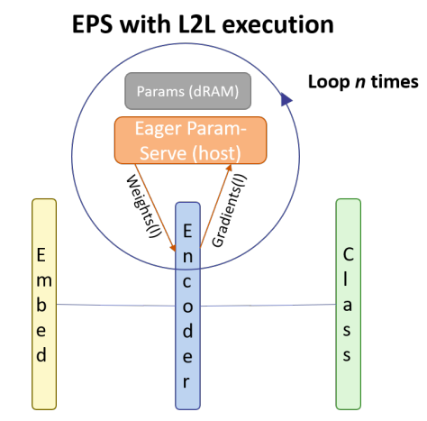
Memory offloading
L2L: https://arxiv.org/abs/2002.05645
Initialize all layers on CPU
Move k layers at a time to GPU
Remove layers after computation
Fetch k+1-st layer while k-th runs
Still 20-50% overhead

Slide 28
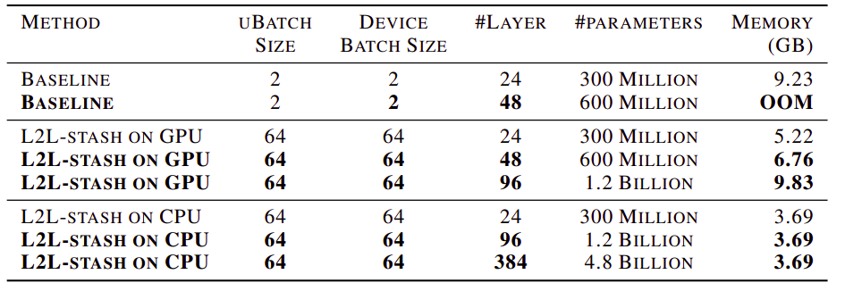
Memory offloading
L2L: https://arxiv.org/abs/2002.05645

Slide 29
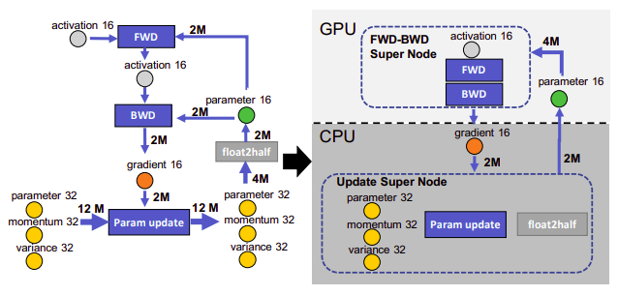
Memory offloading
ZeRO-offload: https://arxiv.org/abs/2101.06840

Slide 30
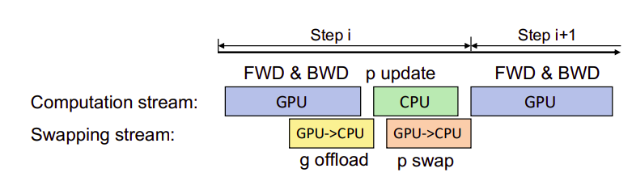
Memory offloading
ZeRO-offload: https://arxiv.org/abs/2101.06840
Offload in parallel with computation
Use gradient checkpointing
Delayed parameter update

Slide 31
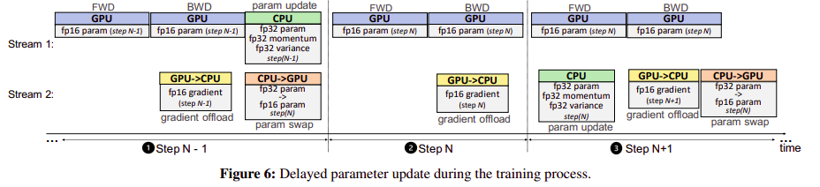
Memory offloading
ZeRO-offload: https://arxiv.org/abs/2101.06840
Offload in parallel with computation
Use gradient checkpointing
Delayed parameter update

Slide 32
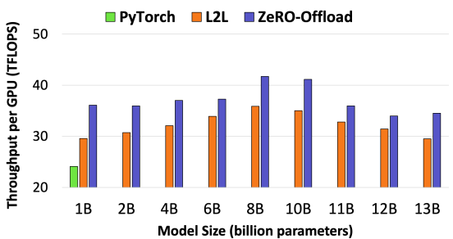
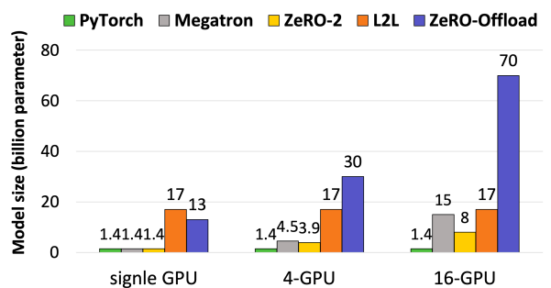
Memory offloading
ZeRO-offload: https://arxiv.org/abs/2101.06840
Offload in parallel with computation
Use gradient checkpointing
Delayed parameter update

Slide 33
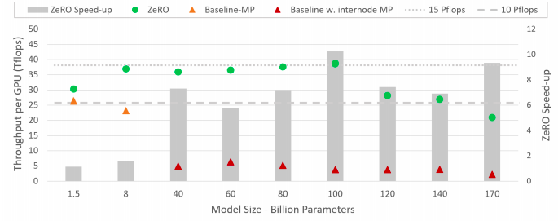
DeepSpeed / ZeRO
ZeRO: https://arxiv.org/pdf/1910.02054v3.pdf
Combines sharded DPP and offload
… and some tensor parallelism
… and a ton of hacks

Slide 34
</ZeRO>
Multi-GPU strategies:
* Pipeline model-parallel – allocate layers on different GPUs
* Sharded data-parallel – split optimizer state and/or parameters
Single GPU strategies:
* Small model – gradient checkpointing & virtual batch
* Large model – optimizer state sharding (keep parameters on GPU)
Implementations:
  DeepSpeed– sharded DP, offload, tensor parallelism, active development
      Offload – https://www.deepspeed.ai/news/2021/03/07/zero3-offload.html
  Fairscale – most of DeepSpeed features with friendrier API
  One great implementation – https://github.com/NVIDIA/Megatron-LM

Slide 35
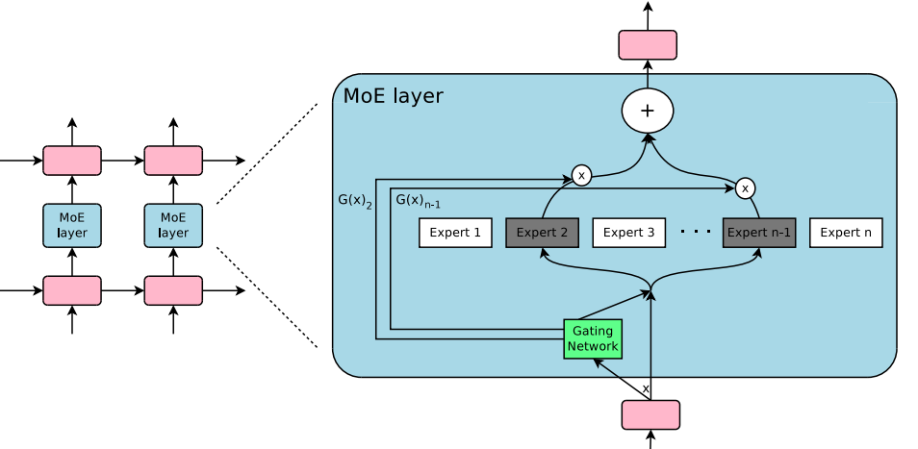
Expert Parallelism
Sparsely gated MoE: https://arxiv.org/pdf/1701.06538.pdf

Slide 36
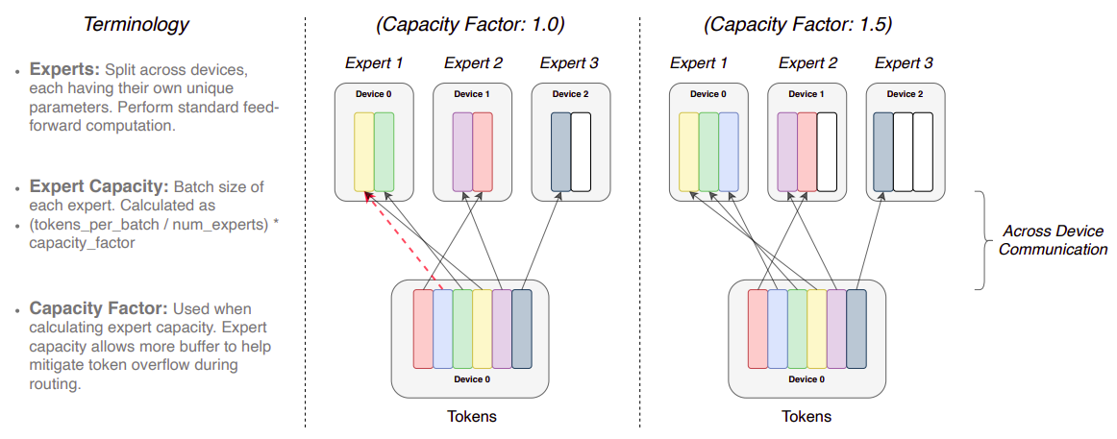
MoE Variant: Switch Transformer
Switch: https://arxiv.org/pdf/2101.03961.pdf

Slide 37
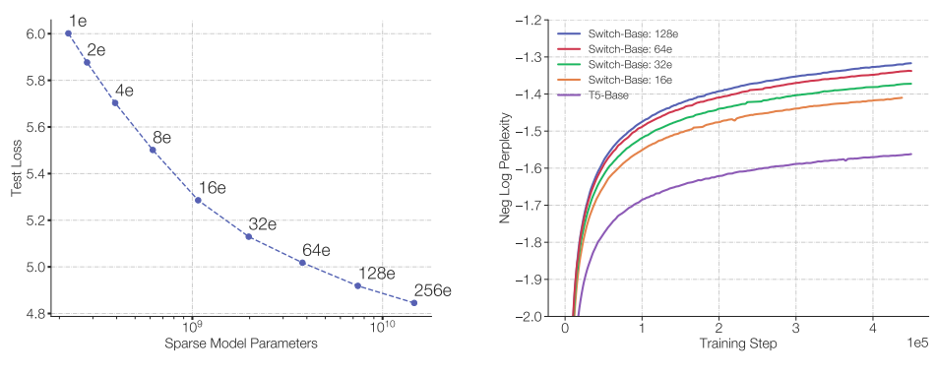
MoE Variant: Switch Transformer
Switch: https://arxiv.org/pdf/2101.03961.pdf
MLM pre-training objective [BERT-like]

Slide 38
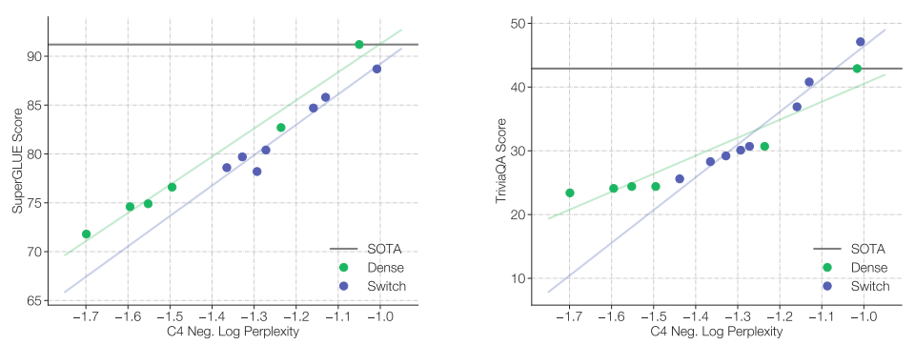
MoE Variant: Switch Transformer
Switch: https://arxiv.org/pdf/2101.03961.pdf
Pre-training vs downstream quality

Slide 39


The square-cube law of deep learning
Explainer: https://www.youtube.com/watch?v=f7KSfjv4Oq0
n
n
Surface area O(n²)
Volume O(n³)
1
1
n
1

Slide 40
The square-cube law of deep learning
Explainer: https://www.youtube.com/watch?v=f7KSfjv4Oq0
x
Linear
n x n
ReLU
Linear
n x n
ReLU
Linear
n x n
ReLU
n samples
Loss
server 1
server 2
server 3

Slide 41
The square-cube law of deep learning
Explainer: https://www.youtube.com/watch?v=f7KSfjv4Oq0
Compute = O(n samples × n units × n units)
x
Linear
n x n
ReLU
Linear
n x n
ReLU
Linear
n x n
ReLU
n samples
Loss
server 1
server 2
server 3
Network traffic = O(n samples × n units)

Slide 42
The square-cube law of deep learning
Explainer: https://www.youtube.com/watch?v=f7KSfjv4Oq0
Training batch
Worker 1
Worker 2
Worker 3
micro
batch
micro
batch
2
1
L1
L2
L3
L4
L5
L6
micro
batch
micro
batch
4
micro
batch
idle
idle
3
1

Slide 43
The square-cube law of deep learning
Explainer: https://www.youtube.com/watch?v=f7KSfjv4Oq0
Training batch
Worker 1
Worker 2
Worker 3
micro
batch
micro
batch
2
1
L1
L2
L3
L4
L5
L6
micro
batch
micro
batch
4
micro
batch
idle
3
micro
batch
idle
3
2
micro
batch
1

Slide 44
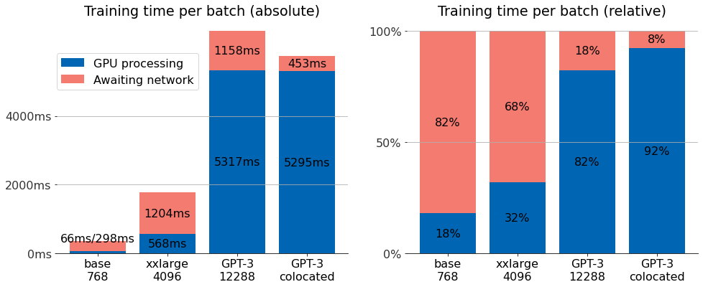
The square-cube law of deep learning
Explainer: https://www.youtube.com/watch?v=f7KSfjv4Oq0

Slide 45
Hivemind
https://learning-at-home.github.io/

Slide 46
</lecture>

