Slide 1


Data-Parallel Deep Learning
Episode II, YSDA’21
Yandex
Research

Slide 2
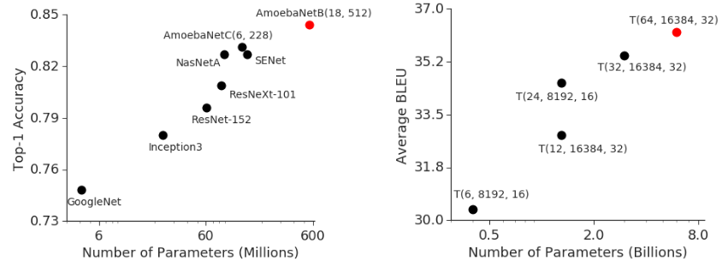
Large problems need large models
Image Classification
ImageNet
Machine Translation
average over WMT
Source: https://arxiv.org/abs/1811.06965

Slide 3
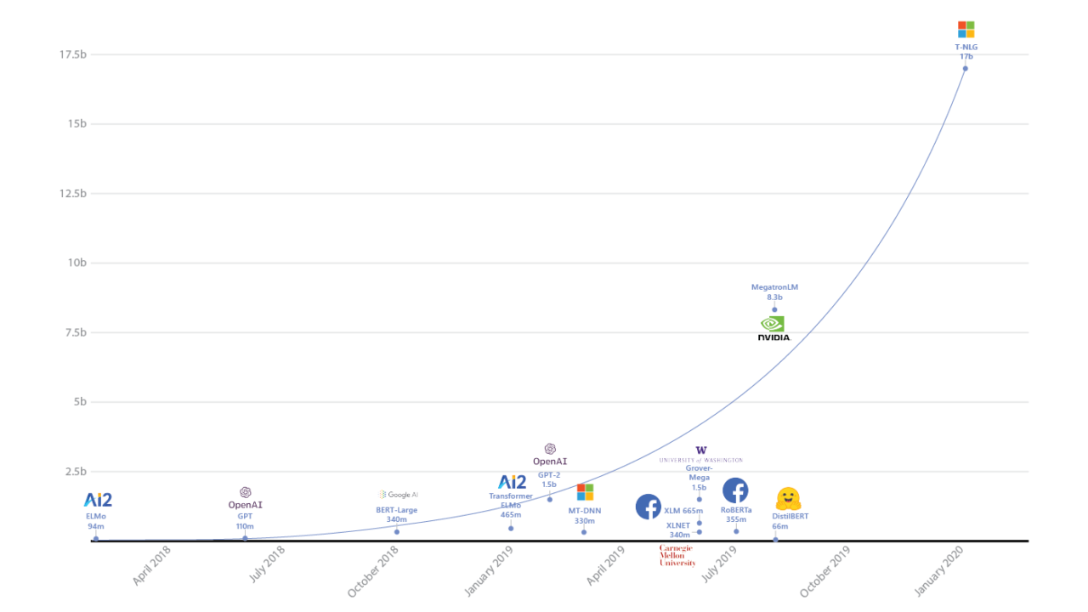
The transformer curve
Source: microsoft

Slide 4
Machine Learning Supertasks
Image classification – ImageNet, JFT300M
Generative models – ImageNet(biggan), the internet
Language Models – common crawl, BERT / MLM
Machine Translation – multilingual translation
Reinforcement Learning – playstation* & steam :)
* playstation for RL: https://arxiv.org/abs/1912.06101
Meanwhile, exabytes of YouTube videos lay dormant across
the web, waiting for someone who can make use of them

Slide 5
Data-parallel training (naive)
cs.cmu.edu/~muli/file/parameter_server_osdi14.pdf
Host
model
CPU
θ
Devices
.cuda()
GPU1
θ

Slide 6
Data-parallel training (naive)
cs.cmu.edu/~muli/file/parameter_server_osdi14.pdf
Host
model
batch
CPU
θ
. . .
x
Devices
.cuda()
.cuda()
GPU1
θ
x
forward pass
backward pass
∇θL(x1)

Slide 7
Data-parallel training (naive)
cs.cmu.edu/~muli/file/parameter_server_osdi14.pdf
Host
model
batch
CPU
θ
. . . prepare next batch
x
Devices
.cuda()
.cuda()
new model
GPU1
θ
x
forward pass
backward pass
∇θL(x1)
step
θ

Slide 8
Data-parallel training (naive)
cs.cmu.edu/~muli/file/parameter_server_osdi14.pdf
Host
model
CPU
θ
Devices
replicate
GPU1
θ
GPU2
θ
GPU3
θ
GPU4
θ

Slide 9
Data-parallel training (naive)
cs.cmu.edu/~muli/file/parameter_server_osdi14.pdf
Host
model
batch
CPU
θ
x1
x2
x3
x4
Devices
replicate
scatter
GPU1
θ
x1
GPU2
θ
x2
GPU3
θ
x3
GPU4
θ
x4

Slide 10
Data-parallel training (naive)
cs.cmu.edu/~muli/file/parameter_server_osdi14.pdf
Host
model
batch
CPU
θ
. . .
x1
x2
x3
x4
Devices
replicate
scatter
GPU1
θ
x1
forward pass
backward pass
∇θL(x1)
GPU2
θ
x2
forward pass
backward pass
∇θL(x2)
GPU3
θ
x3
forward pass
backward pass
∇θL(x3)
GPU4
θ
x4
forward pass
backward pass
∇θL(x4)

Slide 11
Data-parallel training (naive)
cs.cmu.edu/~muli/file/parameter_server_osdi14.pdf
Host
model
batch
full grad
new model
CPU
θ
. . .
θ
x1
x2
x3
x4
∇θL(x)
step
Devices
replicate
scatter
reduce (sum)
replicate
GPU1
θ
x1
forward pass
backward pass
∇θL(x1)
θ
GPU2
θ
x2
forward pass
backward pass
∇θL(x2)
θ
GPU3
θ
x3
forward pass
backward pass
∇θL(x3)
θ
GPU4
θ
x4
forward pass
backward pass
∇θL(x4)
θ

Slide 12
Data-parallel training (naive)
cs.cmu.edu/~muli/file/parameter_server_osdi14.pdf
Host
model
batch
full grad
new model
CPU
θ
. . .
θ
x1
x2
x3
x4
∇θL(x)
step
Devices
replicate
scatter
reduce (sum)
replicate
GPU1
θ
x1
forward pass
backward pass
∇θL(x1)
θ
GPU2
θ
x2
forward pass
backward pass
∇θL(x2)
θ
GPU3
θ
x3
forward pass
backward pass
∇θL(x3)
θ
GPU4
θ
x4
forward pass
backward pass
∇θL(x4)
θ

Slide 13
All-Reduce data parallel
arxiv.org/abs/1706.02677
Idea: get rid of the host, each gpu runs its own computation
Q: why will weights be equal after such step?
Data
Get full grads on each device
new θ are equal across devices
Devices
θ
A
L
L
R
E
D
U
C
E
θ
GPU1
x1
forward pass
backward pass
∇θL(x1)
∇θL(x)
step
GPU2
θ
x2
forward pass
backward pass
∇θL(x2)
∇θL(x)
step
θ
GPU3
θ
x3
forward pass
backward pass
∇θL(x3)
∇θL(x)
step
θ
GPU4
θ
x4
forward pass
backward pass
∇θL(x4)
∇θL(x)
step
θ

Slide 14
Faster allreduce
Input: each device has its its own vector
Output: each device gets a sum of all vectors
Devices
A
L
L
R
E
D
U
C
E
GPU1
∇θL(x1)
∇θL(x)
GPU2
∇θL(x2)
∇θL(x)
GPU3
∇θL(x3)
∇θL(x)
GPU4
∇θL(x4)
∇θL(x)

Slide 15
Faster allreduce
Input: each device has its its own vector
Output: each device gets a sum of all vectors
Naive implementation
Devices
GPU1
∇θL(x1)
Sum
∇θL(x)
GPU2
∇θL(x2)
∇θL(x)
GPU3
∇θL(x3)
∇θL(x)
GPU4
∇θL(x4)
∇θL(x)

Slide 16
Faster allreduce
Input: each device has its its own vector
Output: each device gets a sum of all vectors
Q: Can we do better?
Devices
GPU1
∇θL(x1)
Sum
∇θL(x)
GPU2
∇θL(x2)
∇θL(x)
GPU3
∇θL(x3)
∇θL(x)
GPU4
∇θL(x4)
∇θL(x)

Slide 17
Faster allreduce
Input: each device has its its own vector
Output: each device gets a sum of all vectors
Tree-allreduce
Devices
GPU1
∇θL(x1)
Sum
Sum
∇θL(x)
∇θL(x)
GPU2
∇θL(x2)
∇θL(x)
GPU3
∇θL(x3)
Sum
∇θL(x)
∇θL(x)
GPU4
∇θL(x4)
∇θL(x)

Slide 18
Faster allreduce
Input: each device has its its own vector
Output: each device gets a sum of all vectors
Butterfly-allreduce – split data into chunks (ABCD)
Devices
Part A
GPU1
∇θL(x1)
Sum
A
GPU2
∇θL(x2)
GPU3
∇θL(x3)
GPU4
∇θL(x4)

Slide 19
Faster allreduce
Input: each device has its its own vector
Output: each device gets a sum of all vectors
Butterfly-allreduce – split data into chunks (ABCD)
Devices
Part A
GPU1
∇θL(x1)
Sum
A
GPU2
∇θL(x2)
Sum
B
GPU3
∇θL(x3)
Sum
C
GPU4
∇θL(x4)
Sum
D

Slide 20
Faster allreduce
Input: each device has its its own vector
Output: each device gets a sum of all vectors
Butterfly-allreduce – split data into chunks (ABCD)
Devices
Part A
GPU1
∇θL(x)
∇θL(x1)
Sum
A
concat
∇θL(x)
GPU2
∇θL(x2)
Sum
B
GPU3
∇θL(x3)
Sum
C
GPU4
∇θL(x4)
Sum
D

Slide 21
Faster allreduce
Input: each device has its its own vector
Output: each device gets a sum of all vectors
Ring-allreduce – split data into chunks (ABCD)
Devices
Part A
GPU1
∇θL(x1)
Sum
A
concat
∇θL(x)
GPU2
∇θL(x2)
Sum
B
concat
∇θL(x)
GPU3
∇θL(x3)
Sum
C
concat
∇θL(x)
GPU4
∇θL(x4)
Sum
D
concat
∇θL(x)

Slide 22
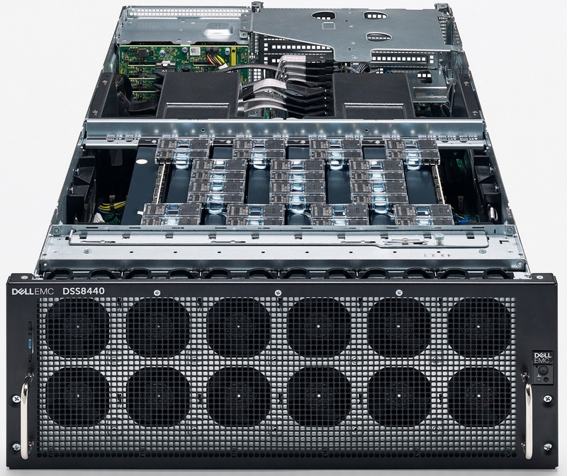
Ring allreduce
Bonus quest: you can only send data between adjacent gpus
GPU1
GPU2
GPU3
GPU4
Ring topology
Image: graphcore ipu server
Answer & more: tinyurl.com/ring-allreduce-blog

Slide 23
Ring allreduce
Bonus quest: you can only send data between adjacent gpus
[Time to use the whiteboard]
Answer & more: tinyurl.com/ring-allreduce-blog

Slide 24
All-Reduce data parallel
arxiv.org/abs/1706.02677
Idea: get rid of the host, each gpu runs its own computation
Q: why will weights be equal after such step?
Data
Get full grads on each device
new θ are equal across devices
Devices
θ
A
L
L
R
E
D
U
C
E
θ
GPU1
x1
forward pass
backward pass
∇θL(x1)
∇θL(x)
step
GPU2
θ
x2
forward pass
backward pass
∇θL(x2)
∇θL(x)
step
θ
GPU3
θ
x3
forward pass
backward pass
∇θL(x3)
∇θL(x)
step
θ
GPU4
θ
x4
forward pass
backward pass
∇θL(x4)
∇θL(x)
step
θ

Slide 25
All-Reduce data parallel VS reality
arxiv.org/abs/1706.02677
Each gpu has different processing time & delays
Q: can we improve device utilization?
Data
Devices
θ
A
L
L
R
E
D
U
C
E
GPU1
x1
forward pass
backward pass
∇θL(x1)
GPU2
θ
x2
forward
backward
∇θL(x2)
GPU3
θ
x3
forward pass
backward pass
∇θL(x3)
θ
network delay
x4
forward pass
backward pass
GPU4
∇θL(x4)

Slide 26
Recap: Parameter Server
HOGWILD! arxiv.org/abs/1106.5730
Idea: remove synchronization step alltogether, use parameter server
Model parameters
Devices
GPU1
θ
Train step
∇θL
θ
Train step
∇θL
GPU2
. . .
θ
Train step
θ
Train step
Train step
∇θL
∇θL
. . .
GPU3
Train step
. . .
Train step
. . .
Train step
. . .

Slide 27
Recap: Parameter Server
HOGWILD! arxiv.org/abs/1106.5730
Idea: remove synchronization step alltogether, use parameter server
Model parameters
Devices
GPU1
θ
Train step
∇θL
θ
Train step
∇θL
GPU2
. . .
θ
Train step
θ
Train step
Train step
∇θL
∇θL
. . .
GPU3
Train step
. . .
Train step
. . .
Train step
. . .
Problem: parameter servers need to ingest tons of data over training

Slide 28
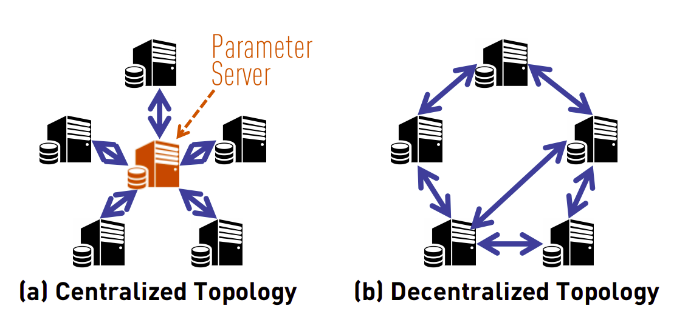
Decentralized Training with Gossip
Gossip (communication): https://tinyurl.com/boyd-gossip-2006
Gossip outperforms All-Reduce: https://tinyurl.com/can-dsgd-outperform

Slide 29
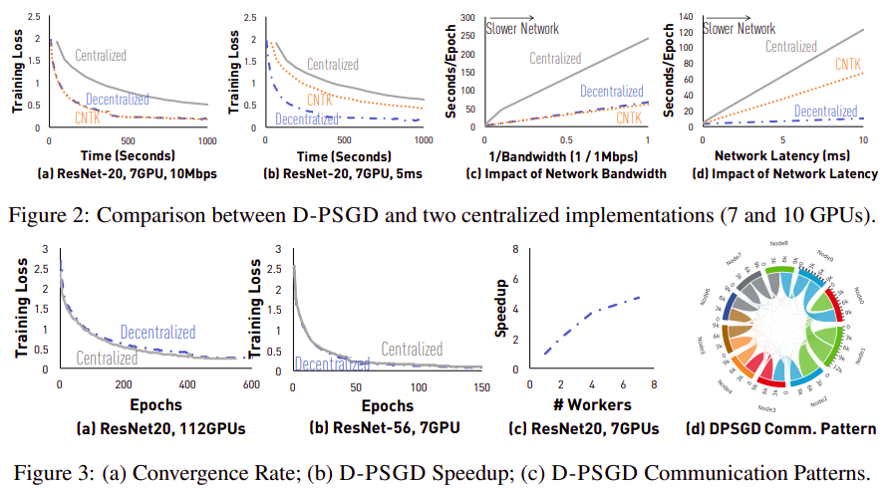
Decentralized Training with Gossip
Source: https://tinyurl.com/can-dsgd-outperform

Slide 30
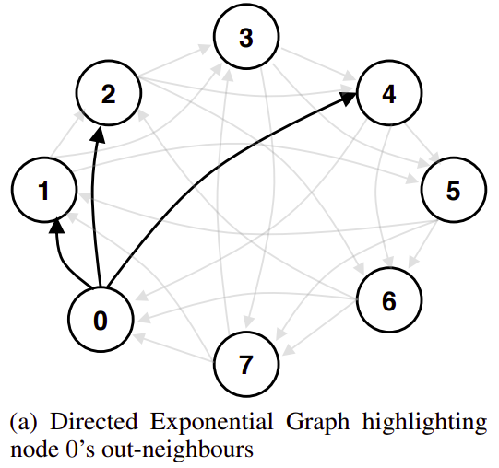
Stochastic Gradient Push
Source: https://arxiv.org/abs/1811.10792

Slide 31
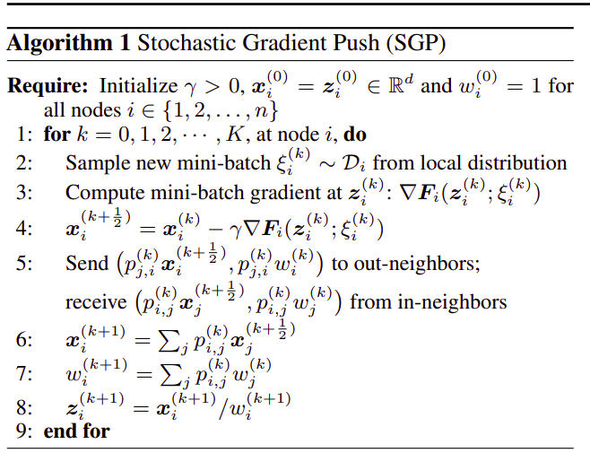
Stochastic Gradient Push
Source: https://arxiv.org/abs/1811.10792
<to be continued>

Slide 32
Stochastic Gradient Push
Source: https://arxiv.org/abs/1811.10792
<to be continued>
normal GD step

Slide 33
Stochastic Gradient Push
Source: https://arxiv.org/abs/1811.10792
<to be continued>

Slide 34
Stochastic Gradient Push
Source: https://arxiv.org/abs/1811.10792
weighted
average

Slide 35
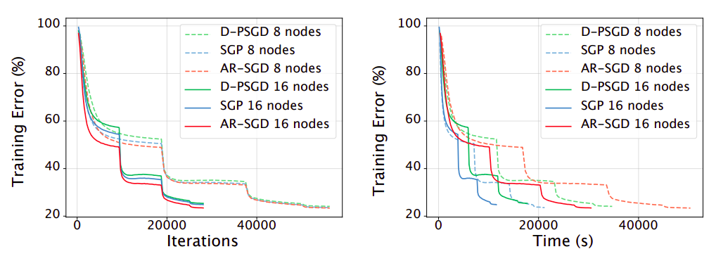
Stochastic Gradient Push
Source: https://arxiv.org/abs/1811.10792
SGP vs ImageNet (ResNet50 + SGD w/ momentum)

Slide 36
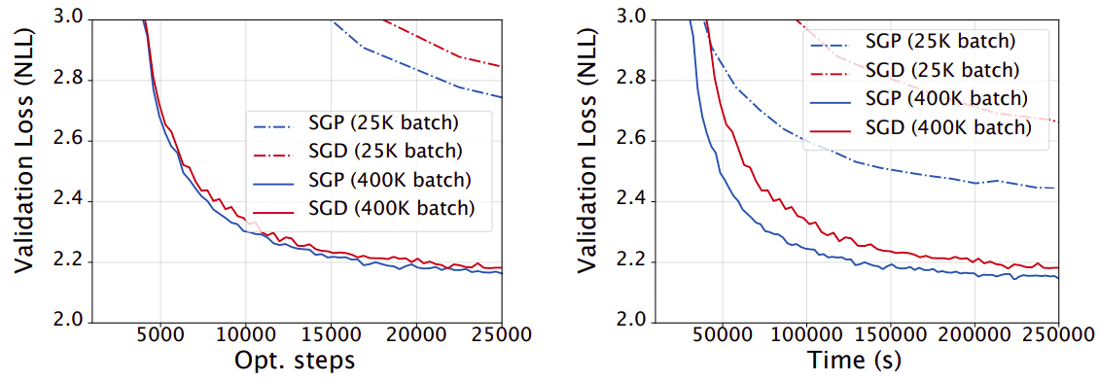
Stochastic Gradient Push
Source: https://arxiv.org/abs/1811.10792
SGP vs WMT English-German (Transformer, Adam)

Slide 37
Gossip vs All-Reduce
Your thoughts?

Slide 38
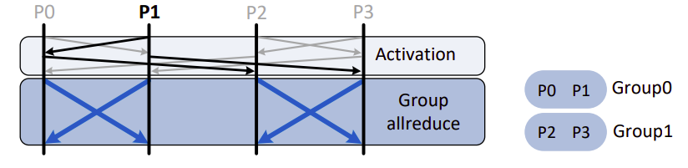
Gossip + All-Reduce
Source: arxiv.org/abs/2005.00124
Core idea: run all-reduce in independent groups
You only have to synchronize for your small group
Swap groupmates between iterations

Slide 39
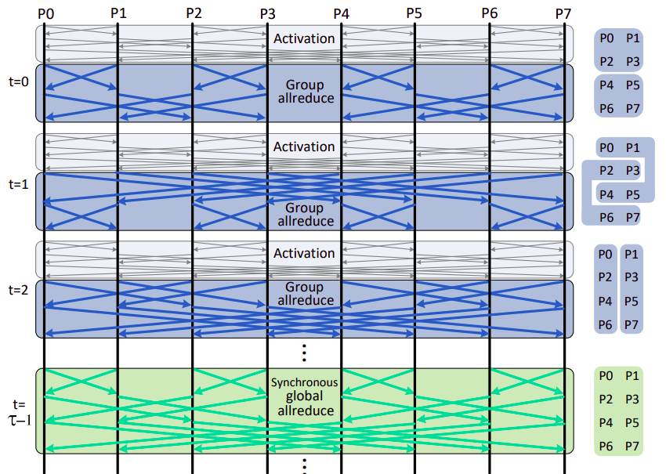
Gossip + All-Reduce
Source: arxiv.org/abs/2005.00124
Core idea: run all-reduce in independent groups
You only have to synchronize for your small group
Swap groupmates between iterations

Slide 40
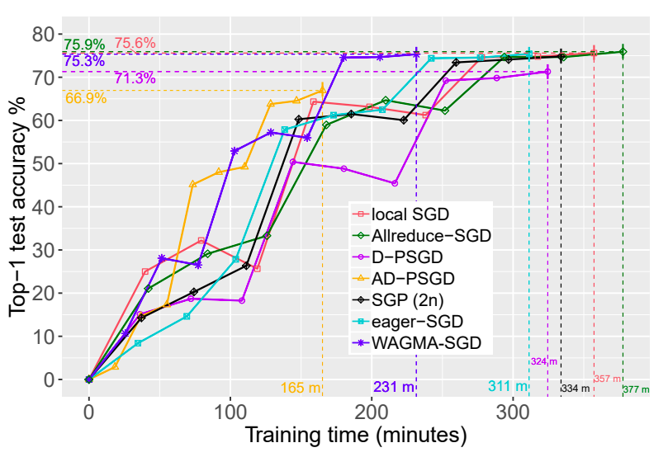
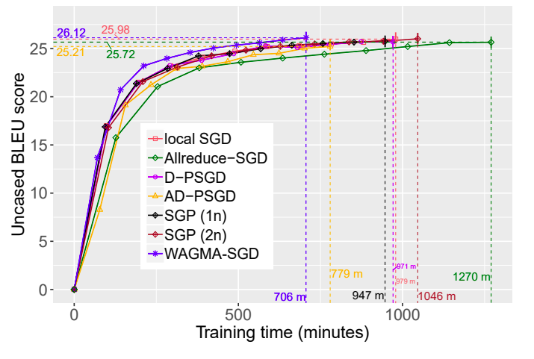
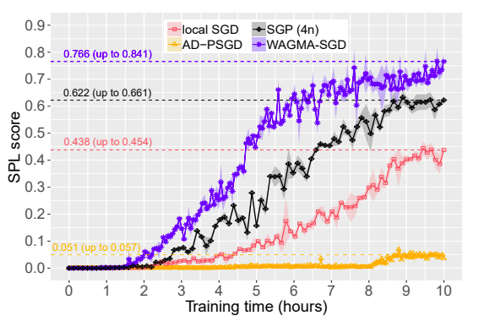
Gossip + All-Reduce
Source: arxiv.org/abs/2005.00124
Experiment setup: up to 1024 GPU,
Natural (or emulated) network latency
Image Classification
ResNet50 @ ImageNet
Machine Translation
Transformer @ WMT17
Reinforcement Learning
DDPO on Habitat

Slide 41
Side-quest: reducing network usage

Slide 42
Virtual batch / virtual pipeline
ёж, открой доску

Slide 43
</Data-parallel>
+ easy to implement
+ can scale to 100s of gpus
+ can be fault-tolerant
- model must fit in 1 gpu
- large batches aren’t always
good for generalization
2-4 GPUs & no time – naive data parallel tinyurl.com/torch-data-parallel
4+ GPUs or multiple hosts – horovod (allreduce) github.com/horovod/horovod
  High-level distributed pytorch (allreduce): tinyurl.com/distributed-dp
Somewhat faulty GPU/network: synchronous data parallel + drop stragglers
Very faulty or uneven resources: asynchronous data parallel (more later)
Efficient training with large batches: LAMB https://arxiv.org/abs/1904.00962
Dynamically adding or removing resources: https://tinyurl.com/torch-elastic

Slide 44


