Slide 1


Distributed Machine Learning
Episode I, YSDA’21
Yandex
Research

Slide 2
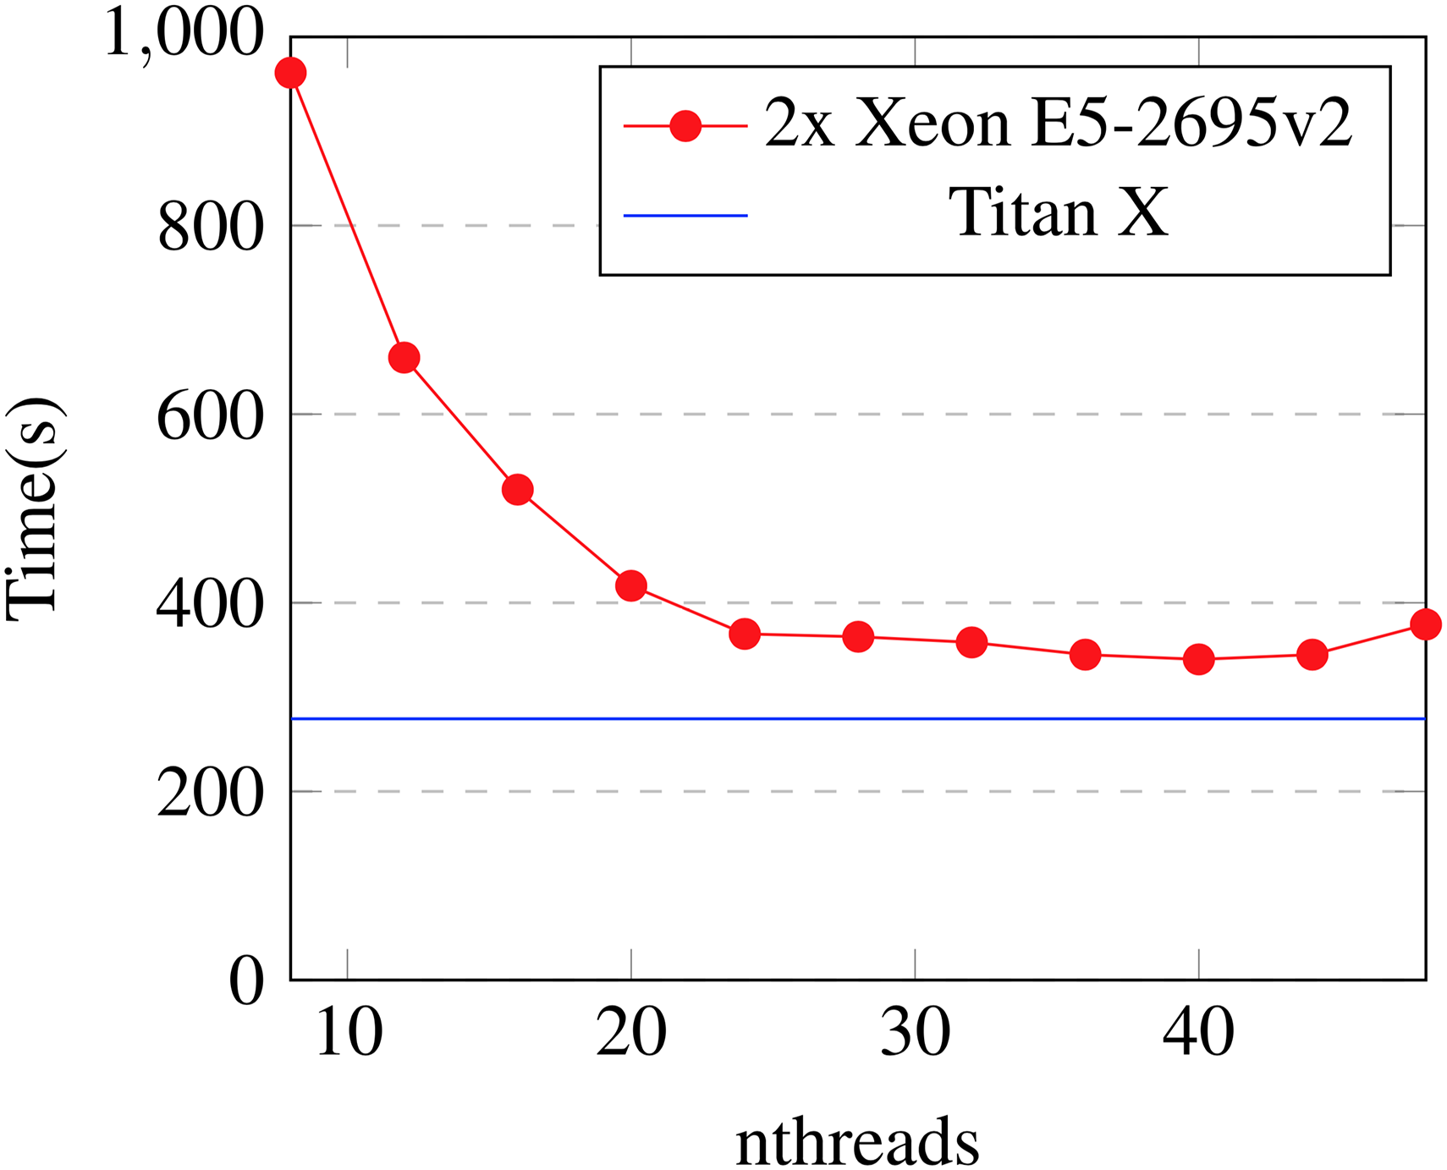
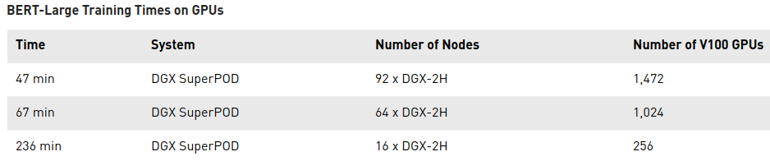
Зачем это всё?
XGBoost training time
nthreads
(single V100 – over 2 weeks)

Slide 3
Зачем это всё?
XGBoost training time
nthreads

Slide 4
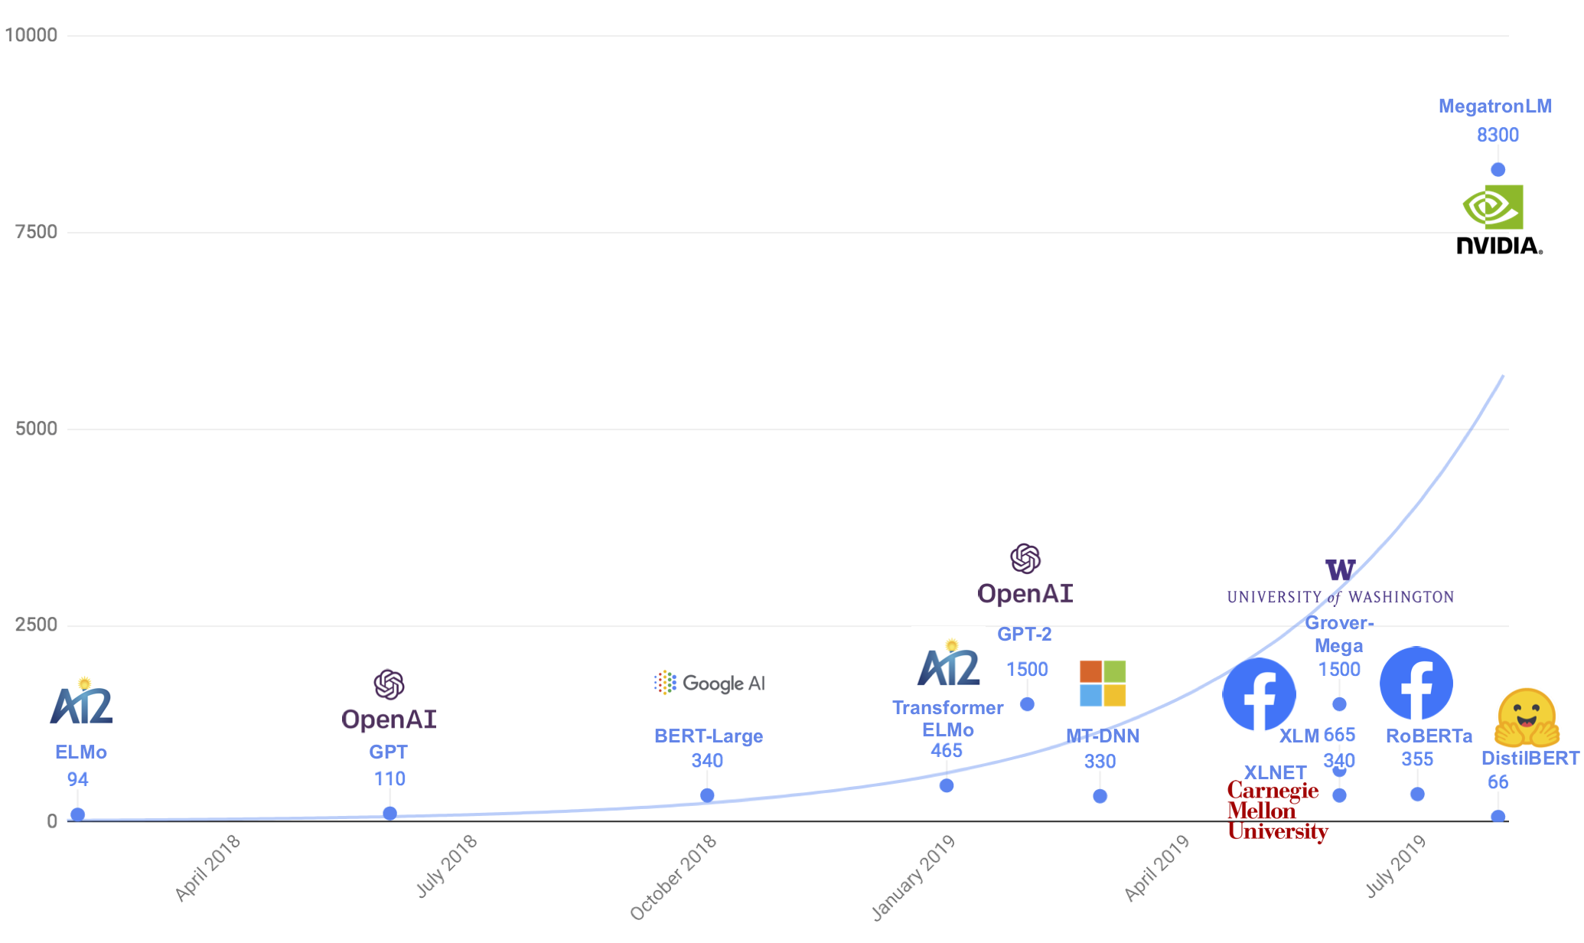
Зачем это всё?
XGBoost training time
10⁶ x parameters vs time
Model size trend up to 2019
nthreads
(single V100 – over 2 weeks)

Slide 5
Зачем это всё?
XGBoost training time
10⁶ x parameters vs time
Model size trend up to 2019
jan’21 update: over 1 trillion
~200-300 gpu-years
nthreads
(single V100 – over 2 weeks)

Slide 6

Зачем мы тут?
Заставить много железяк вместе учить одну модель

Slide 7

Зачем мы тут?
Заставить много железяк вместе учить одну модель
понять общие подходы
закодить своими руками
на python / pytorch
Notes:
НЕ про частные случаи. Потому что они скучные и вы и так их знаете. Вместе придумать про random forest

Slide 8
TL;DR this course with sample problems
Distributed machine learning
Embeddings or log.regression with tons of training data
Data-parallel deep learning
Train BERT-base on wikipedia in 20 minutes or less
Model-parallel deep learning
Train BERT-xxxxxxxxxxxlarge in less than a lifetime
Decentralized deep learning
Train ~something~ with a thousand smartphones

Slide 9
TL;DR this course with sample problems
Distributed machine learning
Embeddings or log.regression with tons of training data
Data-parallel deep learning
Train BERT-base on wikipedia in 20 minutes or less
Model-parallel deep learning
Train BERT-xxxxxxxxxxxlarge in less than a lifetime
Decentralized deep learning
Train ~something~ with a thousand smartphones

Slide 10
TL;DR this course with sample problems
Distributed machine learning
Embeddings or log.regression with tons of training data
Data-parallel deep learning
Train BERT-base on wikipedia in 20 minutes or less
Model-parallel deep learning
Train BERT-xxxxxxxxxxxlarge in less than a lifetime
Decentralized deep learning
Train ~something~ with a thousand smartphones

Slide 11
TL;DR this course with sample problems
Distributed machine learning
Embeddings or log.regression with tons of training data
Data-parallel deep learning
Train BERT-base on wikipedia in 20 minutes or less
Model-parallel deep learning
Train BERT-xxxxxxxxxxxlarge in less than a lifetime
Decentralized deep learning
Train ~something~ with a million smart teapots

Slide 12
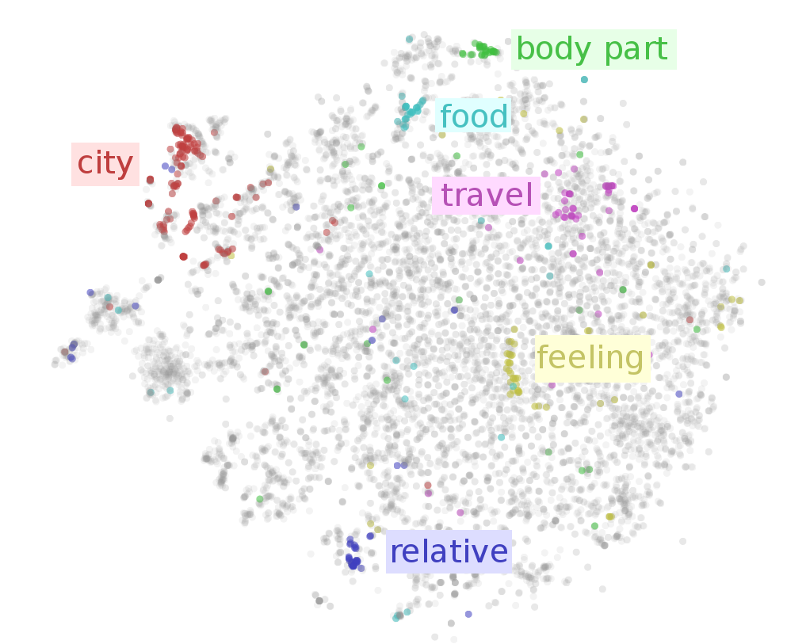
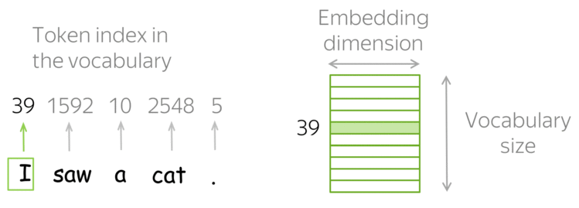
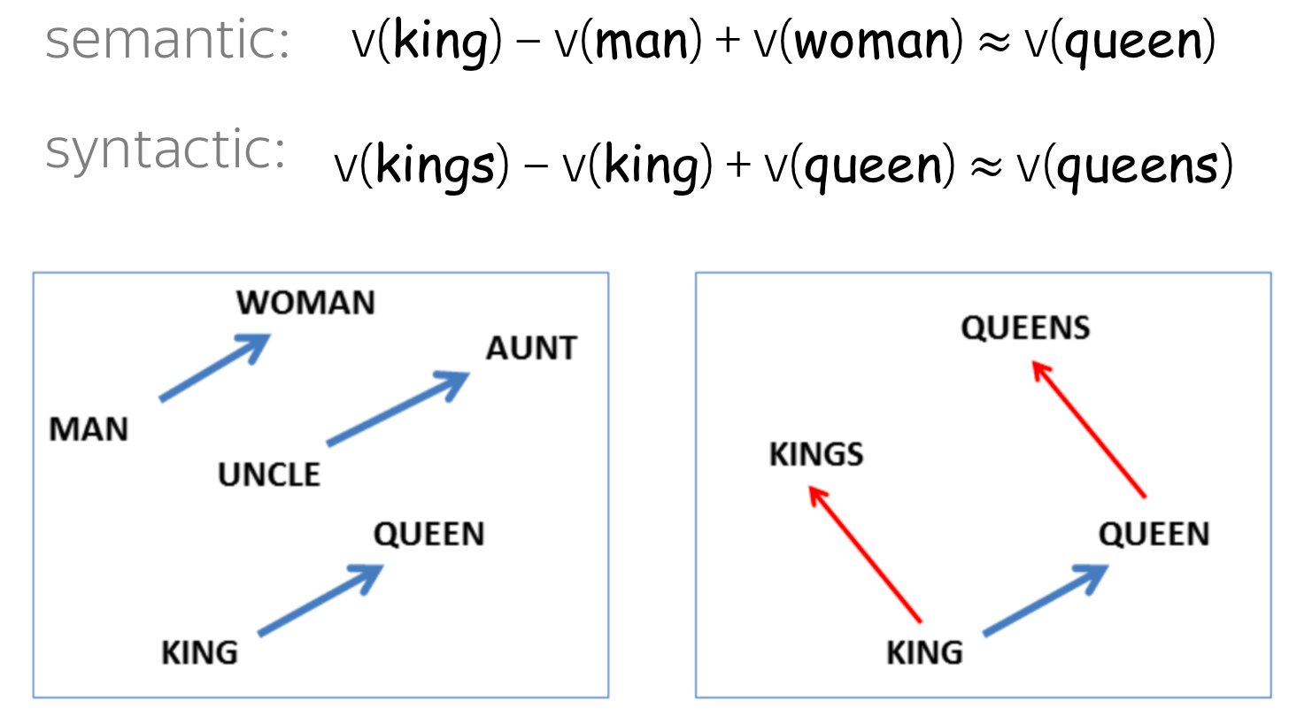
Problem of the day: word embeddings
Image source: Lena’s blog, Ruder’s blog

Slide 13
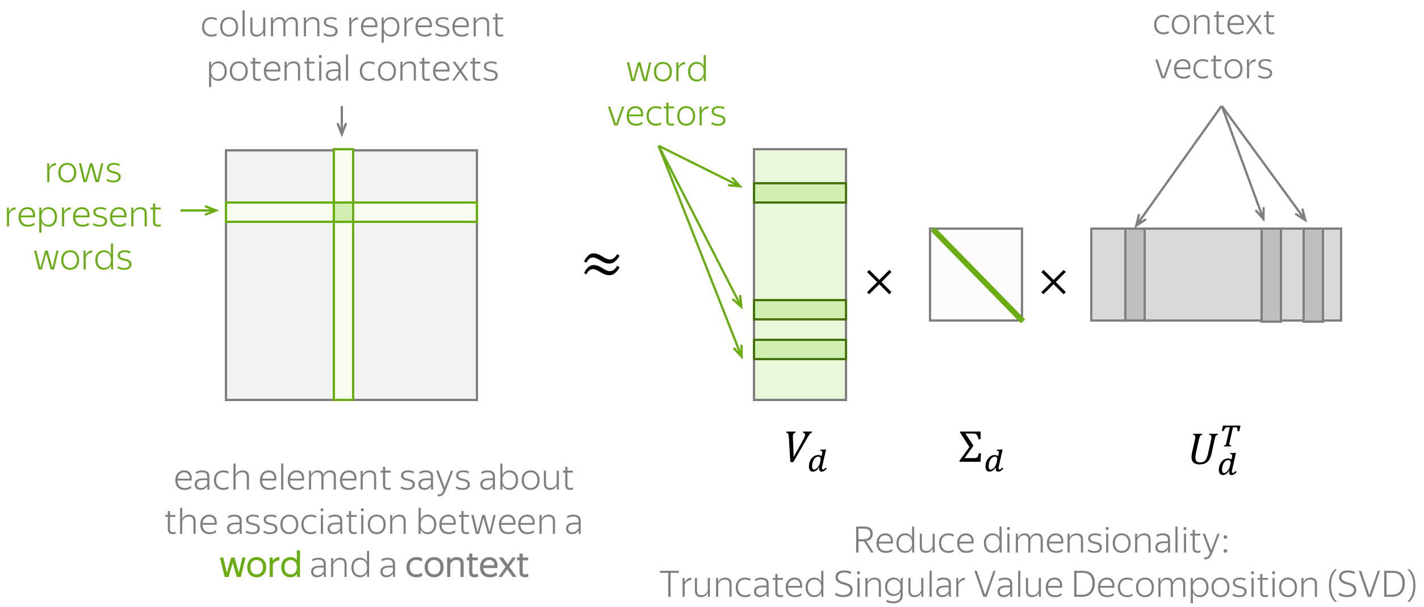
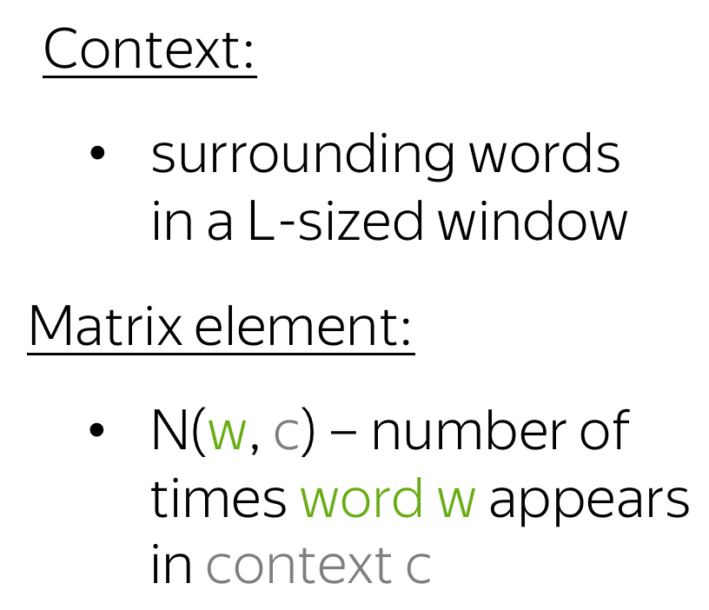
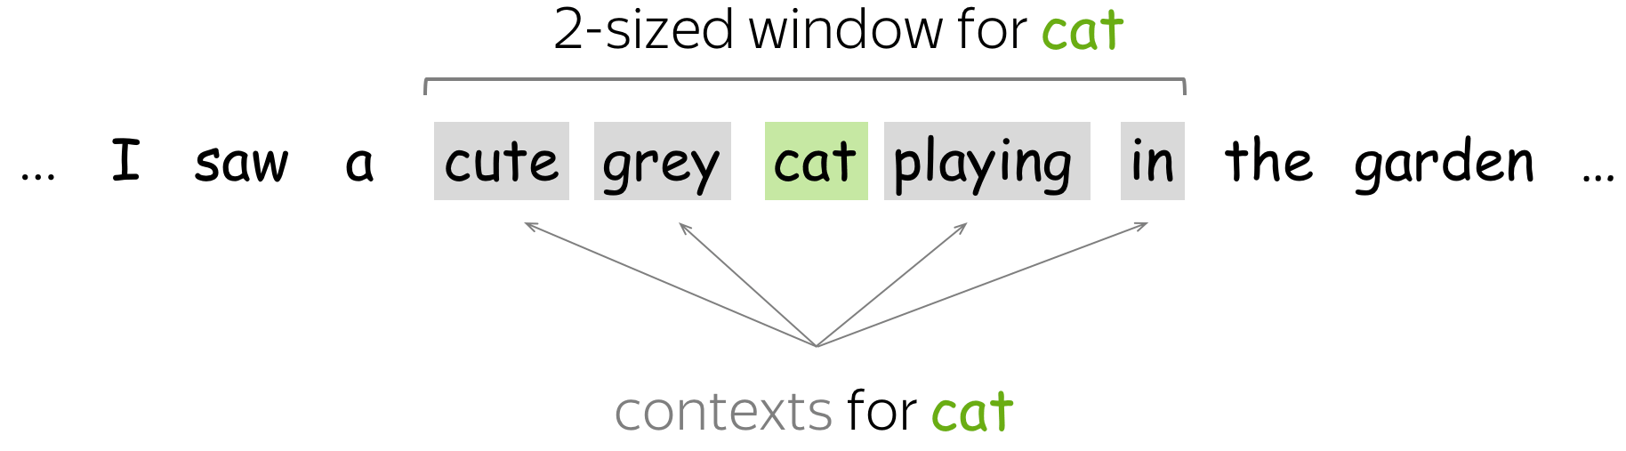
Co-occurence matrix
Note: in our case, N is symmetric!
Slide source: Lena’s blog

Slide 14
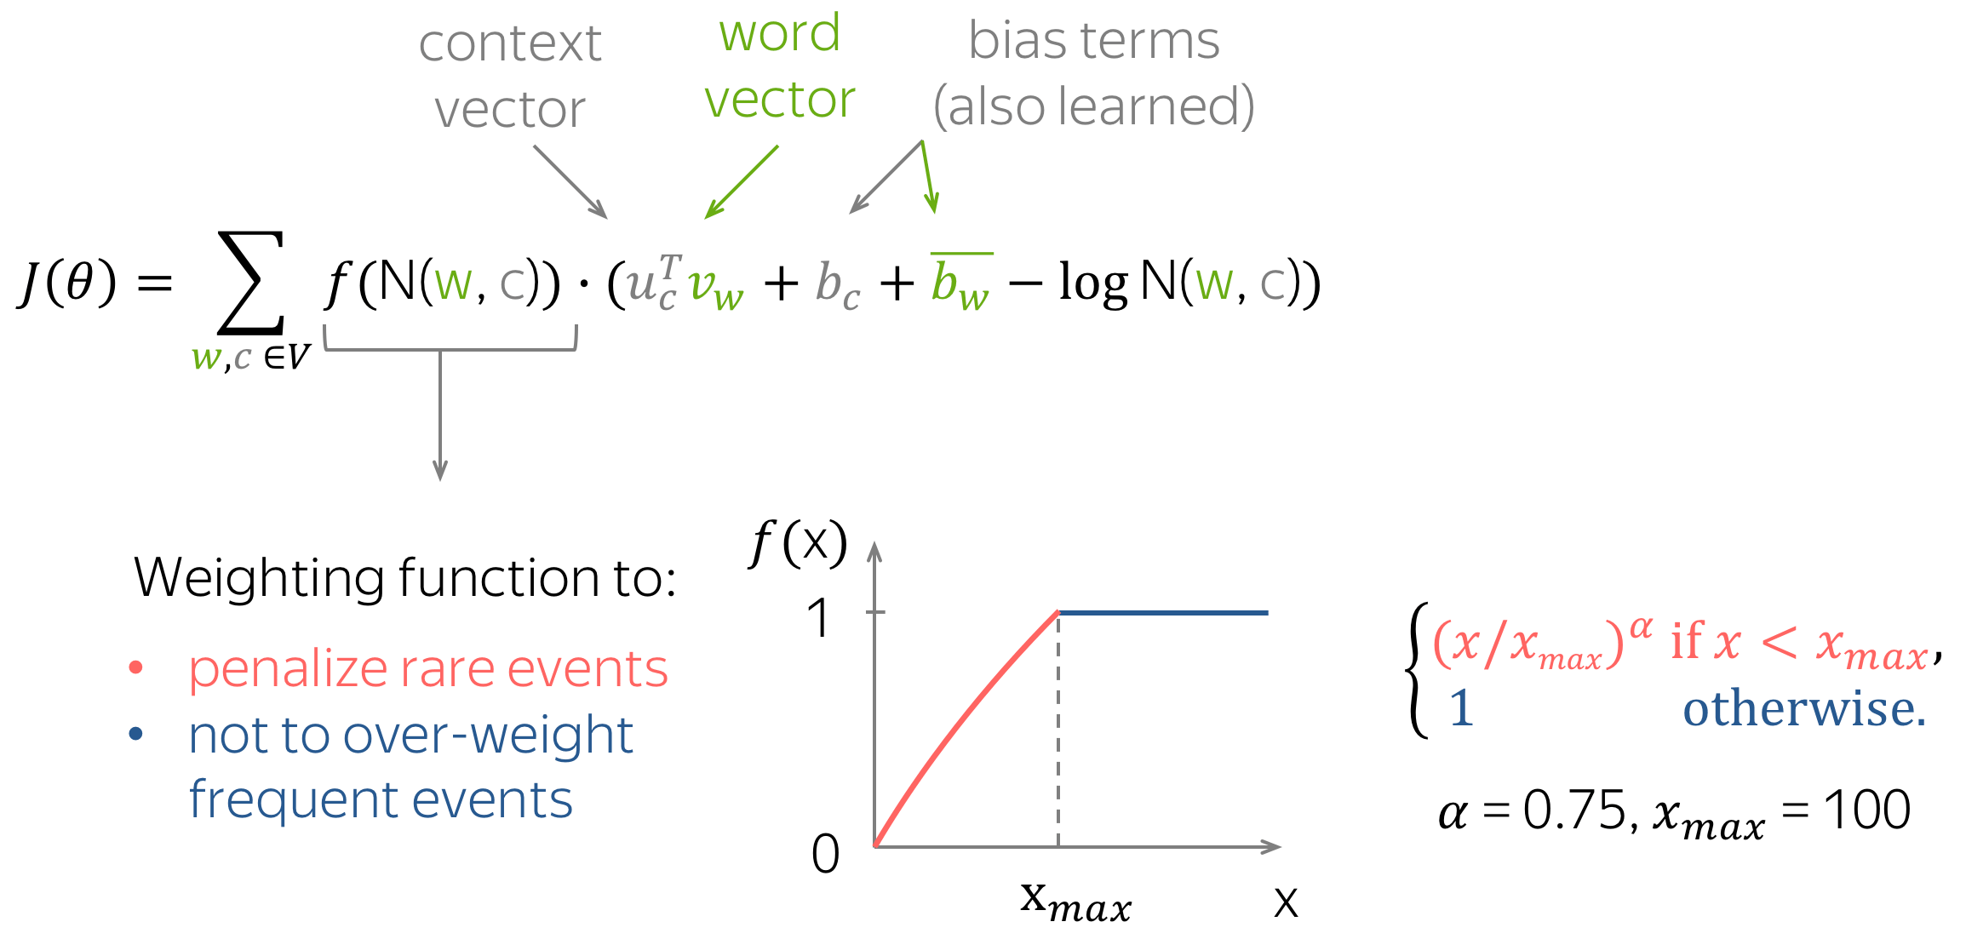
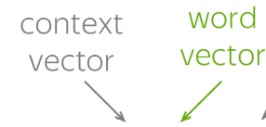
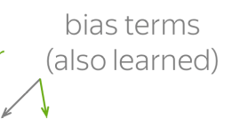
GloVe
Slide source: Lena’s blog

Slide 15
GloVe
Slide source: Lena’s blog

Slide 16
GloVe
Learn more: lena-voita.github.io/nlp_course/word_embeddings.html
So how do we train ‘em?

Slide 17
Training Step
θ
sample i,j
compute L(i, j,θ)
compute ∇θ L(...)
SGD step
θ
current
params
θ: {v, b}
updated
params

Slide 18
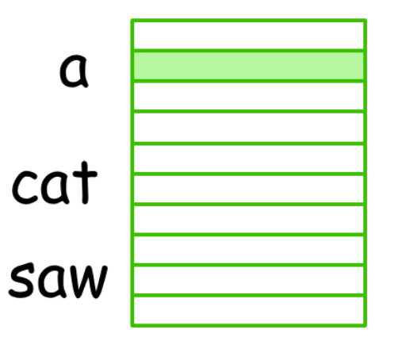
Training Step
θ
sample i,j
compute L(i, j,θ)
compute ∇θ L(...)
SGD step
θ
current
params
θ: {v, b}
updated
params
Trainable parameters:
V matrix
b

Slide 19
Training Step
θ
sample i,j
compute L(i, j,θ)
compute ∇θ L(...)
SGD step
θ
current
params
θ: {v, b}
updated
params
Trainable parameters:
V matrix
b
How do we go faster
with 8 CPU cores?

Slide 20
Rules: Process
foo
bar
baz
qux
...
Process:
Runs some code
Has some memory
No one else can access your memory

Slide 21

Rules: Process
foo
bar
baz
qux
...
Process:
Runs some code
Has some memory
No one else can access your memory

Slide 22
Rules: Process
foo
bar
baz
qux
...
Process:
Runs some code
Has some memory
No one else can access your memory*
* – not if you use shared memory

Slide 23
Rules: Process
foo
bar
baz
qux
...
Process:
Runs some code
Has some memory
No one else can access your memory*†
* – not if you use shared memory
† – superuser can still do that (os-dependent)

Slide 24
Rules: Process
foo
bar
baz
qux
...
Process:
Runs some code
Has some memory
No one else can access your memory*†‡
* – not if you use shared memory
† – superuser can still do that (os-dependent)
‡ – attacker can do that through spectre/meltdown/etc

Slide 25
Rules: Process
foo
bar
baz
qux
...
Process:
Runs some code
Has some memory
No one else should access your memory*†‡
*†‡ – not relevant for this course

Slide 26
Rules: Process
foo
bar
baz
qux
...
Process:
Runs some code
Has some memory
No one else should access your memory*†‡
*†‡ – not relevant for this course
Q: How do we make processes work together?

Slide 27
Rules: Channel / Pipe
Process A:
foo
bar
baz
qux
result
Process B:
func
otherfunc
Channel (pipe):
Communication in O(message size)
Asynchronous read/write

Slide 28
MP Rules
Process A:
not waiting on write
foo
bar
baz
qux
awaiting data ...
Process B:
func
otherfunc
Channel (pipe):
Communication in O(message size)
Asynchronous read/write

Slide 29
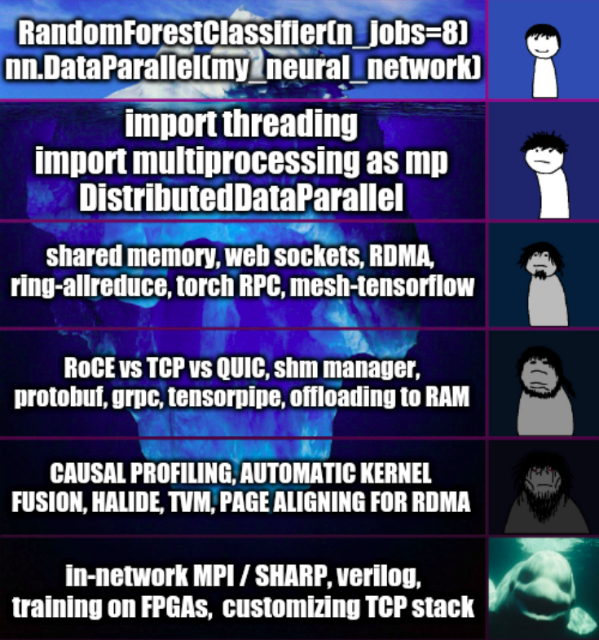
Details are (not) important
Notes:
Не процесс а…?
поток, корутина, горутина, гринлет, warp(gpu), ...
Не пайп а…
(задать вопрос)
tcp/udp socket, filesys, shmem, RDMA, голуби
НО! Всё можно выразить через процесс+канал

Slide 30
Operation parallelism
run algorithm in parallel without changing the math
CPU1
sample i,j
Compute <vi,vj>
+b
L
CPU2
CPU3
CPU4

Slide 31
Operation parallelism
run algorithm in parallel without changing the math
<vi,vj>
CPU1
sample i,j
Slice 1/4
Σ
...
CPU2
Slice 2/4
CPU3
Slice 3/4
CPU4
Slice 4/4

Slide 32
Operation parallelism
How to organize parameters across processes?
CPU1
θ
replicate
params
Slice 1/4
Σ
...
sample i,j
CPU2
can be slow
θ
Slice 2/4
CPU3
θ
Slice 3/4
CPU4
θ
Slice 4/4

Slide 33
Operation parallelism
Each process holds one shard of parameters
(no transfer required)
1/4
CPU1
θ
sample i,j
Slice 1/4
Σ
...
CPU2
θ
2/4
Slice 2/4
CPU3
θ
Slice 3/4
3/4
CPU4
θ
Slice 4/4
4/4

Slide 34
Operation parallelism
What can we improve for 10⁶-dim vectors and 256 cores?
CPU1
sample i,j
Slice 1/4
Σ
...
CPU2
Slice 2/4
CPU3
Slice 3/4
CPU4
Slice 4/4

Slide 35
Operation parallelism
Если мы идём быстро, тут можно поговорить про бустинг.

Slide 36
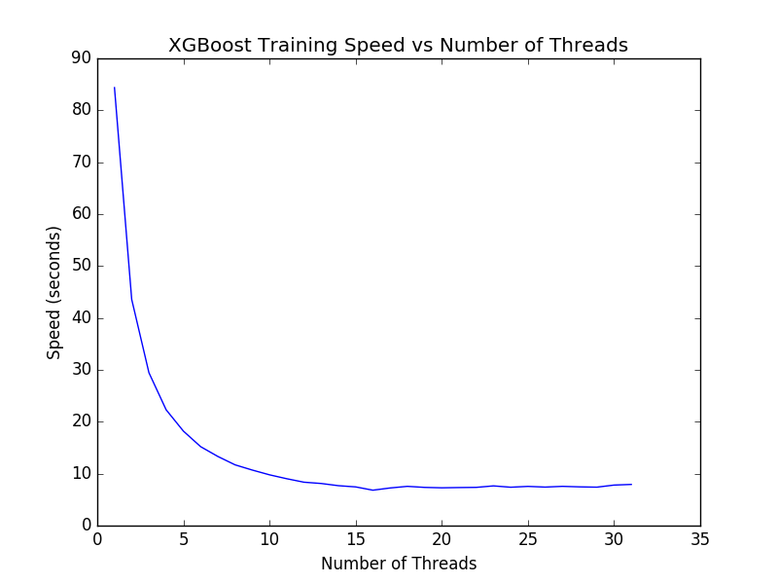
Operation parallelism
More processes = more overhead
waiting for each other
sending data over the network
performance fluctuations
Eventually adding more threads
will no longer boost performance
saturation point

Slide 37
Operation parallelism
More processes = more overhead
waiting for each other
sending data over the network
performance fluctuations
Eventually adding more threads
will no longer boost performance
saturation point
How do we push this point further?

Slide 38
Parameter Server
Paper: Smola et al. (2010)
Make a dedicated process for parameters & optimizer
Model parameters
Workers
CPU1
θ
Train step
∇θL
θ
Train step
∇θL
. . .

Slide 39
Asynchronous training
HOGWILD! arxiv.org/abs/1106.5730
Idea: remove synchronization step alltogether, use parameter server
Model parameters
Devices
CPU1
θ
Train step
∇θL
θ
Train step
∇θL
. . .

Slide 40
Asynchronous training
HOGWILD! arxiv.org/abs/1106.5730
Idea: remove synchronization step alltogether, use parameter server
Model parameters
Devices
CPU1
θ
Train step
∇θL
θ
Train step
∇θL
CPU2
. . .
θ
Train step
θ
Train step
Train step
∇θL
∇θL
. . .
CPU3
Train step
. . .
Train step
. . .
Train step
. . .

Slide 41
Asynchronous training
HOGWILD! arxiv.org/abs/1106.5730
Idea: remove synchronization step alltogether, use parameter server
Model parameters
Devices
CPU1
θ
Train step
∇θL
θ
Train step
∇θL
CPU2
. . .
θ
Train step
θ
Train step
Train step
∇θL
∇θL
. . .
CPU3
Train step
. . .
Train step
. . .
Train step
. . .
Q: have we lost anything by going asynchronous?

Slide 42
Asynchronous training
HOGWILD! arxiv.org/abs/1106.5730
Idea: remove synchronization step alltogether, use parameter server
Model parameters
Devices
get
get
set
set – stale gradient!
CPU1
θ
Train step
∇θL
. . .
CPU2
. . .
θ
Train step
∇θL
CPU3
. . .
. . .
. . .

Slide 43
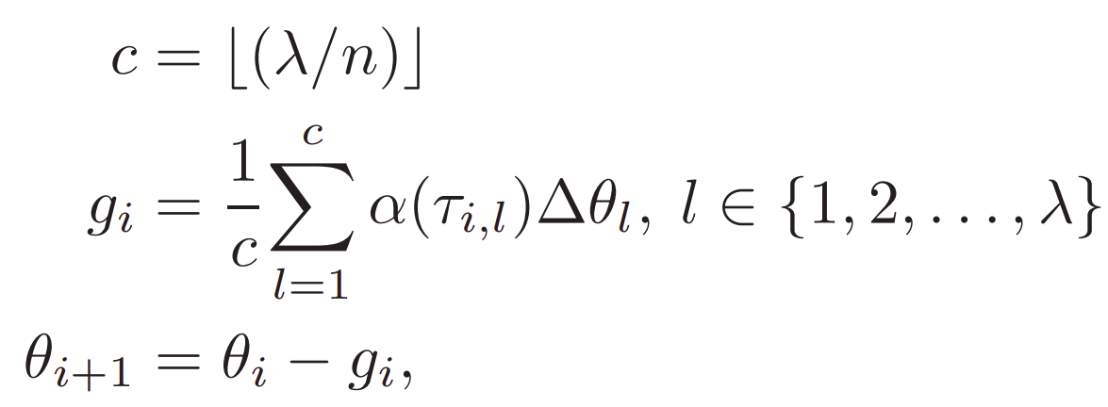
Staleness-aware SGD
Paper: arxiv.org/abs/1511.05950 & others
Updates accumulated:
Average gradient:
New parameters:

Slide 44
Staleness-aware SGD
Paper: arxiv.org/abs/1511.05950 & others
n = total workers
λ = “accumulation factor”
Updates accumulated:
Average gradient:
New parameters:

Slide 45
Staleness-aware SGD
Paper: arxiv.org/abs/1511.05950 & others
Updates accumulated:
Average gradient:
staleness-dependent
“learning rate”
New parameters:

Slide 46
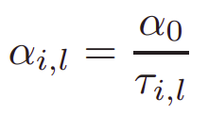
Staleness-aware SGD
Paper: arxiv.org/abs/1511.05950 & others
Updates accumulated:
Average gradient:
New parameters:
base learning rate
staleness (≥1)
aka number of skipped updates

Slide 47
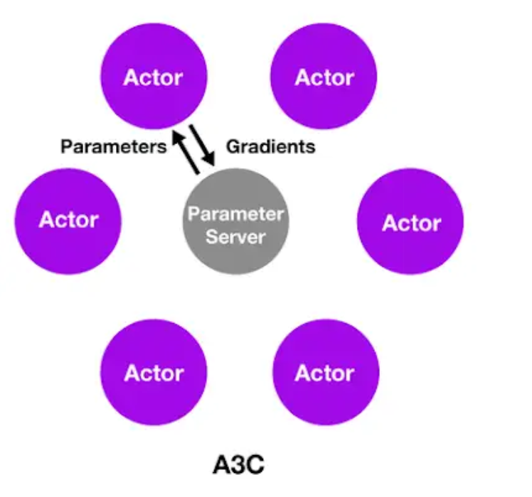
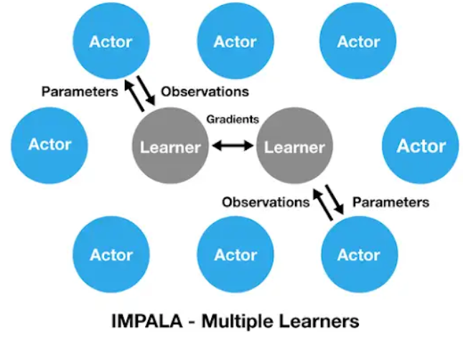
Parameter Server Applications
Conventional ML: e.g. (Logistic Regression, CNN classifiers)
Paper (sharded PS): https://www.cs.cmu.edu/~muli/file/ps.pdf
Another paper (optimizaton tricks): parameter_server_nips14.pdf
PyTorch tutorial (hogwild), TF tutorial (parameter server)
Reinforcement learning:
Async. RL: arxiv.org/abs/1602.01783
IMPALA: arxiv.org/abs/1802.01561
SEED RL: arxiv.org/abs/1910.06591
More:
(english) https://youtu.be/kOy49NqZeqI
(russian) https://youtu.be/wswbMkT55mI

Slide 48
Привет, Ёж. Это – последний слайд.
Если вы уже здесь, а время ещё осталось,
разбери-ка вот эту статью:
https://www.usenix.org/system/files/osdi20-jiang.pdf

