Slide 1


MDP & POMDP
Agent
observe
apply
action
Observation
action
Environment

Slide 2
Approximate Q-learning
nice and simple
Q-values:
Q(s,a0),
Q(s,a1),
Q(s,a2)
model
W = params
Objective:
Gradient step:
image

Slide 3
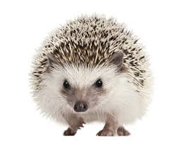
DQN
nutrition facts
ϵ-greedy rule
(tune ϵ or use probabilistic rule)
action
apply
action
Qvalues is a dense layer with no nonlinearity
Qvalues
Dense
Change axis order to fit in with lasagne convolutions
Any neural network you can think of.
conv
pool
dense
dropout
batchnorm
...
Conv1
image
(i,w,h,3)
Dimshuffle
(i,3,w,h)
Conv0

Slide 4
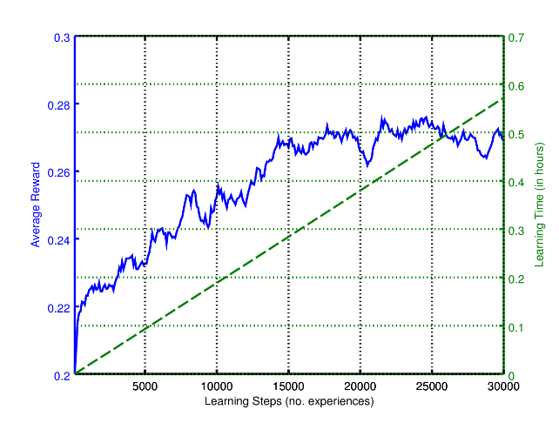
Approximate Q-learning
problems
  Training samples are not “i.i.d”,
  Model forgets parts of environment it haven't visited for some time,
  Fallbacks on the learning curve
  Any ideas?

Slide 5

Deep Q-learning
Multiple agent trick
parameter
server
W
Idea: Throw in several agents with shared W.
  Chances are, they will be exploring different parts of the environment,
  More stable training,
  Requires a lot of interaction,
  Alternative to experience replay.
agent0
agent1
agent2
env0
env1
env2

