Slide 1



MLHEP2017
Day -1.2
Recurrent Neural Networks

Slide 2

Sequential data
Time series
  Financial data analysis
  Demand prediction
  Predict vehicle breakdown
    using sensor data
  Medical sensors
    e.g. sugar level
Etc
  Speech, music
  Molecules (SMILES)
  Decay trees
  …
Text
  Generating tweets, poetry
  Sentiment analysis
Spatio-temporal
  Video
  Precipitation maps
  Ultrasonography
  Could go on all day

Slide 3

Time series @finance
Data:
  Stock indices
  Commodities
  Forex
Objectives:
  Portfolio management
  Volatility targeting
  Estimating true value
  ...

Slide 4
Time series @finance
Data:
  Stock indices
  Commodities
  Forex
Objectives:
  Portfolio management
  Volatility targeting
  Estimating true value
  ~ trading stuff
  ~ evaluating risk
  ...

Slide 5
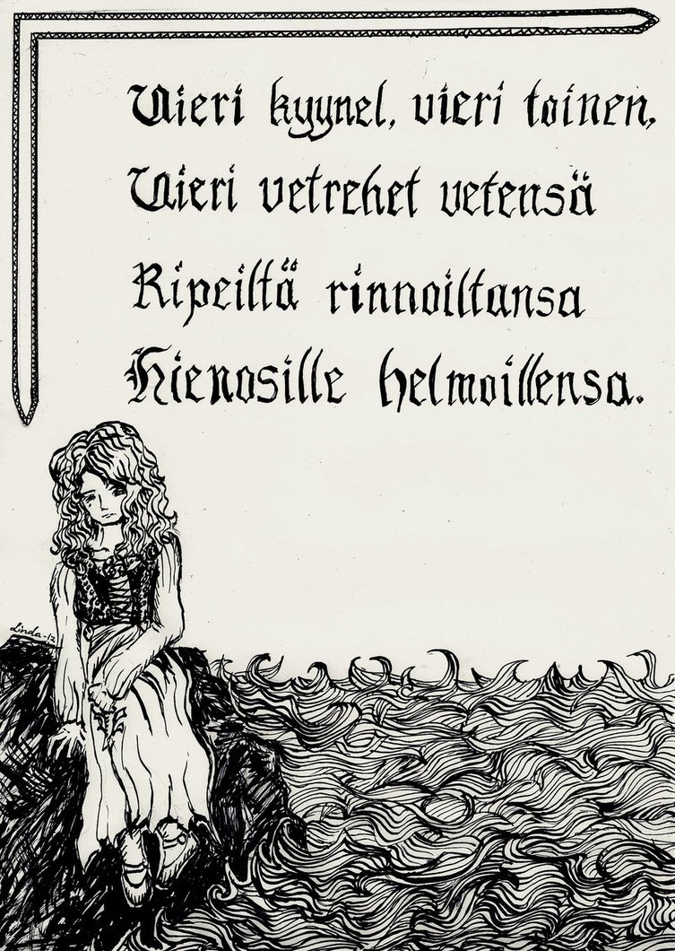
Natural language as time series
Data:
  Literature
  Conversation
  Tweets
  Book scans
  Speech

Slide 6
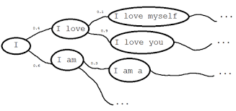
Language model
Objective:
    Learn P(text)

Slide 7
Language model
Why learning it?
    Detect languages as P(text|language)
    Sentiment analysis P(text|happy)
    Any text analysis you can imagine
    Generate texts!
      Cool article http://bit.ly/1K610Ie
      Generating clickbait: http://bit.ly/21cZM70

Slide 8
Language model
    Actual distribution
    Bag of words assumption (independent words)
    Anything better?

Slide 9
Language model
    Actual distribution
    Bag of words assumption (independent words)
    Markov assumption
      also 3-gram, 5-gram, 100-gram

Slide 10
Can we learn* arbitrarily long dependencies?
* without infinitely many parameters

Slide 11
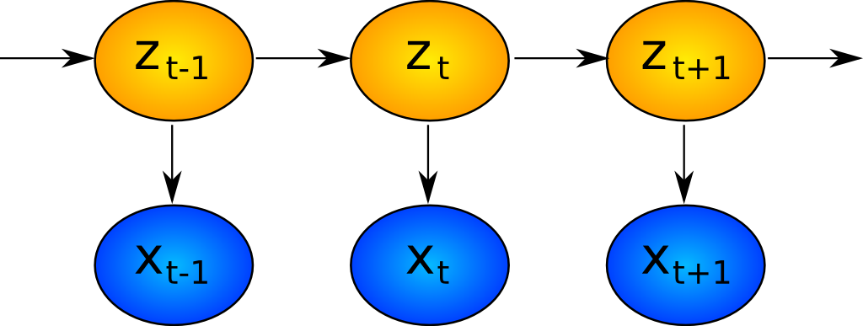
Hidden Markov Models: what's hidden
Hidden
Observed

Slide 12
Hidden Markov Models: what is hidden
Author's brain state
Hidden
Observed
Words

Slide 13
Recurrent neural network: one step
output
concat
Wx+b
H units
Last
State
sigmoid
New
state
z_t
time
Input at
This tick
x_t

Slide 14
Recurrent neural network: one step
output
Elementwise
Wx+b
h x h
matrix
+
sigmoid
Last
State
h units
New
state
Wx+b
i x h matrix
time
Input at
This tick

Slide 15
Recurrent neural network
Zoom-out
of previous slide

Slide 16
Recurrent neural network
old state
new state
Input x0

Slide 17
Recurrent neural network
old state
new state
even newer state
Input x0
Input x1

Slide 18
Recurrent neural network
old state
new state
even newer state
Input x0
Input x1
We use same weight matrices for all steps

Slide 19
Recurrent neural network
P(next)
x0=”the”
x1=”cat”
x2=”sat”
x3=”on”

Slide 20
Recurrent neural network
P(next)
x0=”the”
x1=”cat”
x2=”sat”
x3=”on”
How can we represent words?

Slide 21
Recurrent neural network
P(next)
h0
h1
h1
h2
h3
embed
embed
embed
embed
x0=”the”
x1=”cat”
x2=”sat”
x3=”on”

Slide 22
Recurrent neural network
P(next)
h0
h1
h1
h2
h3
embed
embed
embed
embed
x0=”the”
x1=”cat”
x2=”sat”
x3=”on”

Slide 23
Recurrent neural network
P(next)
h0
h1
h1
h2
h3
embed
embed
embed
embed
x0=”the”
x1=”cat”
x2=”sat”
x3=”on”

Slide 24
Recurrent neural network
P(next)
embed
embed
embed
embed
x0=”the”
x1=”cat”
x2=”sat”
x3=”on”

Slide 25
Recurrent neural network
Loss
P(next)
...
embed
embed
embed
embed
x0=”the”
x1=”cat”
x2=”sat”
x3=”on”

Slide 26
Recurrent neural network
Loss
How do we train it?
P(next)
...
embed
embed
embed
embed
x0=”the”
x1=”cat”
x2=”sat”
x3=”on”

Slide 27


Slide 28

Backpropagation through time
Loss
Chain rule
unroll
P(next)
...
embed
embed
embed
embed
x0=”the”
x1=”cat”
x2=”sat”
x3=”on”

Slide 29

Truncated BPTT
Reality: roll for T steps, then truncate
(T=10? 20? 1000?)
Loss
Chain rule
unroll
P(next)
...
embed
embed
embed
embed
x0=”the”
x1=”cat”
x2=”sat”
x3=”on”

Slide 30
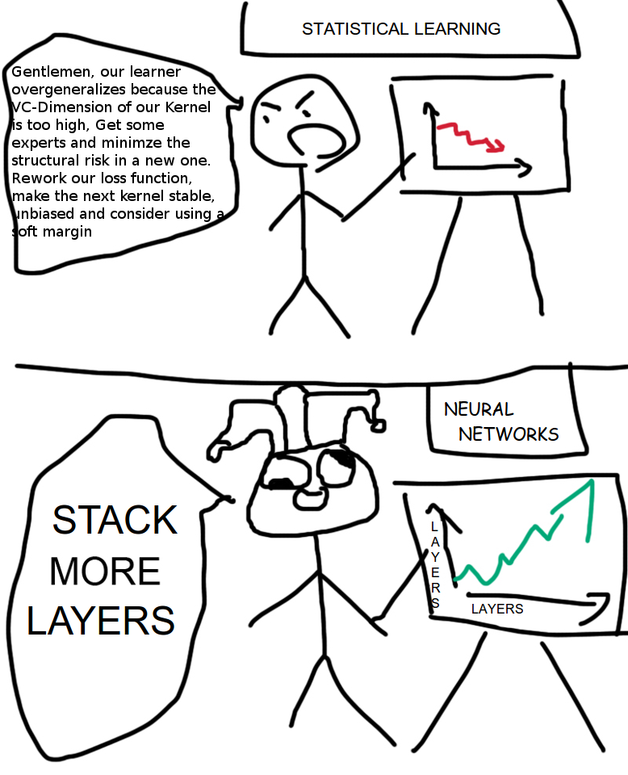

Slide 31
What is layer, again?
x1
x2
x3
x4
embed
embed
embed
embed
x0=”the”
x1=”cat”
x2=”sat”
x3=”on”

Slide 32
Layers
Where to stick more layers?
Dense
(softmax)
x1
x2
x3
x4
RNN
embed
embed
embed
embed
Embedding
Input
x0=”the”
x1=”cat”
x2=”sat”
x3=”on”

Slide 33
More layers
Dense
(softmax)
x1
x2
x3
x4
RNN 2
RNN 1
embed
embed
embed
embed
Embedding
Input
x0=”the”
x1=”cat”
x2=”sat”
x3=”on”

Slide 34

Too f**king complicated
Dense
(softmax)
x1
x2
x3
x4
RNN 2
RNN 1
embed
embed
embed
embed
Embedding
Input
x0=”the”
x1=”cat”
x2=”sat”
x3=”on”

Slide 35
2-layer RNN
Dense
(softmax)
x1
x2
x3
x4
RNN 2
RNN 1
embed
embed
embed
embed
Embedding
Input
x0=”the”
x1=”cat”
x2=”sat”
x3=”on”

Slide 36
BPTT again
Dense
(softmax)
x1
x2
x3
x4
RNN 2
RNN 1
embed
embed
embed
embed
Embedding
Chain rule
unroll
Input
x0=”the”
x1=”cat”
x2=”sat”
x3=”on”

Slide 37
BPTT Again
Loss
?!
P(next)
Chain rule
unroll
embed
embed
embed
embed
x0=”the”
x1=”cat”
x2=”sat”
x3=”on”

Slide 38
BPTT Again
Loss
P(next)
Chain rule
unroll
embed
embed
embed
embed
x0=”the”
x1=”cat”
x2=”sat”
x3=”on”

Slide 39
BPTT Again
consider h2 constant
Loss
P(next)
Chain rule
unroll
embed
embed
embed
embed
x0=”the”
x1=”cat”
x2=”sat”
x3=”on”

Slide 40
BPTT Again
Loss
P(next)
Chain rule
unroll
embed
embed
embed
embed
x0=”the”
x1=”cat”
x2=”sat”
x3=”on”

Slide 41
BPTT Again
Loss
Your guess?
P(next)
Chain rule
unroll
embed
embed
embed
embed
x0=”the”
x1=”cat”
x2=”sat”
x3=”on”

Slide 42
BPTT Again
Loss
P(next)
Chain rule
unroll
embed
embed
embed
embed
x0=”the”
x1=”cat”
x2=”sat”
x3=”on”

Slide 43
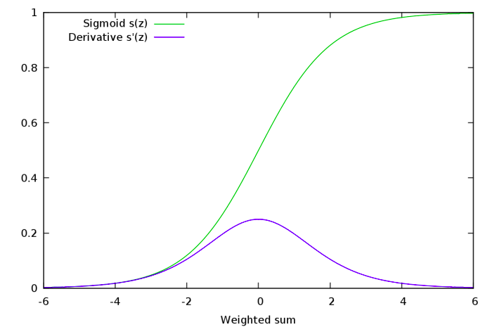
Gradient explosion and vanishing
Many sigmoids near 0 or 1
  Gradients → 0
  Not training for long-term dependencies
Many nonzero values
  Derivative stacks to >1
  Gradients → inf
  Weights → shit

Slide 44
RNN step
Elementwise
Wx+b
H units
+
Nonline-
arity
Last
State
New
state
Wx+b
H units
time
Input at
This tick

Slide 45
RNN step
Elementwise
Wx+b
H units
+
Tanh
Last
State
New
state
Wx+b
H units
time
Input at
This tick

Slide 46
Residual RNN step
Elementwise
+
New
state
Last
State
Elementwise
Wx+b
H units
+
Tanh
Wx+b
H units
time
Input at
This tick

Slide 47
Residual RNN step
Elementwise
+
New
state
Last
State
Elementwise
Wx+b
H units
+
Tanh
Difference:
Preserving information through time is now effortless.
Gradients do not vanish.
Much harder to get rid of something (reset cell to zero) when you need to do so.
Wx+b
H units
Chain rule
unroll
time
Input at
This tick

Slide 48
Residual RNN step
Elementwise
+
New
state
Last
State
Elementwise
Wx+b
H units
+
Tanh
Wx+b
H units
Update
time
Input at
This tick

Slide 49
Residual RNN step
Elementwise
+
New
state
Last
State
Update
time
Input at
This tick

Slide 50
Residual RNN step
Elementwise
+
New
state
Last
State
Update
time
Input at
This tick

Slide 51
Residual RNN step
Elementwise
mul
Elementwise
+
New
state
Last
State
sigm
Wx+b
Update
Trivia:
What should the new Wx+b be equivalent to previous slide RNN?
How can it fully erase the memory?
time
Input at
This tick

Slide 52
Residual RNN step
Elementwise
mul
Elementwise
+
New
state
Last
State
sigm
forget
gate
Wx+b
Update
Note: If at some tick we killed h while we needed them later, the gradient will cause forgetgate to “open”
time
Input at
This tick

Slide 53
What we drew
*
h
prev
sigm
+
h
new
Wx+b
forget
gate
Update
xi

Slide 54
What we drew
*
h
prev
sigm
+
h
new
Wx+b
forget
gate
Update
xi

Slide 55
What we drew
*
+
How to compute
h_new?
h
prev
sigm
forget
gate
h
new
Wx+b
Update
xi

Slide 56
What we drew

Slide 57
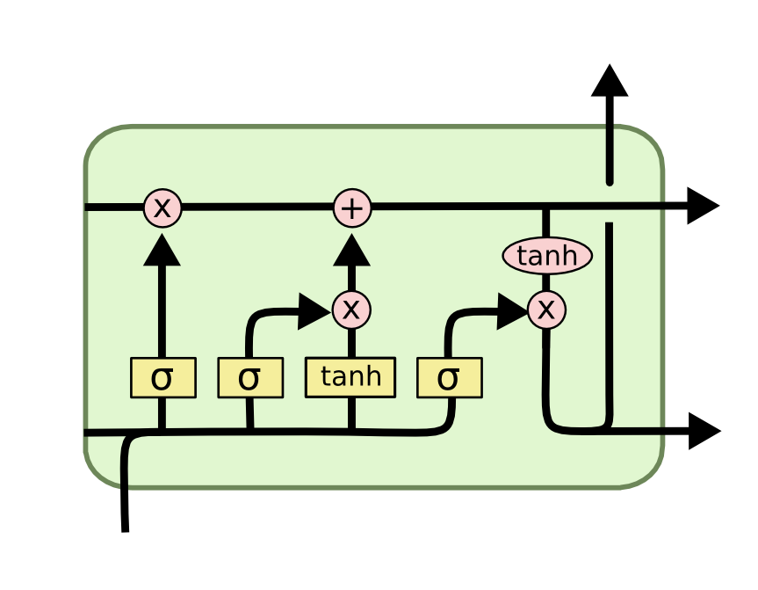
LSTM
2 hidden states:
Cell (“private” state)
Output (“public” state)
4 blocks:
Update
Forget gate
Input gate
Output gate

Slide 58
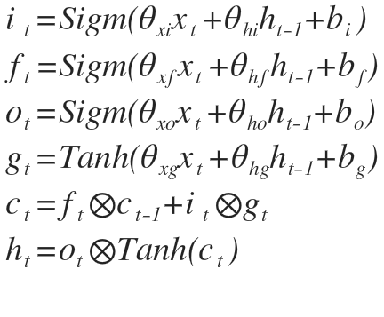
LSTM
h new
(output)
c
prev
c
new
h
prev
h
new
x
Where are the gates?

Slide 59
LSTM
new h
(output)
c
prev
c
new
i
f
g
h
prev
o
h
new
x

Slide 60

GRU

Slide 61
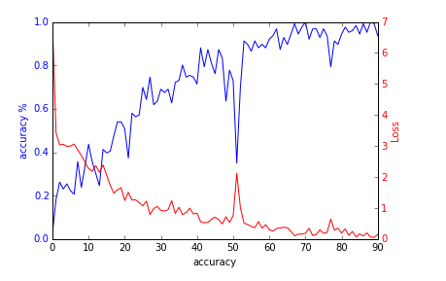
Okay, the gradients no longer vanish
except they still do, if only slower
But how do we deal with exploding grads?
Ideas?

Slide 62
Gradient clipping
At each time tick,
  check if grad abs value is more than … 5?
  If so, clip it
      large positive is now 5,
      large negative is now -5
  How large is too large?
    Reduce clipping threshold until explosions disappear

Slide 63
Gradient clipping
Where do I clip?
  Clip each element of
  Clip each element of
  Clip whole by norm
    If , scale

Slide 64
Generating stuff
Easy:
  Names, small phrases
  Orthographically correct delirium
Medium:
  Grammatically coherent text
  Resembling particular author
Hard:
  C/C++ source code
  Music
  Organic molecules
  LaTex articles
  Your course projects

Slide 65

Nuff
Coding time!

