Slide 1



MLHEP
Day -1.1
Generative models

Slide 2
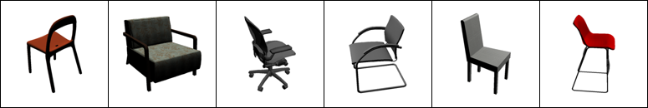
Image generation
Chairs (type, view, orientation)
Classifier

Slide 3
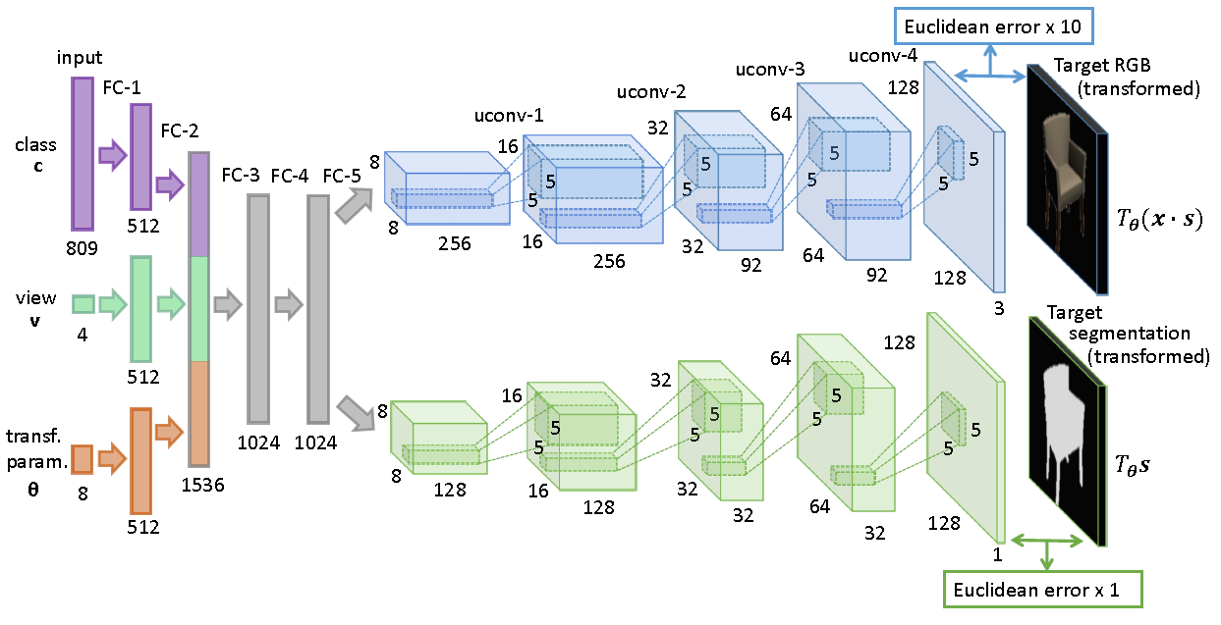
Image generation
Generator
MSE

Slide 4
Mean Squared Error
Pixelwise MSE:
A “cat on the left” is closer to “dog on the left” than to “cat on the right”
We may want to avoid that effect
Can we obtain image representation that is less sensitive to small shifts?

Slide 5
Problem: MSE sucks at this task.
Ideas?

Slide 6
Sketch: using pre-trained nets
Generator
Seed &
parameters
VGG16
(pretrained)
Real
image
VGG16
(pretrained)
MSE

Slide 7
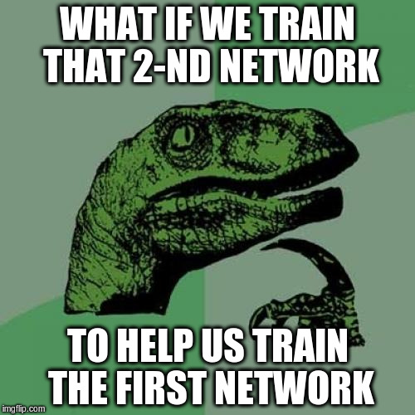

Slide 8

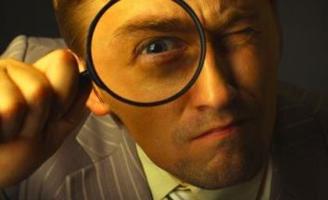
Generative Adversatial Networks
Generator
Discriminator
content
feedback
Generate image
(should be plausible)
Tell if image is plausible
(image) → P(fake)

Slide 9
Generative Adversarial Networks
Generator
Discriminator
Image
Fake
Image
Noise
/params
NN
Image
(fake/real)
Other NN
P(fake|image)

Slide 10
Generative Adversarial Networks
Generator
Discriminator
Image
Fake
Image
Noize
/params
Gen(seed)
Image
(fake/real)
Disc(x)
P(fake|image)

Slide 11
Generative Adversarial Networks
Generator
Discriminator
Image
Fake
Image
Noize
/params
Gen(seed)
Image
(fake/real)
Disc(x)
P(fake|image)

Slide 12
Generative Adversarial Networks
Algorithm
  sample noise z and images x
  for k in 1...K
    Train discriminator(x), discriminator(generator(z))
  For m in 1...M
    Train generator(z)

Slide 13
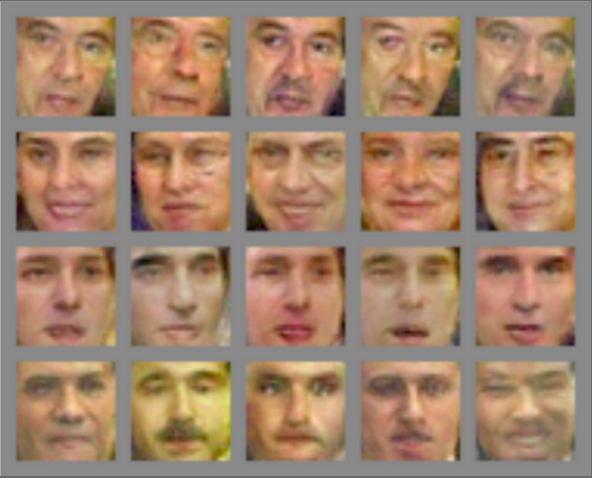
Generative Adversarial Networks

Slide 14
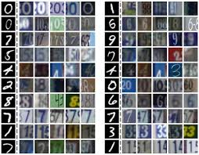
Adversarial domain adaptation
Two domains
  e.g. mnist digits Vs actual digits on photos
First domain is labeled, second isn't
Wanna learn for the second domain
Immediate use case: monte-carlo vs real data

Slide 15
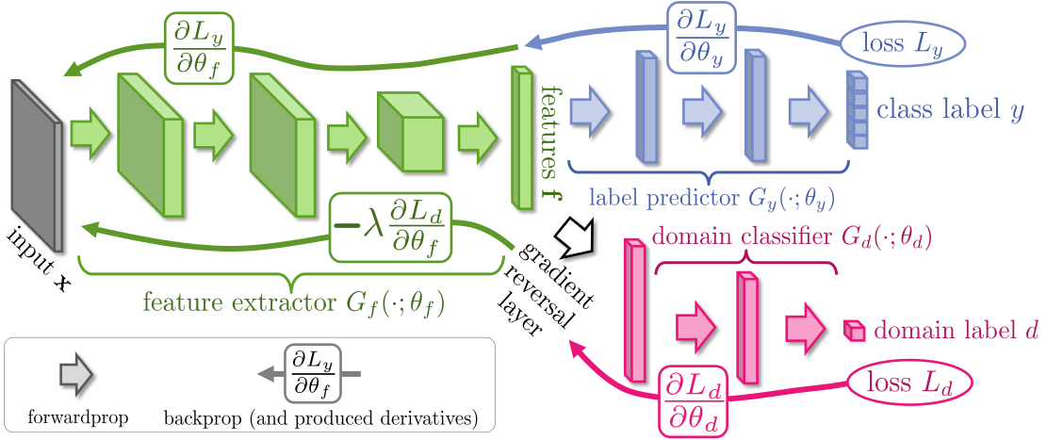
Domain adaptation
Idea: discriminator should not be able to distinguish features on two domains

Slide 16
Domain adaptation
Idea: discriminator should not be able to distinguish features on two domains

Slide 17
Domain adaptation
Idea: discriminator should not be able to distinguish features on two domains

Slide 18
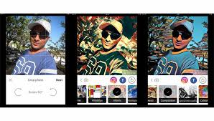
Art style transfer
Ideas?

Slide 19
Art style transfer
Formulate and optimize texture loss
Reference
image
VGG16
(pretrained)
First K layers
Compute
gram matrix
Texture
features
Original
image
VGG16
(pretrained)
Almost full
Content
features

Slide 20
Art style transfer

