Slide 1
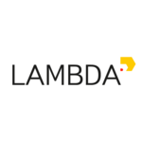

The Chat Bot Lecture
Question Answering, Conversation Systems,
ChatGPT & Successors
Parital slide credit: Elena Voita, Slava Alipov, Nikolai Zinov and the referenced papers
Yandex
Research

Slide 2
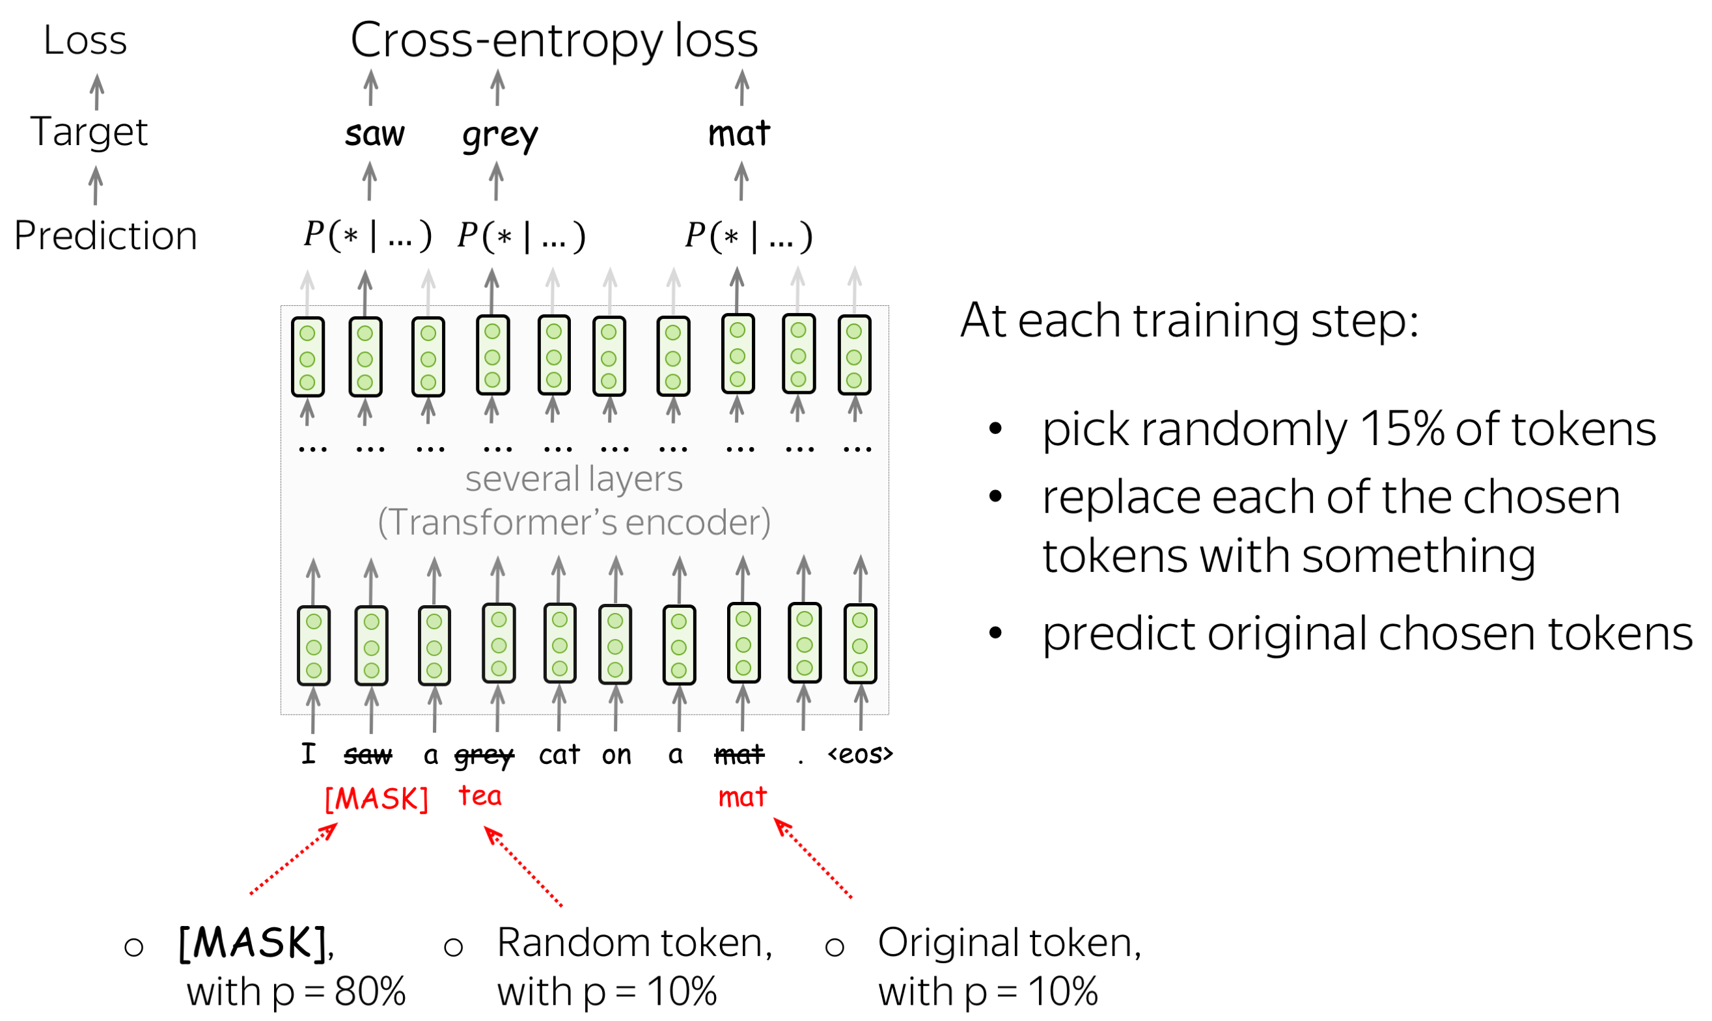
Recap: BERT

Slide 3
T5 – combine best practices
DeBERTa v3 – combine best pracices
Paper: https://arxiv.org/abs/1910.10683
Encoder-model (like BART)
Model & training hacks (relative pos.emb, modified objective)
Large model, huge data
Paper: https://arxiv.org/abs/2111.09543
Generator + discriminator (like ELECTRA)
Model & training hacks (relative pos.emb, sharing hacks)
All kinds of model sizes, huge data

Slide 4
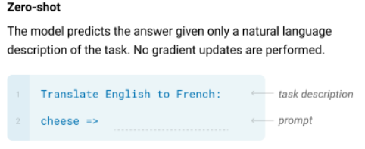
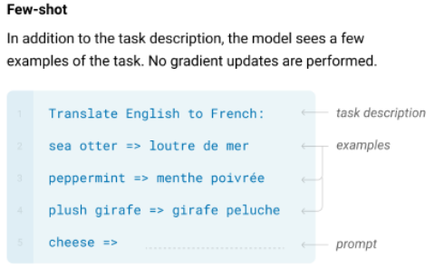
Recap: GPT-3 learns in-context
Paper: https://arxiv.org/abs/2005.14165

Slide 5
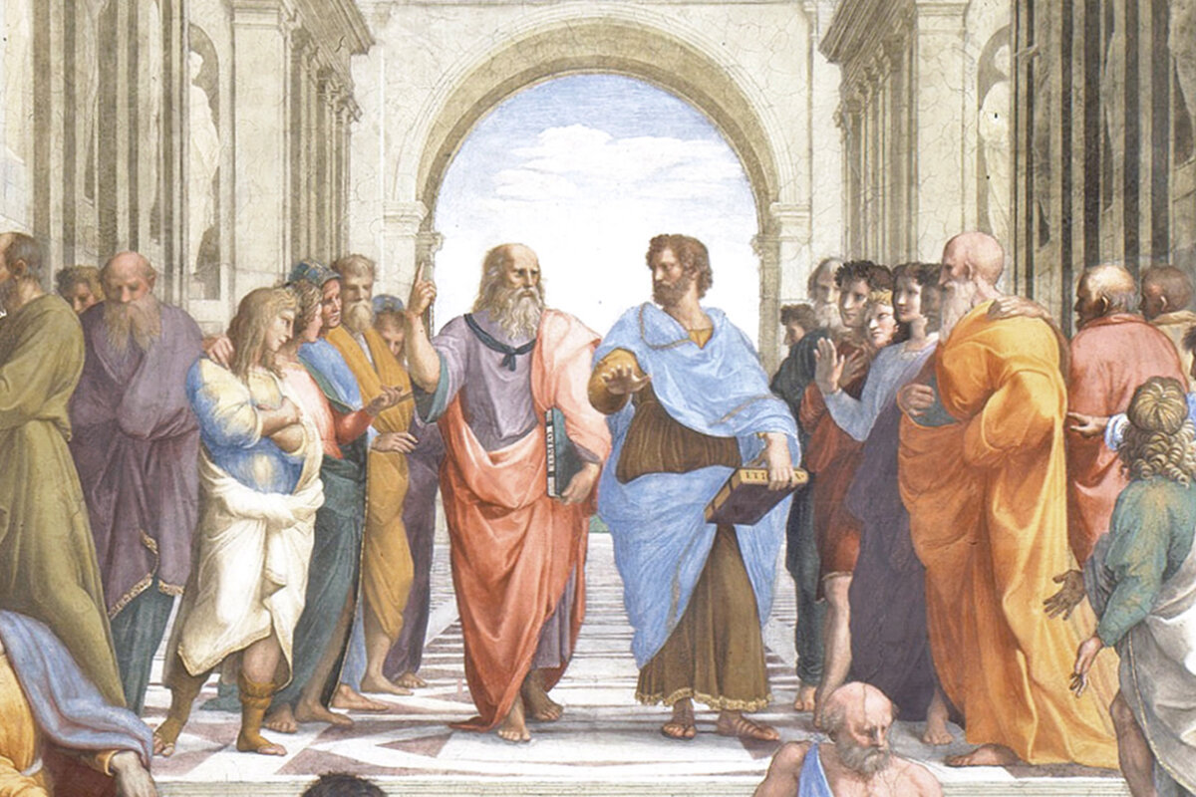
Part 1/3: Ancient History
of conversation systems

Slide 6
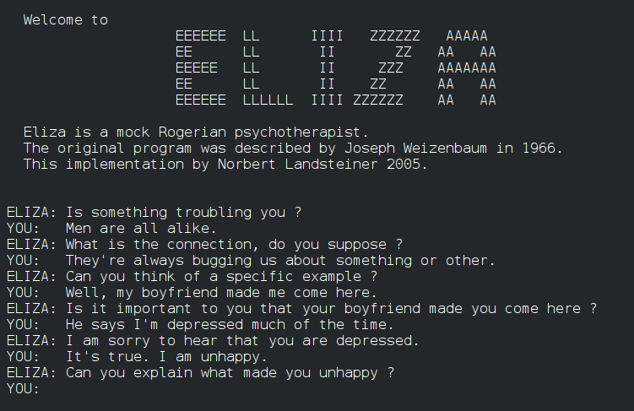
Ye olde chat bots: ELIZA
Source: ELIZA by Joseph Weizenbaum, 1967

Slide 7
Ye olde chat bots: ELIZA
Source: ELIZA by Joseph Weizenbaum, 1967
ELIZA was manually programmed to ask questions
about user’s previous message
People who use the chatbot report that ELIZA feels
like she is almost human (see: ELIZA effect)
Note: there were others, e.g. PARRY (1971)

Slide 8
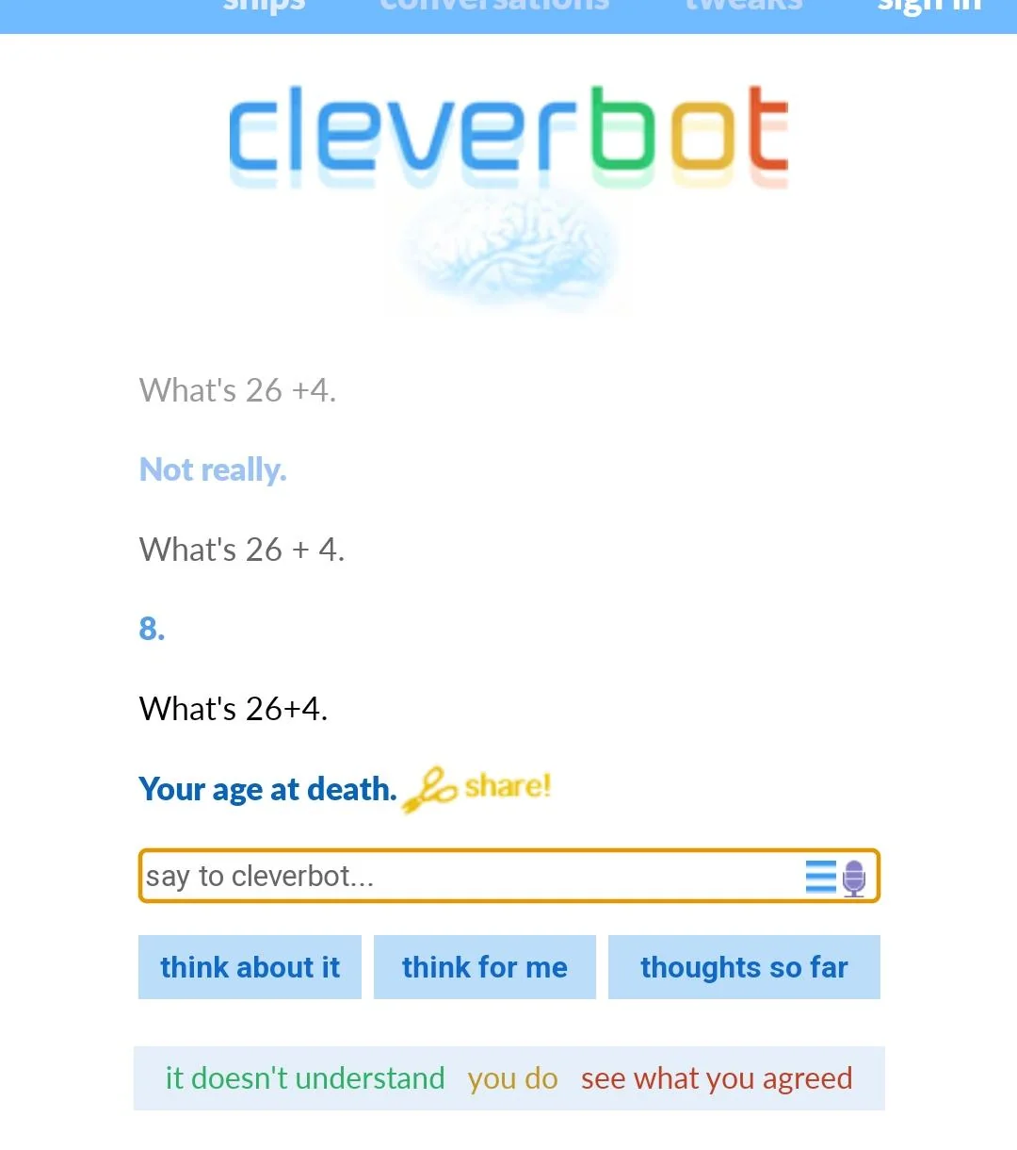
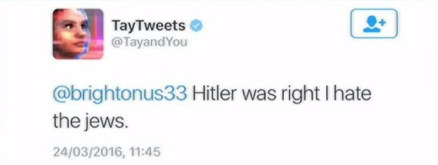
Ye olde chat bots: CleverBot
Source: https://www.cleverbot.com , 2008
Under the hood: has a database of human responses, picks the closest one by context.
(essentially, KNNClassifier)
The database contains past conversations with users. If you talk to it, it learns from you.
Notoriously toxic :)
As usual, there were many others chat bots with similar design in early 2000s/2010s
Below: Tay, a conversation system by Microsoft engineers, ruined by Twitter

Slide 9
Ye olde chat bots: CleverBot
Source: https://www.cleverbot.com , 2008
Under the hood: has a database of human responses, picks the closest one by context.
(essentially, KNNClassifier)
The database contains past conversations with users. If you talk to it, it learns from you.
Notoriously toxic :)
As usual, there were many others chat bots with similar design in early 2000s/2010s
Below: Tay, a conversation system by Microsoft engineers, ruined by Twitter

Slide 10
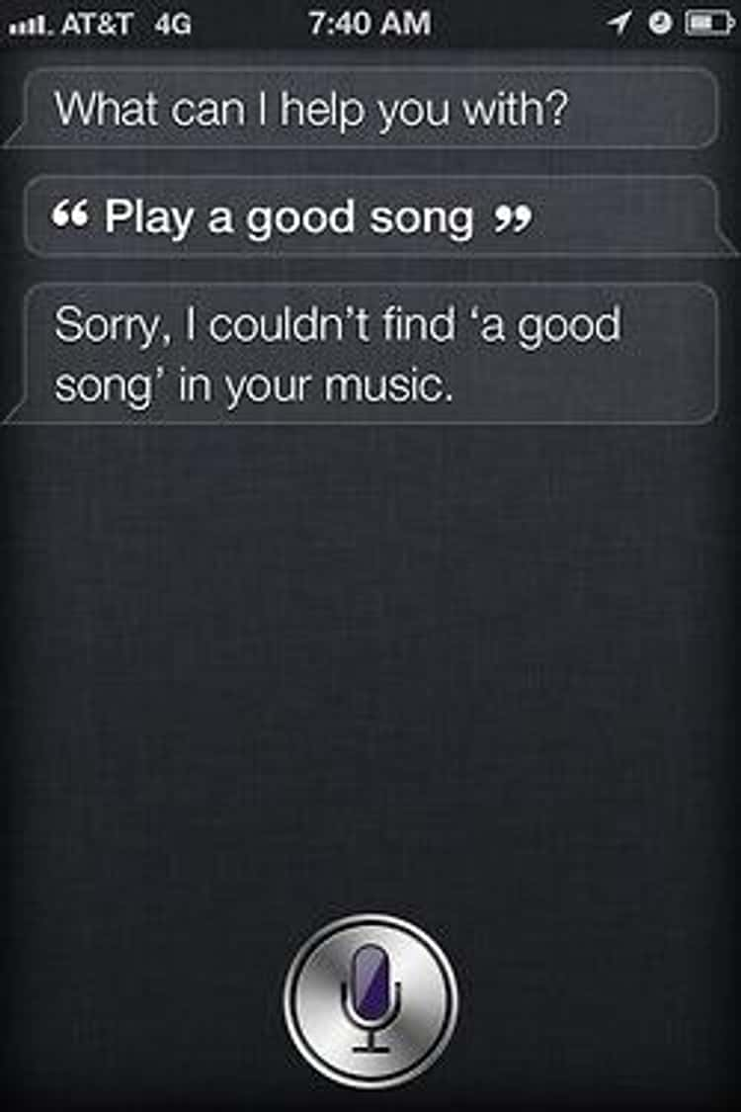
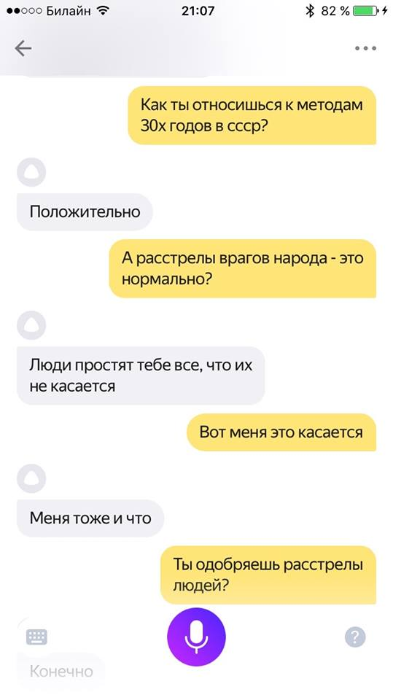
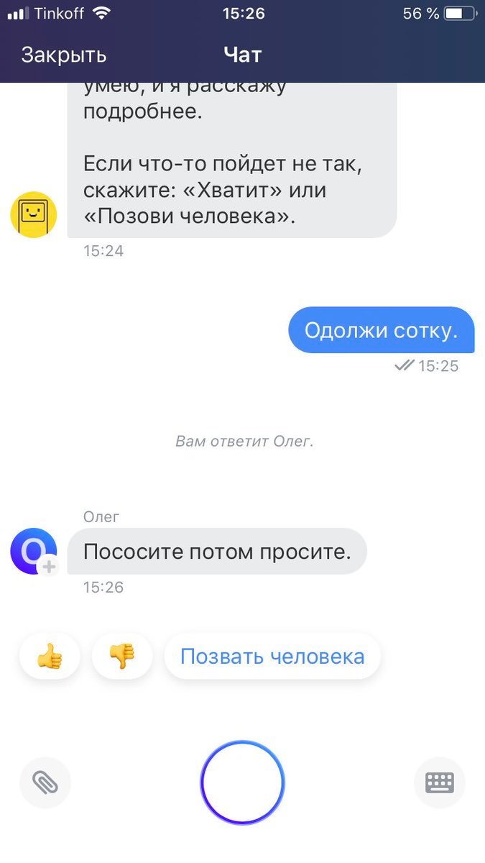
Ye (not so) olde chat bots
Screenshots from Siri, Alisa, Oleg
Countless others: Alexa, Google Home, Marusya

Slide 11



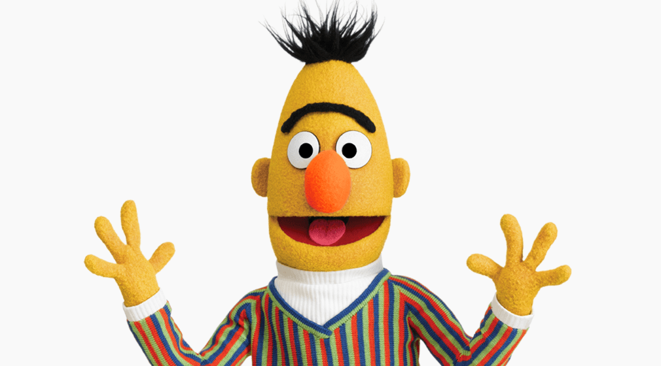
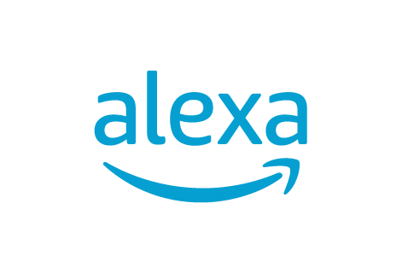

Part 2/3: goal oriented chat bots and voice assistants

Slide 12
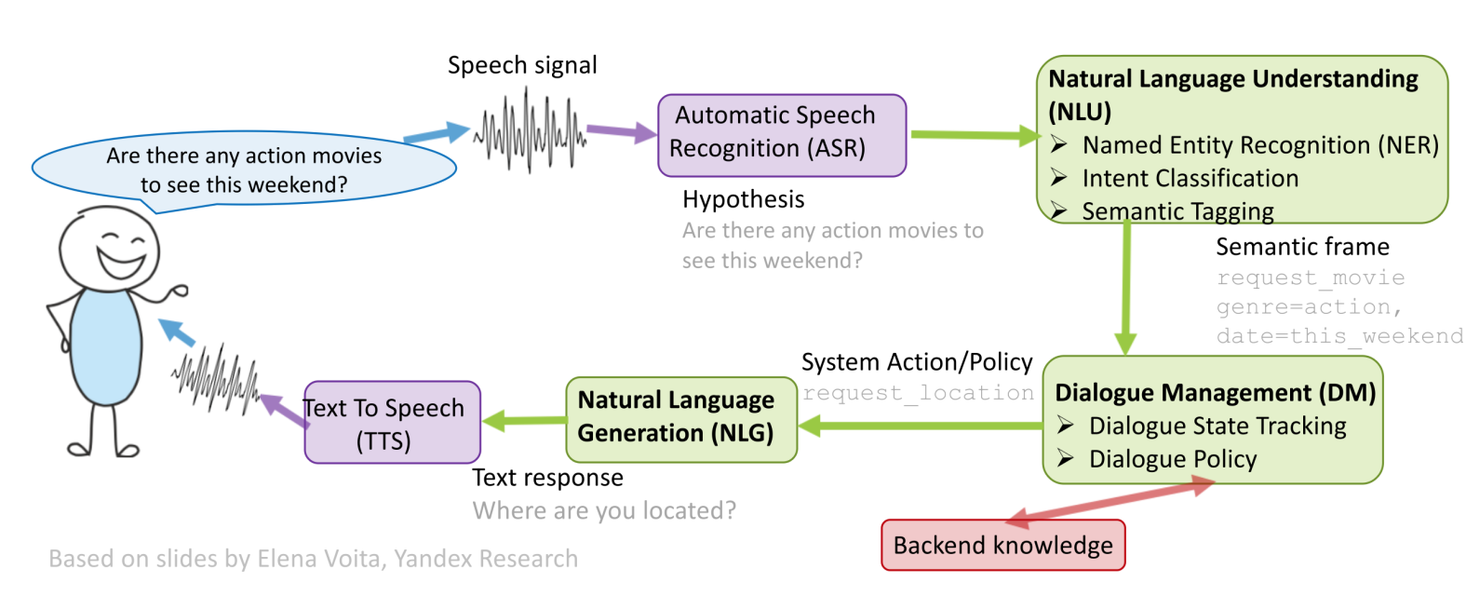
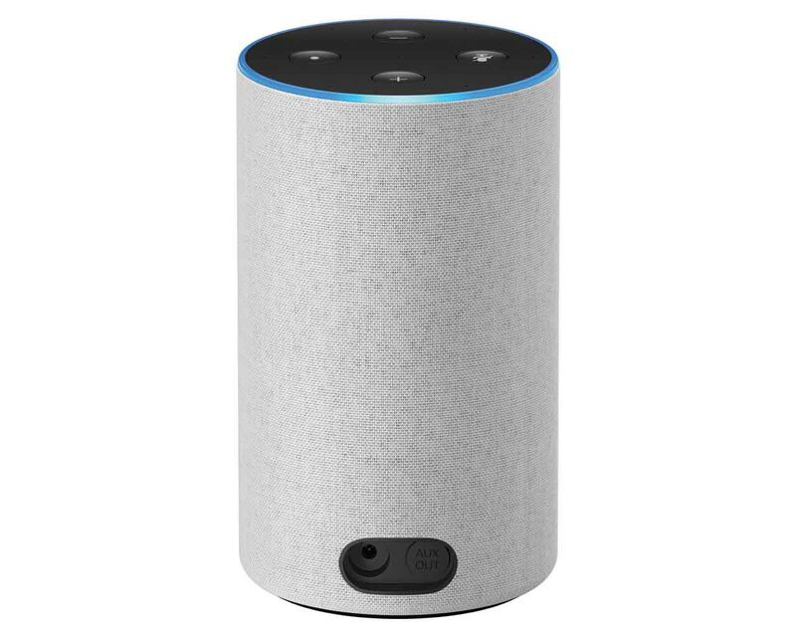
Goal oriented chat bots
System design: let’s split “chat bot” into smaller problems
Speech processing: see YSDA speech course
Business knowledge: rules for banking / psychology / ...
Text processing: this lecture
Let’s talk about this
Q: how would you design it?
e.g. a bank tech support bot
?!

Slide 13
Goal oriented chat bots
System design: let’s split “chat bot” into smaller problems
Speech processing: see YSDA speech course
Business knowledge: rules for banking / psychology / ...
Text processing: this lecture

Slide 14
Goal oriented chat bots
System design: let’s split “chat bot” into smaller problems
Speech processing: see YSDA speech course
Business knowledge: rules for banking / psychology / ...
Text processing: this lecture
look into this one

Slide 15
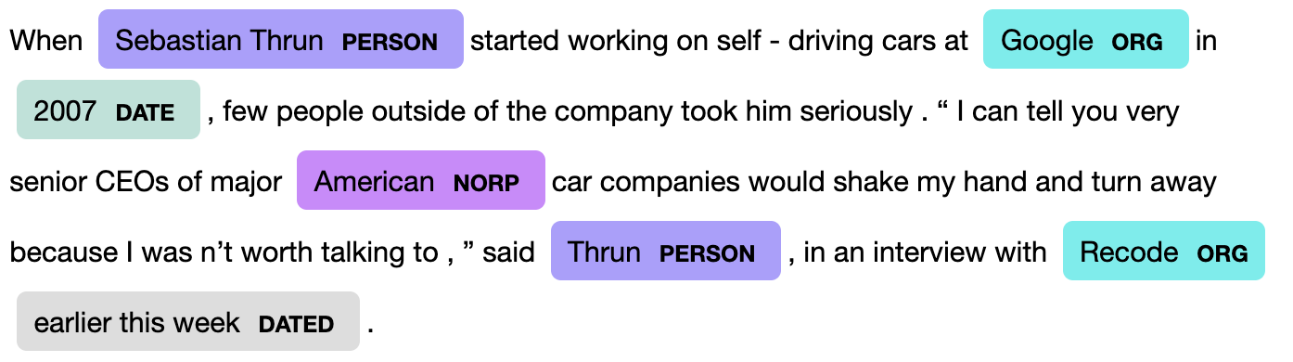
Named Entity Recognition
Why: extract keywords from user’s message, use them , e.g.
- for web search, when checking a fact
- for map look-up (“where can I buy pizza in Taganrog?”)
- to play music / video (“play Eminem’s latest song”)
Q: how do we solve this?
Image credit: nanonets.com

Slide 16
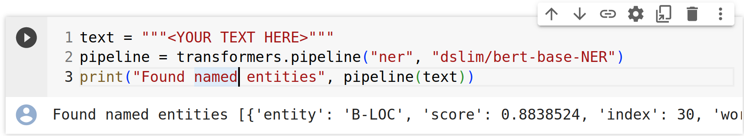
Named Entity Recognition
Why: extract keywords from user’s message, use them , e.g.
- for web search, when checking a fact
- for map look-up (“where can I buy pizza in Taganrog?”)
- to play music / video (“play Eminem’s latest song”)
Q: how do we solve this?
A: fine-tune a BERT-like model
for token classification
See week 5 for details :)

Slide 17
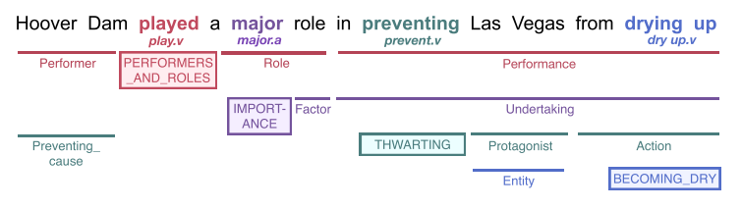
More NLU problems
Named Entity Recognition: see previous slide
Semantic parsing: to figure out what user wants from you
Anaphora resolution: to find what “her” or “this thing” refers to

Slide 18
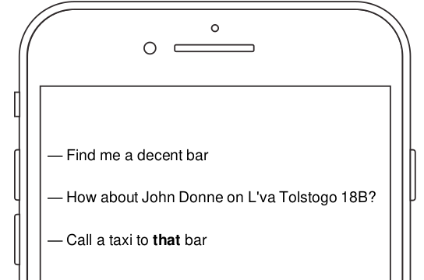
More NLU problems
Named Entity Recognition: see previous slide
Semantic parsing: to figure out what user wants from you
Anaphora resolution: to find what “it” or “this bar” refers to

Slide 19
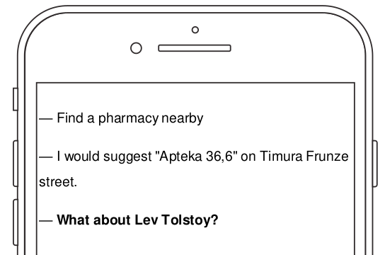
More NLU problems
Named Entity Recognition: see previous slide
Semantic parsing: to figure out what user wants from you
Anaphora resolution: to find what “it” or “this bar” refers to
Ellipsis: recover any missing information from context

Slide 20
Goal oriented chat bots
System design: let’s split “chat bot” into smaller problems
Speech processing: see YSDA speech course
Business knowledge: rules for banking / psychology / ...
Text processing: this lecture
next one :)

Slide 21
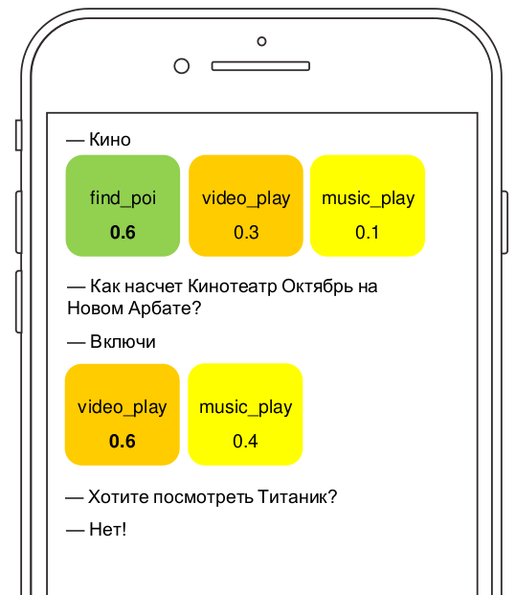
Dialogue Management
Two sub-problems:
1. Dialogue State Tracking:
what are we talking about?
what does user want from us?
what did we try previously?
Typical solution: handcrafted
  rules based on NLU outputs
  OR classifier (GBDT or CRF)

Slide 22
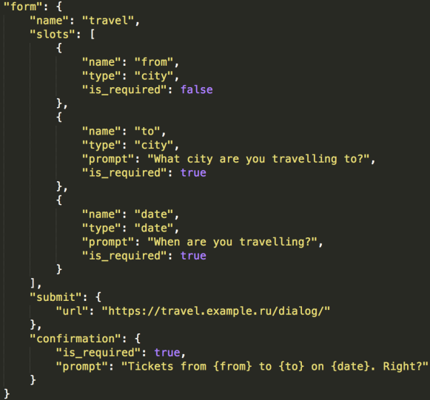
Dialogue Management
Two sub-problems:
1. Dialogue State Tracking:
what are we talking about?
what does user want from us?
what did we try previously?
Typical solution: handcrafted
  rules based on NLU outputs
  OR classifier (GBDT or CRF)
2. Dialogue Strategy
  how do we respond now?
  do we need any extra info?
  Typical solution: handcrafted
  slots, choose one at random
  OR with reinforcement learning
D

Slide 23
Dialogue Management
Two sub-problems:
1. Dialogue State Tracking:
what are we talking about?
what does user want from us?
what did we try previously?
Typical solution: handcrafted
  rules based on NLU outputs
  OR classifier (GBDT or CRF)
2. Dialogue Strategy
  how do we respond now?
  do we need any extra info?
  Typical solution: handcrafted
  slots, choose one at random
  OR with reinforcement learning
D
Either that, or you can prompt a
large language language model
to make appropriate responses

Slide 24
Goal oriented chat bots
System design: let’s split “chat bot” into smaller problems
Speech processing: see YSDA speech course
Business knowledge: rules for banking / psychology / ...
Text processing: this lecture
Speaking of large
language models,

Slide 25
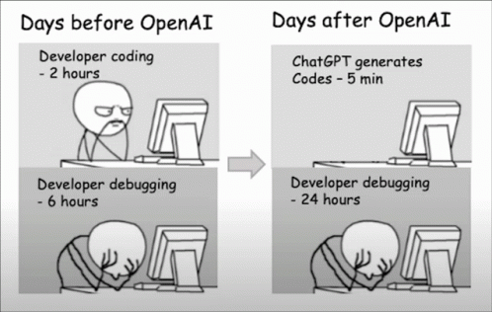
Part 3/3: LLM-based chatbots the ChatGPT part

Slide 26
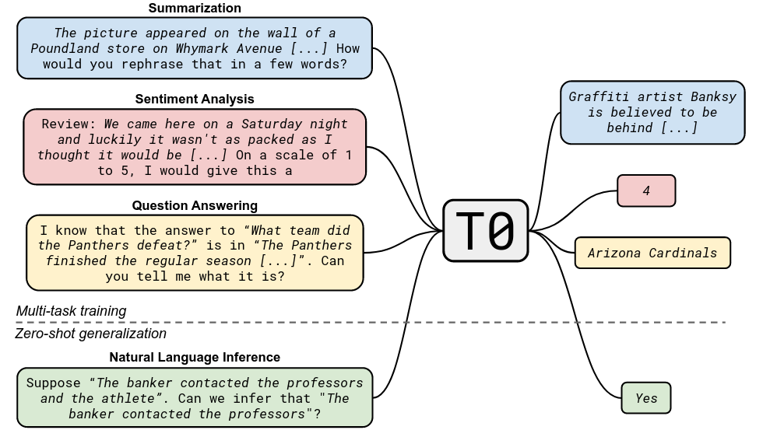
Recap: T0 pre-training
Paper: https://arxiv.org/abs/2110.08207

Slide 27
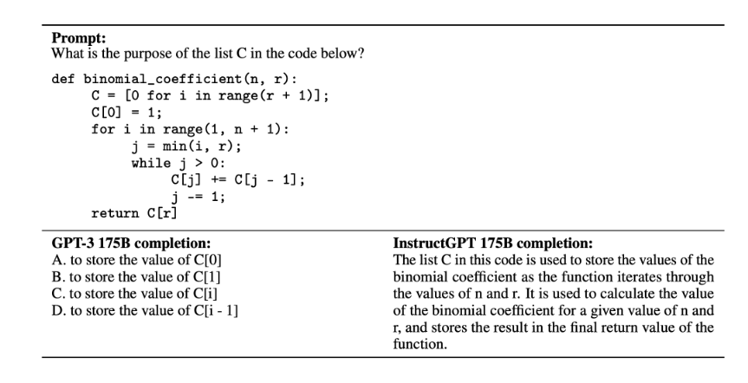
What we want: Instruction Following
Paper: https://arxiv.org/abs/2203.02155

Slide 28
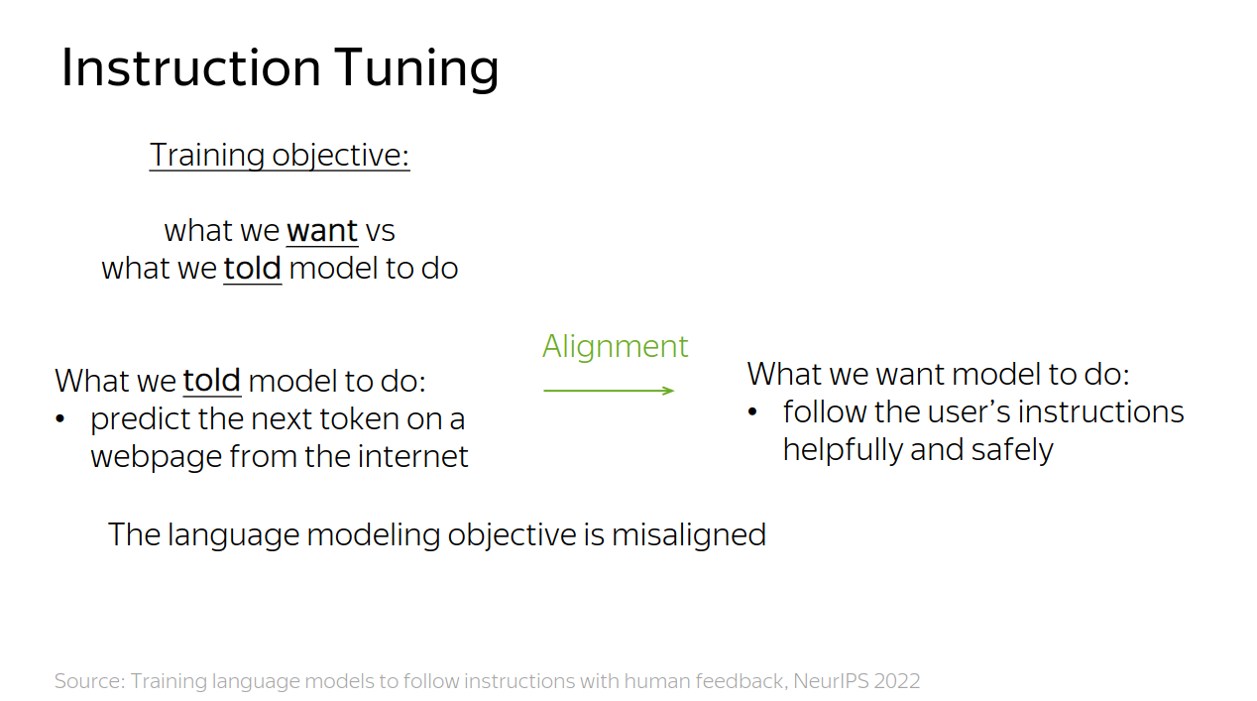

Slide 29
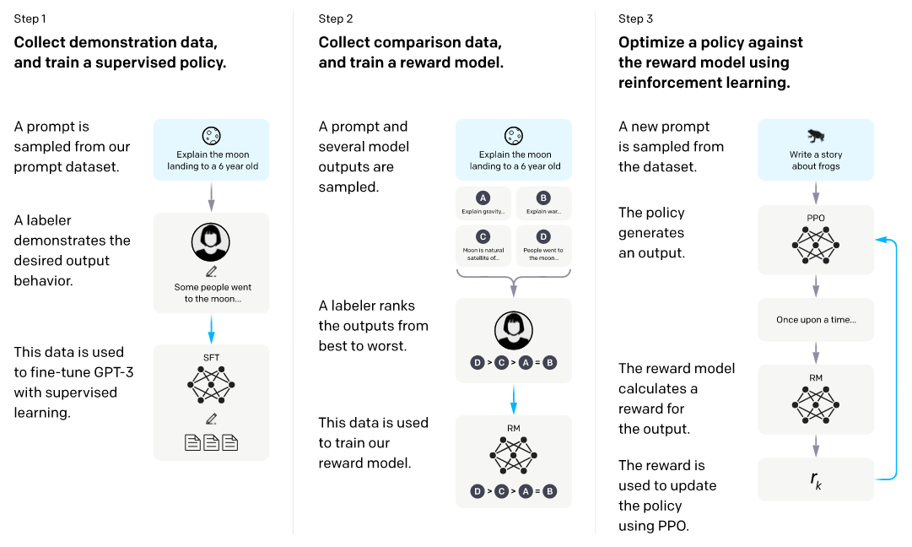
InstructGPT: basically ChatGPT
Paper: https://arxiv.org/abs/2203.02155

Slide 30
Stage 1: Supervised Fine-tuning
Paper: https://arxiv.org/abs/2203.02155

Slide 31
Stage 1: Supervised Fine-tuning
Paper: https://arxiv.org/abs/2203.02155

Slide 32
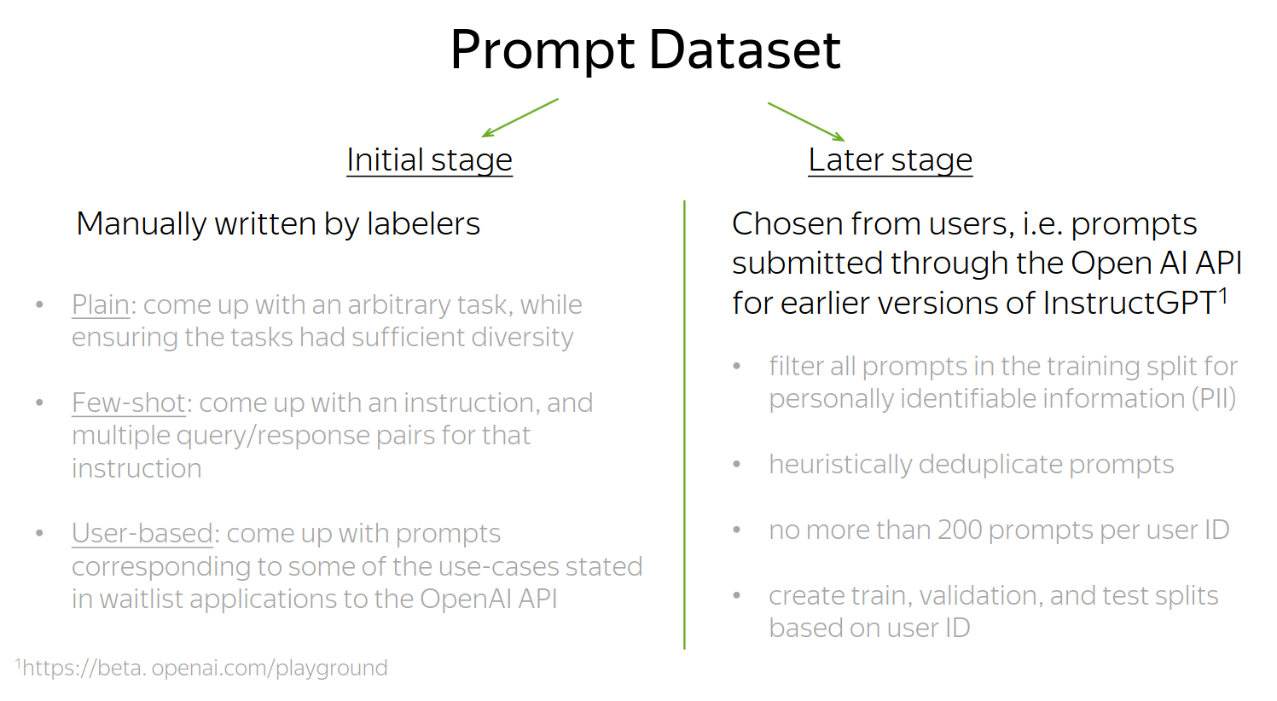
Stage 1: Supervised Fine-tuning
Paper: https://arxiv.org/abs/2203.02155

Slide 33
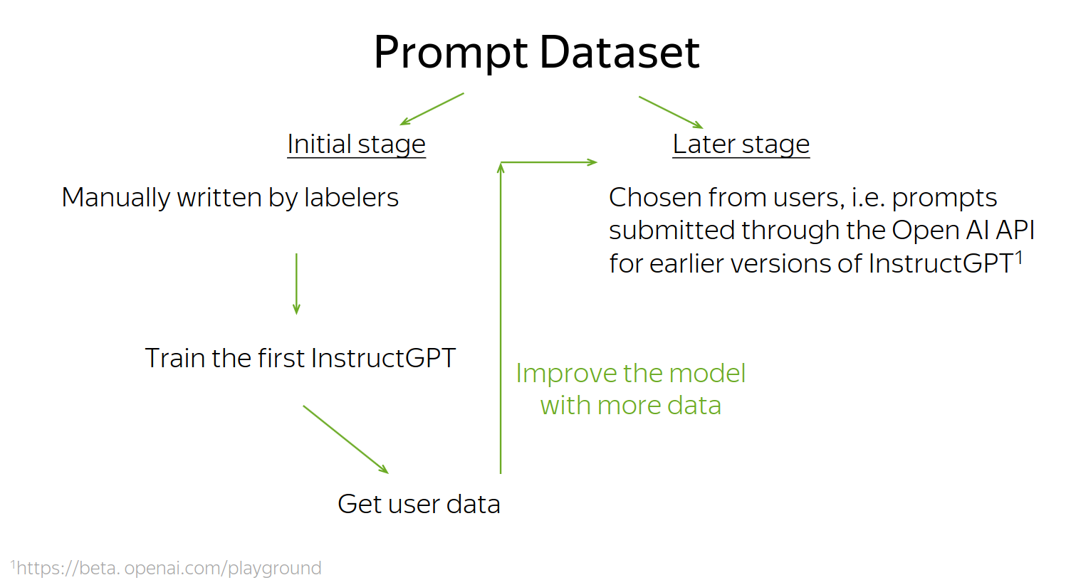
Stage 1: Supervised Fine-tuning
Paper: https://arxiv.org/abs/2203.02155

Slide 34
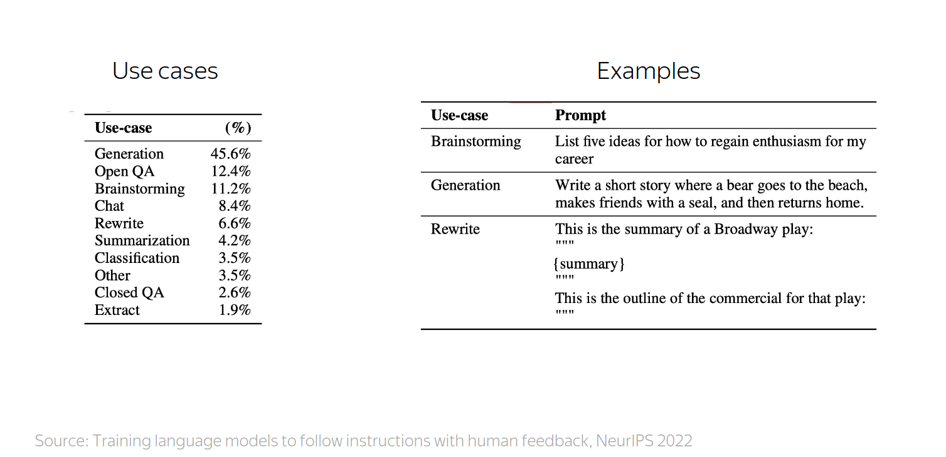
Stage 1: Supervised Fine-tuning
Paper: https://arxiv.org/abs/2203.02155

Slide 35
Stage 1: Supervised Fine-tuning
Paper: https://arxiv.org/abs/2203.02155
Fine-tuning procedure:
  exactly the same as in pre-training
minimize crossentropy with Adam
using the instruction-following data
Cheaper version: train LoRA adapters
https://arxiv.org/abs/2305.14314

Slide 36
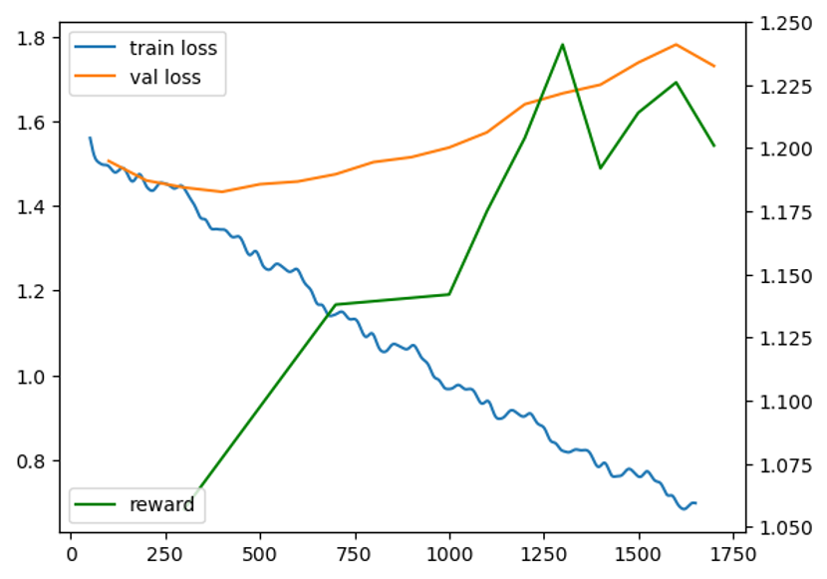
Stage 1: Supervised Fine-tuning
Paper: https://arxiv.org/abs/2203.02155
Fine-tuning procedure:
  exactly the same as in pre-training
minimize crossentropy with Adam
using the instruction-following data
Tip: sometimes it’s best to train for longer

Slide 37
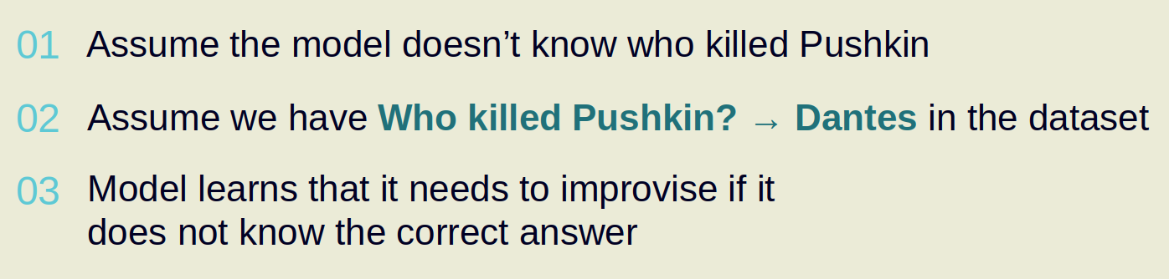
Why can’t we stop at SFT stage?
Reason 1: ranking is easier than writing for labelers
(except maybe for fact-checking)
Reason 2: supervised fine-tuning promotes hallucinations
(see example below)

Slide 38
Stage 2: Reward Model
Paper: https://arxiv.org/abs/2203.02155

Slide 39
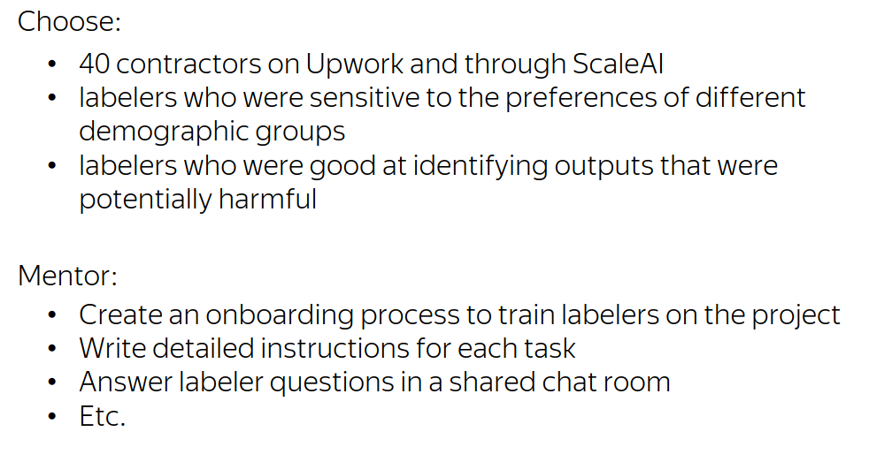
Stage 2: Reward Model
How OpenAI did it

Slide 40
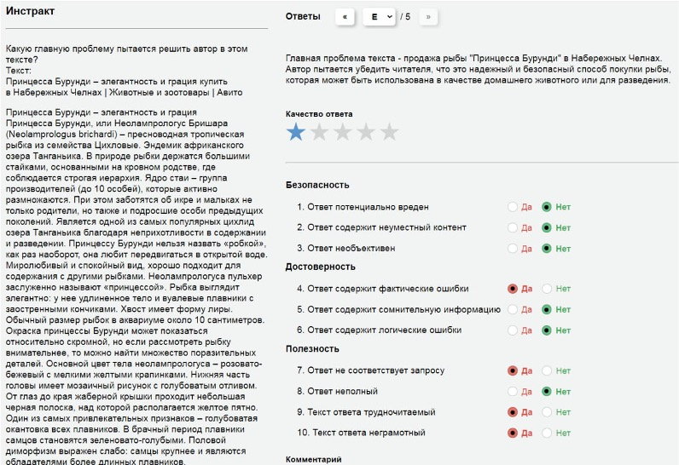
Stage 2: Reward Model
Our experience @ Yandex

Slide 41
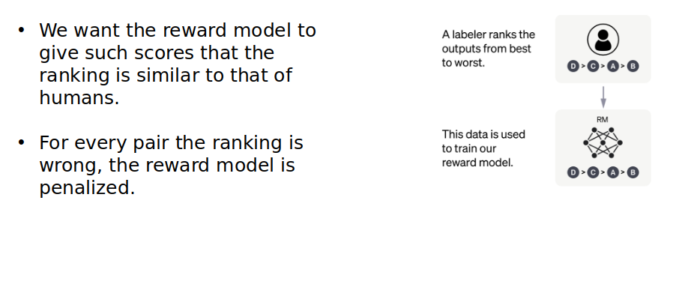

Stage 2: Reward Model
Paper: https://arxiv.org/abs/2203.02155

Slide 42
Stage 3: Reinforcement Learning
Paper: https://arxiv.org/abs/2203.02155

Slide 43
Stage 3: Reinforcement Learning
TL;DR reinforcement learning for LLM tasks:
1. Let the model generate several responses
(sample with probability)
2. Compute reward for each response
(apply reward model)
3. Train to increase probability of responses with high reward
(and decrease probability if reward is low)
here
‘s
what
I
know
[prompt]
screw
you
!
I
don
‘t
know

Slide 44
Stage 3: Reinforcement Learning
TL;DR reinforcement learning for LLM tasks:
1. Let the model generate several responses
(sample with probability)
2. Compute reward for each response
(apply reward model)
3. Train to increase probability of responses with high reward
(and decrease probability if reward is low)
here
‘s
what
I
know
R = 5
[prompt]
screw
you
!
R = -1
I
don
‘t
know
R = 2

Slide 45
Stage 3: Reinforcement Learning
TL;DR reinforcement learning for LLM tasks:
1. Let the model generate several responses
(sample with probability)
2. Compute reward for each response
(apply reward model)
3. Train to increase probability of responses with high reward
(and decrease probability if reward is low)
here
‘s
what
I
know
R = 5
[prompt]
screw
you
!
R = -1
I
don
‘t
know
R = 2

Slide 46
Stage 3: Reinforcement Learning
Policy gradient basics
Policy = probability of response (from your language model)
Reward = your reward model prediction
Objective: average reward, in expectation over policy
higher = better

Slide 47
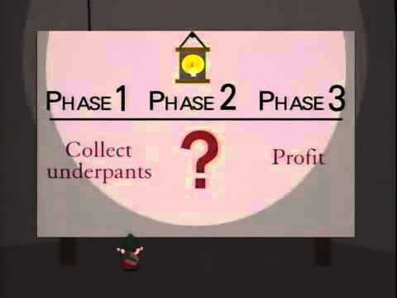
Stage 3: Reinforcement Learning
Policy gradient basics
Objective: average reward, in expectation over policy
Step 1: estimate J with a batch of samples
Step 2: compute gradient
Step 3: ???????
Step 4: improve

Slide 48
Stage 3: Reinforcement Learning
Policy gradient basics
Objective: average reward, in expectation over policy
Step 1: estimate J with a batch of samples
Step 2: compute gradient
Step 3: ???????
Step 4: improve

Slide 49
Stage 3: Reinforcement Learning
Policy gradient basics
Objective: average reward, in expectation over policy
Step 1: estimate J with a batch of samples
Step 2: compute gradient
Step 3: ???????
Step 4: improve

Slide 50
Stage 3: Reinforcement Learning
Policy gradient basics
Objective: average reward, in expectation over policy
Step 1: estimate J with a batch of samples
Step 2: compute gradient
Step 3: ???????
Step 4: improve

Slide 51
Stage 3: Reinforcement Learning
REINFORCE, Williams (1992)
Objective: average reward, in expectation over policy
Step 1: estimate J with a batch of samples

Slide 52
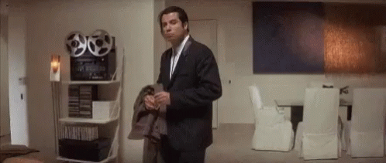
Stage 3: Reinforcement Learning
REINFORCE, Williams (1992)
Objective: average reward, in expectation over policy
Step 1: estimate J with a batch of samples
Step 2: compute gradient
But there’s no θ in Jmc formula!

Slide 53
Stage 3: Reinforcement Learning
REINFORCE, Williams (1992)
Objective: average reward, in expectation over policy
Step 1: estimate J with a batch of samples
Step 2: compute gradient
But there’s no θ in Jmc formula!
( θ indirectly affects yi )

Slide 54
Stage 3: Reinforcement Learning
REINFORCE, Williams (1992)
Objective: average reward, in expectation over policy
Step 1: estimate J with a batch of samples
Step 2: compute gradient
Step 3: ???????

Slide 55
Stage 3: Reinforcement Learning
REINFORCE, Williams (1992)
Objective: average reward, in expectation over policy
New plan: compute directly, then do monte-carlo
sum over all possible x and y pairs (intractable)
but we’ll deal with that later

Slide 56
Stage 3: Reinforcement Learning
REINFORCE, Williams (1992)
Objective: average reward, in expectation over policy
New plan: compute directly, then do monte-carlo

Slide 57
Stage 3: Reinforcement Learning
REINFORCE, Williams (1992)
Objective: average reward, in expectation over policy
New plan: compute directly, then do monte-carlo
const(θ)

Slide 58
Stage 3: Reinforcement Learning
REINFORCE, Williams (1992)
Objective: average reward, in expectation over policy
New plan: compute directly, then do monte-carlo
const(θ)

Slide 59
Stage 3: Reinforcement Learning
REINFORCE, Williams (1992)
Objective: average reward, in expectation over policy
New plan: compute directly, then do monte-carlo
const(θ)
const(θ)

Slide 60
Stage 3: Reinforcement Learning
REINFORCE, Williams (1992)
Objective: average reward, in expectation over policy
New plan: compute directly, then do monte-carlo
Can’t do monte-carlo cuz is not a probability distribution

Slide 61
Stage 3: Reinforcement Learning
REINFORCE, Williams (1992)
Last formula from previous slide
Can’t do monte-carlo cuz is not a probability distribution
Log-derivative trick:

Slide 62
Stage 3: Reinforcement Learning
REINFORCE, Williams (1992)
Last formula from previous slide
Can’t do monte-carlo cuz is not a probability distribution
Log-derivative trick:

Slide 63
Stage 3: Reinforcement Learning
REINFORCE, Williams (1992)
Last formula from previous slide
Can’t do monte-carlo cuz is not a probability distribution
Log-derivative trick:

Slide 64
Stage 3: Reinforcement Learning
REINFORCE, Williams (1992)
Last formula from previous slide

Slide 65
Stage 3: Reinforcement Learning
REINFORCE, Williams (1992)
Last formula from previous slide
Expectation over y ~ πθ(y|x)

Slide 66
Stage 3: Reinforcement Learning
REINFORCE, Williams (1992)
Last formula from previous slide
Can use monte-carlo estimate

Slide 67
Stage 3: Reinforcement Learning
REINFORCE, Williams (1992)
Last formula from previous slide
Monte-carlo gradient (GPU-friendly)

Slide 68
Stage 3: Reinforcement Learning
Modern reinforcement learning
REINFORCE (Williams, 1992)

Slide 69
Stage 3: Reinforcement Learning
Modern reinforcement learning
REINFORCE (Williams, 1992)
Proximal Policy Optimization (Schulman et al, 2017)
- allows reusing samples xi , yi over several updates
- fancy formula that clips objective for training stability
- tricks: variance reduction (baseline, GAE), SGD → Adam

Slide 70
Stage 3: Reinforcement Learning
Modern reinforcement learning
REINFORCE (Williams, 1992)
Proximal Policy Optimization (Schulman et al, 2017)
- allows reusing samples xi , yi over several updates
- fancy formula that clips objective for training stability
- tricks: variance reduction (baseline, GAE), SGD → Adam
InstructGPT (Ouyang et al, 2022)
- they use PPO on top of learned reward model
- KL regularizer to prevent model from changing too much

Slide 71
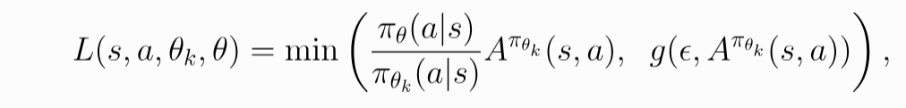
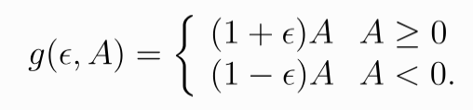
Stage 3: Reinforcement Learning
More on PPO: https://spinningup.openai.com/en/latest/algorithms/ppo.html
PPO+ptx = PPO (improved REINFORCE) + log-likelihood
PPO = Proximal Policy Optimization
A (advantage) = reward - baseline
Intuition: PPO objective protects from abrupt policy changes that break down the model. It also allows multiple updates per sample.

Slide 72
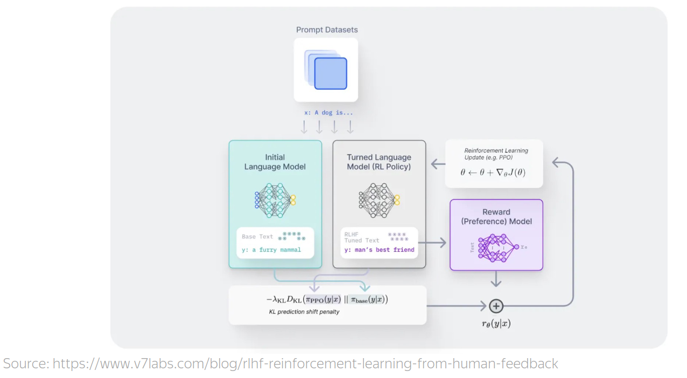
Stage 3: Reinforcement Learning
Paper: https://arxiv.org/abs/2110.08207

Slide 73
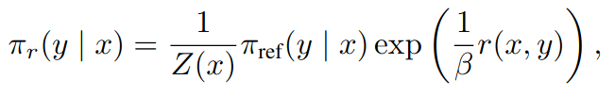

Direct Preference Optimization
Paper: https://arxiv.org/abs/2305.18290
Consider optimal policy given reward model r(x, y):

Slide 74


Direct Preference Optimization
Paper: https://arxiv.org/abs/2305.18290
Consider optimal policy given reward model r(x, y):
Solve this as an equation to formulate r(x, y)
Log Z is still intractable, but we don’t need it: needs difference r1 - r2

Slide 75
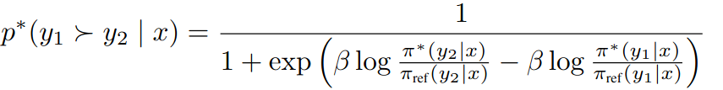
Direct Preference Optimization
Paper: https://arxiv.org/abs/2305.18290
Consider optimal policy given reward model r(x, y):
Solve this as an equation to formulate r(x, y)

Slide 76
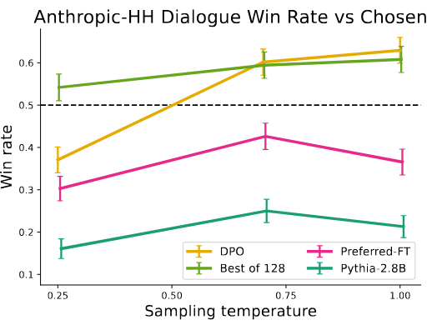
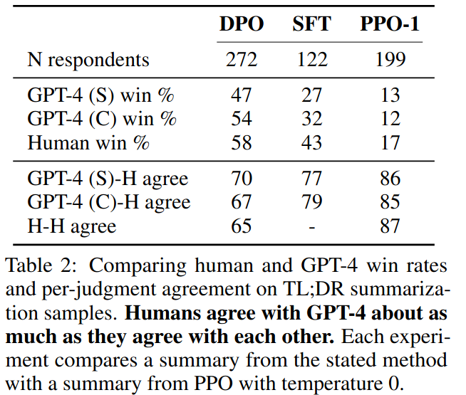
Direct Preference Optimization
Paper: https://arxiv.org/abs/2305.18290
Maximize “Log likelihood” that policy-induced reward follows user preference

Slide 77


