Slide 1

Natural Language Processing
Episode 10-ish
Model Compression & Acceleration
by Andrei Panferov

Slide 2
Chapter 1: Why Should You Care?

Slide 3
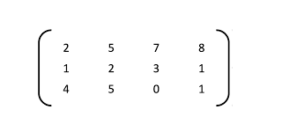
Case Study: Text Classification
“I saw a cat”
“I f*** your mom”
prepare
batch
(0) Normal tweet
(1) Should ban
model

Slide 4

Case Study: Text Classification
“I saw a cat”
“I f*** your mom”
prepare
batch
(0) Normal tweet
(1) Should ban
model
Three kinds of efficiency:
Model Size
(mega)bytes

Slide 5

Case Study: Text Classification
“I saw a cat”
“I f*** your mom”
prepare
batch
(0) Normal tweet
(1) Should ban
model
Three kinds of efficiency:
Model Size
(mega)bytes
Throughput
samples/second

Slide 6

Case Study: Text Classification
“I saw a cat”
“I f*** your mom”
prepare
batch
(0) Normal tweet
(1) Should ban
model
Three kinds of efficiency:
Model Size
(mega)bytes
Throughput
samples/second
Latency
ms@percentile

Slide 7








Scenario 1: Inference Server

Slide 8
Scenario 1: Inference Server
input (raw text)
Inference Server
CPU / GPU / FPGA
predictions

Slide 9
Scenario 1: Inference Server
input (raw text)
Inference Server
CPU / GPU / FPGA
predictions
+ relatively easy to deploy
+ you control model & inference
+ clients don’t run compute

Slide 10
Scenario 1: Inference Server
input (raw text)
Inference Server
CPU / GPU / FPGA
predictions
+ relatively easy to deploy
+ you control model & inference
+ clients don’t run compute
– you pay for each inference
– clients can’t work offline
– network latency

Slide 11
Scenario 1: Inference Server
input (raw text)
Inference Server
CPU / GPU / FPGA
predictions
+ relatively easy to deploy
+ you control model & inference
+ clients don’t run compute
– you pay for each inference
– clients can’t work offline
– network latency
Which is the most important?
?
?
?

Slide 12
Scenario 1: Inference Server
input (raw text)
Inference Server
CPU / GPU / FPGA
predictions
+ relatively easy to deploy
+ you control model & inference
+ clients don’t run compute
– you pay for each inference
– clients can’t work offline
– network latency
Priorities:

Slide 13


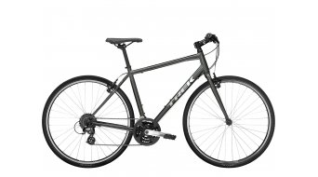
Scenario 1: Inference Server
Group inputs into batches (e.g. by length)
  improves throughput at the cost of latency
Multiple servers with load balancing
improves throughput at the cost of your budget :)
Popular frameworks: priorities
TensorFlow Serving efficiency ≪ developer time
TensorRT Inference Server (Triton) efficiency ≈ developer time
Custom model-dependent code efficiency ≫ developer time

Slide 14

Scenario 1: Inference Server
Group inputs into batches (e.g. by length)
  improves throughput at the cost of latency
Multiple servers with load balancing
improves throughput at the cost of your budget :)
Popular frameworks: priorities
vLLM efficiency ≪ developer time
Triton Inference Server efficiency ≈ developer time
Custom model-dependent code efficiency ≫ developer time

Slide 15
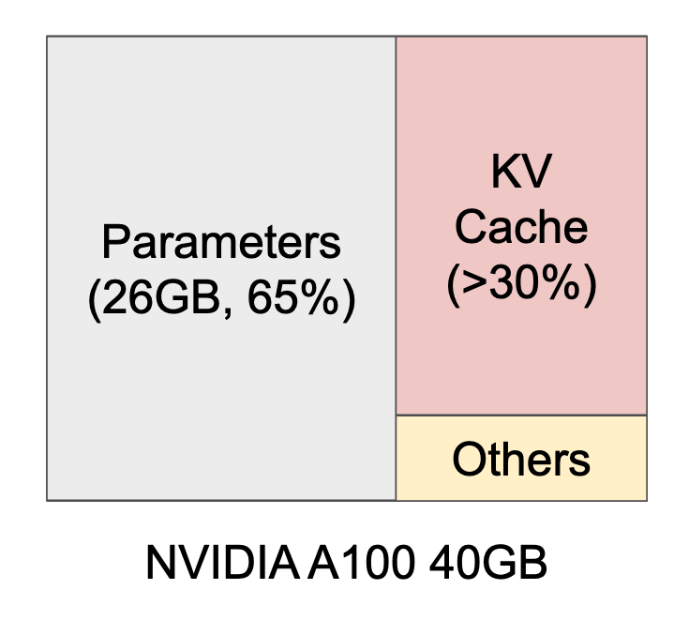
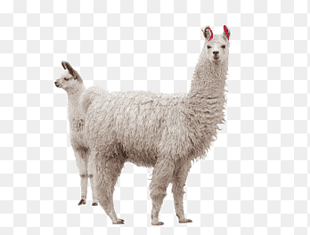
Scenario 1: Inference Server
Question: what did behind the Llama?
Image: arxiv.org/pdf/2309.06180

Slide 16
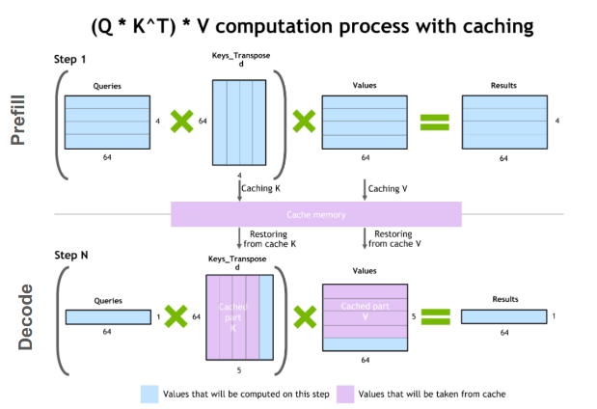
Scenario 1: Inference Server
Question: what did behind the Llama?
Answer: KV Cache
Image: arxiv.org/pdf/2309.06180

Slide 17
Scenario 1: Inference Server
Question: how many parallel requests we can serve if we have 20Gb
of extra DRAM and one token takes up 200kb of cache?
Answer: it depends…
Image: arxiv.org/pdf/2309.06180

Slide 18
Scenario 1: Inference Server
Question: how many parallel requests we can serve if we have 20Gb
of extra DRAM and one token takes up 200kb of cache?
Answer: it depends…
What if requests were very diverse:
2000 prompt tok, 1 gen tok
2000 prompt tok, 2000 gen tok
50 prompt tok, 1 gen tok
Image: arxiv.org/pdf/2309.06180

Slide 19
Scenario 1: Inference Server
Question: how many parallel requests we can serve if we have 20Gb
of extra DRAM and one token takes up 200kb of cache?
Answer: it depends…
What if requests were very diverse:
2000 prompt tok, 1 gen tok
2000 prompt tok, 2000 gen tok
50 prompt tok, 1 gen tok
Image: arxiv.org/pdf/2309.06180

Slide 20
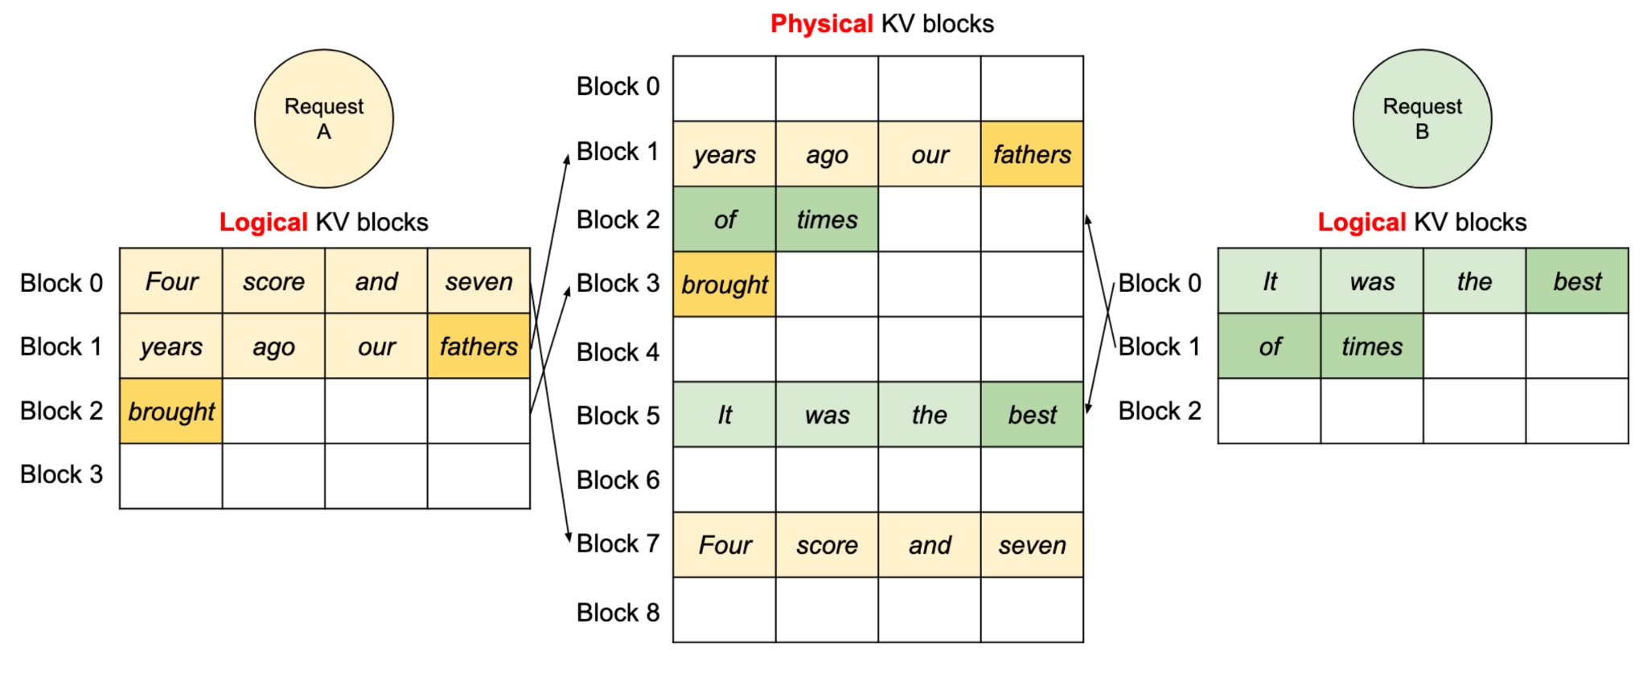
Scenario 1: Inference Server
Question: how many parallel requests we can serve if we have 20Gb
of extra DRAM and one token takes up 200kb of cache?
Answer: ~100000 tokens with Paged Attention
Image: arxiv.org/pdf/2309.06180

Slide 21
Scenario 1: Inference Server
TLDR:
Prioritizing throughput
Many concurrent users with diverse requests
Smart KV-Cache management is a must

Slide 22
Scenario 2: Workstation Deployment
Preload model onto a dedicated device, infer locally
Features:
  Data privacy
Requirements:
  Predictable hardware
LLM frameworks:
  llama.cpp
  ollama
  exllama-v2
Priorities:

Slide 23
Scenario 3: Mobile Deployment
Run model on a mobile device
Features:
  Diverse devices (or not if you’re Apple)
  New priority: power consumption
  Specialized matmul kernels
Priorities:

Slide 24
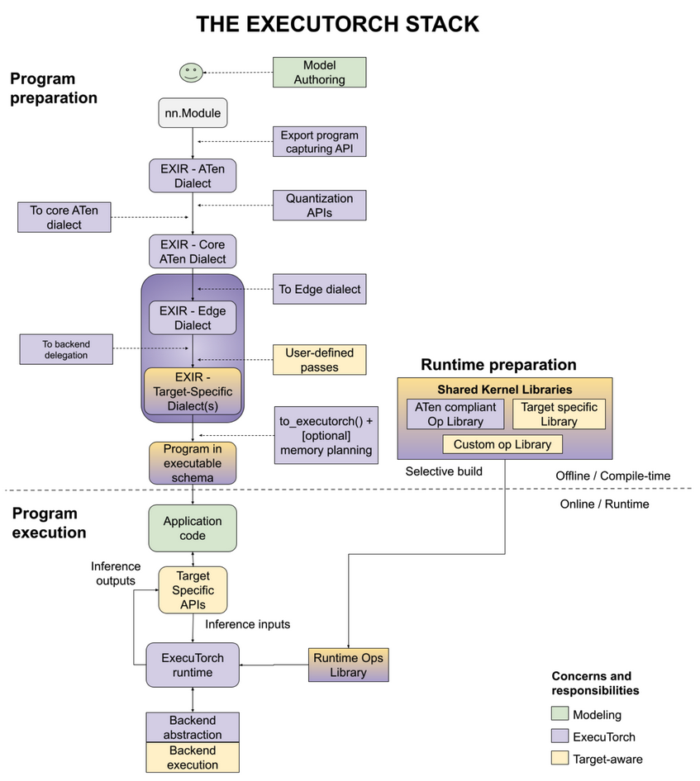
Scenario 3: Mobile Deployment
Same model…
Tracing the model
Compiling
Different backends
Mapping to kernels

Slide 25





Scenario 3: Mobile Deployment
TensorFlow.js All modern browsers
CoreML iOS devices
NNAPI Android devices
ExecuTorch iOS/Android/Embedded
MLX Apple Silicon

Slide 26
Scenario 3: Mobile Deployment
TLDR:
Often limited by RAM/Latency
Sensitive to power consumption
Specialized/unique/diverse hardware

Slide 27
Chapter 2: How Do I Improve My Model?

Slide 28

Compression by Distillation
Distillation…
Heard that word before?

Slide 29


Compression by Distillation
teacher
First, get the best
performing model
regardless of size
Then, train a more compact model to
approximate it!

Slide 30
Compression by Distillation
Training
batch
X
batch
teacher

Slide 31
Compression by Distillation
Training objective:
Kullback-Leibler divergence
or MSE/MAE for regression
Training
batch
X
batch
teacher
D_{KL}
Loss

Slide 32
Compression by Distillation
Training objective:
Kullback-Leibler divergence
or MSE/MAE for regression
Training
batch
X
batch
teacher
D_{KL}
Loss
Note: distillation can
train on unlabeled data!

Slide 33
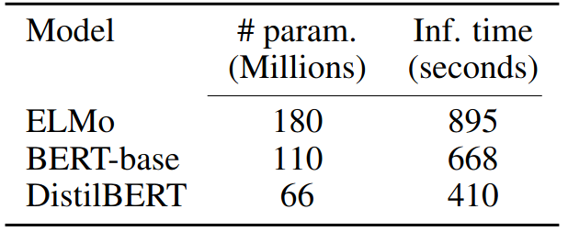
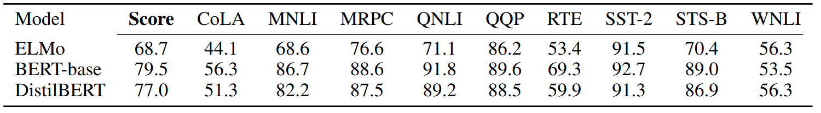
Compression by Distillation
Student architecture choices:
Naïve: same but smaller, less layers / hidden units
  e.g. DistillBERT: https://arxiv.org/pdf/1910.01108.pdf
  Same as BERT-base, but with
  half as many layers
  (and ≈1.5 times faster)

Slide 34
Compression by Distillation
Student architecture choices:
Naïve: same but smaller, less layers / hidden units, random init
Sparse along layers/attn_heads/mlp_neurons: sparsify but obtain dense representation, init from teacher
Let’s focus on that…

Slide 35
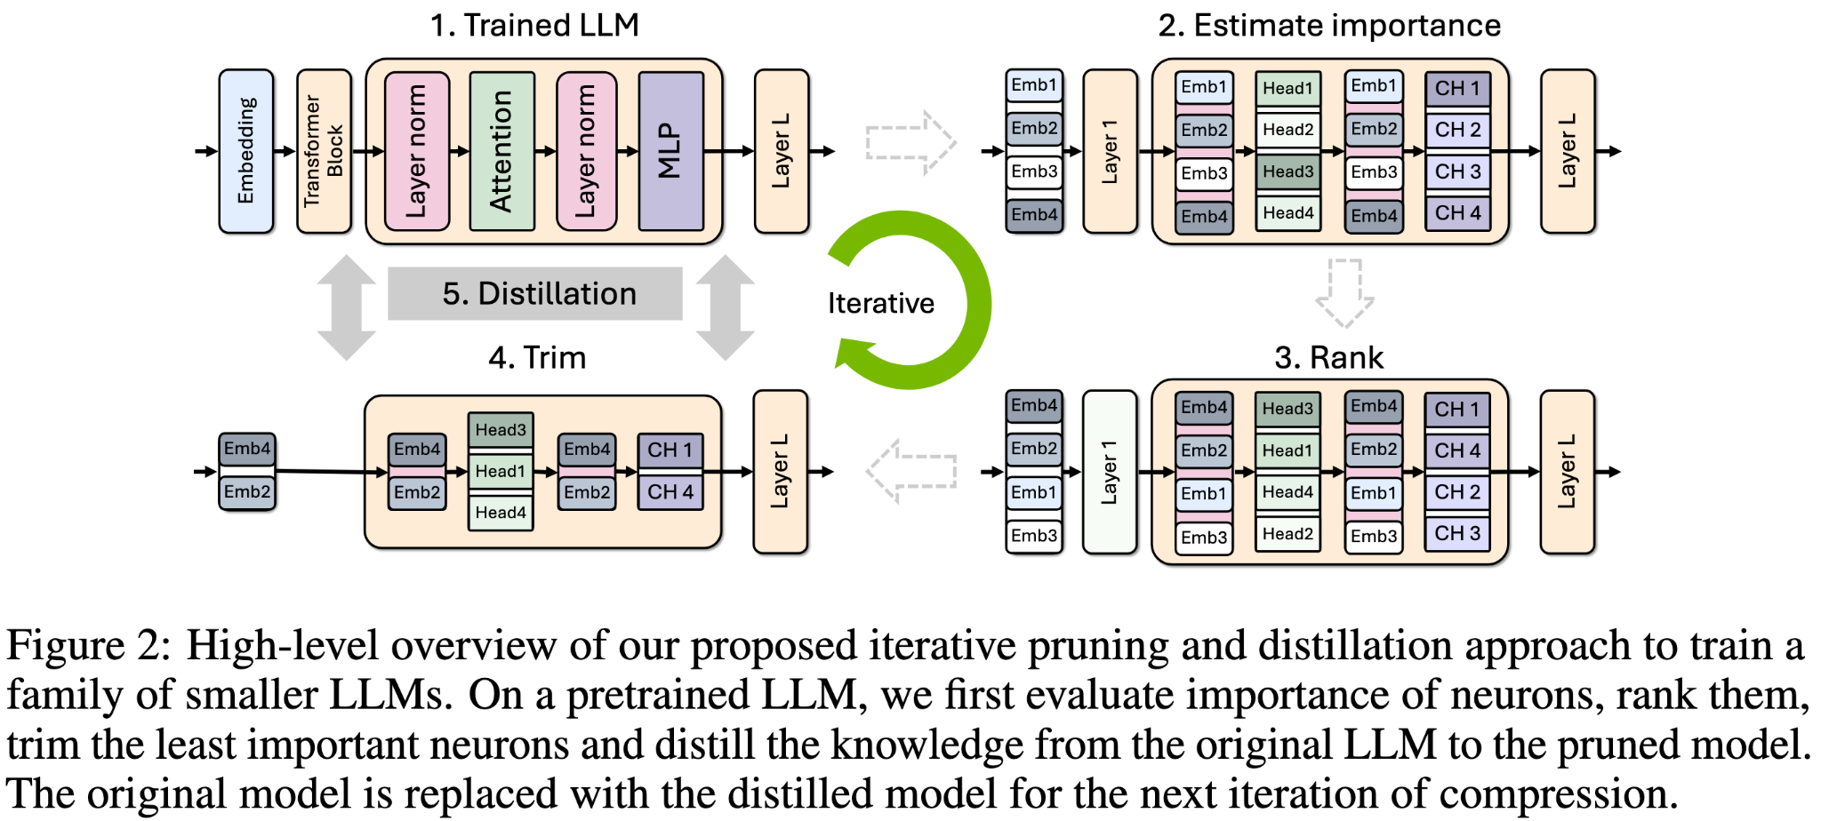
Minitron Approach
Image: arxiv.org/pdf/2407.14679

Slide 36
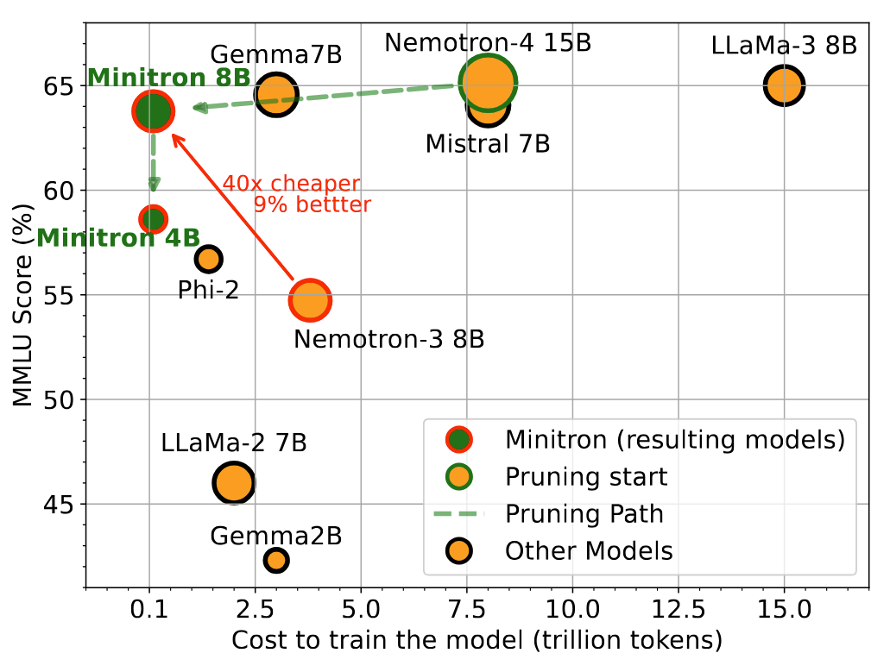
Minitron Approach
Source: arxiv.org/pdf/2407.14679

Slide 37
Minitron Approach
1. To train a family of LLMs, train the largest one and prune+distill iteratively to smaller LLMs.
2. Use (batch=L2, seq=mean) importance estimation for width axes and PPL/BI for depth.
3. Use single-shot importance estimation; iterative provides no benefit.
4. Prefer width pruning over depth for the model scales we consider (≤ 15B).
5. Retrain exclusively with distillation loss using KLD instead of conventional training.
6. Use (logit+intermediate state+embedding) distillation when depth is reduced significantly.
7. Use logit-only distillation when depth isn’t reduced significantly.
8. Prune a model closest to the target size.
9. Perform lightweight retraining to stabilize the rankings of searched pruned candidates.
10. If the largest model is trained using a multi-phase training strategy, it is best to prune and
retrain the model obtained from the final stage of training.
Source: arxiv.org/pdf/2407.14679

Slide 38
Compression by Distillation
More distillation tricks:
  Ensemble distillation https://arxiv.org/abs/1702.01802
  Dropout distillation http://proceedings.mlr.press/v48/bulo16.pdf
  Co-distillation https://arxiv.org/abs/1804.03235

Slide 39
Smaller Model for Simpler Inputs
If Hard
X
batch
Output
batch
If Easy

Slide 40
Smaller LLMs for Simpler Tokens?
If Hard
Previous token
Next
token
If Easy

Slide 41
Bottlenecks in GPU Inference
The math behind GPU utilization.
K tokens at a time:
Memory transfer load of O(N^2 + KxN) per matrix-vector product.
Compute load of O(KxN^2) per matrix-vector product.
Time cost of GPU operations:
Bring million numbers from memory into kernels - SLOW
Multiply million numbers with kernels - FAST

Slide 42
Bottlenecks in GPU Inference
K≈1 token at a time:
The primary load in single user chat applications.
Memory transfer load of O(N^2) per matrix-vector product.
Compute load of O(KxN^2) per matrix-vector product.
Memory transfer bottlenecked.
K>N tokens at a time:
Prompt preprocessing, highly parallel inference.
Memory transfer load of O(KxN) per matrix-matrix product.
Compute load of O(KxN^2) per matrix-matrix product.
Compute bottlenecked.

Slide 43
Bottlenecks in GPU Inference
K≈1 token at a time:
Latency doesn’t depend on K!
K>N tokens at a time:
Latency is linear with K.

Slide 44
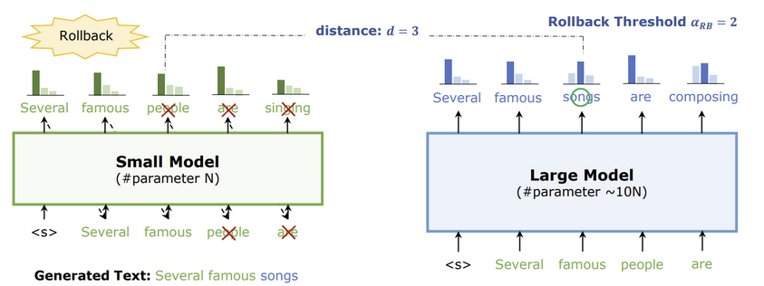
Speculative Decoding
https://arxiv.org/abs/2211.17192
Two models: main model (~Llama-70B) and draft model (~Llama-7B)
Greedy decoding:
Step 1: generate with draft model (sequential)
people
are
singing
people
are

Slide 45
Speculative Decoding
https://arxiv.org/abs/2211.17192
Two models: main model (~Llama-70B) and draft model (~Llama-7B)
Greedy decoding:
Step 1: generate with draft model (sequential)
Step 2: verify with large model (parallel)
people
are
singing
people
are

Slide 46
Speculative Decoding
https://arxiv.org/abs/2211.17192
Two models: main model (~Llama-70B) and draft model (~Llama-7B)
Greedy decoding:
Step 1: generate with draft model (sequential)
Step 2: verify with large model (parallel)
Accept multiple tokens

Slide 47
Speculative Decoding
https://arxiv.org/abs/2211.17192
Two models: main model (~Llama-70B) and draft model (~Llama-7B)
Greedy decoding:
Step 1: generate with draft model (sequential)
Step 2: verify with large model (parallel)
Accept multiple tokens
Repeat

Slide 48
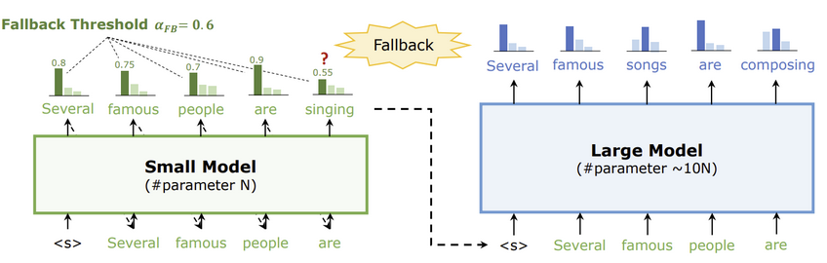
Speculative Decoding
https://arxiv.org/abs/2211.17192
Two models: main model (~Llama-70B) and draft model (~Llama-7B)
Sampling (temperature, top-p, top-k): generate, then reject with probability
sampling probability proven equal to regular sampling

Slide 49
Speculative Decoding
That you’ll implement
Two models: main model (Llama-8B) and draft model (of your choice)
Greedy Sampling: generate, then reject everything after exact match

Slide 50
Going Inside Model Layers

Slide 51
Compression by Sparsification
Do we really need all D by D weights?

Slide 52
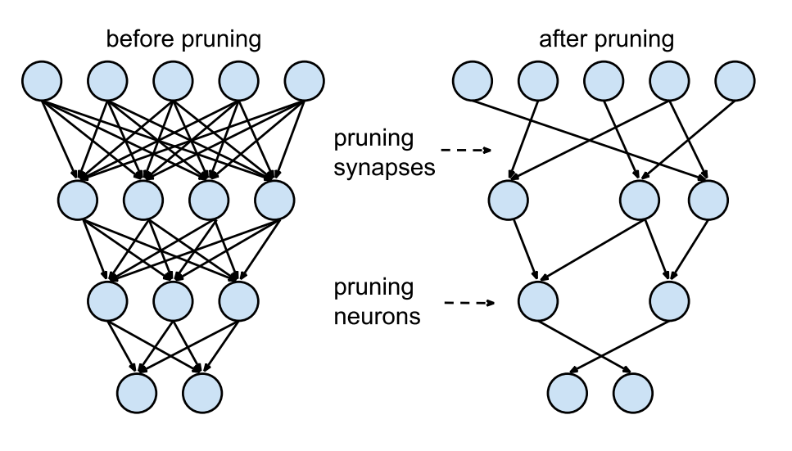
Compression by Pruning
Do we really need all D by D weights?
pruning
weights
pruning
neurons

Slide 53
Magnitude Pruning
Drop ~5% smallest weights
from each layer every 1000 steps
(and keep training)

Slide 54
Importance Estimation
Minitron:
attn_head/neuron level: activation scales
Block level: PPL
L0: Learnable importance estimation:
Read more: https://arxiv.org/abs/1712.01312
Alternative: https://arxiv.org/abs/1701.05369

Slide 55
Compression by Sparsification
Unstructured sparsity = prune individual weights
(minimal model size)
Structured sparsity= prune entire neurons/heads
(fastest inference)

Slide 56
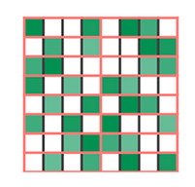
Compression by Sparsification
Unstructured sparsity = prune individual weights
(minimal model size)
Structured sparsity= prune entire neurons/heads
(fastest inference)
Note: some GPU/FPGAs also run fast with low-level structured sparsity, e.g. “Any 2 of 4 consecutive weights” (left)

Slide 57


Compression by quantization
model
model
model
INT8
8 BITS

Slide 58
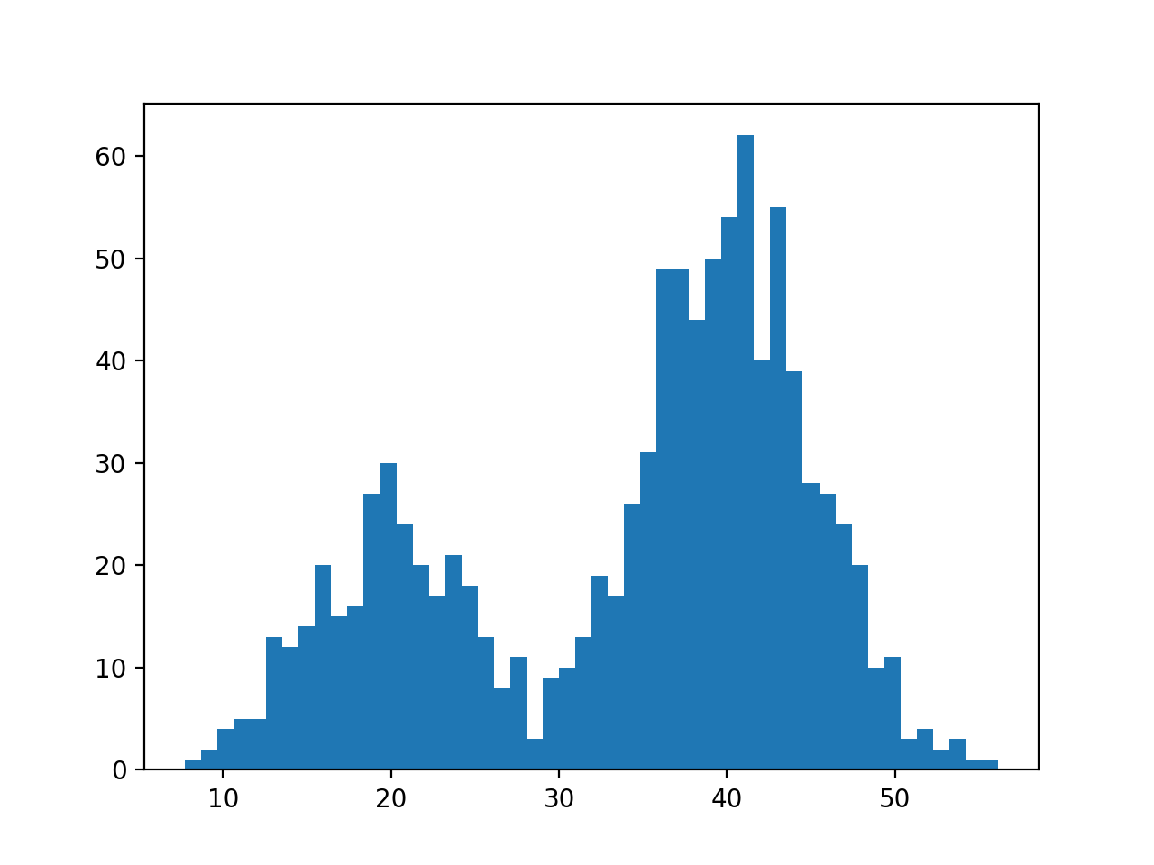
Quantization basics
Goal: encode data as int8 / int4

Slide 59
Quantization basics
Goal: encode data as int8 / int4
not an ideal range for int4

Slide 60
Linear quantization
Fit a linear range to data
scale = (max(w) – min(w)) / 2^4
zero = -min(w) / scale

Slide 61
Linear quantization
Fit a linear range to data
Encode:
c_{i} = (w_{i} / s + z).clip(0, 15)
uint4 range
Decode:
w_{i} = ??? ideas?
z
scale = (max(w) – min(w)) / 2^4
zero = -min(w) / scale

Slide 62
Linear quantization
Fit a linear range to data
Encode:
c_{i} = (w_{i} / s + z).clip(0, 15)
uint4 range
Decode:
w_{i} ≈ s * c_{i} – z
z
scale = (max(w) – min(w)) / 2^4
zero = -min(w) / scale

Slide 63
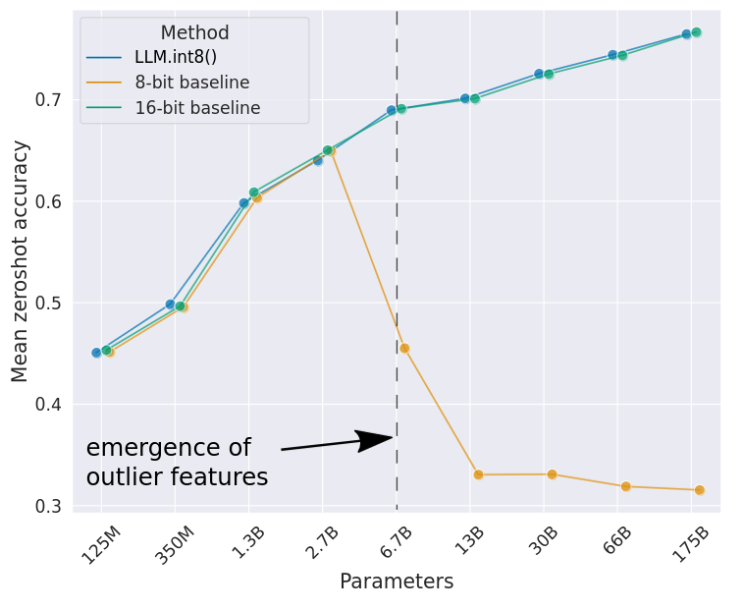
LLM.8bit(): some weights are more important
https://arxiv.org/abs/2208.07339
TL;DR in very LLM, some input features become outliers
Weights for those features are sensitive
KEEP <1% MOST SENSITIVE WEIGHTS IN 16-bit!

Slide 64
Nonlinear quantization
Fit codes to data
Compute a grid of percentiles or centroids (k-means 1d)
Store each weight as the index of nearest percentile/centroid

Slide 65
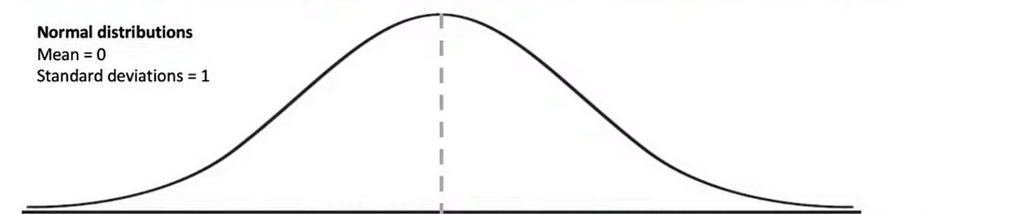
Static nonlinear case: NF4
https://arxiv.org/abs/2305.14314
https://arxiv.org/abs/2306.06965
7 negative quantiles
8 positive quantiles
zero
(exact)

Slide 66
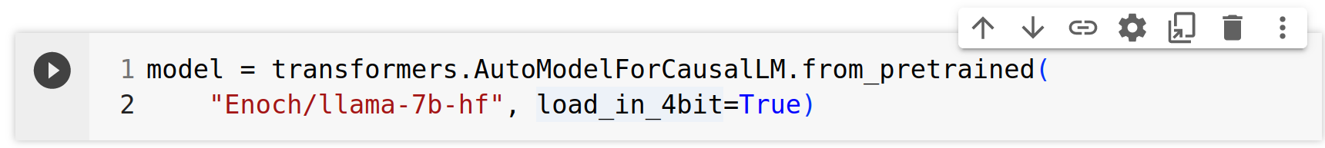
Static nonlinear case: NF4
https://arxiv.org/abs/2305.14314
https://arxiv.org/abs/2306.06965
How to use:
7 negative quantiles
8 positive quantiles
zero
(exact)

Slide 67
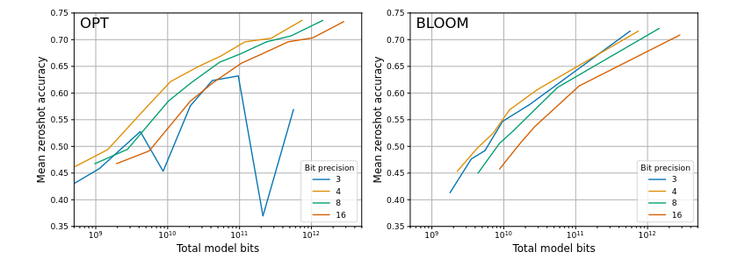
How many bits is best?
https://arxiv.org/abs/2212.09720
TL;DR 3-4 bits looks optimal
2-bit: Smaller models in 4 bits are better than larger models in 2 bits

Slide 68
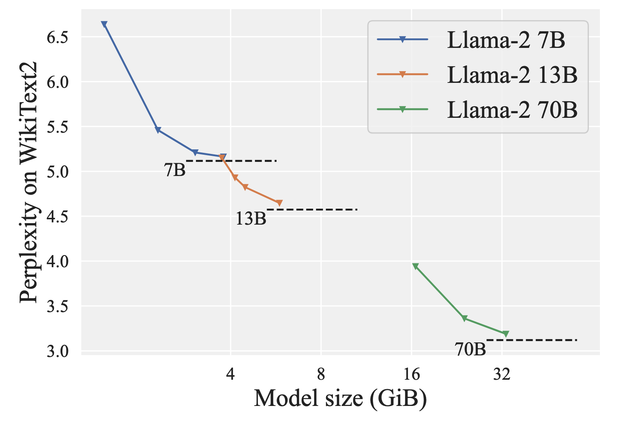
How many bits is best?
https://arxiv.org/abs/2401.06118
TL;DR ~2 bits looks optimal
2-bit: more expensive to quantize, more expensive to run

Slide 69
GPU Inference
K≈1 token at a time:
The primary load in single user chat applications.
Memory transfer load of O(N^2) per matrix-vector product.
Compute load of O(KxN^2) per matrix-vector product.
Memory transfer bottlenecked.
K>N tokens at a time:
Prompt preprocessing, highly parallel inference.
Memory transfer load of O(KxN) per matrix-matrix product.
Compute load of O(KxN^2) per matrix-matrix product.
Compute bottlenecked.

Slide 70
Quantized GPU Inference
With weight compression ratio С.
K≈1 token at a time:
The primary load in single user chat applications.
Memory transfer load of O(N^2 / C) per matrix-vector product.
Compute load of O(KxN^2) per matrix-vector product.
Memory transfer bottlenecked.
K>N tokens at a time:
Prompt preprocessing, highly parallel inference.
Memory transfer load of O(KxN) per matrix-matrix product.
Compute load of O(KxN^2) per matrix-matrix product.
Compute bottlenecked.

Slide 71
Quantized GPU Inference
With weight compression ratio С.
K≈1 token at a time:
Memory transfer load of O(N^2 / C) per matrix-vector product.
Memory transfer bottlenecked.
K>N tokens at a time:
Compute load of O(KxN^2) per matrix-matrix product.
Compute bottlenecked.

Slide 72
Quantized GPU Inference
With weight compression ratio С.
K≈1 token at a time:
C times faster inference!
K>N tokens at a time:
No speedup :(

Slide 73
Fully Quantized GPU Inference
With weight+activations compression ratio С.
K≈1 token at a time:
Memory transfer load of O(N^2 / C) per matrix-vector product.
Memory transfer bottlenecked.
K>N tokens at a time:
Compute load of O(KxN^2 / C) per matrix-matrix product.
Compute bottlenecked.

Slide 74
Fully Quantized GPU Inference
With weight+activations compression ratio С.
K≈1 token at a time:
C times faster inference!
K>N tokens at a time:
C times faster inference!

Slide 75
Model compression landscape
Goal: faster / smaller / both
Compression: quantize / prune / factorize
Setup: no data, some data, training data
Compress what: weights / activations /cache

Slide 76
Model compression landscape
Goal: faster / smaller / both
Compression: quantize / prune / factorize
Setup: no data, some data, training data
Compress what: weights / activations /cache
Q: can we take advantage of data
to improve quantization?

Slide 77
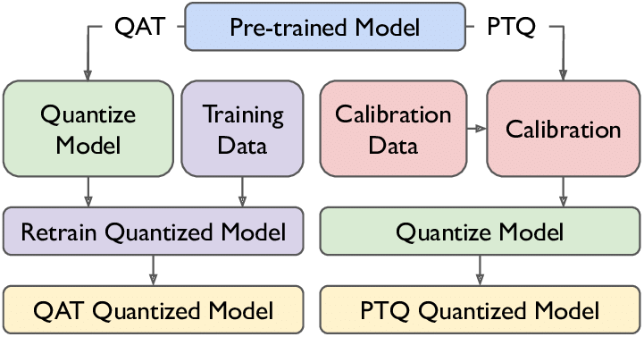
Model compression landscape
Goal: faster / smaller / both
Compression: quantize / prune / factorize
Setup: no data, some data, training data
Compress what: weights / activations /cache

Slide 78
Compression-aware training
Step 1: train normally for T steps
Step 2: prune 5% weights (or quantize 10% layers)
Step 3: freeze pruned/quantized parts
GoTo step 1

Slide 79
Post-training compression
Can we take advantage of a few data points
without training the model?

Slide 80
Post-training compression
Can we take advantage of a few data points
without training the model?
- find which weights are multiplied by larger inputs
- find correlated or anti-correlated weights
- try to “cancel out” quantization errors

Slide 81
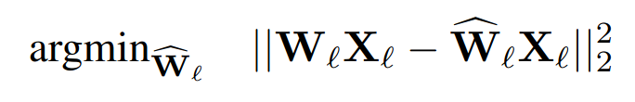
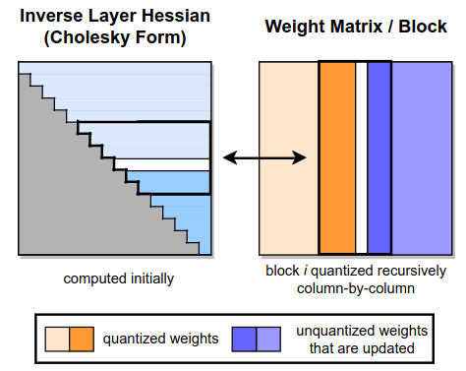
GPTQ
Frantar et al, 2022
Minimize the same objective
For i = 1 … in_features:
- quantize i-th column of weight matrix
(from one input feature and all outputs)
- freeze the quantized model forever
- update all remaining columns

Slide 82
GPTQ
Frantar et al, 2022
Minimize the same objective
For i = 1 … in_features:
- quantize i-th column of weight matrix
(from one input feature and all outputs)
- freeze the quantized model forever
- update all remaining columns
Use linear quantization with one scale & zero per each group of G weights
Tricks: process weights in “hacky” order

Slide 83
GPTQ
Frantar et al, 2022
Minimize the same objective
Native support in HF Transformers:
https://huggingface.co/blog/gptq-integration
Original implementation:
https://github.com/IST-DASLab/gptq
For i = 1 … in_features:
- quantize i-th column of weight matrix
(from one input feature and all outputs)
- freeze the quantized model forever
- update all remaining columns
Use linear quantization with one scale & zero per each group of G weights
Tricks: process weights in “hacky” order

Slide 84
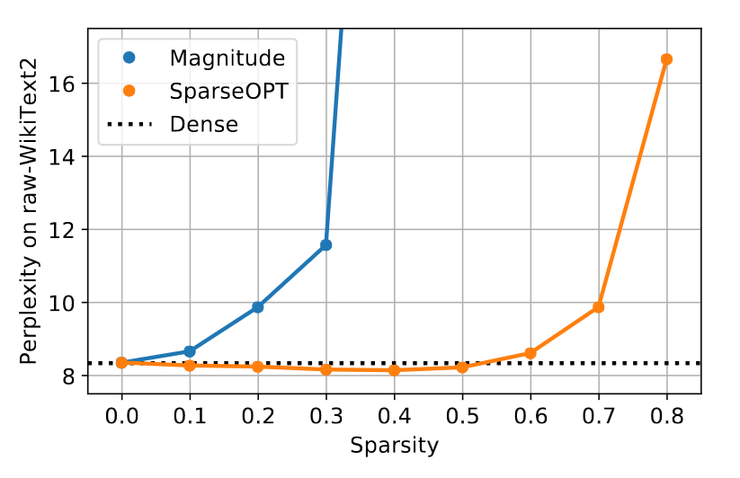
SparseGPT
Frantar et al, 2023
Minimize the same objective
For i = 1 … in_features:
- sparsify i-th column of weight matrix
(from one input feature and all outputs)
- freeze the quantized model forever
- update all remaining columns
OPT-175B
Dynamically choose how many weights to prune on each step (threshold on error)
Trick: can do 2-out-of-4 sparsity for A100

Slide 85
QuIP#/AQLM/SpinQuant
Minimize the same objective

Slide 86
QuIP#/AQLM/SpinQuant
Minimize the same objective
But also finetune while quantizing!

Slide 87
QuIP#
Minimize the same objective
But also finetune while quantizing!
On the level of blocks, after quantizing each linear layer:

Slide 88
More Quantization Papers
PV-Tuning – SOTA weight-only quantization optimization procedure
https://arxiv.org/abs/2405.14852
QTIP – SOTA weight-only quantization algorithm
https://arxiv.org/abs/2406.11235
QuaRot - SOTA GPTQ-based weight+act quantization algorithm
https://arxiv.org/abs/2404.00456
SpinQuant – SOTA weight+act quantization algorithm with finetuning
https://arxiv.org/abs/2405.16406
Many more cool papers

Slide 89
Homework:
`hw_speculative.ipynb` - Implement simple speculative decoding
  4+(?) Points
`hw_quantization.ipynb` - Implement GPTQ
  6+(3) Points

