Slide 1
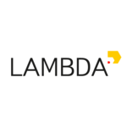

Fine-tuning Transformers
For fun and profit
Image credit: lena-voita.github.io and the respective papers
Yandex
Research

Slide 2
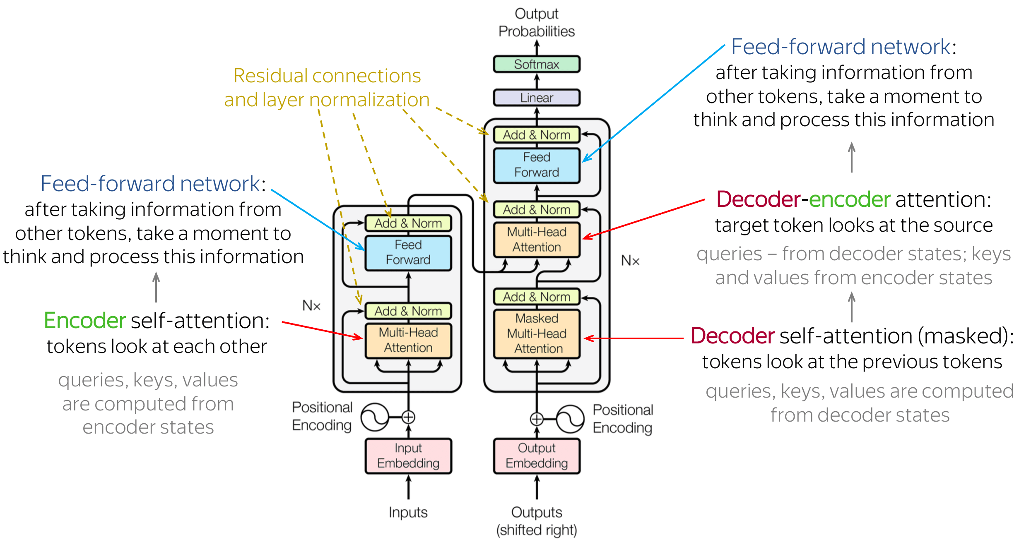
Recap: Transformers

Slide 3
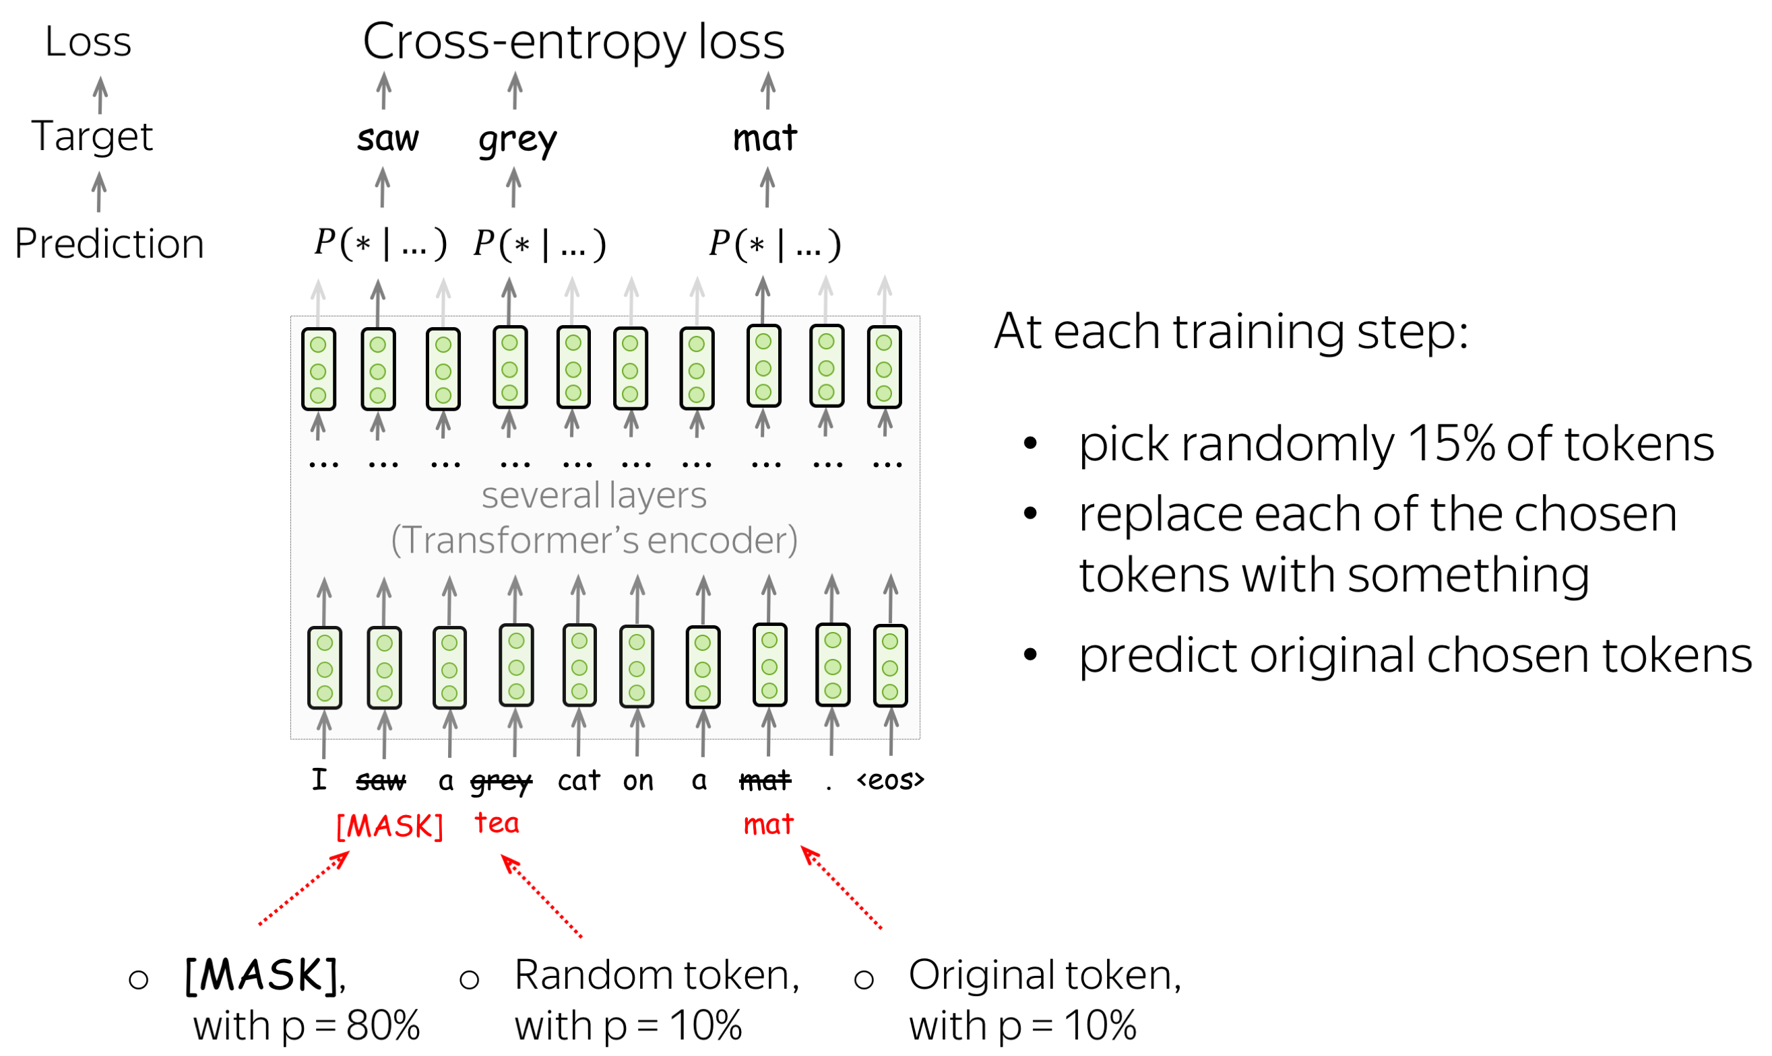
Recap: BERT

Slide 4
Recap: the humble language model
“Transformers make good language models”
everyone, 2017
“Language modeling kinda works for pretraining”
GPT-1 (2018), 117M weights, 5GB data
“Language models can do simple tasks without explicit training”
GPT-2 (2019), 1500M weights, 40GB data
What if we make it larger?
GPT-3 (2020), 175,000M weights, ~45,000 GB data

Slide 5
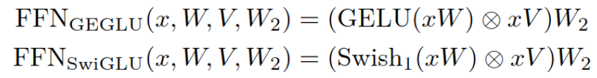
Architecture: where we’re at?
Attention: What changed since Vaswani et al 2017?
Rotary Positional Encoding – used in LLaMA, Qwen, most LLMs
Others: ALiBi, Relative Positional Embeddings, etc
Less KV size: Group Query Attention, limited window for some layers
Attention cache quantization, pruning, decomposition (next weeks!)
Sparse attention: trained (MLA) or post-training (ShadowKV-like)
Feedforward (FFN):
Gated activation (paper)
Sparse Mixture-of-Experts (2020, Mixtral, DeepSeek, most 100B+)
Other:
Replace LayerNorm: RMSNorm - works just as well, but simpler
A ton of technical improvements: Flash Attention, parallelism
???
???
???

Slide 6
Architecture: where we’re at?
Attention:
Rotary Positional Encoding – used in LLaMA, Qwen, most LLMs
Others: ALiBi, Relative Positional Embeddings, etc
Less KV size: Group Query Attention, limited window for some layers
Attention cache quantization, pruning, decomposition (next weeks!)
Sparse attention: trained (MLA) or post-training (ShadowKV-like)
Feedforward (FFN):
Gated activation (paper)
Sparse Mixture-of-Experts (2020, Mixtral, DeepSeek, most 100B+)
Other:
Replace LayerNorm: RMSNorm - works just as well, but simpler
A ton of technical improvements: Flash Attention, parallelism

Slide 7
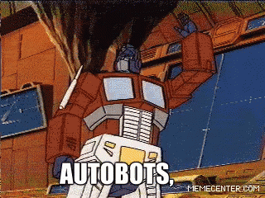
How to train your transformer? (at home)

Slide 8
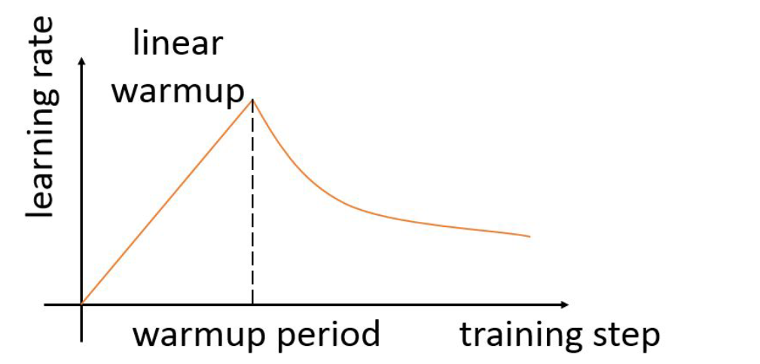
Training Tips for Transformers
https://arxiv.org/abs/1804.00247
Learning rate “warm-up”
from Vaswani et al. (2017)

Slide 9
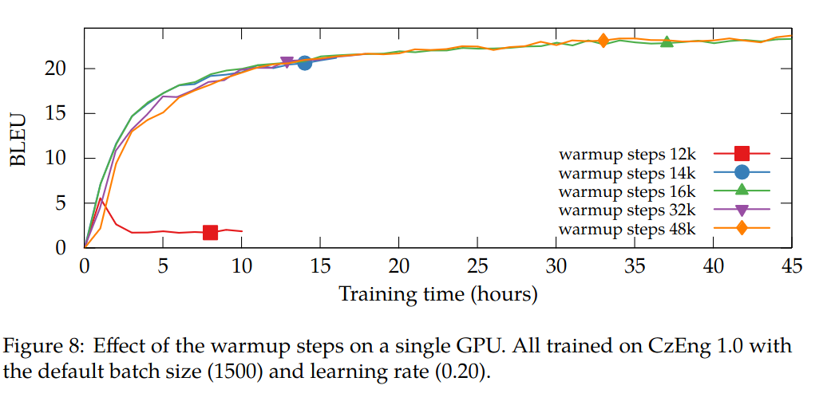
Training Tips for Transformers
https://arxiv.org/abs/1804.00247
Learning rate “warm-up”
from Vaswani et al. (2017)

Slide 10
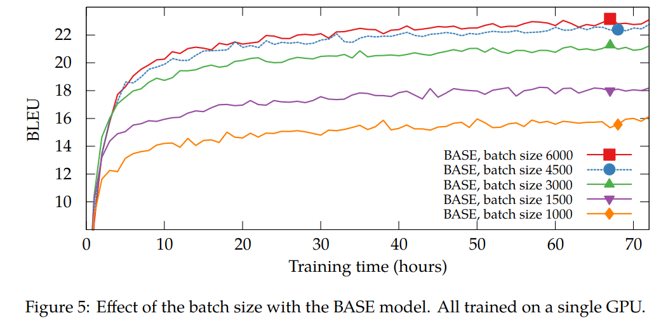
Training Tips for Transformers
https://arxiv.org/abs/1804.00247
Batch needs to be large enough

Slide 11
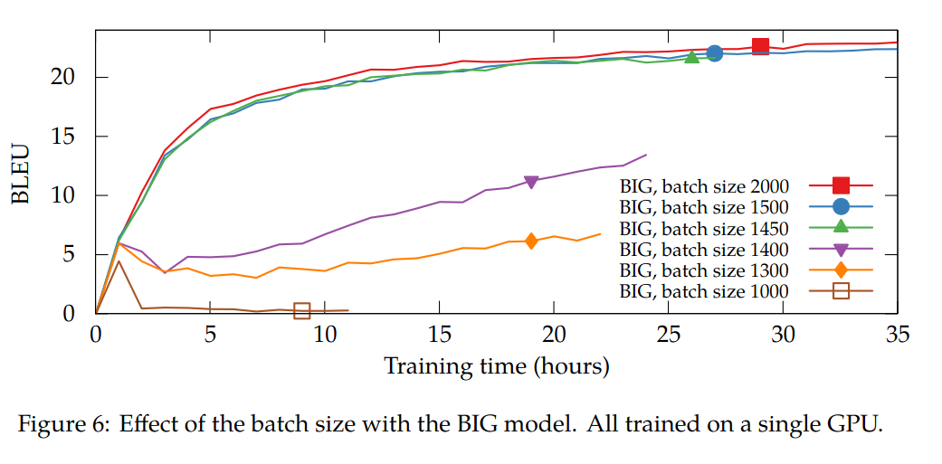
Training Tips for Transformers
https://arxiv.org/abs/1804.00247
Batch needs to be large enough

Slide 12
Training Tips for Transformers
https://arxiv.org/abs/1804.00247
From Vaswani et al (2017):
Adam optimizer (SGD is way worse)
Learning rate warmup / inverse sqrt decay
Large batch sizes – accumulate over multiple fwd/bwd passes
Form batches out of sentences of similar length
Scale attention logits by 1 / sqrt(dim)
Other works (e.g. GPT-3)
A ton of pre-processing tricks, e.g. concatenate texts
Mixed precision training – Bfloat16 if able; float16 + hacks if not
Adam-like optimizers: LAMB (large batch), AdaFactor(low memory)
& many more
Warm-up batch size – first few batches have fewer tokens
Warm-up sequence length

Slide 13
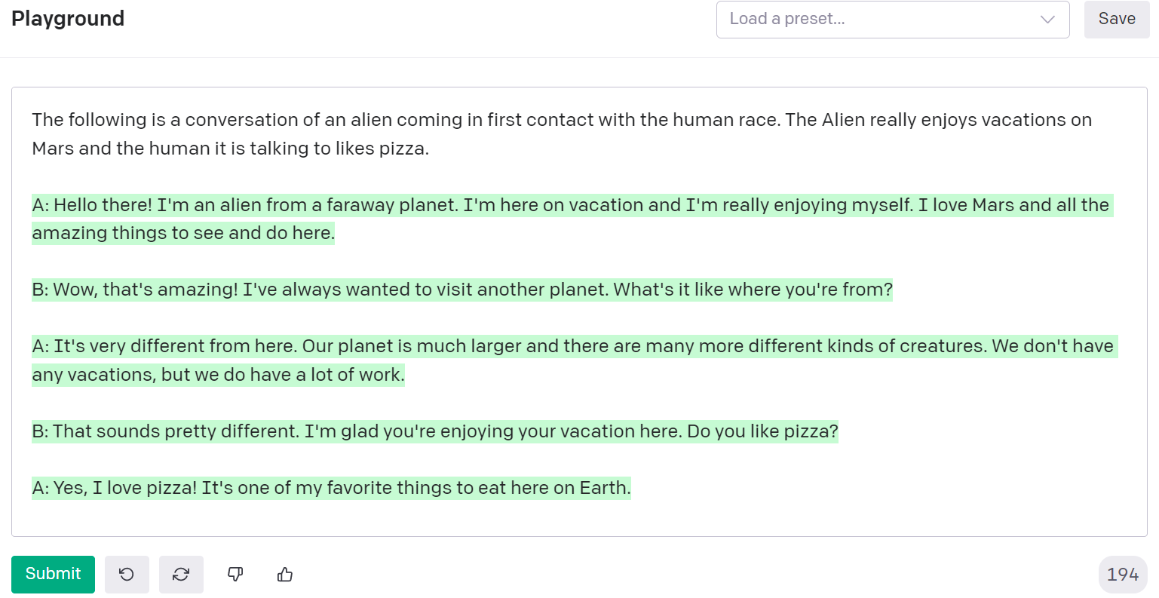
Recap: Prompt Engineering

Slide 14
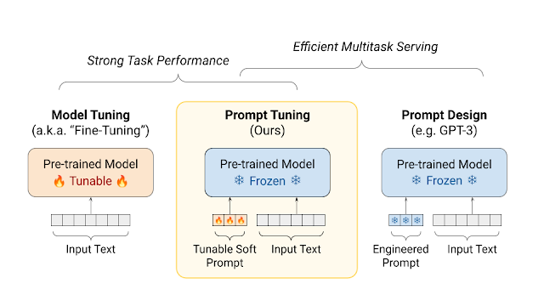
Prompt Tuning
https://aclanthology.org/2021.emnlp-main.243.pdf
Image Credit: https://ai.googleblog.com/2022/02/guiding-frozen-language-models-with.html

Slide 15
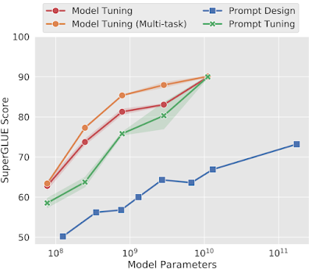
Prompt Tuning
https://aclanthology.org/2021.emnlp-main.243.pdf
Prompt Tuning gets more competitive with scale!

Slide 16
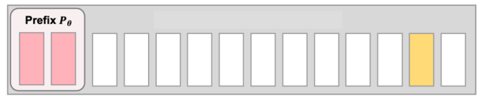
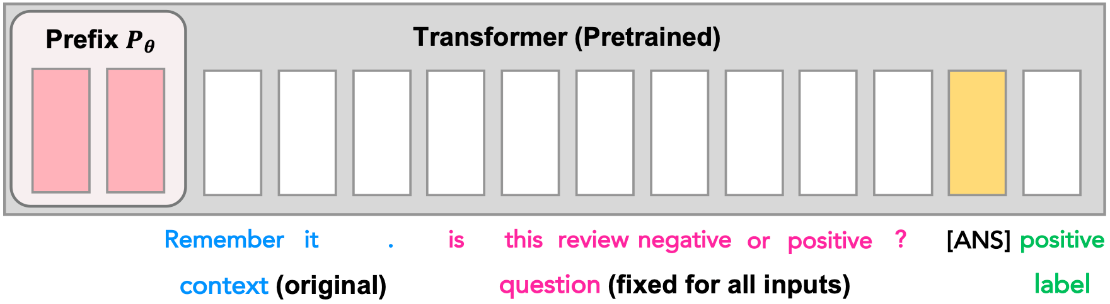
Prefix tuning: p-tuning goes deep
https://arxiv.org/abs/2101.00190
https://arxiv.org/abs/2110.07602
transformer block 1
transformer block 2
. . .
transformer block N

Slide 17
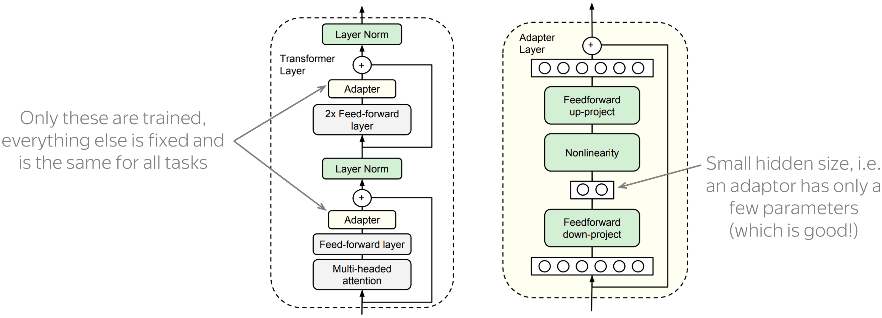
Adapters
https://arxiv.org/abs/1902.00751
Core idea: train small sub-networks

Slide 18
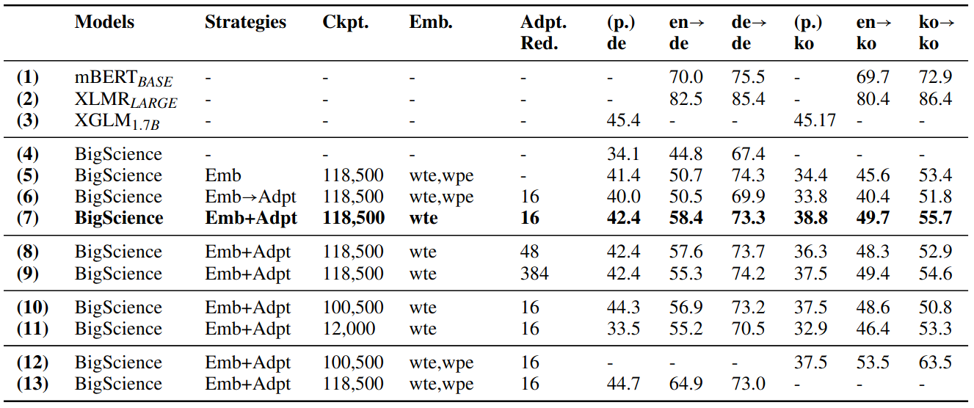
Adapters can do language adaptation
https://arxiv.org/abs/2204.04873
Generalize BLOOM to unseen languages without full model training
Only adapters and token embeddings are trained

Slide 19
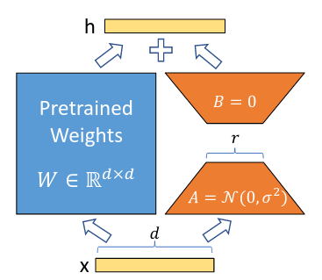
LoRA
https://arxiv.org/abs/2106.09685
Add adapters in parallel with linear layers
train only A & B

Slide 20
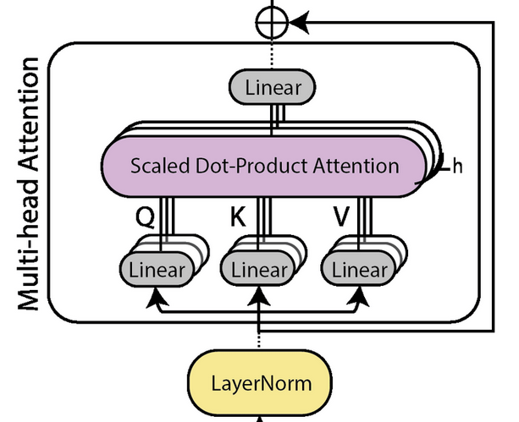
LoRA
https://arxiv.org/abs/2106.09685
Add adapters in parallel with linear layers
B
A
B
B
B
A
A
A
Add LoRA adapters to Q K & V layers
(but not to attention O, MLP, embeddings, logits)
Subsequent papers: add to QKVO and MLP

Slide 21
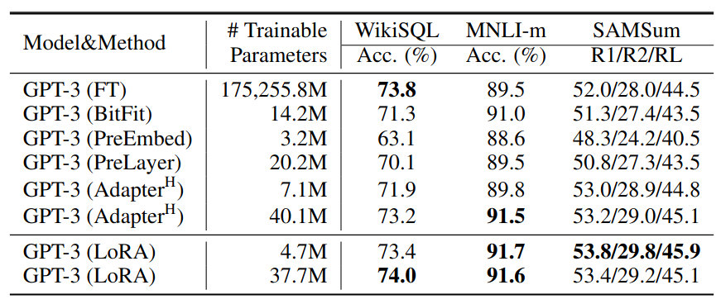
LoRA
https://arxiv.org/abs/2106.09685
Add adapters in parallel with linear layers
B
A
B
B
B
A
A
A

Slide 22
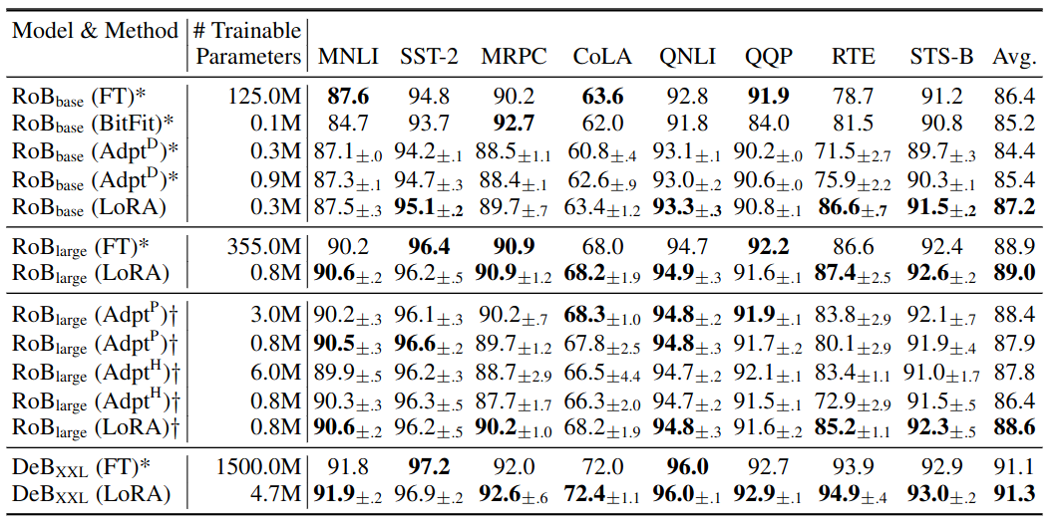
LoRA
https://arxiv.org/abs/2106.09685
Below: RoBERTa-base/large & DeBerta XXL

Slide 23
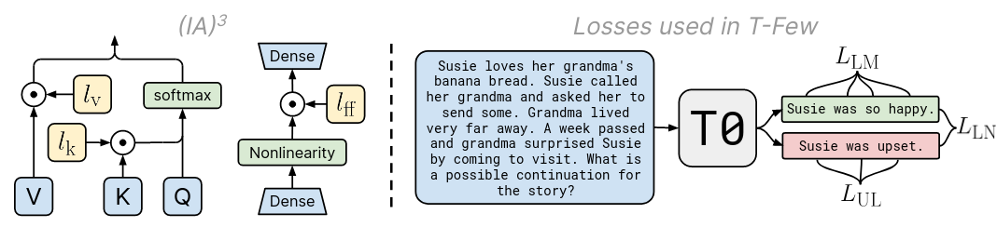
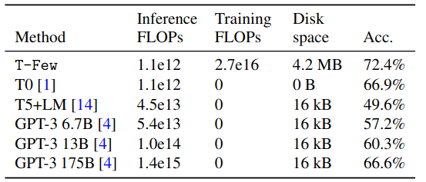
T-Few (IA3)
https://arxiv.org/abs/2205.05638
Accuracy and costs on held-out T0 tasks

Slide 24
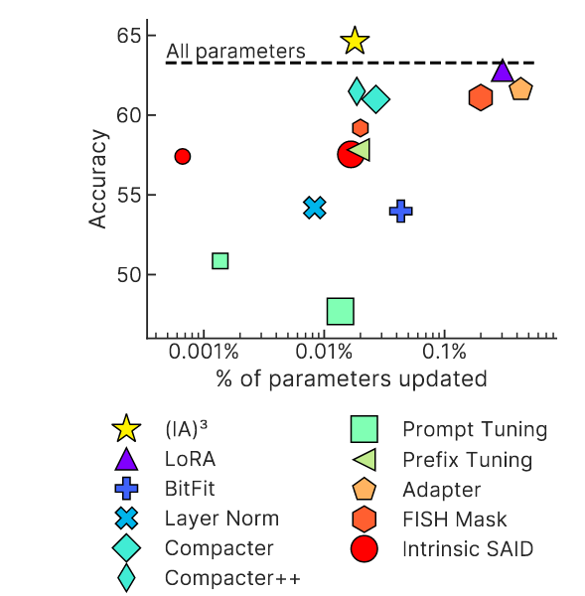
T-Few (IA3)
https://arxiv.org/abs/2205.05638

Slide 25
TL;DR PEFT
Parameter Efficient Fine-Tuning
“When do I use this?”
10s-100s of examples = prompt engineering, IA3
100s, 1000s of examples = prompt tuning, IA3
more examples = LoRA adapters
“Which method do I use?”
Try latest p-tuning and latest adapters, compare
“Where can I play with these methods?”
https://huggingface.co/docs/peft/index

Slide 26
TL;DR PEFT
Parameter Efficient Fine-Tuning
That’s just a rule of thumb!
“When do I use this?”
10s-100s of examples = prompt engineering, IA3
100s, 1000s of examples = prompt tuning, IA3
more examples = LoRA adapters
“Which method do I use?”
Try latest p-tuning and latest adapters, compare
“Where can I play with these methods?”
https://huggingface.co/docs/peft/index

Slide 27



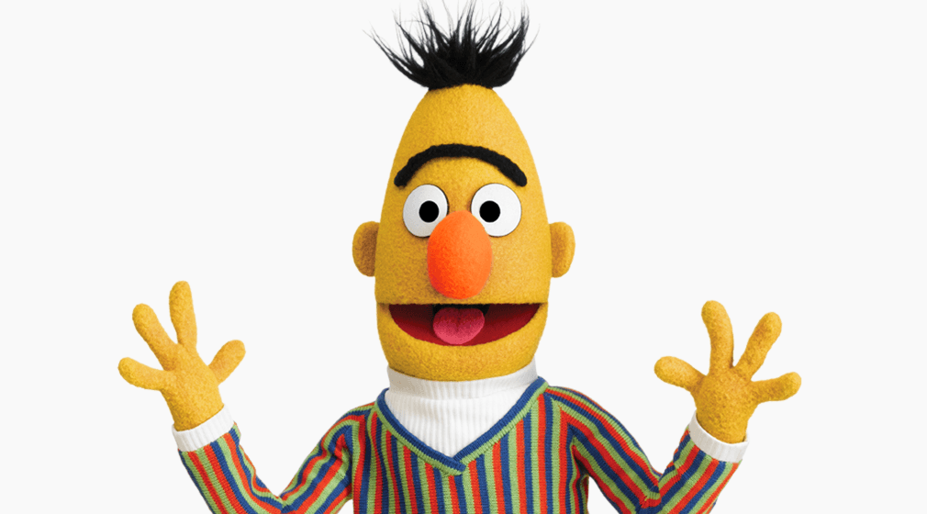
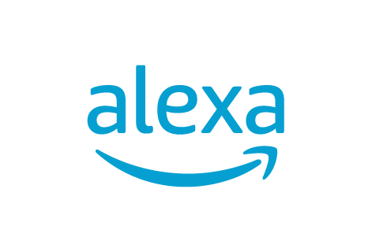

Let’s make us a chat assistant!
(Chat Assistant != LLM)

Slide 28
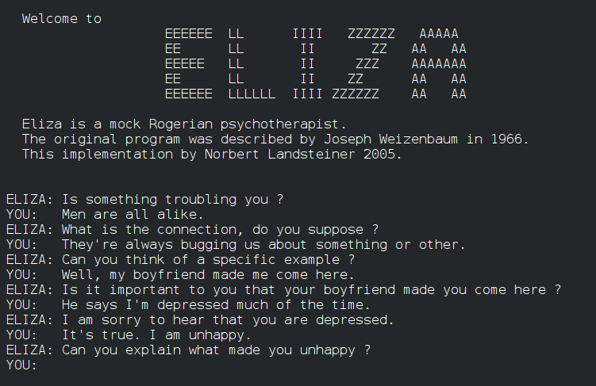
Ye olde chat bots: ELIZA
Source: ELIZA by Joseph Weizenbaum, 1967

Slide 29
Ye olde chat bots: ELIZA
Source: ELIZA by Joseph Weizenbaum, 1967
ELIZA was manually programmed to ask questions
about user’s previous message
People who use the chatbot report that ELIZA feels
like she is almost human (see: ELIZA effect)
Note: there were others, e.g. PARRY (1971)

Slide 30
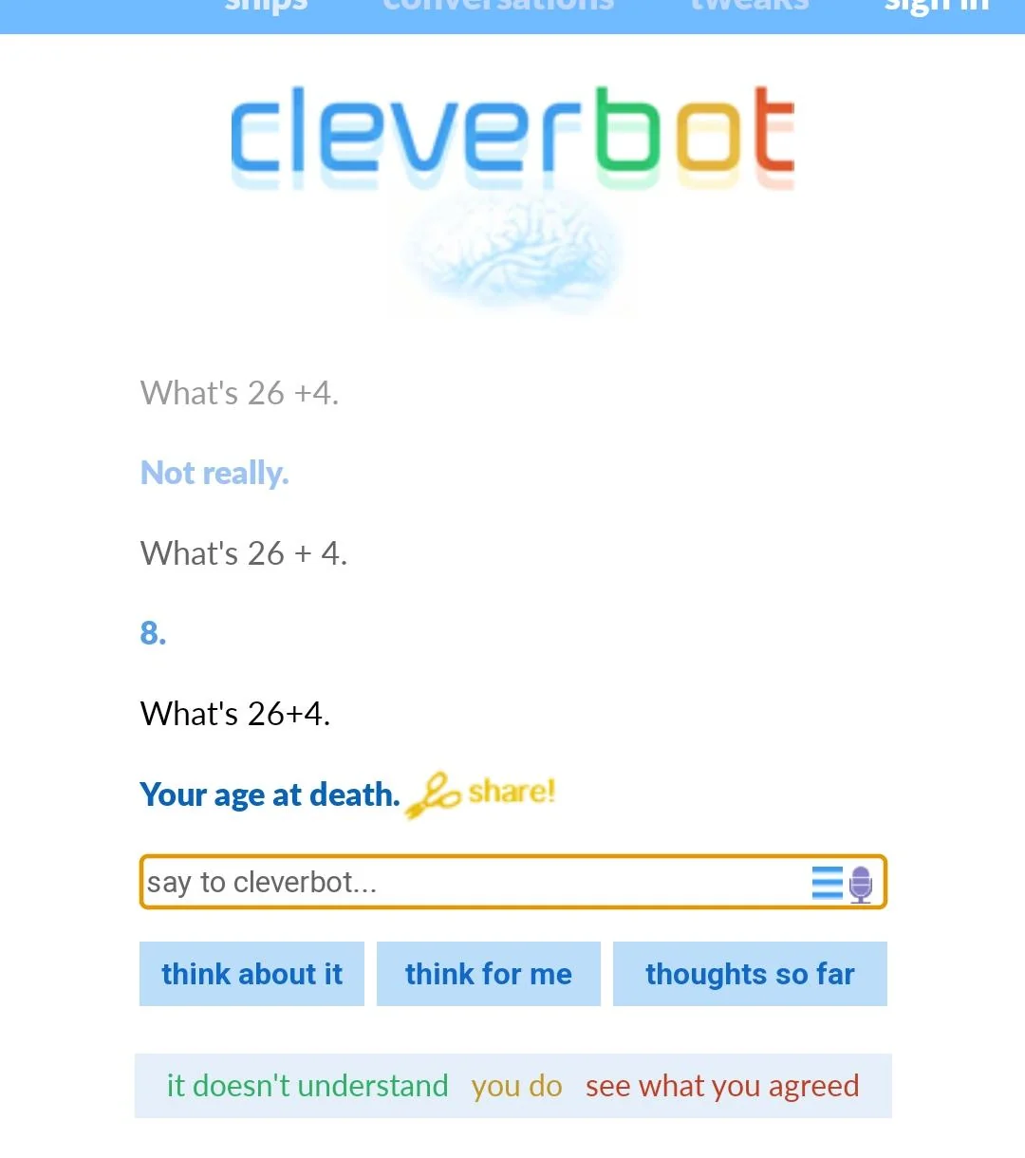
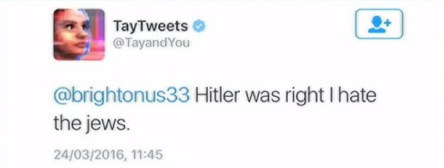
Ye olde chat bots: CleverBot
Source: https://www.cleverbot.com , 2008
Under the hood: has a database of human responses, picks the closest one by context.
(essentially, KNNClassifier)
The database contains past conversations with users. If you talk to it, it learns from you.
Notoriously toxic :)
As usual, there were many others chat bots with similar design in early 2000s/2010s
Below: Tay, a conversation system by Microsoft engineers, ruined by Twitter

Slide 31
Ye olde chat bots: CleverBot
Source: https://www.cleverbot.com , 2008
Under the hood: has a database of human responses, picks the closest one by context.
(essentially, KNNClassifier)
The database contains past conversations with users. If you talk to it, it learns from you.
Notoriously toxic :)
As usual, there were many others chat bots with similar design in early 2000s/2010s
Below: Tay, a conversation system by Microsoft engineers, ruined by Twitter

Slide 32
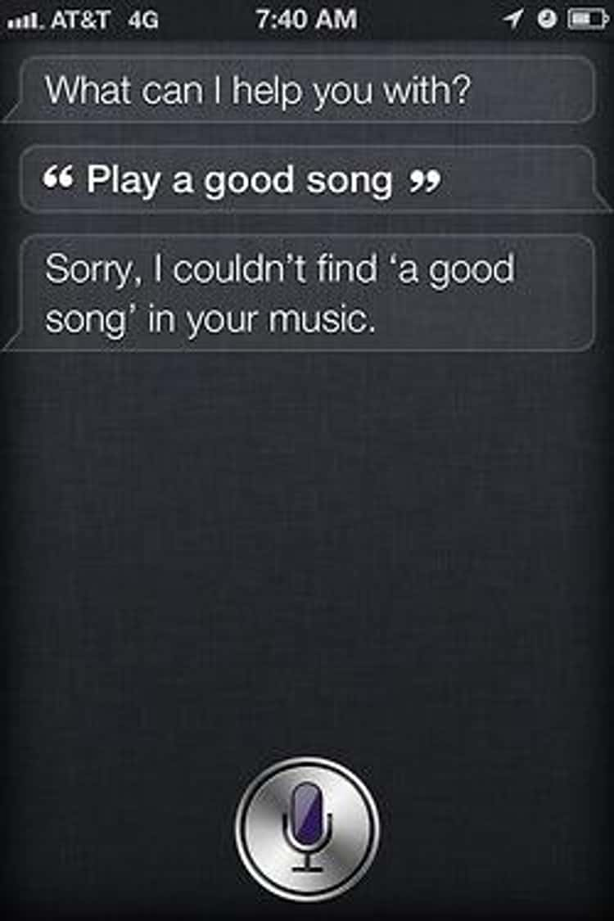
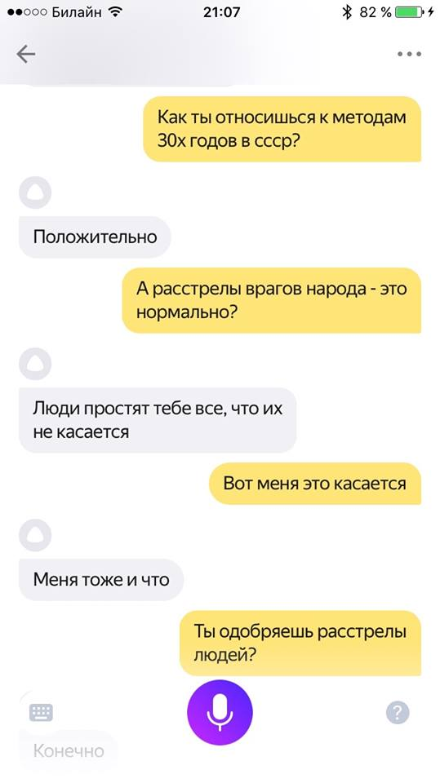
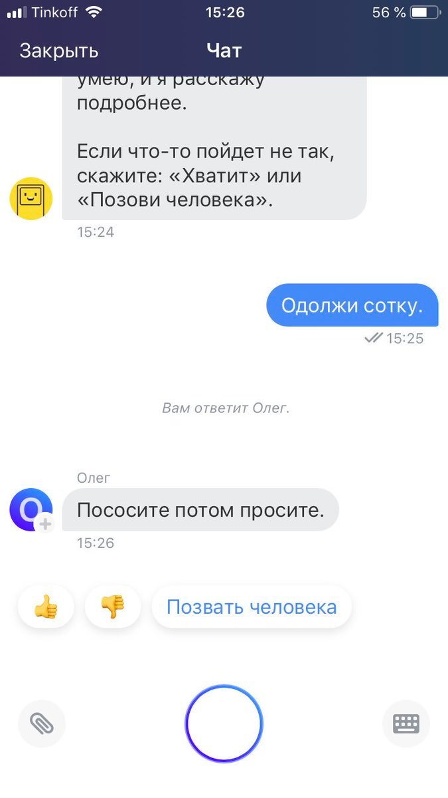
Ye (not so) olde chat bots
Screenshots from Siri, Alisa, Oleg
Countless others: Alexa, Google Home, Marusya

Slide 33
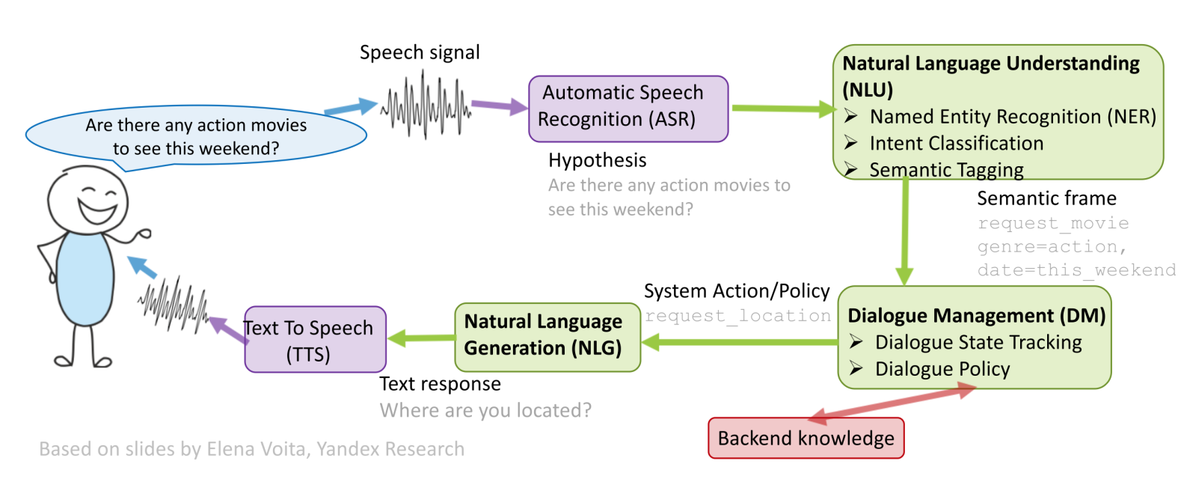
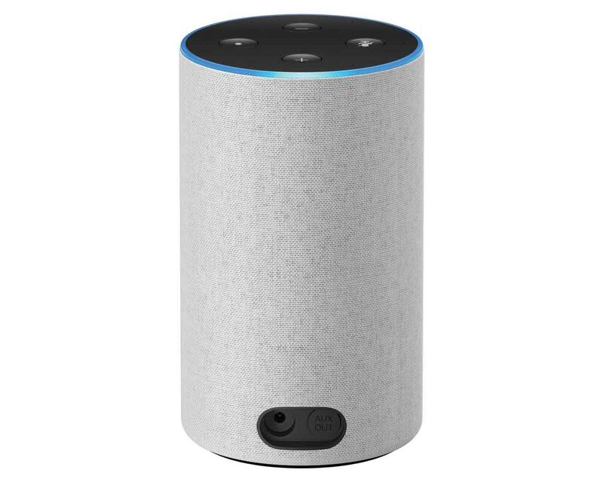
How to build your chat assistant?
System design: let’s split “chat bot” into smaller problems
Speech processing: see YSDA speech course
Business knowledge: rules for banking / psychology / ...
Text processing: this lecture
Let’s talk about this
Q: how would you design it?
e.g. a bank tech support bot
?!
Must be able to:
- talk to you in voice
- make transactions for you
- answer your questions about
… bank services, history, etc
- must *not* accidentally lose your money!

Slide 34
How to build your chat assistant?
Two design philosophies
Software with LLMs as tools
- Handcrafted scenarios:
search, music, shopping, etc
- Use LLM (or encoders) to help
with narrow subtasks, e.g.NER
LLMs with software as tools
- Feed all user’s inputs into a
smart-enough LLM, let it answer.
- Let LLM call tools through text,
e.g. search / music / shopping.

Slide 35
How to build your chat assistant?
Two design philosophies
Software with LLMs as tools
- Handcrafted scenarios:
search, music, shopping, etc
- Use LLM (or encoders) to help
with narrow subtasks, e.g.NER
LLMs with software as tools
- Feed all user’s inputs into a
smart-enough LLM, let it answer.
- Let LLM call tools through text,
e.g. search / music / shopping.
Which one should you use?

Slide 36
How to build your chat assistant?
Two design philosophies
Software with LLMs as tools
- Handcrafted scenarios:
search, music, shopping, etc
- Use LLM (or encoders) to help
with narrow subtasks, e.g.NER
- Less capable, can’t generalize outside pre-defined scenarios.
LLMs with software as tools
- Feed all user’s inputs into a
smart-enough LLM, let it answer.
- Let LLM call tools through text,
e.g. search / music / shopping.
+ More capable, can generalize beyond pre-defined instructions.

Slide 37
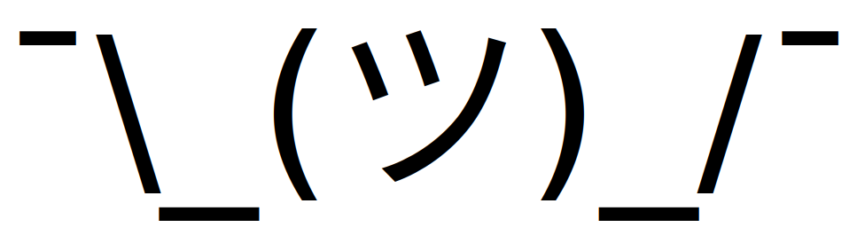
How to build your chat assistant?
Two design philosophies
Software with LLMs as tools
- Handcrafted scenarios:
search, music, shopping, etc
- Use LLM (or encoders) to help
with narrow subtasks, e.g.NER
- Less capable, can’t generalize outside pre-defined scenarios.
+ Easier to control and audit.
+ Will not burn all your money because of prompt injection.
LLMs with software as tools
- Feed all user’s inputs into a
smart-enough LLM, let it answer.
- Let LLM call tools through text,
e.g. search / music / shopping.
+ More capable, can generalize beyond pre-defined instructions.

Slide 38
Design A: Software with LLM tools
System design: let’s split “chat bot” into smaller problems
Speech processing: see YSDA speech course
Business knowledge: rules for banking / psychology / ...
Text processing: this lecture

Slide 39
Design A: Software with LLM tools
System design: let’s split “chat bot” into smaller problems
Speech processing: see YSDA speech course
Business knowledge: rules for banking / psychology / ...
Text processing: this lecture
Look here first

Slide 40
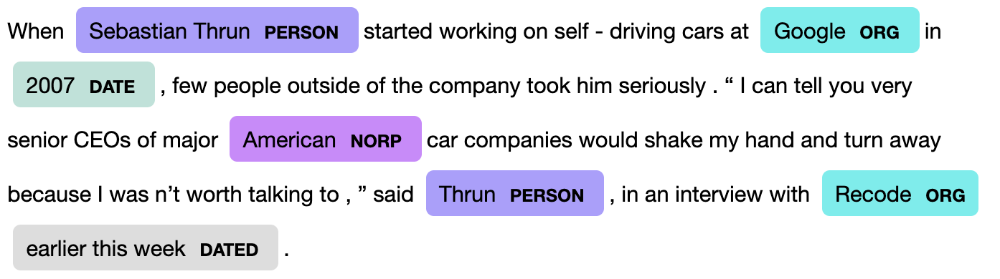
Named Entity Recognition
Why: extract keywords from user’s message, use them , e.g.
- for web search, when checking a fact
- for map look-up (“where can I buy pizza in Taganrog?”)
- to play music / video (“play Eminem’s latest song”)
Q: how do we solve this?
Image credit: nanonets.com

Slide 41
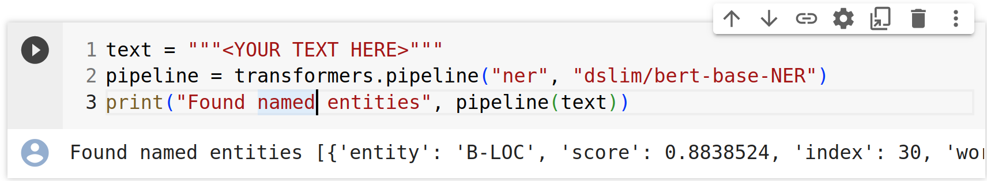
Named Entity Recognition
Why: extract keywords from user’s message, use them , e.g.
- for web search, when checking a fact
- for map look-up (“where can I buy pizza in Taganrog?”)
- to play music / video (“play Eminem’s latest song”)
Q: how do we solve this?
A: fine-tune a BERT-like model
for token classification
See week 5 for details :)

Slide 42
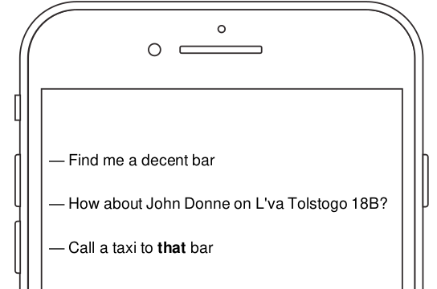
More NLU problems
Named Entity Recognition: see previous slide
Semantic parsing: to figure out what user wants from you
Anaphora resolution: to find what “it” or “this bar” refers to

Slide 43
More NLU problems
Named Entity Recognition: see previous slide
Semantic parsing: to figure out what user wants from you
Anaphora resolution: to find what “it” or “this bar” refers to

Slide 44
Design A: Software with LLM tools
System design: let’s split “chat bot” into smaller problems
Speech processing: see YSDA speech course
Business knowledge: rules for banking / psychology / ...
Text processing: this lecture
next one :)

Slide 45
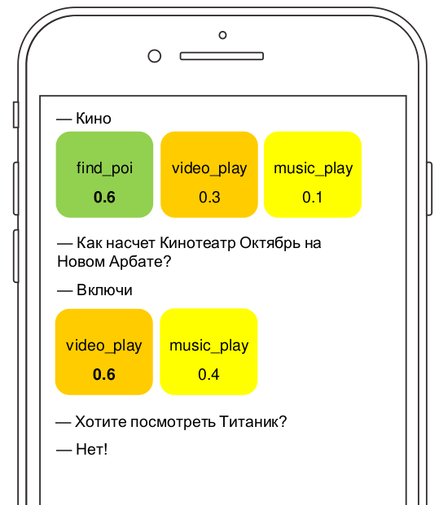
Dialogue Management
Two sub-problems:
1. Dialogue State Tracking:
what are we talking about?
what does user want from us?
what did we try previously?
Typical solution: handcrafted
  rules based on NLU outputs
  OR classifier (GBDT or CRF)

Slide 46
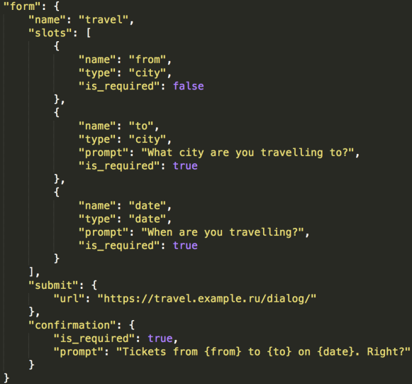
Dialogue Management
Two sub-problems:
1. Dialogue State Tracking:
what are we talking about?
what does user want from us?
what did we try previously?
Typical solution: handcrafted
  rules based on NLU outputs
  OR classifier (GBDT or CRF)
2. Dialogue Strategy
  how do we respond now?
  do we need any extra info?
  Typical solution: handcrafted
  slots, choose one at random
  OR with reinforcement learning
D

Slide 47
Dialogue Management
Two sub-problems:
1. Dialogue State Tracking:
what are we talking about?
what does user want from us?
what did we try previously?
Typical solution: handcrafted
  rules based on NLU outputs
  OR classifier (GBDT or CRF)
2. Dialogue Strategy
  how do we respond now?
  do we need any extra info?
  Typical solution: handcrafted
  slots, choose one at random
  OR with reinforcement learning
D
Either that, or you can prompt a
large language language model
to make appropriate responses

Slide 48
Design A: Software with LLM tools
System design: let’s split “chat bot” into smaller problems
Speech processing: see YSDA speech course
Business knowledge: rules for banking / psychology / ...
Text processing: this lecture
Use LLM (or templates)
to phrase the answer

Slide 49
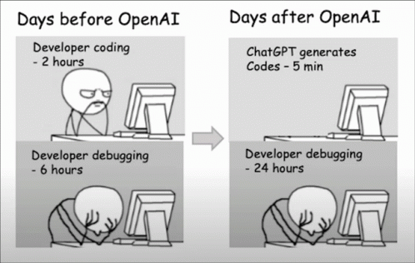
Design B: LLM with software as tools

Slide 50
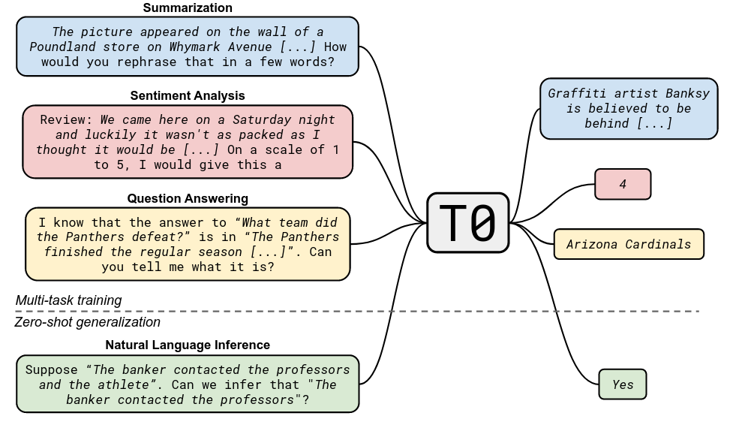
Recap: T0 pre-training
Paper: https://arxiv.org/abs/2110.08207

Slide 51
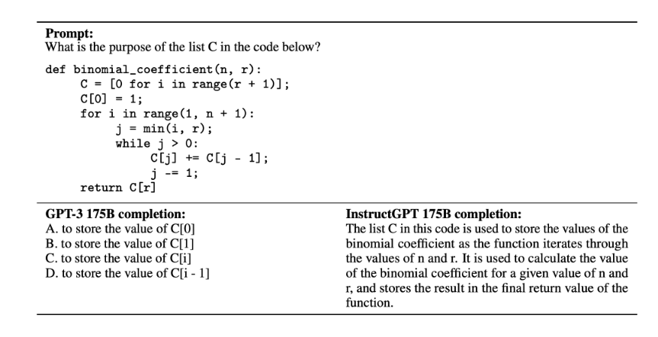
What we want: Instruction Following
Paper: https://arxiv.org/abs/2203.02155

Slide 52
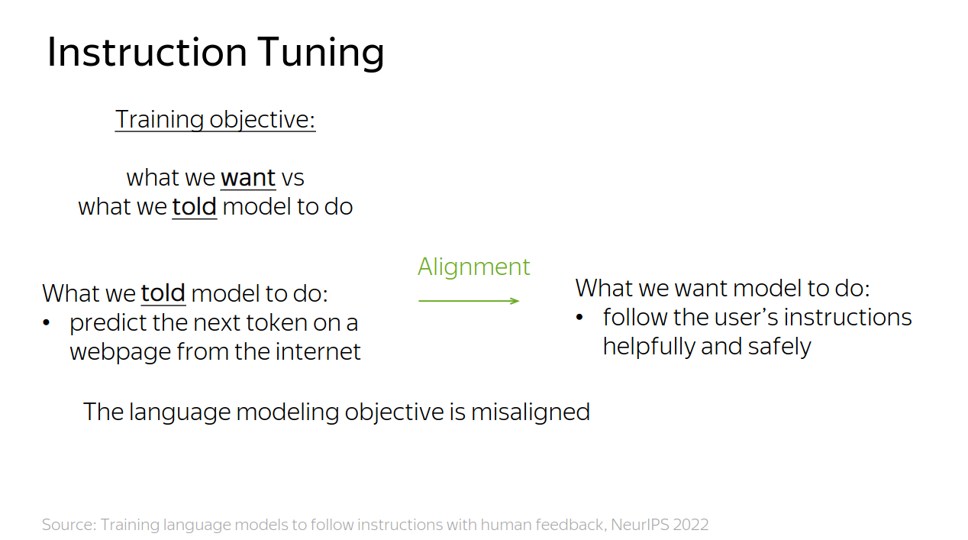

Slide 53
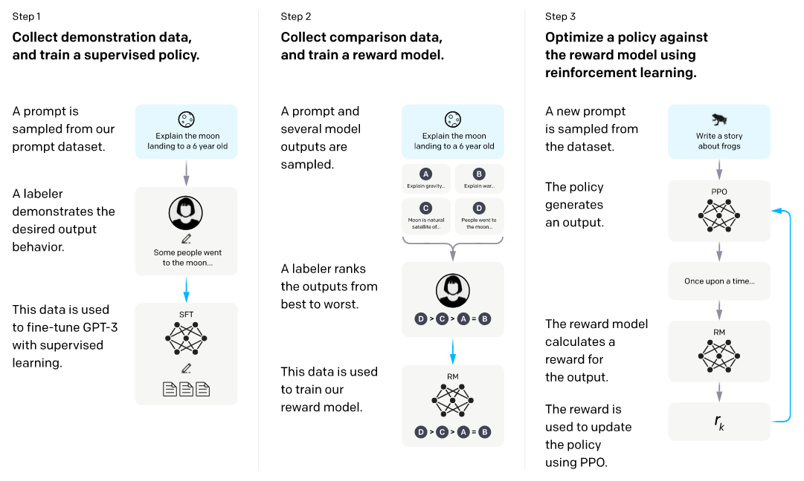
InstructGPT: basically ChatGPT
Paper: https://arxiv.org/abs/2203.02155

Slide 54
Stage 1: Supervised Fine-tuning
Paper: https://arxiv.org/abs/2203.02155

Slide 55
Stage 1: Supervised Fine-tuning
Paper: https://arxiv.org/abs/2203.02155

Slide 56
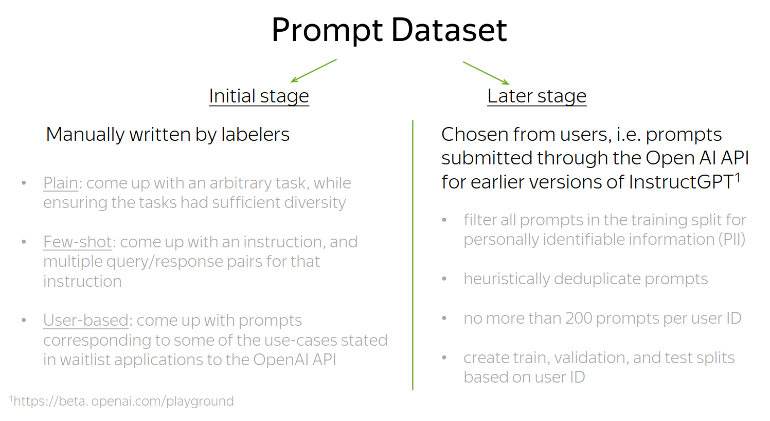
Stage 1: Supervised Fine-tuning
Paper: https://arxiv.org/abs/2203.02155

Slide 57
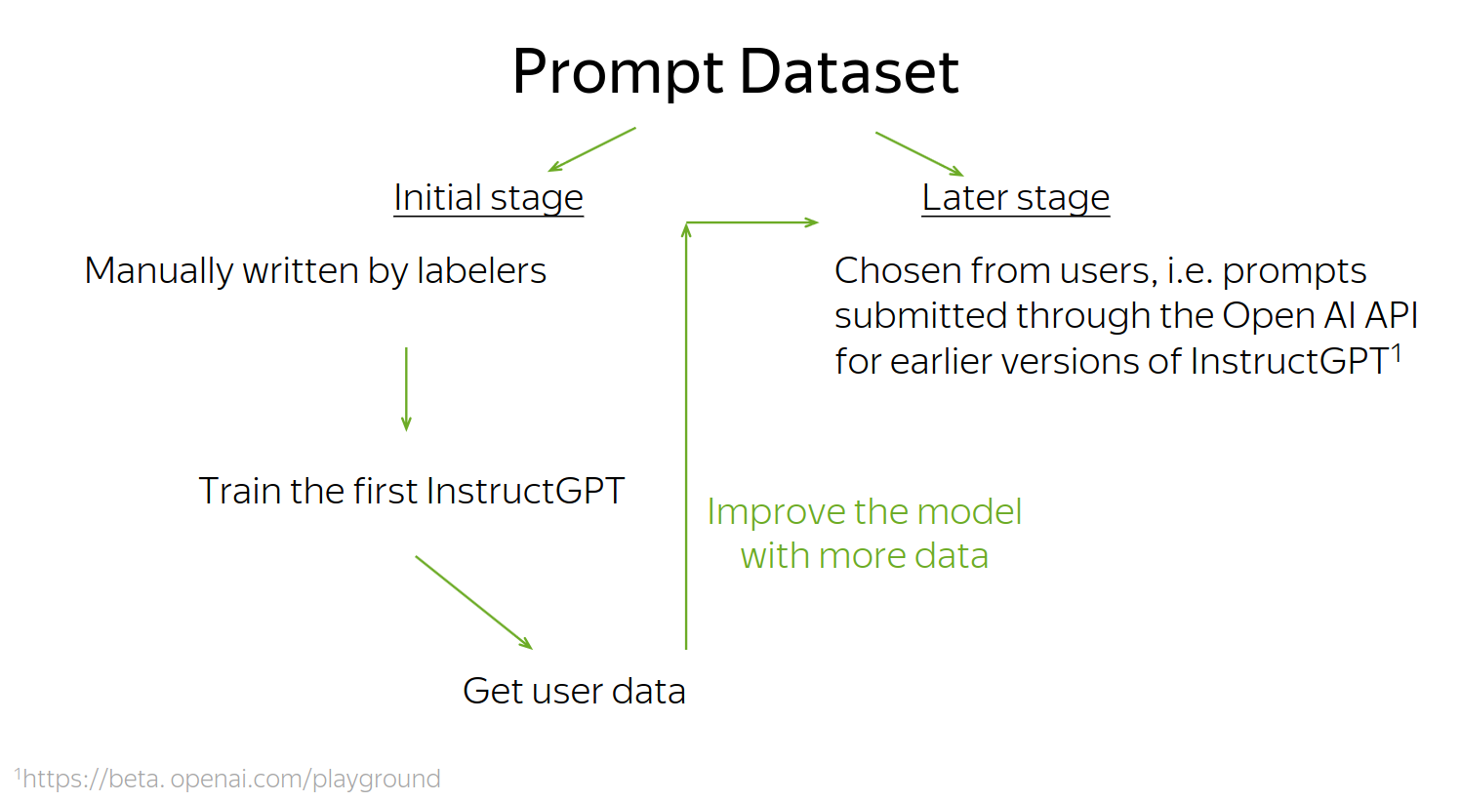
Stage 1: Supervised Fine-tuning
Paper: https://arxiv.org/abs/2203.02155

Slide 58
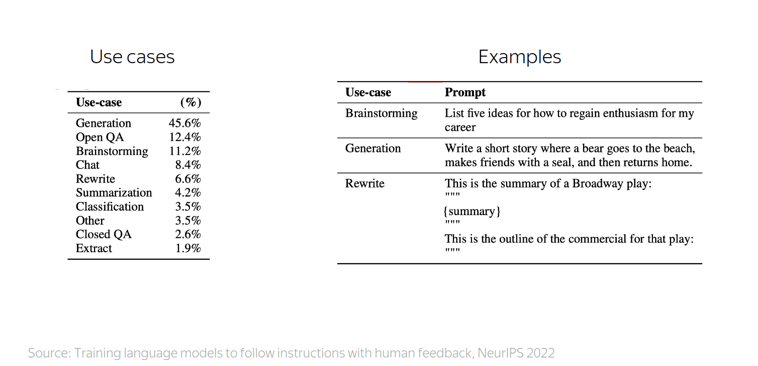
Stage 1: Supervised Fine-tuning
Paper: https://arxiv.org/abs/2203.02155

Slide 59
Stage 1: Supervised Fine-tuning
Paper: https://arxiv.org/abs/2203.02155
Fine-tuning procedure:
  exactly the same as in pre-training
minimize crossentropy with Adam
using the instruction-following data
Cheaper version: train LoRA adapters
https://arxiv.org/abs/2305.14314

Slide 60
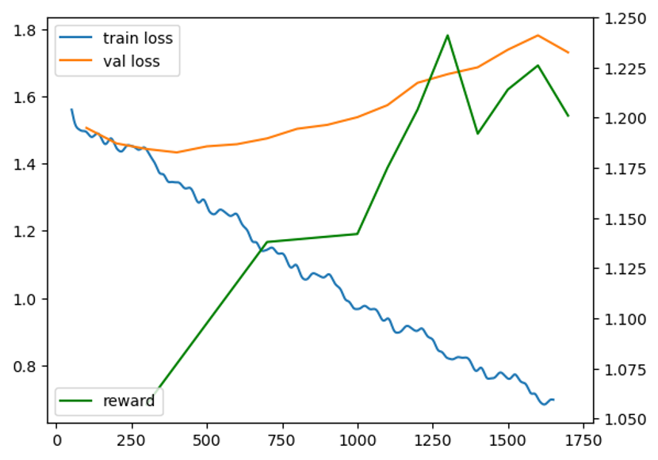
Stage 1: Supervised Fine-tuning
Paper: https://arxiv.org/abs/2203.02155
Fine-tuning procedure:
  exactly the same as in pre-training
minimize crossentropy with Adam
using the instruction-following data
Tip: sometimes it’s best to train for longer

Slide 61
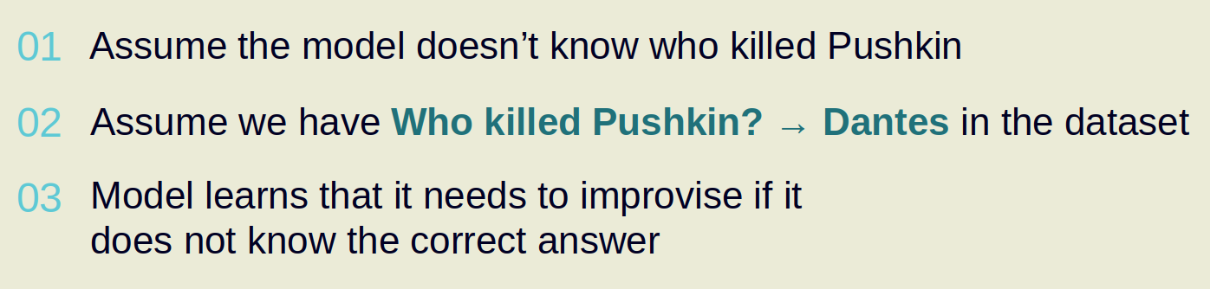
Why can’t we stop at SFT stage?
Reason 1: ranking is easier than writing for labelers
(except maybe for fact-checking)
Reason 2: supervised fine-tuning promotes hallucinations
(see example below)

Slide 62
Stage 2: Reward Model
Paper: https://arxiv.org/abs/2203.02155

Slide 63
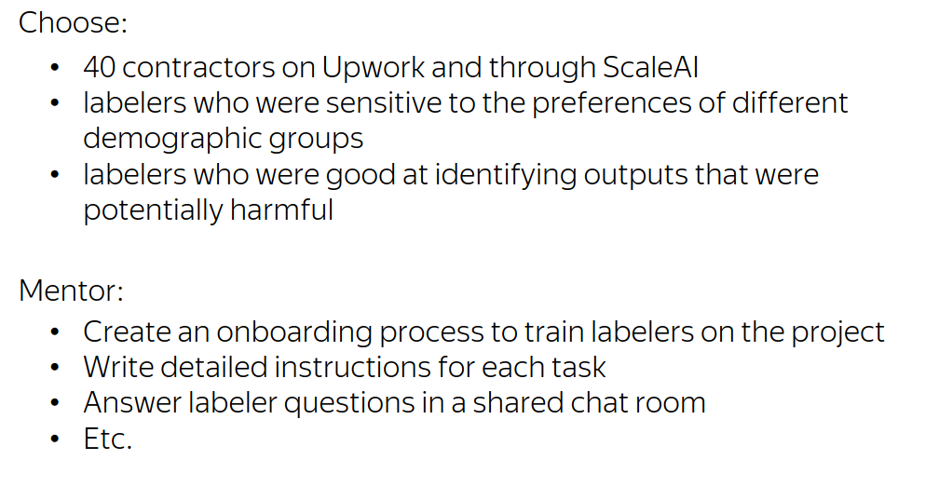
Stage 2: Reward Model
How OpenAI did it

Slide 64

Stage 2: Reward Model
Our experience @ Yandex

Slide 65


Stage 2: Reward Model
Paper: https://arxiv.org/abs/2203.02155

Slide 66
Stage 3: Reinforcement Learning
Paper: https://arxiv.org/abs/2203.02155

Slide 67
Stage 3: Reinforcement Learning
TL;DR reinforcement learning for LLM tasks:
1. Let the model generate several responses
(sample with probability)
2. Compute reward for each response
(apply reward model)
3. Train to increase probability of responses with high reward
(and decrease probability if reward is low)
here
‘s
what
I
know
[prompt]
screw
you
!
I
don
‘t
know

Slide 68
Stage 3: Reinforcement Learning
TL;DR reinforcement learning for LLM tasks:
1. Let the model generate several responses
(sample with probability)
2. Compute reward for each response
(apply reward model)
3. Train to increase probability of responses with high reward
(and decrease probability if reward is low)
here
‘s
what
I
know
R = 5
[prompt]
screw
you
!
R = -1
I
don
‘t
know
R = 2

Slide 69
Stage 3: Reinforcement Learning
TL;DR reinforcement learning for LLM tasks:
1. Let the model generate several responses
(sample with probability)
2. Compute reward for each response
(apply reward model)
3. Train to increase probability of responses with high reward
(and decrease probability if reward is low)
here
‘s
what
I
know
R = 5
[prompt]
screw
you
!
R = -1
I
don
‘t
know
R = 2

Slide 70
Stage 3: Reinforcement Learning
Policy gradient basics
Policy = probability of response (from your language model)
Reward = your reward model prediction
Objective: average reward, in expectation over policy
higher = better

Slide 71

Stage 3: Reinforcement Learning
Policy gradient basics
Objective: average reward, in expectation over policy
Step 1: estimate J with a batch of samples
Step 2: compute gradient
Step 3: ???????
Step 4: improve

Slide 72
Stage 3: Reinforcement Learning
Policy gradient basics
Objective: average reward, in expectation over policy
Step 1: estimate J with a batch of samples
Step 2: compute gradient
Step 3: ???????
Step 4: improve

Slide 73
Stage 3: Reinforcement Learning
Policy gradient basics
Objective: average reward, in expectation over policy
Step 1: estimate J with a batch of samples
Step 2: compute gradient
Step 3: ???????
Step 4: improve

Slide 74
Stage 3: Reinforcement Learning
Policy gradient basics
Objective: average reward, in expectation over policy
Step 1: estimate J with a batch of samples
Step 2: compute gradient
Step 3: ???????
Step 4: improve

Slide 75
Stage 3: Reinforcement Learning
REINFORCE, Williams (1992)
Objective: average reward, in expectation over policy
Step 1: estimate J with a batch of samples

Slide 76

Stage 3: Reinforcement Learning
REINFORCE, Williams (1992)
Objective: average reward, in expectation over policy
Step 1: estimate J with a batch of samples
Step 2: compute gradient
But there’s no θ in Jmc formula!

Slide 77
Stage 3: Reinforcement Learning
REINFORCE, Williams (1992)
Objective: average reward, in expectation over policy
Step 1: estimate J with a batch of samples
Step 2: compute gradient
But there’s no θ in Jmc formula!
( θ indirectly affects yi )

Slide 78
Stage 3: Reinforcement Learning
REINFORCE, Williams (1992)
Objective: average reward, in expectation over policy
Step 1: estimate J with a batch of samples
Step 2: compute gradient
Step 3: ???????

Slide 79
Stage 3: Reinforcement Learning
REINFORCE, Williams (1992)
Objective: average reward, in expectation over policy
New plan: compute directly, then do monte-carlo
sum over all possible x and y pairs (intractable)
but we’ll deal with that later

Slide 80
Stage 3: Reinforcement Learning
REINFORCE, Williams (1992)
Objective: average reward, in expectation over policy
New plan: compute directly, then do monte-carlo

Slide 81
Stage 3: Reinforcement Learning
REINFORCE, Williams (1992)
Objective: average reward, in expectation over policy
New plan: compute directly, then do monte-carlo
const(θ)

Slide 82
Stage 3: Reinforcement Learning
REINFORCE, Williams (1992)
Objective: average reward, in expectation over policy
New plan: compute directly, then do monte-carlo
const(θ)

Slide 83
Stage 3: Reinforcement Learning
REINFORCE, Williams (1992)
Objective: average reward, in expectation over policy
New plan: compute directly, then do monte-carlo
const(θ)
const(θ)

Slide 84
Stage 3: Reinforcement Learning
REINFORCE, Williams (1992)
Objective: average reward, in expectation over policy
New plan: compute directly, then do monte-carlo
Can’t do monte-carlo cuz is not a probability distribution

Slide 85
Stage 3: Reinforcement Learning
REINFORCE, Williams (1992)
Last formula from previous slide
Can’t do monte-carlo cuz is not a probability distribution
Log-derivative trick:

Slide 86
Stage 3: Reinforcement Learning
REINFORCE, Williams (1992)
Last formula from previous slide
Can’t do monte-carlo cuz is not a probability distribution
Log-derivative trick:

Slide 87
Stage 3: Reinforcement Learning
REINFORCE, Williams (1992)
Last formula from previous slide
Can’t do monte-carlo cuz is not a probability distribution
Log-derivative trick:

Slide 88
Stage 3: Reinforcement Learning
REINFORCE, Williams (1992)
Last formula from previous slide

Slide 89
Stage 3: Reinforcement Learning
REINFORCE, Williams (1992)
Last formula from previous slide
Expectation over y ~ πθ(y|x)

Slide 90
Stage 3: Reinforcement Learning
REINFORCE, Williams (1992)
Last formula from previous slide
Can use monte-carlo estimate

Slide 91
Stage 3: Reinforcement Learning
REINFORCE, Williams (1992)
Last formula from previous slide
Monte-carlo gradient (GPU-friendly)

Slide 92
Stage 3: Reinforcement Learning
Modern reinforcement learning
REINFORCE (Williams, 1992)

Slide 93
Stage 3: Reinforcement Learning
Modern reinforcement learning
REINFORCE (Williams, 1992)
Proximal Policy Optimization (Schulman et al, 2017)
- allows reusing samples xi , yi over several updates
- fancy formula that clips objective for training stability
- tricks: variance reduction (baseline, GAE), SGD → Adam

Slide 94
Stage 3: Reinforcement Learning
Modern reinforcement learning
REINFORCE (Williams, 1992)
Proximal Policy Optimization (Schulman et al, 2017)
- allows reusing samples xi , yi over several updates
- fancy formula that clips objective for training stability
- tricks: variance reduction (baseline, GAE), SGD → Adam
InstructGPT (Ouyang et al, 2022)
- they use PPO on top of learned reward model
- KL regularizer to prevent model from changing too much

Slide 95


Stage 3: Reinforcement Learning
More on PPO: https://spinningup.openai.com/en/latest/algorithms/ppo.html
PPO+ptx = PPO (improved REINFORCE) + log-likelihood
PPO = Proximal Policy Optimization
A (advantage) = reward - baseline
Intuition: PPO objective protects from abrupt policy changes that break down the model. It also allows multiple updates per sample.

Slide 96

Stage 3: Reinforcement Learning
Paper: https://arxiv.org/abs/2110.08207

Slide 97

Case Study 2: RL for math/coding
DeepSeek-R1 https://arxiv.org/pdf/2501.12948
← user prompt
<think>
Model can generate
arbitrary thoughts here,
and its only goal is to
produce the correct
final answer after
</think>
← final answer here

Slide 98

Case Study 2: RL for math/coding
DeepSeek-R1 https://arxiv.org/pdf/2501.12948
Stage 1: general LLM pre-training
In this case, the base model was DeepSeek v3.0, 671B MoE
Stage 2 (optional): supervised fine-tuning on problem solving data
Stage 3: reinforcement learning, reward for correct answers
DeepSeek R1 – all 3 stages. DeepSeek R1 Zero – skip stage 2.

Slide 99

Case Study 2: RL for math/coding
DeepSeek-R1 https://arxiv.org/pdf/2501.12948
Why SFT: R1 (with SFT) is not always better than R1-Zero,
but it produces more human-readable thoughts.

Slide 100

Bonus stuff: advanced RL for LLMs
Image Credit: Berkley CS188, materials are available at http://ai.berkeley.edu

Slide 101

Group Relative Policy Optimization
Paper: https://arxiv.org/abs/2402.03300
Idea: instead of using the absolute reward, make several generations
and compare your score against the average for this task.
Decent answer v.s. usually awful = reinforce!
Decent answer v.s. usually perfect = penalize!
Image credit: https://medium.com/@yuvrajsagar117

Slide 102

TreePO – trees of candidates
Paper: https://arxiv.org/pdf/2508.17445
Idea: Don’t just sample K independent solution attempts, build a tree!
Reuse prefix, expand more promising directions first.
Also: More fine-grained advantage computation (next slide)

Slide 103

TreePO – trees of candidates
Paper: https://arxiv.org/pdf/2508.17445
Idea: Don’t just sample K independent solution attempts, build a tree!
Reuse prefix, expand more promising directions first.
Trick: you can compare v.s. average reward for this subtree

Slide 104


Direct Preference Optimization
Paper: https://arxiv.org/abs/2305.18290
Consider optimal policy given reward model r(x, y):

Slide 105


Direct Preference Optimization
Paper: https://arxiv.org/abs/2305.18290
Consider optimal policy given reward model r(x, y):
Solve this as an equation to formulate r(x, y)
Log Z is still intractable, but we don’t need it: needs difference r1 - r2

Slide 106

Direct Preference Optimization
Paper: https://arxiv.org/abs/2305.18290
Consider optimal policy given reward model r(x, y):
Solve this as an equation to formulate r(x, y)

Slide 107


Direct Preference Optimization
Paper: https://arxiv.org/abs/2305.18290
Maximize “Log likelihood” that policy-induced reward follows user preference

Slide 108


