Slide 1

HCSC
Health Economics team Interview
dec 2, 2022

Slide 2
Discussion Objectives
Dataset Overview
PMPM Evaluation
ML Modeling
Feature Importance
Wellness Visit Evaluation
Inpatient Wellness Evaluation
Final Recommendations

Slide 3
Dataset Overview

Slide 4
Summary of Datasets Provided
Client Membership Metrics
dw_mbr_key
gender
age
zip_cd
relationship
enrollment_month
MSA
state
area_id
risk_score
sdoh_percentile
urban_percentile
hypertension_ind
depression_ind
hyperlipidemia_ind
cad_ind
diabetes_ind
alcohol_ind
sud_ind
copd_ind
psychotic_ind
hypothyroidism_ind
anxiety_ind
cancer_ind
pregnancy_ind
annual_wellness_visit
Client Data Metrics
dw_mbr_key
mbr_months_ccs
Primary_CCS_Dx_Level_1
Primary_CCS_Dx_Level_2
Total_Allowed
Total_Paid
Allowed_Inpatient
Allowed_Outpatient
Allowed_Professional
Paid_Inpatient
Paid_Outpatient
Paid_Professional
Adm_cnt_Inpatient
Day_cnt_Inpatient
Visit_cnt_Outpatient
Visit_cnt_Professional
Proc_cnt_Professional
Svc_unit_cnt_Professional
non_utilizer
Benchmark Metrics
gender
age
uniq_mbr_cnt
mbr_months_ccs
Primary_CCS_Dx_Level_1
Primary_CCS_Dx_Level_2
Total_Allowed
Total_Paid
Allowed_Inpatient
Allowed_Outpatient
Allowed_Professional
Paid_Inpatient
Paid_Outpatient
Paid_Professional
Adm_cnt_Inpatient
Day_cnt_Inpatient
Visit_cnt_Outpatient
Visit_cnt_Professional
Proc_cnt_Professional
Svc_unit_cnt_Professional
non_utilizer

Slide 5
PMPM Evaluation

Slide 6
Paid Per Member Per Month
PMPM
Calculation
= Total Paid / member months
- Primary Metric used to evaluate performance. Often used to score year over year increase/declines.

Slide 7
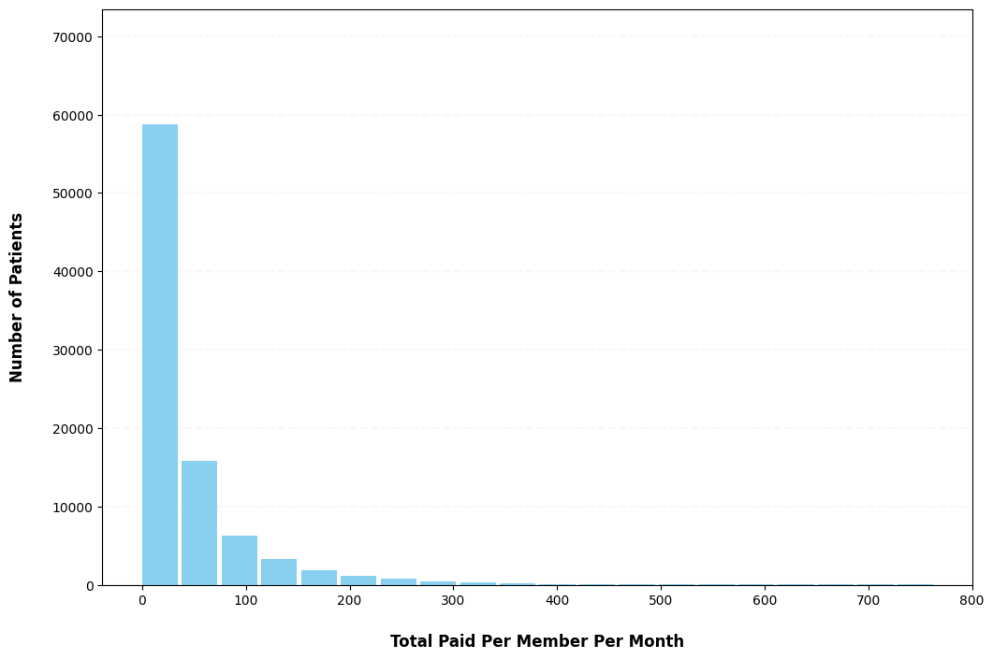
Distribution of Total Paid per Member Per Month

Slide 8

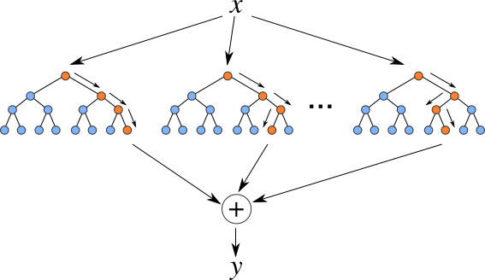

Random Forest Model
Random forest
Random Forest is a type of supervised learning algorithm that uses ensemble methods to solve both regression and classification problems.

Slide 9
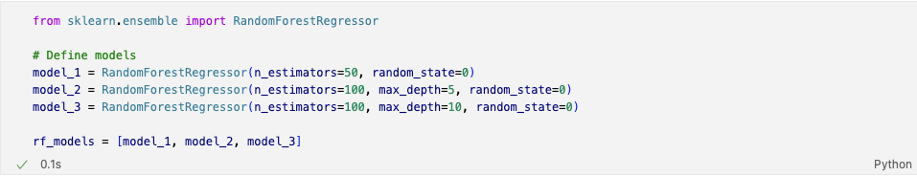
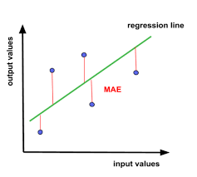
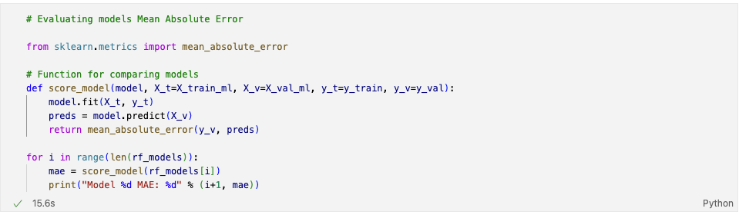

Random Forest Model
Actual
Predicted

Slide 10
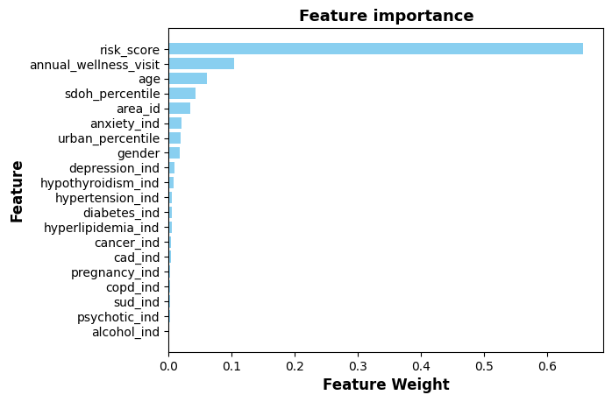
Feature Importance
Feature importance
Feature importance is a key concept in machine learning that refers to the relative importance of each feature in the training data.
In other words, it tells us which features are most predictive of the target variable.

Slide 11
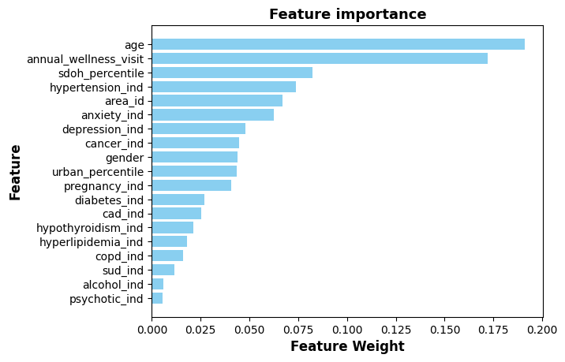
Feature Importance
Feature importance
Feature importance is a key concept in machine learning that refers to the relative importance of each feature in the training data.
In other words, it tells us which features are most predictive of the target variable.

Slide 12
Wellness Visit Evaluation

Slide 13
Wellness Visit Evaluation
Wellness Visits
Wellness visits are among the features that most contribute to PMPM.

Slide 14

Wellness Visit Evaluation

Slide 15
Inpatient Wellness Visit Evaluation

Slide 16
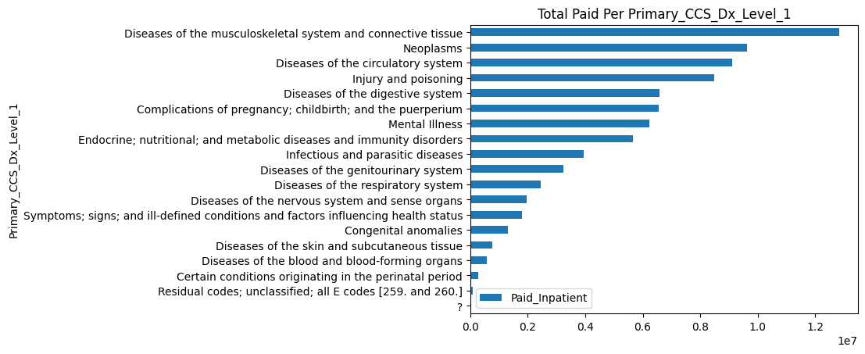
Inpatient Total Paid Per Primary CCS_DX_Level_1

Slide 17
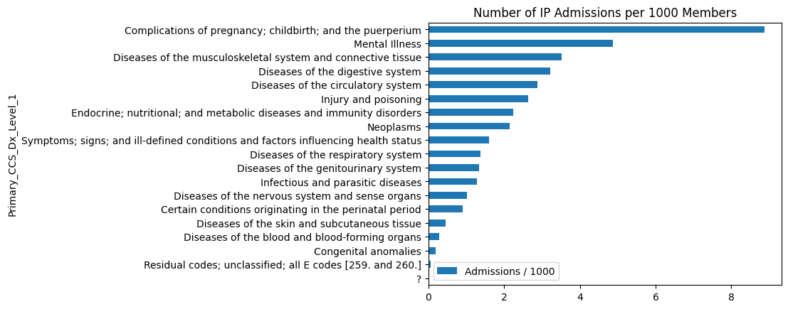
Inpatient Admissions / 1000 Members

Slide 18
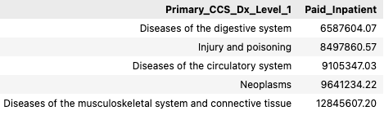
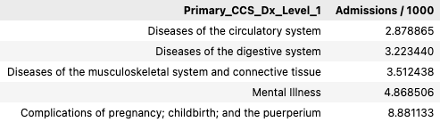
Inpatient Wellness Visit Evaluation
Total Paid Per Primary CCS_DX_Level_1
Admissions / 1000 Members

Slide 19
Final Recommendation

Slide 20




Yandi Farinango

