Slide 1
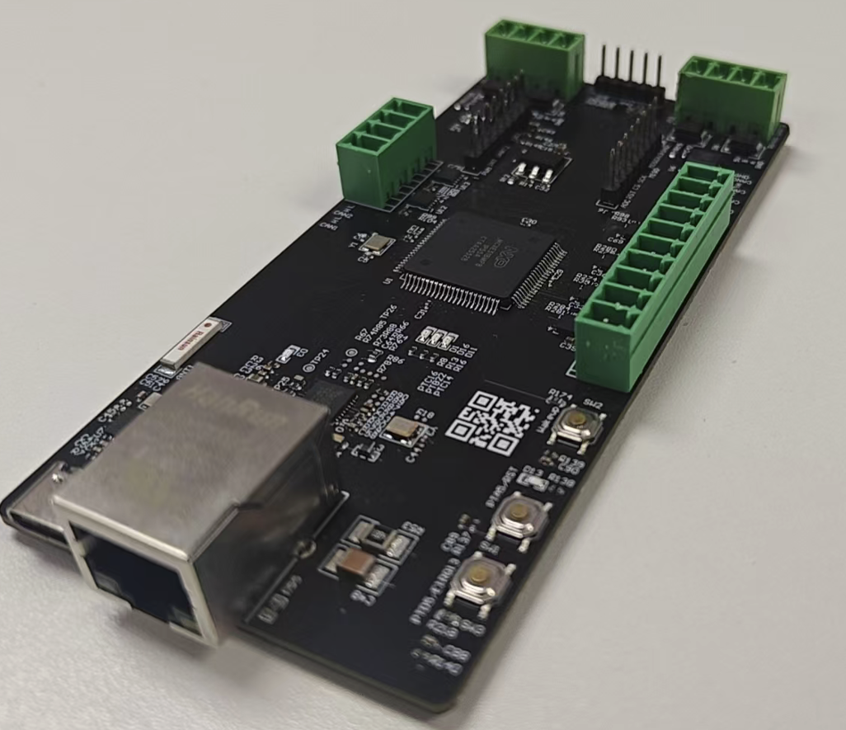
CAN FD Control Domain for Humanoid Robots
6× CAN FD ↔ Ethernet gateway based on MCXE31B
Key Advantages
6× CAN FD buses bridged to Ethernet on one cable
Native Linux SocketCAN (can0–can5)
~50 µs on-chip forwarding latency (DWT, host-clock free)
Lossless at 1000 fps/channel on all 6 buses at once
Core Features
MCXE31B Cortex-M7F @160 MHz, bare-metal lock-free loop
CAN FD 1 Mbps arb / 5-8 Mbps data, BRS (CAN 2.0 ready)
RMII 10/100M Ethernet, DHCP or static IP
JSON control plane: runtime bitrate / filter / per channel
Real-time bridge (SCHED_FIFO + mlockall), self-proves no loss
Target Applications
Humanoid robot joint & limb control domain
Multi-axis servo / motor-control CAN FD networks
Dexterous hands & actuator clusters
Industrial CAN FD-to-Ethernet aggregation

