Slide 1



Bounded Conjunctive Queries
Yang Cao^{1,2}, Wenfei Fan^{1,2}, Tianyu Wo², Wenyuan Yu³
¹University of Edinburgh,
²Beihang University,
³Facebook Inc.

Slide 2

Query answering on Big Data
Query answering is expensive
  Complexity of query answering is high
    SQL (RA): PSPACE-complete, SPC: NP-complete
  On BIG D: simple operation is cost-prohibitive
    State-of-Art: A linear scan of a data set D would take
      1.9 days when D is of 1PB (10¹⁵B)
      5.28 years when D is of 1EB (10¹⁸B)
Fast! (6GB/s)
Query answering is cost-prohibitive when D is big, even for simple queries

Slide 3

What can we do?
Is it possible to compute Q(D) within our available resources,
no matter how large D is ?
scale independence

Slide 4
On Scale Independence
In practice: explicit terminating within certain budget
  Anytime algorithms for Intelligent Systems (Dean, 1987)
  Approximate aggregate query answering systems (Armbrust; Agarwal)
  Querying graphs within bounded resource (Fan, 2014)
In theory: complexity bounds
  Formalization and sound characterizations (Fan, PODS’14)
    Impossibility: characterization for RA queries is impossible.
    SPC queries: “the most fundamental and the most widely used queries”
How to decide queries that can be accurately answered scale independently?
How to scale independently answer such queries?
What if a query cannot be accurately answered scale independently?

Slide 5
Characterizing scale independence for SPC
  Whether a query Q has the following properties?
    for all datasets D, there exists a subset D_{Q} of D such that
      Q(D_{Q}) = Q(D);
      D_{Q} consists of no more than M tuples; and
      D_{Q} can be effectively identified with a cost independent of |D|.
Boundedness
Effective Boundedness
Use effective boundedness to formalize scale independent queries

Slide 6
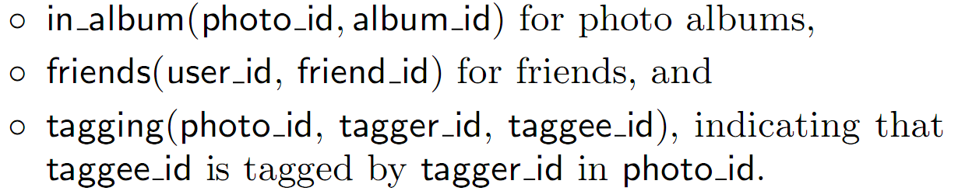
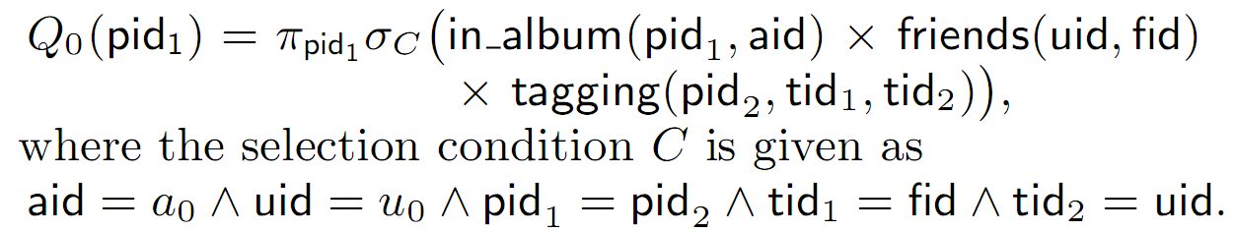
Example: A Real-life Query from Facebook
1.25 billion users;
140 billion friend links
Facebook graph DB (D₀)
Q₀: find all photos from an album a₀ in which a person u₀ is tagged by one of her friends.
Q is neither bounded nor effectively bounded!

Slide 7



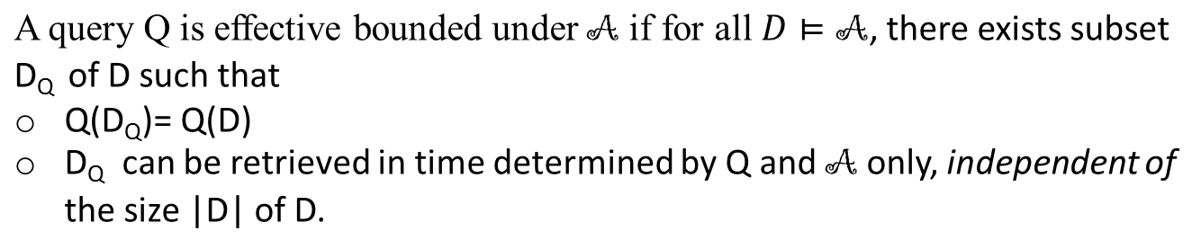
Access Schema: utilizing data semantics
in_album:
tagging:
friends:
Q₀ (D₀) can be evaluated
by accessing no more than 7000 tuples
Access schema for D₀
Q is effectively bounded under the access schema

Slide 8
A bounded evaluation approach for querying Big Data
Given an SPC query Q:
1. Checking
  Check whether Q is effectively bounded.
2. Evaluation
  Generate bounded query plans if it is.
3. Adjusting
  Making Q effectively bounded if it isn’t.

Slide 9
A bounded evaluation approach for querying Big Data
Given an SPC query Q:
1. Checking
  Check whether Q is effectively bounded.
2.Generating
  Generate scale independent query plans if it is.
3. Making
  Making Q effectively bounded if it isn’t.

Slide 10
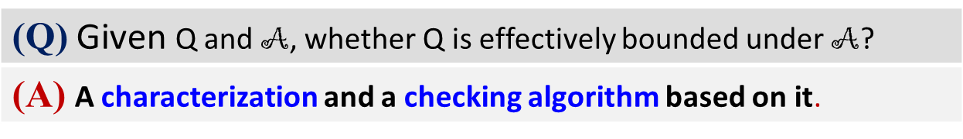
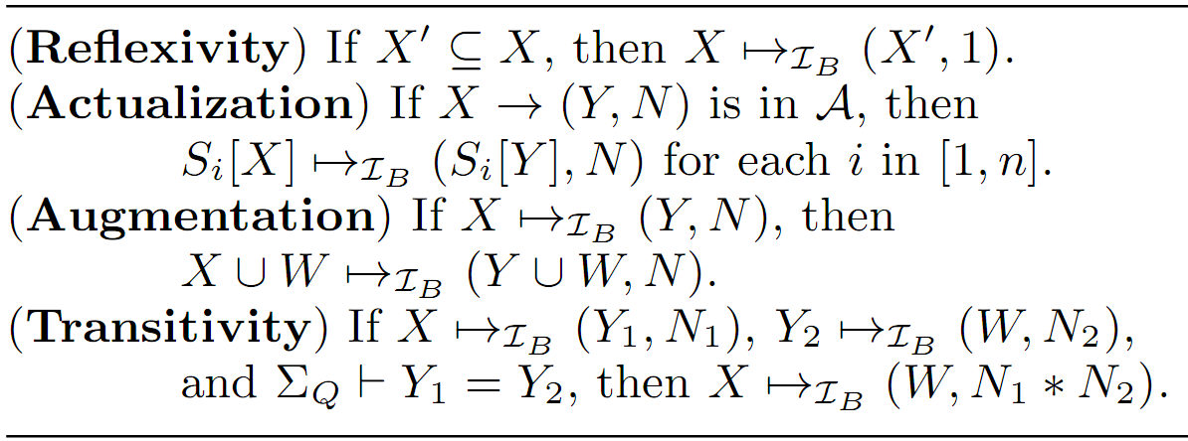
Effective Boundedness Checking
A characterization for boundedness:
A sound and complete set of inference rules for boundedness
A quadratic-time checking algorithm based on
  The above characterization
  Connection between boundedness and effective boundedness
Checking effective boundedness is fast with our characterization!

Slide 11
A bounded evaluation approach
Given an SPC query Q:
1. Checking
  Check whether Q is effectively bounded.
2. Evaluation
  Generate bounded query plans if it is.
3. Making
  Making Q effectively bounded if it isn’t.

Slide 12
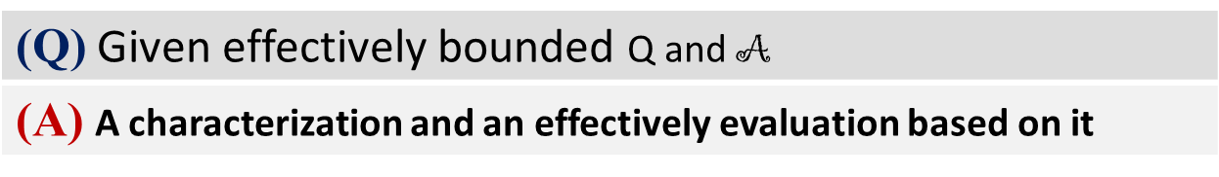
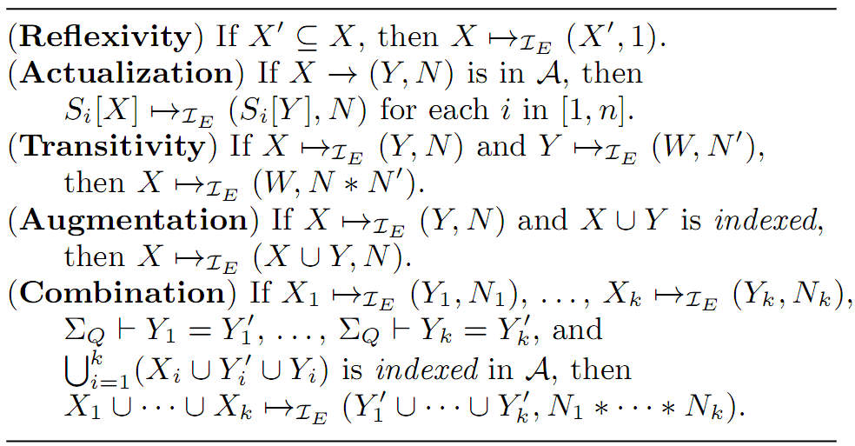
Generating Effectively Bounded Query Plans
A direct characterization of effective boundedness:
A sound and complete set of inference rules for effective boundedness
A O(|Q|²|A|³) bounded query plan generation algorithm
Generating scale independent query plan is fast!

Slide 13
A bounded evaluation approach
Given an SPC query Q:
1. Checking
  Check whether Q is effectively bounded.
2. Evaluation
  Generate bounded query plans if it is.
3. Adjusting
  Making Q effectively bounded if it isn’t.

Slide 14
Making Queries Effectively Bounded
Finding dominating parameters:
  Good news: always possible (trivial parameters)
  Bad news: nontrivial dominating parameters
    NP-complete and NPO-complete
Parameterized queries in
recommender systems,
e-commercial searching and
social search platforms.
A quadratic time heuristic algorithm to making queries effectively bounded

Slide 15
Evaluation on Real-life Datasets
Real-life datasets:
UK traffic accident data (21.4GB)
The Ministry of Transport Test data (16.2GB)
Experimental Results:
1. Effective boundedness is practical:
-- easy to make parameterized queries effectively bounded
2. Bounded query evaluation approach is effective on big data:
-- scale independent query plans
-- 10³ faster than MySQL (even faster when D grows)
Bounded query evaluation approach is an effective solution for querying big data!

Slide 16
Conclusion
Summary
  Two characterizations of (effective) boundedness
  Fundamental problems
  A bounded evaluation framework for querying big data
  Algorithms underlying the framework

