Slide 1
Making Pattern Queries Bounded in Big Graphs
Yang Cao^{1,2} Wenfei Fan^{1,2} Jinpeng Huai² Ruizhe Huang¹
¹University of Edinburgh
²Beihang University

Slide 2
Challenges introduced by big graphs
Graph pattern matching for querying data graphs
  intractable for subgraph isomorphism;
  O((|V|+|V _{Q}|)(|E|+|E_{Q}|)) for graph simulation.
Social graphs are typically huge
  Facebook graph: 1.26 billion nodes, 140 billion links, 300PB
What happens when it comes to big graphs?
Using SSD of 6G/s, a linear scan of a data set D would take
  1.9 days when D is of 1PB (10¹⁵B)
  5.28 years when D is of 1EB (10¹⁸B)
O(n) time is already beyond reach on big data in practice!
Can we still answer queries on big data with limited resources?

Slide 3
Making big graphs small: effectively boundedness
Question: Can we find a class L of queries such that, for each Q in L and for any (possibly big) graph, a fraction G_{Q} of G such that
  Q(G) = Q(G_{Q}), and
  G_{Q} can be identified in time determined by Q?
“Effectively bounded”
queries
|G_{Q}| is independent of the size of G
G
Q( )
Q( )
G_{Q}
G_{Q}
Scales with G no matter how big G grows
Making the cost of computing Q(G) independent of |G|!

Slide 4
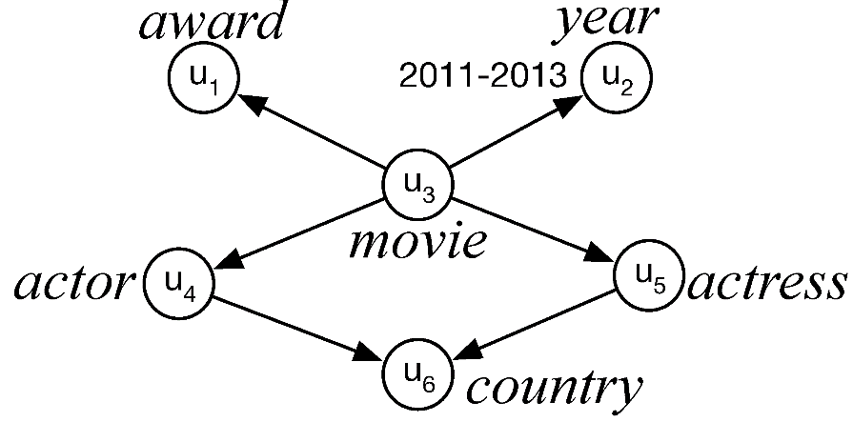
An example: Graph Search (IMDb)
Find pairs of first-billed actor and actress from the same country who co-starred in an award-winning film released in 2011-2013.
Semantic constraints on IMDb
(C1) In each year, every award is presented to no more than 4 movies;
(C2) Each movie has at most 30 first-billed actors and actresses;
(C3) Each person has only one country of origin;
(C4) There are no more than 135 years, 24 major movie awards and 196 countries.

Slide 5

Effectively bounded query evaluation
A query plan
(C4) Identify a set V₁ of 135 year nodes, 24 award and 196 country nodes.
(C1) Fetch a set V₂ of at most 24*3*4=288 award-winning movie nodes, with no more than 288*2=576 edges connecting movies to awards and years.
(C2) Fetch a set V₃ of at most (30+30)*288=17280 actors and actresses with 17280 edges.
(C3) Connect the actors and actresses in V₃ to country nodes in V, with at most 17280 edges.
“Effectively bounded”
queries under semantic constraints
NO MATTER HOW BIG the IMDb graph can be
(Q is effectively bounded under constraints)
Accessing 135 + 24 + 196 + 288 + 17280 = 17923 nodes and
576 + 17280 + 17280 = 35136 edges in total

Slide 6
Questions raised
(1) Given a pattern query Q and a set A of “semantic constraints”, can we determine whether Q is effectively bounded under A?
(2) If Q is effectively bounded, how can we generate a query plan to compute Q(G) in big G by accessing a bounded G_{Q}?
(3) If Q is not bounded, can we make it “bounded” in G by adding simple extra constraints (indices)?
(4) Does the approach work on both localized queries (subgraph isomorphism) and non-localized queries (graph simulation) ?
A package of effectively bounded evaluation for pattern queries to answer these questions.

Slide 7
Overview
Formalization of effective boundedness for graph pattern queries
  Semantics constraints
  Effectively bounded queries
Deciding effectively bounded localized pattern queries
  Characterization and complexity
Generating effectively bounded query plans if so.
Make Q instance-bounded if it is not effectively bounded.
Extend the study to non-localized queries

Slide 8
Effectively bounded pattern queries: formulation

Slide 9
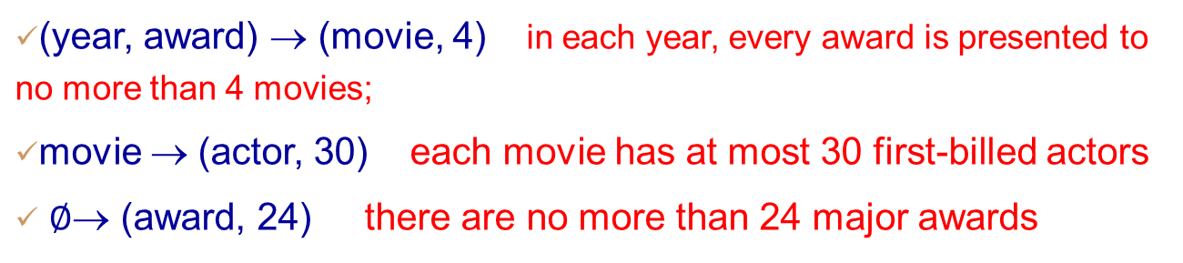
Access constraints on graphs
Combining cardinality constraint and index
An access constraint is of form S → (l, N)
S: a set of labels; l: a label.
G satisfies it if for any S-labelled set V_{S}, there exist at most N l-labelled common neighbours of V_{S}.
Index on G: given an V_{S}, find relevant l-labelled neighbours.
Examples
Discovery: functional dependencies, simple aggregate queries, degree bounds, global constraints.
Maintenance: incrementally and locally by inspecting changes to G only, independent of G.
Access schema: A set of access constraints

Slide 10
Effectively bounded graph patterns
Graph pattern Q is effectively bounded under access schema A:
for any (big) graph G that satisfies A, there exists a subgraph G_{Q} of G such that
  Q(G) = Q(G_{Q}), and
  G_{Q} can be identified in time determined by Q and A only.
Query plan (effectively bounded):
  Identify V_{Q} and E_{Q} by using indices in A only
    Node fetching operations
    Building G_{Q}
  Return the evaluation results of Q on G_{Q}(V_{Q},E_{Q})
Coping with big data: Independent of the size of G

Slide 11
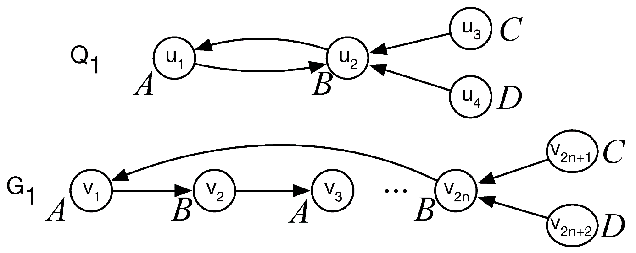
Localized and non-localized patterns
Data locality: Q is localized if for any G that matches Q, any u and neighbor u’ of u in Q, and for any match v of u in G, there must exists a match v’ of u’ in G such that v’ is a neighbor of v in G.
Localized query: subgraph queries (via subgraph isomorphism)
Non-localized query: simulation queries (via graph simulation)
Data locality makes localized queries more likely effectively bounded

Slide 12
Effective boundedness of subgraph queries

Slide 13
The effective boundedness problem EBnd(Q,A)
Input: A subgraph query Q, an access schema A
Question: Is Q effectively bounded under A?
When Q can be answered scale independently on any big graphs G satisfying A, with indices in A?
Sufficient and necessary condition for effective boundedness
What is the complexity?

Slide 14

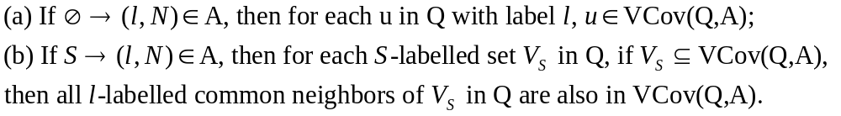

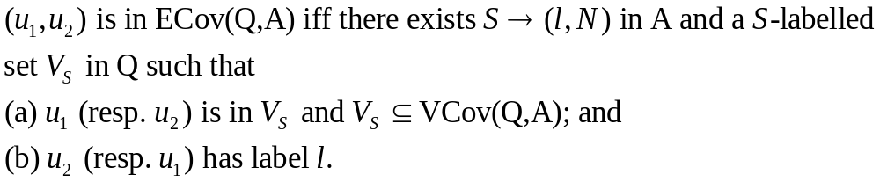
Characterization for subgraph queries
Subgraph query Q is effectively bounded under access schema A iff
(1) VCov(Q,A) = V_{Q} and (2) ECov(Q,A) = E_{Q.}
Node coverage
Edge coverage

Slide 15

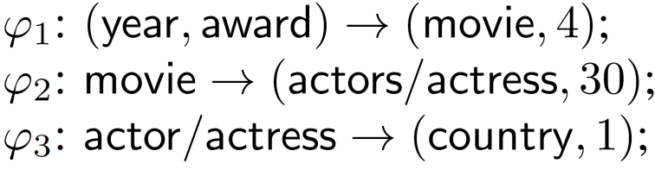
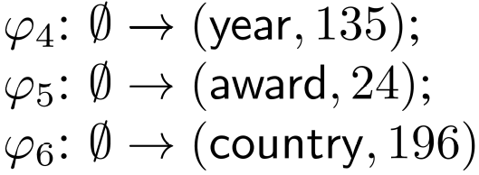
Characterization for subgraph queries
A subgraph query Q is effectively bounded under an access schema A iff (1) VCov(Q,A) = V_{Q} and (2) ECov(Q,A) = E_{Q.}

Slide 16
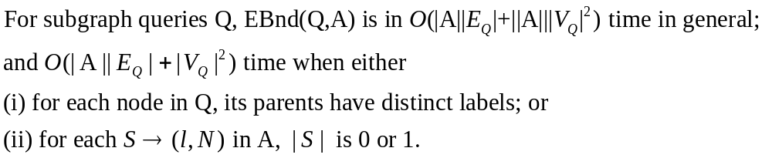
The complexity of EBnd for subgraph queries
We prove this by providing such an algorithm EBChk, which
Combines Q and A via a notion of actualized constraints
Use inverted index on actualized constraints to compute coverages.

Slide 17
Generating query plans for subgraph queries

Slide 18
Effectively bounded query plans
A query plan ξ for pattern query Q under A consists of
(a) Node fetching: a sequence of node fetching operations of the form ft(u, V_{S}, φ, g_{Q}(u))
u is a l-labelled node in Q
V_{S} is a S-labelled set of nodes in Q
φ is an access constraint in A
g_{Q}(u) is the matching predicates on node u
(b) Building G_{Q}: fetches E_{Q} over V_{Q} via node fetching operations
ξ is effectively bounded if for all G satisfying A, if ξ(G,A) = G_{Q} satisfies
-Q(G_{Q}) = Q(G)
- the time of all operations in ξ depends on A and Q only.

Slide 19
Optimal effectively bounded query plans
Instance optimal
Optimal effectively bounded query plan ξ:
For each graph G satisfying A, ξ(G,A) = G_{Q} is the smallest among all G_{Q}’ for any other plan ξ’ with ξ’(G,A)=G_{Q}’.
There exists no instance optimal effectively bounded query plan.
What about a weaker optimal effectively bounded query plan?

Slide 20
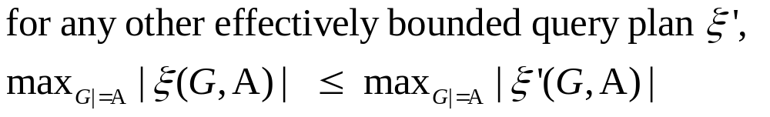
Generating worst-case optimal query plans
Worst-case optimal effectively bounded query plan ξ:
Worst-case optimal query plans are within reach in practice!
Given Q, A, we provide an algorithm that finds a worst-case optimal effectively bounded query plan in O(|V_{Q}||E_{Q}||A||) time.

Slide 21
Making queries instance bounded

Slide 22
Instance-bounded patterns
What can we do if query Q in L is not effectively bounded under A?
M-bounded extension A_{M} of A on G: extending A with access constraints S→(l, N) with |S| = 0 or1 such that N ≤ M.
Instance-bounded patterns
Given a G satisfying A_{M}, a finite set L_{Q} of patterns is instance-bounded in G under A_{M} if for all Q in L_{Q}, there exists a subgraph G_{Q} of G such that
Q(G_{Q}) = Q(G); and
(b) G_{Q} can be found in time determined by A_{M} and Q only.
Instance boundedness aims to process a finite set L_{Q} of queries on a particular instance G by accessing a bounded amount of data.

Slide 23
The extended effectively bounded problem EEP(L_{Q},A,M,G)
  Input: finite set L_{Q} of subgraph queries, access schema A, natural number M, a graph G satisfying A.
  Question: Does there exist a M-bounded extension A_{M} of A such that L_{Q} is instance-bounded in G under A_{M}?
  Want a stronger result?
  minEEP(L_{Q},A,G):
  Input: L_{Q}, A and G
  Output: minimum M such that L_{Q} is instance-bounded in G under A_{M}
EEP(LQ,A,M,G) is in O(|G|+(|A|+|L_{Q}|)|E_{LQ}|+(||A||+|L_{Q}|)|V_{LQ}|²) time.
minEEP(LQ,A,G) is logAPX-hard.

Slide 24
Effectively bounded simulation queries

Slide 25
Characterization for simulation queries
Ebnd problem for simulation queries.
Input: A simulation query Q, an access schema A
Question: Is Q effectively bounded under A?
Characterization for simulation queries:
Simulation query Q is effectively bounded under A iff
sVCov(Q,A) = V_{Q} and sECov(Q,A) = E_{Q}
sVCov(Q,A) and sECov(Q,A) are revisions of Vcov(Q,A) and Ecov(Q,A) for subgraph queries, by taking care of data locality.
If pattern Q is effectively bounded under A via simulation, then Q is also effectively bounded under A via subgraph isomorphism.

Slide 26
Ebnd and EEP revisited for simulation queries
For simulation queries Q, EBnd(Q,A) is in
(1) O(|A||E_{Q}| + ||A|||V_{Q}|²) time in general; and
(2) O(|A||E_{Q}| + |V_{Q}|²) time in special cases as for subgraph queries.
Given a simulation query Q and access schema A, we provide an algorithm that finds a worst-case effectively bounded query plan in O(|V_{Q}||E_{Q}||A|) time.
For simulation queries, EEP(LQ,A,M,G) is in
O(|G|+(|A|+|L_{Q}|)|E_{LQ}|+(||A||+|L_{Q}|)|V_{LQ}|²)
Complexities for simulation queries are the same as for subgraph queries.

Slide 27
Experimental study

Slide 28
Experimental settings
Real-life datasets
(1) Webbase-2011 (WebBG):
0.1 billion nodes, 1 billion edges and 0.18 billion labels
204 access constraints
(2) Internet Movie Data graph (IMDbG):
5.1 million nodes, 19.5 million edges and 168 labels.
168 access constraints
(3) Knowledge graph (DBpediaG):
4.1 million nodes, 19.5 million edges and 1434 labels
315 access constraints
Pattern queries
randomly generated 100 pattern queries for each dataset, controlled by # of nodes, edges, match predicates.

Slide 29
Experimental results
  Effectiveness of effective boundedness
  (1) Percentage of effectively bounded queries
  Subgraph queries: 61%, 67%, 58% of queries on IMDbG, DBpediaG, WebBG are effectively bounded
  Simulation queries: 32%, 41% and 33%.
  (2) Effectiveness of bounded queries
  Evaluation time is independent of |G|
  Effective for both localized and non-localized queries
  Outperform optimized VF2 and graphSim by 4 and 3 orders of magnitude on average on WebBG, respectively.
  (3) Effectiveness of instance boundedness
  Small M suffices to make queries instance-bounded:
  0.006% (resp. 0.009%) of |G| for 95% of subgraph (resp. simulation) queries on WebBG.

Slide 30
Summing up

Slide 31
Effectively bounded pattern queries
We propose to answer graph pattern queries by making use of effective boundedness, by developing techniques:
access constraints on graphs and effectively bounded pattern queries,
Identify the complete class of effectively bounded graph patterns,
Generating (worst-case) optimal query plans if so, and otherwise,
Instance-boundedness for queries that are not in the class.
Outlook:
Systematic method for discovering access constraints on graphs
Incremental boundedness

