Slide 1


Determining the Relative Accuracy of Attributes
Yang Cao ^{1, 2} Wenfei Fan ^{1, 2} Wenyuan Yu ¹
¹University of Edinburgh
²Beihang University

Slide 2
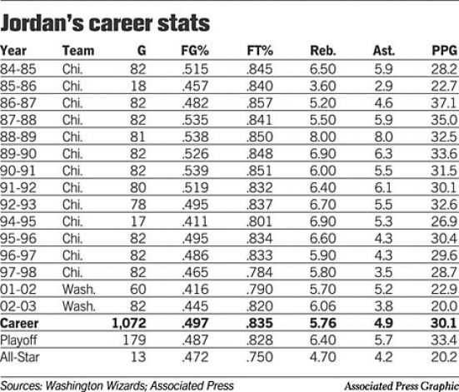
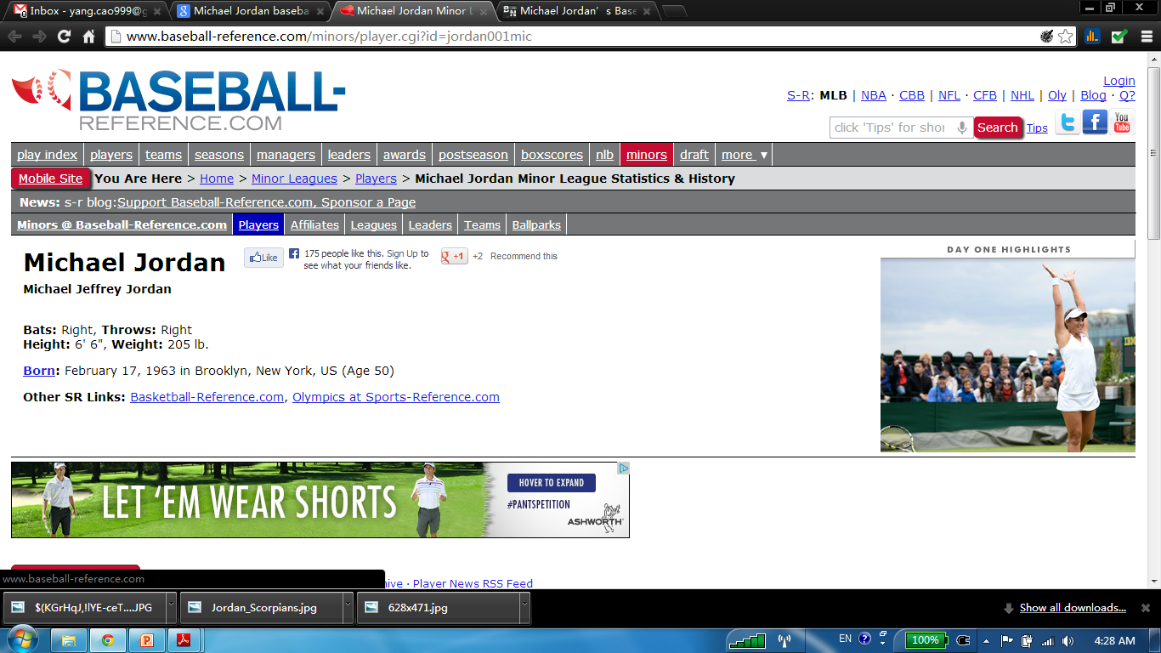
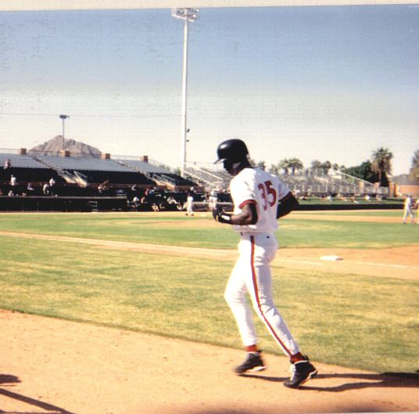
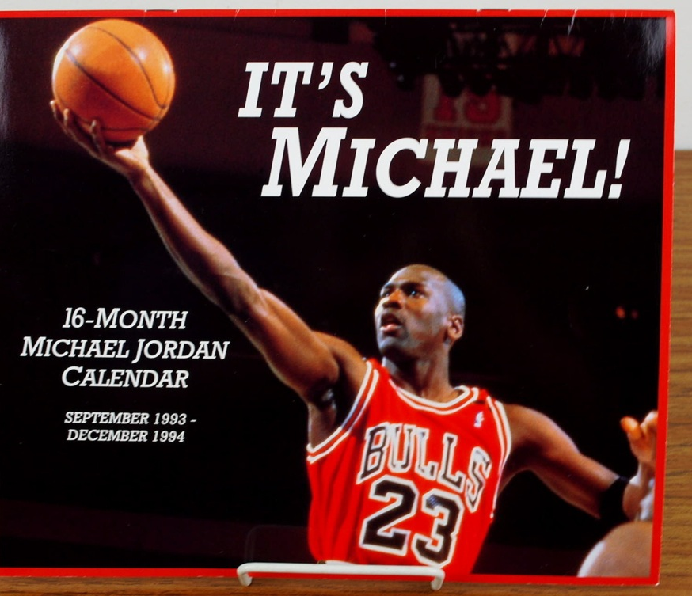
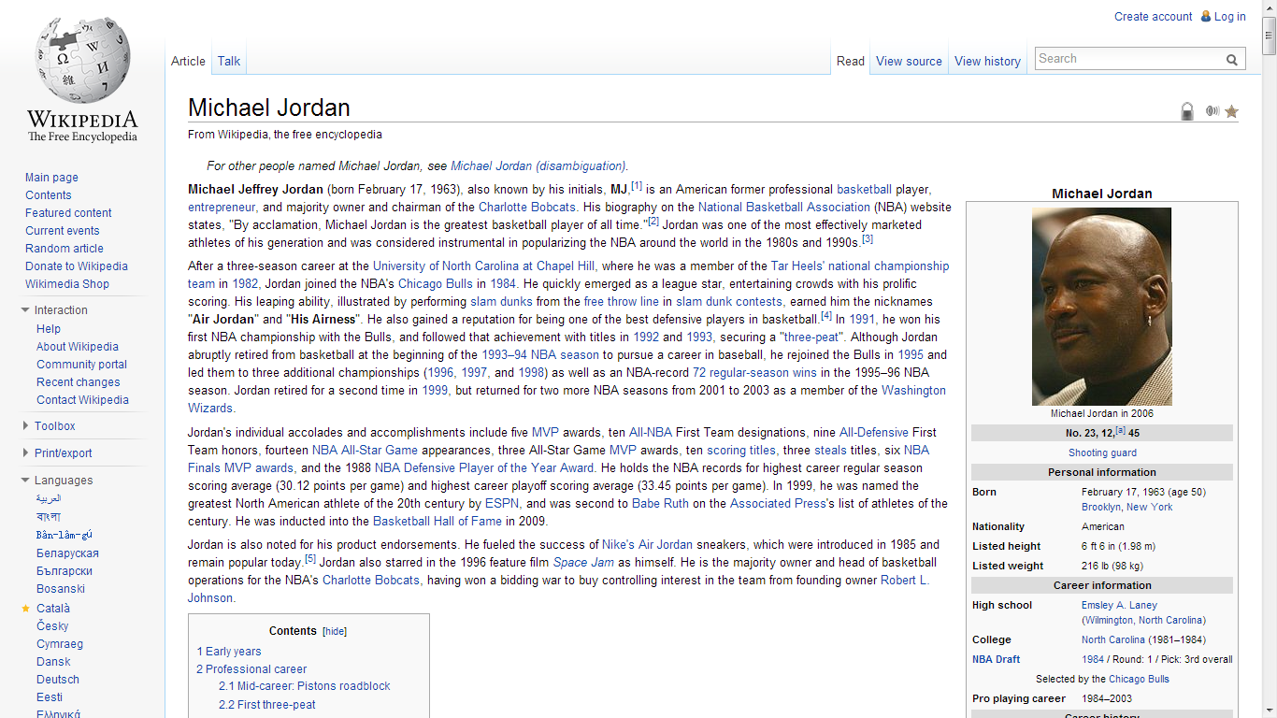
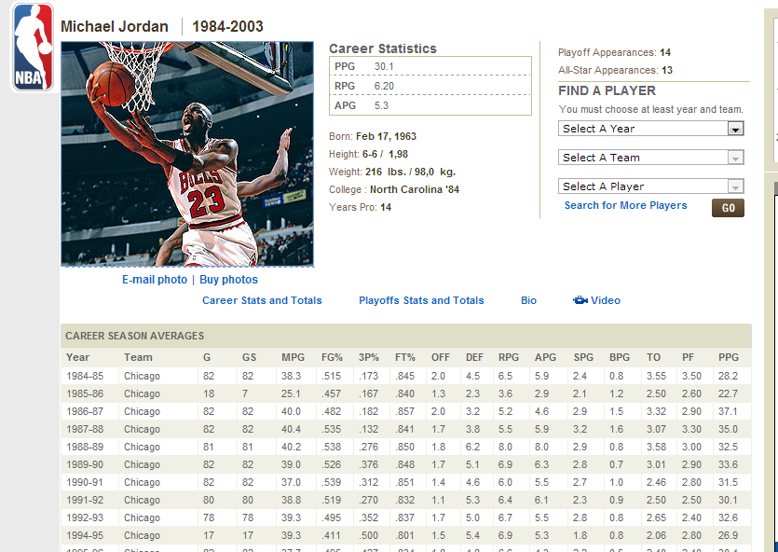

Slide 3

FN | LN | height | date of birth | team | arena
M | J | 7ft | 1963 | Chicago Bulls | United Center
Michael | Jordan | 198cm | 17/02/1963 | Chicago | Chicago Stadium
Chicago Bulls
United Center
Michael
Jordan
198cm
17/02/1963
FD: [FN, LN, team, height → date of birth]
CFD: [team = “Chicago Bulls” → arena = “United Center”]
Instance may be consistent, but its values may still be inaccurate
Data Accuracy
Find the most accurate values for Jordan within D
Applications: Data fusion for big data, decision making, information systems, …
Data Accuracy: a central problem that has not been formally studied

Slide 4

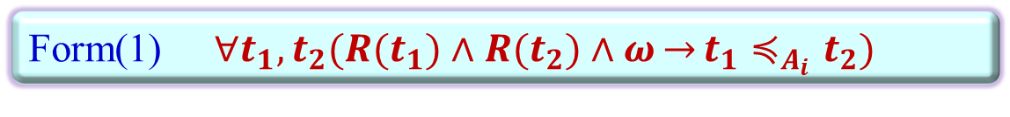



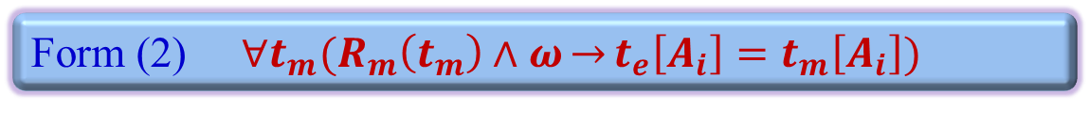
Form(1) $∀t_{1}, t_{2}(R(t_{1})∧R(t_{2})∧ω\overset{→}{}t_{1}≼_{A_{i}}t_{2})$
D
FN | LN | height | unit | date of birth | team | arena
M | J | 7 | ft | 1963 | Chicago Bulls | United Center
Michael | Jordan | 198 | cm | 17/02/1963 | Chicago | Chicago Stadium
t₁
Chicago Bulls
United Center
t₂
Michael
Jordan
17/02/1963
FN | LN | team | season
Michael | Jordan | Chicago Bulls | 94-95
… | … | … | …
t_{m}
Accuracy Rules
$$t_{1}\left[FN,LN,birth\right]<t_{2}\left[FN,LN,birth\right]\overset{→}{}t_{1}≼_{F,L,b}t_{2}$$
$$t_{1}≺_{unit}t_{2}\overset{→}{}t_{1}≼_{height}t_{2}$$
$$t_{1}≺_{team}t_{2}\overset{→}{}t_{1}≼_{arena}t_{2}$$
$$t_{m}\left[FN\right]=t_{e}\left[FN\right]∧t_{m}\left[LN\right]=t_{e}\left[LN\right]\overset{→}{}t_{e}\left[team\right]=t_{m}[team]$$
Form (2) $∀t_{m}(R_{m}\left(t_{m}\right)∧ω\overset{→}{}t_{e}\left[A_{i}\right]=t_{m}\left[A_{i}\right])$
Using Accuracy Rules to capture data semantics

Slide 5









Inferring Relative Accuracy with ARs
φ₁: $t_{1}\left[FN,LN,birth\right]<t_{2}\left[FN,LN,birth\right]\overset{→}{}t_{1}≼_{F,L,b}t_{2}$
φ₂: $t_{1}≺_{unit}t_{2}\overset{→}{}t_{1}≼_{height}t_{2}$
φ₃: $t_{1}≺_{team}t_{2}\overset{→}{}t_{1}≼_{arena}t_{2}$
φ₄: $t_{m}\left[FN\right]=t_{e}\left[FN\right]∧t_{m}\left[LN\right]=t_{e}\left[LN\right]\overset{→}{}t_{e}\left[team\right]=t_{m}[team]$
D
FN | LN | height | unit | date of birth | team | arena
M. | J. | 7 | ft | 1963 | Chicago Bulls | United Center
Michael | Jordan | 198 | cm | 17/02/1963 | Chicago | Chicago Stadium
t₁
Chicago Bulls
United Center
t₂
Michael
Jordan
17/02/1963
A chasing sequence
D_{m}
FN | LN | team | season
Michael | Jordan | Chicago Bulls | 94-95
t_{m}
$$D_{0}:$$
$$D_{1}:$$
$$D_{3}:$$
$$:$$
$$D_{2}:$$
φ₁
φ₄
φ₃
A chase-like procedure with ARs to deduce relative accuracy

Slide 6










D
FN | LN | height | unit | date of birth | team | arena
M. | J. | 7 | ft | 1963 | Chicago Bulls | United Center
Michael | Jordan | 198 | cm | 17/02/1963 | Chicago | Chicago Stadium
t₁
t₂
D_{m}
FN | LN | team | season
Michael | Jordan | Chicago Bulls | 94-95
t_{m}
φ₁: $t_{1}\left[FN,LN,birth\right]<t_{2}\left[FN,LN,birth\right]\overset{→}{}t_{1}≼_{F,L,b}t_{2}$
Yes
$$Σ$$
Finite ??
(φ₁φ₄φ₃.. φ_{j}..)
φ₂: $t_{1}≺_{unit}t_{2}\overset{→}{}t_{1}≼_{height}t_{2}$
φ₃: $t_{1}≺_{team}t_{2}\overset{→}{}t_{1}≼_{arena}t_{2}$
φ₄: $t_{m}\left[FN\right]=t_{e}\left[FN\right]∧t_{m}\left[LN\right]=t_{e}\left[LN\right]\overset{→}{}t_{e}\left[team\right]=t_{m}[team]$
$$D_{0}:$$
$$D_{1}:$$
$$D_{3}:$$
$$:$$
$$D_{2}:$$
φ₁
φ₄
φ₃
Termination Problem: Every chasing sequence always terminates.

Slide 7





D
FN | LN | height | unit | date of birth | team | arena
M. | J. | 7 | ft | 1963 | Chicago Bulls | United Center
Michael | Jordan | 198 | cm | 17/02/1963 | Chicago | Chicago Stadium
t₁
t₂
D_{m}
FN | LN | team | season
Michael | Jordan | Chicago Bulls | 94-95
Not always
t_{m}
φ₁: $t_{1}\left[FN,LN,birth\right]<t_{2}\left[FN,LN,birth\right]\overset{→}{}t_{1}≼_{F,L,b}t_{2}$
Whether different chasing sequences coincide?
$$Σ$$
φ₂: $t_{1}≺_{unit}t_{2}\overset{→}{}t_{1}≼_{height}t_{2}$
φ₃: $t_{1}≺_{team}t_{2}\overset{→}{}t_{1}≼_{arena}t_{2}$
φ₄: $t_{m}\left[FN\right]=t_{e}\left[FN\right]∧t_{m}\left[LN\right]=t_{e}\left[LN\right]\overset{→}{}t_{e}\left[team\right]=t_{m}[team]$
φ₅: $t_{1}≺_{FN}t_{2}∧t_{1}≺_{LN}t_{2}\overset{→}{}t_{1}≼_{team}t_{2}$
$$D_{0}:$$
$$D_{1}:$$
$$D_{3}:$$
$$:$$
$$D_{2}:$$
φ₁
φ₄
φ₃
φ₅
Church-Rosser Problem: The Church-Rosser property is not guaranteed.
But can be checked in cubic time.

Slide 8










Fundamental Problems: Deducing candidate targets
φ₁: $t_{1}\left[FN,LN,birth\right]<t_{2}\left[FN,LN,birth\right]\overset{→}{}t_{1}≼_{F,L,b}t_{2}$
$$Σ$$
φ₂: $t_{1}≺_{unit}t_{2}\overset{→}{}t_{1}≼_{height}t_{2}$
φ₃: $t_{1}≺_{team}t_{2}\overset{→}{}t_{1}≼_{arena}t_{2}$
φ₄: $t_{m}\left[FN\right]=t_{e}\left[FN\right]∧t_{m}\left[LN\right]=t_{e}\left[LN\right]\overset{→}{}t_{e}\left[team\right]=t_{m}[team]$
D
FN | LN | height | unit | date of birth | team | arena
M. | J. | 7 | ft | 1963 | Chicago Bulls | United Center
Michael | Jordan | 198 | cm | 17/02/1963 | Chicago | Chicago Stadium
t₁
Not always
t₂
t_{e}
Michael
Jordan
?
17/02/1963
Whether candidate targets always exist?
?
Chicago Bulls
United Center
D_{m}
FN | LN | team | season
Michael | Jordan | Chicago Bulls | 94-95
t_{m}
$$D_{3}:$$
$$D_{0}:$$
Target tuple may be incomplete: the need to find candidate targets
$$D_{1}:$$
$$:$$
$$D_{2}:$$
t_{e}'₁
Michael | Jordan | 198 | cm | 17/02/1963 | Chicago | Chicago Stadium
Michael | Jordan | 7 | ft | 17/02/1963 | Chicago Bulls | United Center
t_{e}'₂
φ₁
φ₄
φ₃

Slide 9






Fundamental Problems: Deducing candidate targets
φ₁: $t_{1}\left[FN,LN,birth\right]<t_{2}\left[FN,LN,birth\right]\overset{→}{}t_{1}≼_{F,L,b}t_{2}$
φ₆: $t_{1}\left[height\right]<t_{2}[height]\overset{→}{}t_{2}≼_{height}t_{1}$
$$Σ$$
φ₂: $t_{1}≺_{unit}t_{2}\overset{→}{}t_{1}≼_{height}t_{2}$
φ₃: $t_{1}≺_{team}t_{2}\overset{→}{}t_{1}≼_{arena}t_{2}$
φ₄: $t_{m}\left[FN\right]=t_{e}\left[FN\right]∧t_{m}\left[LN\right]=t_{e}\left[LN\right]\overset{→}{}t_{e}\left[team\right]=t_{m}[team]$
D
FN | LN | height | unit | date of birth | team | arena
M. | J. | 7 | ft | 1963 | Chicago Bulls | United Center
Michael | Jordan | 198 | cm | 17/02/1963 | Chicago | Chicago Stadium
t₁
t₂
t_{e}
Michael
Jordan
?
?
17/02/1963
Chicago Bulls
United Center
D_{m}
FN | LN | team | season
Michael | Jordan | Chicago Bulls | 94-95
t_{m}
(φ_{2,} φ₆)
t_{e}'₁
Michael | Jordan | 198 | cm | 17/02/1963 | Chicago | Chicago Stadium
Michael | Jordan | 7 | ft | 17/02/1963 | Chicago Bulls | United Center
t_{e}'₂
It is NP-complete to determine whether there exist candidate targets
There can be exponentially or even infinitely many candidate targets

Slide 10

Fundamental Problems: Top-k candidate targets
φ₁: $t_{1}\left[FN,LN,birth\right]<t_{2}\left[FN,LN,birth\right]\overset{→}{}t_{1}≼_{F,L,b}t_{2}$
$$Σ$$
φ₂: $t_{1}≺_{unit}t_{2}\overset{→}{}t_{1}≼_{height}t_{2}$
φ₃: $t_{1}≺_{team}t_{2}\overset{→}{}t_{1}≼_{arena}t_{2}$
φ₄: $t_{m}\left[FN\right]=t_{e}\left[FN\right]∧t_{m}\left[LN\right]=t_{e}\left[LN\right]\overset{→}{}t_{e}\left[team\right]=t_{m}[team]$
D
FN | LN | height | unit | date of birth | team | arena
M. | J. | 7 | ft | 1963 | Chicago Bulls | United Center
Michael | Jordan | 198 | cm | 17/02/1963 | Chicago | Chicago Stadium
t₁
t₂
t_{e}
Michael
Jordan
?
?
17/02/1963
Chicago Bulls
United Center
D_{m}
FN | LN | team | season
Michael | Jordan | Chicago Bulls | 94-95
t_{m}
Preference model: (k, p(.)): p(.) is any monotone scoring function (e.g., occurrences)
Top-k candidate targets problem: whether there exists a k-set T_{e} such that p(T_{e}) > C
t_{e}'₁
Michael | Jordan | 198 | cm | 17/02/1963 | Chicago | Chicago Stadium
Michael | Jordan | 7 | ft | 17/02/1963 | Chicago Bulls | United Center
t_{e}'₂
K=2, p(T_{e}) = 14
The Top-k candidate targets problem is NP-complete

Slide 11


A framework for deducing target tuples
No
IsCR
$$S=(D_{0}, Σ, I_{m}, {t_{e}^{}}^{D_{0}^{}})$$
Is S Church-Rosser?
Yes
t'_{e}
Yes
complete t_{e} derived?
Return t_{e}
feedback
No
T_{e}
Compute top-k candidate targets T_{e}
Preference Model (k,p(.))
RankJoinCT
TopKCT
TopKCT_{h}

Slide 12
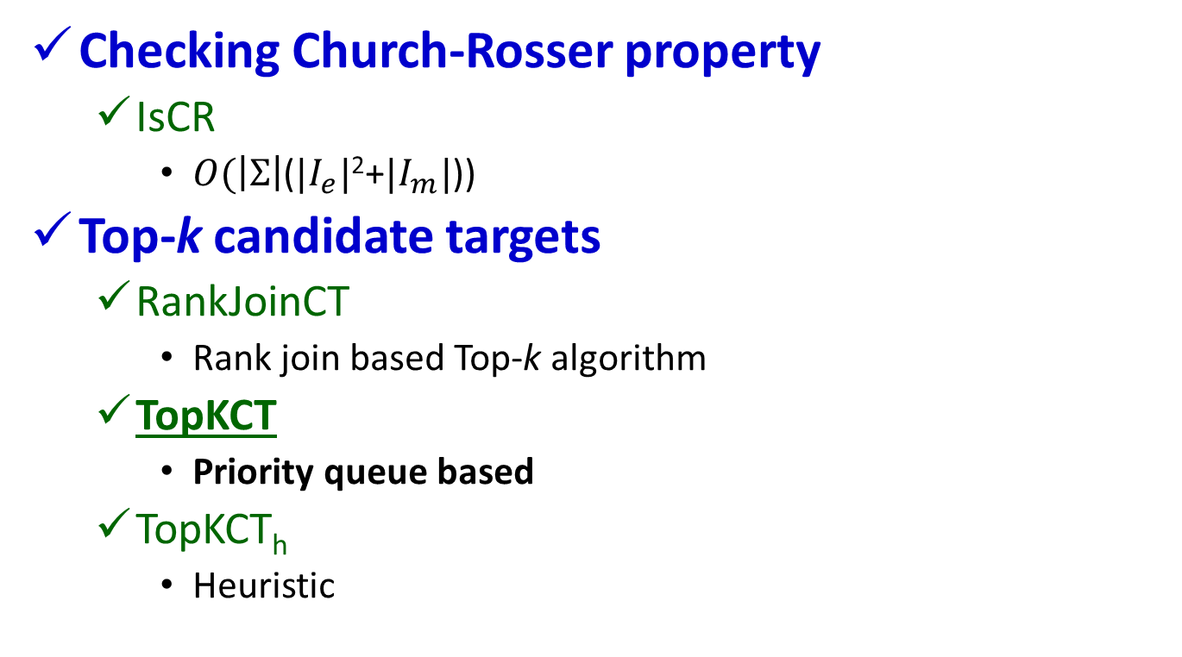
Algorithms
Checking Church-Rosser property
IsCR
$O(\left|Σ\right|$($|I_{e}|$²+$|I_{m}|$))
Top-k candidate targets
RankJoinCT
Rank join based Top-k algorithm
TopKCT
Priority queue based
TopKCT_{h}
Heuristic

Slide 13
TopKCT: Brodal Queue based Top-k algorithm
Input:
A Church-Rosser Specification S
Preference model (k, p(.))
A heap for each attributes A with null values in t_{e}
Output:
The set T_{e} of top-k scored candidate targets w.r.t.(k, p(.))
D
FN | LN | height | unit | date of birth | team | arena
M. | J. | 7 | ft | 1963 | Chicago Bulls | United Center
Michael | Jordan | 198 | cm | 17/02/1963 | Chicago | Chicago Stadium
t₁
t₂
t₃
Michael | Jordan | 200 | cm | 17/02/1963 | Chicago | Chicago Stadium
Michael | Jordan | 198 | m | 17/02/1963 | Chicago Bulls | United Center
t₄
t_{e}
Michael
Jordan
?
?
17/02/1963
Chicago Bulls
United Center
H_{height}
H_{unit}
7,198,200
ft, cm, m
Top-1:t_{e}[height, unit] = (198, cm)
13

Slide 14
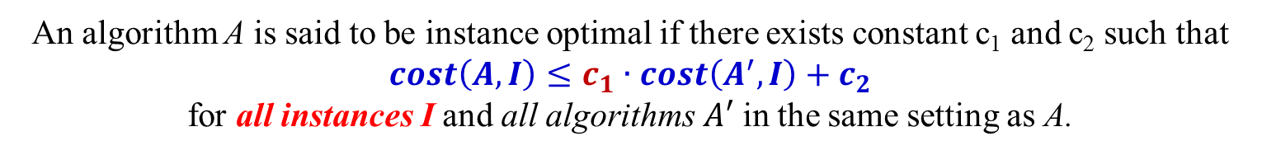
TopKCT: Brodal Queue based Top-k algorithm
Input:
A Church-Rosser Specification S
Preference model (k, p(.))
A heap for each attributes A with null values in t_{e}
Output:
The set T_{e} of top-k scored candidate targets w.r.t.(k, p(.))
Early termination: Stops as soon as top-k candidate targets are found.
Instance Optimal: w.r.t. the number of visits of each heap with optimality ratio 1.
Optimality ratio
An algorithm A is said to be instance optimal if there exists constant c₁ and c₂ such that
$cost\left(A,I\right)≤c_{1}∙cost\left(A^{′},I\right)+c_{2}$
for all instances I and all algorithms $A′$ in the same setting as A.
TopKCT has early termination property and is Instance Optimal.
14

Slide 15
Experimental Study: Settings
Datasets
Med: sale records of medicines from various stores
10K tuples for 2.7K entries; 2.4K tuples as master data; 105 ARs
CFP: call for papers/participation found by Google
503 tuples for 100 entries; 55 tuples as master data; 43 ARs
Rest: Restaurant data*
246 tuples 5149 entries; 131 ARs
Syn: Synthetic data generator
20 attributes; ARs: 75% of form (1), 25% of form (2)
Implementation
64 bit Linux Amazon EC2 High-CPU Extra Large Instance
7GB of memory and 20 EC2 Compute Unites

Slide 16
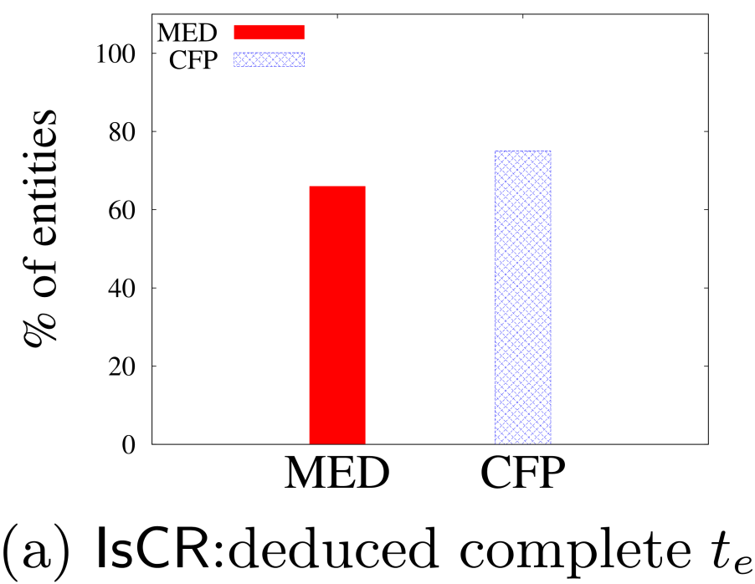
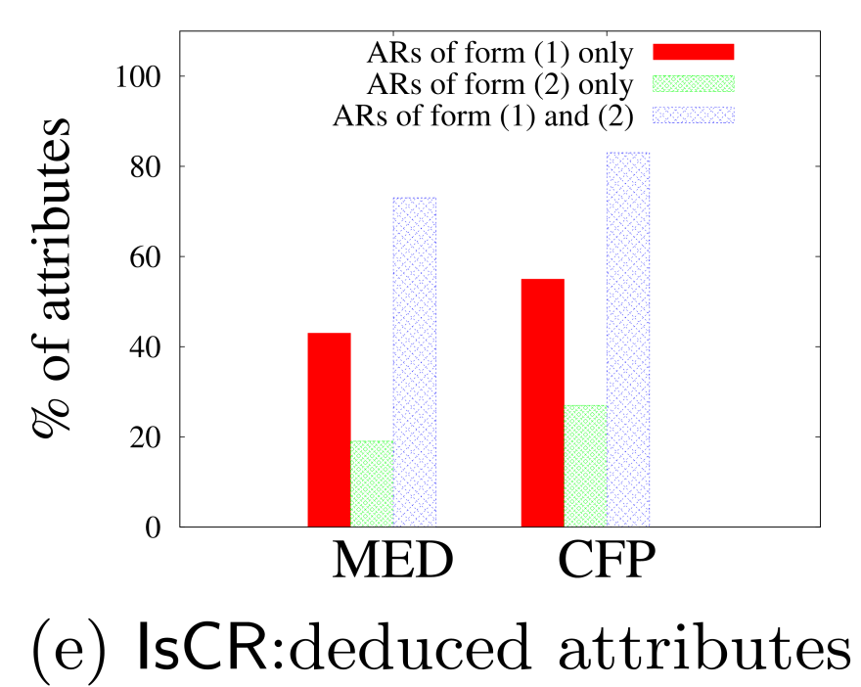
Experimental Study: IsCR
Effectiveness of IsCR
Complete target tuples: Complete target tuples could be deduced for over 2/3 of the entries without user interaction
Non-null values: over 70% when both ARs of form(1) and (2) are used

Slide 17
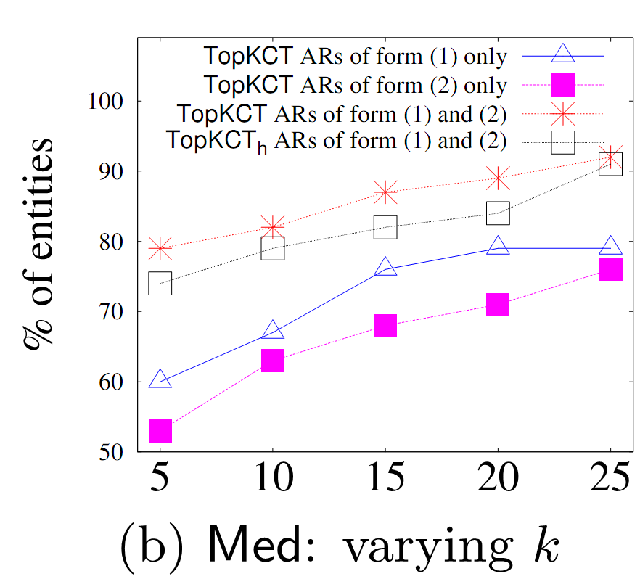
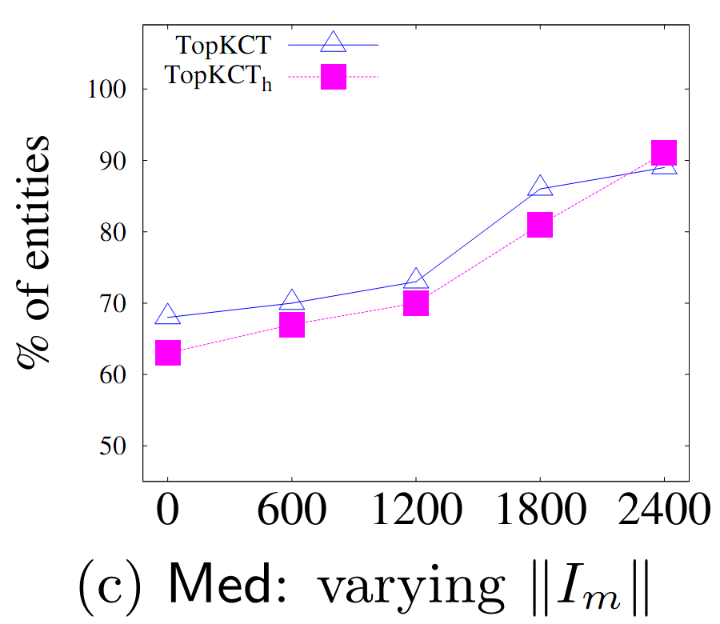
Experimental Study: candidate targets
Computing top-k candidates
k doesn’t have to be large: k=15 suffices for over 85% of the entries;
Master data does help, but even when it is not available, TopKCT still works well

Slide 18
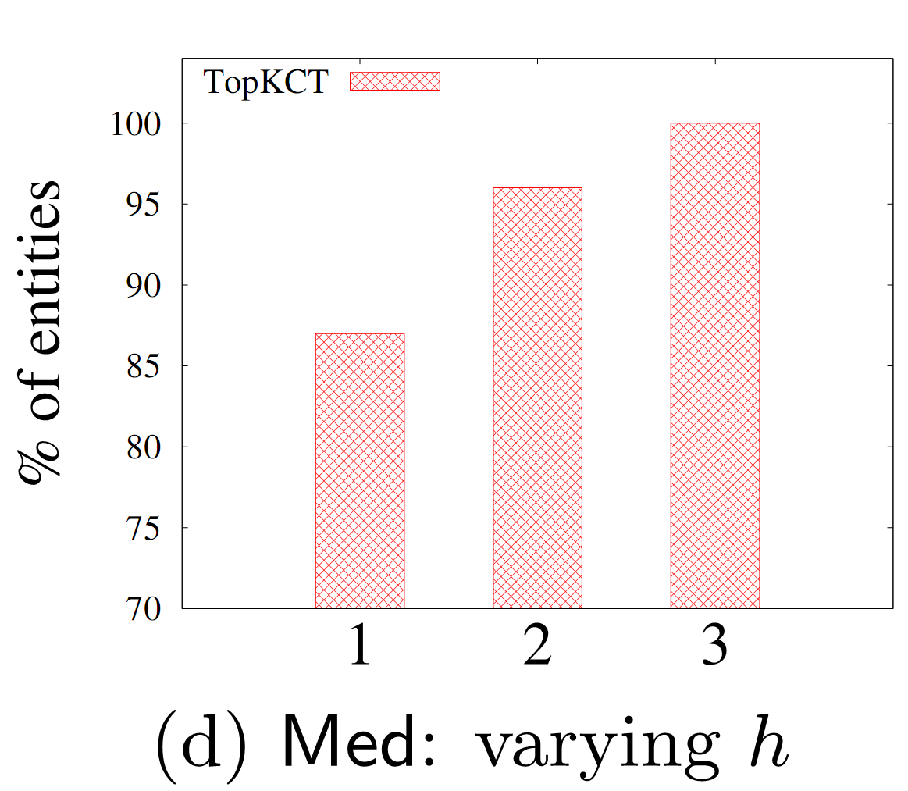
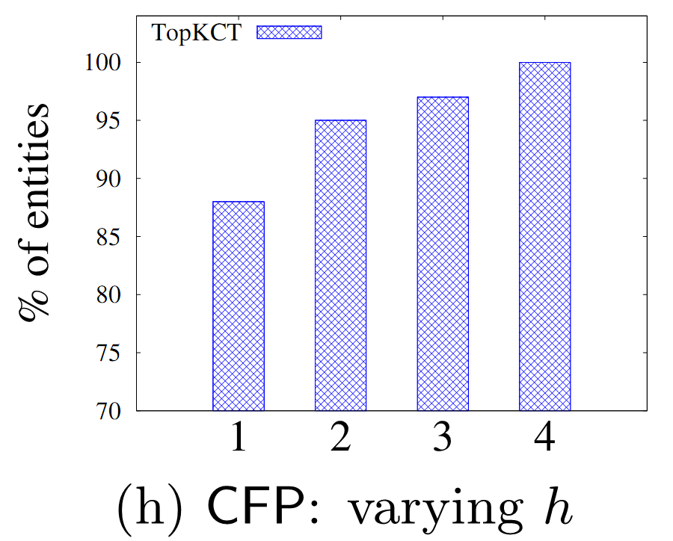
Experimental Study: user interaction
User interactions
Few rounds of interactions are needed to deduce the targets for all the entries:
at most 3 for Med and 4 for CFP

Slide 19
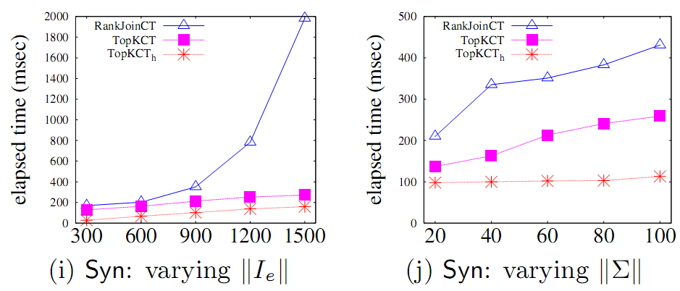
Experimental Study: efficiency
Efficiency

Slide 20
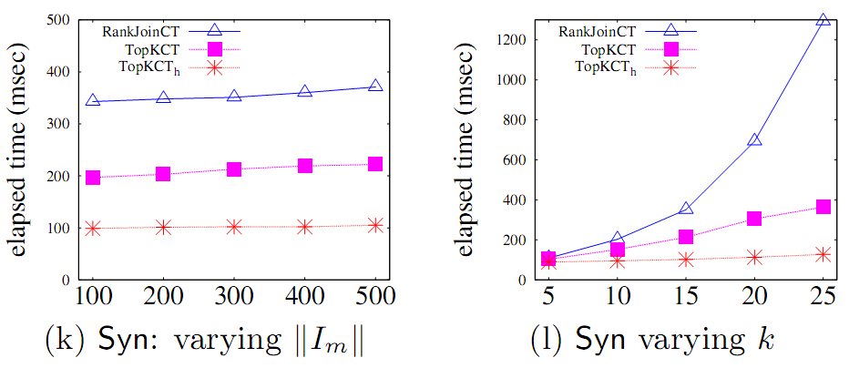
Experimental Study: efficiency
Efficiency
For Syn with ||I_{e}|| = 1500, ||I_{m}|| = 300 and $\left|\left|Σ\right|\right|$=50, TopKCT_{h}, TopKCT and RankJoinCT took 159ms, 271ms and 1983 ms, respectively.

Slide 21
Conclusion
Summary
A model for determining relative accuracy
Fundamental problems
A framework for deducing relative accuracy
Algorithms underlying the framework
Outlook
Discovery of ARs
Improve the accuracy of data in a database

