Slide 1


对抗攻击
叶 俊 杰
杨 馥 冰
2021年12月21日

Slide 2

目
录
1
前置知识
2
实验过程
3
回顾总结

Slide 3

前置知识
01

Slide 4

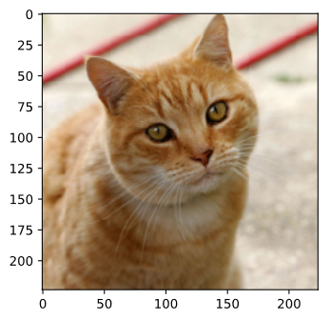
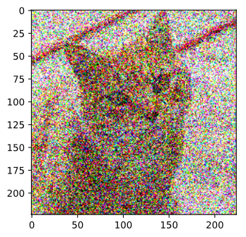
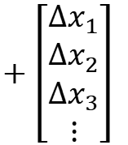

对抗攻击
Benign Image
Network
(Image Classifier)
Starfish
Tiger Cat
Non-targeted
任何不是“Cat”的类别
Targeted
$$\left[\begin{aligned}x_{1} \\ x_{2} \\ x_{3} \\ ⋮\end{aligned}\right]$$
$$+\left[\begin{aligned}{∆x}_{1} \\ {∆x}_{2} \\ ∆x_{3} \\ ⋮\end{aligned}\right]$$
Attacked Image
分类到特定的错误类别（如“Starfish”)
small

Slide 5

对抗攻击
Attacked
Object
白盒攻击
拥有被攻击模型的参数
黑盒攻击
没有模型具体信息，但是有训练集，可以自行训练代理模型，产生攻击对象。
Network
Black
Network
Proxy
Training Data

Slide 6




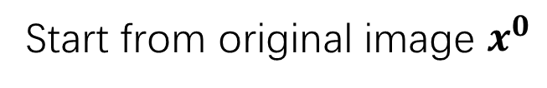




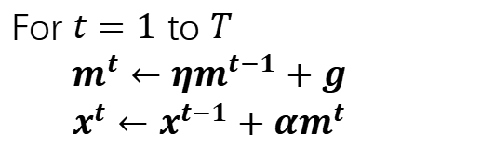



损失函数
FGSM
Non-targeted
https://arxiv.org/abs/1412.6572
Start from original image $x^{0}$
$$x^{∗}=arg\min_{d\left(x^{0},x\right)≤ε }{L\left(x\right)}$$
使人无法察觉
$$x^{1}←x^{0}−ηg$$
1
2
$$\left[\begin{aligned}+1 \\ −1 \\ +1 \\ ⋮\end{aligned}\right]$$
$$L\left(x\right)=−e\left(y,\hat{y} \right)$$
Targeted
$$ε$$
$$L\left(x\right)=−e\left(y,\hat{y} \right)+e\left(y,y^{target}\right)$$
3
4
I-FGSM
MI-FGSM
https://arxiv.org/abs/1607.02533
https://arxiv.org/abs/1710.06081
Start from original image $x^{0}$
Start from original image $x^{0}$
For $t=1$ to $T$
For $t=1$ to $T$
$m^{t}←{ηm}^{t−1}+g$
$x^{t}←x^{t−1}+αm^{t}$
$$x^{t}←x^{t−1}−ηg$$
If $d\left(x^{0},x\right)>ε$
$$x^{t}←fix\left(x^{t}\right)$$

Slide 7
02
实验过程

Slide 8

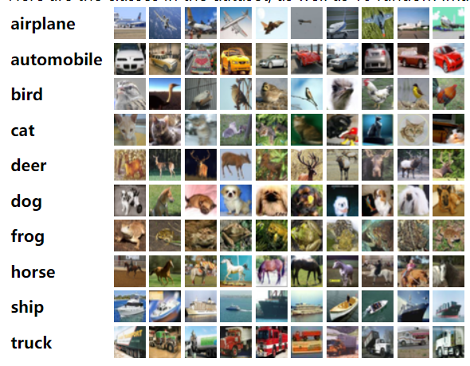
总体情况
攻击对象：
CIFAR-10图片（每类挑选20张）
目标网络：CIFAR-10 预训练模型，如：
ResNet
DenseNet
ResNeXt
SE-PreResNet
PyramidNet
RoR-3

Slide 9
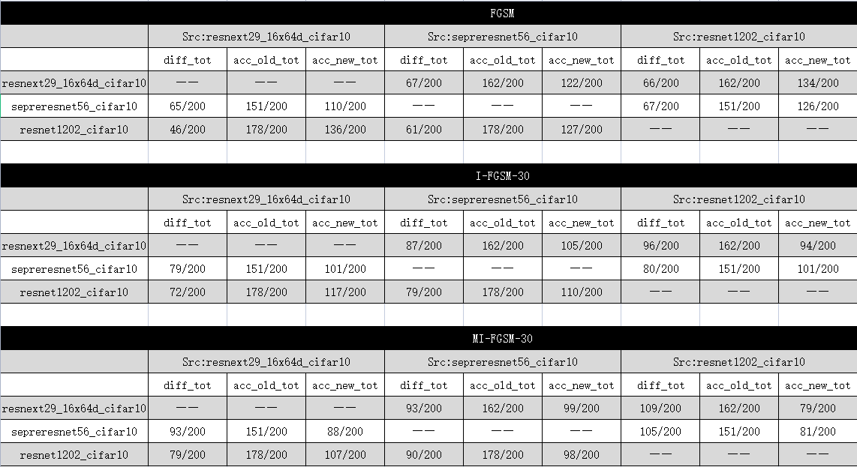
分类不同；攻击前acc；攻击后acc
单代理攻击

Slide 10











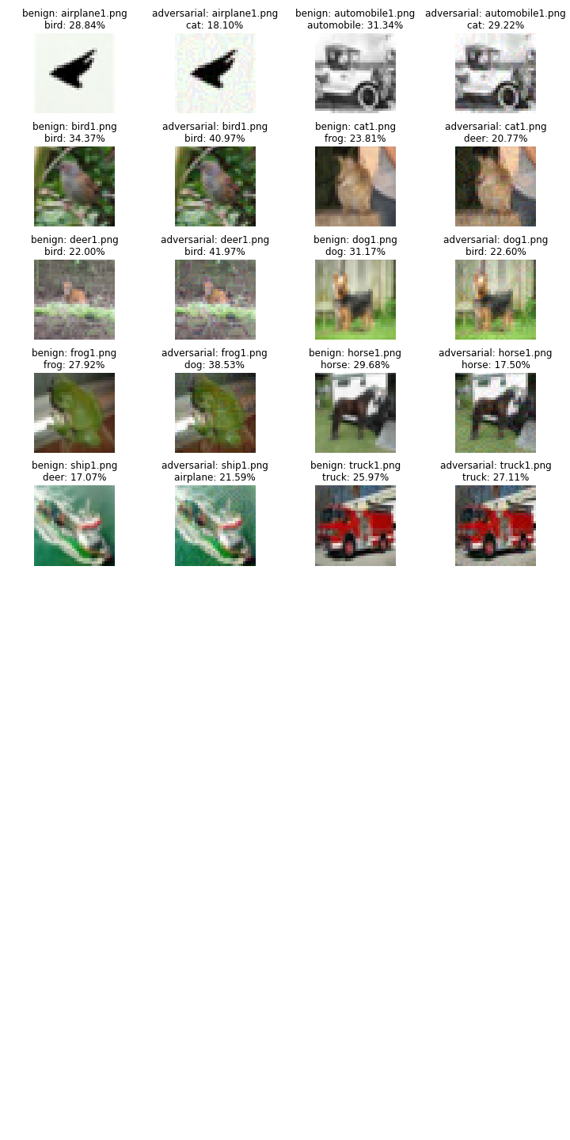
结果展示
MI-FGSM-30
resnet1202_cifar10
目标网络：
resnext29_16x64d_cifar10

Slide 11
Ensemble攻击
模型列表：
resnext29_16x64d_cifar10
resnext29_32x4d_cifar10
preresnet56_cifar10
preresnet110_cifar10
preresnet164bn_cifar10
seresnet110_cifar10
sepreresnet56_cifar10
sepreresnet110_cifar10
diaresnet56_cifar10
resnet1001_cifar10
diapreresnet56_cifar10
resnet1202_cifar10
resnet56_cifar10
resnet110_cifar10
diapreresnet110_cifar10

Slide 12
迭代 15 次
 | FGSM |  |  | I-FGSM-15 |  |  | MI-FGSM-15 |  |  | Type
 | diff_tot | acc_old_tot | acc_new_tot | diff_tot | acc_old_tot | acc_new_tot | diff_tot | acc_old_tot | acc_new_tot
resnext29_16x64d_cifar10 | 83/200 | 162/200 | 107/200 | 172/200 | 162/200 | 10/200 | 166/200 | 162/200 | 17/200 | inside
sepreresnet56_cifar10 | 80/200 | 151/200 | 104/200 | 160/200 | 151/200 | 17/200 | 156/200 | 151/200 | 20/200
resnet1202_cifar10 | 60/200 | 178/200 | 126/200 | 163/200 | 178/200 | 20/200 | 164/200 | 178/200 | 21/200
densenet100_k12_cifar10 | 79/200 | 150/200 | 103/200 | 155/200 | 150/200 | 18/200 | 158/200 | 150/200 | 19/200 | outside
resnet272bn_cifar10 | 81/200 | 154/200 | 98/200 | 164/200 | 154/200 | 16/200 | 161/200 | 154/200 | 19/200
pyramidnet164_a270_bn_cifar10 | 68/200 | 161/200 | 116/200 | 157/200 | 161/200 | 24/200 | 160/200 | 161/200 | 25/200
ror3_110_cifar10 | 82/200 | 157/200 | 104/200 | 157/200 | 157/200 | 19/200 | 159/200 | 157/200 | 21/200

Slide 13
迭代 20 次
 | FGSM |  |  | I-FGSM-20 |  |  | MI-FGSM-20 |  |  | Type
 | diff_tot | acc_old_tot | acc_new_tot | diff_tot | acc_old_tot | acc_new_tot | diff_tot | acc_old_tot | acc_new_tot
resnext29_16x64d_cifar10 | 83/200 | 162/200 | 107/200 | 174/200 | 162/200 | 7/200 | 172/200 | 162/200 | 11/200 | inside
sepreresnet56_cifar10 | 80/200 | 151/200 | 104/200 | 167/200 | 151/200 | 12/200 | 163/200 | 151/200 | 13/200
resnet1202_cifar10 | 60/200 | 178/200 | 126/200 | 172/200 | 178/200 | 12/200 | 173/200 | 178/200 | 12/200
densenet100_k12_cifar10 | 79/200 | 150/200 | 103/200 | 172/200 | 150/200 | 7/200 | 169/200 | 150/200 | 9/200 | outside
resnet272bn_cifar10 | 81/200 | 154/200 | 98/200 | 167/200 | 154/200 | 13/200 | 169/200 | 154/200 | 11/200
pyramidnet164_a270_bn_cifar10 | 68/200 | 161/200 | 116/200 | 164/200 | 161/200 | 20/200 | 158/200 | 161/200 | 23/200
ror3_110_cifar10 | 82/200 | 157/200 | 104/200 | 162/200 | 157/200 | 15/200 | 164/200 | 157/200 | 14/200

Slide 14
迭代 30 次
 | FGSM |  |  | I-FGSM-30 |  |  | MI-FGSM-30 |  |  | Type
 | diff_tot | acc_old_tot | acc_new_tot | diff_tot | acc_old_tot | acc_new_tot | diff_tot | acc_old_tot | acc_new_tot
resnext29_16x64d_cifar10 | 83/200 | 162/200 | 107/200 | 181/200 | 162/200 | 3/200 | 178/200 | 162/200 | 6/200 | inside
sepreresnet56_cifar10 | 80/200 | 151/200 | 104/200 | 170/200 | 151/200 | 10/200 | 175/200 | 151/200 | 6/200
resnet1202_cifar10 | 60/200 | 178/200 | 126/200 | 175/200 | 178/200 | 9/200 | 175/200 | 178/200 | 9/200
densenet100_k12_cifar10 | 79/200 | 150/200 | 103/200 | 167/200 | 150/200 | 8/200 | 170/200 | 150/200 | 7/200 | outside
resnet272bn_cifar10 | 81/200 | 154/200 | 98/200 | 170/200 | 154/200 | 10/200 | 175/200 | 154/200 | 6/200
pyramidnet164_a270_bn_cifar10 | 68/200 | 161/200 | 116/200 | 166/200 | 161/200 | 17/200 | 162/200 | 161/200 | 19/200
ror3_110_cifar10 | 82/200 | 157/200 | 104/200 | 166/200 | 157/200 | 14/200 | 167/200 | 157/200 | 12/200

Slide 15
15
20
30
acc_old_tot
162/200
151/200
178/200
150/200
154/200
161/200
157/200
acc_new_tot
17/200
20/200
21/200
19/200
19/200
25/200
21/200
acc_new_tot
11/200
13/200
12/200
9/200
11/200
23/200
14/200
acc_new_tot
6/200
6/200
9/200
7/200
6/200
19/200
12/200

Slide 16










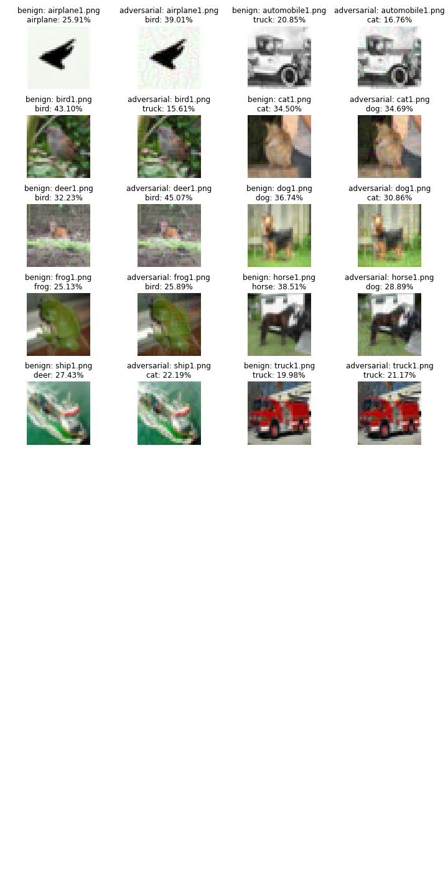
结果展示
MI-FGSM-30
Ensemble 攻击
目标网络：
densenet100_k12_cifar10

Slide 17
03
总结展望

Slide 18

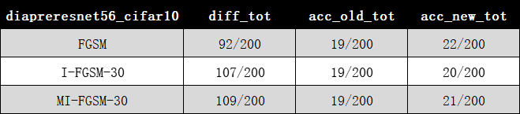
总结展望
特殊结果
某些模型，经过攻击，性能反而得到提升。
实验结论
·实验比较了不同攻击算法对对抗攻击的影响，证明了I-FGSM算法的优越性以及MI-FGSM算法的泛化能力
·实验利用Ensemble Attack技术有效提升了模型性能，增加了模型泛化能力
·实验为对抗攻击提供了基本思想，便于后续拓展研究。
·无训练集黑盒攻击
·单像素攻击
·迁移攻击
·防御
拓展方向

Slide 19

感谢观看

