Slide 1
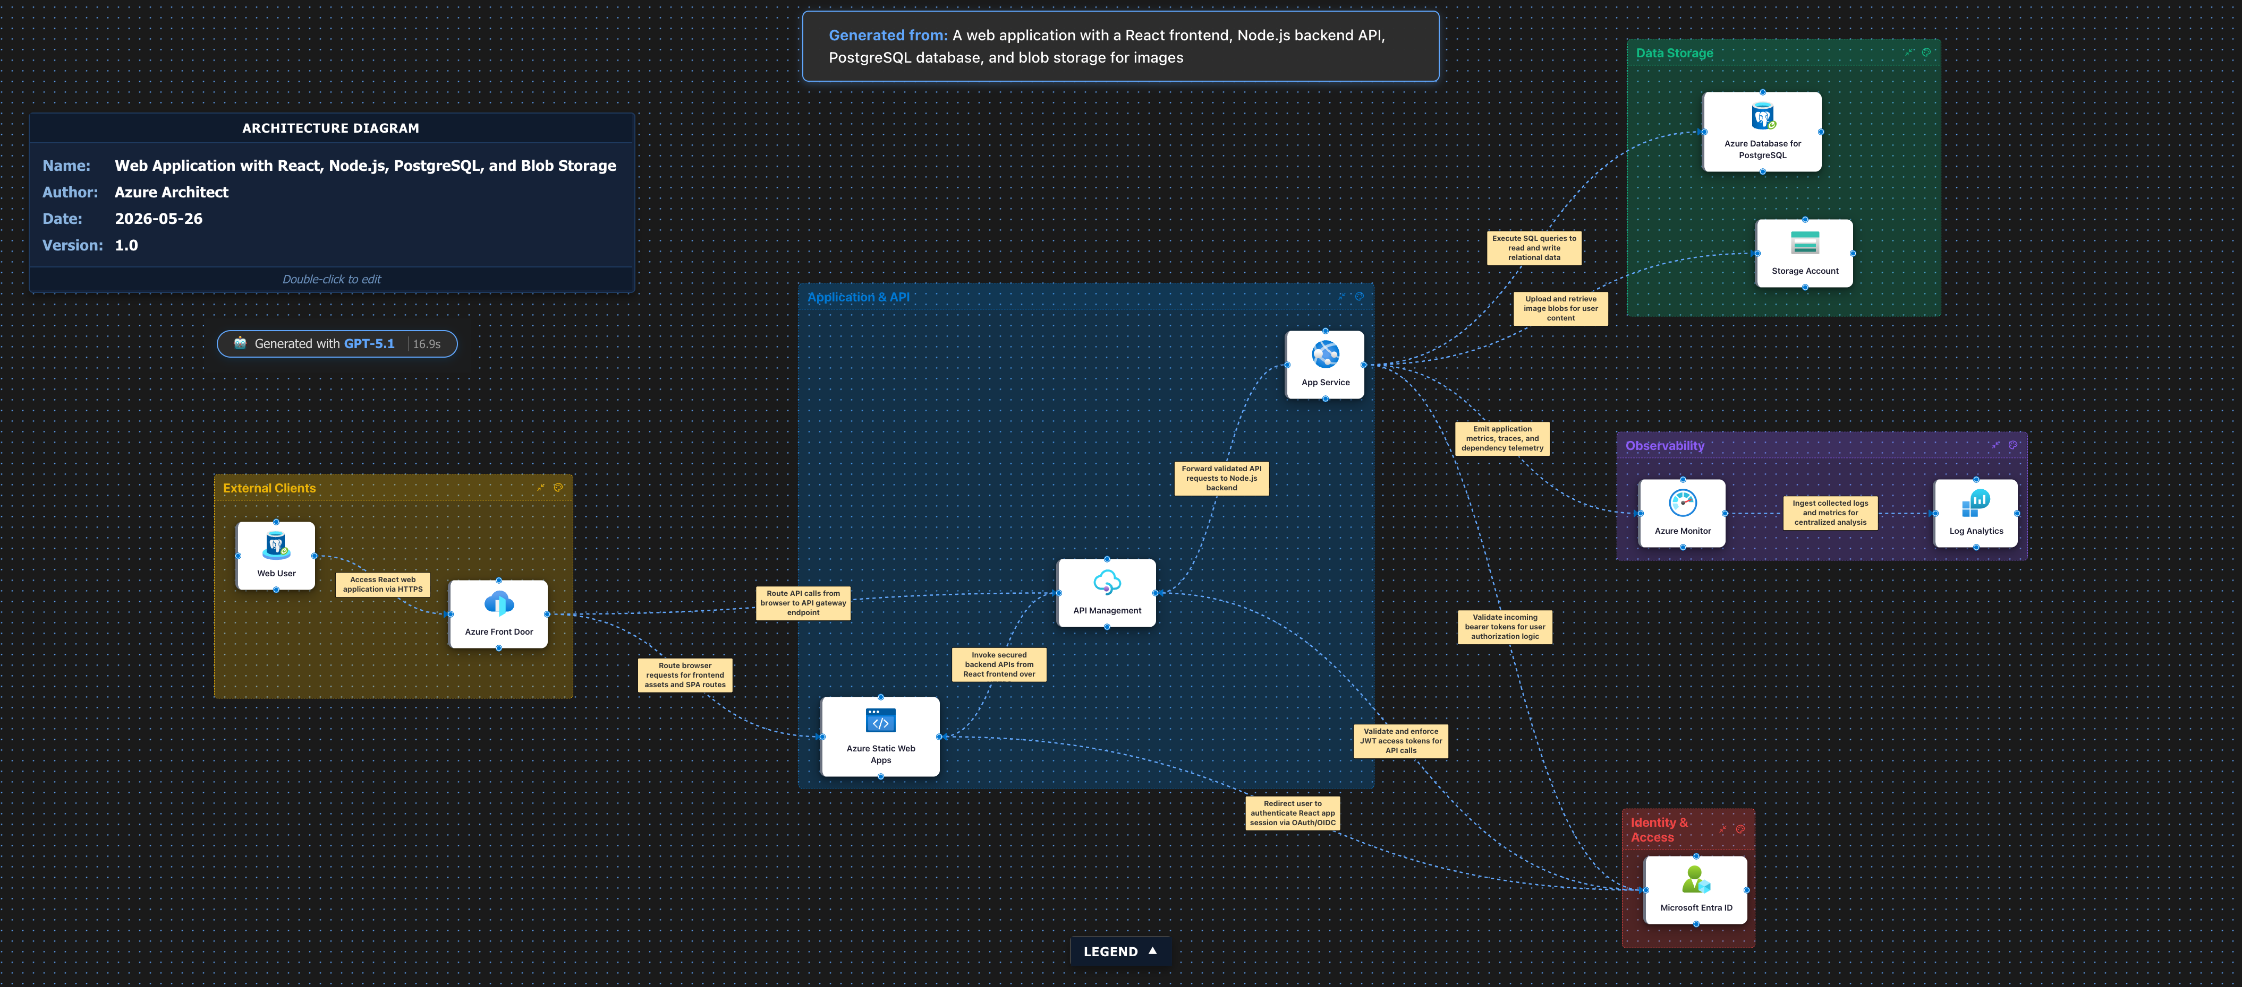
Web Application with React, Node.js, PostgreSQL, and Blob Storage
Azure Architect · 2026-05-26
Generated by Azure Architecture Diagram Builder · microsoft.com/azure

