Slide 1


Student Feedback Exercise: Your Voice Matters!
Be Constructive
Be Specific
Be Considerate
Comments on your learning experience increase the value of your feedback.
Provide examples of how you think your teacher or the way the course is organised have helped (or not helped!) your learning.
Improper language or personal comments* are highly inappropriate, and undermine your feedback.
* Personal comments — those unrelated to the course, such as remarks about an instructor's ethnicity, gender, age, appearance, sexual identity, or religion — have no place in constructive feedback and simply detracts from its purpose. While you are encouraged to provide any course-related feedback, the University reserves the right to redact course-irrelevant abusive comments directed at an instructor's identity and/or take disciplinary action.

Slide 2


Student Feedback Exercise: Your Voice Matters!
Your feedback counts
It’s confidential
It’s quick
Your constructive feedback helps professors to improve their courses and is one source of evidence for the university's appraisal decisions.
Your professors will never see your name. They will only get an aggregate report after the exam results have been released.
Complete your course feedback on campus, at home, or on the go! It is easy to use and mobile compatible.

Slide 3

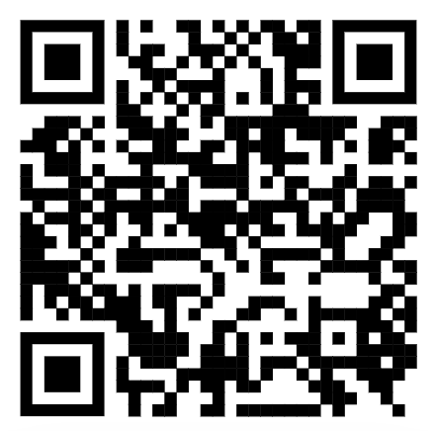
Student Feedback Exercise: Your Voice Matters!
https://blue.nus.edu.sg/Blue/

