Slide 1
Reinforcement Learning in Finance
Kaige Yang
Applied Scientist Intern
AWS

Slide 2
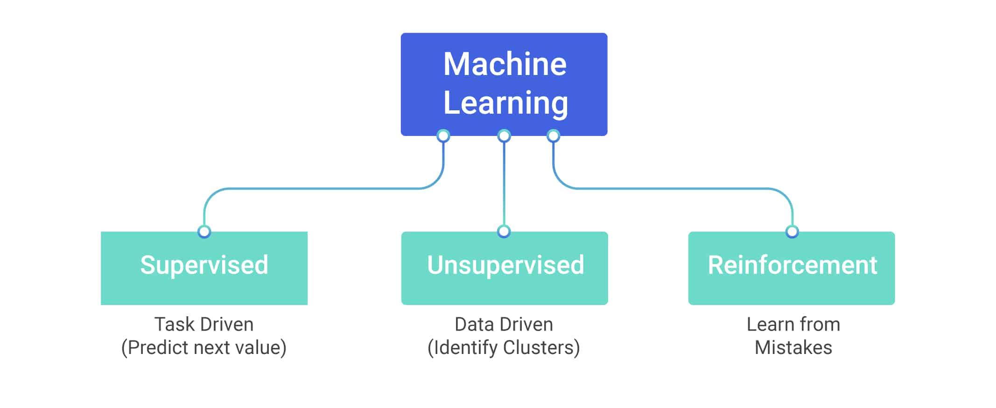
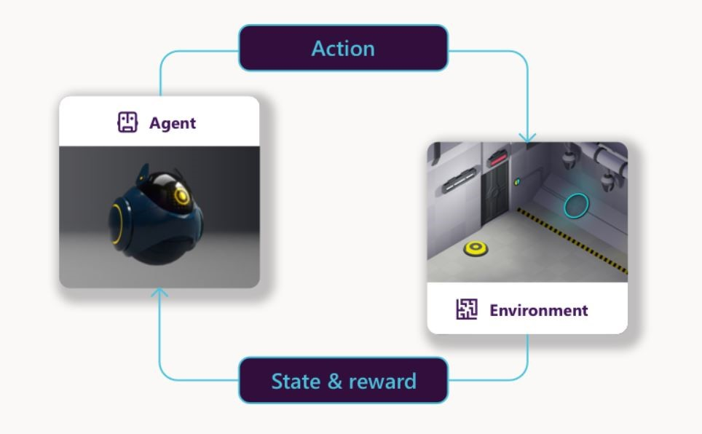
Reinforcement Learning
Reinforcement Learning (RL) is a branch of Machine Leanring (ML) for sovling sequential decision making under uncertainty
RL problem consists of agent and environment.
At each interaction,
The agent sees an observatio of the state of the environment.
Then decides on an action to take.
The agent received a reward (feedback) upon the action and current state.
The state of environment changes when the agent acts in it.
The process repeats until research the terminate state.
The goal of the agent is to maximize the cumulative rewards.

Slide 3
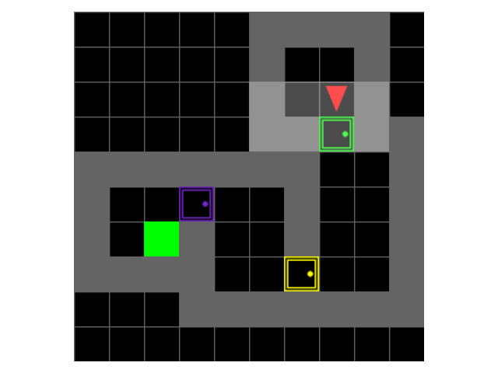
Example
Maze Navigation: Find the shortest path in a Maze environment.
Goal: arrive the green spot as soon as possible.
State: location of the agent
Action: up, down, left and right
Reward: -1 for each step, and -10 for hitting the wall.
To maximize the cumulative rewards, the agent is encouraged to find the shortest path to the goal.

Slide 4
Applications
RL methods have recentely enjoyed a wide variery of successes
Playing games
Resource relocation
Traffic light controller
Robotics
Personalized Recommendations
Manage an investment portfolio
Control a power station

Slide 5

Markov Decision Processes (MDPs)
The class of problems solved by RL can be described as a mathematical framework Markov Decision Processes (MDPs).
A stochastic process has the Markov property if the conditional probability distribution of future states of the process depends only upon the present state. i.e., given the present, the future does not depend on the past.
An MDP is a 5-tuple $<S, A, R, P, P_{0}>$
$S$: state space is the set of all valid states.
$A$: action space is the set of all valid actions.
$R$: the reward function $r_{t}=R(s_{t}, a_{t}, s_{\left\{t+1\right\}})$.
$P$: transition probability function $P\left(s_{\left\{t+1\right\}} | s_{t}, a_{t}\right)$ is the proability of transitioning into state s’ if action a is taken in state s.
$P_{0}$: initial state distribution$s_{0}∼P_{0}(s)$.
Suppose at time step $t$, the state of environment is denoted as $s_{t}$. The agent takes an action $a_{t}$. Then, the environment state transits to the next state according to the transition probability $s_{\left\{t+1\right\}}.$The agent receives a reward upon the action taken according to the reward function $r_{t}.$This process repeats a course of T steps. The goal of the agent is to maximize the cumulative rewards.

Slide 6

The RL problem
The goal of RL is to select a policy which maximizes expected return.
The policy is a rule used by an agent to decide what actions to take under a state. The policy is usually denoted by $π$ with
$$a_{t}∼π (⋅|s_{t})$$
A trajectory $τ$ is a sequence of states and actions
$$τ=\left(s_{0},a_{0},s_{1},a_{1},…\right)$$
A reward is defined as
$$r_{t} =R\left(s_{t}, a_{t}, s_{\left\{t+1\right\}}\right)$$
The undiscounted/discounted return of a trajectory is defined as
$$R\left(τ\right)=\sum_{t=0}^{T}{r_{t} } or R\left(τ\right)=\sum_{\left\{t=0\right\}}^{T}{γ^{t }r_{t} }$$
Where the discount factor $γ∈(0,1].$
The expected return denoted by $J\left(π\right)$ is defined as
$$J\left(π\right)=E_{τ∼π} [R\left(τ\right)]$$
The goal of RL algorithm is to find the optimal policy such that
$$π^{∗}=argmax_{π} J(π)$$

Slide 7
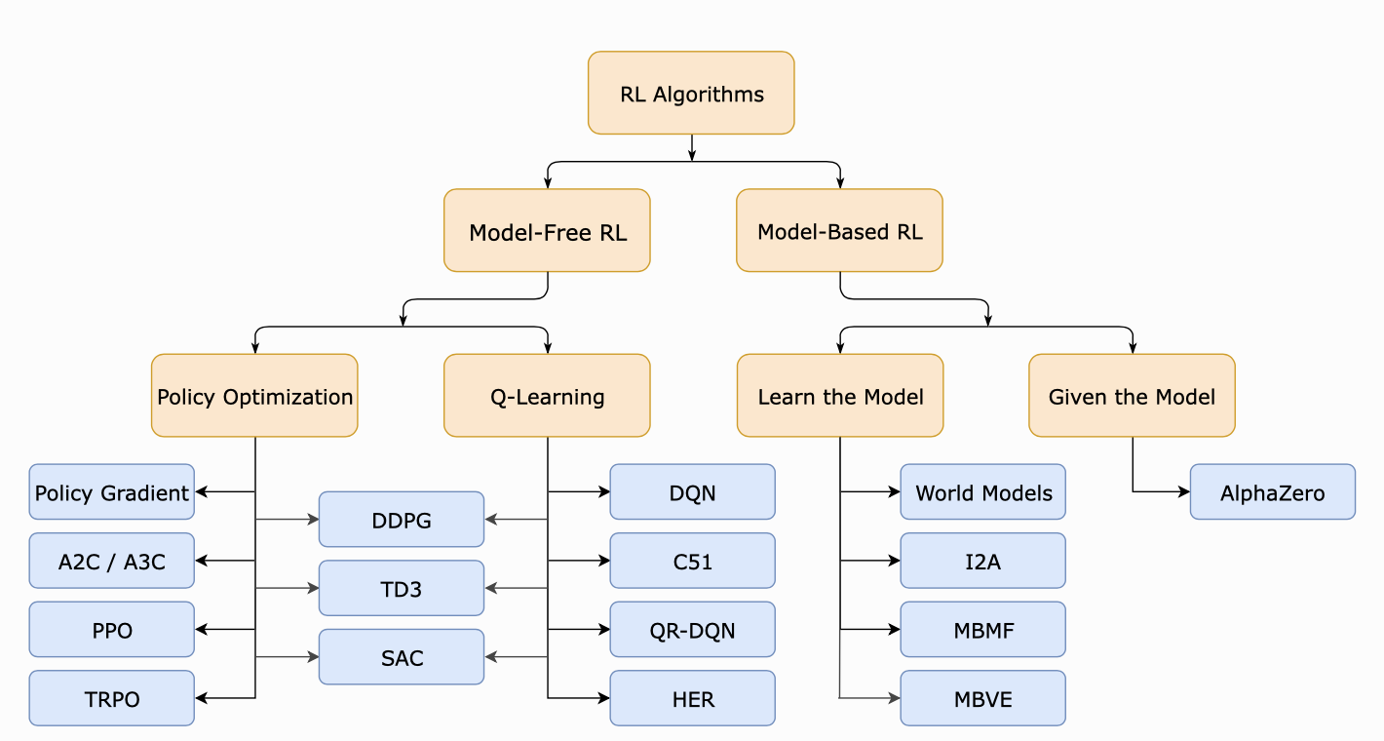

RL Algorithms
Model-based and model-free algorithms
Whether the agent has access to (or learns) a model of the environment. Model referes to transition probability and reward $P\left(s_{\left\{t+1\right\}} | s_{t}, a_{t}\right) and R\left(s_{t}, a_{t}, s_{\left\{t+1\right\}}\right)$.
Policy-based and value-based
Policy-based algorithms represent the policy explicitly as $π_{θ} \left(⋅ | s\right)$ and optimize the parameter $θ$.
Value-based algorithms represent the expected return of state-action pair as $Q_{θ} (s,a)$. The agent takes the action with highest value
$$a_{t}=\arg{max_\left\{a∈A\right\}{ Q}_{θ}(s_{t},a)}$$

Slide 8

Q-Learning
Q-learning is an off-policy RL approach that aims to learn the optimal action-value function.
Action-value function
$$Q\left(s_{t}, a_{t}\right)=r_{t}+γ\max_{\left\{a∈A\right\}}{Q(s_{\left\{t+1\right\}}, a) }$$
This function can be updated recursively as
$$Q^{π}(s_{t},a_{t})=E_{\left\{s_{\left\{t+1\right\}}\right\}}[R\left(s_{t}, a_{t}\right)+γ\max_{\left\{a∈A\right\}}Q^{π}(s_{\left\{t+1\right\}}, a) ]$$
After learning the action-value function, the optimal policy can be retrived by selecting the best action at every state.
$$π^{∗}\left(s\right)=\arg{\max_{\left\{a∈A\right\}}{Q^{π}(s,a)}}$$

Slide 9

REINFORCE
REINFORCE is a policy gradient approach that aims to learn the policy directly instead of learning state-action value function and acting greedily.
The policy is parameterized by $θ$, denoted as $π_{\left\{θ\right\}}\left(s\right).$
Recall that the goal is to find the pollicy that maximize the expected return
$$π^{∗}=\arg{\max{_\left\{π\right\} J\left(π\right) }}$$
As $π$ is a function of $θ$, the optimization problem is
$$θ^{∗}=\arg{\max{_θ J(θ)}}$$
The problem can be solved by gradient descent to search local optimum. What we need is the gradient of $θ$.
Due to the Policy Gradient Theorem
$$∇_{θ} J\left(θ\right)=E[Q_{θ}\left(s,a\right)∇_{θ}\log{π_{θ}(s,a)}]$$
Therefore, $θ$ can be updated via
$$θ ←θ+α Q\left(s_{t}, a_{t}\right)∇_{θ}\log{π_{θ}(s_{t}, a_{t})}$$

Slide 10
RL in finance
Motivation
Given that actions taken in finance and trading may have long-term effects not immediately measurable, some financial problems can be viewed as sequential decision problems, and the environment in which these areas work may be very large or continuous, reinforcement learning can be well-suited to solving finance problems.
Applications
Stock trading
Portfolio management
Market making
Pricing and hedge
Order excution
Use RL as a solution
Formalize the problem as a MDP
Chose a suitable RL algorithm

Slide 11
Papers
Modern perspective on reinforcement learning in finance
Deep Reinforcement Learning in Quantitative Algorithmic Trading: A Review
Deep Reinforcement Learning for Active High Frequency Trading
Double Deep Q-Learning for Optimal Execution
Deep Graph Convolutional Reinforcement Learning for Financial Portfolio Management - DeepPocket
Market Making via Reinforcement Learning
Hedging Derivatives Under Generic Market Frictions Using Reinforcement Learning

Slide 12
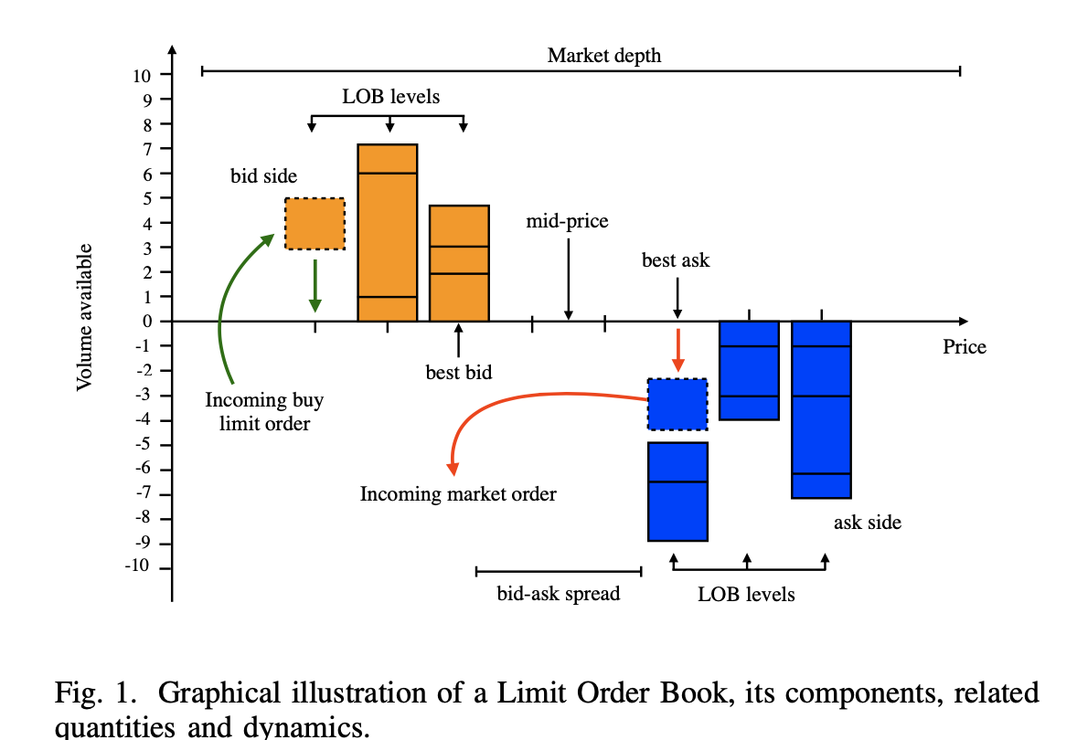
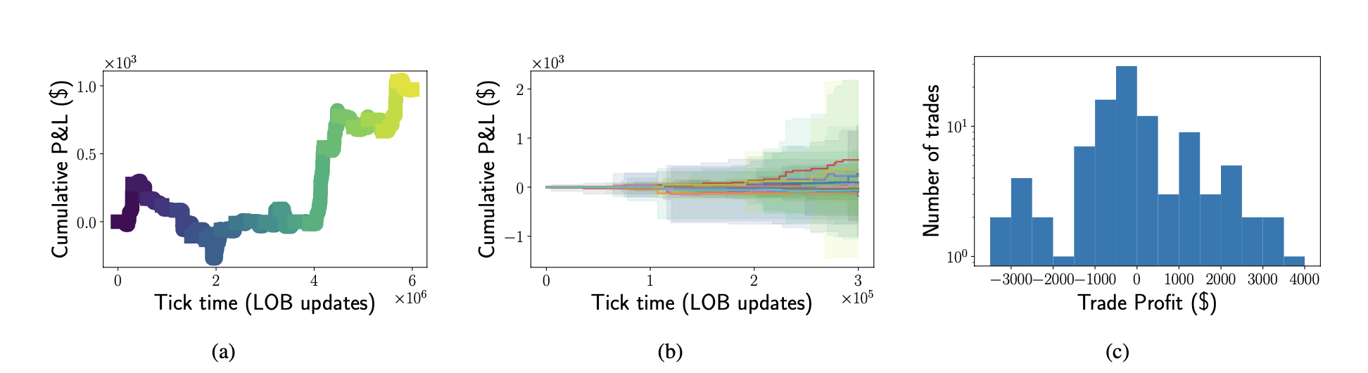

Deep Reinforcement Learning for Active High Frequency Trading
Problem setting
Trade one unit of INTEL stock at each second during a trading day. The goal is to maximize the net profit at the end of the day.
Formalize as a MDP
State: the LOB current state and historical LOB state within a window
Action: [buy, sell, stay]
Reward: net value change $P_{t}−P_{\left\{t−1\right\}}$
Algorithm
PPO
Data
Train: 60 days 04-02-2019, 30-04-2019
Test: 22 days 01-05-2019, 31-05-2019
Results

Slide 13
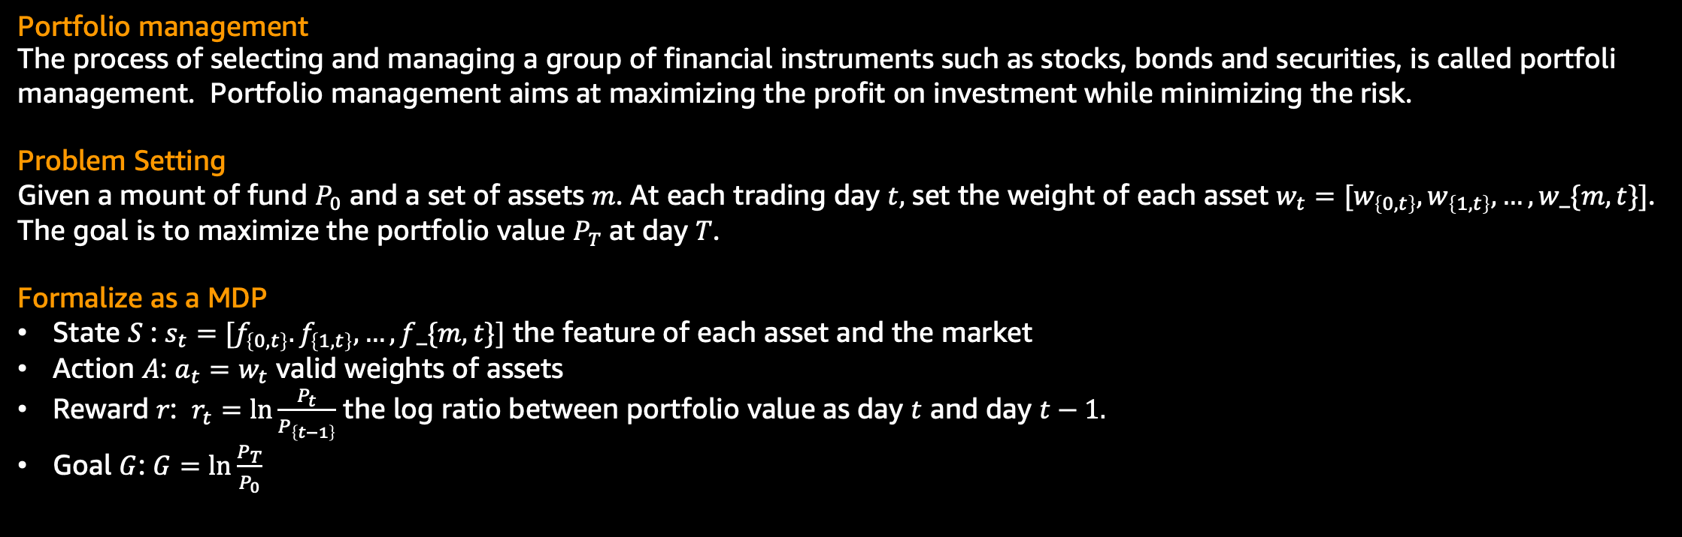
Deep Graph Convolutional Reinforcement Learning for Financial Portfolio Management - DeepPocket
Portfolio management
The process of selecting and managing a group of financial instruments such as stocks, bonds and securities, is called portfoli management. Portfolio management aims at maximizing the profit on investment while minimizing the risk.
Problem Setting
Given a mount of fund $P_{0}$ and a set of assets $m$. At each trading day $t,$ set the weight of each asset $w_{t}=[w_{\left\{0,t\right\}}, w_{\left\{1,t\right\}},…, w_\{m,t\}]$.
The goal is to maximize the portfolio value $P_{T}$at day $T$.
Formalize as a MDP
State $S$ : $s_{t}=[f_{\left\{0,t\right\}}. f_{\left\{1,t\right\}},…, f_\{m,t\}]$ the feature of each asset and the market
Action $A$: $a_{t}=w_{t}$ valid weights of assets
Reward $r$: $r_{t}=\ln{\frac{P_{t}}{P_{\left\{t−1\right\}}}}$ the log ratio between portfolio value as day $t$ and day $t−1.$
Goal $G$: $G=\ln{\frac{P_{T}}{P_{0}}}$

Slide 14
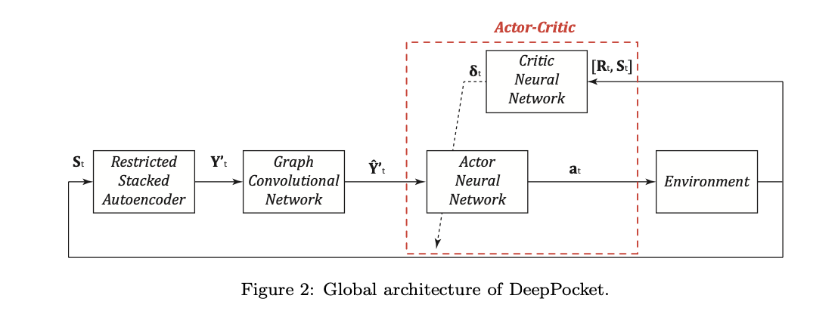
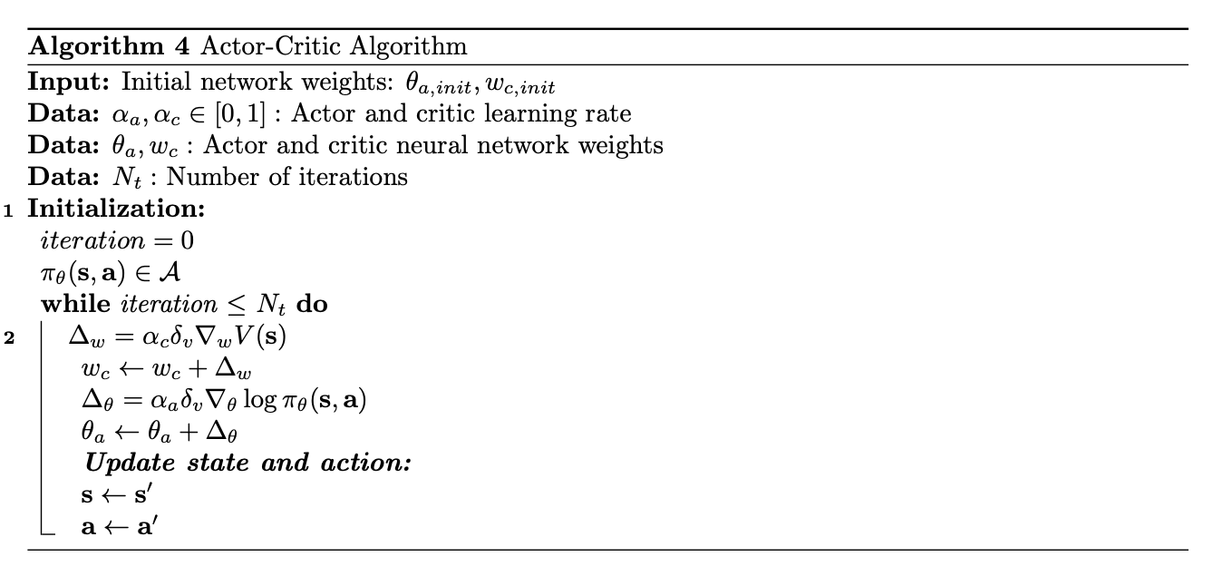
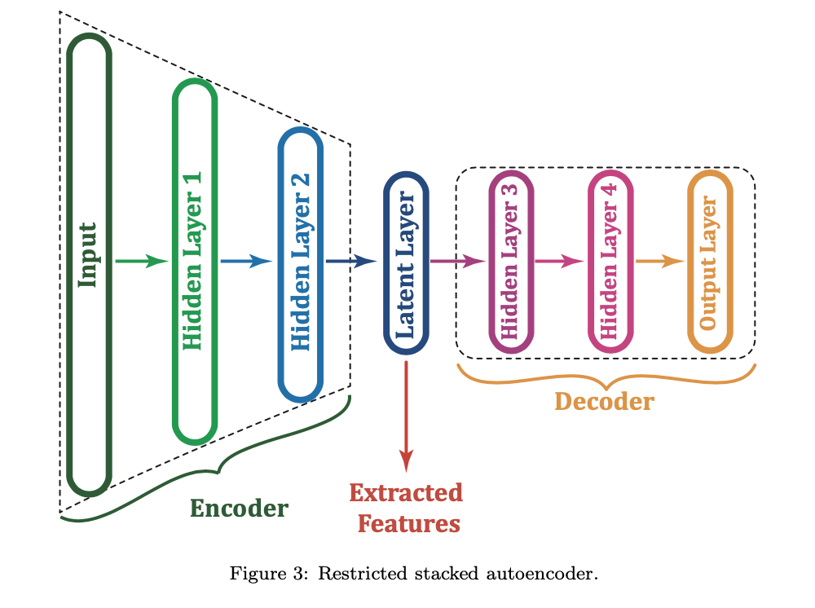
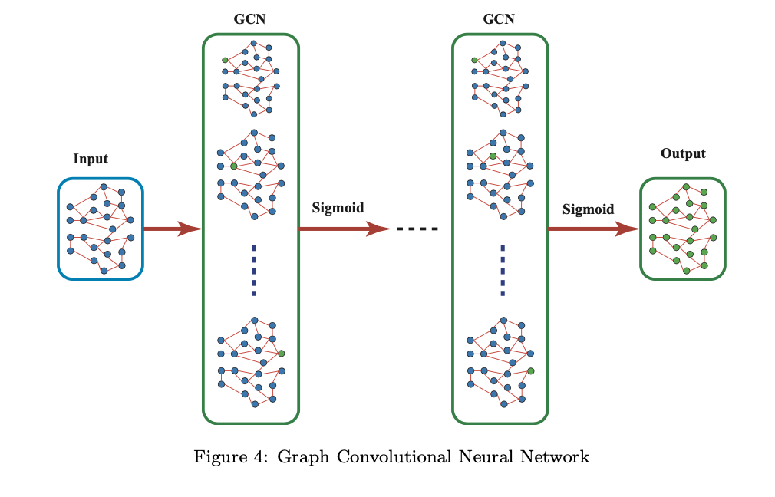

Deep Graph Convolutional Reinforcement Learning for Financial Portfolio Management - DeepPocket
Algorithm
Autoencoder: feature extraction
GCN: exploit the correlation between assets
Actor: learn policy function
Critic: learn action-value function
State: each asset is described by a vector $f_{\left\{i,t\right\}}=[open, close,low, high, moving averaging momentum,…]$

Slide 15
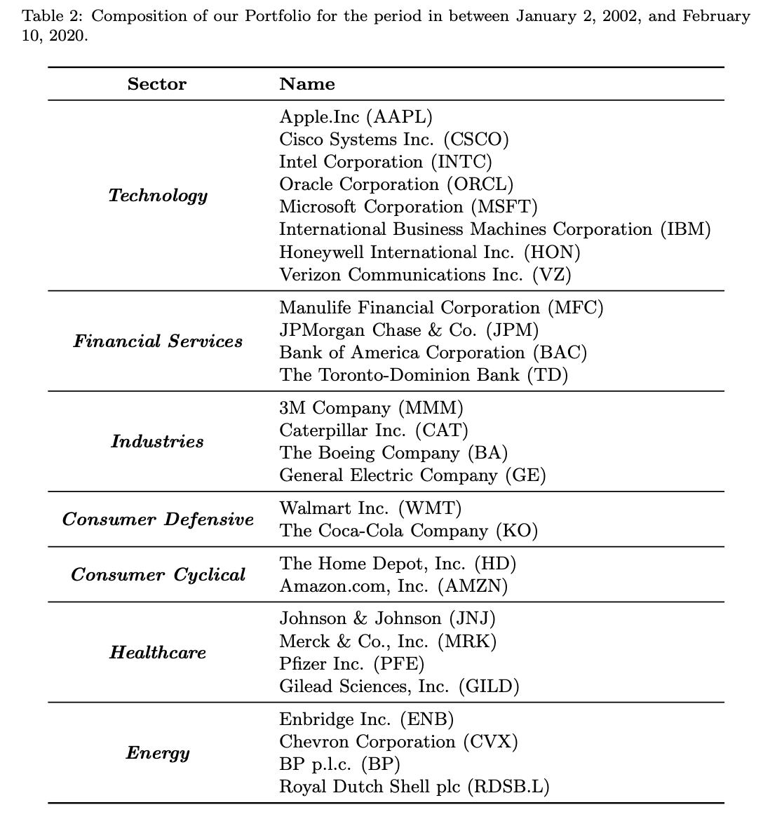
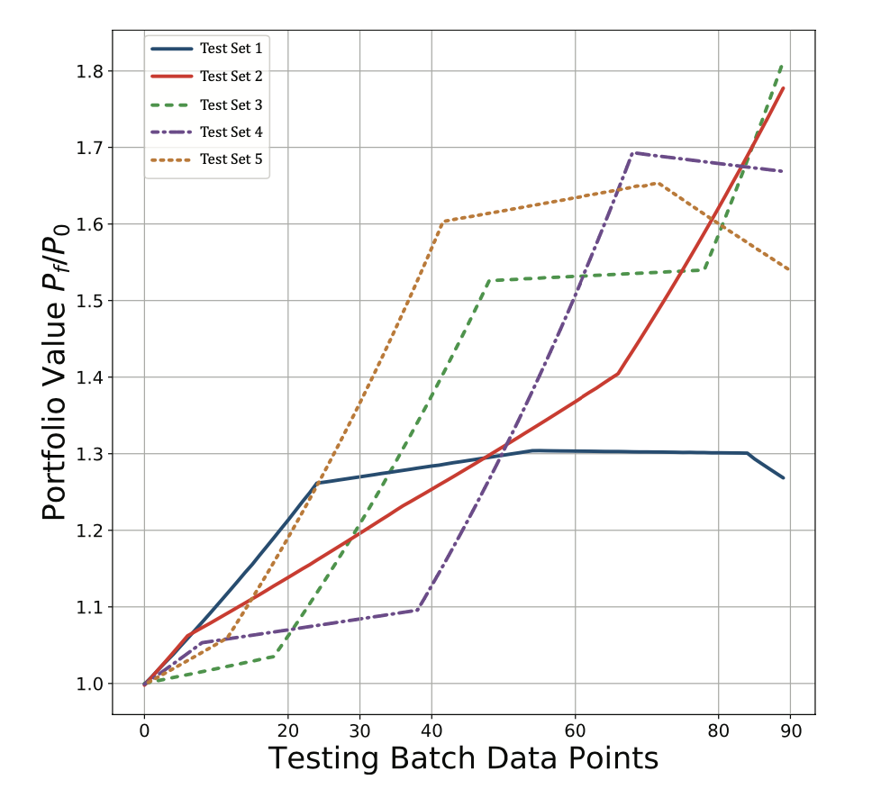
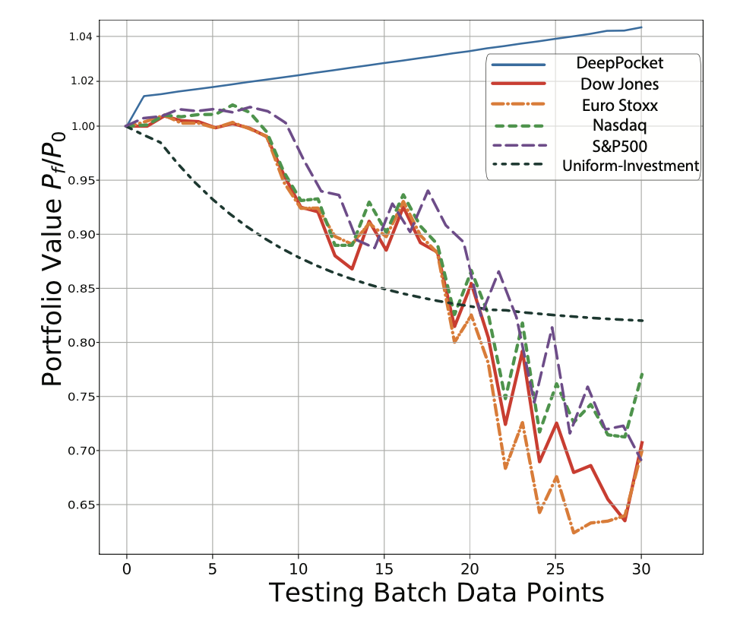
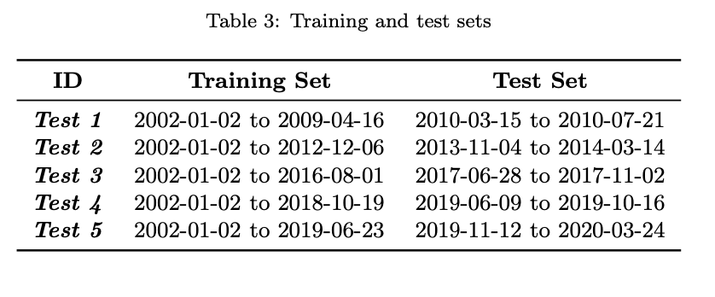
Deep Graph Convolutional Reinforcement Learning for Financial Portfolio Management - DeepPocket
Experiments
Data: historical data covers Jan 2002– March 2020
Asset set: 28 stocks cover several industries
Training: training set and test set
Results

Slide 16
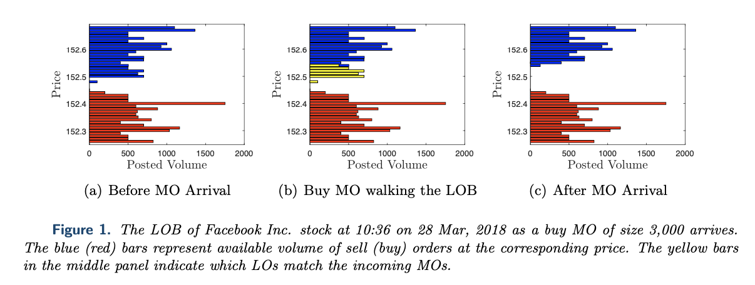
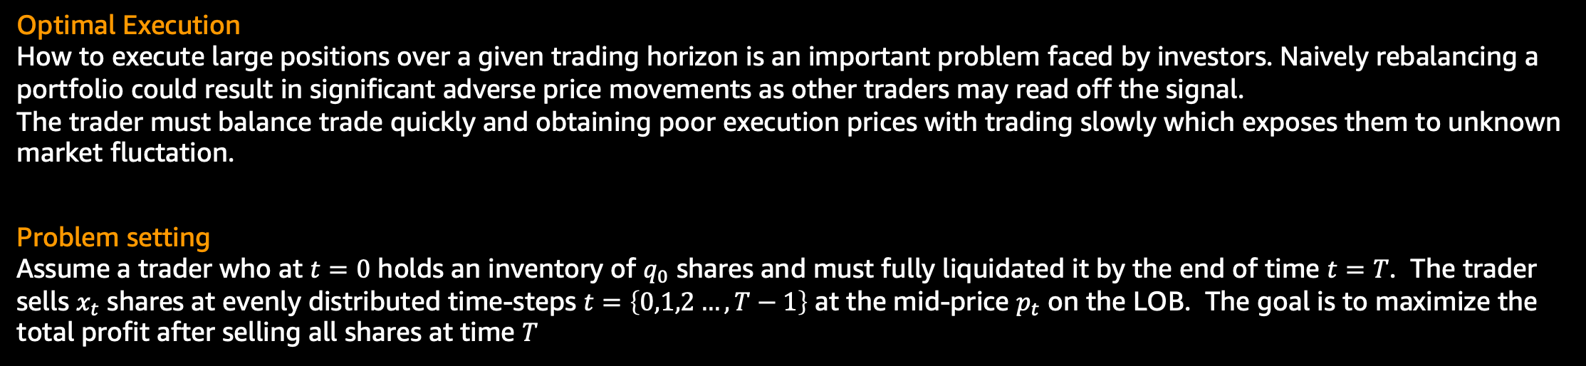
Double Deep Q-Learning for Optimal Execution
Optimal Execution
How to execute large positions over a given trading horizon is an important problem faced by investors. Naively rebalancing a portfolio could result in significant adverse price movements as other traders may read off the signal.
The trader must balance trade quickly and obtaining poor execution prices with trading slowly which exposes them to unknown market fluctation.
Problem setting
Assume a trader who at $t=0$ holds an inventory of $q_{0}$ shares and must fully liquidated it by the end of time $t=T$. The trader sells $x_{t}$ shares at evenly distributed time-steps $t=\left\{0,1,2…,T−1\right\}$ at the mid-price $p_{t}$ on the LOB. The goal is to maximize the total profit after selling all shares at time $T$

Slide 17
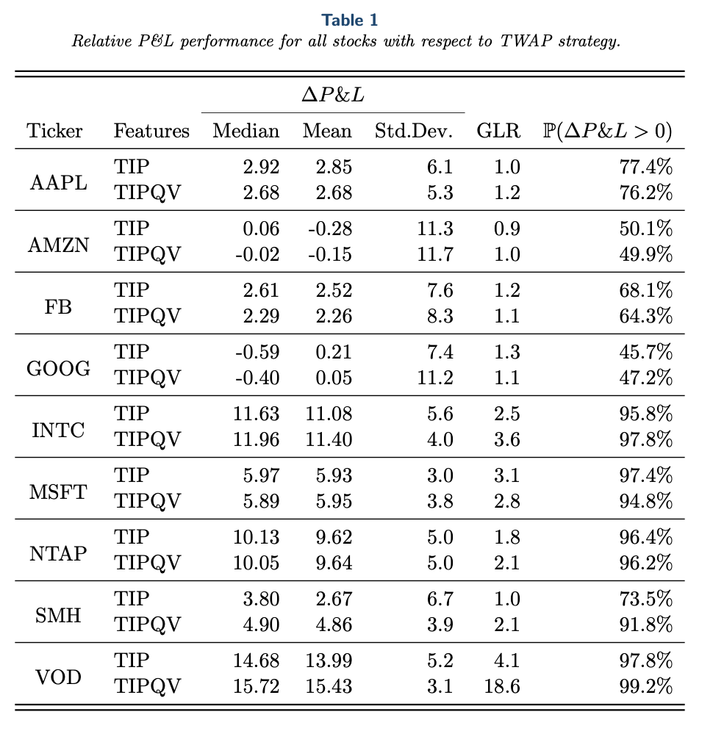
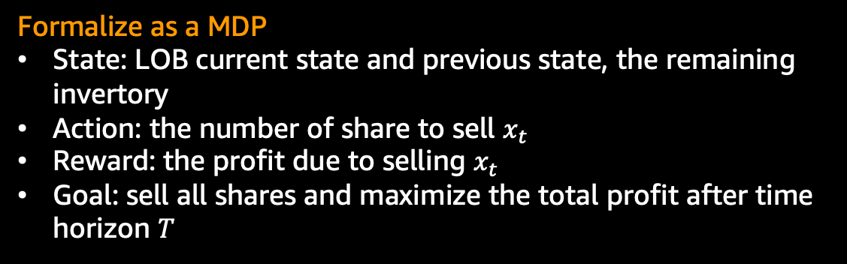
Double Deep Q-Learning for Optimal Execution
Formalize as a MDP
State: LOB current state and previous state, the remaining invertory
Action: the number of share to sell $x_{t}$
Reward: the profit due to selling $x_{t}$
Goal: sell all shares and maximize the total profit after time horizon $T$
Algorithm
Double DQN
Data
LOB data ranges from Jan-02-2017 to March-30-2018.
Stocks: APPL, AMZN, FB, GOOG, INTC, MSFT and NTAP
Result
Compare profit with as basedline called TWAP (Time-Weighted Average Price) i.e, selling the same number of shares at each action-executable timestep

Slide 18
Deep Reinforcement Learning in Quantitative Algorithmic Trading: A Review
Many of the reviewed studies had only proof-of-concept ideals with experiments conducted in unrealistic settings and no real-time trading applications.
If their new algorithm performed as well in the real-world, they certainly would not publish a paper about it and give away their edge.
More extensive experiments on live-trading platforms rather than back-testing or very limited real-time trading.
Direct comparisons between DRL trading agents with human traders
More comparisons among state-of-the-art DRL approaches under similar conditions and data sources.

Slide 19
Frameworks
FinRL: Deep Reinforcement Learning for Quantitative Finance
MAXE: Market simulator designed by oxford man institute
Trading Gym: A toolkit for developing and comparing reinforcement learning trading algorithms
Stock market reinforcement learning: OpenAI Gym Environment with Deep Reinforcement Learning using Keras
PGPortfolio: A toolkit of portfolio management research

Slide 20
FinRL Demo
FinRL example link

