Slide 1
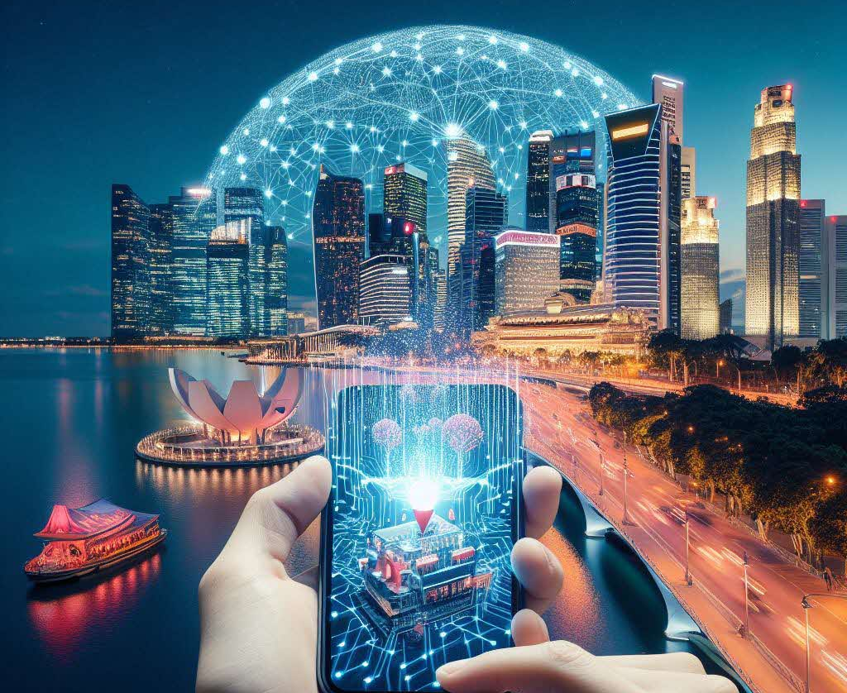
Tourist Data Analysis
By Yang Kewen
22/Jan/2024

Slide 2
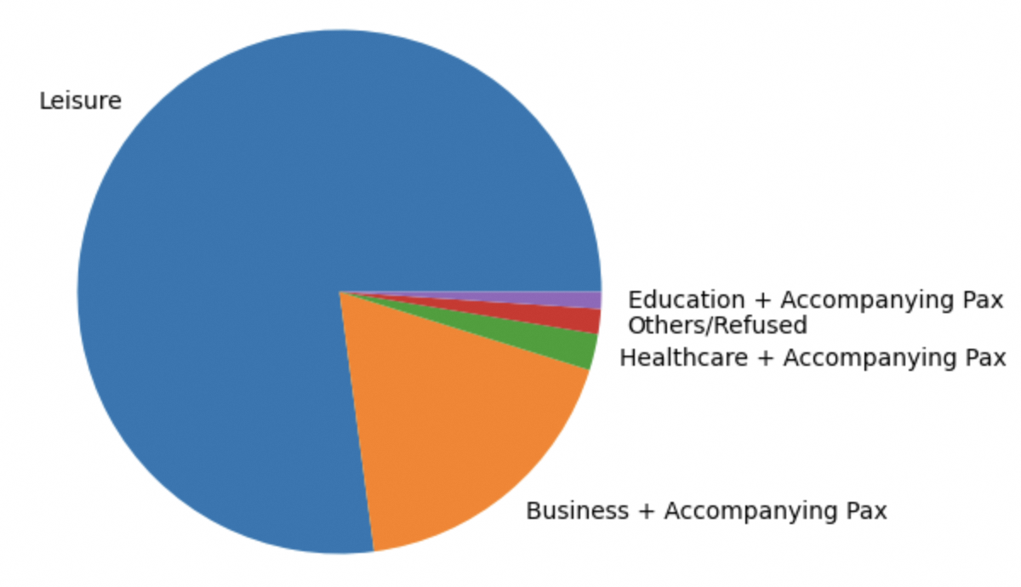




Problem Statement
Tourist Data
Year 2018
22,974 visitors
From 119 countries
Spent total 21 millions dollars
Can we leverage AI model to do targeted marketing to attract more spendings?

Slide 3



Solution Idea
Processed data feed to AI model
Apply SHAP graph for interpretation
Data
XGBoost Model
SHAP Graph
Based on the SHAP graph and Statistics, as well as domain knowledge, we can provide actionable insights.

Slide 4
Insights

Slide 5
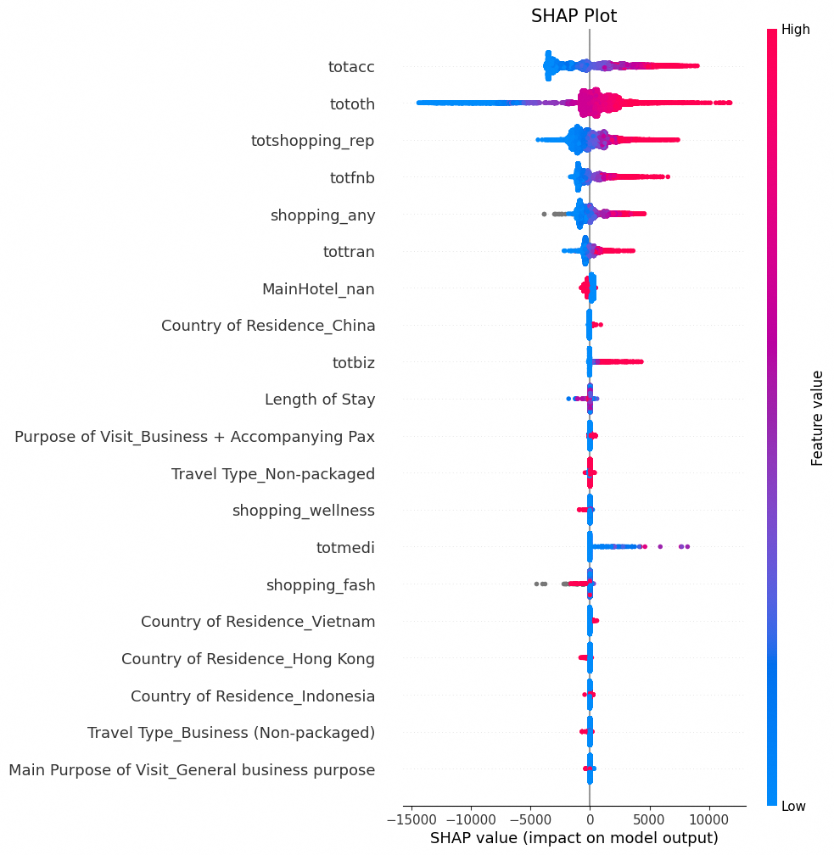
About SHAP Graph
How to read the SHAP graph?
Y-axis: the value of total cost, more red means larger value.
X-axis: the impact of this feature to total spend.
e.g., take first variable as example, “totacc” means total accommodation cost, the larger the accommodation cost is, the larger impact to the total spend.

Slide 6
Overall Insights
Accommodation is the most important feature to the total spend by visitors, followed by shopping spend and Country of Residence. Thus, We shall delve into them in details.

Slide 7
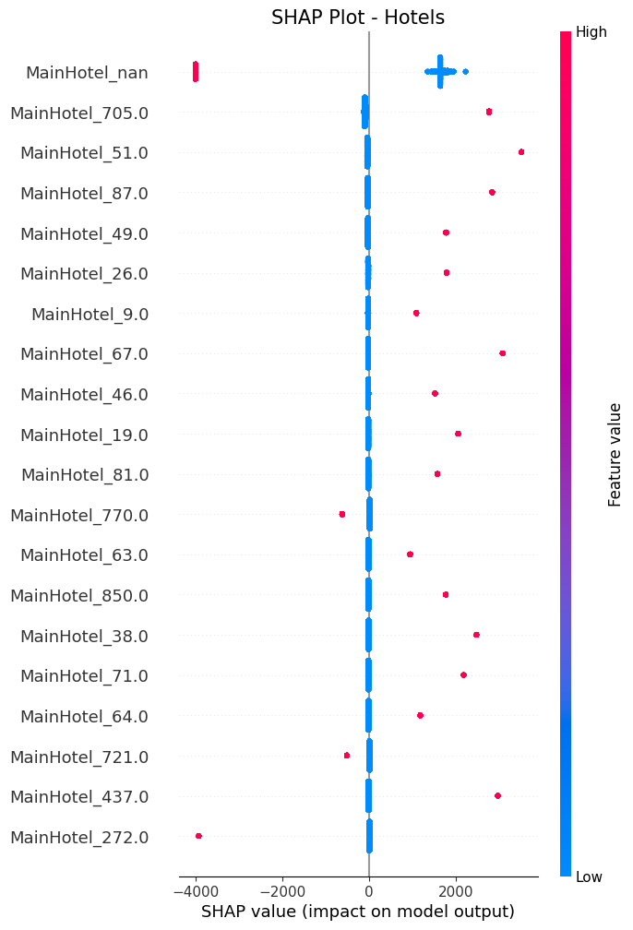
Hotel Insights
Insights:
Tourists who did not indicate their hotel info, tend to spend less.
Visitors who stayed at Marina Bay Sands(705.0), Mandarin Orchard Singapore(51.0) and Pan Pacific Hotel(87.0) tend to spend more.

Slide 8
Hotel Insights
Recommendations:
For tourists who are staying in those top spending hotels, we further zoom into their profiles, and send relevant shopping vouchers to them. e.g., For visitors staying in MBS, we derived the table by analyzing their data.
 | Male | Female
Most Spending Shopping | Gifts | Food, Fashion

Slide 9
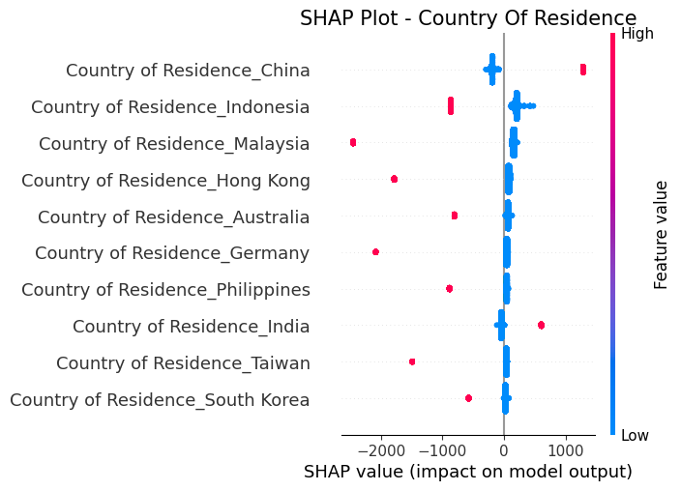
Country Of Residence Insights
Insights:
Visitors from China tend to spend more.
Visitors from Indonesia, Malysia, Hongkong etc. tend to spend less.

Slide 10
Country Of Residence Insights
Recommendations:
Attract more Chinese visitors, e.g., free of visa etc.
Analyze Chinese visitors’ shopping pattern and send targeted marketing to them. e.g. We derived this table by analyzing the Chinese visitors’ data.
 | Male | Female
Most Spending Shopping | Wellness | Consumer Tech and Fashion

Slide 11
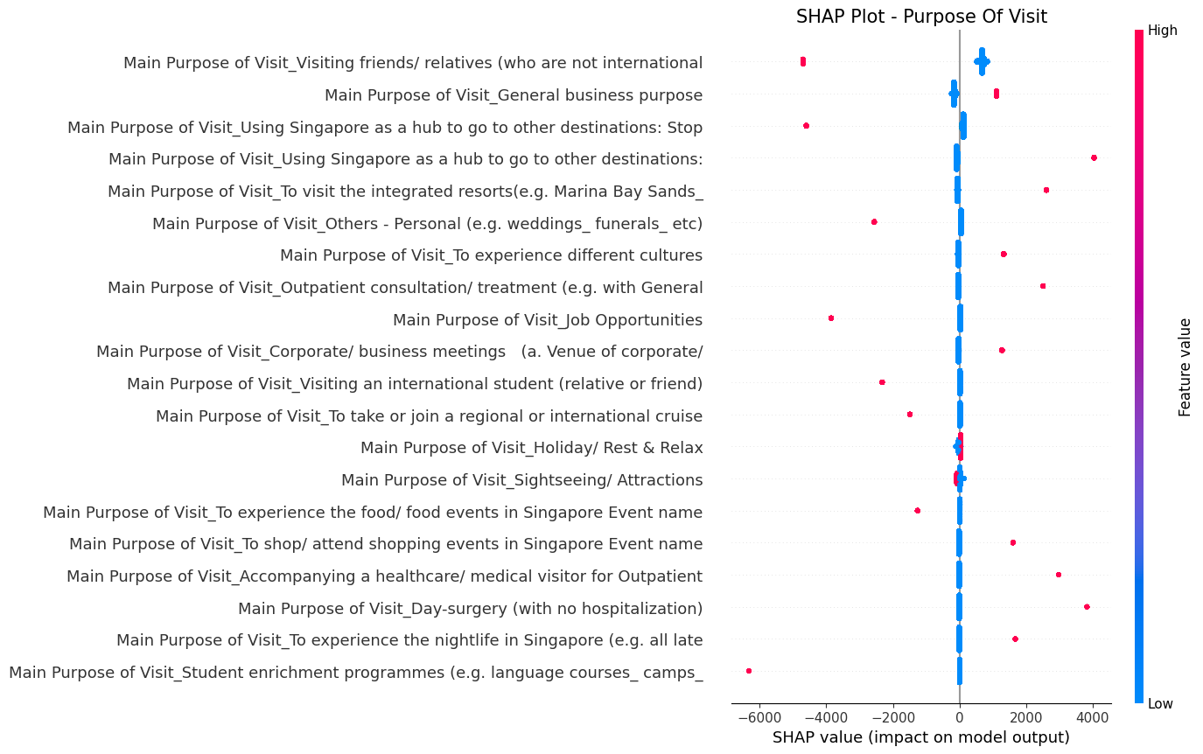
Visit Purpose Insights
Insights:
Visitors came for purpose of visiting friends, attending weddings, studying tend to spend less.
Businessmen, shoppers, healthcare patients, nightlife seekers tend to spend more.

Slide 12
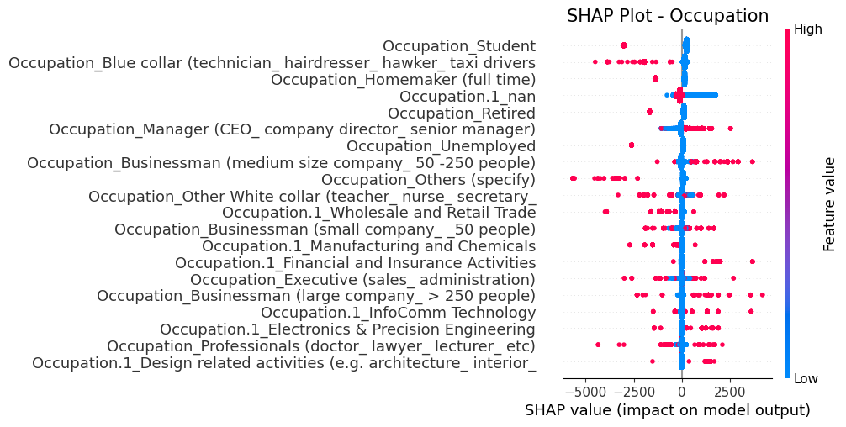
Occupation Insights
Insights:
Students, taxi-drivers, homemakers, retired, unemployed tend to spend less, while managers, businessmen tend to spend more.

Slide 13
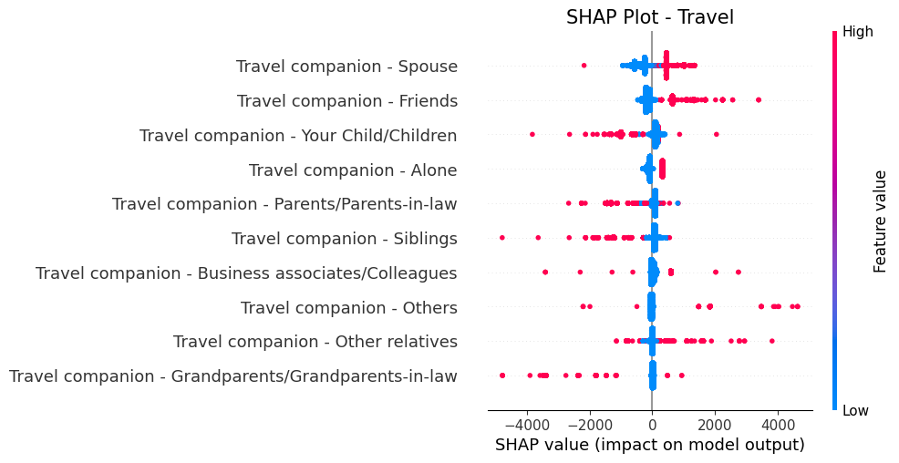
Companion Insights
Insights:
Visitors travelling alone, or with spouses, friends tend to spend more. While visitors travelling with children, parents, siblings tend to spend less.

Slide 14
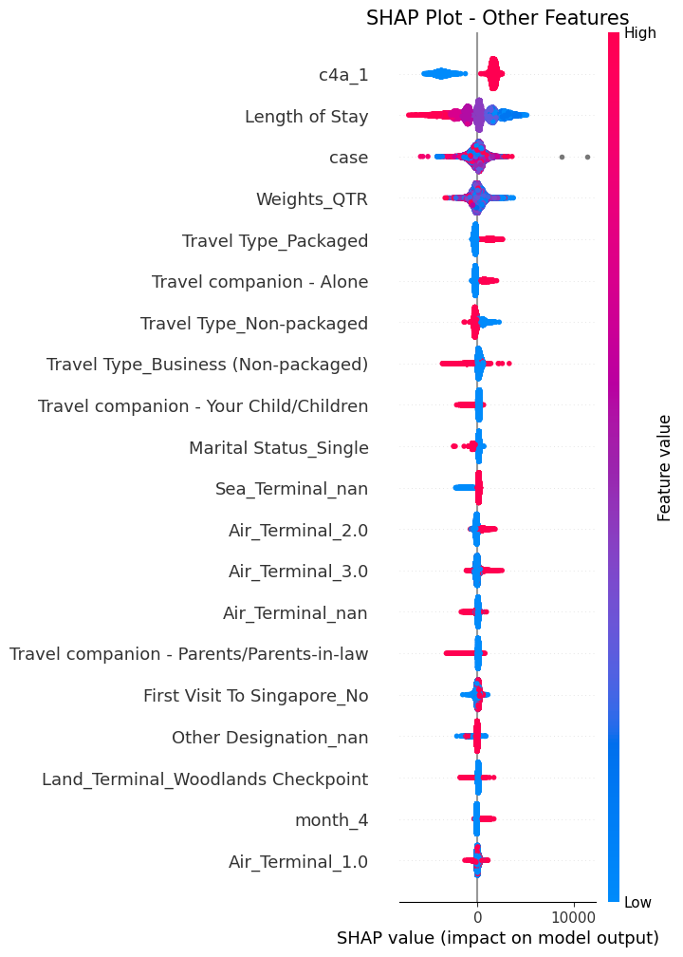
Other Insights
Insights:
Packaged tourists tend to spend more.
Visitors tend to spend more during April.

Slide 15
Overall Recommendations
As visitors travelling alone or with friends/spouse, and visitors with travelling package tend to spend more, we can provide themed travelling package(e.g., cheap flight ticket if you travel with spouse) to attract more tourists.
As businessmen, healthcare seeker, nightlife seeker tend to spend more, we can invest more on the advertisement of Singapore healthcare, nightlife events etc. to attract them to visit, as well as to encourage international event or conference to attract business visits.
As tourists from certain country(e.g. China) tend to spend more, we can analyze their spending profile and send targeted marketing to attract them to spend more.

Slide 16

Q&A

