Slide 1
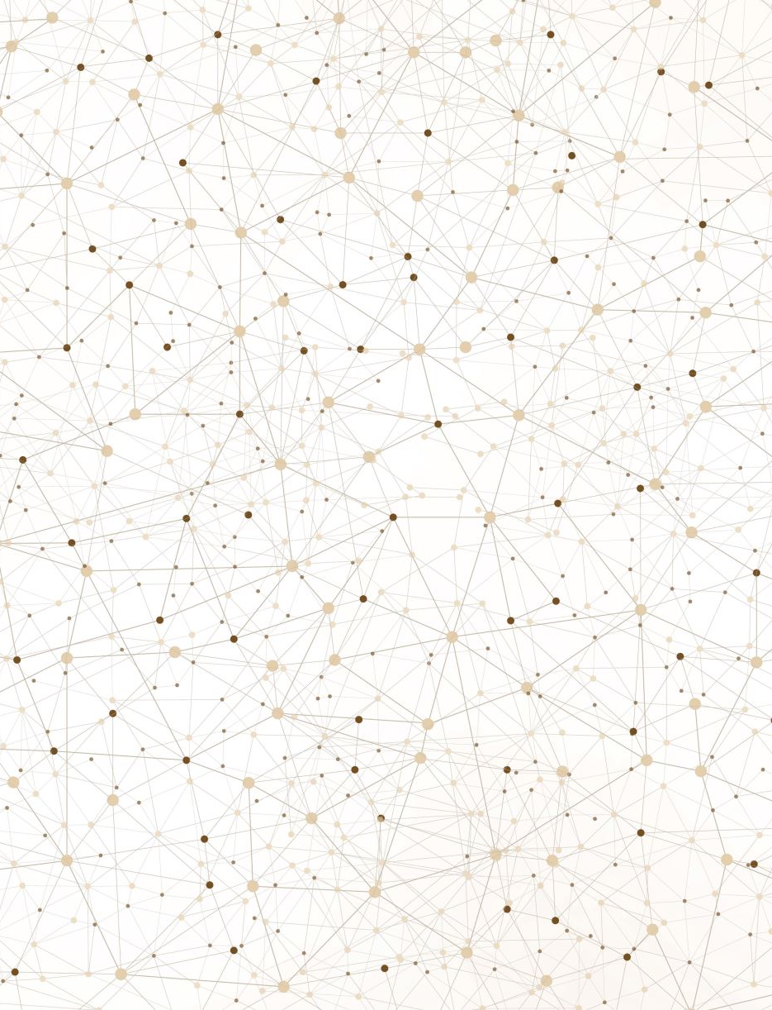
Adversarial Defense via PGD-Based Adversarial Training
Motivation:
A small perturbation negatively impacts the model accuracy, is there a way to make the model more robust?
Main Idea:
Adversarial training using PGD generated training data.
Result:
Sihan Yang
MSCS2201 Spring 2026

Slide 2
Literature Review
Intriguing Properties of Neural Networks Szegedy et al. (2014)
First to discover adversarial examples. Invisible perturbations cause confident misclassification. Motivated the entire field.
Explaining and Harnessing Adversarial Examples
Goodfellow et al. (2015)
Proposed FGSM — single-step attack. Vulnerability stems from the linear nature of neural networks. First basic adversarial training idea.
Towards Deep Learning Models Resistant to Adversarial Attacks
Madry et al. (2018)
Robustness as min-max optimization. PGD = strongest first-order attack. PGD adversarial training is the gold standard defense.

Slide 3
Approach
Dataset: MNIST
Model: small CNN
Eval attacks: FGSM + PGD (40 steps, α = ε/10)
Optimizer: Adam, lr = 1e-3
Iteration | ε | PGD train steps | Step size α | Epochs | Notes
iter1 | 0.3 | 7 | 0.01 | 10 | default baseline
iter2 | 0.3 | 20 | 0.03 (ε/10) | 20 | stronger PGD training
iter3 | 0.2 | 20 | 0.02 (ε/10) | 20 | smaller perturbation budget

Slide 4
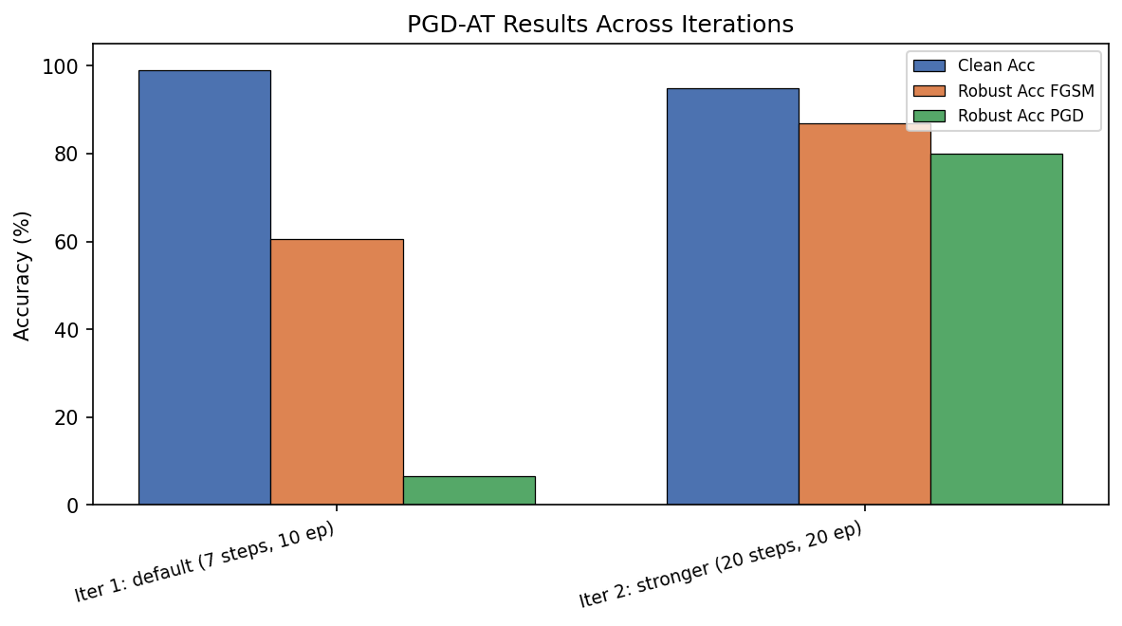
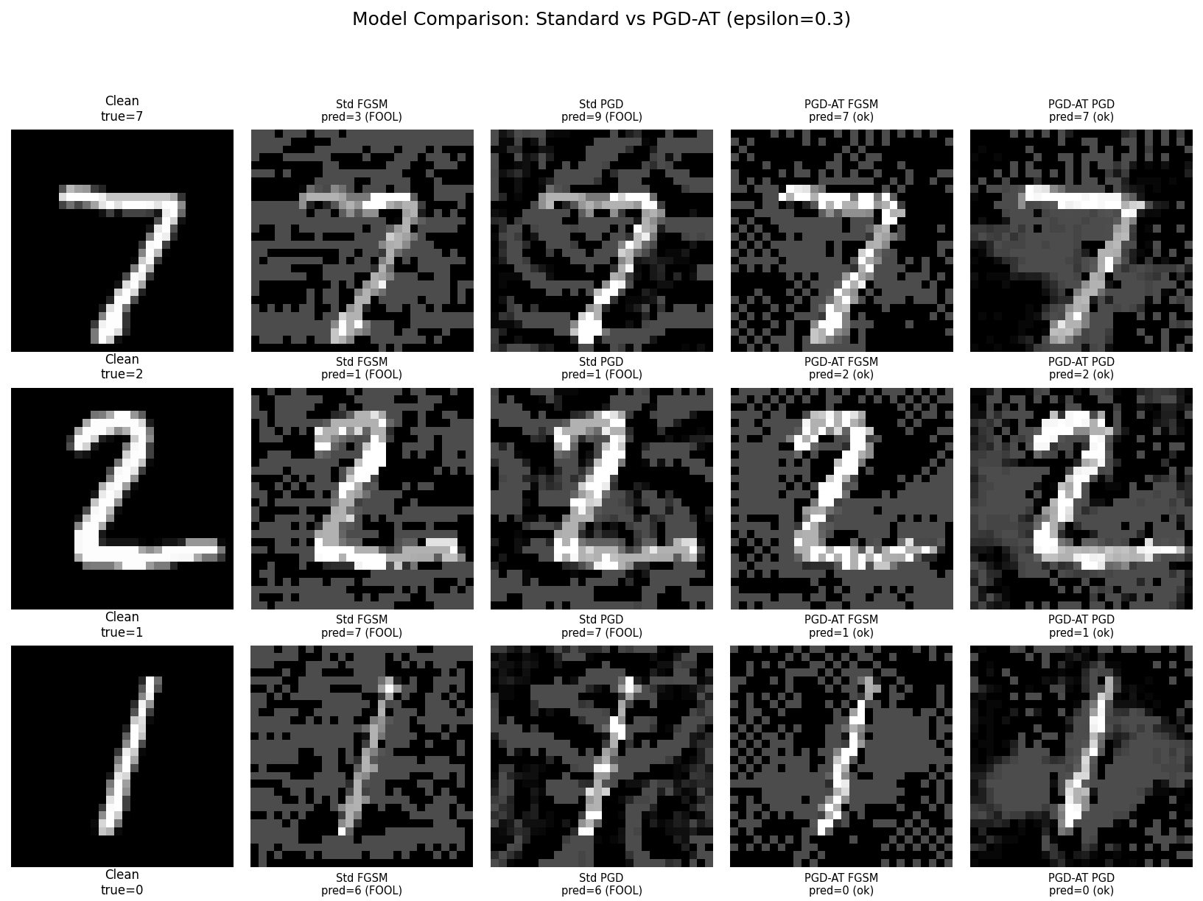
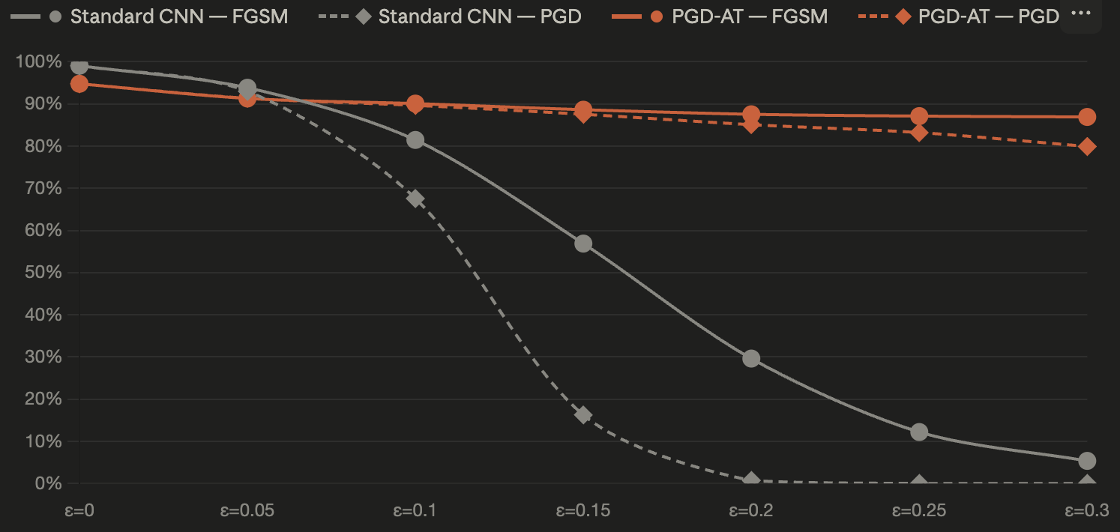
Results
Iter 2: Robustness vs. epsilon

Slide 5
Reference
[1] Szegedy, C. et al. (2014). Intriguing properties of neural networks. ICLR 2014. arxiv.org/abs/1312.6199
[2] Goodfellow, I., Shlens, J., & Szegedy, C. (2015). Explaining and harnessing adversarial examples. ICLR 2015. arxiv.org/abs/1412.6572
[3] Madry, A. et al. (2018). Towards deep learning models resistant to adversarial attacks. ICLR 2018. arxiv.org/abs/1706.06083

