Slide 1

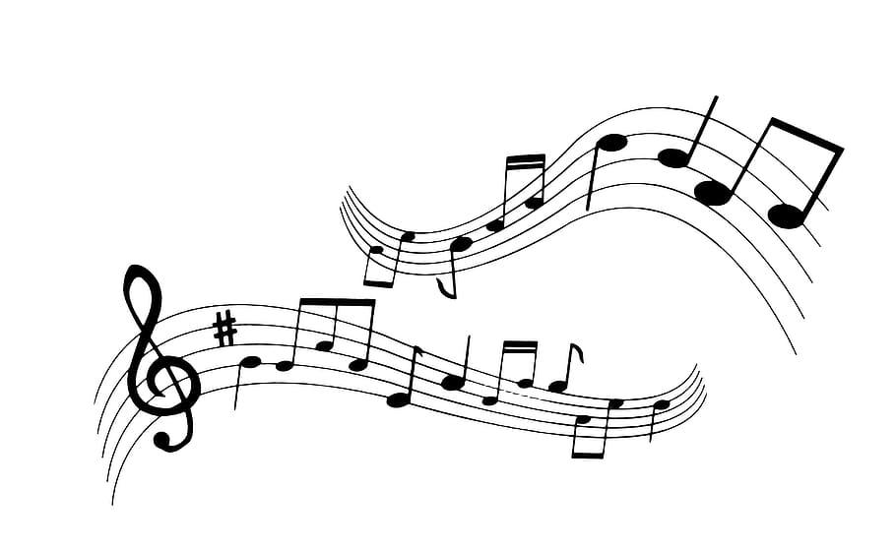
Pitch
Pyfect
Staci Wilson, Yang Shi, Zach Moormeier

Slide 2
Questions:
There is a lot of Spotify data that can be collected on song structure and music theory.
Looking at the genres of Rock, Pop, and Hip-Hop:
What are the popular key signatures in each genre?
Do certain genres prefer major or minor key signatures?
Do major or minor keys affect valence?
What is the average tempo in beats per minute?
Are there differences in beats per measure?
Do these factors reveal how to compose the perfect Rock, Pop, and Hip-Hop song?

Slide 3
Data
Data Cleanup
Song Lyrics from 6 genres (vagalume.com)
150K Lyrics Labeled with Spotify Valence
Spotify 1.2M+ Songs with Universal Product Code
Spotify 1921-2020 csv
New York Times API article search with facets
Reduce the data frame columns to the project scope
Merged and concatenate all dataset
Remove null values and duplicates
Use Loc and Groupby methods to plot the data
Notes:
We didn’t pull the data from Spotify directly, and we don’t know how to pull from web API, so we used the csv files on kaggle in this study.
We first narrow down our genre studies on Rock, Pop, and Hip-Hop music.
With the artist lists we have under those three genres, we cross-check the data with the Spotify data in hand to get a final data frame with tracks(songs), artists, genres, mode, key, tempo, valence, year, and lyrics.
We then find out the popular keys, common mode, valence value tendencies, temp range for each genre.

Slide 4
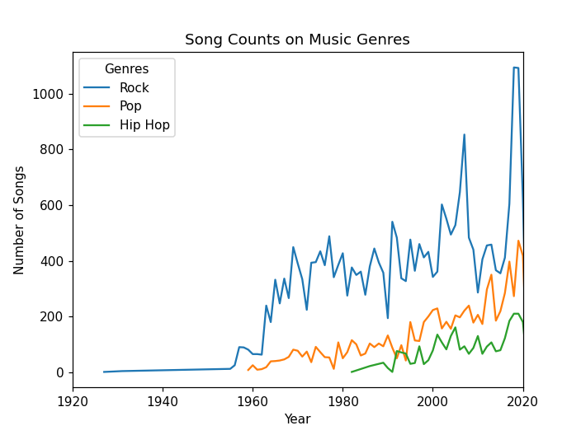
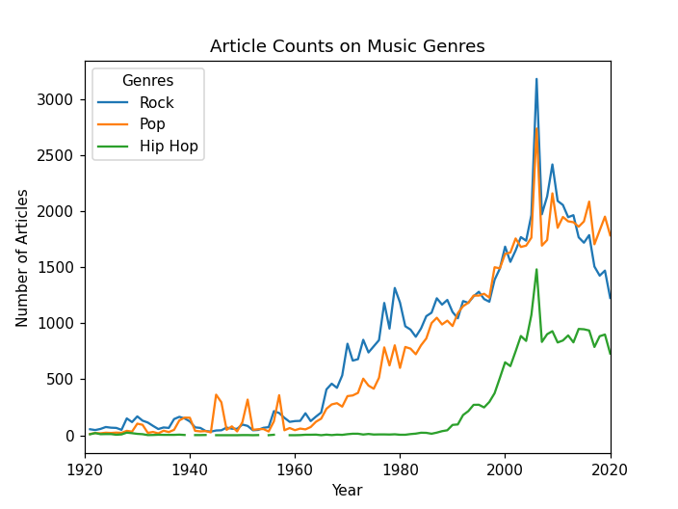
Our data contains more Rock songs than both Pop and Hip-Hop
Rock was created in the 1950’s
Pop evolved out of Rock music
Hip-Hop was created 30 years later in the 1980’s
Notes:
After we cleaned our data. We plotted the number of songs we have in our study by publication year for each genre. With that information, we also utilized New York Times API on the article count with keys words 'Rock Music', 'Pop Music', and "Hip Hop" from 1921 to 2020. As we can see from the graph, rock originated in the 1950s, while pop evolved out of rock and pick up around the same time but not as popular. In the 1980s, there are more and more Hip-Hop music tracks were made and start becoming mainstream.
As for what we found in the music theory, I will let Zack to talk more about it.

Slide 5
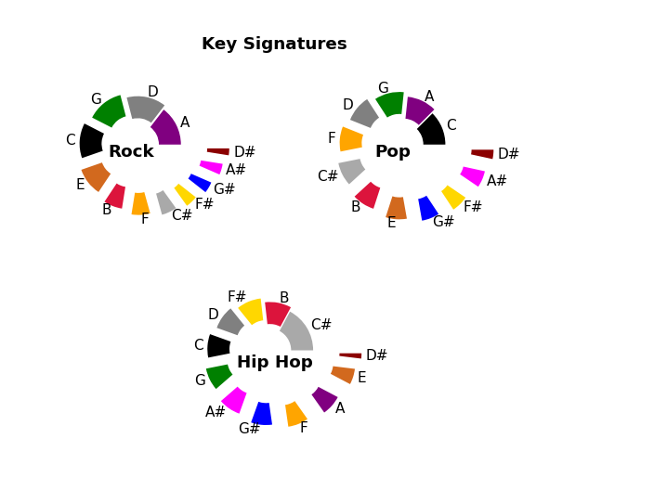
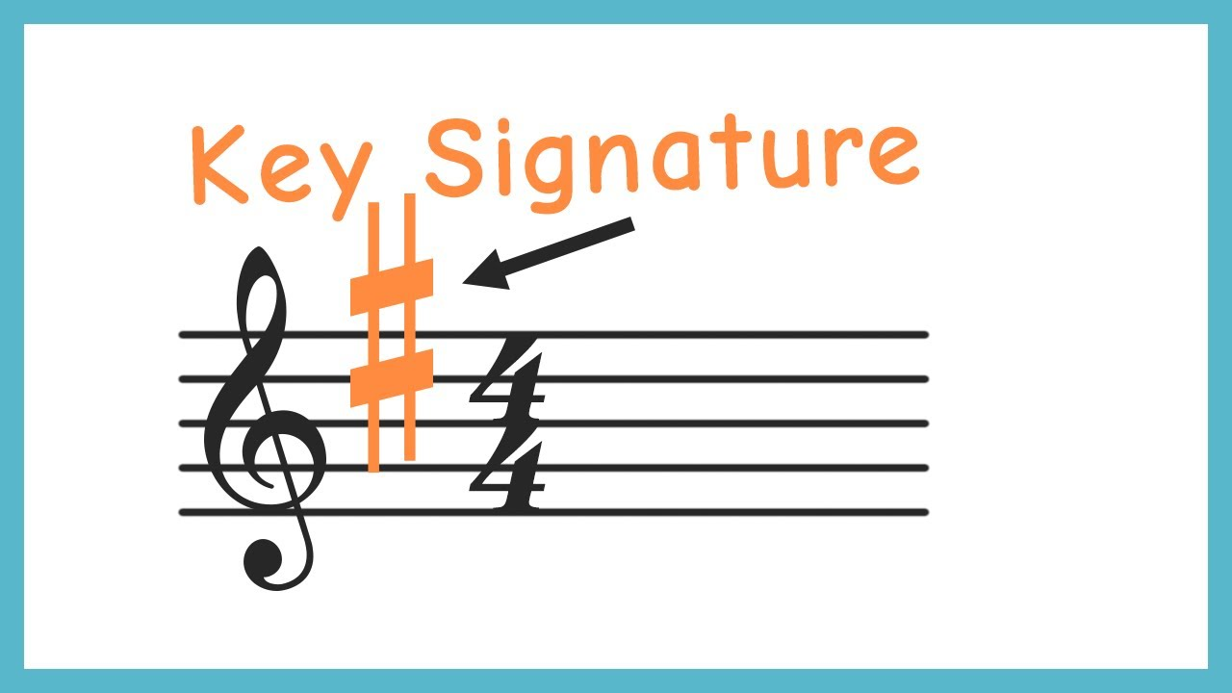
Key Signature identifies which notes and chords can be used in a song
Rock and Pop favor:
G, C, A, D
Hip-Hop has more freedom to use a variety of keys
Notes:
Our data shows that the top 4 keys in pop and rock are G, C, D, A. We also see that pop and rock don’t utilize these sharp keys as much.
When we look at Hip-Hop, sharp keys are more prevalent like C# and F#.
And overall, the keys are more evenly distributed.
This is because Hip-hop music is composed from a keyboard-oriented standpoint as opposed to a guitar-oriented standpoint. Sharp keys are more complex to play on the guitar. It is much easier for a piano/keyboard or synthesizer to utilize these #sharp keys.
Our data shows that Hip-Hop music uses a wider variety of key signatures than pop and rock.

Slide 6
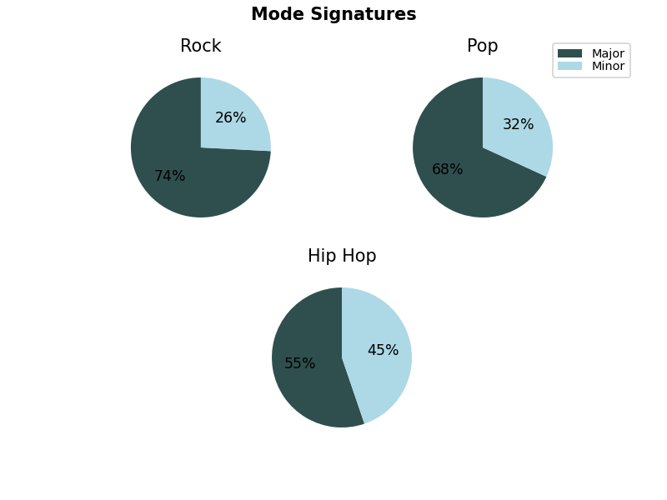
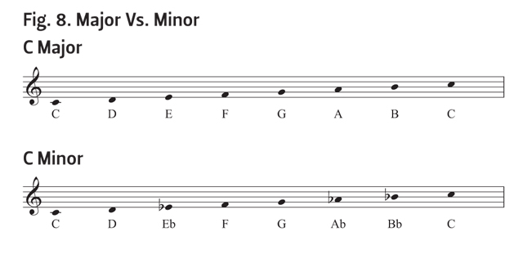
Major vs Minor Keys
Rock and Pop prefer major key signatures
Minor keys are more complex for guitar players
Hip-Hop has no preference
Notes:
Next, we studied if these genres preferred major or minor key signatures.
This told us a similar story.
Our results showed that rock and pop both prefer major keys
Hip-hop is split 55/45
Therefore, Hip-Hop also has more freedom when choosing if their key will be major or minor
Again, this could have to do with the fact that major keys are preferred by guitar players and Hip-Hop music doesn’t have that limitation

Slide 7
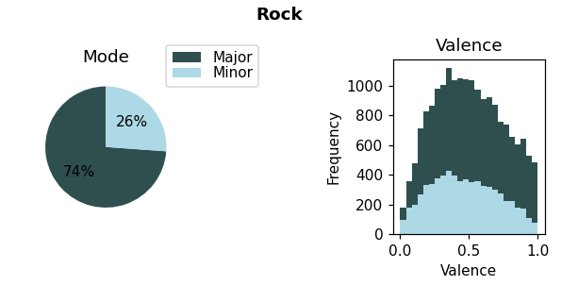
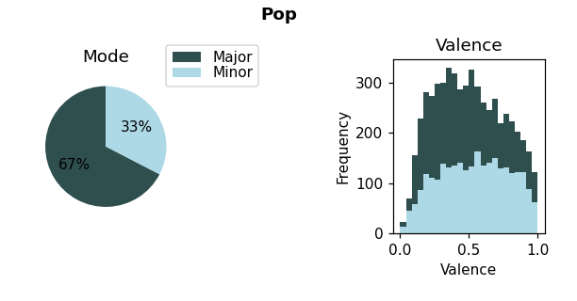
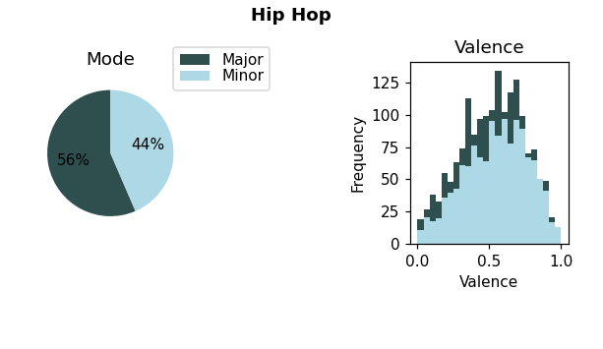
Valence measures positive (happy) tones vs.
negative (sad) tones
We thought Major would correspond to high valence
We thought Minor would correspond to low valence
This is not the case
Sad songs can be written in major keys and vice versa
Notes:
Valence measures happy(positive) tones vs sad(negative) tones.
The closer you get to one, the happier the song gets.
As you approach zero, the song gets more depressing.
Typically, major key signatures are used to compose happy songs and minor keys are used for sad songs.
We predicted that songs composed in a major key would have a higher valence, and songs composed in a minor key would have a lower valence.
However, this is not the case
It is possible to write a happy song in a minor key and a sad song in a major key
_________________________________________
We also wanted to compare the overall valence across the 3 genres. We were hoping to find that pop was skewed toward 1. And rock was skewed toward 0.
However, rock and pop actually look very similar. This just means that there is a normal distribution of both happy and sad songs in each genre.
Hip-Hop does look different.
Songs are more concentrated around the 0.5 range.
This could mean that Hip-Hop songs have less range when it comes to happiness or sadness, and that Hip-Hop songs have a more consistent tone.

Slide 8
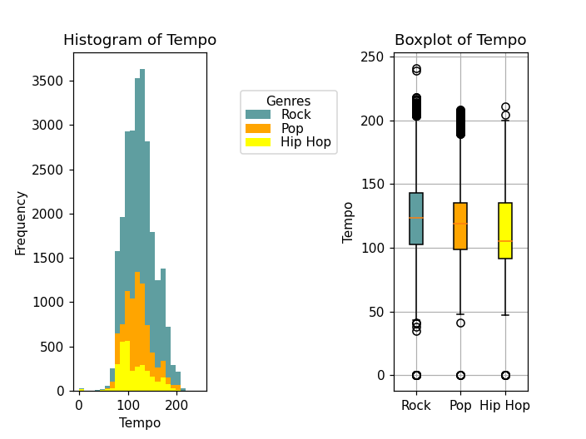
Tempo measures how fast a song is in beats per minute
Genre | Median
Rock & Pop | 125 bpm
Hip-Hop | 100 bpm
It is easier to rap over a slower tempo
Notes:
Tempo measures how fast a song is in beats per minute
The x-axis shows tempo from 0 to 250 beats per minute
The y-axis shows how many songs from each genre have that given tempo
*Like we said before, we analyzed more rock songs than the other 2 genres
*But let’s study the peaks
The majority of rock and pop songs occur within the range of 100-140 bpm
Hip-Hop’s peak is between 80 and 100 bpm.
Then looking at the box plot, rock and pop have a median of around 125
Hip-Hop has a median of around 100 bpm
Our theory is that hip-hop songs have a slightly slower tempo on average because it is easier to rap over a slower tempo

Slide 9
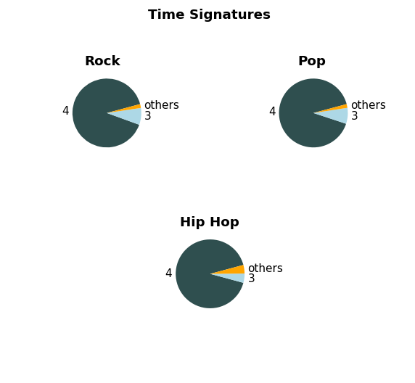
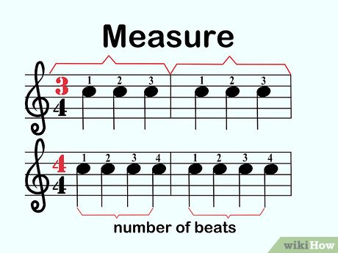
Beats Per Measure
Songs are organized and transcribed using measures
Rock, Pop. and Hip-Hop use
4 beats per measure over 90% of the time
Notes:
Songs are organized and transcribed using measures.
We wanted to study beats per measure to get a better understanding of how these songs are structured
We were hoping to find a difference here, but our results were the same for all three genres
They all compose using 4 beats per measure over 90% of the time

Slide 10
Conclusion
Overall, we found that Rock and Pop are similar in composition. However, we did identify a few key differences with Hip-Hop:
 | Key Signature | Major or Minor? | Valence | Tempo
Rock | G, C, D, A | Major | 0 to 1 | 125 bpm
Pop* | G, C, D, A | Major | 0 to 1 | 125 bpm
Hip-Hop | unrestricted | unrestricted | Around 0.5 | 100 bpm
*Pop has slightly more freedom to experiment with key signature than rock because it is less reliant on the guitar
Notes:
After comparing the 3 genres in terms of song structure, we found rock and pop to be very similar. However, we did find a few differences when it came to hip-hop.
If you want to compose a typical rock song, choose G, C, D, A and make your key signature major.
Set your valence anywhere between 0 and 1. Rock songs can be happy, sad, or anywhere in between.
Also, make sure your song is around 125 bpm
For pop, follow the same guidelines but know you have slightly more freedom to experiment with key signature because you are less reliant on the guitar
For Hip-Hop, feel free to experiment with any key signature whether it be major or minor.
Set your Valence around 0.5. Hip-Hop songs aren’t overly happy or depressing. They have a more consistent tone.
Finally, pull your tempo back to around 100 bpm, so it’s easier to rap over.
So, if you want to compose a song in any of these genres, these are a few tips to consider.

Slide 11
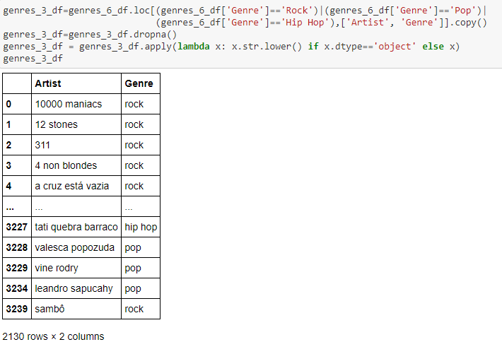
Supplement Materials (genre)

Slide 12
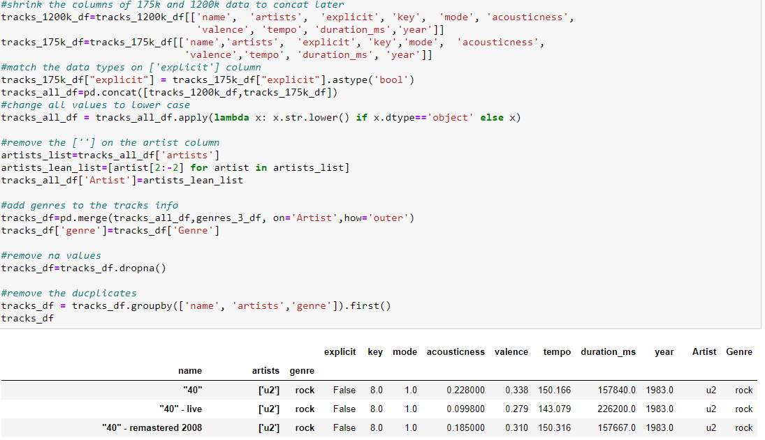
Supplement Materials (music theory - 1)

Slide 13
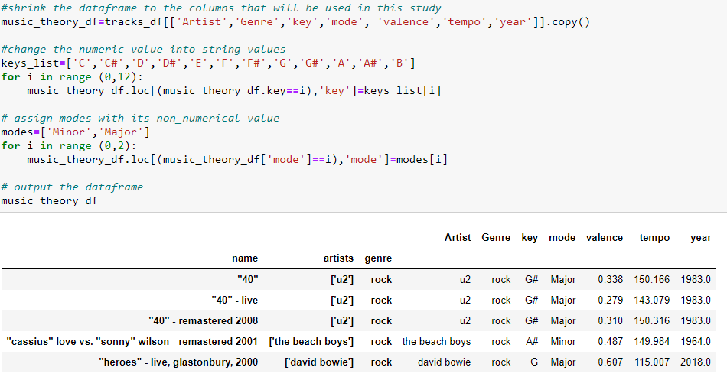
Supplement Materials (music theory - 2)

Slide 14
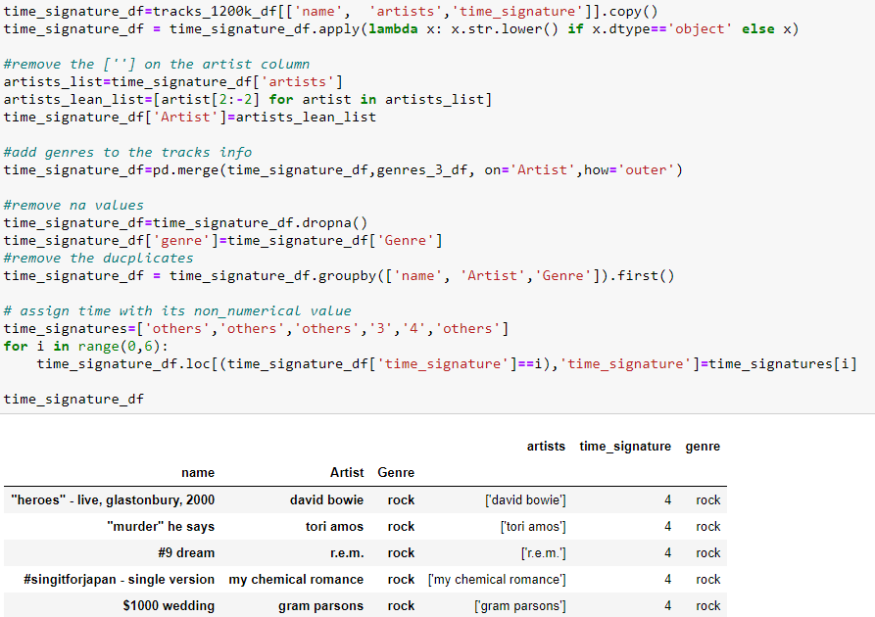
Supplement Materials (music theory - 3)

Slide 15
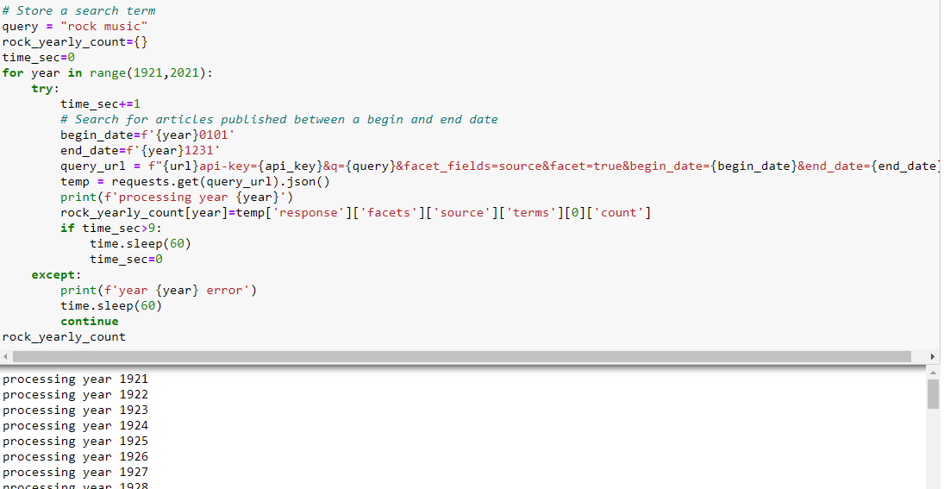
Supplement Materials (NYT API)

Slide 16
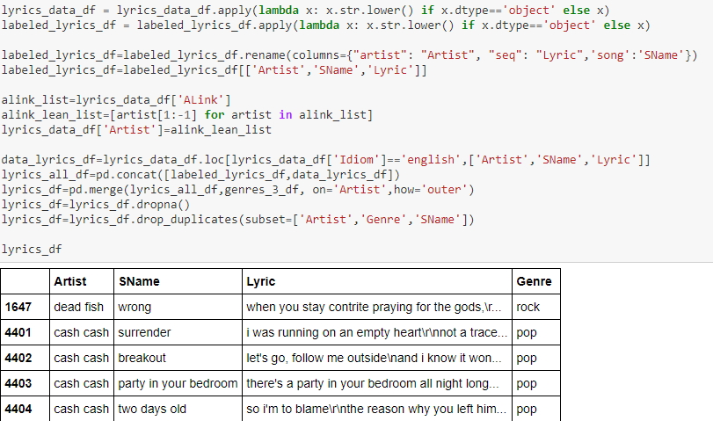
Supplement Materials (lyrics-1)

Slide 17
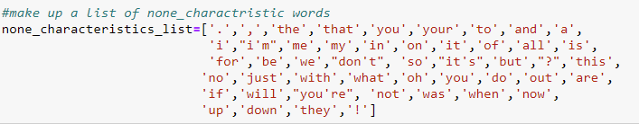
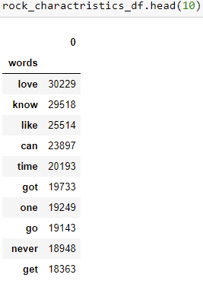
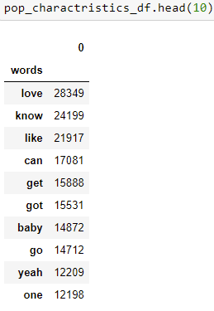
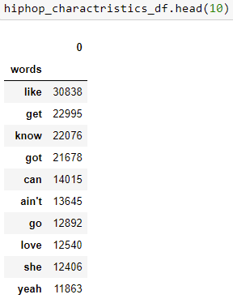
Supplement Materials (lyrics-2)

