Slide 1
Support vector machine
Zonghao Lu, Jianbo Li, Jiayi Yang

Slide 2
Background
To diagnose breast cancer through the Support Vector Machine.
By some measurements (radius, area, smoothness, etc.), tumor cells can be classified as malignant or benign.
Plotting the data points, we will get two clusters.

Slide 3
Separation margin
To find a line separating the two clusters.
Notes:
Find the line wTx + b = 0 should separate the two classes as distinctly as possible.
This occurs when the distance between the lines, the separation margin, is large as possible

Slide 4

Support vectors
= $\frac{2}{\left|ω\right|}$
The support vector machine is nothing but the mathematical rule by which new data points can be classified.
Notes:
Find the line wTx + b = 0 should separate the two classes as distinctly as possible.
This occurs when the distance between the lines, the separation margin, is large as possible

Slide 5
“outliers” →
Optimization problem:

Slide 6
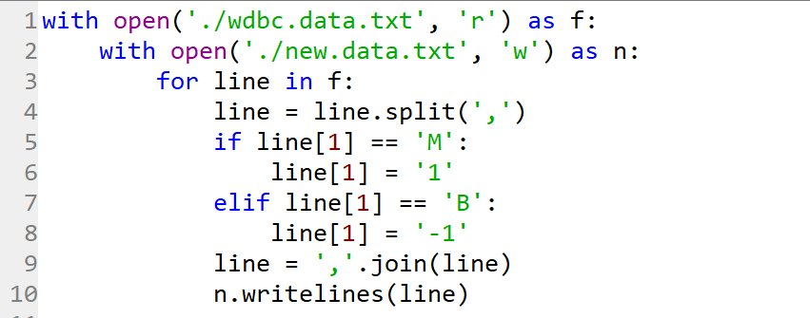
Data preprocessing
We store the raw data in txt and then use python to preprocess the data.
We replaced all M with 1 and all B with -1.

Slide 7
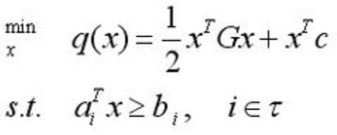

Quadratic Programming
quadprog function in Matlab:
Notes:
Max Iterations 500. H symmetric matrix in 1/2*x'*H*x. F Vector in linear term f’*x
A, b is our constrains. The empty part are the lower bounds upper bounds or initial point which
We donot have in here.

Slide 8
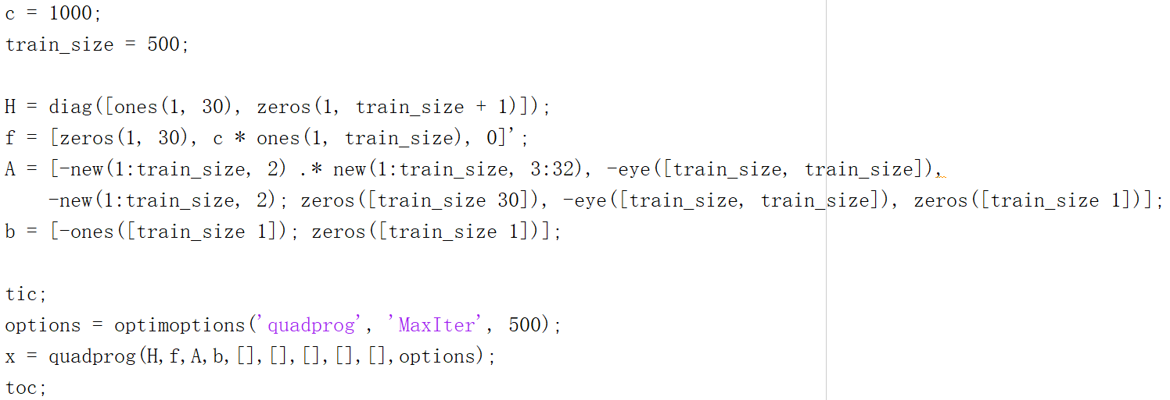
SVM Function
Notes:
Here is our function. We start at c = 1000 and the train size is 500.

Slide 9
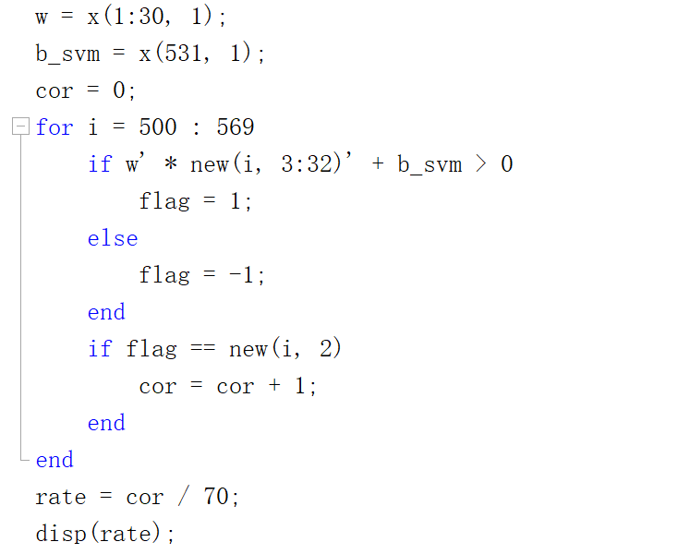
Calculate the accuracy

Slide 10
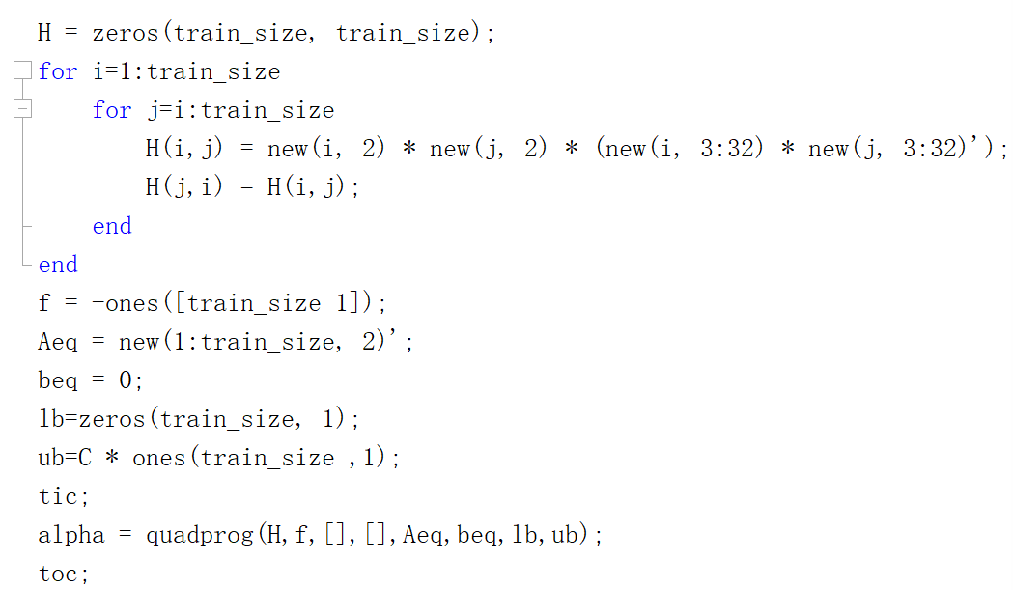
Dual Function
Notes:
As we can see, in the dual function we do not have constrains anymore. Instead of we set the upper bound and the lower bound.
So what the different between this two functions? My friend we show the conclusion.

Slide 11
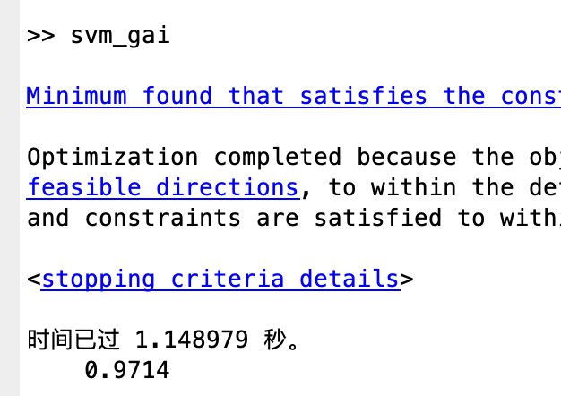
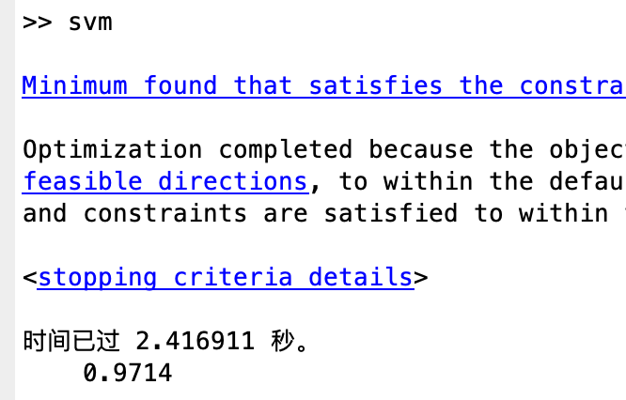
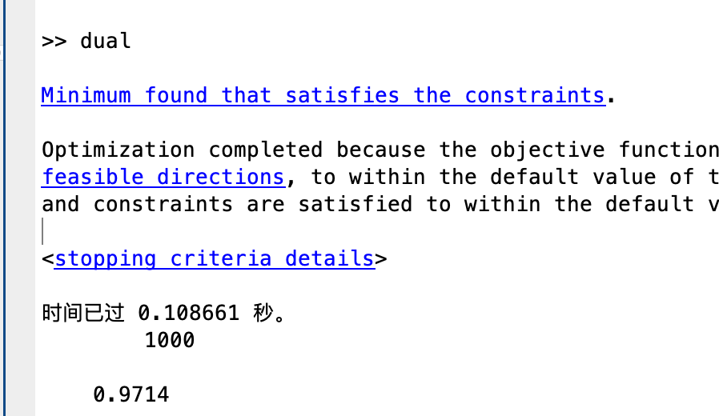
Conclusion

Slide 12
Choice of C
Try from 0.01 to 1, by step 0.01, from 1 to 2000, by step 1
C = 351 or 0.38, both can get an accuracy of 0.9875 when predict, and a lot of other C can be chosen to get this result.
The data is so good!! Even it has 30 dimensions and we can see it visually.

Slide 13
Also try use the first 400 rows of data to train and predict the last 169 rows
C = 452, accuracy = 0.9763

Slide 14
% Thank you!
% Questions?

