Slide 1
Support vector machine
Zonghao Lu, Jianbo Li, Jiayi Yang

Slide 2
Background
To diagnosticate breast cancer through the Support Vector Machine.
By some measurements (radius, area, smoothness, etc.), tumor cells can be classified as malignant or benign.
Plotting the data points, we will get two clusters.

Slide 3
Separation margin
To find a line separating the two clusters.
Notes:
Find the line wTx + b = 0 should separate the two classes as distinctly as possible.
This occurs when the distance between the lines, the separation margin, is large as possible

Slide 4

Support vectors
= $\frac{2}{\left|ω\right|}$
The support vector machine is nothing but the mathematical rule by which new data points can be classified.
Notes:
Find the line wTx + b = 0 should separate the two classes as distinctly as possible.
This occurs when the distance between the lines, the separation margin, is large as possible

Slide 5
Method

Slide 6
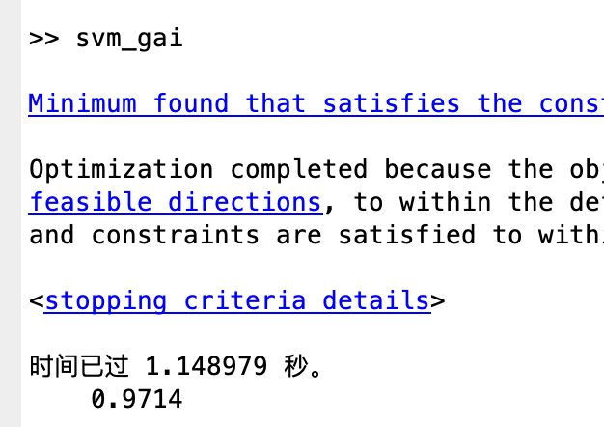
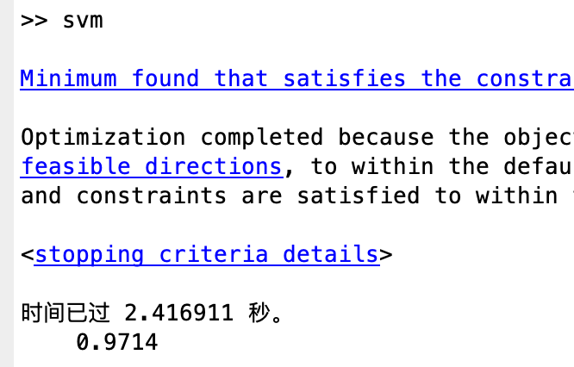
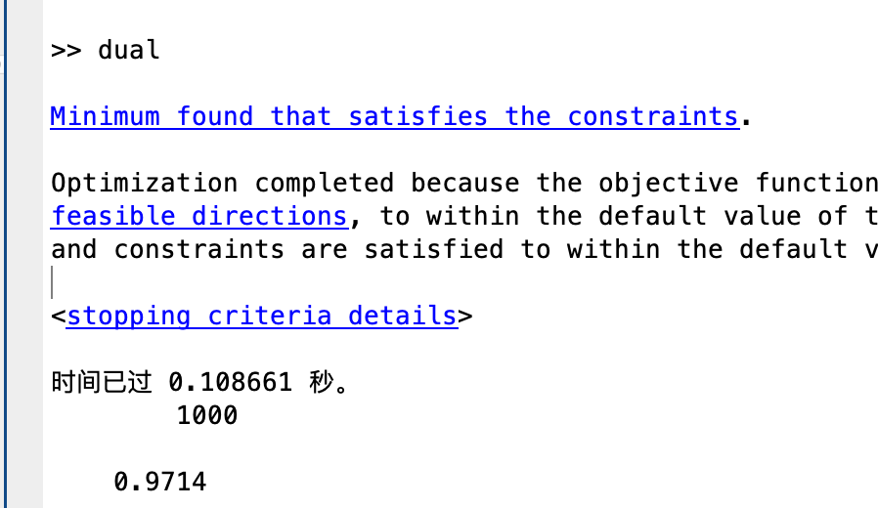
Conclusion

Slide 7
Choice of C
Try from 0.01 to 1, by step 0.01, from 1 to 2000, by step 1
C = 351 or 0.38, both can get an accuracy of 0.9875 when predict, and a lot of other C can be chosen to get this result.
The data is so good!! Even it has 30 dimensions and we can see it visually.

Slide 8
Also try use the first 400 rows of data to train and predict the last 169 rows
C = 452, accuracy = 0.9763

Slide 9
Thank you!

