Slide 1
Assignment 3: Transportation Problem
Zonghao Lu, Jianbo Li, Jiayi Yang

Slide 2
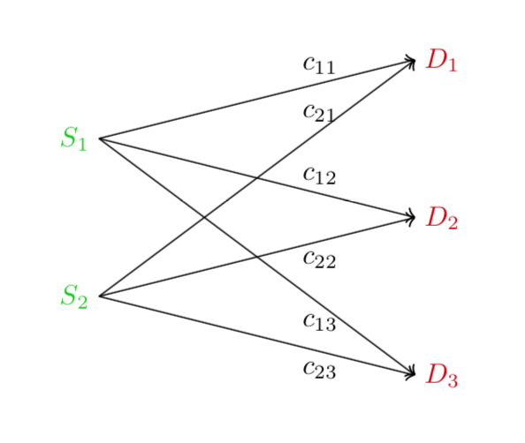
Problem Description
costs
Some destinations
Some sources

Slide 3
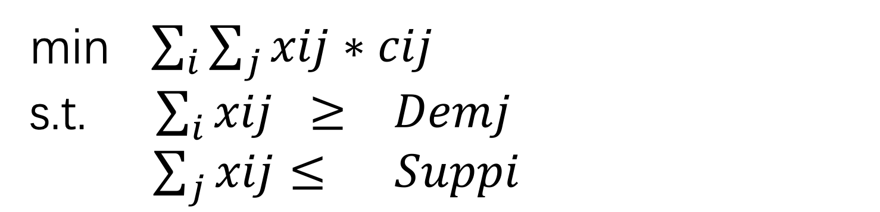
Formulation
min $\sum_{i}{\sum_{j}{xij∗cij }}$
s.t. $\sum_{i}{xij ≥ Demj}$
$\sum_{j}{xij≤ Suppi}$
xij is things transported from Si to Dj, cij is the cost from Si to Dj,
Demj is the demand of Dj, Suppi is the supply capacity of Si

Slide 6
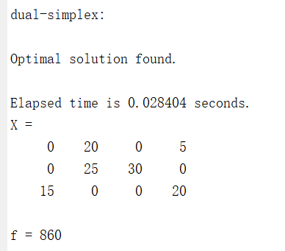
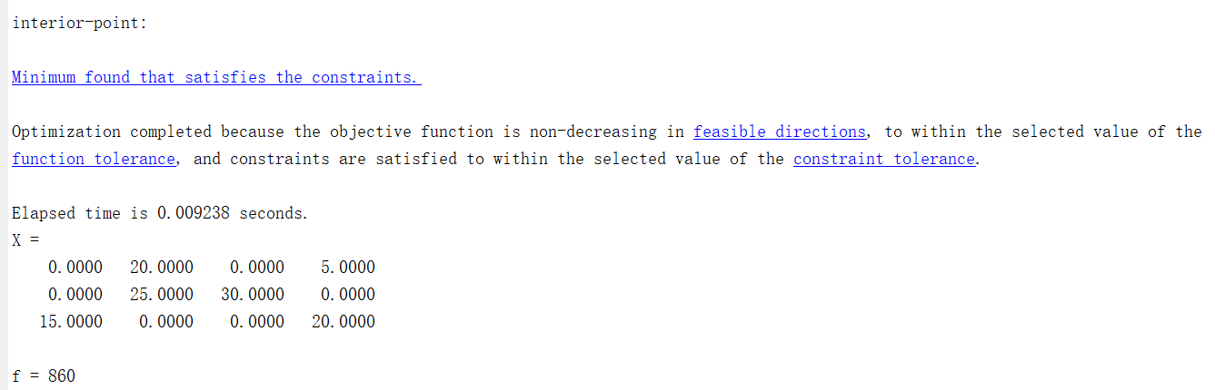

Results
When $S_{2}=55$

Slide 7
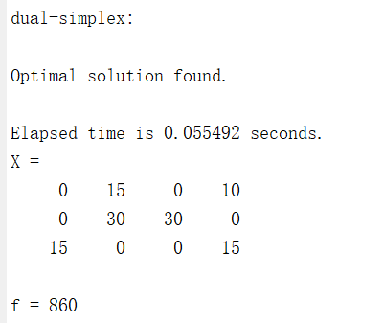
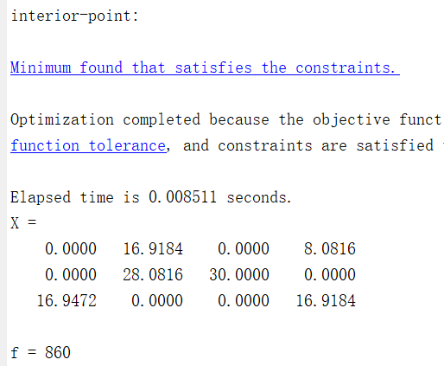

Results
When $S_{2}=60$

Slide 8
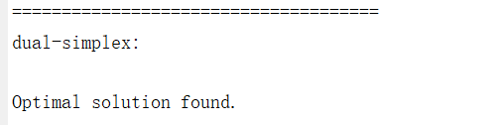
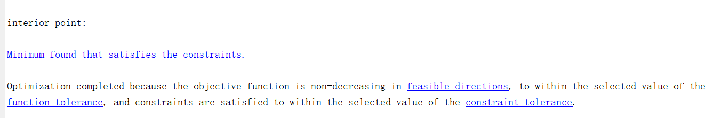
Discussion

