Slide 1
Black-box optimization
Zonghao Lu, Jiayi Yang, Jianbo Li

Slide 2
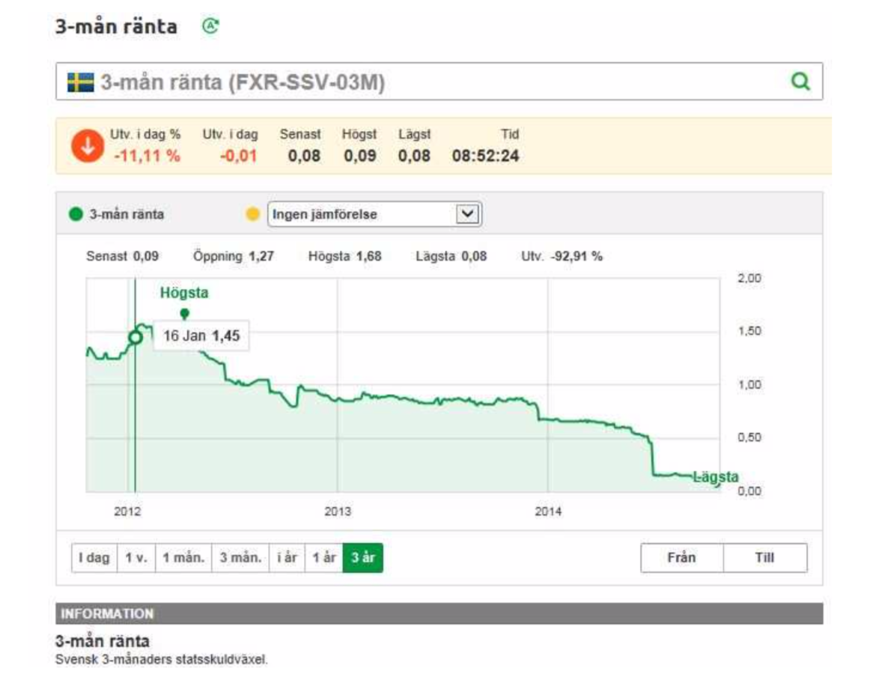
Problem description
Notes:
This problem is in the financial domain. This picture shows the variation of the treasury bill interest rate over a period of three years. This process is a stochastic process, but it has some systematic factors in the change, which I mean, the variation of interest rate actually depends on something, but we don’t know, maybe the policy or something else. So we want to build a build which can reflect the underlying variations.

Slide 3
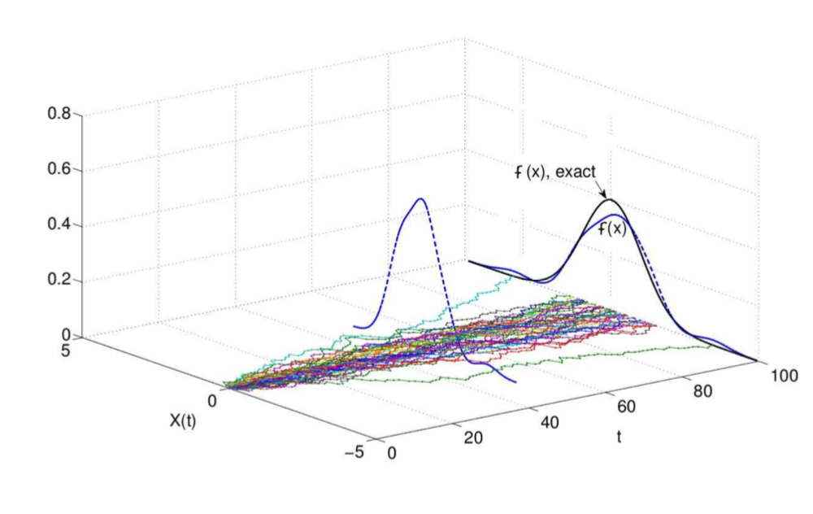

How to do
CIR model:
Notes:
So we have this CIR model. This is a stochastic differential equation, where dX is the change in the interest rate x over a short time interval dt. a, b and σ are parameters and dW is a random variable known as the Wiener process. Actually, I don’t know what is a Wiener process , but we can write another form of the equation, as you can se below. There, kesi is a standard normal distributed random variable. If we integration
this equation, we will get one realisation of the process. Then do simulation, it will cause different results because of the kesi, it is a stochastic variable, if you draw it, you will get this pic. I mean in this x-t plane. Then you can draw a possibility density function of x in each ti. Cuz this is a stochastic process, so you can not say at ti, xi must be some number, but you can say it has a possibility of balabal to be a number.

Slide 4
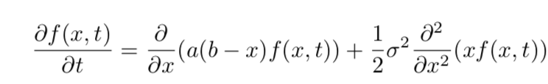
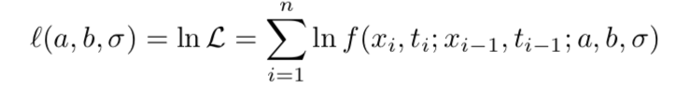

Method
FP equation:
Maximum Likelihood :
max L(a, b, $σ$)
Notes:
So what we need to do is to estimate the a b and sigma.We can write this fokker-planck equation which can directly give the function f of xi and ti. Then we use maximum likelihood
This the formula of maximum likelihood. It is summation of logrithm of the pdf. And we need to get a pair of (a,b,sigma) which can make this value the biggest.

Slide 5
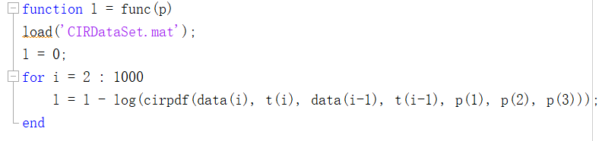
Method
Then call this function in the Optimization Tool

Slide 6
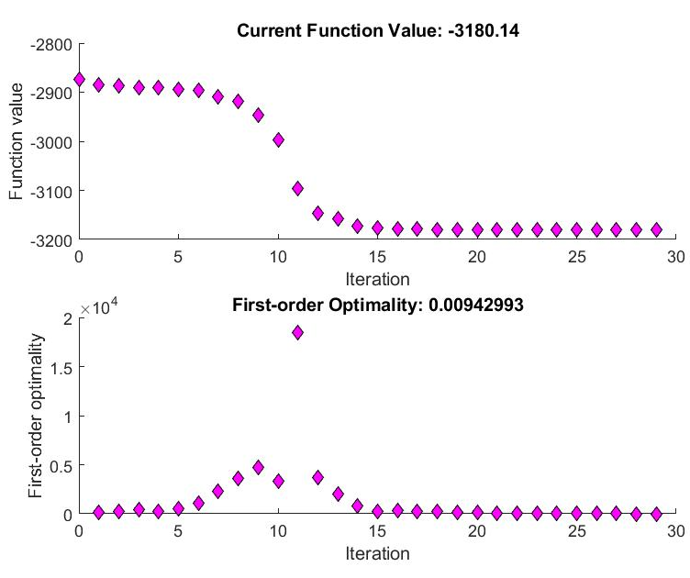
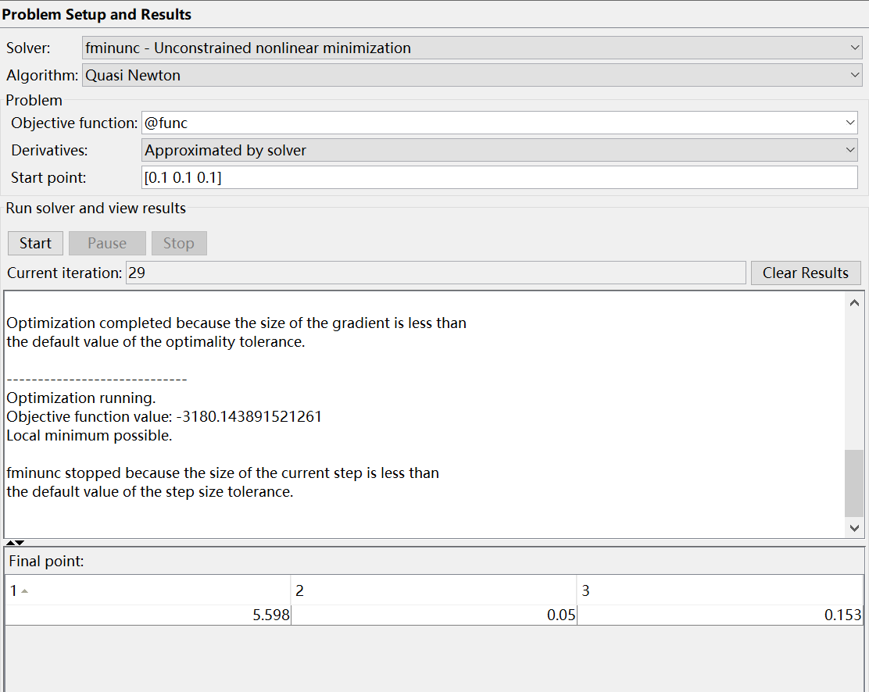
Results
Using fminunc
Starting point: [0.1 0.1 0.1]
a = 5.598
b = 0.05
σ = 0.153

Slide 7
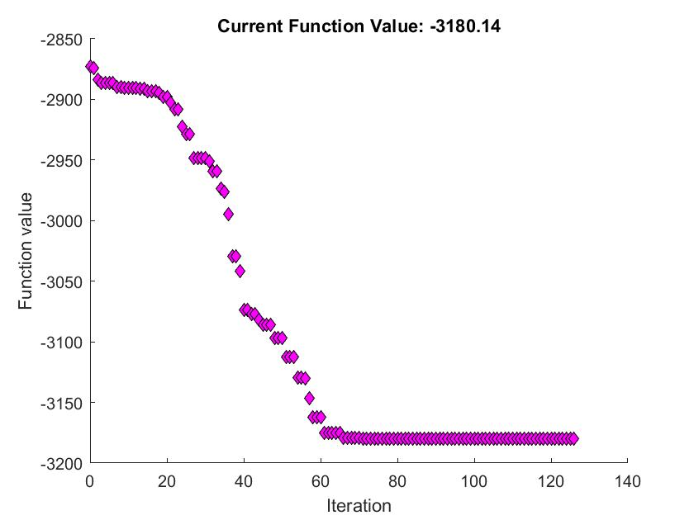
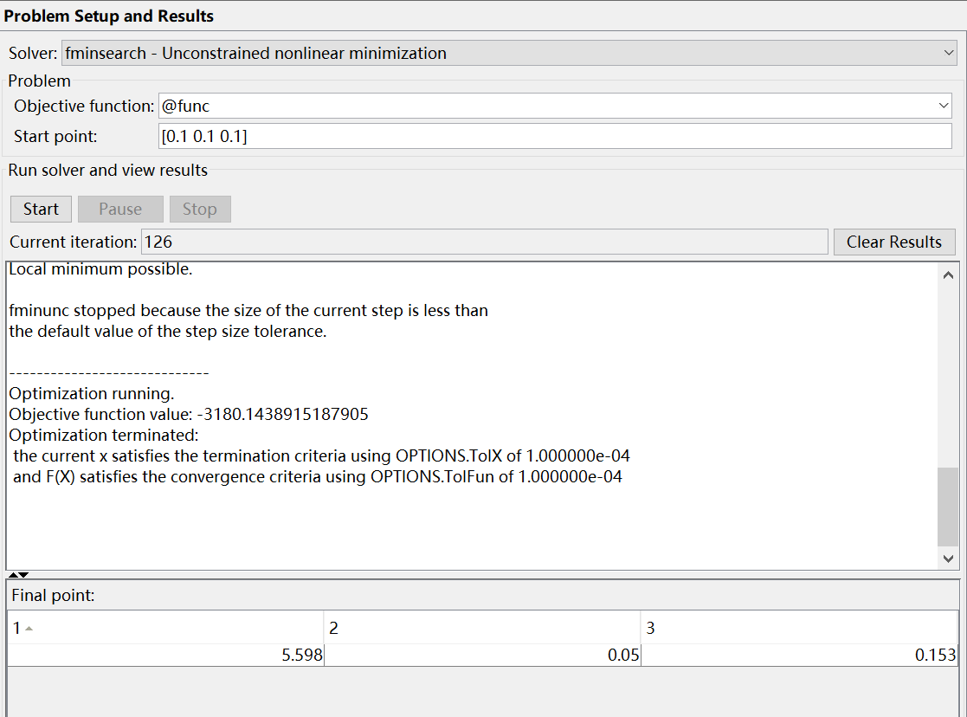
Results
Using fminsearch
Starting point: [0.1 0.1 0.1]
a = 5.598
b = 0.05
σ = 0.153

Slide 8
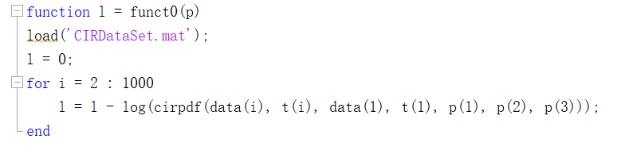
Discussion
Solving all the equations from t0

Slide 9
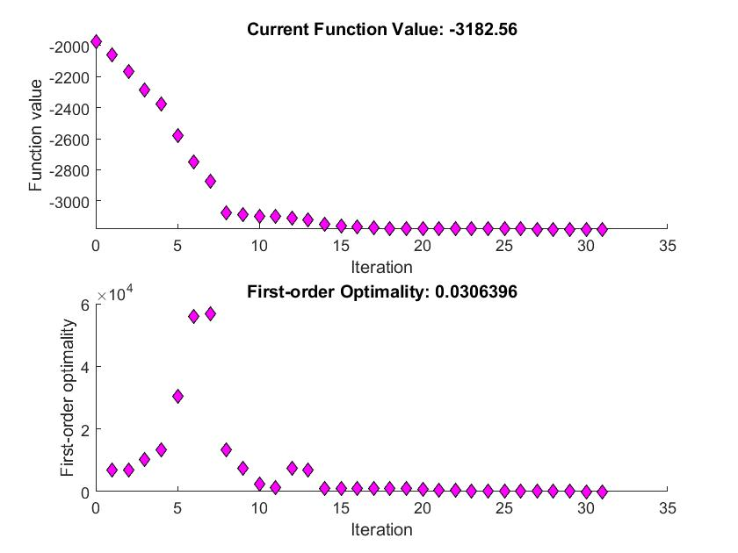
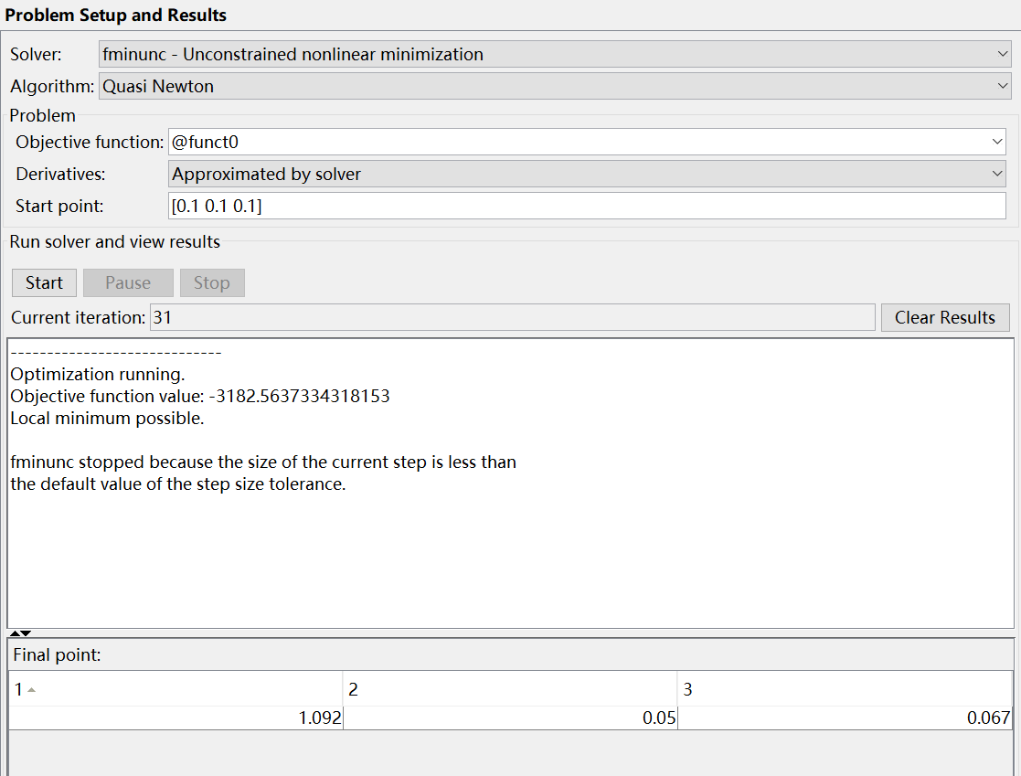
Discussion
Using fminunc
Starting point: [0.1 0.1 0.1]
a = 1.092
b = 0.05
σ = 0.067

Slide 10
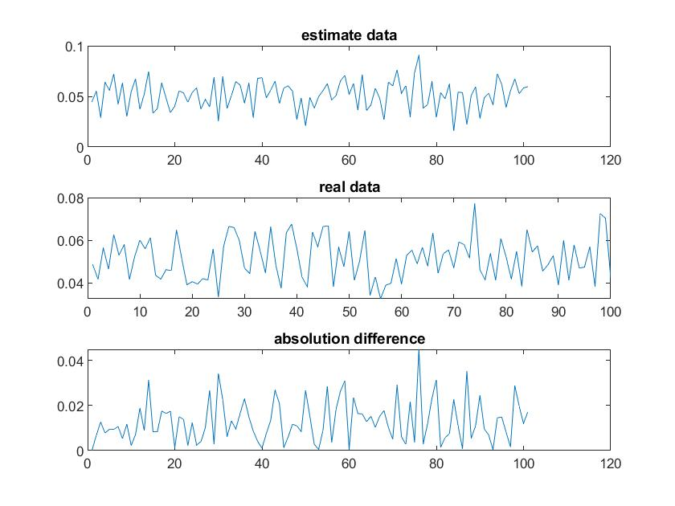
Discussion
Notes:
Yong 1-900 , dan shi yi t0 wei jichu, de dao de a b sigma
Yu ce 901 – 1000, yu zhen shi shu ju bijiao
Ruo yong yi lai ti-1 de fangfa , de chu fu li lv

