Slide 1
Feliks Ianganaev
DevOps School Diploma 22 stream
https://github.com/yanganaev/epam-diploma
© 2022 EPAM Systems, Inc.

Slide 2
Application architecture
Task
Use NHL API
Analyze last 3 seasons
Select All-Stars & Final game players
Show player info
Show final game statistics

Slide 3
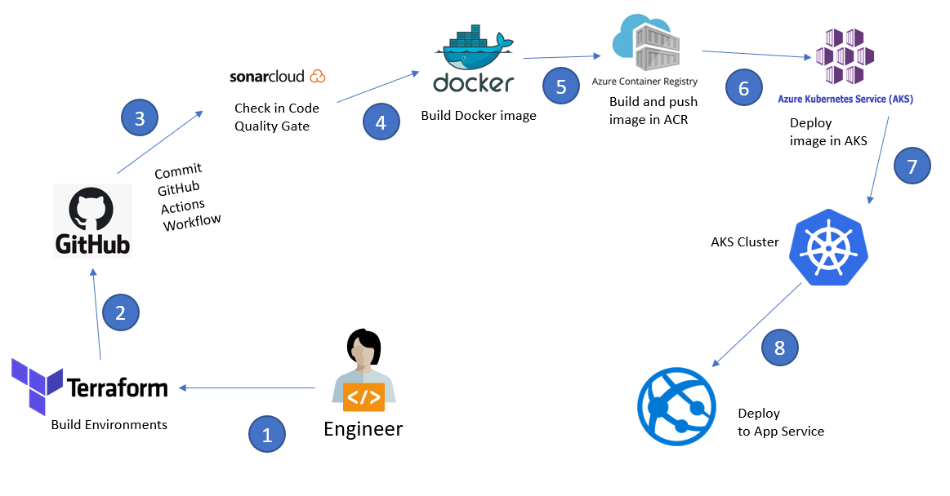
CI/CD using Terraform and Kubernetes on Azure Kubernetes Service (AKS)

Slide 4
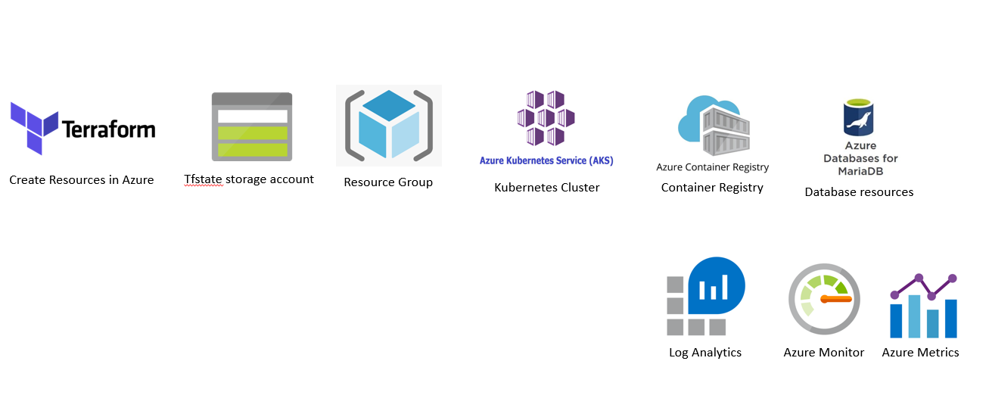
Terraform Create Environments in Azure

Slide 5
Azure Infrastructure

Slide 6
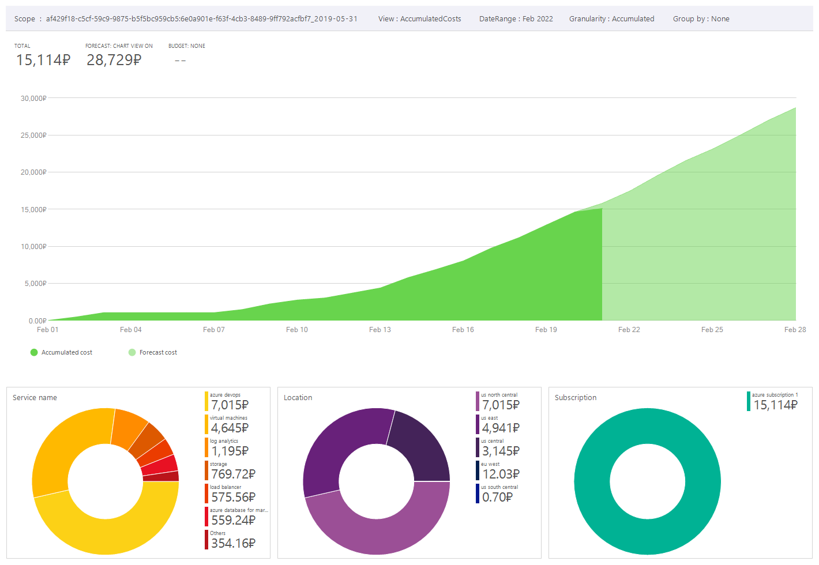
COSTS – AZURE

Slide 7
LINKS
https://github.com/yanganaev/epam-diploma- code repository
http://epam-diploma.azurewebsites.net – environment (Azure)

