Slide 1
Substrate Storage Repository
Fields in decl_storage!
↓
Storage Key
↓
ChangeTrie
↓
Trie
↓
HashDB
paritytech/substrate
paritytech/trie

Slide 2
Substrate Storage Crate
Fields in decl_storage!
↓
Storage Key
↓
ChangeTrie
↓
Trie
↓
HashDB
frame/support
primitives/state-machine
trie-db
hash-db

Slide 3
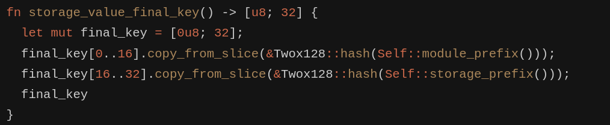
Substrate Storage
Fields in decl_storage!
↓
Storage key
Example: substrate/frame/support/src/storage/generator/value.rs

Slide 4

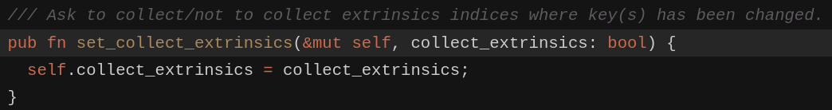
Substrate Storage
ChangeTrie
There are two fn generate change trie, fn call and fn contextual_call
In client/service/src/client/call_executor.rs
Overlay change should be enabled, such that change trie will work
In state-machine/src/overlayed_changes/mod.rs
There is an api to set_collect_extrinsics but currently I am not total know how to enable the chaine tire for save the change trie

Slide 5
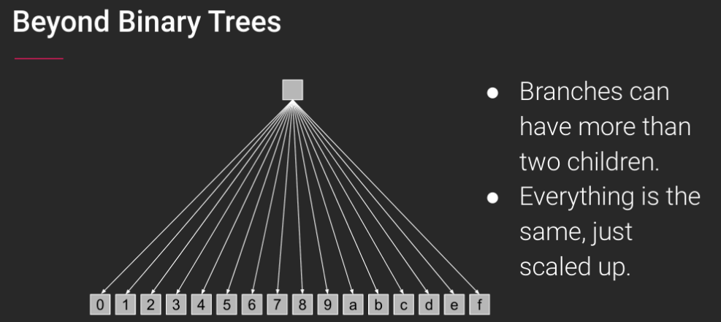
Substrate Storage
Trie
↓
HashDB
Each block has own state root hash
Example: 0x26…
Generally every char in a position is a trie node
For example,
1st char 2 node
2nd char 6 node

Slide 6
Substrate Storage
Trie
↓
HashDB
Partial - compression of
3rd char 1 node
4th char 2 node
5th char 3 node
… ...
10th char 8 node
Example: 0x2612345678ab
Example: 0x2612345678ab
Example: 0x2612345678ac...
Childern – has two childern
Example: 0x2612345678ab
Example: 0x2612345678ab12..
Value
– can be end and has value

Slide 7
Substrate Storage
Trie
↓
HashDB
Trie Nodes
- Leaf
- Value
- Branch
- Value + Childern
- NibbledBranch
- Value + Partial + Childern
- Extension
- Value + Partial
- Empty

Slide 8
Substrate Storage
Trie
↓
HashDB
A Key, Value DB, can be RocksDB, Memory DB, SubDB ….
Value = encode(Trie Nodes)
Key = Hash(Value)

Slide 9
Substrate Storage
Fields in decl_storage!
↓
Storage Key
↓
ChangeTrie
↓
Trie
↓
HashDB
Know changing extrinsics
Know changing storage item
Know changing hash item

Slide 10
Substrate Storage
Fields in decl_storage!
↓
Storage Key
↓
ChangeTrie
↓
Trie
↓
HashDB
Know changing extrinsics
Know changing storage item
By Hash Table to know the changing extrinsics
SSI
Know changing hash item

Slide 11
Substrate Storage
Fields in decl_storage!
↓
Storage Key
↓
ChangeTrie
↓
Trie
↓
HashDB
Know changing extrinsics
Change Trie Solution
Know changing storage item
Directly know chainges in extrinsics
Know changing hash item

Slide 12
Substrate Storage
ChangeTrie Solution
- Make sure change trie is enabled
- Check there are storage -> changinge extrinsics map
- Expose change trie

