Slide 1
Research Introduction
Bin Yang

Slide 2
Contents
Previous Research
Bandit Algorithms
User Preference Analysis
Bayesian Optimization
Dynamic Bandit Algorithm
Future Research
Bandit for Long Tail & Cold-Start

Slide 3



Bandit Algorithms
A/B Test
Trying A, B and C with the same traffic in a fixed period, and selecting the one with the best performance. Each one consumes a certain number of traffic.
Bandit algorithm
Trying A, B and C with the same traffic in the beginning, analyzing the feedback and adjusting the traffic for each one in real time. As a result, the best one can be selected very rapidly.
C wins!
C wins!
100%
0%
100%
0%
A
A
B
Traffic(Trials#)
B
Traffic(Trials#)
C
C
Time
Time

Slide 4
Bandit Mechanisms
Exploration vs. Exploitation(UCB)
Posterior estimation
UCB = μ + ασ
Select the arm with the biggest UCB.
Exploitation
Bigger μ is easier to be selected.
Exploration
Bigger σ is easier to be selected.
Exploration vs. Exploitation(TS)
Posterior estimation
Distribution (μ, σ)
Draw a sample from the distribution.
Select the arm with the biggest sample.
Exploitation
Bigger μ is easier to be selected.
Exploration
Bigger σ is easier to be selected.
Data is insufficient -> need for some trials!
A
Data is sufficient,
but not good ->
no need for trials!
B
Data is sufficient,
and very good ->
need for many trials!
C
Upper Confidence Bound
Data is insufficient -> need for some trials!
A
Data is sufficient,
but not good ->
no need for trials!
B
Probability
Data is sufficient,
and very good ->
need for many trials!
C
Thompson Sampling

Slide 5
Motivation: Recommendation (Show & Click)
Traditional Recommendation
Input
Purchase/browsing history data
Assumption
User buy items from all items.
Problem
Shown items are easy to be bought.
Recommendation with Shown Items
Input
Shown item list
Clicked item list
Assumption
User buy items from shown items.

Slide 6
Multi-Contents Mixture Model
LDA
Document-word model
Recommendation
Document => User
Word => Item
Multi-Contents Mixture Model
Document-(word 1, …, word n)
Recommendation
Document => User
Word 1 => Item
Word 2 => Ad
……
Scenario 1: User with different types of contents
Scenario 2: User with each item (Each item is one distribution φ)
User
α
θ
Ｚ
Ｘ
φ
β
Item
LDA (Latent Dirichlet Allocation)
Ｚ
Ｘ
φ
β
Item
User
α
θ
Ｚ
Ｘ
φ
β
Ad
Multi-Contents Mixture Model

Slide 7
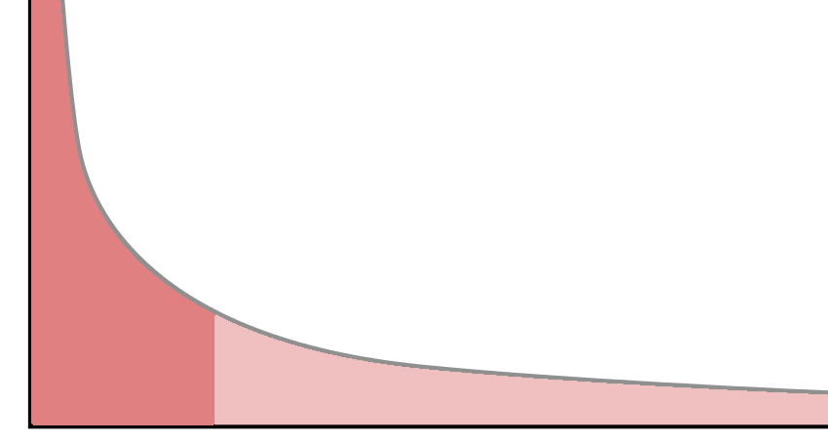
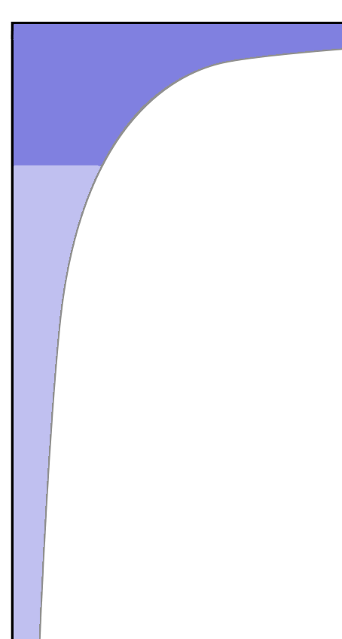
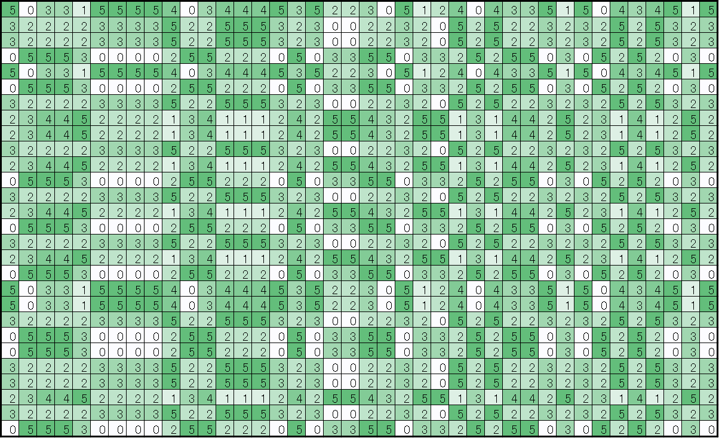
Bandit for Long Tail & Cold-Start
Situation: Both users and items are long tail data!
Long tail (User)
User
Item
Long tail (Item)
Long Tail
Problem
Long Tail
Problem
Heavy
Light
New
Light
Heavy
New
Incomplete
Data!
Cold-Start Problem
Cold-Start Problem
？
？

Slide 8
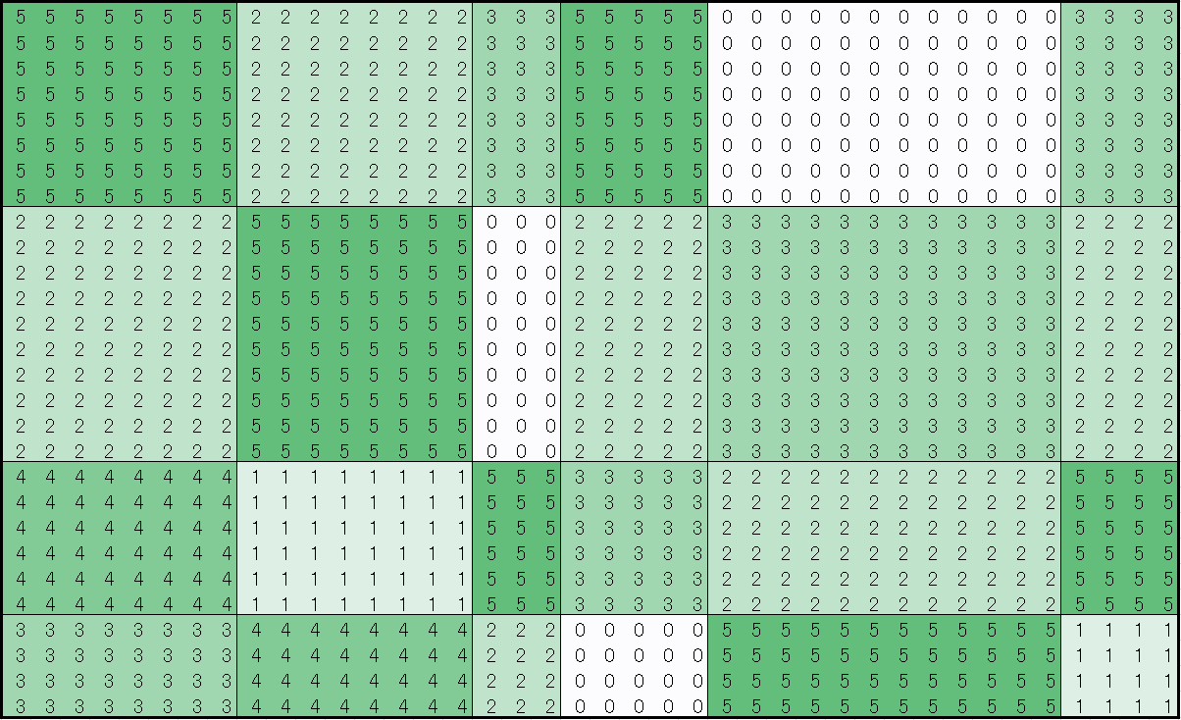
Task for Long Tail & Cold-Start
Tasks
How to analyze the long tail (incomplete & biased) data?
What items should be recommended to a light/new user?
(Which user class should this user belong to?)
Whom should a light/new item be recommended to?
(Which item class should this item belong to?)
Potential Applications
Recommender system
Advertisement
Promotion optimization
Etc.
A light item
Which item class?
Which user class?
A light user

Slide 9
Difficulties
Bandit can only deal with small number of arms.
The number of trials is NOT enough
Idea: applying complex model to reduce the necessary number of trials
Long tail & cold-start user problem
Less user records / No user record
Idea: Thompson sampling
Long tail & cold-start item problem
Less item records / No item record
Idea: Thompson sampling

Slide 10


Framework: Bandit for Long Tail & Cold-Start
Solution: Combining bandit mechanism with complex models.
Data is insufficient,
Accuracy is low.
Data is sufficient,
Accuracy is high.
+
Exploration > Exploitation
Exploration < Exploitation
Action
Model
Bandit Mechanism
RL
(Reinforcement
Learning)
AI
Environment
A
Ｚ
Ｘ
φ
β
B
C
α
θ
Ｚ
Ｘ
φ
β
Ｚ
Ｘ
φ
β
Trial
Complex Models
Reward

Slide 11
Multi-Contents Mixture Model
Multi-contents mixture model for each item
θ ~ Dir(α)
z ~ Multi(θ)
φ ~ Beta(β)
x ~ Bernoulli(φ)
Each topic is a set of CTRs.
Each φ is the CTR of one item.
Ｚ
Ｘ
φ
β
Item 1
User
α
θ
Ｚ
Ｘ
φ
β
Item 2
Ｚ
Ｘ
φ
β
Item 3
Multi-Contents Mixture Model
1-φ
1-φ
1-φ
1-φ
1-φ
φ
1-φ
φ
φ
φ
φ
φ
……
Item 1
Item 2
Item 3
Item 1
Item 2
Item 3
Topic 1
Topic 2

Slide 12
Bandit Mechanism in Mixture Model
Light/new user
Topic distribution (Posterior)
Thompson sampling
Light/new item
Heavy item
Large amount of records
Small variance
High certainty
High expectation => More traffic!
Low expectation => Low traffic!
Light/new item
Small amount of records
Large variance
Low certainty
More traffic!
Gibbs-Thompson Sampling
Using Gibbs sampling result directly as Thompson sampling
Heavy User
Light User
Data is insufficient -> need for some trials!
A
Data is sufficient,
but not good ->
no need for trials!
B
Data is sufficient,
and very good ->
need for many trials!
C

Slide 13
Simulation: Bandit for Long Tail & Cold-Start
Result (Simulation): Lifting up the light and new users/items!
Merits
Lifting up the Long Tail data
Solving Cold-Start problem
Improving both users and items
Simulation Result：
Improvement：５～１０％
Simulate Web
Browsing Data
Complex Models
+
Bandit Mechanism
Ad1
Ad2
Action
Ad3
Ad4
RL
(Reinforcement
Learning)
AI
Simulator
A
Ｚ
Ｘ
φ
β
B
C
α
θ
Ｚ
Ｘ
φ
β
Ｚ
Ｘ
φ
β
Trial
Reward
Simulation

