Slide 1
Research Introduction
Bin Yang

Slide 2
Contents
Previous Research
Bandit Algorithms
User Preference Analysis
Future Research
Bandit for Long Tail & Cold-Start

Slide 3



Previous 1: Bandit Algorithms
A/B Test
Trying A, B and C with the same traffic in a fixed period, and selecting the one with the best feedback. Each one consumes a certain number of traffic.
Bandit algorithm
Trying A, B and C with the same traffic in the beginning, selecting the feedback and adjusting the traffic for each one in real time. As a result, the best one is selected very rapidly.
C wins!
C wins!
100%
0%
100%
0%
A
A
B
C
Traffic(Trials#)
B
Traffic(Trials#)
C
Time
Time

Slide 4
Previous 1: Bandit Algorithms
Main Contributions
Proposal of Mini-Batch Thompson sampling
Very easy to integrate to a system
Perfect performance
Extremely short computational time
Implementation of library
Business proposal
Applications
Bandit algorithm platform for A/B test
Event page optimization (2-3% improvement in CVR)
Advertisement optimization (3-5% improvement in CTR)
Web page optimization (3% improvement in CTR)
Coupon distribution strategy optimization (5% improvement in reservation rate)

Slide 5
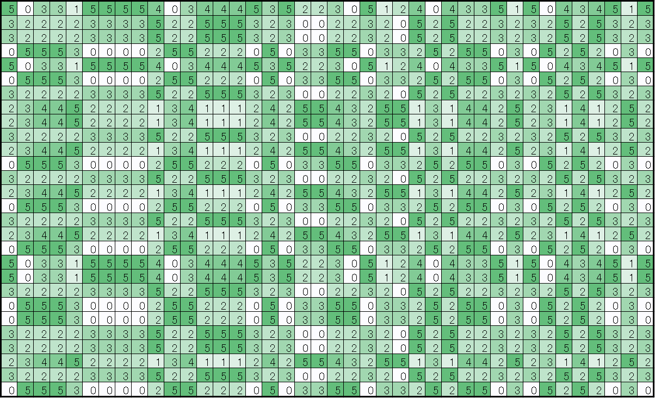
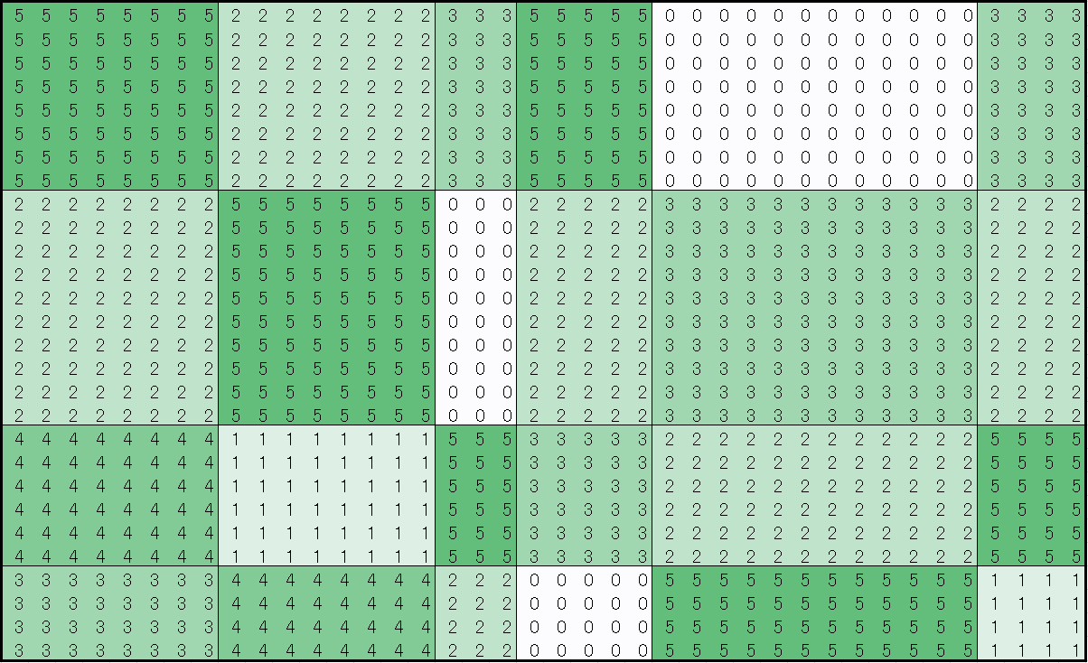
Previous 2: User Preference Analysis
Mixture models (LDA and its variants)
Gibbs sampling proposal
User preferences and item attributes extraction
Feature of user preference analysis platform
LDA with purchase history
W2V with browsing history
α
β
φ
θ
Ｚ
Ｘ
LDA
Item
Item
Big
Big
User
KPI
User
KPI
Small
Small
Pattern Extraction

Slide 6
Previous 2: User Preference Analysis
Main Contributions
Proposed the model and its inference algorithm based on Gibbs sampling
Implemented the algorithm in an efficient multi-thread manner
Business proposal
Applications
User fashion style extraction and prediction
Shop recommender system
Potential customer extraction

Slide 7
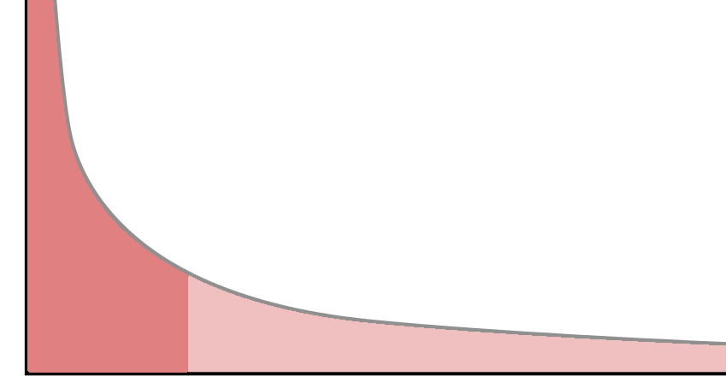
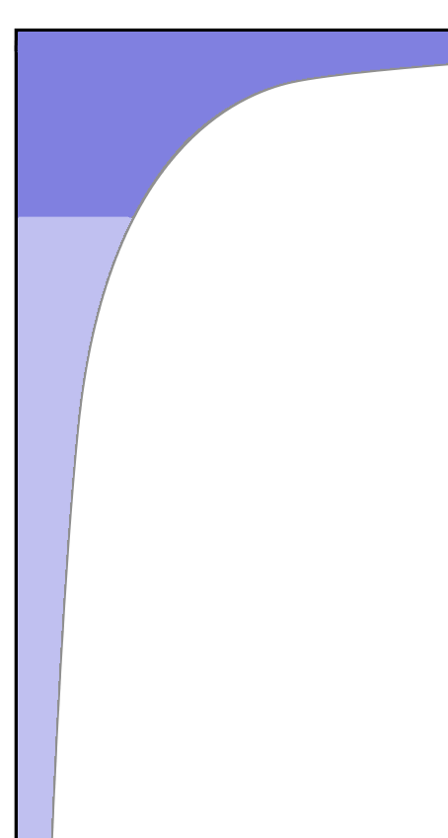
Future: Bandit for Long Tail & Cold-Start
Situation: Matching users with the items for long tail is difficult!
Long tail (User)
User
Item
Long tail (Item)
Long Tail
Problem
Long Tail
Problem
Heavy
Light
New
Light
Heavy
New
Incomplete
Data!
Cold-Start Problem
Cold-Start Problem
？
？

Slide 8
Future: Bandit for Long Tail & Cold-Start
Task
How to analyze the long tail (incomplete & biased) data?
What items should be recommended to a light/new user?
Whom should a light/new item be recommended to?
Potential Applications
Recommender system
Advertisement
Promotion optimization
Etc.

Slide 9


Future: Bandit for Long Tail & Cold-Start
Solution: Combining bandit mechanism with complex models.
Big
Exploration < Exploitation
Exploration > Exploitation
Model
KPI
Small
Solution
Probabilistic Model
+
RL(Bandit)
RL
(Reinforcement
Learning)
AI
Environment
A
α
β
φ
B
C
θ
Ｚ
Ｘ
Modeling
Trial
Feedback

Slide 10
Future: Bandit for Long Tail & Cold-Start
Result: Lifting up the light and new users/items!
Simulation Result：
Improvement：５～１０％
Solution
Probabilistic Model
+
RL(Bandit)
RL
(Reinforcement
Learning)
AI
Simulator
A
α
β
φ
B
C
θ
Ｚ
Ｘ
Modeling
Trial
Feedback
Merits
Lifting up the Long Tail data
Dealing with Cold-Start problem
Improving both users and items
Ad1
Ad2
Simulate Web
Browsing Data
Ad3
Ad4

