Slide 1
Research Introduction
Bin Yang

Slide 2
Contents
Previous Research
Bandit Algorithms
User Preference Analysis
Future Research
Bandit for Long Tail & Cold-Start

Slide 3



Previous 1: Bandit Algorithms
A/B Test
Trying A, B and C with the same traffic in a fixed period, and selecting the one with the best performance. Each one consumes a certain number of traffic.
Bandit algorithm
Trying A, B and C with the same traffic in the beginning, analyzing the feedback and adjusting the traffic for each one in real time. As a result, the best one can be selected very rapidly.
C wins!
C wins!
100%
0%
100%
0%
A
A
B
Traffic(Trials#)
B
Traffic(Trials#)
C
C
Time
Time

Slide 4
Previous 1: Bandit Algorithms
Main Contributions
Mini-Batch Thompson sampling
Very easy to integrate into the system
Perfect performance
Extremely short computational time
Bandit with personalization
Implementation of the algorithm
Business proposal
Applications
Bandit algorithm platform for A/B test
Advertisement optimization (3-5% improvement in CTR)
Event page optimization (2-3% improvement in CVR)
Web magazine optimization (3% improvement in CTR)
Coupon distribution strategy optimization (3% improvement in reservation)
Data is insufficient -> need for some trials!
A
Data is sufficient,
but not good ->
no need for trials!
B
Traffic
Data is sufficient,
and very good ->
need for many trials!
C
Mini-Batch Thompson Sampling

Slide 5
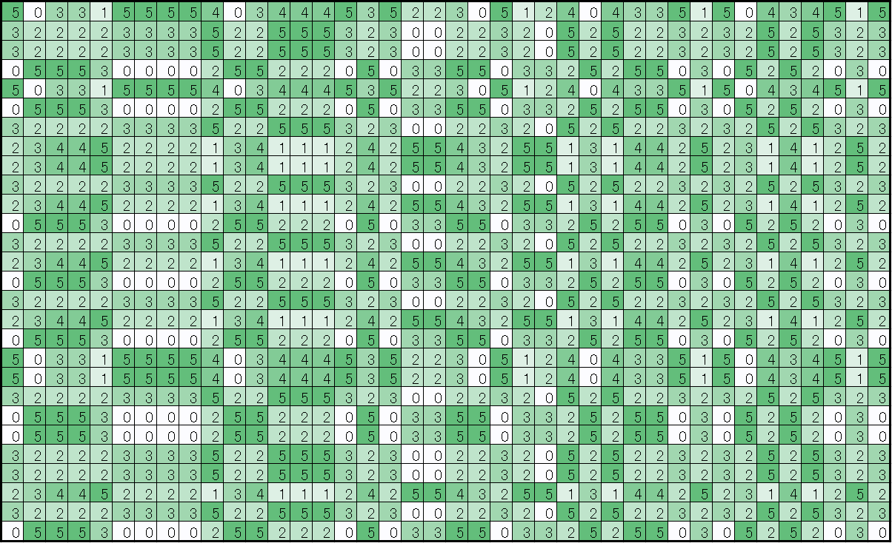
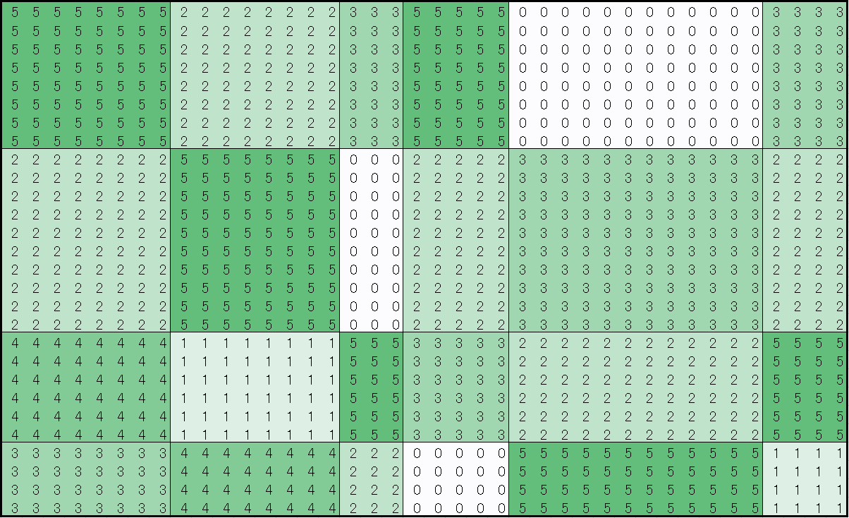
Previous 2: User Preference Analysis
Mixture models (LDA and its variants)
Multi-Contents Mixture Model
Gibbs sampling inference
User preferences extraction
Item attributes extraction
Feature of user preference analysis platform
LDA with purchase history
W2V with browsing history
α
β
φ
θ
Ｚ
Ｘ
LDA
(Latent Dirichlet Allocation)
Item
Item
Big
Big
User
KPI
User
KPI
Small
Small
Pattern Extraction

Slide 6
Previous 2: User Preference Analysis
Main Contributions
Implementation of LDA
Multi-thread Gibbs sampling
Very efficient!
Multi-Contents Mixture Model
Proposal of the model
Gibbs sampling inference method
Implementation of the algorithm
Integrated into the System
Business proposal
Applications
User fashion style extraction and prediction (4% improvement in CVR)
Shop recommender system (3% improvement in CVR)
Potential customer extraction
Being used as basic feature of personalization
User
α
θ
Ｚ
Ｘ
φ
β
Item
LDA (Latent Dirichlet Allocation)
Ｚ
Ｘ
φ
β
Item
User
α
θ
Ｚ
Ｘ
φ
β
Ad
Multi-Contents Mixture Model

Slide 7
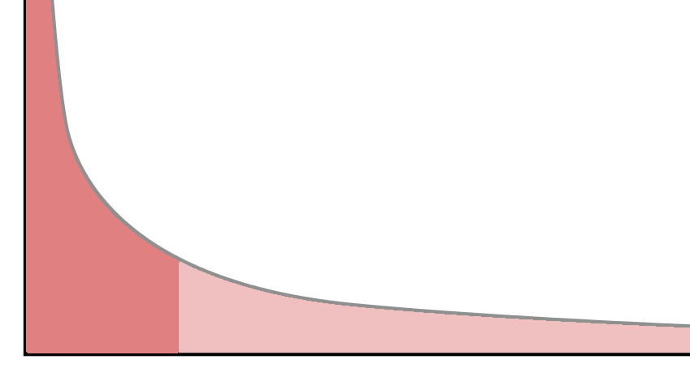
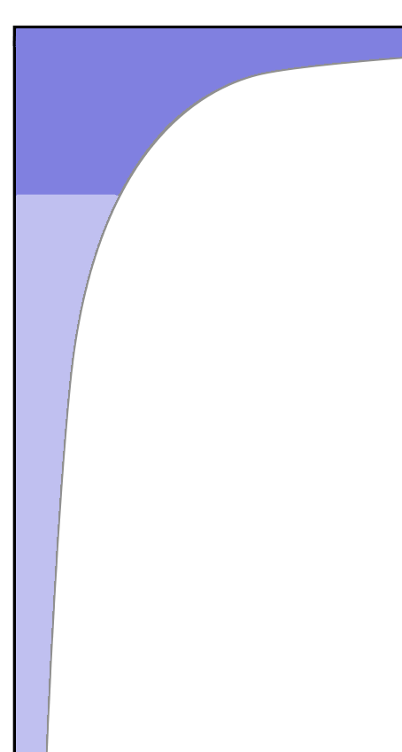
Future: Bandit for Long Tail & Cold-Start
Situation: Both users and items are long tail data!
Long tail (User)
User
Item
Long tail (Item)
Long Tail
Problem
Long Tail
Problem
Heavy
Light
New
Light
Heavy
New
Incomplete
Data!
Cold-Start Problem
Cold-Start Problem
？
？

Slide 8
Future: Bandit for Long Tail & Cold-Start
Tasks
How to analyze the long tail (incomplete & biased) data?
What items should be recommended to a light/new user?
(Which user class should this user belong to?)
Whom should a light/new item be recommended to?
(Which item class should this item belong to?)
Potential Applications
Recommender system
Advertisement
Promotion optimization
Etc.
A light item
Which item class?
Which user class?
A light user

Slide 9


Future: Bandit for Long Tail & Cold-Start
Solution: Combining bandit mechanism with complex models.
Data is insufficient,
Accuracy is low.
Data is sufficient,
Accuracy is high.
+
Exploration > Exploitation
Exploration < Exploitation
Action
Model
Bandit Mechanism
RL
(Reinforcement
Learning)
AI
Environment
A
Ｚ
Ｘ
φ
β
B
C
α
θ
Ｚ
Ｘ
φ
β
Ｚ
Ｘ
φ
β
Trial
Complex Models
Reward

Slide 10
Future: Bandit for Long Tail & Cold-Start
Result (Simulation): Lifting up the light and new users/items!
Merits
Lifting up the Long Tail data
Solving Cold-Start problem
Improving both users and items
Simulation Result：
Improvement：５～１０％
Simulate Web
Browsing Data
Complex Models
+
Bandit Mechanism
Ad1
Ad2
Action
Ad3
Ad4
RL
(Reinforcement
Learning)
AI
Simulator
A
Ｚ
Ｘ
φ
β
B
C
α
θ
Ｚ
Ｘ
φ
β
Ｚ
Ｘ
φ
β
Trial
Reward
Simulation

