Slide 1
FLEX + AIR + Mobile
https://github .com/yangboz/tripping-batman

Slide 2
Agenda
Overview.
Architecture.
Developer.
Tester.
Deployment.

Slide 3




Overview
Flash(Sprite/Button/Movie Clip /Graphic/Text Field).
AS3(JavaScript, Java).
FLEX MXML.
AIR(air runtime).
ANE/LLVM.
Notes:
http://www.adobe.com/devnet/flex.html
http://feathersui.com/

Slide 4
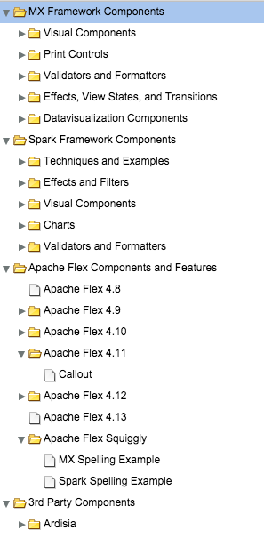
Architecture
MX Components.
Spark Components.
Apache Flex Components.
3rd Party Components.
Mobile Components.
Notes:
http://www.adobe.com/devnet/flex/architecture.html

Slide 5
Developer
Integration
Business Logic
Presentation
Documentation

Slide 6
Developer
Integration
Business Logic
Presentation
Documentation

Slide 7
Developer
Integration
Business Logic
Presentation
Documentation
Notes:
http://www.adobe.com/devnet/flex/articles/mobile-skinning-part1.html
http://www.adobe.com/devnet/flex/articles/dynamic_skin_parts.html
http://tv.adobe.com/watch/adc-presents/dynamically-adapt-the-layout-of-tablet-and-mobile-apps/
http://blogs.adobe.com/jasonsj/2011/06/ios-theme-for-flex-mobile-projects-proof-of-concept.html

Slide 8
Documentation
AS3 help reference
FLEX help reference
AIR/Mobile help reference
Bitmap/Bitmap Data graphic reference
Notes:
http://help.adobe.com/en_US/FlashPlatform/reference/actionscript/3/
http://www.adobe.com/devnet/flex/documentation.html
http://www.endmemo.com/sconvert/dpippi.php

Slide 9

Work shop

Slide 10

Q&A
THANK YOU!
Email: youngwelle@gmail.com

