Slide 1
Mobile Edge Computing (MEC) Network Control: Tradeoff Between Delay and Cost
(GlobeCom 2020)
Yang Cai, Jaime Llorca, Antonia M. Tulino, Andreas F. Molisch
University of Southern California
New York University

Slide 2
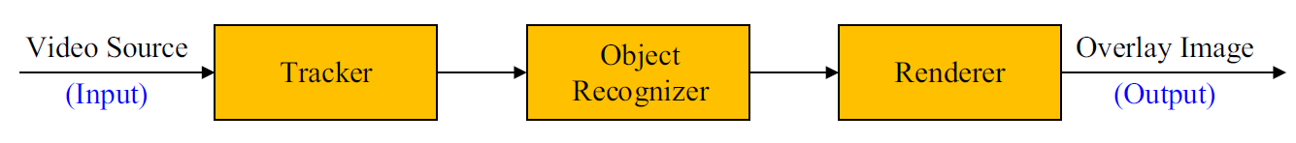
Background
Augmented Information (AgI) Services
Communication + Computation
The example of augmented reality
Not suitable to complete the computation tasks at user equipment (UE)
Why: restricted computation capability + limited power
How: offload the tasks to cloud networks

Slide 3
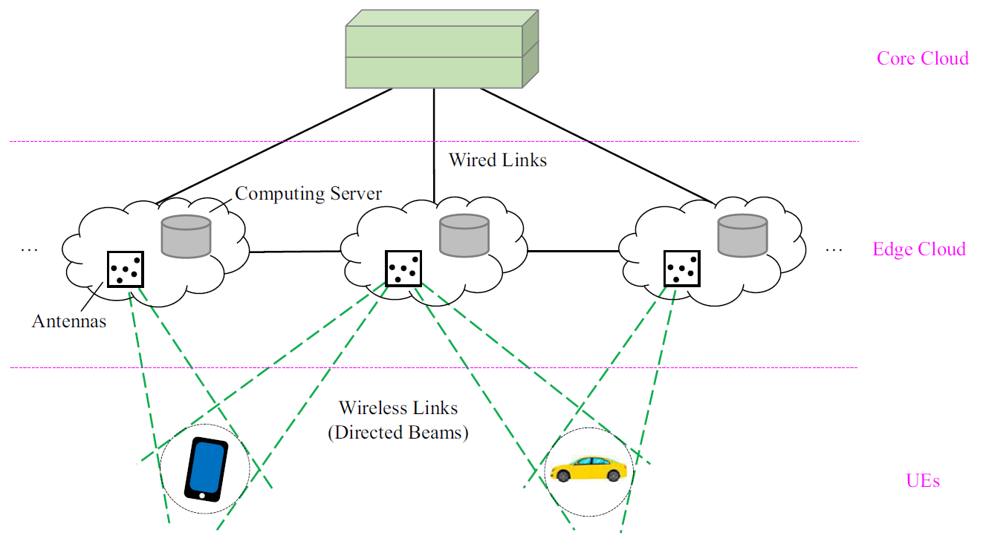
Background
Mobile Edge Computing network
Computation resource -> end user

Slide 4
Background
Related Problems
Task offloading
Packet routing and scheduling
Resource allocation
Performance Metrics: average delay and resource cost
In general, there is a tradeoff
Better delay -> data-center in proximity -> can be expensive
Cheap network location -> can be remote -> excessive delay
Goal of this work: to design a control policy that trades off the two metrics
Each individual problem is difficult
Joint optimization is more complicated

Slide 5



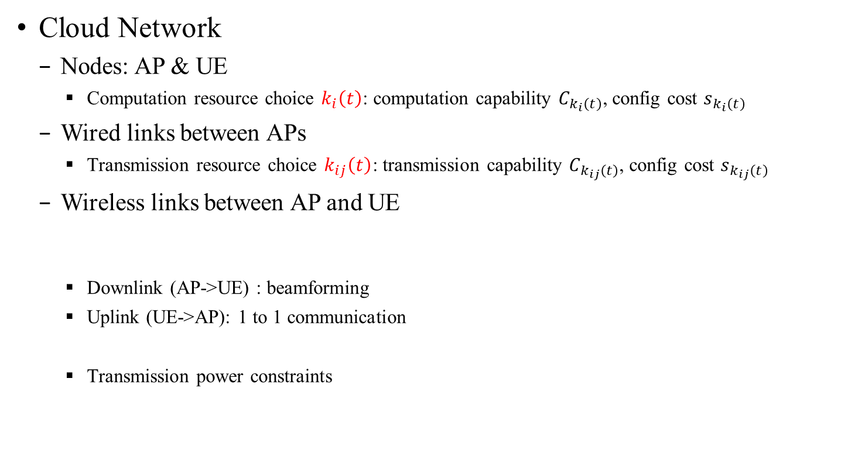
System Model
Cloud Network
Nodes: AP & UE
Computation resource choice $k_{i}\left(t\right)$: computation capability $C_{k_{i}\left(t\right)}$, config cost $s_{k_{i}\left(t\right)}$
Wired links between APs
Transmission resource choice $k_{ij}\left(t\right)$: transmission capability $C_{k_{ij}\left(t\right)}$, config cost $s_{k_{ij}\left(t\right)}$
Wireless links between AP and UE
Downlink (AP->UE) : beamforming
Uplink (UE->AP): 1 to 1 communication
Transmission power constraints

Slide 6

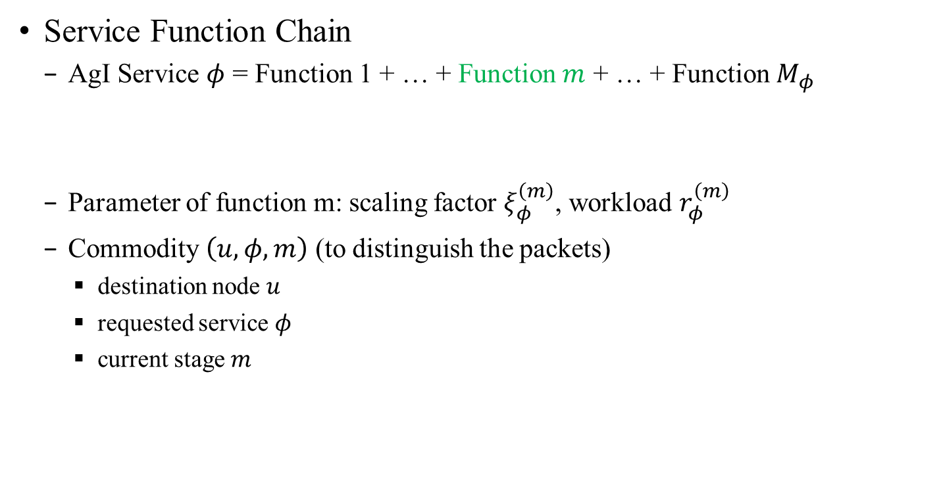

System Model
Service Function Chain
AgI Service $φ$ = Function 1 + … + Function $m$ + … + Function $M_{φ}$
Parameter of function m: scaling factor $ξ_{φ}^{\left(m\right)}$, workload $r_{φ}^{\left(m\right)}$
Commodity $\left(u, φ, m\right)$ (to distinguish the packets)
destination node $u$
requested service $φ$
current stage $m$
packets of stage $m$
packets of stage $m+1$

Slide 7
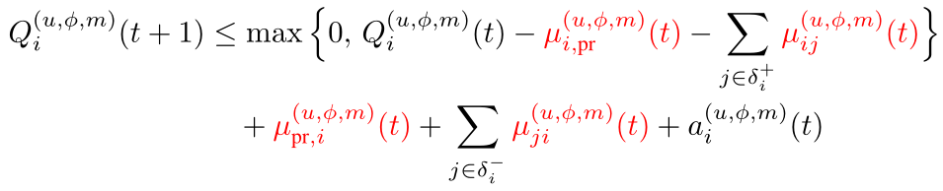


Queuing System
Queues and Flow Variables
Queues $Q_{i}^{\left(u,φ,m\right)}\left(t\right)$ for different commodities $\left(u,φ,m\right)$
Flow variable
Processing flow $μ_{i, pr}^{\left(u,φ,m\right)}\left(t\right)$
Transmission flow $μ_{ij}^{\left(u,φ,m\right)}\left(t\right)$
Queuing dynamics
Flow received from computation

Slide 8
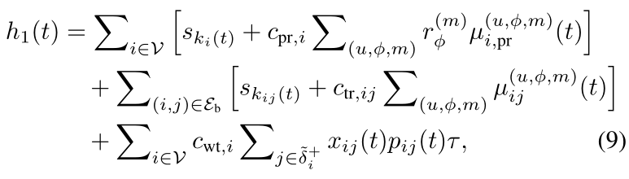
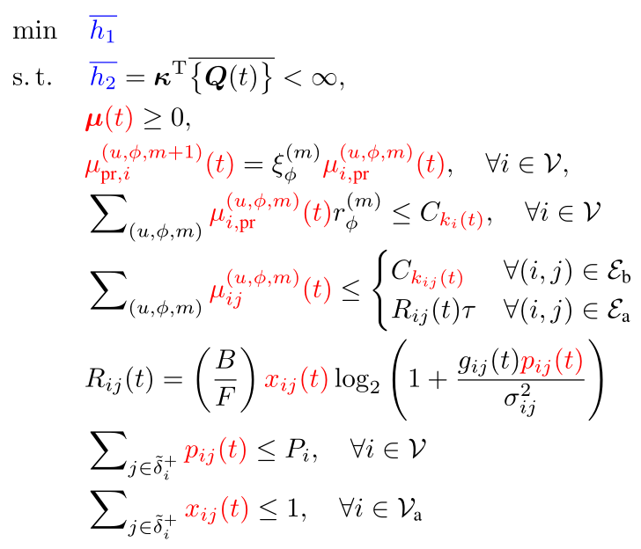
Studied Problem
(Goal 1: resource cost)
(Goal 2: average delay)
Capacity constraint

Slide 9
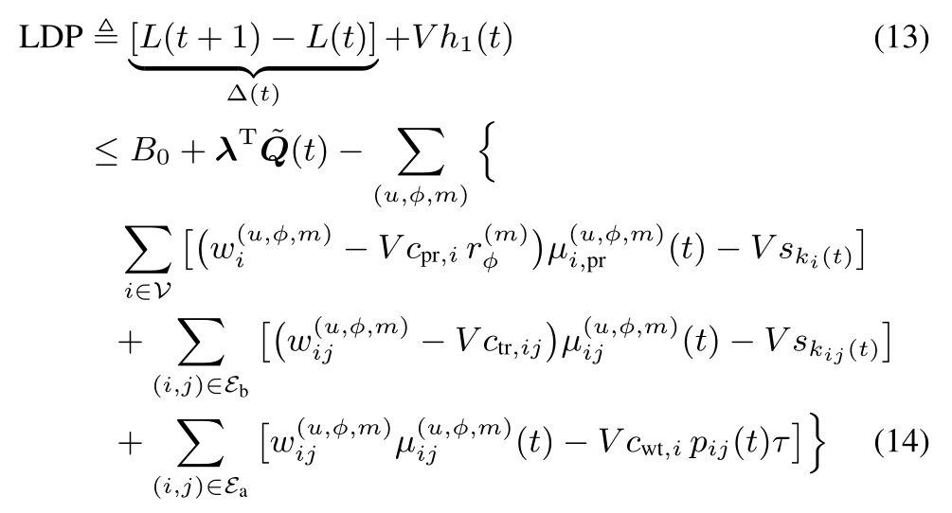
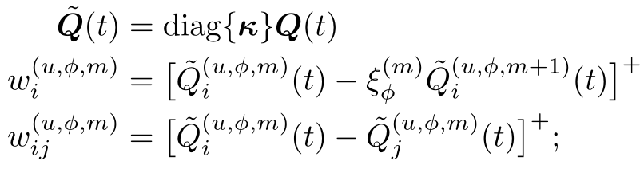
Proposed Design
Solve the problem by Lyapunov drift-plus-penalty (LDP) approach
Linear combination of drift and penalty weighted by parameter V
Processing | Max-weight
Wired Trans | Max-weight
Wireless Trans | cvx problem

Slide 10
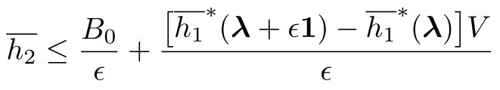
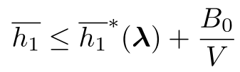


Performance Analysis
The delay performance
The cost performance
The algorithm is fully distributed and efficient
$$\sim O(V)$$
optimal cost
$$\sim O(1/V)$$

Slide 11
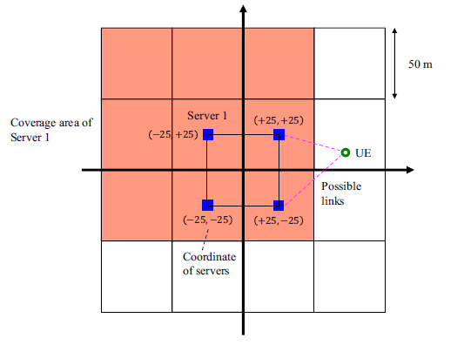
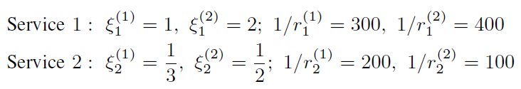
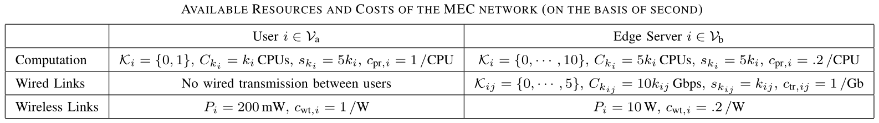
Numerical Experiments
Network Setup
4 APs serving 100 UEs (random walk)
3GPP urban microcell model
100 MHz band allocated for each AP
AgI services

Slide 12
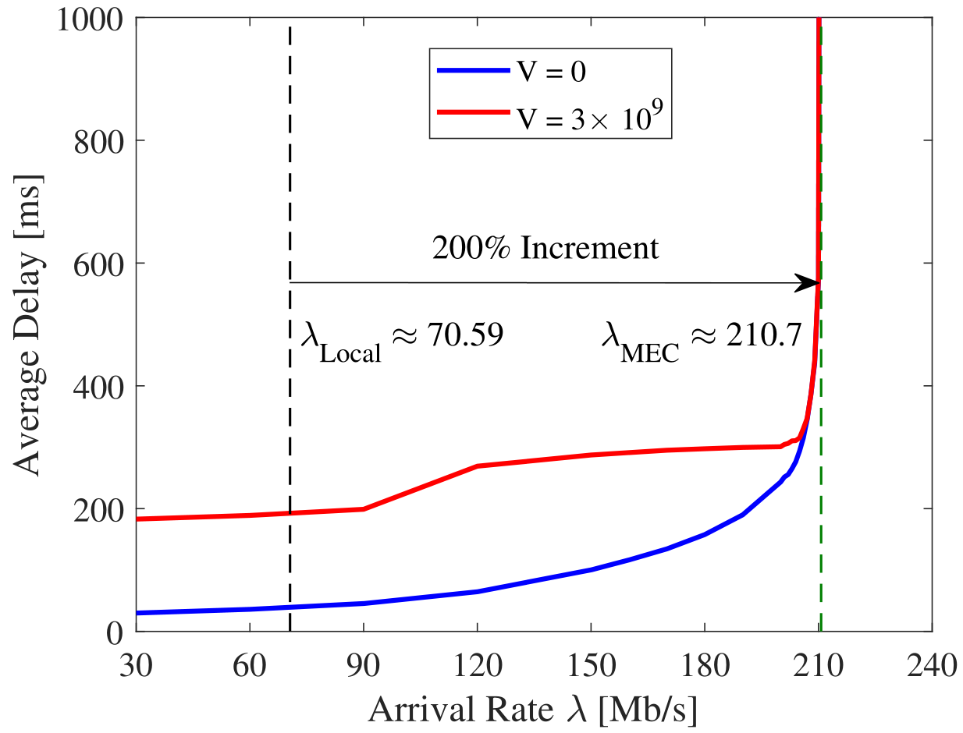
Numerical Experiments
Stable region
The maximum arrival rate of requests that the considered network can support

Slide 13
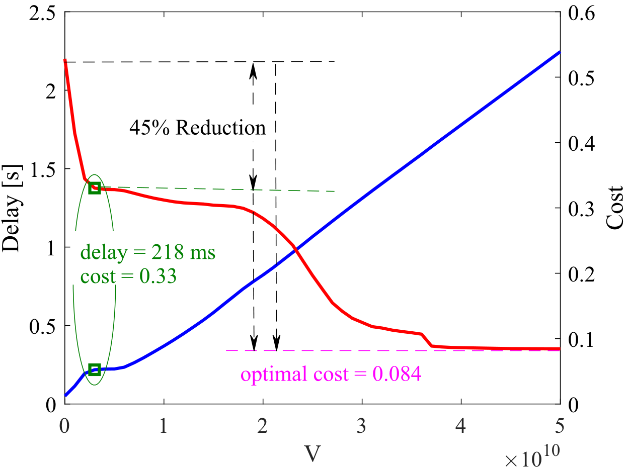
Numerical Experiments
Delay-Cost Tradeoff
1) Task offloading
2) Stop cooperating

Slide 14
Conclusions
MEC can aid the delivery of real-time AgI services requested by end users, which can significantly improve the stable region
The developed LDP-based algorithm can trade off the delay and cost performance, i.e., achieving near-optimal resource cost with guaranteed average delay performance
The developed LDP-based algorithm is efficient and fully distributed

Slide 15
Q & A
Thanks for joining the talk
References
Y. Cai, J. Llorca, A. M. Tulino, and A. F. Molisch, “Mobile edge computing network control: Tradeoff between delay and cost,” arXiv.
H. Feng, J. Llorca, A. M. Tulino, and A. F. Molisch, “Optimal dynamic cloud network control,” IEEE/ACM Trans. Netw..
H. Feng, J. Llorca, A. M. Tulino, and A. F. Molisch,, “Optimal control of wireless computing networks,” IEEE Trans.Wireless Commun..
Any questions, comments, please contact via
Email: yangcai@usc.edu
Website: https://wides.usc.edu/

