Slide 1
Optimal Cloud Network Control with Strict Latency Constraints
(ICC 2021)
Yang Cai, Jaime Llorca, Antonia M. Tulino, Andreas F. Molisch
Email: yangcai@usc.edu

Slide 2
Background
Increasing demand for computational resource
Real-time computer vision, multi-user conferencing, and augmented/virtual reality
Limited local computational resource at UE
Tendency: light weight, portable devices
Restricted processing capability, battery
Solution: requesting computing service from the cloud
Better delay and cost performance

Slide 3
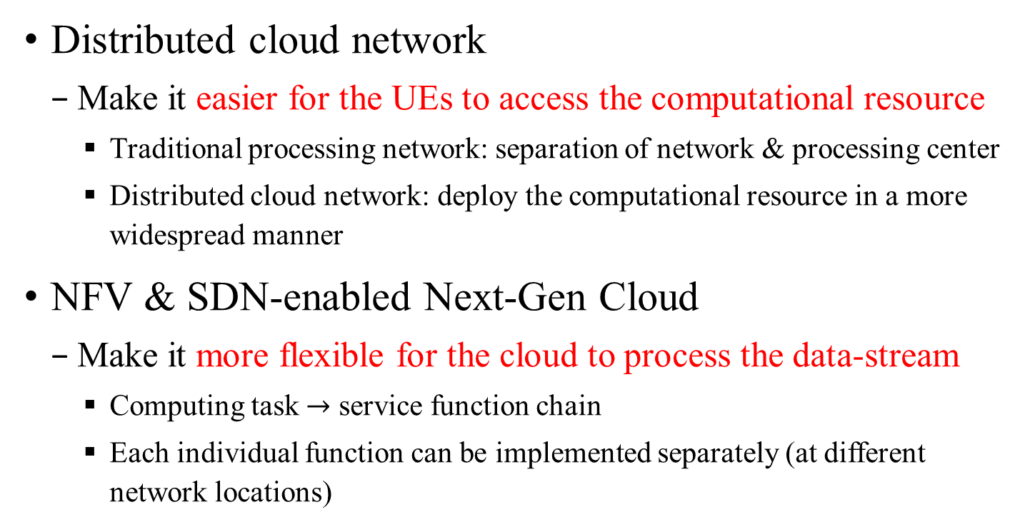
Background
Distributed cloud network
Make it easier for the UEs to access the computational resource
Traditional processing network: separation of network & processing center
Distributed cloud network: deploy the computational resource in a more widespread manner
NFV & SDN-enabled Next-Gen Cloud
Make it more flexible for the cloud to process the data-stream
Computing task $→$ service function chain
Each individual function can be implemented separately (at different network locations)

Slide 4
Background
The goal is to design a dynamic cloud control algorithm that achieves:
Better delay performance
Autonomous transportation, machine control in Industry 4.0
From average delay to per-packet delay
Better cost performance
Especially in heterogeneous network

Slide 5
System Model
Cloud layered graph
The original problem can be transformed to packet routing problem
source
destination
source
1
2
1
2
Function
1’
2’
destination

Slide 6
System Model
Request model
Lifetime
The deadline by which the packet becomes outdated
The packet is called effective otherwise
I.I.D. arrival processes of packets with various initial lifetime at any node
Timely throughput
The rate of effective packet delivery
Reliability
The ratio of effective packets to all arrival packet

Slide 7
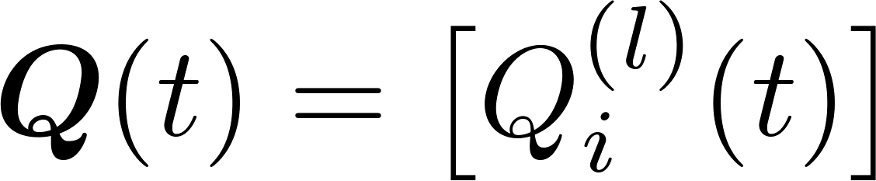
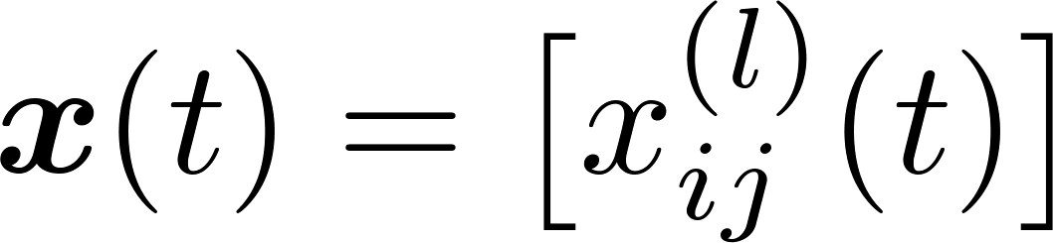
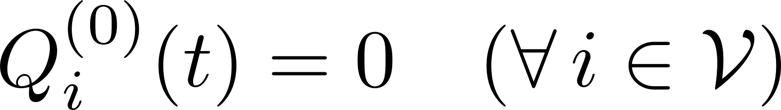
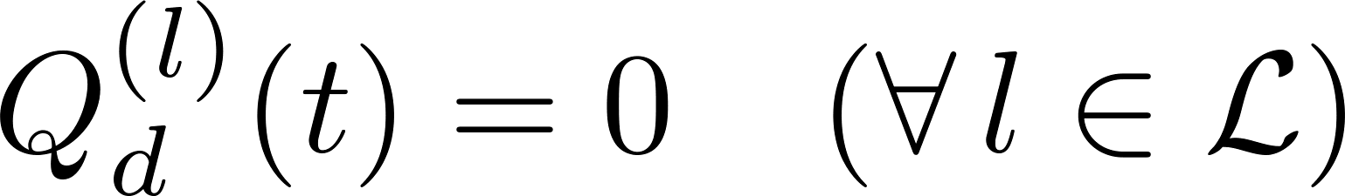

System Model
Queuing system
Queues
The queue of lifetime $l$ at node $i$ on time slot $t$
Flow variables
The actual amount of lifetime $l$ packets sent from node $i$ to $j$
Queuing dynamics
exogenous packets

Slide 8
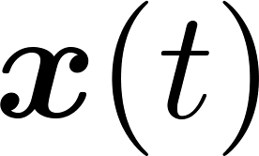
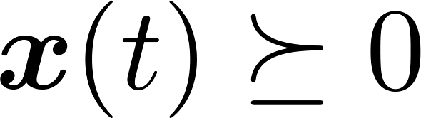
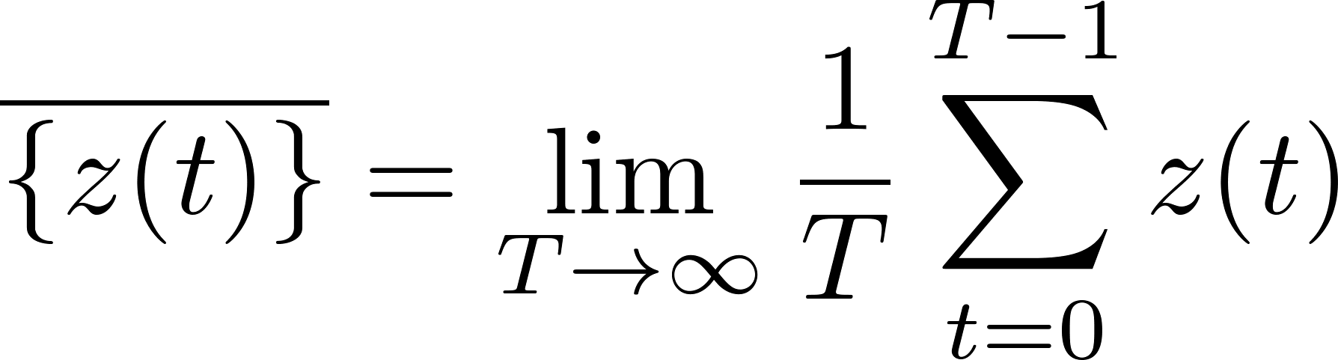
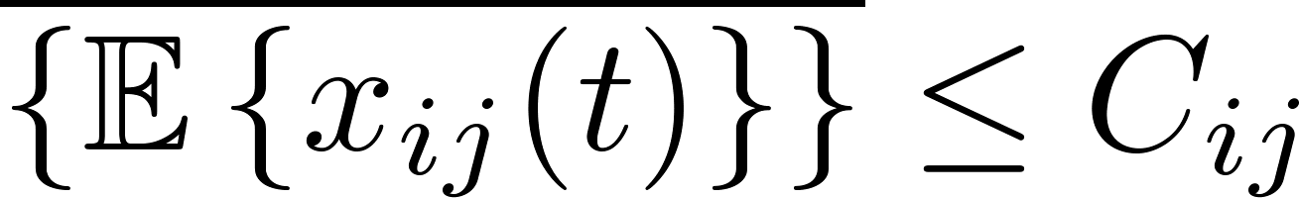
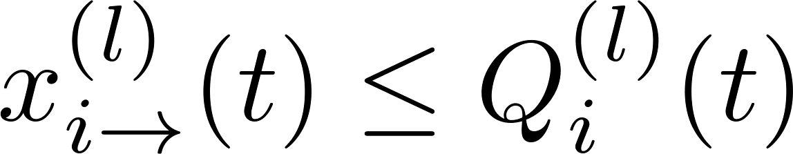
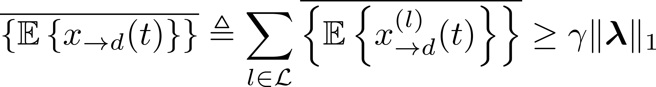

System Model
Policy space
Decision variable: the flow variables
Constraints
Non-negativity
Link capacity constraint
Availability constraint
Reliability constraint
Delivered effective packets
Reliability level $×$ total arrival rate

Slide 9
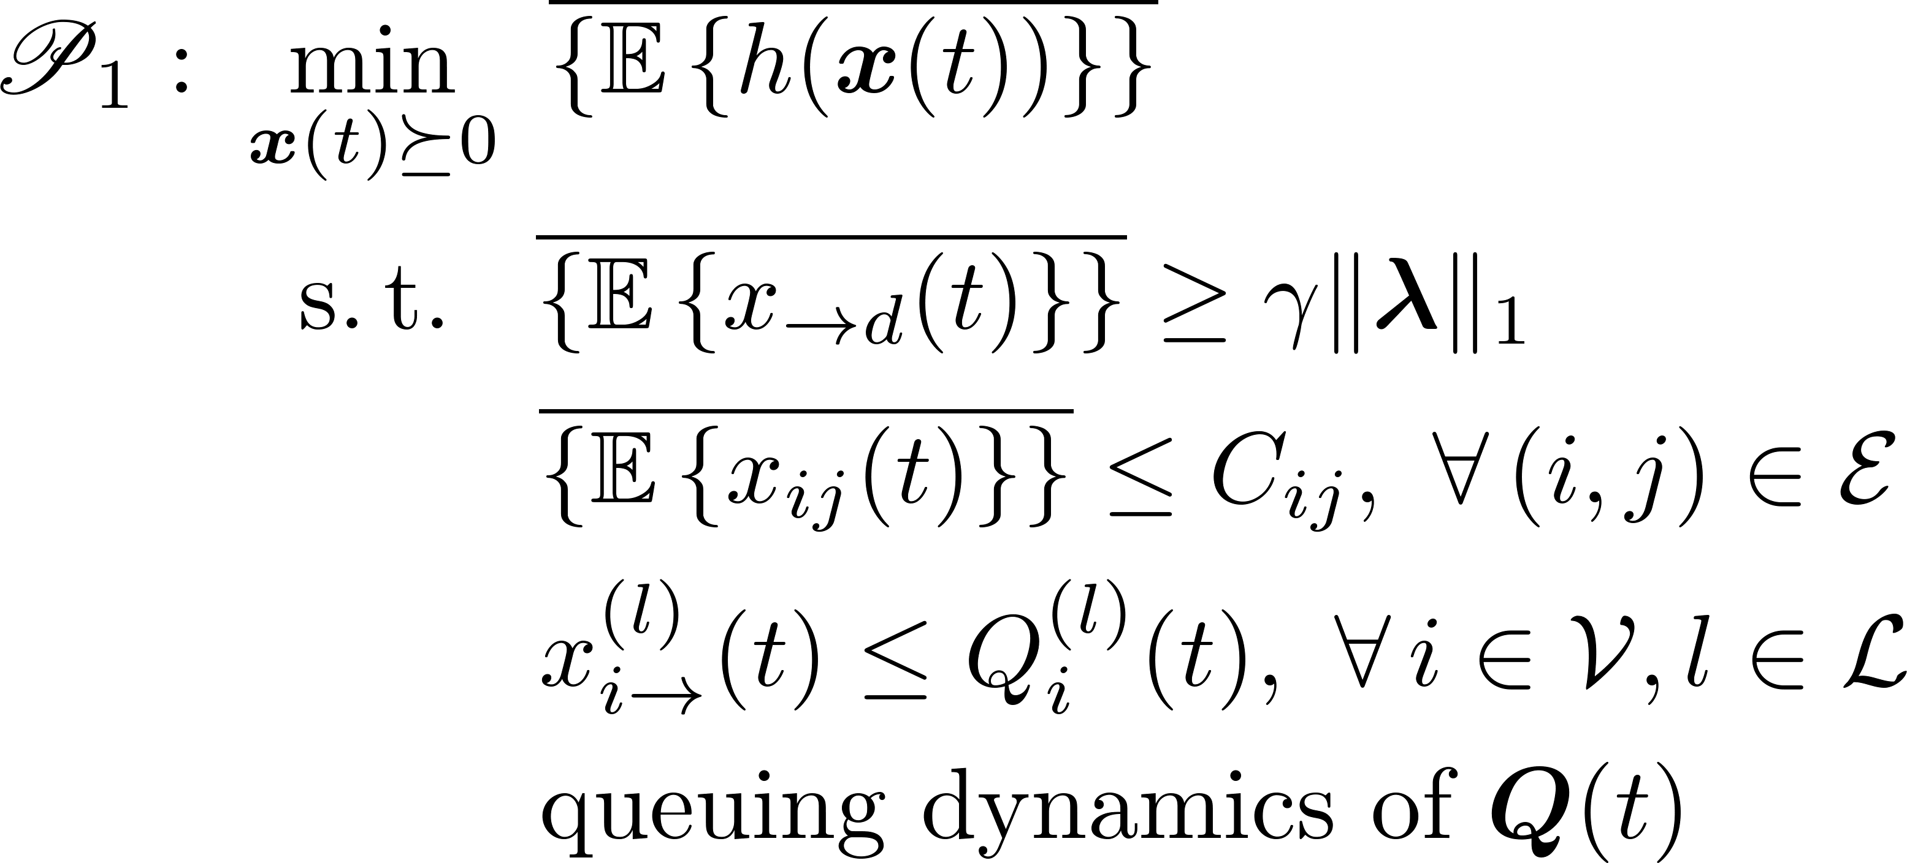
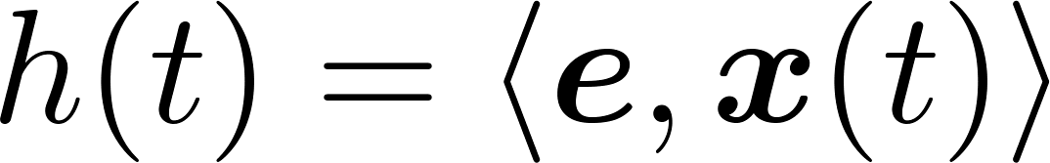
System Model
Problem Formulation
Challenges to solve the above problem

Slide 10
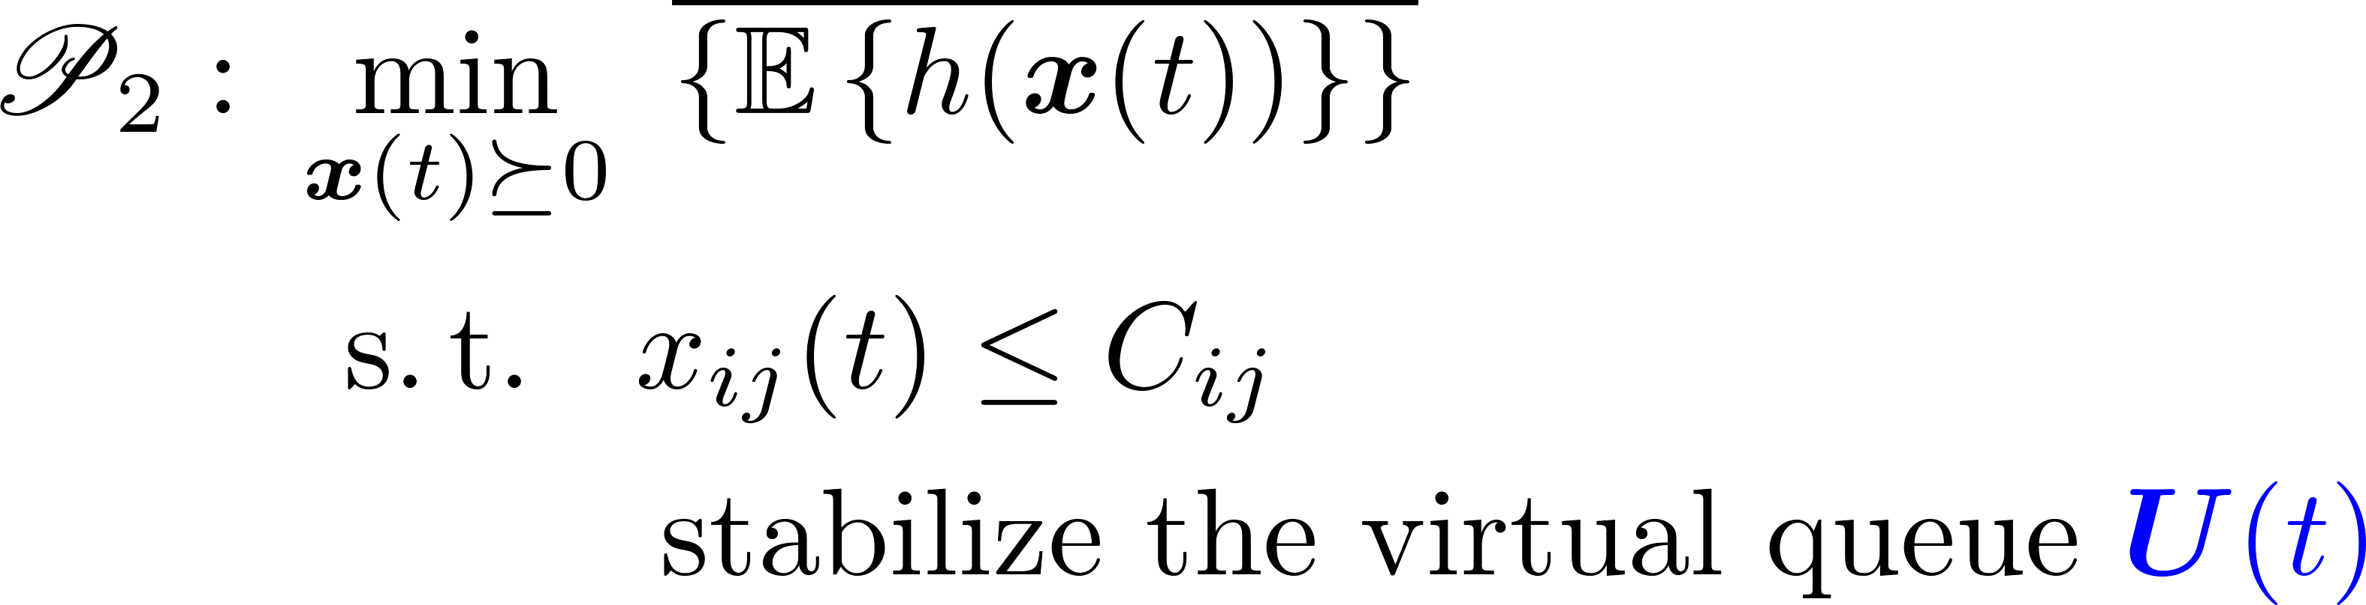
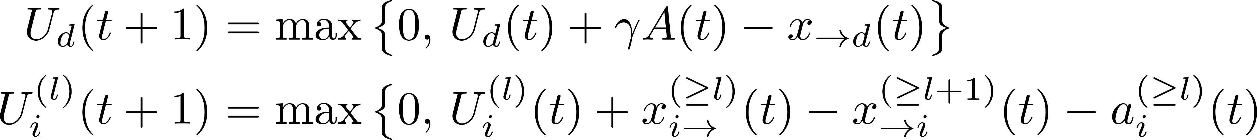
Proposed solution
Transform it to standard form

Slide 11
Relationship (Theoretical)
The two problems have
Different admissible policy space
Feasible set for the decision variables
The same network stability region
Set of arrival rates under which there exists at least one admissible policy
We present an explicit characterization for the stability region
The same space of network flow assignment
The average transmission rate for a link
Furthermore, the same optimal cost

Slide 12
Physical Interpretation
We name the second problem virtual network
Imagine that each node is connected to a data-reservoir
The supply for packets of any lifetime is sufficient
Mechanism (borrow-return)
First borrow the packets from the reservoir to satisfy the needs
Then return the received packets to the reservoir
Virtual queue record the data deficit of the data reservoir

Slide 13
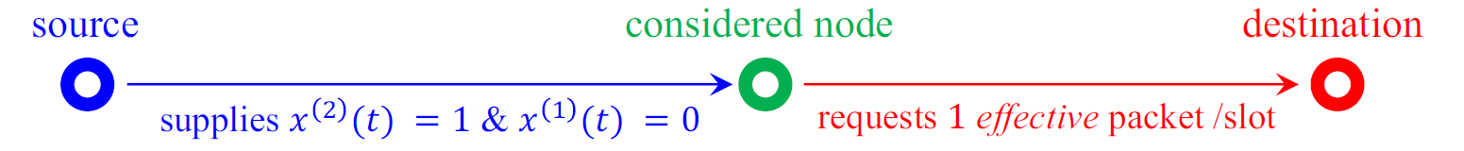
Physical Interpretation
We name the second problem virtual network
Equilibrium
Virtual queues are stabilized implies all network flows can be supported by actual packets
At any network location, by observing its virtual queues, we can know packets of which lifetime are available
Example (packets of lifetime 2 arrive at the source node)

Slide 14
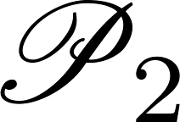
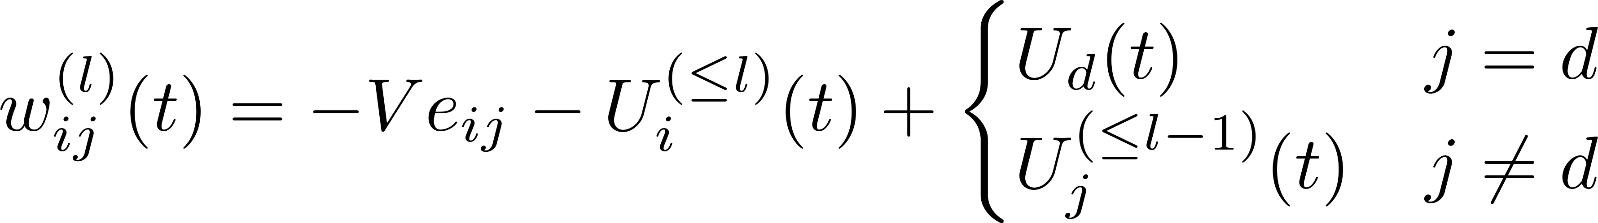
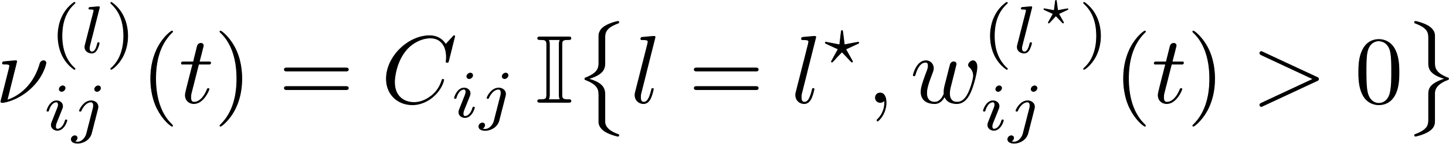
Proposed Algorithm
A two-step procedure
Find the solution to by Lyapunov Drift-plus-Penalty
Goal: min
Algorithm: find the best lifetime (with max weight)
Throughput optimal & near-optimal cost performance

Slide 15
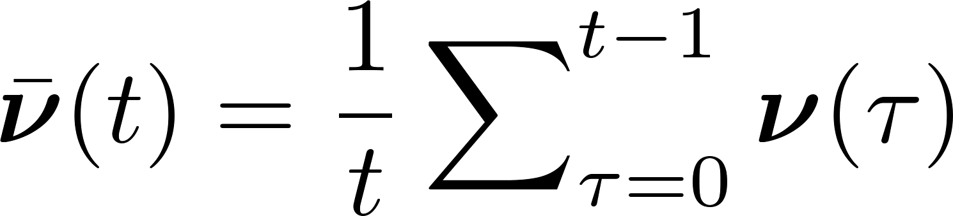
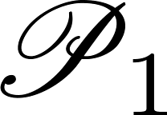

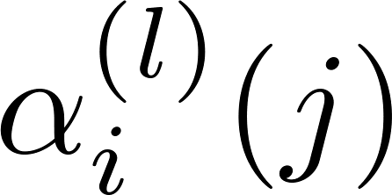
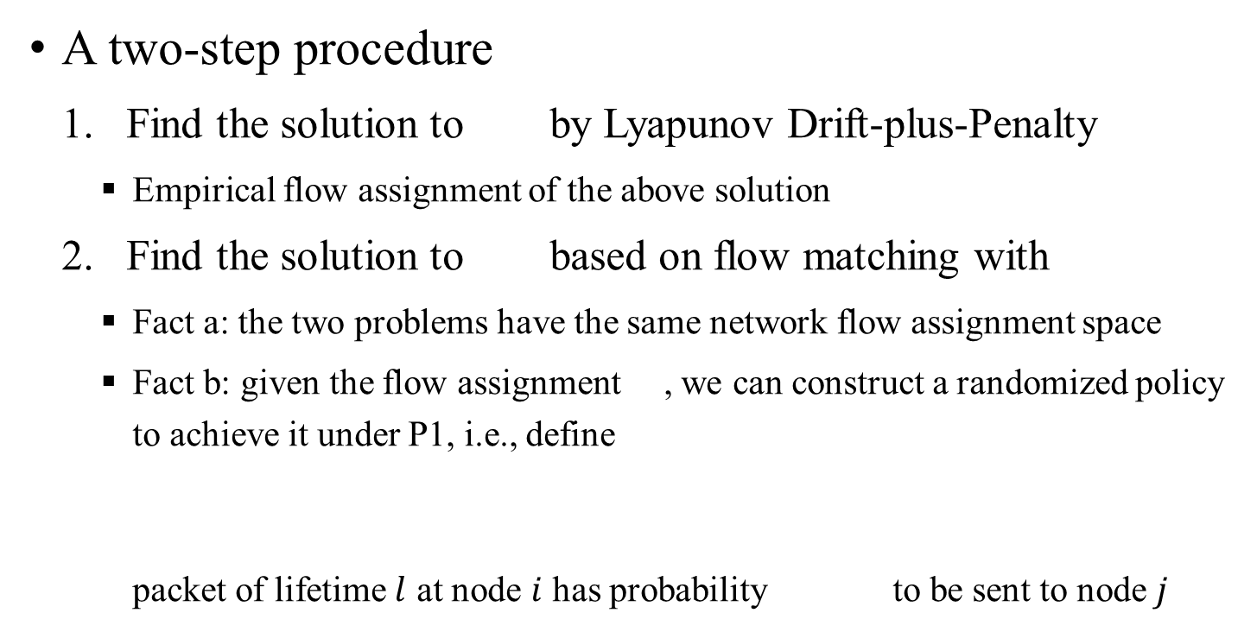
Proposed Algorithm
A two-step procedure
Find the solution to by Lyapunov Drift-plus-Penalty
Empirical flow assignment of the above solution
Find the solution to based on flow matching with
Fact a: the two problems have the same network flow assignment space
Fact b: given the flow assignment , we can construct a randomized policy to achieve it under P1, i.e., define packet of lifetime $l$ at node $i$ has probability to be sent to node $j$

Slide 16
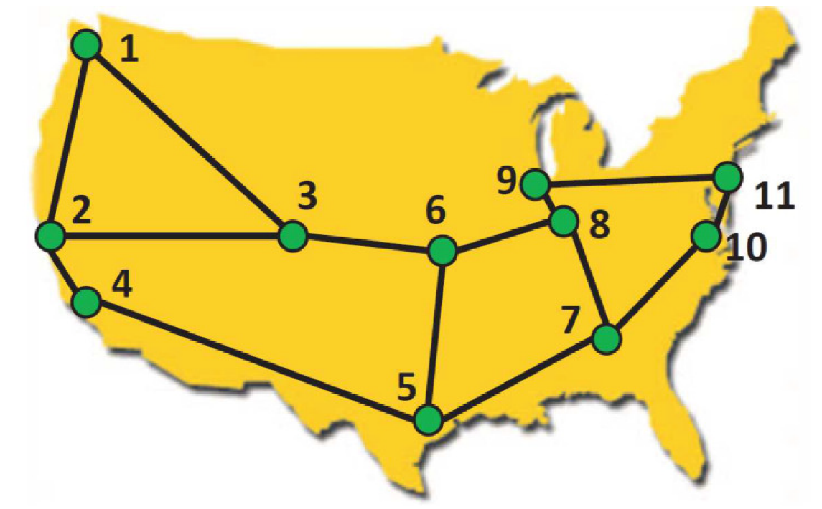
Numerical Experiments
Configuration
Network topology (Abilene network)
Available resource & cost
The computational resource is 2 CPUs at any node, with cost 1 /CPU for node 5, 6, and 2 /CPU at other nodes
The transmission resource is 1 Gb/slot for any link, with a cost of 1 /Gb
Provided service
AgI service with 1 function: 50 Mbps/CPU, the same size of output as input
Two clients: (1, 9) and (3, 11)

Slide 17
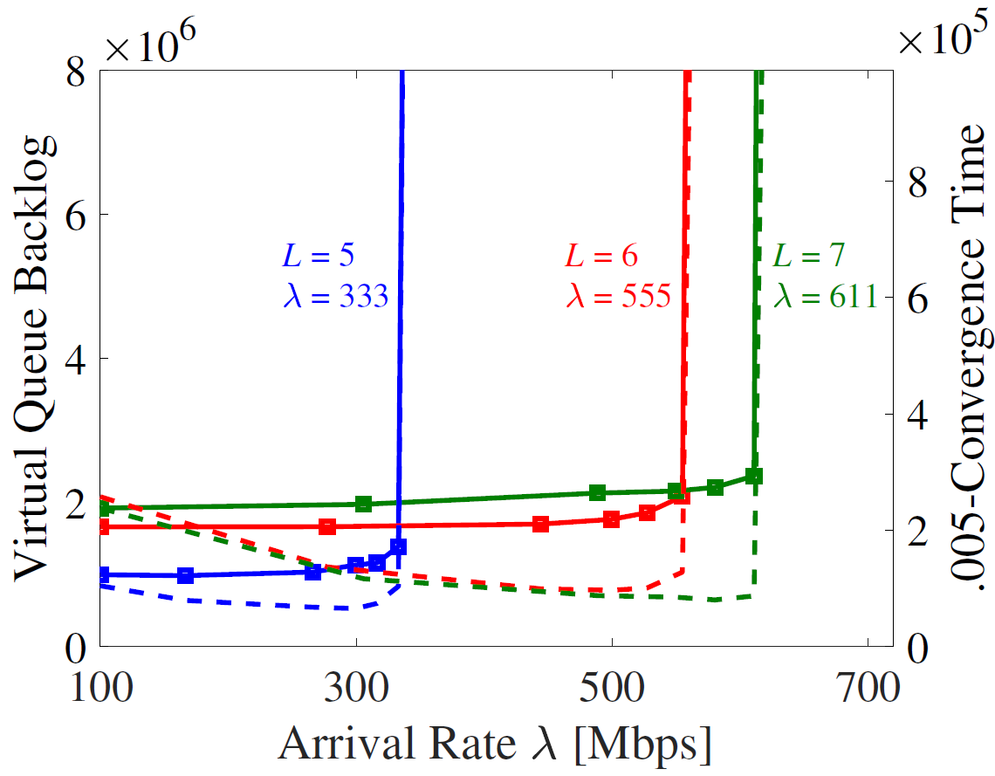
Numerical Experiments
Network stability region
Actual network (solid line, convergence time), virtual network (dashed line, virtual queue backlog)
The same stability region
Effects of different lifetime

Slide 18
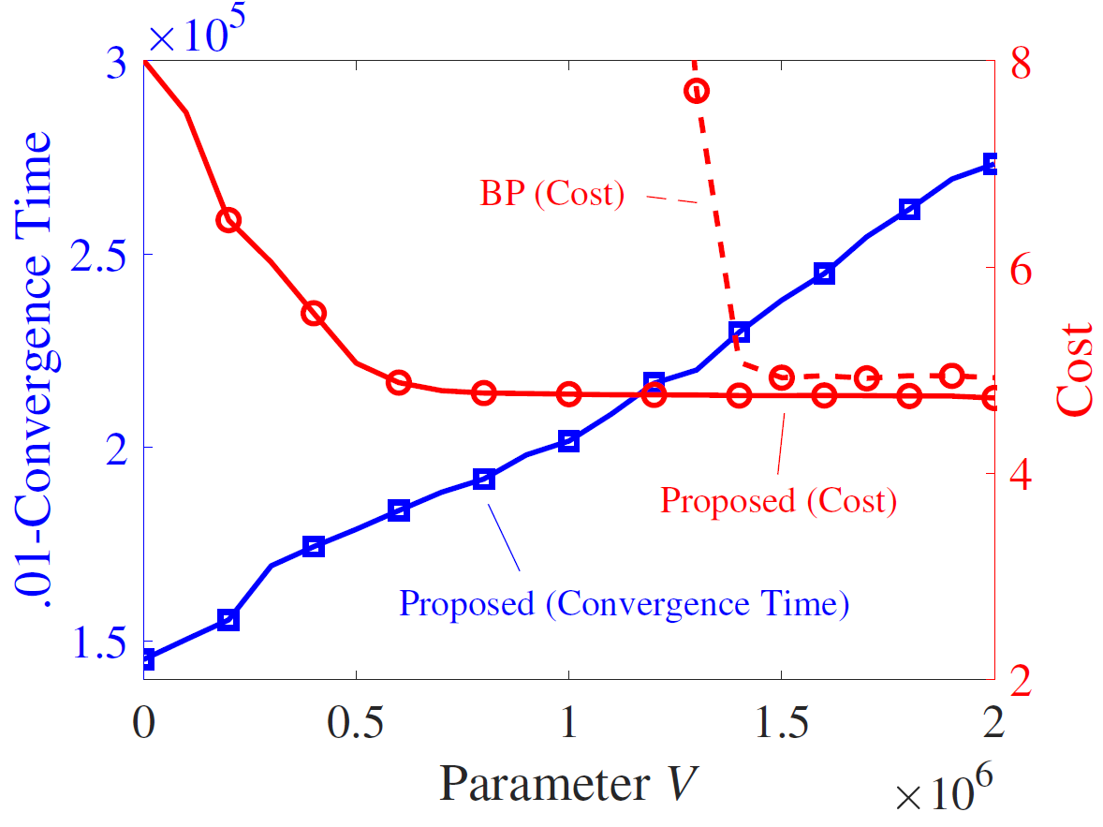
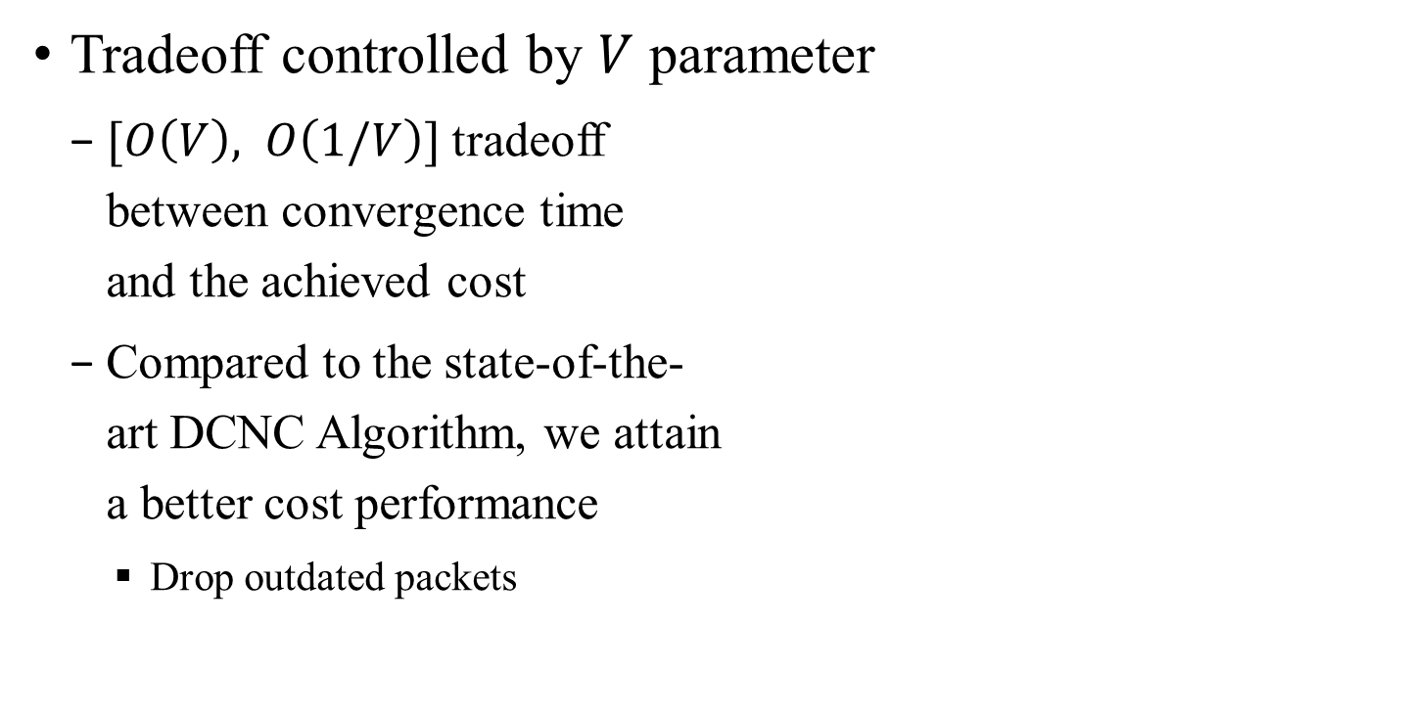
Numerical Experiments
Tradeoff controlled by $V$ parameter
$[O\left(V\right), O\left(1/V\right)]$ tradeoff between convergence time and the achieved cost
Compared to the state-of-the- art DCNC Algorithm, we attain a better cost performance
Drop outdated packets
DCNC (Cost)

Slide 19
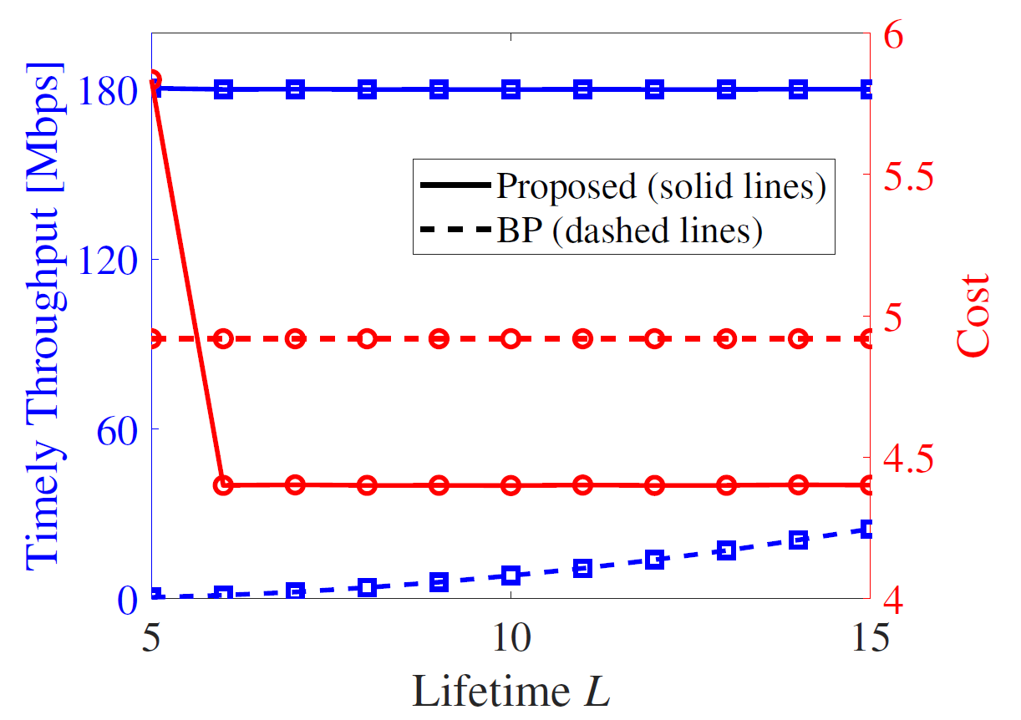
Numerical Experiments
Effects of packets’ lifetime
Increase max-lifetime
DCNC: throughput grows because more packets are counted effective
Proposed approach: cost reduces since the data packets can detour to cheaper network locations for processing
DCNC (dashed lines)

Slide 20
Conclusions
Per-packet delay is a more realistic requirement, but it is also more challenging (does not admit LDP solution!)
The proposed approach uses virtual network to find flow assignment, and actual network for routing & scheduling
The proposed approach significantly outperforms the DCNC algorithm in timely throughput

Slide 21
Acknowledgement
Thanks for joining in the talk!
Please contact yangcai@usc.edu if you have any questions, comments
The most recent results on this topic (with peak link capacity constraint) are under review for publication at IEEE/ACM Trans. Network.

