Slide 1
Optimal Multicast Service Chain Control: Packet Processing, Routing, Duplication
(ICC 2021)
Yang Cai, Jaime Llorca, Antonia M. Tulino, Andreas F. Molisch
Email: yangcai@usc.edu

Slide 2
Background
Increasing demand for computational resource
Augmented reality, telepresence, industrial automation
Limited local computational resource at UE
Tendency: light weight, portable devices
Restricted processing capability, battery
Solution: offloading computing tasks to the cloud
Better delay and cost performance

Slide 3
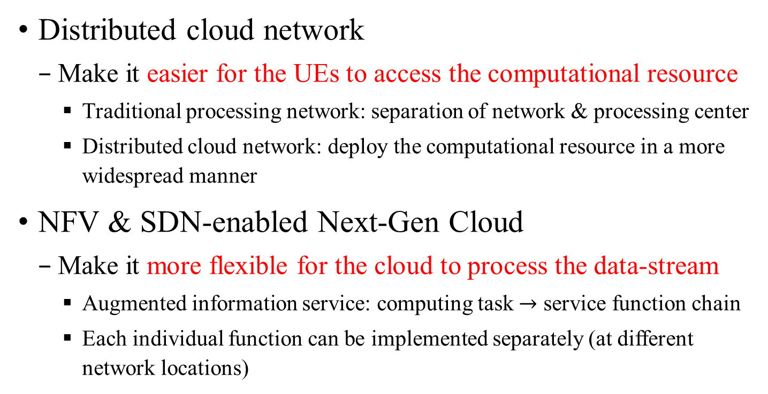
Background
Distributed cloud network
Make it easier for the UEs to access the computational resource
Traditional processing network: separation of network & processing center
Distributed cloud network: deploy the computational resource in a more widespread manner
NFV & SDN-enabled Next-Gen Cloud
Make it more flexible for the cloud to process the data-stream
Augmented information service: computing task $→$ service function chain
Each individual function can be implemented separately (at different network locations)

Slide 4
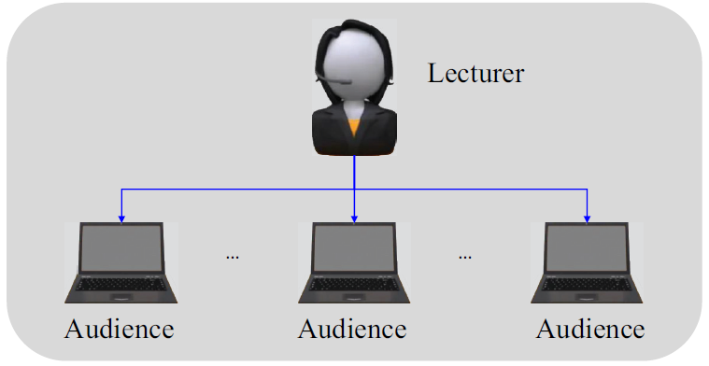
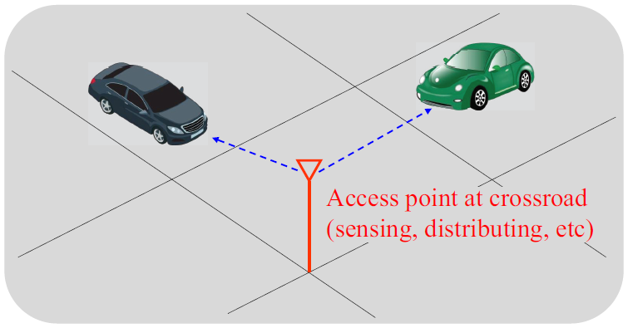
Background
Multicast flow is an increasingly dominant component of the network traffic
Applications with multiple destinations
Multi-user conferencing
Coordinated decision making/content distribution within multi-agent systems
Intelligent transportation system, smart factory

Slide 5
Background
Existing Studies
Heuristic algorithms
Unicast approach: treat multicast flow as several individual unicast flows
Throughput-optimal, least cost multicast routing
Few results (centralized control requiring global information)
S
S
D1
D2
D1
D2
Unicast approach
New scheme with flexible duplication

Slide 6


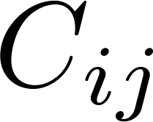
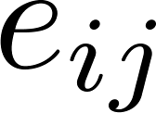
System Model
Cloud network model
Node: data-centers
Computation capacity , associated cost
Edge: transmission link
Transmission capacity , associated cost

Slide 7
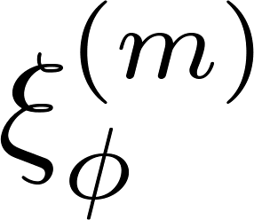
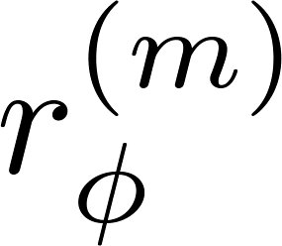

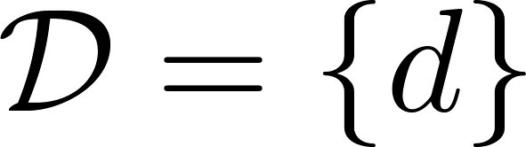
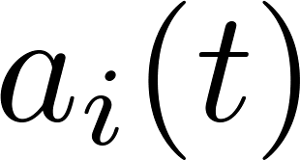
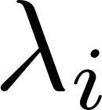
System Model
Service model
Service function chain: a chain of ordered functions
Two parameters: scaling factor , workload
Destination set (multicast)
It becomes a singleton for unicast flow
I.I.D. requests from each client
: the instantaneous arrival
: mean arrival rate

Slide 8
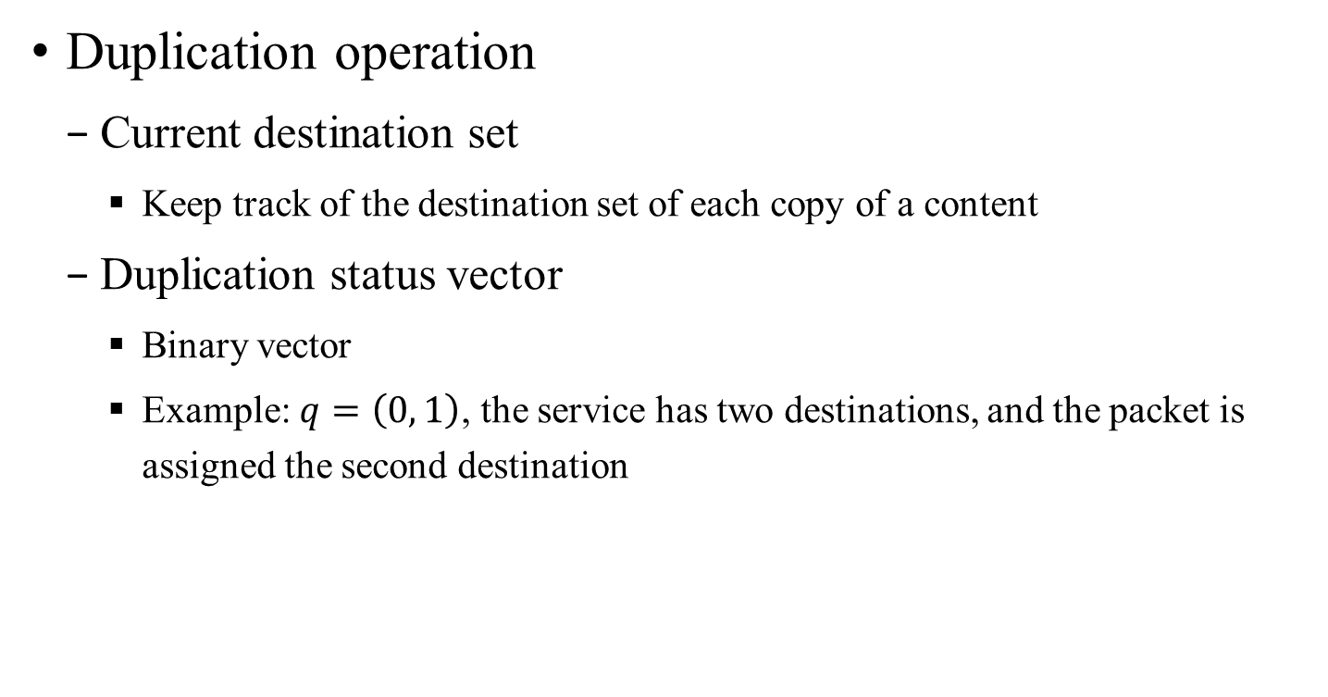
System Model
Duplication operation
Current destination set
Keep track of the destination set of each copy of a content
Duplication status vector
Binary vector
Example: $q=\left(0, 1\right)$, the service has two destinations, and the packet is assigned the second destination

Slide 9
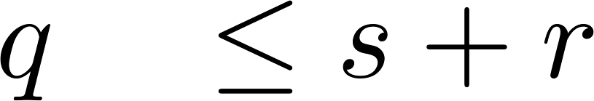
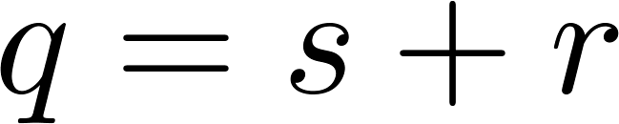
System Model
Duplication operation (assumptions)
The coverage constraint
Efficient duplication: destination sets of the copies do not overlap
2-duplication
original packet
two copies

Slide 10
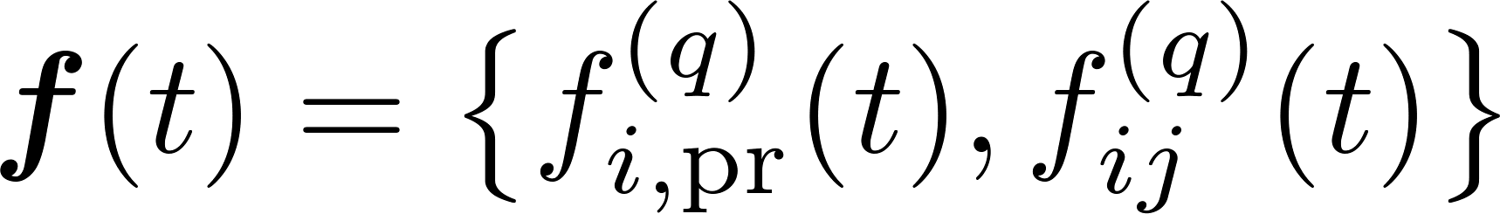
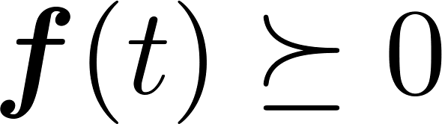
Policy Space
Policy space
Decision variable: the flow variables
Constraints
Non-negativity
Capability constraint
Generalized flow conservation law

Slide 11
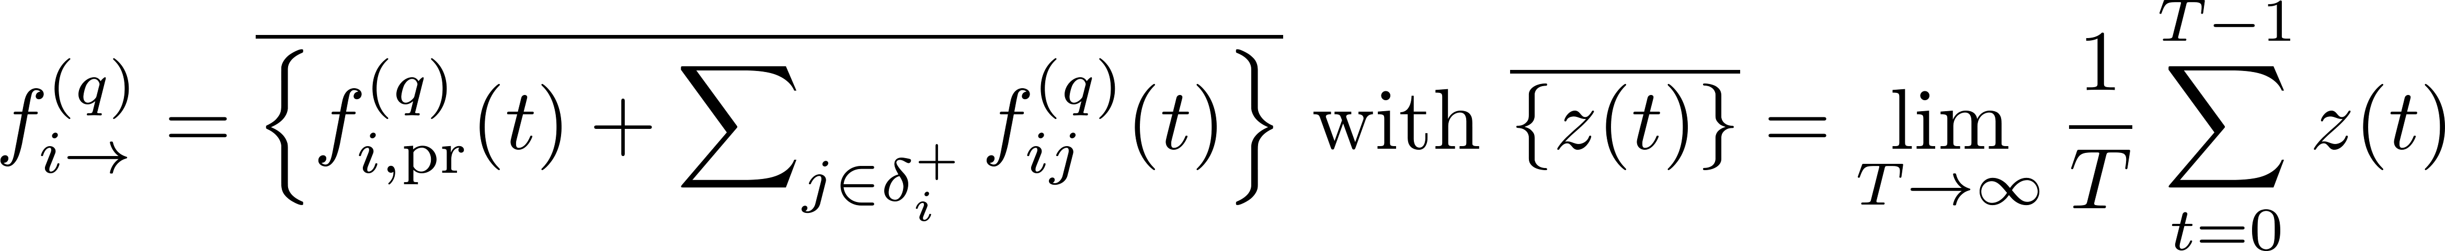
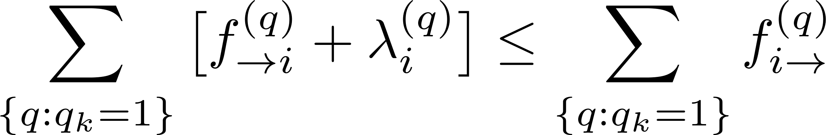
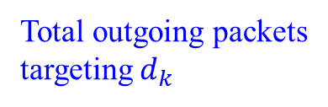
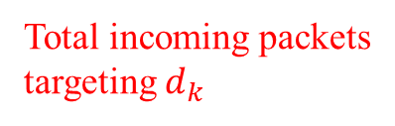
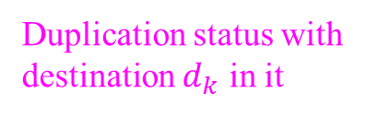
Policy Space
Policy space
Decision variable
Constraints
Generalized flow conservation law (coverage constraint)
Duplication status with destination $d_{k}$ in it
Total incoming packets targeting $d_{k}$
Total outgoing packets targeting $d_{k}$

Slide 12
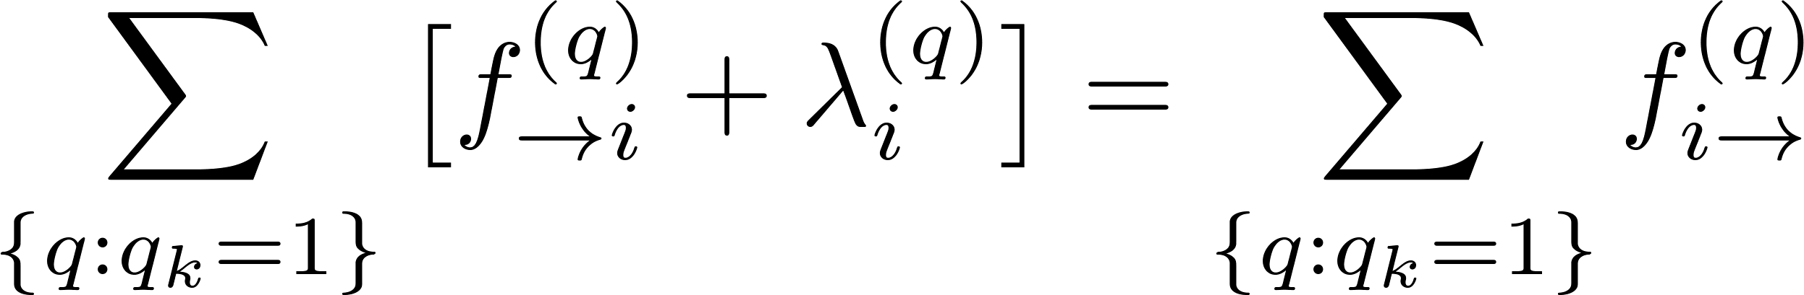
Policy Space
Policy space
Decision variable
Constraints
Generalized flow conservation law (efficient duplication)
(it does not reduce throughput, but can save cost and network traffic)

Slide 13
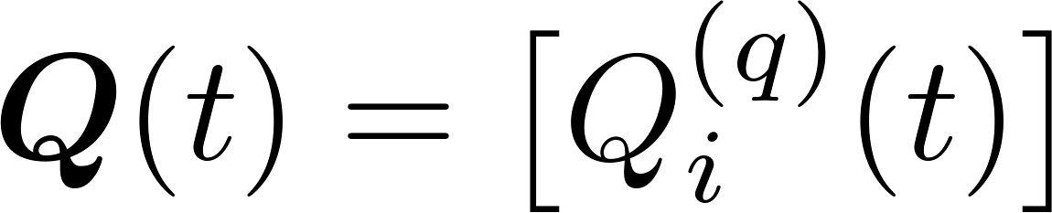
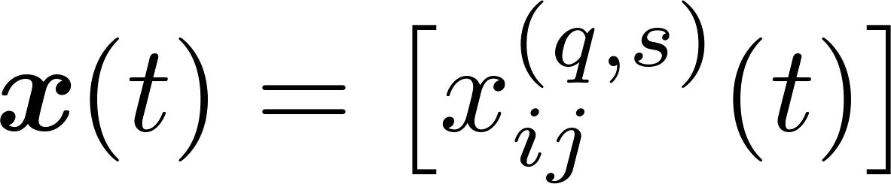
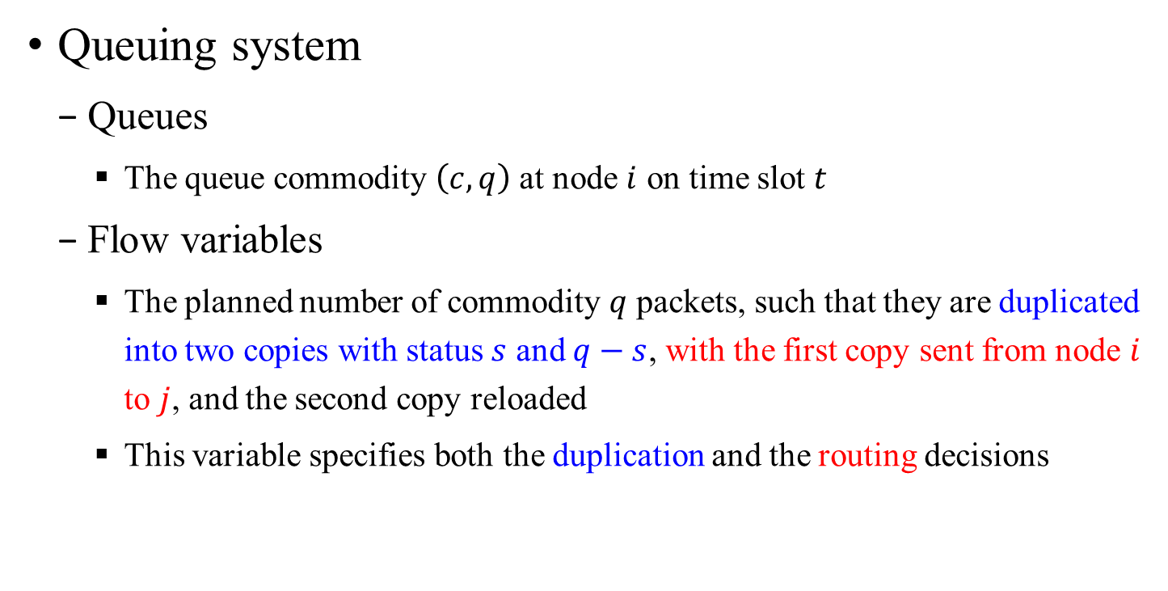
Queuing System
Queuing system
Queues
The queue commodity $\left(c, q\right)$ at node $i$ on time slot $t$
Flow variables
The planned number of commodity $q$ packets, such that they are duplicated into two copies with status $s$ and $q−s$, with the first copy sent from node $i$ to $j$, and the second copy reloaded
This variable specifies both the duplication and the routing decisions

Slide 14
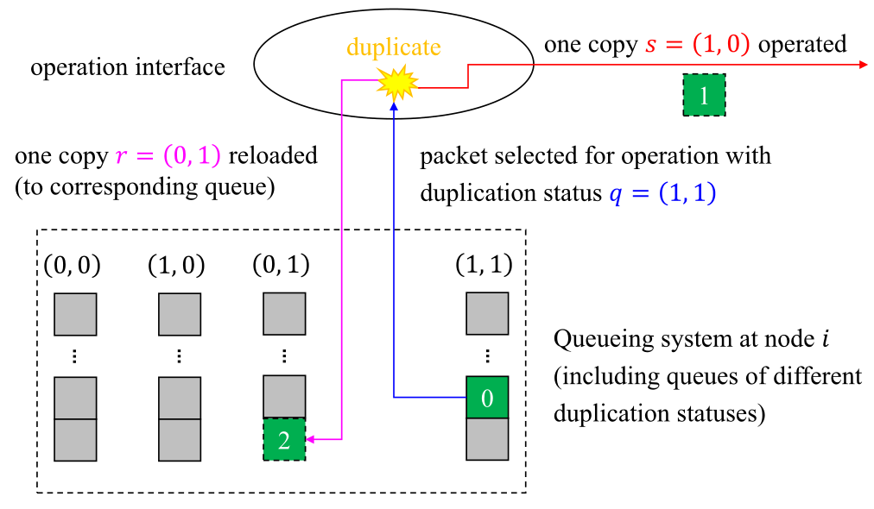
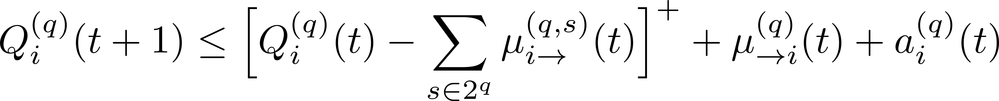
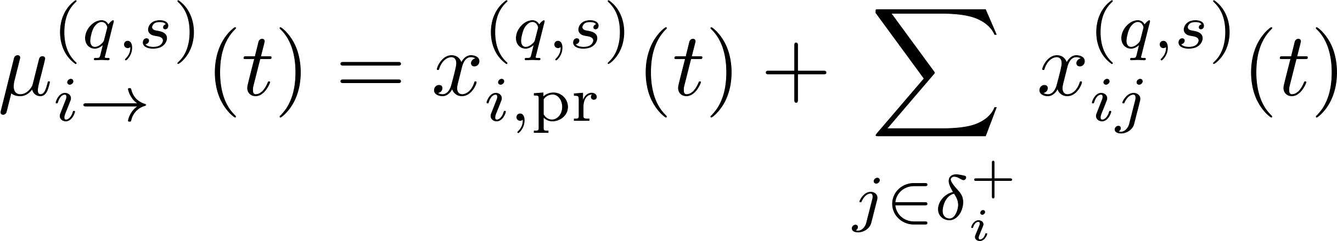
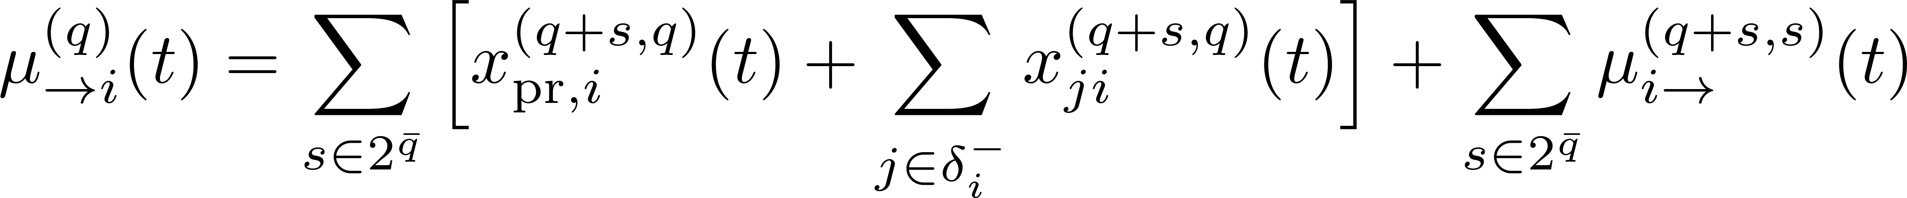
Queuing System
Queuing system
An example
Queuing dynamics
Intermediate nodes

Slide 15
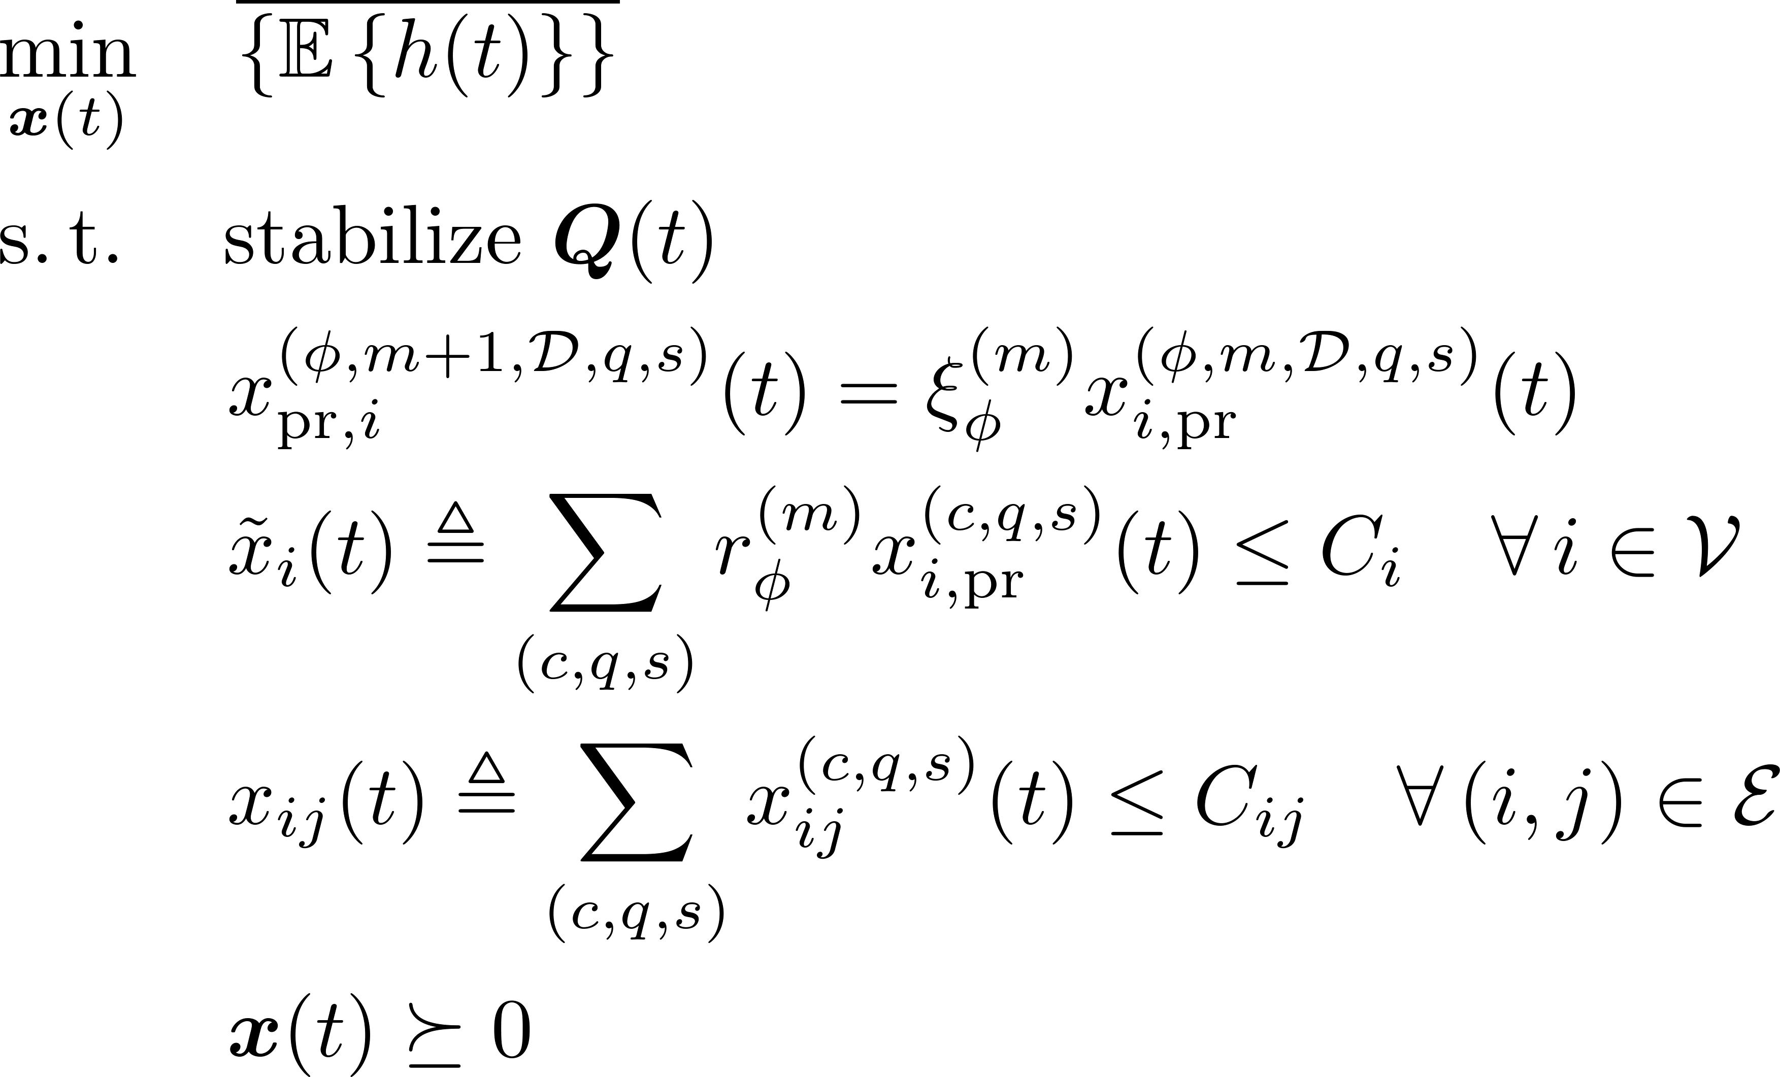
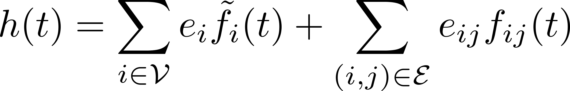
Problem Formulation

Slide 16
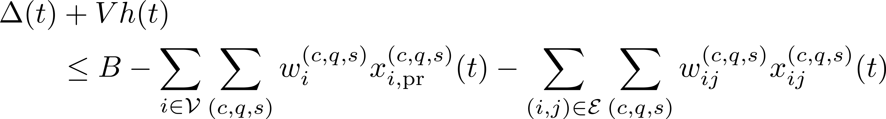
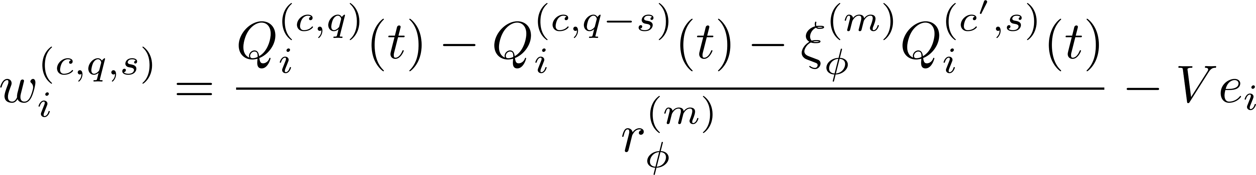
Proposed Algorithm
Based on Lyapunov Drift-plus-Penalty (LDP) approach
Goal: to minimize LDP given by

Slide 17
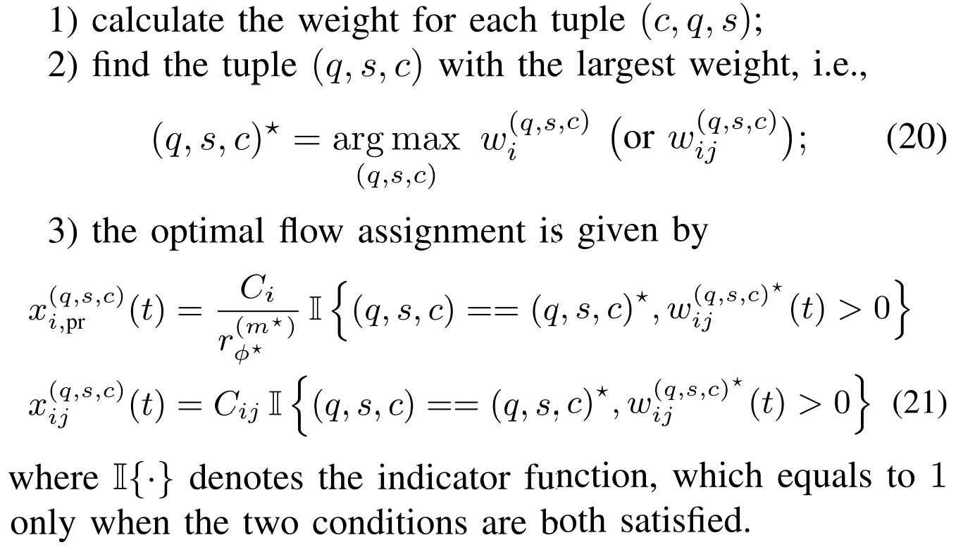
Proposed Algorithm
Algorithm

Slide 18
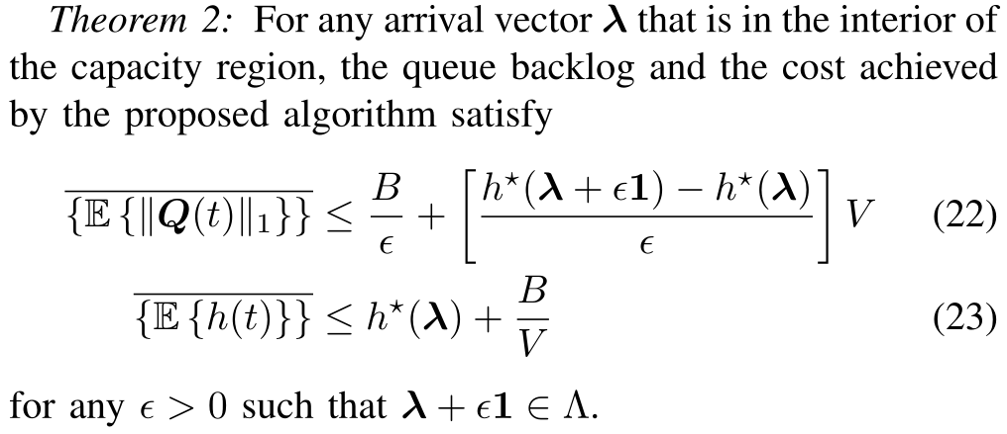
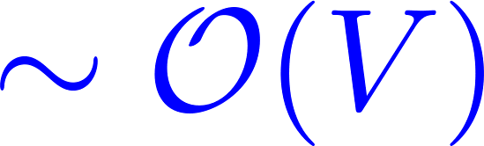

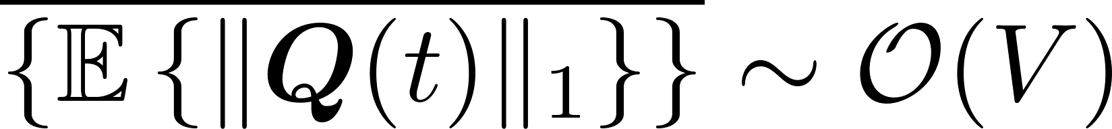
Performance Analysis
Delay-cost trade-off
The average delay is proportional to
del

Slide 19
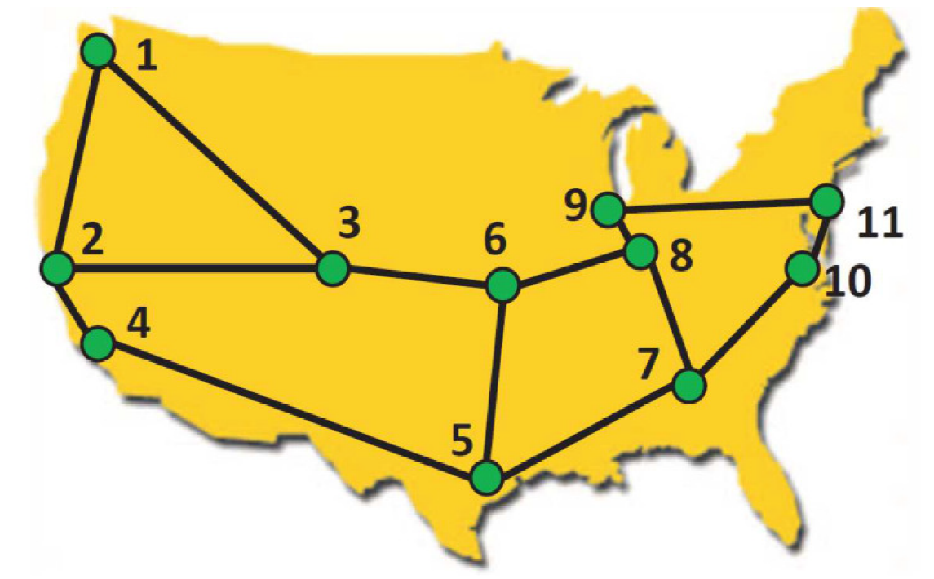
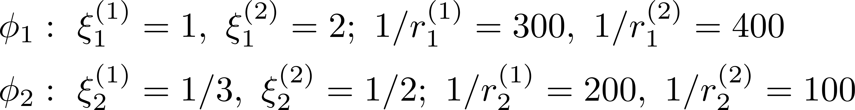
Numerical Experiments
4 source nodes
2 destinations
Configuration
Network topology (Abilene network)
Available resource & cost
The computational resource is 20 CPUs at any node, with cost 0.5 /CPU
The transmission resource is 10 Gbps for any link, with a cost of 1 /Gb
Provided service
Two AgI services, each including two functions with parameter:

Slide 20
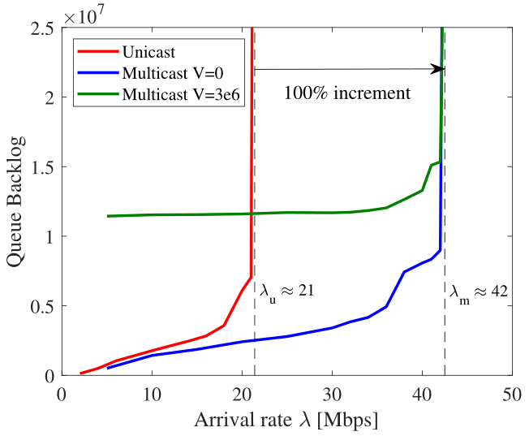

Numerical Experiments
Network capacity region
Different $V$ value leads to the same capacity region
Achieve $2×$ the capacity region of unicast approach
Since there are 2 destinations

Slide 21
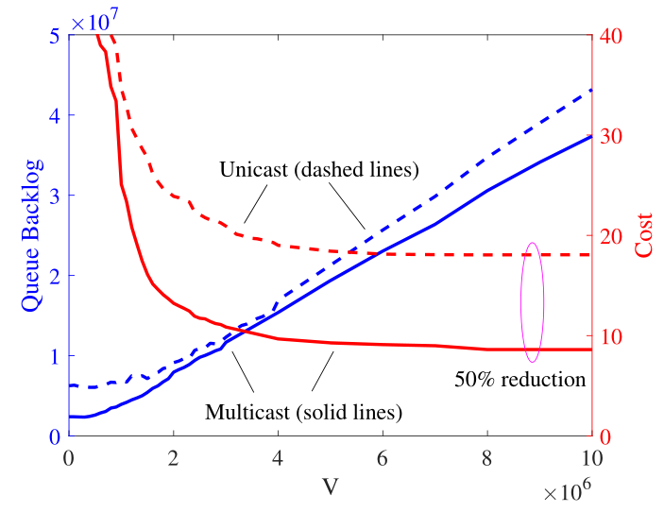

Numerical Experiments
Tradeoff controlled by $V$ parameter
$[O\left(V\right), O\left(1/V\right)]$ tradeoff between queue backlog and the achieved cost
Achieve $1/2×$ the cost of unicast approach
Since there are 2 destinations

Slide 22
Conclusions
The delivery of multicast network flow can be optimized by exploiting the reuse gain
Efficient duplication can 1) ensure information delivery to all destinations, and 2) save the network resource
The proposed approach can support the entire capacity region and achieve near-optimal cost performance

Slide 23
Acknowledgement
Thanks for joining in the talk!
Please contact yangcai@usc.edu if you have any questions, comments
The most recent results on this topic (which deals with mixed-cast flows) are under preparation for submission to IEEE Trans. Comm.

Slide 24
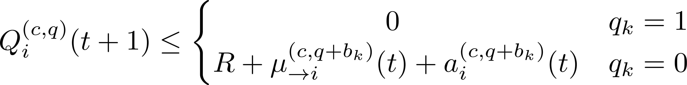




Queuing System
Queuing system
Queuing dynamics
Destination $i=d_{k}$
Example: what happens if a $\left(1, 1\right)$ packets arrives at $d_{1}$
$\left(1, 0\right)$: depart the network since it is at $d_{1}$
$$\left(1, 1\right)$$
$\left(0, 1\right)$: join the queue for $\left(0, 1\right)$ at $d_{1}$

Slide 25
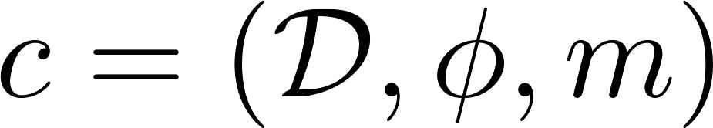
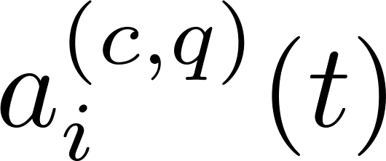
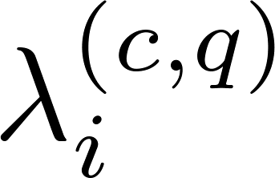
System Model
Request model
Destination set (multicast)
It becomes a singleton for unicast flow
Commodity
(destination set, request service, current stage in the service function chain)
I.I.D. requests from each client
: the instantaneous arrival
: mean arrival rate

